Slide 1
10 REASONS TO INSTALL XTREME READING™ IN YOUR SCHOOL
GRANER REASONS TO INSTALL XTREME 2020
BASED ON SCHUMAKER & GRANER 2018
PGRANER@KU.EDU

Slide 2
#1 EMPIRICAL VALIDATION
Empirically validated in bona fide research experiments, in schools, under typical school conditions
KUCRL’s SIM effect sizes are derived from studies with tremendous variability; however the center has produced remarkable consistency given those contexts including:
Studies conducted in middle, and high schools
Conditions that included an extra period of reading and no extra period for reading
Studies conducted across multiple years and others not
School settings ranging from inner-city to rural
Studies all took place across the U.S.
https://www.huffingtonpost.com/entry/the-rapid-advance-of-rigorous-research_us_5880cfb3e4b0fb40bf6c470e?

Slide 3
#2 EXTERNAL VALIDATION
Listed on educational websites (Evidence of ESSA and What Works Clearing House) as meeting certain important criteria.
“However, unlike small and quasi-experimental studies, rigorous experiments using standardized outcome measures replicate. These effect sizes may not be enormous, but you can take them to the bank….In our secondary reading review, we found an extraordinary example of this. The University of Kansas has an array of programs for struggling readers in middle and high schools, collectively called the Strategic Instruction Model, or SIM.” ~ Robert Slavin, Johns Hopkins Univ.
SIM Rates Strong For Evidence Based Reading Programs. Learn more: https://sim,ku.edu/sim-rates-strong-evidence-based-reading-programs

Slide 4
#3 A COMPREHENSIVE PROGRAM
Intended to empower adolescent learners to reach their goals and to teach them the strategies, habits of learning, and knowledge required to thrive in the 21st century.
Centered on specially designed instruction to help students integrate and generalize strategies within and outside school.
https://sim.drupal.ku.edu/impact

Slide 5
#4 DEFINED STUDENT POPULATION
Xtreme Reading is appropriate for students who exhibit:
Poor reading fluency,
Small sight vocabularies,
Limited understanding of words and multiple word meanings,
Limited background and conceptual knowledge,
Few skills in using strategies that enhance understanding and remembering of oral and written language.

Slide 6
#5 INSTRUCTORS’ MATERIALS
Instructor’s materials that contains step-by-step instructions on how to implement the program.
Instructor’s materials provide daily, detailed lesson plans that include: warm-up activities, guided reading, whole-class strategy instruction, student-practice activities, vocabulary activities, and end- of-lesson wrap-up activities.
A common vocabulary is used across all materials.
Executive skills and metacognitive processes are built in for students and teachers to learn and develop.
Aligned with Student Workbook materials
The lesson format requires a rigorous pace including specific time allotments for each required activity.
The pace is designed to keep students engaged throughout the entire class period.

Slide 7
#6 STUDENT MATERIALS
Clear directions in Instructor’s materials explain how to provide all levels of practice and generalization.
Materials are included in a binder for ease of student use.
Available high interest, strategy focused reading support materials are leveled and are both expository and narrative.
Often, leveled materials at schools can be used.
Recommendations are made for literature for guided and independent reading.
Available as fillable pdf’s.

Slide 8
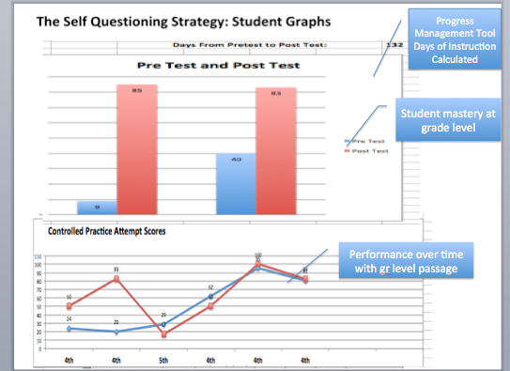
#7 QUANTIFIABLE OUTCOMES
Each Xtreme Reading strategy provides at least one quantifiable measure of student performance so that outcomes can be measured.
A pretest and a posttest is provided with each Learning Strategy related to the skills taught in the program.

Slide 9
#8 Additional GAINS
Teachers, students, and administrators see real gains in student performance, gains that affect the quality of students’ lives, such as:
improvements in grades, and
graduation rates.
Feedback loop
Increased motivation to read
When I was in 10th grade I learned how to use the SIM strategy of Word Identification in the spring. It helped me sound words faster, and I read quicker. I use the strategy in English, Math, and Social Studies. I now learn by reading.

Slide 10
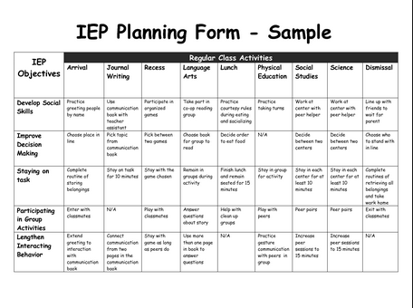
#9 CLEAR DATA FOR DECISION-MAKING
The programs provide student data for IEPs, 504s, placement decisions and student match for support.
The programs provide teacher data for mastery.

Slide 11
# 10 FOCUS ON LITERACY
Xtreme Reading and its components can be used effectively within a school-wide or programmatic focus on literacy, especially for struggling adolescent readers.

