Slide 1
Word Smith/SLEUTH
The Computerized Vocabulary Series
Paula Lancaster
lancastp@gvsu.edu

Slide 2
Wordsmith
Prefixes
Suffixes
Root Words

Slide 3
Wordsmith Sessions
Introduction
The Game
Prefixes
Suffixes,
Roots
The Green Room
Rationale and Purpose
Study cards & Quizzes

Slide 4
Wordsmith Session
Game Play
Controlled Practice
Multiple Choice
Questions
Unlock the
Isolation Booth

Slide 5
Wordsmith Sessions
The Isolation Booth
Independent Practice
Introduced Speed

Slide 6
Wordsmith Results
Prefixes
High School Pre Post
Control 19.7% 18.1%
Experimental 18.8% 80.9%
Junior High Pre Post
Control 9.7% 9.8%
Experimental 12.2% 75.4%

Slide 7
Wordsmith Results
Suffixes
High School Pre Post
Control 13.8% 11.9%
Experimental 13.5% 77.8%
Junior High Pre Post
Control 10% 7.9%
Experimental 12.2% 72.3%

Slide 8
Wordsmith Results
Root Words
High School Pre Post
Control 9.9% 10%
Experimental 8.6% 77.1%
Junior High Pre Post
Control 8.3% 7.5%
Experimental 6.5% 74.3%

Slide 9
Word SLEUTH
Supplements instruction in the Word Mapping Strategy.
S – Scan for Recognizable Word Parts
L – Listen for Recognizable Word Parts
E – Examine Context Clues
U – Use the Word Mapping Strategy
T – Try Looking in a Dictionary
H – Hunt for an Expert

Slide 10
Word SLEUTH Sessions
Introduction
How to
Rationale & Purpose
Expected Results

Slide 11
Word SLEUTH Sessions
Foundations Training
Syllables
Morphemes
Affix and Roots
Review

Slide 12
Word SLEUTH
SLEUTH Training
SLEUTH Steps
MAPS Strategy

Slide 13
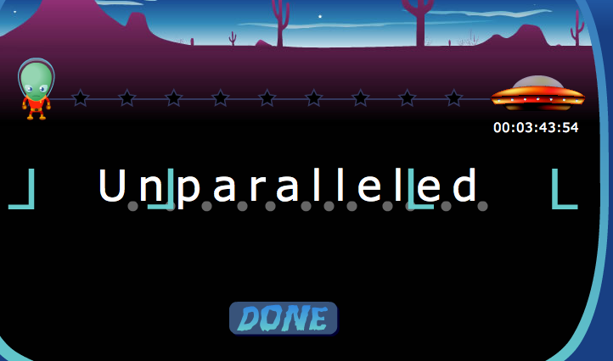
SLEUTH Extras

Slide 14
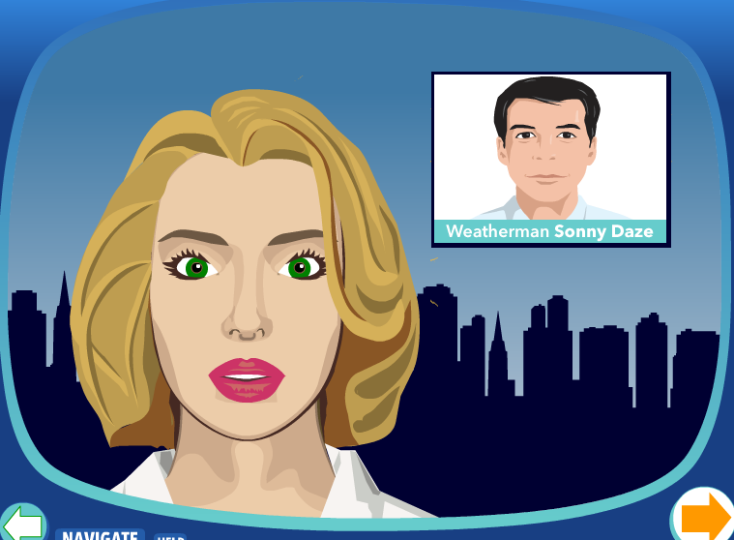
SLEUTH Extras

Slide 15
Word SLEUTH Results
Affix & Roots
Junior High Pre Post
Control 7% 8.3%
Experimental 10.8% 61.4%
High School Pre Post
Control 7.1% 7.8%
Experimental 9.1% 63%

Slide 16
Word SLEUTH Results
Word Knowledge
Junior High Pre Post
Control 9.7% 9.3%
Experimental 13.2% 49.1%
High School Pre Post
Control 14.1% 14.3%
Experimental 14.1% 63.6%

Slide 17
Word SLEUTH Results
Strategy Use
Junior High Pre Post
Control 7.6% 8.7%
Experimental 6.3% 50.1%
High School Pre Post
Control 7.0% 7.9%
Experimental 9.1% 51.4%

