Slide 1
Social-Emotional Learning
Sue Vernon, Ph.D.
Social Perspective, LLC
2018 KU CRL Learning Conference

Slide 2
The school is a safe place.
65,000 students surveyed
48% disagreed or strongly disagreed with the statement
12% did not know
Survey was done in 1993. What about today?

Slide 3
Do students feel safe in today’s schools?
In a 2015 National Crime Victimization Survey of students in grades 6 - 12, approximately 95% reported feeling safe in their school.
(Really?)

Slide 4
Bullying
In a 2015 supplement to the National Crime Victimization Survey of 12 through 18 year old students, approximately 21% reported they were bullied in school.
The National Center for Injury Prevention and Control reported an additional 15.5% reported being bullied electronically during the previous 12 months.
Notes:
During the 2015–16 school year, public schools that reported student bullying occurred at least once a week. Bullying was higher for middle schools (22 percent) than for high schools (15 percent), and primary schools (8 percent). (Indicators of School Crime and Safety: 2017, National Center for Education Statistics)

Slide 5
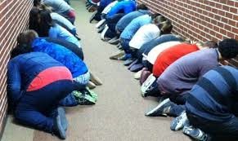
School safety
Discussions related to school safety have often focused on increasing physical security measures (e.g., restricted access to school buildings, resource officers, increased surveillance, lockdown drills).
Notes:
Fact match

Slide 6
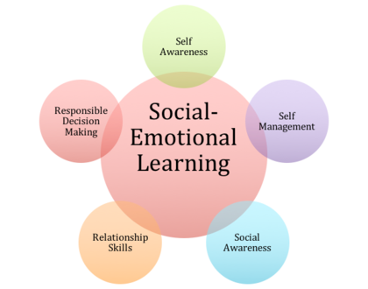
Emotional safety
Creating an emotionally safe, supportive school culture is also critically important.

Slide 7
Outcomes: What happens to students who don’t feel emotionally safe?
Suicide, depression, sleep disorders, stress disorders
Fear, hopelessness, rage
Loneliness, hate going to school, absenteeism
Headaches, stomach aches, and other somatic complaints.
Drop out of school
Parents file law suits
Notes:
Energy is directed toward protection rather than learning. Students under stress:
Are less able to “hear” what is being said to them or asked of them
Are more likely to misunderstand or distort the information that is received

Slide 8
Did you know…?
Suicide is the second leading cause of death among young people ages 15-24 years old (2016).
For each suicide death among youth age 15-19 years, there may be as many as 100–200 suicide attempts (2016).
Suicide ideation and attempts are 3 to 5 times higher among victims and perpetrators of bullying than among uninvolved youths. (Bullying and Suicide: A Public Health Approach, 2013)
According to bullying statistics, 1 out of every 10 students who drop out of school does so because of repeated bullying.
Harassment and bullying have been linked to 75% of school-shooting incidents.
Notes:
Suicide rates are increasing in every region of the US
Kids who are obese, gay, or have disabilities are up to 63% more likely to be bullied than other children.
Suicide rates among 10 to 14-year-olds have grown more than 50 percent over the last three decades. (The American Association of Suicidology, AAS)

Slide 9
To feel emotionally safe, students must…
Feel a sense of belonging
Have the freedom to NOT be good at a particular skill, to make mistakes, or to need extra time
Receive encouragement
Experience success
Have unique talents recognized and valued
Understand expectations and experience predictability & consistency

Slide 10
Learning communities
Our research showed that experimental students learned and retained concepts such as respect and tolerance and used the skills necessary to create an emotionally safe, respectful, productive learning environment.
Notes:
An emotionally safe and productive classroom community includes trusting relationships, collaboration, camaraderie, commitment, meaningful tasks, shared responsibility, organization, a voice.

Slide 11
Contact Info:
Sue Vernon, Ph.D.
Social Perspective, LLC
Lawrence, KS 66049
Email: svernon2@windstream.net
During my break out session, we will be discussing three easy-to-use, research-based social/emotional programs. We will discuss the basics of community-building and skill instruction: who, what, why, when, where and how.

