Slide 1
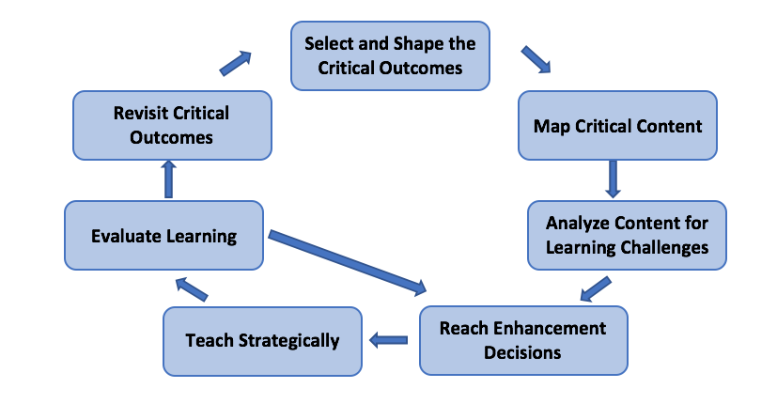
Today’s Schedule
Welcome/Overview
SMARTER planning
Drafting the Device
How to use with students
Cue-Do-Review
Unit Organizer Routine
Sarah Davidson
Instructional Staff Developer
Middle School ESE
Sue Meyer
Tools Used
in our
Learning
Notes:
9:00

Slide 2
Today’s Schedule
Welcome/Overview
SMARTER planning
Drafting the Device
How to use with students
Cue-Do-Review
What are the successes and barriers your students have reaching mastery in your classes?
Tools Used
Please share your response in the Nearpod
in our
Learning

Slide 3
Today’s Schedule
Welcome/Overview
SMARTER planning
Drafting the Device
How to use with students
Cue-Do-Review
Tools Used
Is there anything you would like to add to our norms?
in our
Learning
Notes:
Kerry

Slide 4
Today’s Schedule
Welcome/Overview
SMARTER planning
Drafting the Device
How to use with students
Cue-Do-Review
https://vimeo.com/simnetwork/review/87086441/4715a315fc
Cue: How do you think this tool will help address some of the barriers we discussed?
Tools Used
Is there anything you would like to add to our norms?
in our
Learning
Notes:
9:15

Slide 5
SMARTER PLANNING AND INSTRUCTIONAL CYCLE
Notes:
9:25

Slide 6
Today’s Schedule
Welcome/Overview
SMARTER planning
Drafting the Device
How to use with students
Cue-Do-Review
SMARTER Planning
Looking at the detailed list of SMARTER planning.
What components do you use in your planning? Which ones are you open to learn more about?
Tools Used
in our
Learning

Slide 7
Today’s Schedule
Welcome/Overview
SMARTER planning
Drafting the Device
How to use with students
Cue-Do-Review

Slide 8
SMARTER PLANNING AND INSTRUCTIONAL CYCLE
Notes:
9:25

Slide 9
Today’s Schedule
Welcome/Overview
SMARTER planning
Drafting the Device
How to use with students
Cue-Do-Review
How Would You Define a Unit?
Let’s share using a waterfall…
Type you response in the chat, but
DO NOT send
Tools Used
in our
Learning
Notes:
9:40

Slide 10
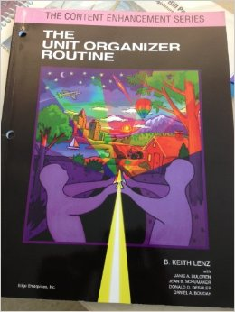
Today’s Schedule
Welcome/Overview
SMARTER planning
Drafting the Device
How to use with students
Cue-Do-Review
How Similar Was Your Thinking?
check your guidebook
pg. 18 definition of “unit” on the top of column 2
Tools Used
in our
Learning
Notes:
Subject area groups

Slide 11
TAB IT
Today’s Schedule
Welcome/Overview
SMARTER planning
Drafting the Device
How to use with students
Cue-Do-Review
In the Unit Organizer Guidebook:
Research (page 3)
Overview of the Sections (pages 6-9)
Linking Steps (pages 10-11)
Cue Do Review Sequence (pages 12-15)
Constructing a Draft (pages 21-26)
Feel free to mark, tab, note, and use the books as guidebooks
Tools Used
in our
Learning
Notes:
Subject area groups

Slide 12
SUPPORTING RESEARCH
Today’s Schedule
Welcome/Overview
SMARTER planning
Drafting the Device
How to use with students
Cue-Do-Review
Positive results were achieved when teachers:
received 2-3 hours of instruction in the routine
discussed the routine with colleagues
spent the necessary time to plan use of the routine
Positive results were achieved when students:
were taught how to participate in and use the routine
used the routine regularly over time
were held the highest expectations for student learning
Tools Used
in our
Learning
Notes:
Subject area groups

Slide 13
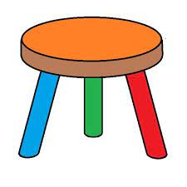
Today’s Schedule
Welcome/Overview
SMARTER planning
Drafting the Device
How to use with students
Cue-Do-Review
COMPONENTS OF THE UNIT ORGANIZER ROUTINE
The
Unit Organizer
Teaching Device
Craft
Linking Steps
Cue-Do-Review
Sequence
Tools Used
in our
Learning
Notes:
Subject area groups

Slide 14
SMARTER PLANNING AND INSTRUCTIONAL CYCLE
Notes:
10:00

Slide 15
FRONT
The Unit Organizer
4
BIGGER PICTURE
NAME
DATE
2
LAST UNIT
/Experience
CURRENT UNIT
3
NEXT UNIT
/Experience
1
CURRENT UNIT
8
UNIT SCHEDULE
5
UNIT MAP
is about...
6
UNIT SELF-TEST QUESTIONS
RELATIONSHIPS
UNIT
7
Notes:
Sarah blanks are white

Slide 16
The Unit Organizer
NAME
DATE
9
Expanded Unit Map
Back
is about...
10
NEW
UNIT
SELF-TEST
QUESTIONS

Slide 17
The Unit Organizer
4
BIGGER PICTURE
NAME
Elida Cordora
DATE
1/22
The roots and consequences of civil unrest.
2
LAST UNIT
/Experience
1
CURRENT UNIT
3
NEXT UNIT
/Experience
CURRENT UNIT
The Civil War
Growth of the Nation
The Causes of the Civil War
8
UNIT SCHEDULE
5
UNIT MAP
is about...
1/22 Cooperative groups -
over pp. 201-210
Sectionalism
1/28 Quiz
was based on
was influenced by
1/29 Cooperative groups -
pp. 201-236
Leaders
over pp. 210-225
Areas of
across the
the U.S.
emerged because of
became greater with
U.S.
"Influential Personalities"
1. CURRENT UNIT
projectdue
Differences
Events in
1/30 Quiz
2. LAST UNIT
between
the U.S.
2/2 Cooperative groups -
the areas
over pp. 228-234
3. NEXT UNIT
4. BIGGER PICTURE
2/6 Review for test
2/7 Review for test
Information is listed to help students see how the current unit is related to other units
an to course ideas.
2/6 Test
What was sectionalism as it existed in the U. S. of 1860?
descriptive
6
UNIT SELF-TEST
QUESTIONS
How did the differences in the sections of the U.S. in 1860 contribute to the start of the Civil War?
compare/contrast
UNIT
RELATIONSHIPS
cause/effect
Page 21
7
What examples of sectionalism exist in the world today?

Slide 18
Today’s Schedule
Welcome/Overview
SMARTER planning
Drafting the Device
How to use with students
Cue-Do-Review
THE “BIG IDEA” PARAPHRASE
Captures the major point of learning
Translated for students
Understandable
Inclusive
is about
Page 22
This is not a place to introduce new vocabulary
Tools Used
in our
Learning
Notes:
Subject area groups

Slide 19
PAIR-SHARE
Breakout and

Slide 20
SMARTER PLANNING AND INSTRUCTIONAL CYCLE
Notes:
Sarah – Introduce digital

Slide 21
The Unit Organizer
4
BIGGER PICTURE
NAME
Elida Cordora
DATE
1/22
Pages 22-23
The roots and consequences of civil unrest.
2
LAST UNIT
/Experience
1
CURRENT UNIT
3
NEXT UNIT
/Experience
CURRENT UNIT
The Civil War
Growth of the Nation
The Causes of the Civil War
8
UNIT SCHEDULE
5
UNIT MAP
is about...
1/22 Cooperative groups -
over pp. 201-210
Sectionalism
1/28 Quiz
was based on
was influenced by
1/29 Cooperative groups -
pp. 201-236
Leaders
over pp. 210-225
Areas of
across the
the U.S.
emerged because of
became greater with
U.S.
"Influential Personalities"
projectdue
Differences
Events in
1/30 Quiz
between
the U.S.
2/2 Cooperative groups -
the areas
over pp. 228-234
2/6 Review for test
2/7 Review for test
5. UNIT MAP
2/6 Test
What was sectionalism as it existed in the U. S. of 1860?
descriptive
6
A Unit Paraphrase of the big idea of the unit and a Content Map are used to show students how to think about and structure the information in the unit.
UNIT SELF-TEST
QUESTIONS
How did the differences in the sections of the U.S. in 1860 contribute to the start of the Civil War?
compare/contrast
UNIT
RELATIONSHIPS
cause/effect
7
What examples of sectionalism exist in the world today?
Notes:
Kerry
Copy the main ideas from the back and copy the main topics to the front. That is all the detail you get on the front.

Slide 22
SMARTER PLANNING AND INSTRUCTIONAL CYCLE
Notes:
Sarah – Introduce digital

Slide 23
The Unit Organizer
4
BIGGER PICTURE
NAME
Elida Cordora
Pages 24-25
DATE
1/22
The roots and consequences of civil unrest.
LAST UNIT
/Experience
8. UNIT SCHEDULE
NEXT UNIT
/Experience
2
1
CURRENT UNIT
3
CURRENT UNIT
The Civil War
Growth of the Nation
The Causes of the Civil War
8
UNIT SCHEDULE
5
UNIT MAP
is about...
1/22 Cooperative groups -
To help students organize
over pp. 201-210
Sectionalism
task management and
1/28 Quiz
was based on
was influenced by
completion, experiences that
1/29 Cooperative groups -
pp. 201-236
Leaders
over pp. 210-225
Areas of
across the
promote learning and show
the U.S.
emerged because of
became greater with
U.S.
"Influential Personalities"
students what they have
projectdue
Differences
Events in
1/30 Quiz
between
the U.S.
learned are listed.
2/2 Cooperative groups -
the areas
over pp. 228-234
2/6 Review for test
2/7 Review for test
2/6 Test
What was sectionalism as it existed in the U. S. of 1860?
descriptive
6
UNIT SELF-TEST
QUESTIONS
How did the differences in the sections of the U.S. in 1860 contribute to the start of the Civil War?
compare/contrast
UNIT
RELATIONSHIPS
cause/effect
7
What examples of sectionalism exist in the world today?
Notes:
kerry

Slide 24
SMARTER PLANNING AND INSTRUCTIONAL CYCLE
Notes:
Sarah – Introduce digital

Slide 25
The Unit Organizer
4
BIGGER PICTURE
NAME
Elida Cordora
Page 23-24
DATE
1/22
The roots and consequences of civil unrest.
2
LAST UNIT
/Experience
1
CURRENT UNIT
3
NEXT UNIT
/Experience
6. UNIT RELATIONSHIPS
CURRENT UNIT
The Civil War
Growth of the Nation
The Causes of the Civil War
8
UNIT SCHEDULE
5
UNIT MAP
is about...
1/22 Cooperative groups -
over pp. 201-210
A list of relationships that reflect
Sectionalism
was based on
was influenced by
the central ideas of the unit are
1/28 Quiz
1/29 Cooperative groups -
pp. 201-236
Leaders
provided so that students can look for
over pp. 210-225
Areas of
across the
the U.S.
emerged because of
became greater with
U.S.
these relationships as the content of
"Influential Personalities"
projectdue
Differences
Events in
1/30 Quiz
between
the unit is learned.
the areas
the U.S.
2/2 Cooperative groups -
over pp. 228-234
2/6 Review for test
2/7 Review for test
2/6 Test
What was sectionalism as it existed in the U. S. of 1860?
descriptive
6
UNIT SELF-TEST
QUESTIONS
How did the differences in the sections of the U.S. in 1860 contribute to the start of the Civil War?
compare/contrast
UNIT
RELATIONSHIPS
cause/effect
7
What examples of sectionalism exist in the world today?
Notes:
Kerry
Commercials for other routines? Compare contrast/concept comparison, cause effect/cause effect routine

Slide 26
The Unit Organizer
4
BIGGER PICTURE
NAME
Elida Cordora
Page 24
DATE
1/22
The roots and consequences of civil unrest.
2
LAST UNIT
/Experience
1
CURRENT UNIT
3
NEXT UNIT
/Experience
CURRENT UNIT
The Civil War
Growth of the Nation
The Causes of the Civil War
8
UNIT SCHEDULE
5
UNIT MAP
is about...
1/22 Cooperative groups -
over pp. 201-210
Sectionalism
7. UNIT SELF-TEST QUESTIONS
1/28 Quiz
was based on
was influenced by
1/29 Cooperative groups -
pp. 201-236
Leaders
over pp. 210-225
Areas of
across the
became greater with
Questions that students can use to
the U.S.
emerged because of
U.S.
"Influential Personalities"
projectdue
Differences
Events in
1/30 Quiz
check understanding of the big ideas
between
the U.S.
2/2 Cooperative groups -
the areas
over pp. 228-234
and relationships in the unit are listed.
2/6 Review for test
2/7 Review for test
2/6 Test
What was sectionalism as it existed in the U. S. of 1860?
descriptive
6
UNIT SELF-TEST
QUESTIONS
How did the differences in the sections of the U.S. in 1860 contribute to the start of the Civil War?
compare/contrast
UNIT
RELATIONSHIPS
cause/effect
7
What examples of sectionalism exist in the world today?
Notes:
kerry
Link to padlet in notes.
Push into comments. https://padlet.com/maitnerap/UO_Use

Slide 27
TYPES OF QUESTIONS
Lesson Question | Unit Questions | Course Questions
What is the theme of this essay? What does a line look like with negative slope? What is the formula for speed? | How do authors use dialogue to support theme? How do you identify slope from an equation, graph, or two points? What is the difference between potential and kinetic energy? | How does the author use multiple literary devices to support their theme? How do linear and exponential functions compare? How can different forms of energy be kinetic or potential? Give examples.
Notes:
10:25

Slide 28
SMARTER PLANNING AND INSTRUCTIONAL CYCLE
Notes:
Sarah – Introduce digital

Slide 29
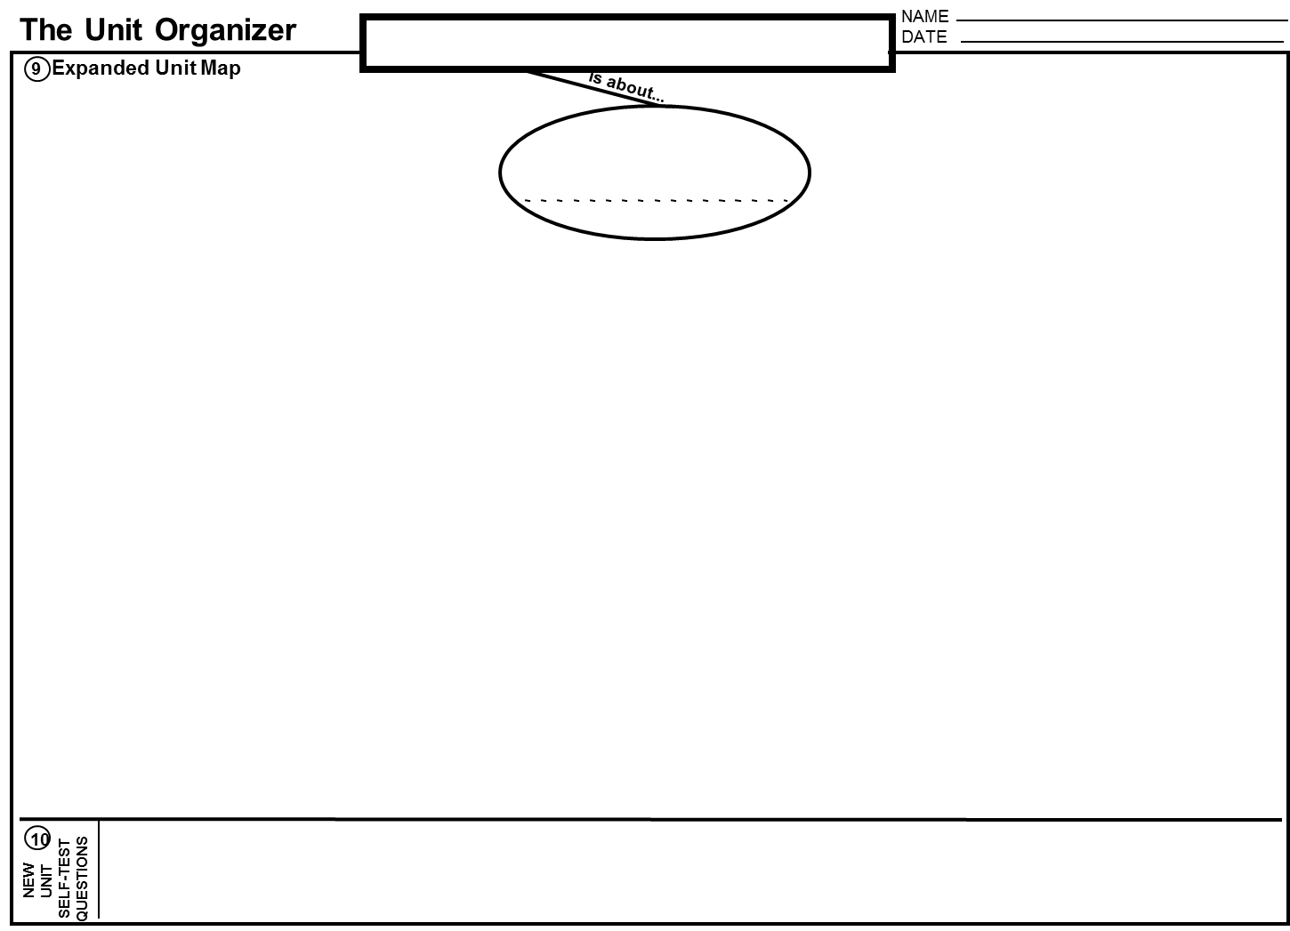
PRACTICE
Draft your unit “is about” bubble on the back
in Box 9, “Expanded Unit Map.”
Back
University of Kansas Center for Research on Learning 2002
Notes:
Dawn

Slide 30
The Unit Organizer
NAME
Elida Cordora
Pages 25-26
The Causes of the Civil War
DATE
1/22
9
Expanded Unit Map
is about...
Sectionalism
was based on the
was influenced by
Areas of the
pp. 201-236
Leaders of
U.S.
change
developed because of
became greater with
such as
-Henry Clay
Differences
Events in the
-Stephen Douglas
between the
U.S.
-Zachary Taylor
which included the
areas
-Harriet Beecher Stowe
and included
and included
and included
such as
-Douglas Filmore
which included the
-John Brown
which included the
Social
Political
Economic
-1820 Missouri Compromise
-Jefferson Davis
Differences
Differences
Differences
-1846 Mexican War
-Abraham Lincoln
-1850 Compromise of 1850
West
-1850 Fugitive Slave Law of 1850
-1852
Uncle Tom's Cabin
-1854 Kansas-Nebraska Act
-1854 Republican Party formed
South
9. EXPANDED UNIT MAP
-1854 Bleeding Kansas
-1857 Dred Scott Case
-1858 Lincoln Douglas Debates
-1859 John Brown's Raid
As the unit progresses, the basic UNIT
-1860 Lincoln Elected
North
-1860 South Carolina Secedes
MAP from the first page of the Unit
-1861 Confederacy formed
Organizer is expanded with key summary
10
information about the
NEW
UNIT
SELF-TEST
QUESTIONS
How did national events and leaders pull the different sections of the U.S. apart?
content of the unit.
Notes:
Dawn Pg 9
Telling them what is on the extended unit map

Slide 31
BACKWARD (OR FORWARD) DESIGN
Today’s Schedule
Welcome/Overview
SMARTER planning
Drafting the Device
How to use with students
Cue-Do-Review
OR
What kind of planning do your identify with
Tools Used
in our
Learning
Notes:
Subject area groups

Slide 32
Equations and Inequalities Developed By Sarah Davidson
MAFS.6.EE.1.4 Identify when two expressions are equivalent (i.e., when the two expressions name the same number regardless of which value is substituted into them).
MAFS.6.EE.2.5 Understand solving an equation or inequality as a process of answering a question: which values from a specified set, if any, make the equation or inequality true? Use substitution to determine whether a given number in a specified set makes an equation or inequality true.
MAFS.6.EE.2.6 Use variables to represent numbers and write expressions when solving a real-world or mathematical problem; understand that a variable can represent an unknown number, or, depending on the purpose at hand, any number in a specified set.
MAFS.6.EE.2.7 Solve real-world and mathematical problems by writing and solving equations of the form x + p = q and px = q for cases in which p, q and x are all non-negative rational numbers.
MAFS.6.EE.2.8 Write an inequality of the form x > c or x < c to represent a constraint or condition in a real-world or mathematical problem. Recognize that inequalities of the form x > c or x < c have infinitely many solutions; represent solutions of such inequalities on number line diagrams.
MAFS.6.EE.3.9 Use variables to represent two quantities in a real-world problem that change in relationship to one another; write an equation to express one quantity, thought of as the dependent variable, in terms of the other quantity, thought of as the independent variable. Analyze the relationship between the dependent and independent variables using graphs and tables, and relate these to the equation.

Slide 33
Equations and Inequalities
Solved
can be
How relationships between numbers are represented
with
Two variables
using
can be
Inverse Relationship
Substitution
independent
dependent
in
show on
Real world problems
Graph
Table
Equation
Real world problems
written as
Equation
inequality
graphed on
for example
Number line diagram
7+x=21
7x=21
x>5
x<5
for example
addition | Multiplication | Greater than | Less than
Increase | Each | More than | Under
Together | Of | Exceeds | Fewer than
Total | Doubled | Over | Smaller than
Plus | Every | Above | Below
Sum | Times | Larger than | Shorter
Altogether | Product | Longer than | Beneath
and | increase | Higher than | Lower than
shows
Signal words
Infinite Solutions
This Photo by Unknown Author is licensed under CC BY-SA

Slide 34
CONNECTORS
are
Linked bubbles can be read as a series of sentences
Line labels stating the relationship between two or more ideas
University of Kansas Center for Research on Learning 2002
Notes:
Line connectors hand out lavender
Share this with people who need the line labels
**Have your green paper with connectors/line labels**

Slide 35
How the earth changes over time
Landforms
Earth's Structure
Changing Earth
Convection
Is about
the material in the earth
Layers of the Earth
Divided in
That power
Layers of the Earth
Tectonic
Plates
Plate Tectonics
Moved by
Convection
Unit Test
How does heat, pressure, and density change as you get deeper into the layers of the earth?
How does changes in density move material and heat in the mantle?
What does convection in the mantle do to the crust?

Slide 36
Earth's Structure
the material in the earth
Tectonic
Plates
Layers of the Earth
That power
Divided in
creating
Split up by
Split up by
Properties we can measure
What it’s made of
Moved by
Transverse
including
Plate Boundaries
Convection
called
Divergent
including
including
Physical Layers
Chemical Layers
creating
Lithosphere
Crust
Happens in the
Because of
Rift Zones
Convergent
Mantle
Density
creating
creating
Folded mountains
Subduction
Asthenosphere
That increases
when
Mesosphere
More dense
Cold
because
becoming
Sinking closer to the core where it becomes
floating closer to the crust where it becomes
Continental Crust
Sinks under
Oceanic Crust
Outer Core
Core
Inner Core
becoming
is
is
Hot
Less Dense
More dense
Less dense

Slide 37
The Unit Organizer
NAME
Elida Cordora
Pages 26-27
The Causes of the Civil War
DATE
1/22
9
Expanded Unit Map
is about...
Sectionalism
was based on the
was influenced by
10. NEW UNIT SELF-TEST QUESTIONS
Areas of the
pp. 201-236
Leaders of
U.S.
change
developed because of
became greater with
such as
As the unit progresses, new questions
-Henry Clay
Differences
Events in the
-Stephen Douglas
between the
U.S.
-Zachary Taylor
that seem important about the content of
which included the
areas
-Harriet Beecher Stowe
and included
and included
and included
such as
-Douglas Filmore
the unit are listed or old questions can be
which included the
-John Brown
which included the
Social
Political
Economic
-1820 Missouri Compromise
-Jefferson Davis
Differences
Differences
Differences
-1846 Mexican War
-Abraham Lincoln
modified.
-1850 Compromise of 1850
West
-1850 Fugitive Slave Law of 1850
-1852
Uncle Tom's Cabin
-1854 Kansas-Nebraska Act
-1854 Republican Party formed
South
-1854 Bleeding Kansas
-1857 Dred Scott Case
-1858 Lincoln Douglas Debates
-1859 John Brown's Raid
-1860 Lincoln Elected
North
-1860 South Carolina Secedes
-1861 Confederacy formed
10
NEW
UNIT
SELF-TEST
QUESTIONS
How did national events and leaders pull the different sections of the U.S. apart?
Notes:
Sarah wrap up back and launch Kerry for the front

Slide 38
Today’s Schedule
Welcome/Overview
SMARTER planning
Drafting the Device
Lunch
How to use with students
Cue-Do-Review
Wrap-up
TIME TO WORK
Identify the Standards that you will be
addressing (you may need to unpack more)
Use curriculum guides to help identify appropriate sub-bubbles(topics) and critical content within your unit.
Map out the pieces and connections between topics
Make sure that the language from your standard is included in the content of your unit map (reference your unpacking)
Tools Used
in our
Learning
Notes:
10:45

Slide 39
The Unit Organizer
NAME
Elida Cordora
Page 54
The Causes of the Civil War
DATE
1/22
9
Expanded Unit Map
is about...
Sectionalism
was based on the
was influenced by
Areas of the
pp. 201-236
Leaders of
U.S.
change
developed because of
became greater with
such as
-Henry Clay
Differences
Events in the
-Stephen Douglas
between the
U.S.
-Zachary Taylor
which included the
areas
-Harriet Beecher Stowe
and included
and included
and included
such as
-Douglas Filmore
which included the
-John Brown
which included the
Social
Political
Economic
-1820 Missouri Compromise
-Jefferson Davis
Differences
Differences
Differences
-1846 Mexican War
-Abraham Lincoln
-1850 Compromise of 1850
West
-1850 Fugitive Slave Law of 1850
-1852
Uncle Tom's Cabin
-1854 Kansas-Nebraska Act
-1854 Republican Party formed
South
-1854 Bleeding Kansas
-1857 Dred Scott Case
-1858 Lincoln Douglas Debates
-1859 John Brown's Raid
-1860 Lincoln Elected
North
-1860 South Carolina Secedes
-1861 Confederacy formed
10
NEW
UNIT
SELF-TEST
QUESTIONS
How did national events and leaders pull the different sections of the U.S. apart?
Notes:
Look at the examples
Do the bubbles, talk about line labels after the bubbles are placed.

Slide 40
Changes in the Earth
Introduction to Earth Space
Earth’s Interior
Earth’s Surface
The effects of Earth’s composition
Geomagnetism
like
explained
by
The Theory of Plate Tectonics
which is divided into
Earth’s Layers
How does the composition of the outer core provide protection for our Earth’s atmosphere?
How do each of the layers of the Earth impact either geomagnetism or plate tectonics? What other layers do they interact with?
How does the type of plate boundary effect the landforms present at that boundary?
How do each of the seismic waves effect the Earth’s surface and provide information in the study of earthquakes?
Constructing explanations and designing solutions
Math connection –
Calculate rate of change, express change over time as a linear function

Slide 41
Earth’s Interior
Geomagnetism
The Theory of Plate Tectonics
The effects of Earth’s composition
explained in the
like
which is a
which states that
magnetic field around Earth
continental
plates
with a
created by
which is divided into
are pieces of the
including
North Pole
iron
Earth’s Layers
that
oceanic
that
create
protects Earth
move
That power
plate boundaries
and a
in the
South Pole
including the
with the
because of
from
which
called
crust
Convection
Differences in density on a single plate
Convergent
Divergent
Transform
solar wind
Cosmic rays
Moves slowly
upper mantle
which can
in the
that create
mantle
and causes
outer core
Heat pushing out
Electrical fields
Strip away Earth’s atmosphere
from the
which create
Poles to reverse
inner core
are site of
that effect
Mountains
Rift valleys
Volcanos
like
Landforms
Power grids
Communication systems
Navigation systems
Satellites
Surface waves
Seismic waves
that produce
Earthquakes
Body waves
called

Slide 42
The Unit Organizer
4
BIGGER PICTURE
NAME
Equations
DATE
2
LAST UNIT
/Experience
CURRENT UNIT
3
NEXT UNIT
/Experience
1
CURRENT UNIT
Linear Equations
Equations in two variables
Functions
8
Vocabulary
5
UNIT MAP
is about...
by finding
determining if a functional relationship exists
by solving
slope
system of equations
slope-intercept form
1) How do I solve and represent solutions to systems of equations? 2) How do you determine if the relationship between two quantities is linear? 3) How do you determine if a relationship is proportional? 4) What are three ways you can find slope? 5) Describe the relationship between unit rate and slope? 6) If you had to define slope and y-intercept, what would you say?
6
UNIT SELF-TEST QUESTIONS
CHECK-IN
SELF
7

Slide 43
Equations in two variables
slope
(rate of change)
determining if a functional relationship exists
systems of
equations
by finding
by solving
By finding the
using the
Shared Point
Slope formula
which
is
With the equation
in a
using a
on a graph
using a
by using
graphically
algebraically
graph
knowing
such as those on the
the solutions are
frame
slope-intercept form
- one solution
- no solution
- infinite solutions
table
knowing
which includes
slope = m
y-intercept (0,b)
Word problem
looking for
per or each
represents
represents
change
start

Slide 44
The Unit Organizer
4
BIGGER PICTURE
NAME
DATE
2
LAST UNIT
/Experience
CURRENT UNIT
3
NEXT UNIT
/Experience
1
CURRENT UNIT
Unit 2 Citizenship
Influential Documents & People
8
UNIT SCHEDULE
5
UNIT MAP
is about...
Unit Organizer
BrainPop + notes
3 Differing Views of
citizenship (reading)
Citizenship group
activity (poster)
“Citizen” FRAME notes
“Can, Should, Must” FRAME notes
Flash cards
Scenarios
Jeopardy! Review
Common Assessment
understanding
how people become US citizens and what citizens do
by defining
Textbook pages 55 to 69
by understanding and experiencing
by listing and evaluating
and identifying and explaining
What is a _______________?
What are the three ways to become a US citizen?
What _______________ do US citizens have?
What ______________ (obligations) do citizens have?
What ____________________ do citizens have?
What would happen if citizens did not use their rights or meet their obligations?
6
UNIT SELF-TEST QUESTIONS
RELATIONSHIPS
UNIT
7

Slide 45
The Unit Organizer
Unit 2 Citizenship
9
Expanded Unit Map
is about...
by defining
understanding
how people become US citizens and what citizens do
Duties/ obligations of Citizens “MUSTs”
Citizen-
FRAME
describing 3 ways to become a US citizen
by listing and evaluating
Responsibilities of Citizens “SHOULDs”
Rights of Citizens “CANs”
but limited by
10
NEW
UNIT
SELF-TEST
QUESTIONS

Slide 46
HOW WOULD YOU RATE YOUR UNIT ORGANIZER?
Notes:
11:15

Slide 47
Today’s Schedule
Welcome/Overview
SMARTER planning
Drafting the Device
Lunch
How to use with students
Cue-Do-Review
Wrap-up
LET’S TAKE A BREAK
Please let us know in a private message any feedback on the presentation so far
See you back at 10:40
Tools Used
in our
Learning

Slide 48
Today’s Schedule
Welcome/Overview
SMARTER planning
Drafting the Device
Lunch
How to use with students
Cue-Do-Review
Wrap-up
THINK & SHARE
How and when are you thinking that you might use the Unit Organizer in your instruction?
Tools Used
in our
Learning

Slide 49
SMARTER PLANNING AND INSTRUCTIONAL CYCLE
Notes:
Sarah – Introduce digital

Slide 50
CRAFT LINKING STEPS
Page 42
Create a context
Explore how the information in this unit fits with previous, future, and bigger learning
Recognize Content Structures
Identify how to think about and structure the information to be learned in the unit
Acknowledge Unit Relationships
Explore relationships that are or might be important in the unit
Frame Unit Questions
Generate and discuss the types of questions that reflect what the unit is really about.
Tie Content to Tasks
Identify a schedule of tasks to be completed and how these tasks connect to learning the content.
University of Kansas Center for Research on Learning 2002

Slide 51
Page 42
Implementing the Unit Organizer Routine
Launching the Unit
Floating the Unit
Tying Up the Unit
GOAL
The new unit is introduced to
Attention is drawn to unit ideas
The Unit Organizer is used to
students using the Unit
as each unit section is
review unit content and promote
Organizer Routine.
completed or introduced.
student confidence.
C
The CURRENT UNIT is related
Each unit section is reviewed
The UNIT MAP, the
to the LAST UNIT, the NEXT
and in conjunction with the
EXPANDED UNIT MAP, and
UNIT, and to a BIGGER IDEA in
UNIT MAP.
relationships to other units and
the course.
ideas are reviewed.
R
The UNIT MAP is revealed
Key information is added to the
Students construct personal unit
through a Unit Paraphrase
EXPANDED UNIT MAP as part
maps without looking at the Unit
and a Content Map.
of section review or introduction.
Organizer and then check
accuracy.
A
The UNIT MAP is explored
UNIT RELATIONSHIPS are
Students explain, edit, and
and UNIT RELATIONSHIPS
confirmed and highlighted on
revise personal content maps
are identified.
the EXPANDED UNIT MAP.
with others.
F
UNIT QUESTIONS reflecting
UNIT QUESTIONS are answered
Students answer the UNIT
central ideas of the unit are
and answers to previously
QUESTIONS and generate
constructed.
answered questions are
new self-test questions.
improved.
T
The UNIT SCHEDULE is
Status of task progress,
Class discusses how unit tasks
constructed and explained.
completion, and student
promoted learning and how
satisfaction with learning is
learning could have been
checked.
improved.
Notes:
Kerry transition to sarah

Slide 52
Launch
Float
Tie-up
Notes:
collaboration boards in the Nearpod

Slide 53
HOW MUCH DO STUDENTS WRITE?
Your professional decision!
Blank devices OK
Partially completed devices OK
Completed devices OK
Why might we want to do this?
University of Kansas Center for Research on Learning 2002
Notes:
Sarah

Slide 54
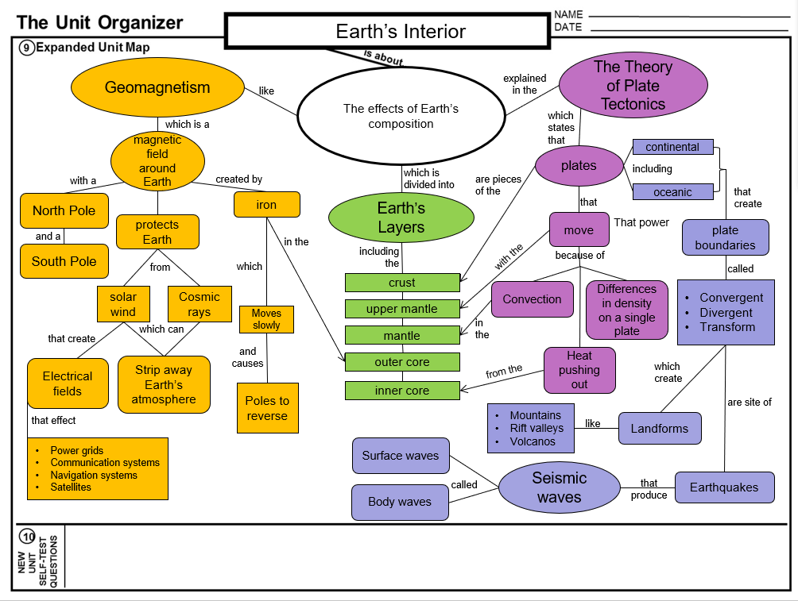

Slide 55
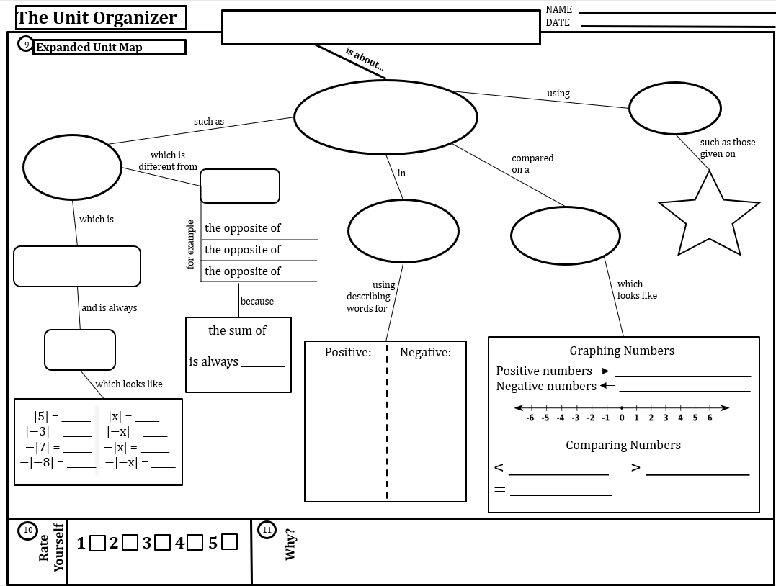

Slide 56
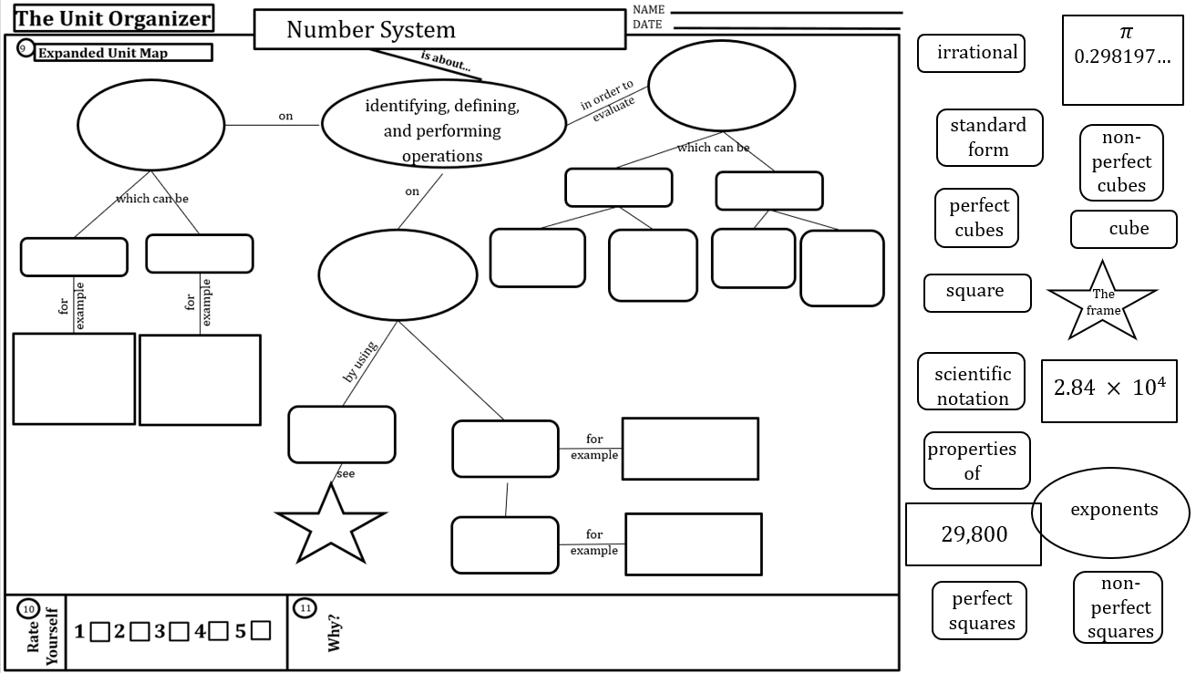

Slide 57
See page 12
What is it? Showing students how to use the device as a learning tool
What is it? The Linking Steps – how you go through the routine
What is it? Telling students what they are doing & why they are doing it
How do I do it?
1) Implement the Linking Steps
How do I do it?
1) Check understanding of content on the routine
How do I do it?
1)Name the Routine
2) Ask questions about the learning process and how the device works
2) Prompt the students in construction, get student friendly language
2) Explain how it will help them learn (ie. improve comprehension, study tool, track progress, etc.)
3) Model how to use the device as a study tool, guide for doing other work
3) Tell them how they should participate (ie. make your paper look like mine
3) Provide positive and corrective feedback if necessary
Notes:
Sarah

Slide 58
SIM Update 2021
Coaching for micro credential
Virtual Platforms for CE
Choice session
creating CE lessons for a digital classroom
Welcome
…
Overview
with devices in
Self Paced Learning
Focused support
Power Point
by
Collaborative Brain storming
Engaging students
that are
Presented
What are the new skills students are required to know before being able to co-construct a device in your class?
How has Cue-Do-Review changed in a virtual setting?
What Strategies, tools, activities, and routines have helped increase students engagement during online classes?
Problem, solution, and results
Deliberation
Comparison

Slide 59
Virtual Platforms for CE
PowerPoint
with devices in
Engaging students
by
following
creating CE lessons for a digital classroom
Call to engagement
using
Drafting tips
In
Chat Box Participation
strategies
programs
like
By creating a
Shapes are text boxes
that are
in
Games
Such
as
Google
Slides
Presented
student version
Phone calls
Lining lines
Nearpod
Building relationships
with
with
Watch me draft
Phone as Doc Camera
Two screen co-construction
Corgi
Annotations on the white board
Lock Slides
Linked Documents
Kami
Closed notes
Closed Captions
Creating sort cards

Slide 60
Today’s Schedule
Welcome/Overview
SMARTER planning
Drafting the Device
Lunch
How to use with students
Cue-Do-Review
Wrap-up
ASK ME QUESTIONS
This will never be perfect… it’s a process. Give yourself grace.
Tools Used
in our
Learning

