Slide 1
© Edwin Ellis All Rights Reserved MakesSenseStrategies.com
TIPS FOR USING VOCABULARY FRAMES
DOs
J
DO prepare lessons that will employ a Vocabulary Frame™ by constructing, in advance, a completed version of the frame
(assures that the modeling takes place seamlessly and that the ideas noted on your Vocabulary Frame™ are very concise)
J
DO employ “gradual release” scaffolded instructional tactics
Especially important is to provide sufficient guided practice using the TEACHER-ASSISTED instructional routines before attempting to use PEER-ASSISTED or SELF-DIRECTED routines.
I do it
We do it
Y’all do it
You do it

Slide 2
© Edwin Ellis All Rights Reserved MakesSenseStrategies.com
© Edwin Ellis All Rights Reserved MakesSenseStrategies.com Tips for Using Vocabulary Frames
smart visual tools
DOs
J
DO employ “think-aloud” tactics as you model and provide guided-assistances in the process of forming…
…content-connections
(relationships between the term and other terms or the lesson topic)
…personal-connections
(relationships between the term and one’s own person experiences or background knowledge).
Then…
Be sure to guide students’ responses as they formulate and articulate content- and personal-connections.

Slide 3
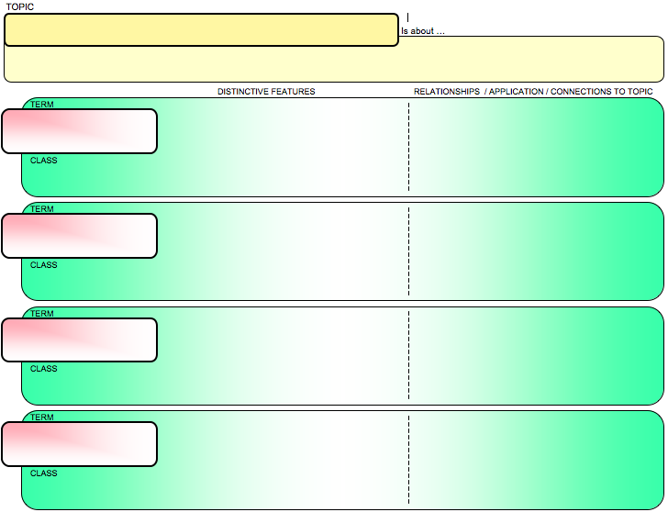
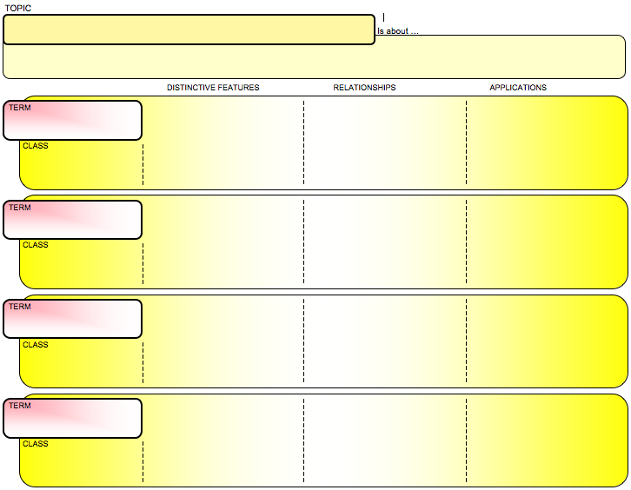
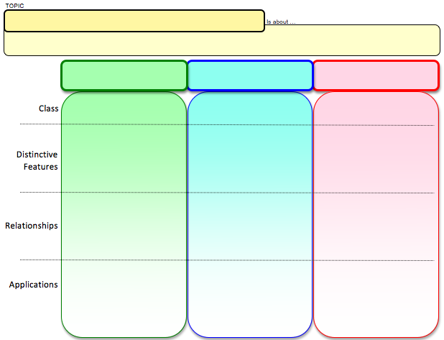
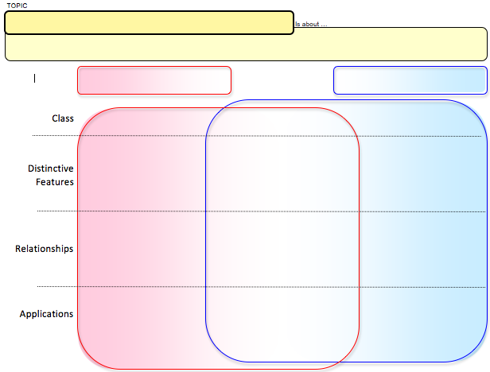
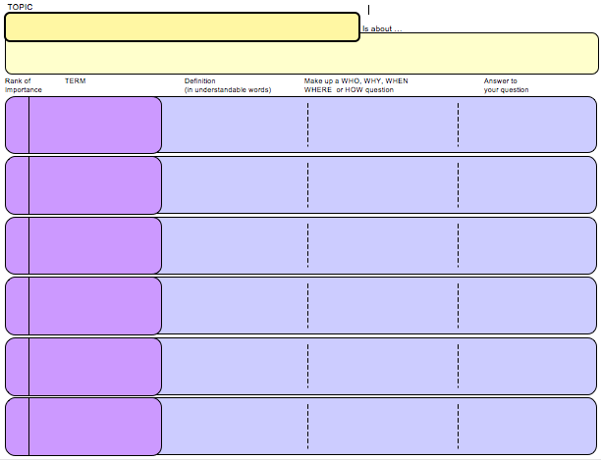
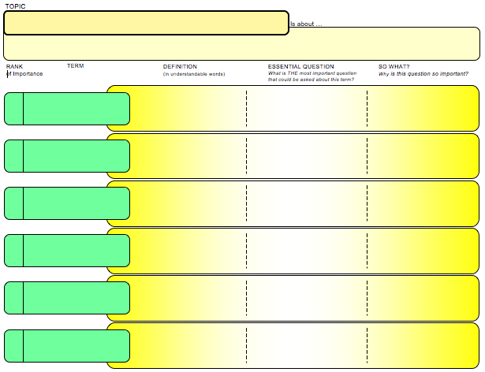
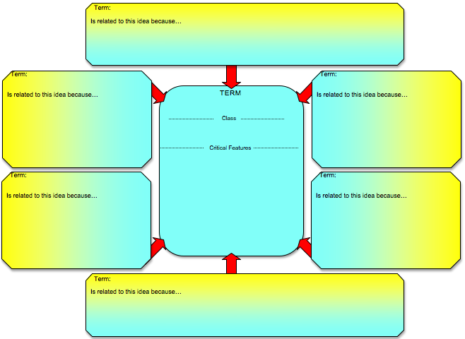
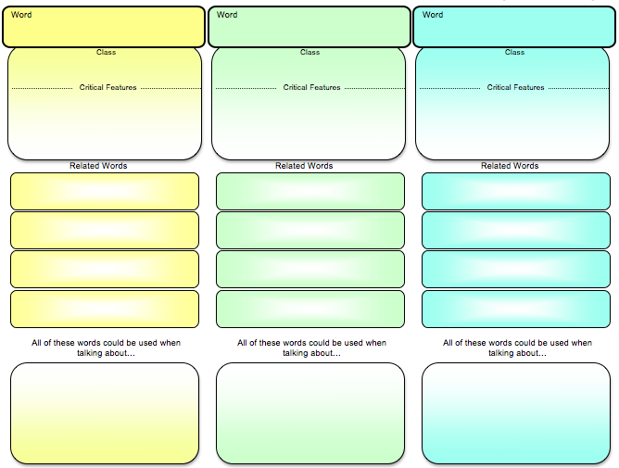
© Edwin Ellis All Rights Reserved MakesSenseStrategies.com
© Edwin Ellis All Rights Reserved MakesSenseStrategies.com Tips for Using Vocabulary Frames
smart visual tools
J
DO differentiate Vocabulary Frames™ used in a lesson, depending on sophistication of learners
Features * Connections less complex version of Essential Understandings
EU Matrix less cognitively demanding comparisons than EU Venn
Q&A focuses on less complex questions than Essential Questions
Related Words Web less demanding connections than Related Words Frame

Slide 4
© Edwin Ellis All Rights Reserved MakesSenseStrategies.com
© Edwin Ellis All Rights Reserved MakesSenseStrategies.com Tips for Using Vocabulary Frames
smart visual tools
J
DO differentiate Vocabulary Frames™ used in a lesson, depending on sophistication of learners
In-class activities → select frames that pose challenge and may require some assistance from you or students’ peers.
Independent assignments (e.g., homework) → select Vocabulary Frames™ that students are already familiar and competent using and thus relatively easy
Usually OK to introduce a new Vocabulary Frame™ and provide guided practice using it during a lesson…
… and then have students complete a homework assignment that involves the same frame
NOT a good idea to assign homework assignments using Vocabulary Frames™ unfamiliar to students.

Slide 5
© Edwin Ellis All Rights Reserved MakesSenseStrategies.com
© Edwin Ellis All Rights Reserved MakesSenseStrategies.com Tips for Using Vocabulary Frames
smart visual tools
J
DO create assignments that require students to make decisions about which Vocabulary Frame™ in their repertoire they should use to complete the assignment.
After students have chosen and completed the Vocabulary Frame™, have students explain their choices.

Slide 6
© Edwin Ellis All Rights Reserved MakesSenseStrategies.com
© Edwin Ellis All Rights Reserved MakesSenseStrategies.com Tips for Using Vocabulary Frames
smart visual tools
J
DO create assignments that require students to convert notes on Vocabulary Frames™ into their own written prose.
Initially….
Provide students with copies of completed Vocabulary Frames™ → have students use as a guide as they explain in writing what the term is about.
Later….
Students collaborate to develop Vocabulary Frame™, and then individually write in paragraph form the information.
Still later….
Students independently develop Vocabulary Frames™, and then independently use their notes as a guide as they explain the information in paragraph form.

Slide 7
© Edwin Ellis All Rights Reserved MakesSenseStrategies.com
© Edwin Ellis All Rights Reserved MakesSenseStrategies.com Tips for Using Vocabulary Frames
smart visual tools
J
DO frequently facilitate class discussions that focus on the utility and generalization of specific Vocabulary Frames™.
Sample “essential” questions…
How does this Vocabulary Frame™ help you learn new terms?
In what ways are using a Vocabulary Frame™ similar / different from assignments that require you to look up and write the definitions of terms and then write a sentence using them?
If you were to re-design this Vocabulary Frame™ to make it better, how would you change it? Why?
What is the most important part of this Vocabulary Frame™? What makes it so important?
What are some situations or places where you could use this Vocabulary Frame™ outside of my class?
When choosing between Vocabulary Frames™ to complete an assignment, what things do you consider in order to make the best choice?

Slide 8
© Edwin Ellis All Rights Reserved MakesSenseStrategies.com
© Edwin Ellis All Rights Reserved MakesSenseStrategies.com Tips for Using Vocabulary Frames
smart visual tools
J
DO integrate into assessments (e.g., quizzes, unit tests) Vocabulary Frames™ students complete.
You can often tell a great deal more about what a student understands (and misunderstands!) about key terms by reviewing the information they note on their Vocabulary Frames™

Slide 9
© Edwin Ellis All Rights Reserved MakesSenseStrategies.com Tips for Using Vocabulary Frames
smart visual tools
DON’Ts
L
DON’T commit assumicide (assuming students will be able to effectively use Vocabulary Frames™ without first being provided scaffolded instruction by you).
L
DON’T make assignments that require students to complete Vocabulary Frames™ with which they are unfamiliar.
L
DON’T model or guide students’ note taking via the Vocabulary Frames™ if you have not, prior to the lesson, thoughtfully developed a completed version to be used as a guide-on-the-side.

