Slide 1
July 13-15, 2021
Teaching Methods and Scaffolding for Struggling Students in Virtual Environments
Bev Colombo
Education Plus
St. Louis, MO

Slide 2
Teaching Methods and Scaffolding for Struggling Students in Virtual Environments
https://bit.ly/KUcolombo

Slide 3
Annotate or chat
Which minion describes how you are feeling?
1
2
3
4
Notes:
(Bev Colombo)

Slide 4
Agenda/Outcomes
Virtual Tools - what have you been using? share and learn
Struggling Readers and Writers - reflect on data and why
Reading Instructional and Learning Strategies - share and discuss tools
Writing Instructional and Learning Strategies - share and discuss tools
Supporting Students through Scaffolding - discuss tools and methods
Assessment in Virtual Environment - embedded - share tools and issues

Slide 5
What tools have you and your staff used to prompt and increase student and adult participation?
Annotate
Google - annotate, chat, reactions, break outs, docs and forms
Jamboard
Peardeck
Padlet
Kahoot
Nearpod
Wakelet
Gimkit
Others?

Slide 6
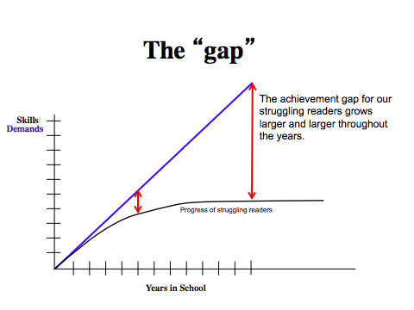
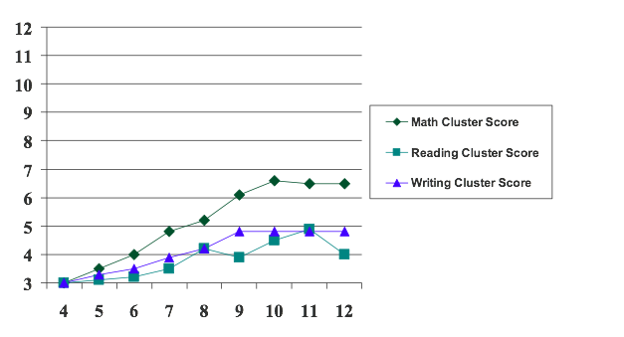
Achievement Data from 1970’s-2020’s

Slide 7
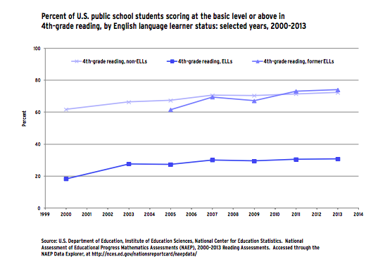
A different way to look at similar data - what do you notice?

Slide 8
© 2020, TNTP. All rights reserved

Slide 9
Big Findings and Ideas about
Students who Struggle to Learn and Perform
Students struggle for different reasons and to different degrees
Overall these students are 2-4 years below grade level by 6th grade
Instructional strategies/methods seem to be effective regardless of why the students have difficulty (but they may need targeted instruction)
Students benefit from learning strategies they can use to learn and perform
Good news - the same methods can often help students regardless of the reason they have difficulty and we can scaffold learning while they are learning to read and write (and most can be used in virtual/online environments)

Slide 10
Literacy Principles and Models

Slide 11
Scientific literacy research identifies two major components of reading.
The Simple View of Reading
(Gough & Tunmer, 1986; Hoover & Gough, 1990)
p. xii
Notes:
Trainer Notes
Briefly review the Simple View of Reading, described in the introduction as a connection to LETRS, and the foundations developed in the early literacy period needed for a successful transition to early reading and writing.
Make sure to emphasize that this formula is a product (multiplied), not a sum (added). If one component is not well-developed, reading comprehension will be compromised. For example, if a student has good language comprehension but does not have word recognition skills, reading comprehension will be impacted, represented mathematically as 0 x 1 = 0.
References
Gough, P. B., & Tunmer, W. E. (1986). Decoding, reading, and reading disability. Remedial and Special Education, 7(1), 6–10.
Hoover, W. A., & Gough, P. B. (1990). The simple view of reading. Reading and Writing, 2(2), 127–160.

Slide 12
Reading Rope
p. xii
(Scarborough, 2001)
Notes:
Trainer Notes
The connection to Scarborough’s Reading Rope is described in the introduction and connected to LETRS.
The beginnings for each skill are described throughout the LETRS Early Childhood training along with the interconnected nature of skill development needed for learning to talk and learning to read and write.
Point out that the “rope” model details the Simple View of Reading by including the skills in each component.
References
Scarborough, H. (2001). Connecting early language and literacy to later reading (dis)abilities: Evidence, theory and practice. In S. B. Neuman & D. K. Dickinson (Eds.), Handbook of early literacy research (Vol. 1) (pp. 97–110). New York, NY: Guilford Press. Used with permission.

Slide 13
Language Essentials
for Teachers of Reading and Spelling
Professional development course that bridges deep, meaningful research into practical classroom success.
Provides educators with the background, depth of knowledge, and tools to teach language and literacy skills to every student.
Can be used regardless of the literacy program in use.
Notes:
LETRS® is a professional development course that bridges deep, meaningful research into practical classroom success.
LETRS provides educators with the background, depth of knowledge, and tools to teach language and literacy skills to every student.
LETRS can be used regardless of the literacy program in use.

Slide 14
Assessment
DESE Screening Organizer - https://dese.mo.gov/sites/default/files/curr-dyslexia-screening-organizer-by-grade.pdf
PAST - David Kilpatrick - https://www.thepasttest.com/
95% Phoneme Screeners - https://www.95percentgroup.com/downloads
Really Great Reading - https://www.reallygreatreading.com/diagnostics
CORE Phonics - https://spes.ncmcs.org/UserFiles/Servers/Server_19566293/File/Academics/Exceptional%20Children's%20Services/CORE%20Phonics%20Survey.pdf

Slide 15
Teaching Phonological Skills: General Principles
Gradually move through the developmental progression of task difficulty (Table 2.3).
Focus on speech sounds before letters.
Encourage mouth awareness.
Include all English phonemes in instruction.
Use multisensory engagement: touch, move, say.
Do brief (5–10 minutes), distributed, frequent lessons.
Model (I DO), lead (WE DO), observe (YOU DO).
Give immediate corrective feedback.
Transition to letters when students are ready.
p. 141
Notes:
Trainer Notes
Review these principles briefly. Keep the developmental progression in mind and make activities brief and fun. These are not workbook activities.
 Speaking Points
For most students, instruction takes only a few minutes for 12–20 weeks to make a difference.
The goal is phoneme segmentation/blending by first grade. The oral production of sounds and words is critical.

Slide 16
Instructional Strategies
Manipulation of sounds - identify, isolate, categorize, blend, segment, delete, add, substitute sounds - through at least 4-5 sounds:
*coosh ball toss - begin with sentences, syllables and words - segment a nursery rhyme or familiar song, rhyming, then move to sounds - change the initial sound or the final sound
*rhyme - nursery rhymes, songs, making up rhymes
*kinesthetic - physical phonics, manipulating tiles/markers and letters
*repetition and chaining - repeating specific sounds and changing sounds
*introduce “easier” sounds first and progress to more difficult sounds
Which virtual tools can we use for these and other instructional methods?

Slide 17
Tap It, Map It, and Zap It!
Using sound boxes, ask students to move markers into each box as they segment the sounds in a word.
Notes:
Materials: Magnetic discs and wands, sound boxes
Trainer Notes
This slide briefly reviews the strategy of Elkonin markers representing phonemes.
The slide is animated so that the markers appear.
 Speaking Points
The goal is to increase phonemic sensitivity and make connections that will eventually lead to phoneme-grapheme mapping. This is a fun and engaging strategy for concretizing phonemes.
ant
bus
cat
fish
kite
duck

Slide 18
Tap It, Map It, and Zap It!
Using sound boxes, ask students to move markers into each box as they segment the sounds in a word.
Notes:
Materials: Magnetic discs and wands, sound boxes
Trainer Notes
This slide briefly reviews the strategy of Elkonin markers representing phonemes.
The slide is animated so that the markers appear.
 Speaking Points
The goal is to increase phonemic sensitivity and make connections that will eventually lead to phoneme-grapheme mapping. This is a fun and engaging strategy for concretizing phonemes.
past
great
lamp
tent
frog
milk
bunch

Slide 19
Tap It, Map It, and Graph It!
ch
a
m
p
Notes:
Trainer Notes
Start by showing participants how to map the sounds of the word champ with colored blocks onto the grid, saying each individual sound as you move the blocks. Each box represents one phoneme or speech sound. Once the sounds are mapped, move the blocks up and write in the letter or letter combination that represents each phoneme.
Move the blocks onto the grid to segment individual speech sounds.
Move each block above the grid, writing in the letter patterns that represent each speech sound.
Ask participants to watch as you complete this example. This is the I DO part of the lesson.
Next, have participants take materials to practice this activity with a partner.
They will need Elkonin boxes, (magnetic) chips, (magnetic) wand, and a list of words.
Leave this slide showing so that participants can follow the “tap it, map it, graph it” format.
 Speaking Points
The big idea here is to increase phonemic sensitivity and make connections with the sound-spelling connection.
This slide is animated to show the progression of mapping sounds (phonemes) to letters (graphemes).
Kathi Grace has developed this technique into a program of instruction (Grace, 2007).
Reference
Grace, K. (2007). Phonics and spelling through phoneme-grapheme mapping. Longmont, CO: Sopris West Educational Services.

Slide 20
Vocabulary Instructional Strategies
Morphology – definition, strategies
Multisensory -Visual and kinesthetic activities
Rasinski – word spokes, word ladders - www.timrasinski.com
Easy Define Http://easydefine.com
Word matrix - www.neilramsden.co.uk
Word Mapping
https://www.edgeenterprisesinc.com/product/word-mapping-strategy-instructors-manual
Personal dictionary or interactive digital dictionary

Slide 21
Connect to Word Meaning (Multiple Meaning Words)
verb/noun
(part of speech)
Dark sticky substance
Asphalt
A resin from tree sap
To throw, usually with careful aim
To discard
Music pitch
Sales pitch
To dip bow and stern
To slope downward
The angle of a roof
Soccer field
Degree of intensity (e.g., work at a feverish pitch)
pitch
Notes:
Trainer Notes
Have participants draw a multiple-meaning web on the blank side of the phoneme-grapheme mapping grid. Then, instruct them to work with the people at their table to come up with at least five different meanings for the word pitch.
The slide is animated to show possible answers once participants are done.

Slide 22
Word Ladders - Tim Rasinski
Thanksgiving Word Ladder Lesson
Start with the word “Give” and work down.
Give Change 1 letter to make a place where bees live.
Hive Change 1 letter to make a way to jump or plunge headfirst into a swimming pool.
Dive Change 1 letter to make another name for supper or to eat dinner.
Dine Change 1 letter to make an evergreen coniferous tree.
Pine Add 1 letter to make another name for your backbone.
Spine Change 1 letter to make a word that means to give off a bright light or to perform well.
“Rise and __________”
Shine Take away 1 letter to make the front part of your leg below the knee.
Shin Change 1 letter to make a word that means very underweight. Also, the opposite of “thick.”
“Let’s stick together through thick or _________”
Thin Add 2 letter to the end to describe what your brain does.
Thinks Change 1 letter to make what we “give” on the last Thursday in November in the United States.
Thanks

Slide 23
Word Spokes - Rasinski
Jamboard activity
https://jamboard.google.com/d/1tBBm0fibOWmfaCHBtvSEZtKF-mAKMEsNd0YzkGRCB1c/viewer?f=0
Choose a Jamboard - 1, 2 or 3 and add post its around the circle

Slide 24
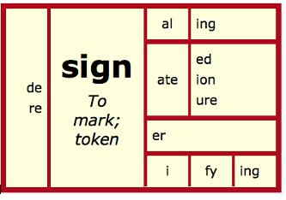
Word Matrix Word Mapping
Map the word parts
Attack the meaning
Predict the meaning
See if you are correct
pre
ven
tion
before
come
act of
the act of coming before
come before or stop something from happening

Slide 25
Fluency and Comprehension
Fluency
Fluency is the ability to read a text accurately, quickly, and with expression. Reading fluency is important because it provides a bridge between word recognition and comprehension.
Comprehension = byproduct of

Slide 26
Why Is Code-Emphasis Instruction Important?
“There is no comprehension strategy powerful enough to compensate for the inability to read the words.”
—Dr. Joseph Torgesen
(Stainthorp & Tomlinson, 2002)
Notes:
 Speaking Points
DIBELS® Next gives us information about accuracy in addition to rate. Understanding the importance of accuracy to measures of fluency is key to the creation of readers who can both read and comprehend. We know that for independent reading children need to be at least 95 percent accurate; in actuality, we want them to be closer to 98 percent accurate.
References
Good, R. H., & Kaminski, R. (2010). DIBELS next: Dynamic indicators of basic early reading skills (7th ed.). Longmont, CO: Cambium/Sopris.
Stainthorp, R., & Tomlinson, P. (Eds.). (2002). Learning and teaching reading (Monograph series II: Psychological aspects of education, current trends). London, UK: British Journal of Educational Psychology.

Slide 27
Assessment
Oral Reading Fluency
AIMSweb R-CBM
Oral AIMSweb Plus
DIBELS 6th and Next ORF DIBELS 8th ORF
EasyCBM Passage Fluency Renaissance
STAR Early Literacy **1 Minute Fluency
Hasbrouck and Tindal ORF norms (revised 2017)
https://www.brtprojects.org/wp-content/uploads/2017/10/TechRpt_1702ORFNorms_Fini.pdf

Slide 28
Assessment
Comprehension
AIMSWeb Maze
AIMSweb Plus
DIBELS Next Daze
DIBELS 8th Maze
EasyCBM Reading Comprehension
Renaissance STAR Early Literacy Curriculum Based Measures
Curriculum Based measures - vetted, field-tested

Slide 29
Reading comprehension is so affected by the readers’ prior knowledge of the subject matter being read about and the language used to express those ideas (e.g., vocabulary, sentence structure, cohesion, text organization, literary devices, graphics), that focusing one’s attention on which kinds of question the kids could answer is a fool’s errand.
If I were trying to assess reading comprehension information to determine who might need more help, the kind of help to provide, or who I should worry about concerning the end of year testing, then I wouldn’t hesitate to ask questions that seemed to reflect the standards… but the information I’d use for assessment would ignore how well the kids could answer particular types of questions.
My interest would be in how well students did with particular types of texts.
Tim Shanahan, 2019

Slide 30
Keep track of their overall comprehension with different types of text. I’d record the following information:
How the student did on each overall text (the percentage of questions answered correctly, or an estimate of the percentage of key information the student could include in a summary).
The topics of the texts (with, perhaps, some rating of each child’s familiarity with those topics).
An estimate of the text difficulty (in terms of Lexiles or another readability estimate).
The lengths of the texts (in numbers of words, preferably).
Whether the text was Literary (narrative or poetry), or Informational (expository or argumentative).

Slide 31
Xtreme Reading Passages - fluency and comprehension
Students go to a break out room with a partner and a passage
Partners take turns reading for one minute and count their words
Students chart their fluency rate
Students take comprehension test independently in Google doc
Students chart their comprehension score in Google sheets
Students discuss their comprehension test answers with their partner
Other ideas?

Slide 32
Research on Comprehension
Instructional and Learning Strategies
Metacognitive strategies and comprehension monitoring: University of Kansas, REWARDS
Cooperative learning: Students learn reading strategies reciprocally: Reciprocal Teaching
Use of graphic and semantic organizers: Thinking Maps, KU Content Enhancement
Question generation: Students ask themselves questions - Question Formulation Technique, KU Self-Questioning
Story structure: use the structure of the story - Story Grammar
Summarization: Students are taught to integrate ideas and generalize from the text information - KU Summarizing and Paraphrasing, Reciprocal Teaching
https://www2.ed.gov/programs/readingfirst/support/compfinal.pdf

Slide 33
From Dyslexia Webinar today - latest research on adolescent literacy

Slide 34
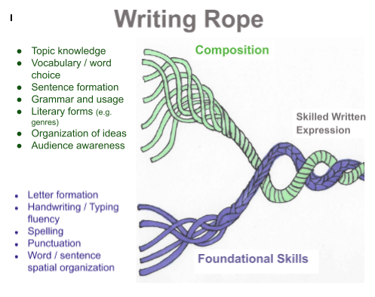
Writing

Slide 35
Research on Writing Instruction
Writing Next report https://media.carnegie.org/filer_public/3c/f5/3cf58727-34f4-4140-a014-723a00ac56f7/ccny_report_2007_writing.pdf

Slide 36
Research-validated Instruction Programs
Sentence writing and sentence combining instruction - Anita Archer REWARDS, University of Kansas, The Writing Revolution, Graham and Harris
Prewriting, writing process, study of models, writing for content learning -
Anita Archer, University of Kansas, The Writing Revolution, Graham and Harris
Writing strategies - University of Kansas Sentence, Paragraph and Theme Writing strategies, Anita Archer

Slide 37
6 + 1 Traits Carousel
1. Write an SV sentence & Search & Check -“rotate”.
2. Change the SV to an SVV - Search & Check - “rotate”
3. Rewrite SVV with more powerful words - Search & Check -“rotate”
4. Change the SVV to a I,c I or I;I
5. Share
University of Kansas Sentence Writing and Combining example
Simple sentence = Independent clause
SV
SSV = I
SVV
SSVV
Compound sentence = 2 Independent clauses & conjunction or ;
I, c I
I ; I

Slide 38
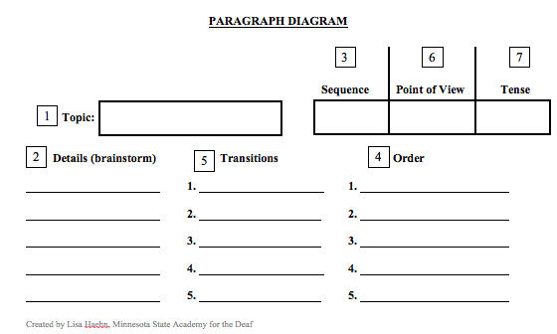
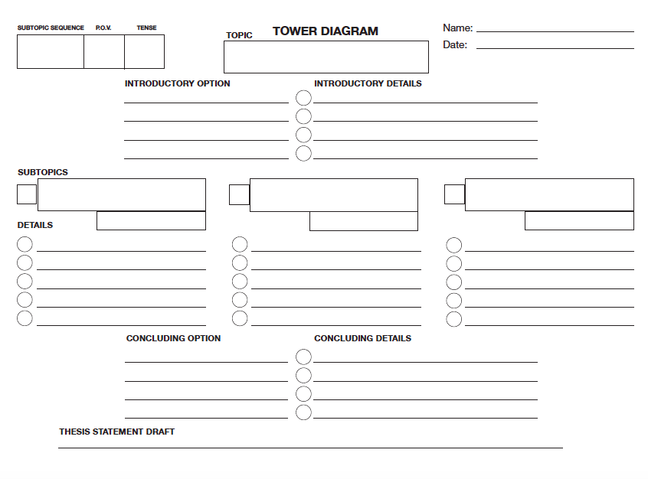
Planning Tools
University of Kansas Center for Research on Learning

Slide 39
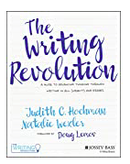
Research-validated Instruction Programs
https://www.thewritingrevolution.org
https://www.edgeenterprisesinc.com/wp-content/uploads/edge_order_form
https://kucrl.ku.edu/sites/kucrl.ku.edu/files/images/general/Handouts/Writing%20Strategies2017%20copy.pdf
http://store.voyagersopris.com/rewards-writing/
https://products.brookespublishing.com/Powerful-Writing-Strategies-for-All-Students-P186.aspx

Slide 40
Providing Feedback
Decades of education research support the idea that by teaching less and providing more feedback, we can produce greater learning (see Bransford, Brown, & Cocking, 2000; Hattie, 2008; Marzano, Pickering, & Pollock, 2001).
Tool: Mote extension for Google Chrome
Easily provide audio feedback to students
Comments are transcribed and can be translated in more than 20 languages

Slide 41
Resources for Virtual Learning
Websites with tools and strategies
https://www.understood.org/en/school-learning/for-educators/distance-learning/distance-learning-toolkit
Apps
OG Card Deck - learning and practicing phonemic awareness

Slide 42
Scaffolding

Slide 43
How would you define or describe
scaffolding?
process by which the teacher adds supports for students in order to enhance learning and assist in the mastery of tasks
building on student’s experiences, knowledge and skills as they are learning new knowledge and skills
like scaffolding for building, these supports are temporary and adjustable; as students acquire knowledge and master skills, the supports are gradually removed
analogies: training wheels on a bike

Slide 44
What kinds of scaffolding support diverse learners
Content scaffolding - same content but change
Reading level or access (e.g. text to speech)
Vocabulary
Interest or relevance
Conceptual or organization of ideas
Task scaffolding
Material scaffolding
Peer scaffolding

Slide 45
Reading Level
Content
● https://newsela.com/
● https://www.commonlit.org/
● https://www.readworks.org/ (including ebooks)
● rewordify.com
● http://donjohnston.com/start-to-finish-core-curriculum/
● https://tarheelreader.org/
https://steinhardt.nyu.edu/metrocenter/resources/glossaries

Slide 46
Access to Text
Content
Microsoft Immersive Reader

Slide 47
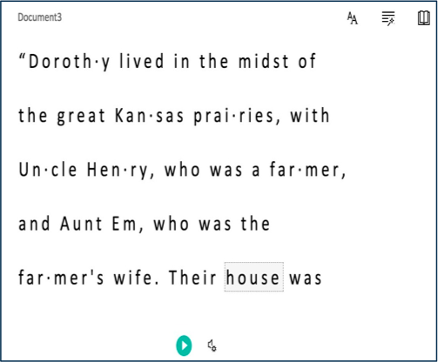
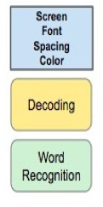
Microsoft Immersive Reader
Speed, voice
Syllables
Language
Parts of speech

Slide 48
Vocabulary
Content
Immediate scaffolds to hear words and see definitions:
Immersive Reader
Read & Write
Dictionary
Personal dictionary or interactive digital dictionary

Slide 49
Concepts & Organization of Ideas
Content
Graphic Organizers:
limited number
focused on ways of thinking (compare, contrast, argumentation)
explains relationship of ideas (how ideas are connected)
assists students in explaining and writing
Tools for organizing ideas for projects and collaborating:
Wakelet
Hyperdocs

Slide 50
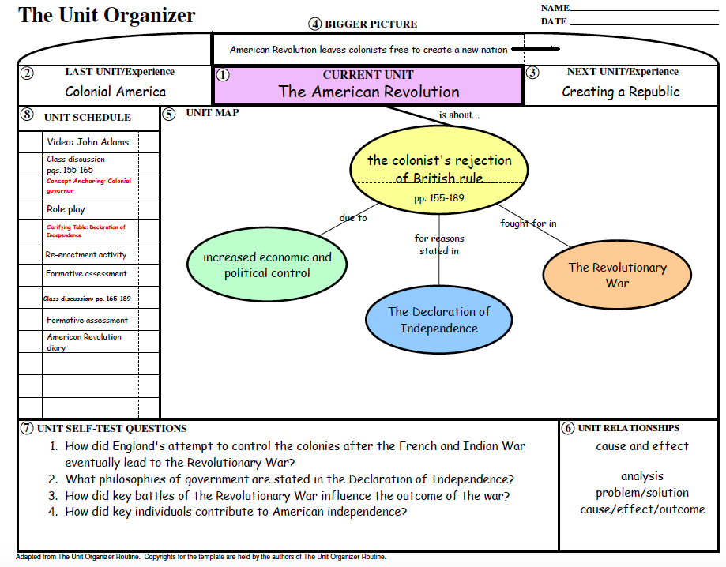
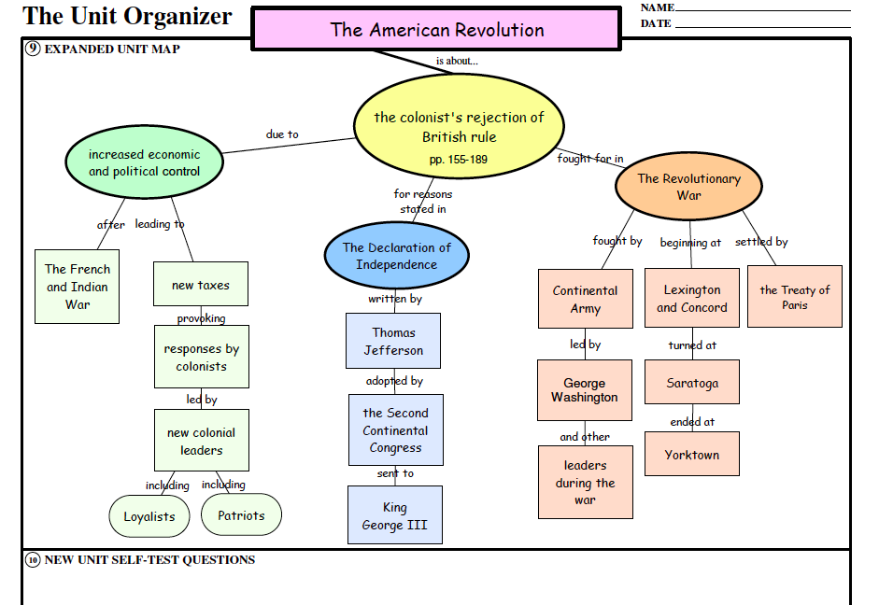
Concepts & Organization of Ideas

Slide 51
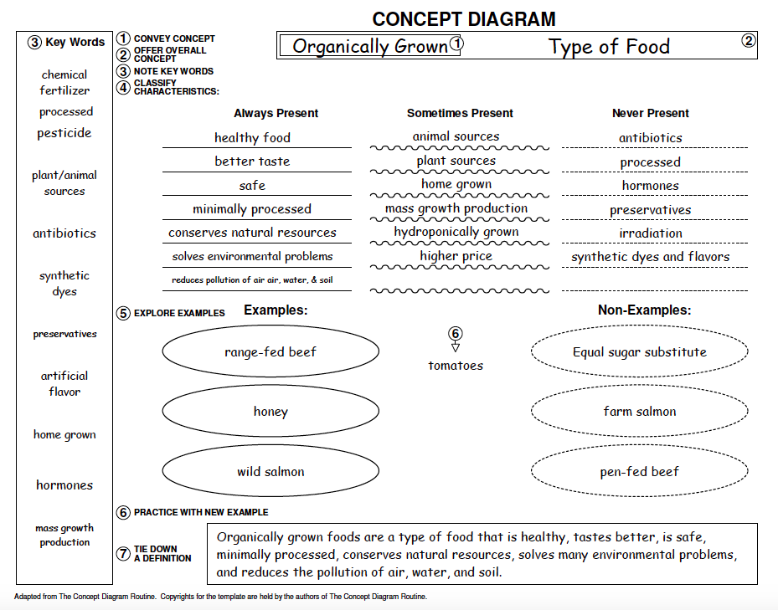

Slide 52
Task Scaffolding
Writing:
Graphic Organizers and planning tools
Speech to text/dictation:

Slide 53
Planning Tools
University of Kansas Center for Research on Learning

Slide 54
Thoughts? Questions?

Slide 55
July 13-15, 2021
Don’t forget to complete a session evaluation!
https://www.surveymonkey.com/r/2021SIMposiumEvals

