Slide 1
Sentence-Writing Programs
What does the research tell us?

Slide 2
Definitions
“Research based” program
A program containing a package of instructional methods, some of which have been shown to be effective (e.g., reinforcement).
• “Empirically validated” program
A program which has been validated in a methodologically sound research study which has been published.

Slide 3
Three Ways to Determine Value
Statistical significance
Effect size
Social significance

Slide 4
Statistical Significance
Probability is less than .05 that two groups are the same

Slide 5
Cohen’s d Effect Size
d = .2 to .4 is small
d = .5 to .7 is medium
d = above .8 is large

Slide 6
Eta Squared Effect Size
Large effect = .14 or larger
Medium effect = .06 to .13
Small effect = .01 to .05

Slide 7
Social Significance
Use what you know about the world to make a decision about whether something is socially significant.

Slide 8
Empirically Validated Sentence Instruction
Writing Frames
Picture-Word Prompts
Sentence Combining
Strategic Instruction

Slide 9
Writing Frames
Research conducted by Pennington, Flick, and Smith-Wehr (2018).

Slide 10
Basic Frames
I want ____________.
I see _____________.
(Students are prompted to fill in the blank with an article (“a,” “the”) and a noun.)
• The ______ is _______.
(Students are prompted to fill in the blanks with a noun and an adjective.)

Slide 11
Software Program
Presents the students with:
Word banks for filling in the blanks
Picture for each frame
• a picture of candy (“I want candy.”)
• a picture of a blue whale
(“The whale is blue.”)
Buttons for clicking on words in sequence

Slide 12
The Program
One-on-one instruction
Modeling
Practice
Feedback

Slide 13
Prompts
“Write a sentence that tells me what you want.” (“I want a ________.”)
“Write a sentence that tells me what you see.” (“I see a _________.”)
“Write a sentence telling me about the _____.” (“The ball is red.”)

Slide 14
Results (N=3)
Students wrote more complete sentences after the instruction.
They wrote three types of sentences.
They generalized their responses by writing complete sentences for new items.

Slide 15
Concepts Taught
Using articles with nouns
Nouns as direct objects
Adjectives corresponding to nouns

Slide 16
Issues??

Slide 17
Handout Activity

Slide 18
Picture-Word Prompts
Datchuk and colleagues have conducted a series of studies

Slide 19
Parts of a Picture-word Prompt
Subject or object
Engaged in an activity
Single words that can be used in the sentence about the picture

Slide 20
Example Picture-word Prompt

Slide 21
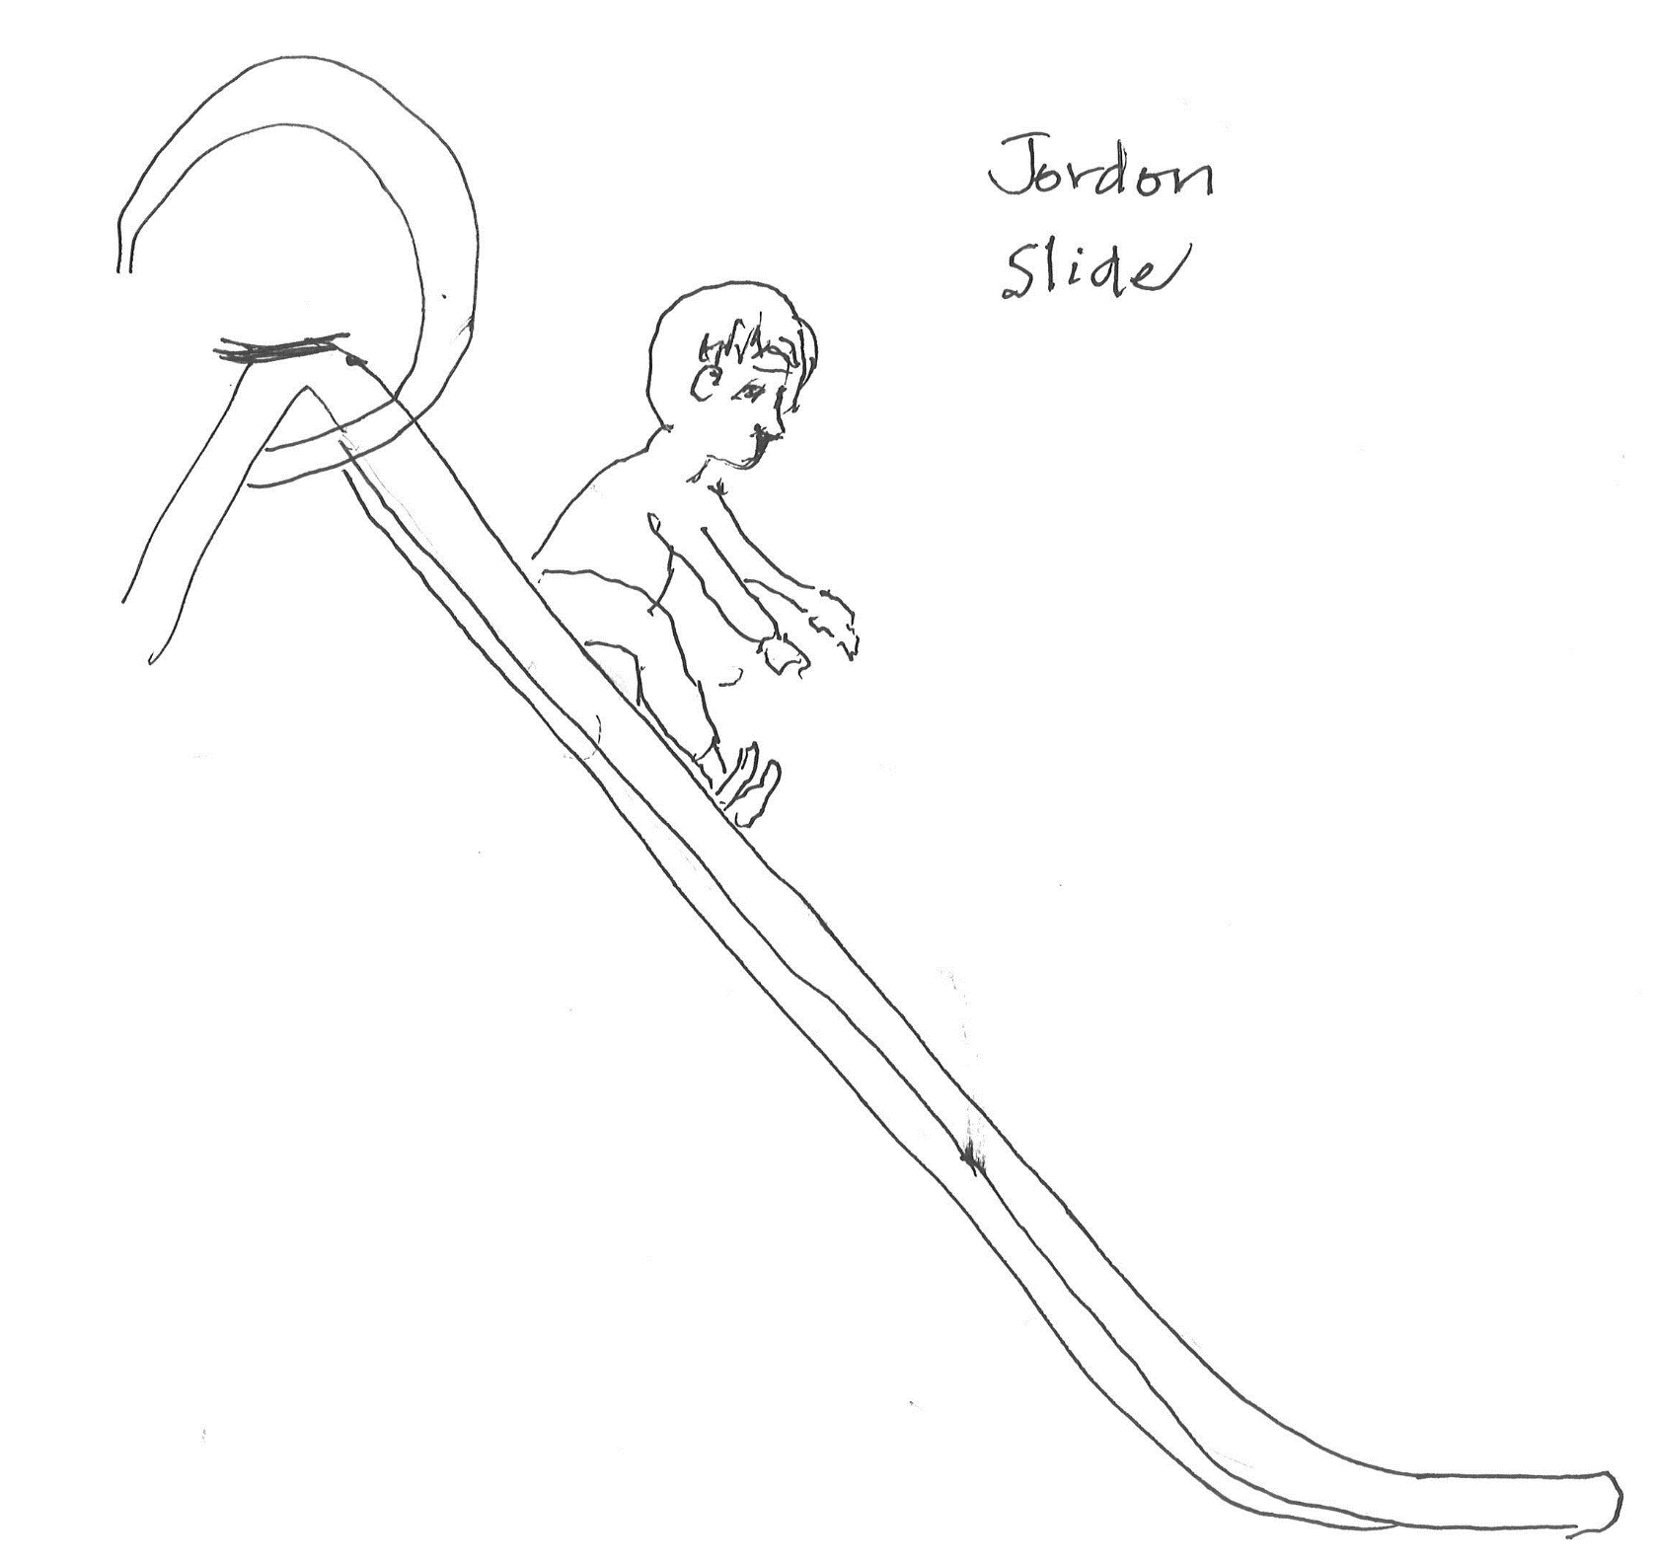

Slide 22
The Program
One-on-one instruction
Picture-word Prompts
Model-lead-test Steps
Timed practice
Goal setting
Feedback & error correction

Slide 23
Results (N=3)
Students wrote more complete word sequences within 1 minute
Students wrote fewer incomplete word sequences within 1 minute
Notes:
Once study had 8 students

Slide 24
Concepts Taught
Capital letter
Period
Subject (part that names someone or something)
Predicate (part that tells more)

Slide 25
Handout Activity

Slide 26
Issues??

Slide 27
Sentence Combining
Saddler and colleagues have published several studies.

Slide 28
Students are given
Two independent clauses
Connector words
adjectives
phrases
conjunctions (but & because)

Slide 29
Example with adjectives
The room was dark.
The room was small.
Combined sentence:
The room was dark and small.

Slide 30
Example with phrase embedding
The ground shook.
The ground was around the mountain.
The mountain was tall.
Combined sentence:
The ground around the tall mountain
shook.

Slide 31
Example with Connector
They landed in the water.
The water was swirling.
They did not sink.
Combined sentence:
They landed in the swirling water but they did not sink.

Slide 32
The Instruction
Introduction
Models of combining sentences
Each lesson focused on one type.
Oral guided practice
Written guided practice
Student ratings

Slide 33
Results (N=6)
Mean scores on the Sentence Combining Subtest of the TOWL-3 increased from 6.3 to 11.5.
T-unit length per sentence increased for all students (sentences were more complex).
The number of combining constructions increased for several students. Adjectives were the most used.

Slide 34
Concepts Taught
Adjectives
Phrases
Compound sentences with “but” (but no comma)
Complex sentences with “because”

Slide 35
Handout Activity

Slide 36
Issues??

Slide 37
Strategic Instruction
Several studies have been conducted by researchers associated with the KU-CRL and Edge Enterprises, Inc.

Slide 38
Five Programs
Fundamentals of the Sentence Writing Strategy
Proficiency in the Sentence Writing Strategy
The Commas Strategies Program (CD)
The Punctuation Strategies Program (CD)
Fundamentals of Paragraph Writing (CD)

Slide 39
The Instruction
Describe
Model
Verbal Practice
Guided Practice
Independent Practice
Generalization

Slide 40
Fundamentals Results (N=113)
Bui Study: Fundamentals of Sentence Writing-
Fifth-grade classes
Whole group difference:
Complicated sentences: ES = .222 (.14 is large)
LD subgroup difference:
Complete sentences: ES = .699 (very large)
Complicated sentences: ES = .22 (large)
Notes:
SWDs = 19
Results showed differences between the Whole groups and between the subgroups of SWDs.

Slide 41
Proficiency Results (N=9)
Schmidt study: Proficiency in Sentence Writing
High school students with LD (grades 10, 11, 12)
Complete sentences:
Social Significance: Growth from 70% to 94%
Complicated sentences:
Social Significance: Growth from 0% to 40%

Slide 42
Sentence Results with Commas Strategies CD
Construction of complicated sentences
Statistically significant difference between experimental and control students p<.001
Middle schoolers: Effect size d = 5.653
High schoolers: Effect size d = 6.360
Socially significant: Growth from 11% to 91%

Slide 43
Sentence Results with Punctuation Strategies
Construction of complicated sentences
Statistically significant difference between experimental and control students p<.001
Middle schoolers: Effect size, d = 5.05
High schoolers: Effect size d = 6.68
Socially significant: Growth from 20% to 88%

Slide 44
Sentence Results with the Paragraph Writing CD

Slide 45
Study 1 Details
18 Students
9 Junior-high students
9 Senior-high students
Multiple-baseline across-students design

Slide 46
PARAGRAPH Test: Percent of COMPLETE SENTENCES
Repeated Measures ANOVA Result: F(1,16)=46.41, p <.0005, Eta Squared=.74 (very large)
Notes:
The ANCOVA compared the posttest scores of School A to the posttest scores of School B, while controlling for the pretest scores in each school. School A posttest scores on this measure were significantly higher than the School B posttest scores. The effect size is very large.

Slide 47
Sentence Test: Percent of Prompts Matched
Repeated Measures ANOVA Result: F(1,16) = 306.95, p < .0005, Eta squared = .95 (very large)
Notes:
The ANCOVA compared the posttest scores of School A to the posttest scores of School B, while controlling for the pretest scores in each school. School A posttest scores on this measure were significantly higher than the School B posttest scores. The effect size is very large.

Slide 48
Sentence Results with Paragraph Writing CD
Construction of prompted sentences:
Statistically significant difference between experimental and control students p < .0005
Eta Squared Effect size = .95 (very large)
Socially significant: Growth from 20% to 95%

Slide 49
Sentence Results with Paragraph Writing CD
Construction of complete sentences within a paragraph:
Statistically significant difference between pretest and posttest scores: p<.0005
Eta Squared Effect size = .74 (very large)
Socially significant: Growth from 44% to 95%

Slide 50
Study 2 Details
Control-group design with randomly selected groups (experimental and control groups)
Plus a normative group

Slide 51
More Study Details
STRUGGLING WRITERS
Junior high writing group = 24 students
Junior high reading group = 17 students
Senior-high writing group = 18 students
Senior-high reading group = 18 students
NORMAL LEARNERS
• Junior-high group = 24 students
• Senior-high group = 21 students

Slide 52
Sentences Test: Percent of Complete Sentences
ANCOVA Result: F(1,68)=32.645, p <.001, Eta Squared=.331 (large)
Notes:
The ANCOVA compared the posttest scores of School A to the posttest scores of School B, while controlling for the pretest scores in each school. School A posttest scores on this measure were significantly higher than the School B posttest scores. The effect size is very large.

Slide 53
Sentence Test: Percent of Prompts Matched
ANCOVA Result: F(1,68) = 203.541, p < .001, Eta squared = .755 (very large)
Notes:
The ANCOVA compared the posttest scores of School A to the posttest scores of School B, while controlling for the pretest scores in each school. School A posttest scores on this measure were significantly higher than the School B posttest scores. The effect size is very large.

Slide 54
Paragraph Test: % of pts earned on Organization
ANCOVA Result: F(1,68) = 76.239, p < .001, Eta squared = .536 (very large)
Notes:
The ANCOVA compared the posttest scores of the writing group with the reading group.

Slide 55
Paragraph Test: % pts earned on Planning Diagram
ANCOVA Result: F(1,68) = 412.112, p < .001, Eta squared = .862 (very large)
Notes:
The ANCOVA compared the posttest scores of the writing group with the reading group.

Slide 56
Results summary
All experimental group students met mastery on the sentence writing and paragraph writing skills.
All experimental group students made statistically significant and socially significant gains on all measures of sentence writing, paragraph planning, and paragraph organization.
The control students made no gains on any measures of writing.

Slide 57
Results summary (continued)
There were no significant differences between the experimental junior-high and senior-high students’ scores on the posttests while controlling for the pretest scores. (Junior-high and senior-high students learned equally well from the program.)
There were significant differences between the experimental and control students’ posttest scores while controlling for the pretest scores, with very large effect sizes for each measure.
The experimental students’ mean posttest scores exceeded the mean end-of-year scores of the normal students.

Slide 58
Concepts Taught Fundamentals of SWS
See handout

Slide 59
Issues??

Slide 60
Thoughts??

