Slide 1
Science of Reading and SIM: What do I need to know?
Jocelyn Washburn, Ph.D.
Director of Professional Development & Senior Associate Researcher, KUCRL
Dana McCaleb SIM Professional Developer & Coordinator, T/TAC at Virginia Tech

Slide 2
Adolescent Literacy
SIM
Content
Enhancement
Routines
Science of Reading
SIM
Learning Strategies
Notes:
When we first started planning for this session, we were discussing all our ideas and possible topics. At some point we said this could be a Unit Organizer! We have all of these ideas that need to be organized and tied together for understanding. From there we decided the balloons would be a nice visual for this session. Together, with Laura’s help and your help, we want to tie these ideas (balloons) together with a bow by the end of the session. Get ready for some deep discussion!

Slide 3
①
Term
Science of Reading
③
Core idea
The focus of our session!
vast body of scientific research on how reading instruction
⑤
Use it to describe...
②
Clarifiers
④
Knowledge connections
Example of...
A movement
&
Addressing the
Opportunity Gap
Simple View of Reading
Scarborough’s Rope
Components of Reading
Structure Literacy
Adolescent Literacy
Research
⑥
Don’t confuse it with...
Not an example of...
only teaching
phonics and
decoding
⑦
Example sentence
The Science of Reading movement focuses attention on using research to make reading instructional decisions.
Notes:
What does the Science of Reading mean?
From Director of the Reading League, Maria Murray, CEO & President: She learned about a vast body of scientific research - “the science of reading.” More than four decades of evidence exists showing that almost all children can become proficient readers, yet the kind of instruction needed to make that happen was not present in schools. The science was separated from our classrooms. Through no fault of their own, educators lacked this knowledge.
Based on brain research, debunks earlier understandings about reading instruction which were based on observation.
Breakout rooms to discuss background knowledge and then add questions to padlet
Set stage with the challenge when something new is introduced and how to connect what we are currently doing (SIM) and how to connect that works to SoR. We ask ourselves questions to reflect on: Is it still relevant, current, viable?

Slide 4
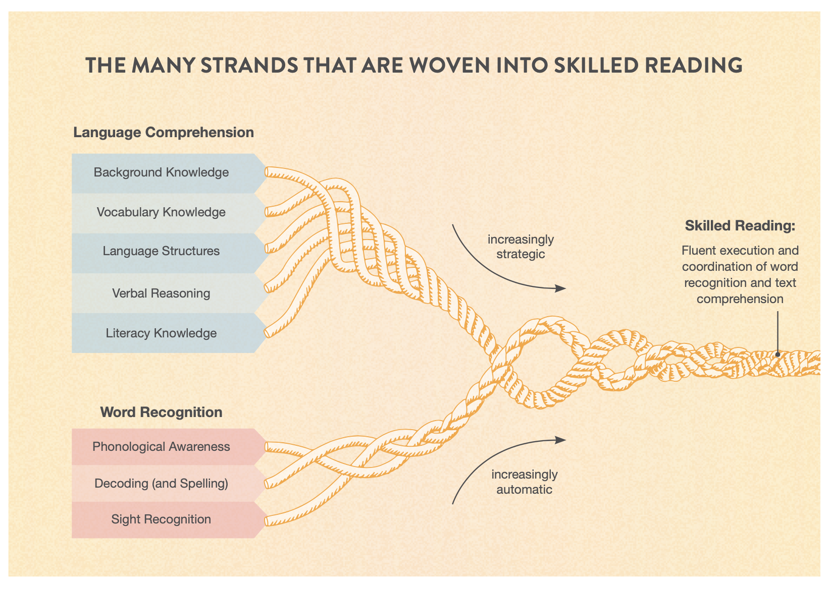
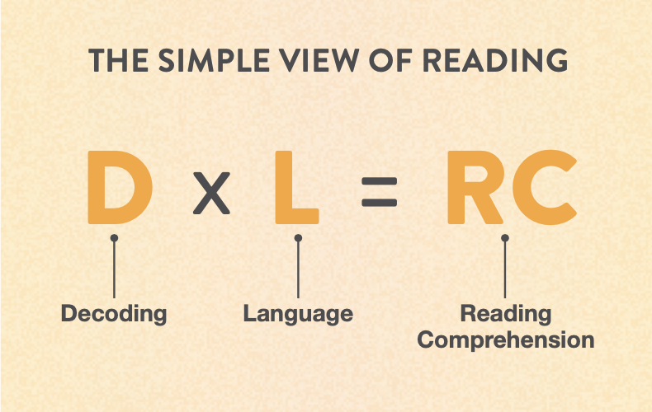
Science of Reading
based on
Gough & Tumner, 1986
Scarborough, 2001
Notes:
Dana
Overview of key theories behind the science of reading
Video on Rope

Slide 5
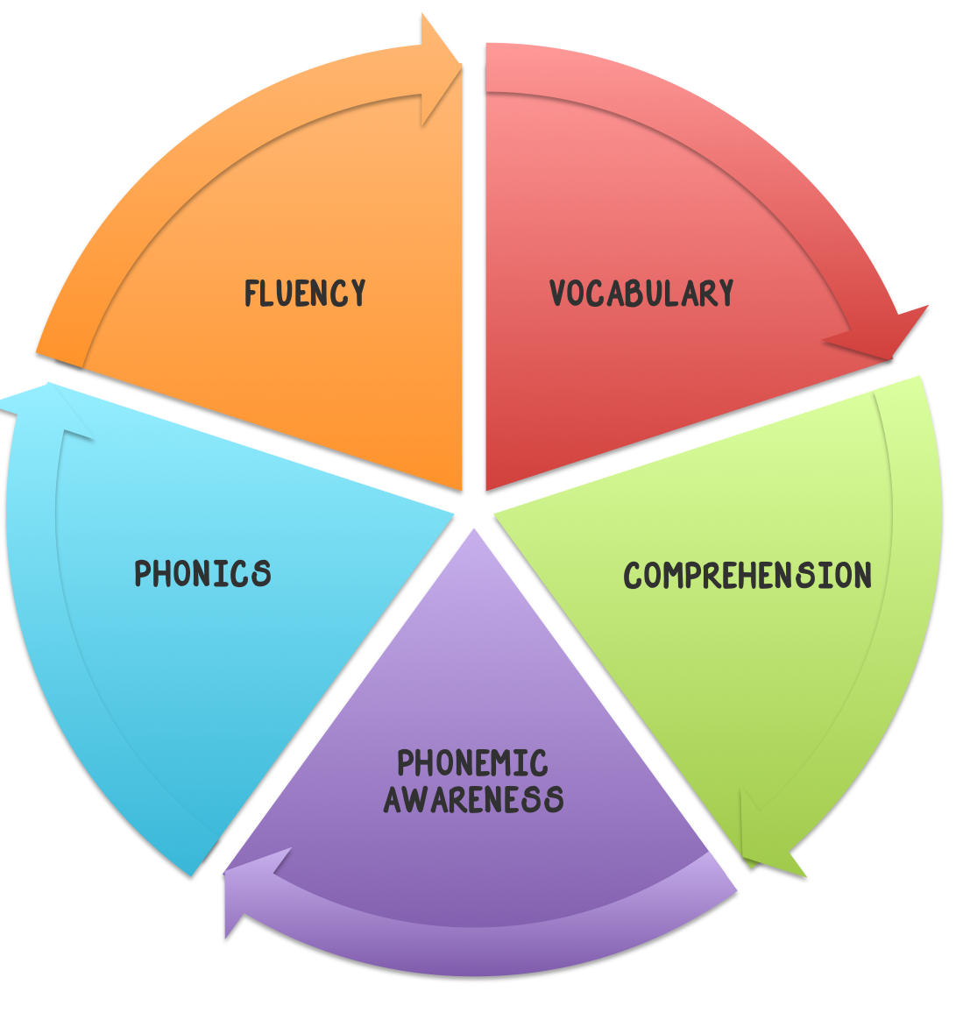
5 COMPONENTS OF READING
Phonemic Awareness - Recognizing and using sounds to create words
Phonics - Understanding the relationship between letters and sounds
Fluency - Reading accurately & Quickly
Vocabulary - Learning the meaning and pronunciation of words
Comprehension - Understanding, remembering and communicating
Notes:
Dana

Slide 6
Structured Literacy
the term adopted by the International Dyslexia Association in 2014 that is meant to be inclusive of all programs and approaches that teach reading through an explicit and systematic approach
Instructional principles are
explicit and direct,
systematic and sequential,
cumulative,
diagnostic,
multisensory, and
progress monitoring
Notes:
Dana

Slide 7
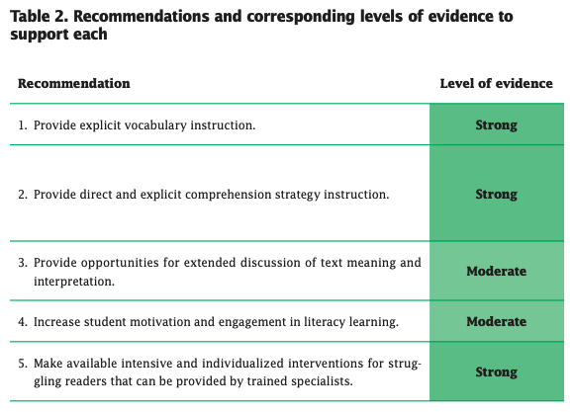
Notes:
Jocelyn
Ask the group to verbally share or type in the chat the key words they think about when asked “What do we know about adolescent literacy?”
About 15 years ago, “we” used to say we don’t know as much about adolescent literacy as they do for the early years, but look at all we know now!!!
Some background in theory:
The Simple View of Reading is not only applicable to early reading. In Sept. 2018, the Remedial and Special Education journal devoted their entire issue to SVR. In that issue, Hoover and Tunmer wrote about the SVR and explained that it is a static model, describing reading at a single point in time and is not intended to describe how reading develops over time.
However, in this same issue, Francis and colleagues shared the results of their study to extend the SVR. The intent of their research was to examine any personalization within the act of reading. Their proposed model, the Complete View of Reading (CVRi), shows that readers approach reading tasks differently due to a differential influence of text features and familiarity with the subject matter on their fluency. With the more complex text at the secondary level and increased expectations for vocabulary and background knowledge, some students may fluctuate their rate in order to improve their decoding and language comprehension. Even still, a strong foundation in basic and intermediate reading makes this possible for all readers.
Hoover and Tunmer (2018) assert that a direct relationship between the SVR and the CVRi requires additional research, yet they expressed value in the CVRi for enabling individualization for instructional interventions that target personalized reading profiles. This seems most applicable to distinct adolescent reader profiles that show different gaps. Often, they have in common below average in word level skills.
Issues that are increasingly important to address AL are…
Literacy is more than reading… of course… and has to be promoted across settings by different content area teachers
Vocabulary so they can recognize from their spoken vocabulary the words they decode, even as the words become more challenging
Advanced phonics and multisyllabic words (continuing to support students who have mastered basic and intermediate reading skills into disciplinary reading)
Keep going down the list here ETC…

Slide 8
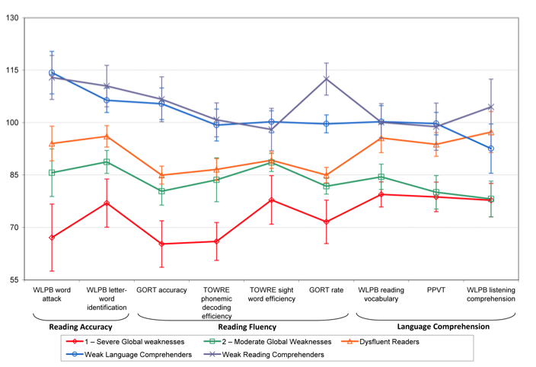
”Clusters” of Poor Comprehenders
Notes:
Jocelyn
Brasseur-hock 80% of readers who are not proficient with reading comprehension need some form of word level skill instruction

Slide 9
2008 Recommendations for effective classroom and intervention practices for adolescents | What are expanded recommendations based on recent research?
1. Provide explicit vocabulary instruction. | Morphology, Word selection
2. Provide direct and explicit comprehension strategy instruction. | THIS IS NOT ALL…
3. Provide opportunities for extended discussion of text meaning and interpretation. | Metacognitive and strategic approach to content learning
4. Increase student motivation and engagement for literacy learning. | Importance of relationship building and social emotional well being
5. Make available intensive and individualized interventions for struggling readers that can be provided by trained specialists. | Include advanced phonics, decoding of multisyllabic words, practice with prosodic (fluent, expressive) reading
 | Writing instruction
Baye et al., 2019; Deshler & Schumaker, 2012; Kamil et al., 2008; Shanahan & Shanahan, 2012; Reynolds, 2020
Notes:
Jocelyn

Slide 10
Pre-requisite:
read at approximately the 4th grade level
Notes:
Dana
We know by 4th grade normally achieving students are reading to learn. Comprehension of text is accounted for by language comprehension, background knowledge, and the upper strands of the reading rope. We also know that students with weak/limited vocabularies, weaknesses in verbal-reasoning ability, and limited background knowledge often have trouble with reading comprehension.
When we look at the reading strategies, what elements do we see from the SoR and what we know about adolescent literacy needs and best practice for instruction? Fundamentals of PS, Paraphrasing, Inference, Self Questioning, , Main Idea, Word Mapping, and Academic Lang are included in the Language Comprehension strand of the reading rope.
The learner’s reading development will help us determine the focus of instruction. These strategies address specific skills and purposes and should be used as intended. Both the reading rope and SIM place emphasis on the importance of explicit, systematic, and sequential instruction.
Comprehensive set of reading strategies:
Features of Both Reading Programs
Explicit direct instruction
Data-driven decision making
Positive, Corrective Feedback
Personalized, differentiated learning
Let’s talk about the specific strategies in a course that focuses on reading instruction for adolescents. Which strands do they teach and are there other elements of AL they foster?

Slide 11
It is crucial for students to have access to evidence-aligned reading instruction “early.” What are the implications for struggling adolescent readers?
Which strands of the rope do reading LS teach, and are there other elements of adolescent literacy they foster?
Notes:
Dana
Probably everyone in this session is or has worked with struggling readers; that is why we are here. We know from first-hand experiences what some of the implications are. Take a minute to think on this and share a couple of your thoughts in the chat box. See if any of your thoughts/responses change by the end of the session.

Slide 12
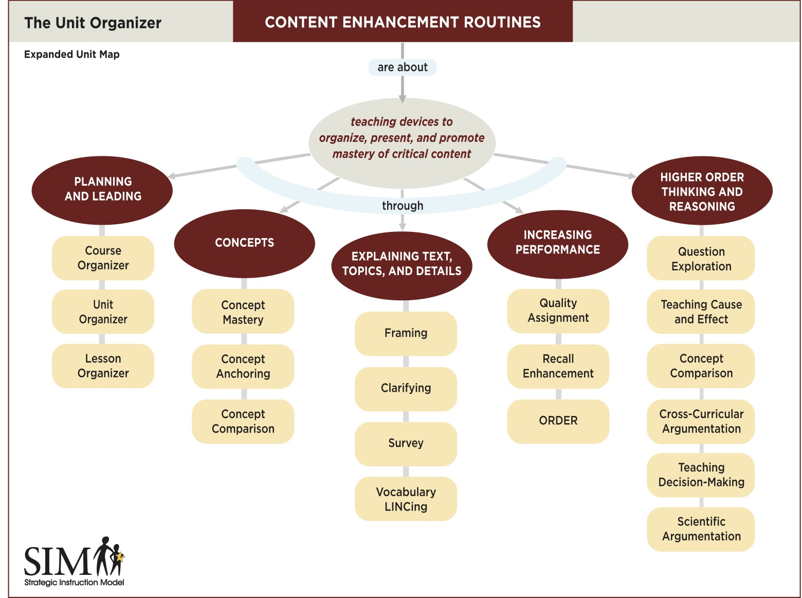
Common CER Features
Cue-do-review instructional sequence
Visual device
Linking steps
Focus on critical vocabulary, concepts, and topics
Metacognition
Notes:
Jocelyn
Let’s turn to CER and discuss what connections we see between the body of evidence for good reading instruction (Science of Reading) and the features of CER instruction
To do this, let’s bring to the forefront of our minds the features common to all CERs and the range of CERs available to teachers
ADD ANSWER TO CHAT: What is common to all Content Enhancement Routines?

Slide 13
What challenges in reading do teachers face in teaching their content at the secondary level?
How do we address these challenges? What supports are needed?
How can we make targeted connections to the strands within Scarborough’s Rope to disciplinary literacy and instruction with CERs?
Notes:
Jocelyn
First, add to the Chat – What connections do you see? How does CER instruction give teachers actionable ways to delivery evidence-based reading instruction in content classrooms?
Here are some additional questions as conversation starters for us…
Notes for us: Connect to Language Comprehension: Background Knowledge, Vocabulary Knowledge (and Conceptual Knowledge), Language Structures, Verbal Reasoning, and Literacy Knowledge, Disciplinary Literacy and Text Discourse

Slide 14
Overall Questions for Conversation Starters
At the secondary level, what should we be doing? What should we not be doing?
What do we know now that changes how we provide reading instruction at the secondary level?
How can school divisions systematically address in-service teachers' gap in knowledge and skills they did not receive in their teacher preparation programs?
Notes:
Hidden Slide, but we can pull up these questions if we need more after we’ve discussed the ones participants add to the Padlet

Slide 15
Adolescent Literacy
SIM
Learning Strategies
SIM
Content
Enhancement
Routines
Science of Reading
Purpose
Notes:
Dana
Remember it’s all about the purpose of addressing student needs based on what multiple data points is telling us. We hope you found this session informative and are leaving with a deeper understanding of each idea.
Informed teachers are our best assurance against reading failure. While programs are very helpful, programs don’t teach; teachers do. Student reading success depends on whether teachers use effective practices or programs and whether those practices or programs are implemented with sufficient skill, intensity, and duration. Furthermore, teachers must understand current, scientifically derived ideas about how students learn to read and scientific studies that describe and report the most effective teaching practices.
Sometimes we are unconsciously incompetent-- we are doing things that we think are educationally sound but may have changed over time. The “Peter Effect” states that one cannot give to others what one does not have oneself.
If you have additional questions once you go home and have time to process all of this, please feel free to email us. Thank you for your deep thinking and rich discussions.

