Slide 1
Introduction to Suicide Prevention
Monica Kurz, BA
Kristin Vernon, LSCSW

Slide 2
Headquarters, Inc
National Suicide Prevention Lifeline Crisis Center
Open since 1969
Student Clinic providing therapy sessions
Online chat service at www.headquarterscounselingcenter.org
Providing suicide prevention training and technical assistance to communities across the state
Online resources at www.kansassuicideprevention.org

Slide 3
Learning Objectives
Familiarize participants with risk factors and warning signs for suicide.
Teach participants which intervention strategies are helpful for a person at risk of suicide, and how to think about sharing these with a community.
Identify protective factors and prevention options
additional resources for supporting persons at risk of suicide.

Slide 4
Why are we reluctant to talk about suicide?

Slide 5
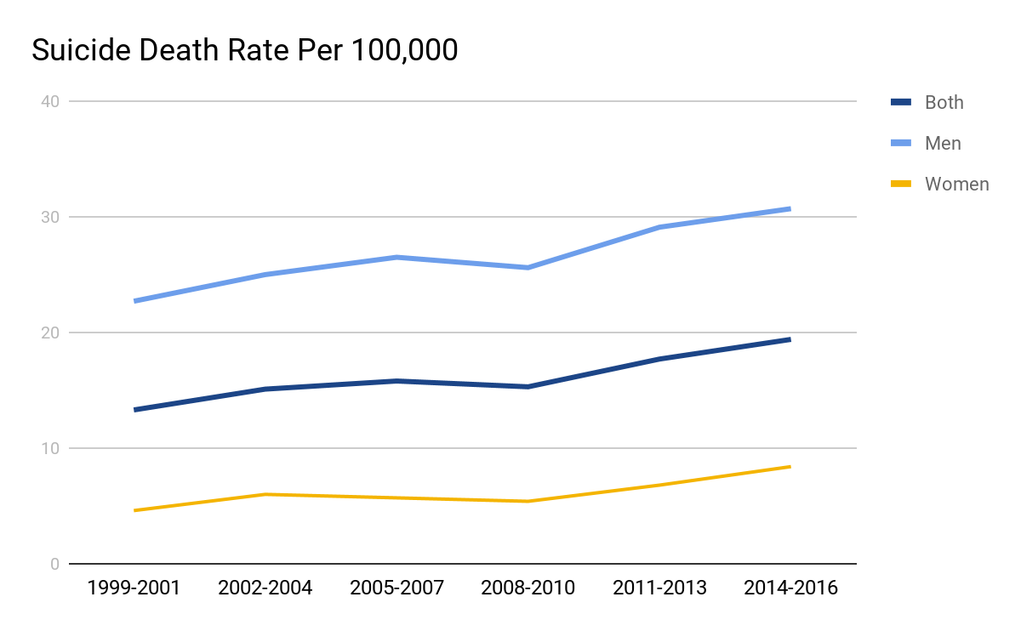
CDC report- Suicide Deaths across States
KS had the 5th largest increase in suicide deaths between 1999-2016 (45%)
54% of the suicide deaths investigated did not have a known mental health condition at the time of death
17.8 suicide deaths per 100,000 in 2016
Notes:
Methods: The CDC report analysed data available for suicide deaths of individuals 10 years and older. Characteristics of these deaths were pulled from 27 states in 2015 for which the National Violent Death Reporting System is used. Kansas is one of those states. NVDRS utilizes data from death certificates, coroner/medical examiner reports, and law enforcement reports.

Slide 6
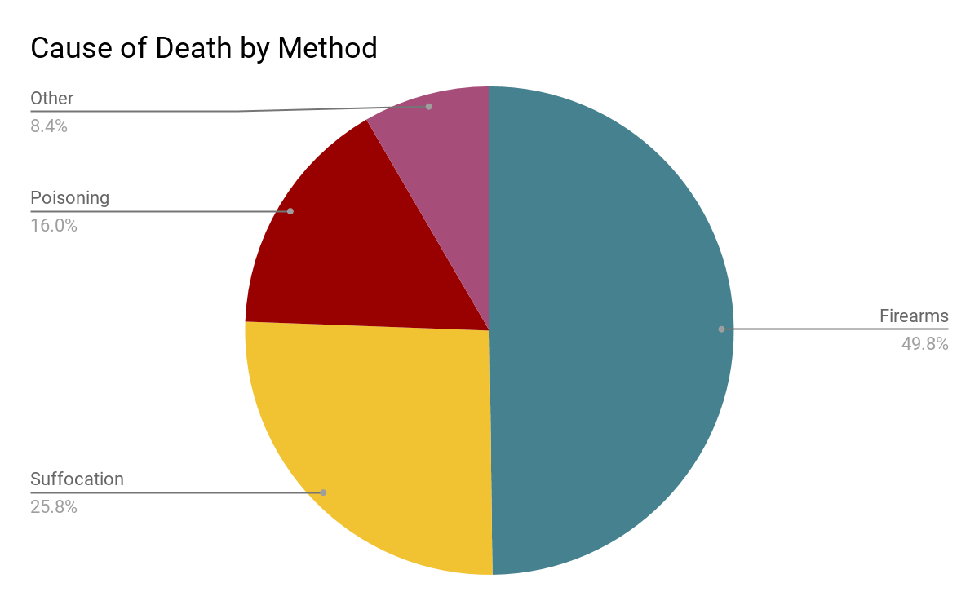
Means Matter
Women attempt up to 4x’s more often than men
Men die far more frequently by suicide
Factors like restrictive emotionality and emphasis on success, money and power may be associated with men’s use of more lethal means

Slide 7
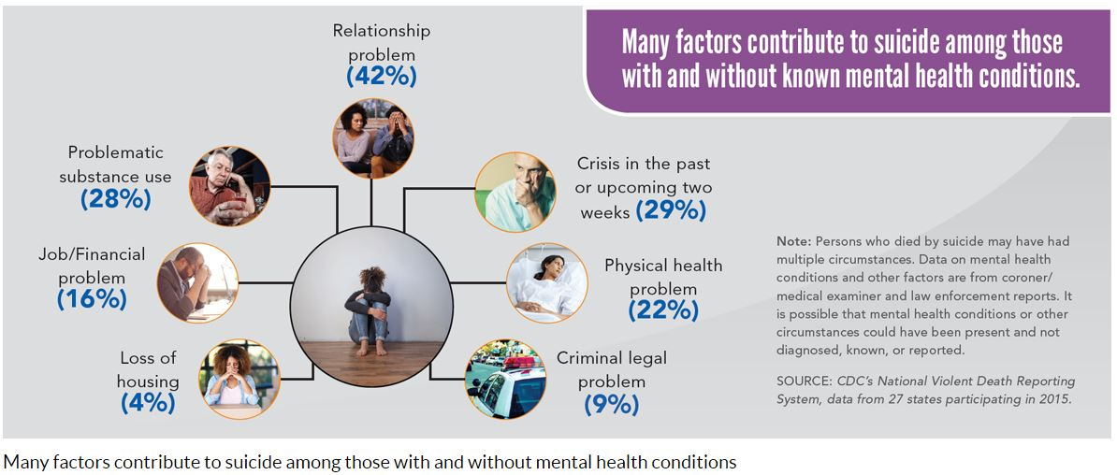

Slide 8
CDC Report- Youth specific data
For the age group 10-24 years: more suicides occurred in individuals without an identified mental health condition
Around 57% did not have an identified mental health condition
19.9% of suicide deaths (10-18 years) identified having “school problems” as a contributing factor
The majority of these deaths (92 or 162) did not have a known mental health condition

Slide 9
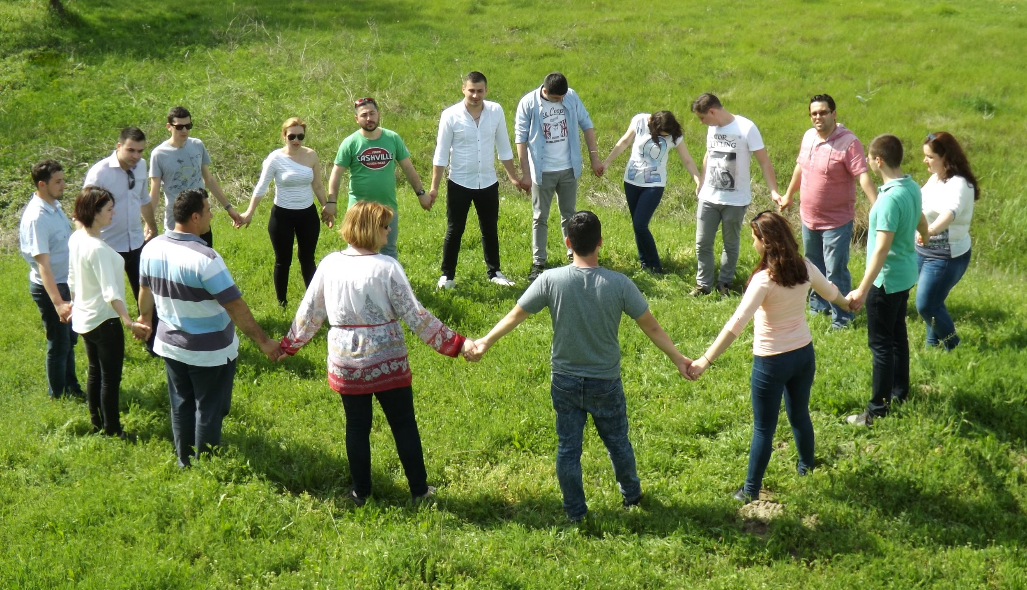
Out There or In Here?
Notes:
Census Questions:
Do you know someone who died or might have died by suicide?
Do you know someone who injured themselves with suicide in mind?
Do you know someone who has or had thoughts of suicide?
Do you know someone, including you, who is or has been personally impacted by suicide?

Slide 10
Suicide is Complex
Suicide prevention has often prioritized identifying suicidal individuals and treatment of mental health conditions. The information from the CDC report shows that more upstream work is needed due to the large percentage of suicide deaths which occurred when no mental health condition was identified.
More investigation will be needed to understand the increasing suicide death rate trend

Slide 11
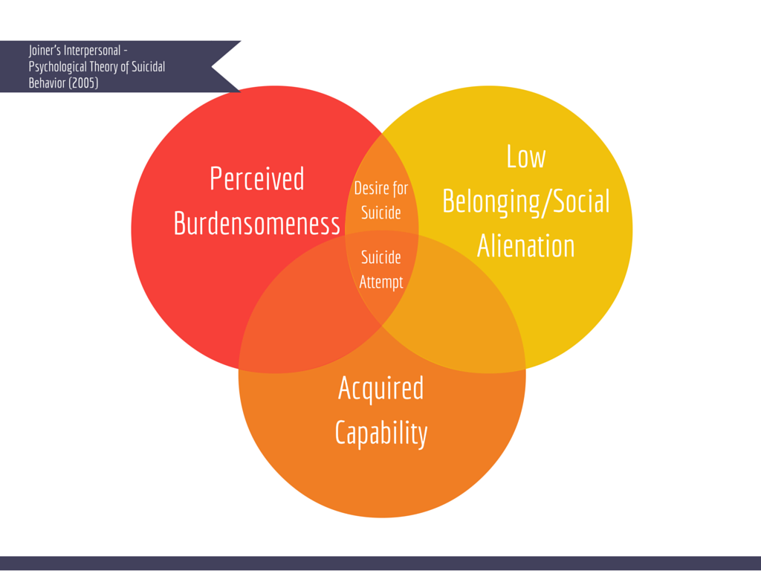
FROM A COMMUNITY PERSPECTIVE
Notes:
Joiner’s theory:
Low belonging – typically a sense of isolation (internally and externally). This also comes with a sense of lack of purpose
Perceived Burdensomeness – “Perceived” is used because this perception is not typically shared by the loved ones of the person with thoughts of suicide. Sometimes comes with feelings of ineffectuality or not being useful to a family unit or friends
Acquired capability – This is the habituation of dangerous or violent behaviors, in effect deadening the natural sensitivity we have for self-injury. One who is thinking about suicide has most likely tried to use all of the coping skills they are aware of before attempting to use more violent or dangerous ones (cutting, reckless behavior, aggressiveness). This component can also be increased in certain occupations like physicians or soldiers where seeing death desensitizes someone to violence or death. All in all, this component refers to someone surmounting the fear we naturally have for self-injury.
- Selfishness (People who attempt suicide or have thoughts of suicide often believe they are a burden on others. By ending their life, they perceive that this will relieve the burden they have on others. When someone attempts suicide, they are often thinking about how their death will BENEFIT their loved ones. This is inherently not selfish).
Three-step theory: Klonsky and May (2014) argued that an “ideation-to-action” framework should guide suicide theory, research, and prevention. From this perspective, (a) the development of suicide ideation and (b) the progression from ideation to suicide attempts are distinct processes with distinct explanations. The Three-Step Theory (3ST). First, the theory hypothesizes that suicide ideation results from the combination of pain (usually psychological pain) and hopelessness. Second, among those experiencing both pain and hopelessness, connectedness is a key protective factor against escalating ideation. Third, the theory views the progression from ideation to attempts as facilitated by dispositional, acquired, and practical contributors to the capacity to attempt suicide.
In step one, a combination of physical or emotional pain and hopelessness spurs thoughts of killing oneself. “Depression and other traditional risk factors matter to the extent that they increase hopelessness and pain,” Klonsky says.
Second, he and May suggest that suicidal thoughts further intensify for people who lack connections to loved ones, to valued roles or to any sense of purpose in life.
Finally, echoing Joiner, the researchers hold that suicide attempts occur only among people with a low sensitivity to pain — a partly genetic trait, according to studies of animals, human genetic variants and human twins — and an ability to overcome fears of death.
Dispositional: long-standing traits, such as low pain sensitivity and general fearlessness, that are assumed to be largely genetic
Acquired: experiences associated with pain, injury, fear and death that boost suicide risk over time
Practical: concrete factors that make it easier to kill oneself, such as access to guns and other lethal methods
E. David Klonsky and Alexis M. May (2015). The Three-Step Theory (3ST): A New Theory of Suicide Rooted in the “Ideation-to-Action” Framework. International Journal of Cognitive Therapy: Vol. 8, Special Issue: Recent Advances in Suicide Research: Mediators and Moderators of Risk and Resilience, pp. 114-129.

Slide 12
Biological
Social/ Environmental
Gender: Male
Middle Age
Reading Disability
Sexual orientation
Conduct Disorder
Impulsivity
Aggressiveness
Family History of Depression
History of Mental Illness
Physical or sexual abuse
Witnessing/experiencing childhood trauma
Pressure to be a good student/athlete
Easy access to lethal methods (guns)
Isolation (lack of connectedness)
Recent Traumatic Event
Poor familial communications
Romantic difficulties for older youth
Prior suicide attempt

Slide 13
Physiological
Mental Health or psychiatric illness
Low self esteem
Medical Illness
Chronic pain and HIV increase risk
Self Harm & Self Destructive behavior
Cutting, eating disorders, etc
50% of people who die by suicide have alcohol or drugs in their system upon death
© 2015 Terri A. Erbacher, Jonathan B. Singer, and Scott Poland. To be used only in teaching material from: Erbacher, T. A., Singer, J. B., and Poland, S.(2015), Suicide in Schools: A Practitioner’s Guide to Multi-level Prevention, Assessment, Intervention, and Postvention. New York: Routledge.

Slide 14
People thinking about suicide give some warning signs: Indirectly or directly.
© 2015 Terri A. Erbacher, Jonathan B. Singer, and Scott Poland. To be used only in teaching material from: Erbacher, T. A., Singer, J. B., and Poland, S.(2015), Suicide in Schools: A Practitioner’s Guide to Multi-level Prevention, Assessment, Intervention, and Postvention. New York: Routledge.

Slide 15
Warning Signs for Suicide
Take note when you see these in yourself or someone else
Significant changes in behavior
Appetite, sleep, concentration, hygiene
Increasing use of alcohol, drugs, or other risky bx
Extreme mood swings, increasingly anxious or agitated
Withdrawal, isolation
Experience of loss – relationship, self-esteem, sense of belonging
Negative thoughts – “this will never end,” “I’m trapped”
Painful feelings – shame, despair, anger, sadness, rejection

Slide 16
Imminent Warning Signs
Talks or writes about suicide
Has a plan
Expressing hopelessness about the future
Making Preparations for suicide
Giving away of treasured belongings
Sorting out care of pets or loved ones
Writing a suicide note
Looking for means to attempt suicide

Slide 17
If ANY of these warning signs are present, follow district procedure for referral and intervention. This typically involves referring to a principal, guidance director, or other mental health staff…

Slide 18
So how do we help?

Slide 19
Help to prepare communities or people to be safe from suicide before it occurs
Prevention
Suicide
Activities that happen after a suicide to support those who are affected
Post-vention
Intervention
Actions that help to support those who are already at risk of suicide
Notes:
Need to think about sharing comprehensive suicide prevention strategies with our communities and partners. It is not enough just to promote awareness or to think about identifying people at risk. We need all the parts.

Slide 20
Prevention
Social skill development groups
Activities that promote community connectedness
Dissemination of means restriction information
Promotion of the National Suicide Prevention Lifeline
“Gatekeeper” training

Slide 21
Building Protective Factors
HS students report that creative activities are important to supporting mental wellness
Parents overestimate how likely they are to hear about stressful life circumstances
Kind Environments Foster Mental Wellness
Relationships & Connection are essential

Slide 22
Kind High Schools
Teachers say “hi”
Classes on MH are offered
Classmates make an effort to include students who are different

Slide 23
Engaged Students
Create opportunities for students to express what gives them hope
Students talk to each other; help prepare them for how to navigate tough conversations
What can students expect when they turn to school staff for help?

Slide 25
GateKeeper Training
Shares risk factors and warning signs
Prepares people to recognize those at risk of suicide
Gives information about how to ask directly
Builds connections to longer term help

Slide 26
Intervention
Suicide Intervention skills training
Support for evidence-based treatment for suicide risk
Zero Suicide
Adequate access to healthcare

Slide 27
Suicide Intervention Basics
Share specific concerns
Ask about suicide directly
Listen, non-judgmentally
Make environment safe (restrict access to means)
Connect person to the next helper
Check back in with the person
National Suicide Prevention Lifeline: 800-273-8255

Slide 28
Establish Rapport
●Listen carefully
●Talk in a calm, accepting, non-confrontational, and supporting manner
●Explain what is happening
●Explain that you are there to help
●Explain how you can help
●Be specific about your concerns:
○“I am feeling concerned because your family says you haven’t been sleeping and you wrote a suicide note”
○“I wanted to check in because there has been so much going on with the kids reintegration plan and you have started using again.”

Slide 29
Assess the Person for Risk of Suicide
●Establish if they have already done something to try to kill themselves
●If they have not done anything in an effort to end their life:
●Ask directly and nonjudgmentally about suicide
○“Are you thinking about suicide?” or “Are you thinking about killing yourself?”
●Ask follow-up questions:
○“Are you actually have thoughts of killing yourself?”
○“Do you have some intent to act on your thoughts of suicide?”
○“Have you made any preparations to kill yourself?”

Slide 30
Uncertainty about Life and Death
1.Acknowledge feelings of pain or hopelessness
2.Say out loud that suicide is a very real possibility or option this person is considering
3.Point out that a small part of the person is also connected to life or safety
4.Invite person to continue exploring their feelings about death and life

Slide 31
Create Immediate Safety
Restrict access to means for suicide
Ask about access to firearms
Identify immediate support people
Explore possible distractions
Think about internal coping skills
Provide a crisis contact

Slide 32
Possible next steps
Reach out to parents about concerning behavior
Refer to an outpatient mental health provider or ED for evaluation
Refer to in school staff to create a safety plan with student
ALWAYS important to communicate among staff and faculty about the follow-up plan for a student who is struggling

Slide 33
Ideas for what you can say...
“I’m concerned about how you feel and can’t let anything happen to you…”
“I care about what happens to you and I need help dealing with this…”
“Thank you for confiding in me. I don’t want you to hurt yourself…”
“I’m no your side, and we’ll get you help…”
“Thank you for trusting me…”
© 2015 Terri A. Erbacher, Jonathan B. Singer, and Scott Poland. To be used only in teaching material from: Erbacher, T. A., Singer, J. B., and Poland, S.(2015), Suicide in Schools: A Practitioner’s Guide to Multi-level Prevention, Assessment, Intervention, and Postvention. New York: Routledge.

Slide 34
Do We Take Kids Seriously?

Slide 35
Post-vention
Community response plan for a suicide
Suicide Loss Survivor Support Groups
Suicide Attempt Survivor Support Groups
Safe Media reporting Guidelines

Slide 36
More Resources
Kansas Suicide Prevention Resource Center
www.kansassuicideprevention.org
Kansas Suicide Prevention State Plan
SPRC.org
Kansas Prevention Collaborative

