Slide 1
We’ve Got Standards!
How the Question Exploration Routine supports organizing, teaching, and selecting other higher order thinking and reasoning Content Enhancements
Presented by Janis Bulgren
Janis Bulgren, Keith Lenz & Vicki Ricketts
SIM 2013

Slide 2
Main Ideas
The Question Exploration Guide and Routine function to support PLANNING, TEACHING, and EXTENDING higher order thinking
Based on PLANNING, the QER helps focus on and answer the critical questions from the CO, UO, and LO in greater detail
Based on TEACHING needs, the QER focuses on essential vocabulary, analysis of a large question, synthesis of a main idea and extensions and generalizations.
Based on DEEPER UNDERSTANDING of Higher Order Thinking and Reasoning challenges, the QER guides the selection of other Content Enhancement Routines needed to respond to the CCSS and assessment across grade and curriculum.

Slide 3
Grade 1: Reading Standards for Informational Text 1. Ask and answer questions about key details 2. Identify a main topic and retell key details 3. Describe connections between individuals, event, ideas 4. Ask and answer question to determine meaning 6. Distinguish between information in various formats 7. Describe 8. Identify reasons to support points 9. Identify similarities and differences Grade 7: Reading Standards for Informational Text 1. Cite evidence to support analysis of explicit and inferential text. 2. Determine central ideas and analyze development with a summary 3. Analyze interactions between individual, events, and ideas 4. Analyze meaning 6. Distinguish point of view and distinguishing one position from another’s 7. Compare and contrast a text to other medium 8. Evaluate and argument and claims, assessing reasoning,& relevant evidence 9. Analyze two or more authors and how they emphasize evidence or interpret facts differently
CCSS Higher Order Thinking and Reasoning highlights
ACROSS GRADE-LEVEL STANARDS

Slide 4
CCSS Higher Order Thinking and Reasoning: CROSS-CURRICULAR
Informational Text: evidence, analysis, inference, central idea, summary, connections, claims, argument, reasoning
Literature Text: central idea, analyze, develop, summarize, differences (compare and contrast)
History: analyze, evidence, central ideas, summary, series of event, (causation) cause, integrate, reasoning, claims, compare and contrast.
Science: evidence, analysis, central ideas, conclusions, summaries, concepts, relationships, assess, reasoning, claims, compare and contrast, contradict
Mathematics: nit 2:linear and exponential relationships p.54-55Define, evaluate, compare, relationship, sequence, interpret, translate, concept, example, effects.

Slide 5
Higher order thinking and reasoning across CCSS Anchor Standards
Anchor Standards for Writing (pp.18-19). Arguments, claims, analysis, valid reasoning, sufficient evidence, complex ideas, organization, event sequence.
Anchor Standards for Reading (p. 35). Logical inference, evidence, central ideas or themes, summarize analyze development of individuals, events and ideas, point of view, integrate, evaluate, argument, claims, validity of reasoning, relevance and sufficiency of evidence, compare
Anchor Standards for Speaking and Listening (p. 22). Evidence, reasoning, organize, development evaluate,

Slide 6
THE QUESTION EXPLORATION GUIDE AS THE “UTILITY PLAYER” (ref. P. Graner) of CONTENT ENHANCEMENT ROUTINES
PLANNING
Course, Unit, and Lesson Organizer Questions and Question Exploration identify the most critical questions
TEACHING to ANSWER CRITICAL QUESTIONS
with the Question Exploration Guide pointing to
EXTENSIONS OF DEEPER UNDERSTANDING NEEDS
to identify and teach Higher Order Thinking & Reasoning:
Conceptual understanding, compare and contrast, cause and effect, argumentation

Slide 7
Development of the most critical questions from the ORGANIZING ROUTINES
FIRST LEVEL RESPONSE:
The Question Exploration Routine is a partner with the Course and Unit Organizer in identifying critical questions that are selected and refined. This often involves understanding, analyzing, and paraphrasing an Original Question that may appear in texts on on assessments.
.

Slide 8
Identifying the thinking and reasoning needs by understanding and paraphrasing an Original Question: Original Question: Deforestation has reached levels of about 40 million acres each year. More than 50 percent of the rain forests have been cut. About 2% of the rest of the rain forests are destroyed in each succeeding year. What has caused this, and what could result? Restated Question: What are the causes and effects of the destruction of the rain forest? Original Question: Why did the Boston Tea Party take place and how did this change the relationship between Britain and the colonies? Restated Question: What were the causes and effects of the Boston Tea Party? Original Question: Why did the Friar meddle in the lives to Romeo and Juliet, and what impact did this have? Restated Question: What were the causes and effects of the Friar’s meddling?

Slide 9
Sequential development of the most critical questions from the ORGANIZING ROUTINES
SECOND LEVEL RESPONSE:
The most critical question are analyzed, explored and answered with the Question Exploration Routine, demonstrating
*vocabulary comprehension,
*question analysis,
*reasoning,
*synthesis of a main idea,
*extension, and
*generalization of a main idea.

Slide 10
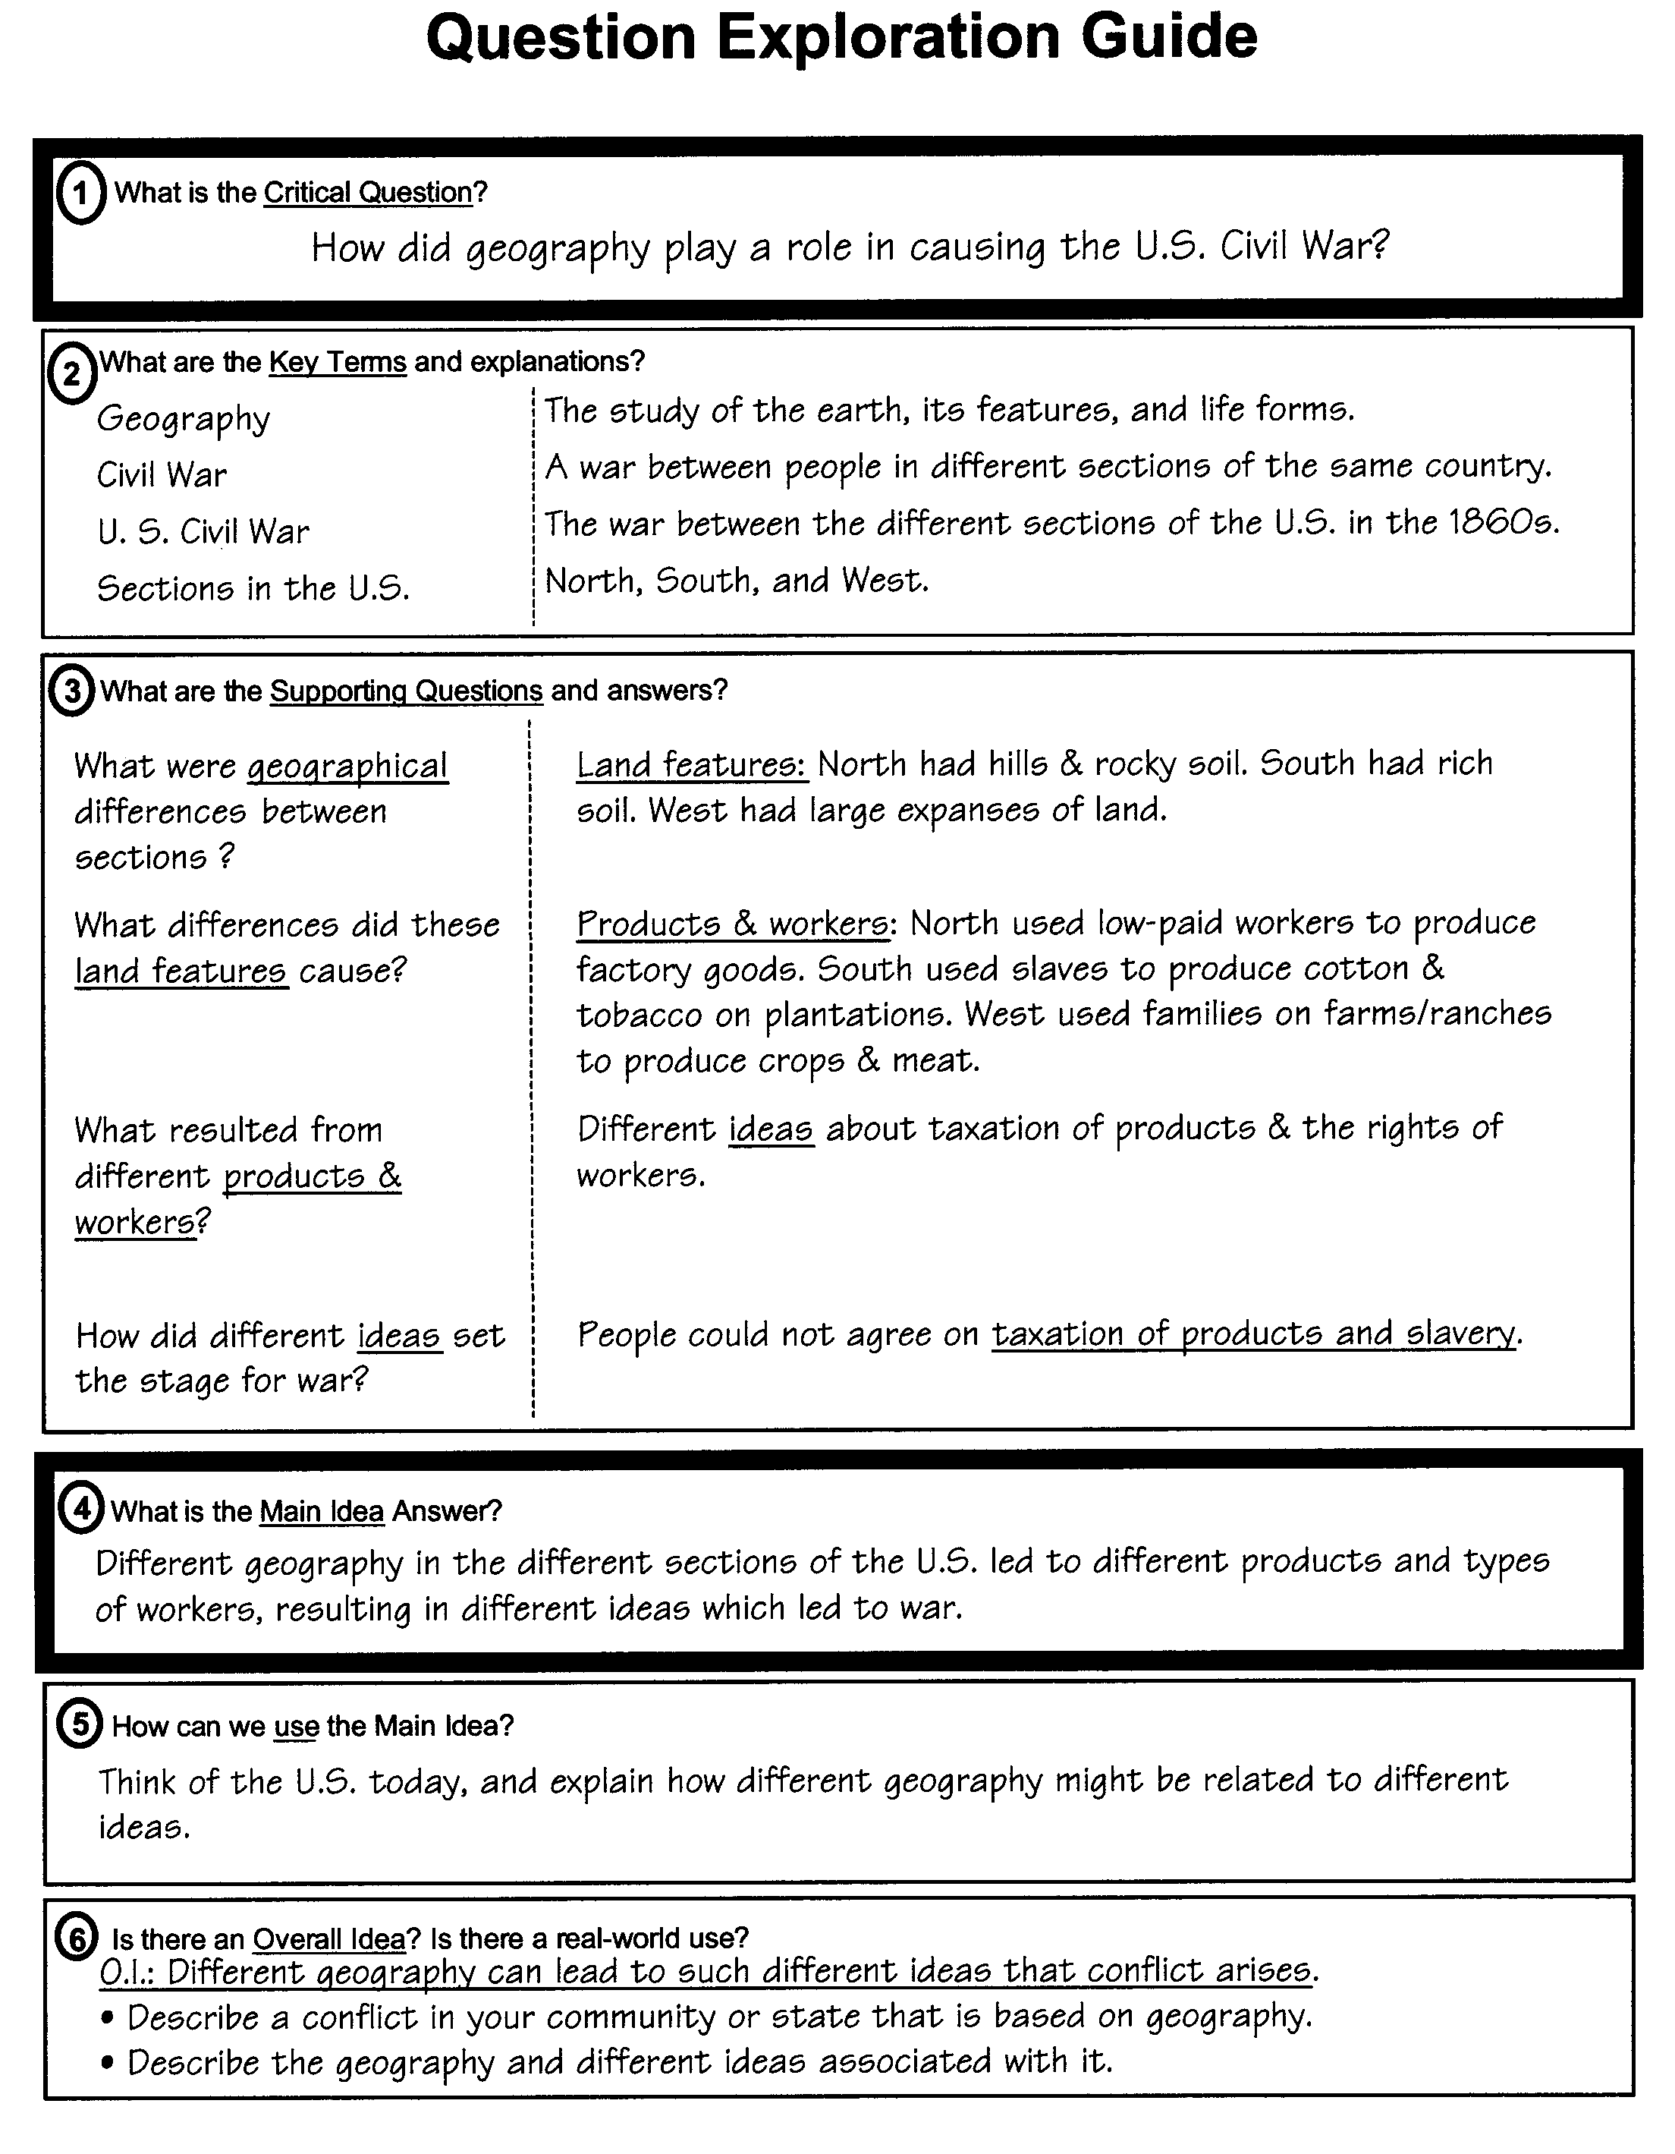

Slide 11
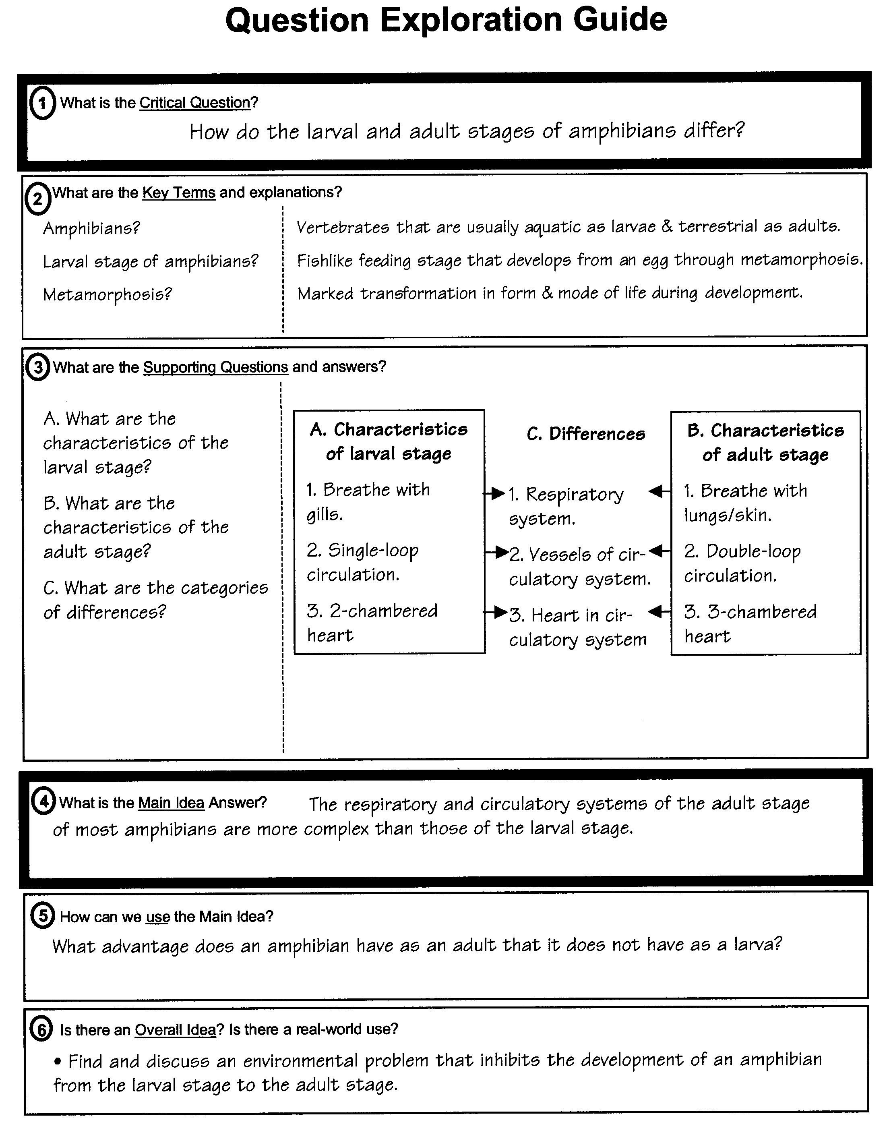
Example of a “Comparison” QEG

Slide 12
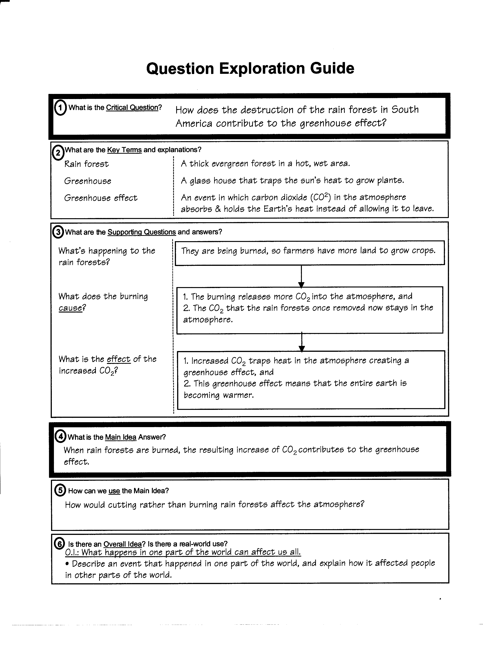
Example of a “Cause & Effect” QEG

Slide 13
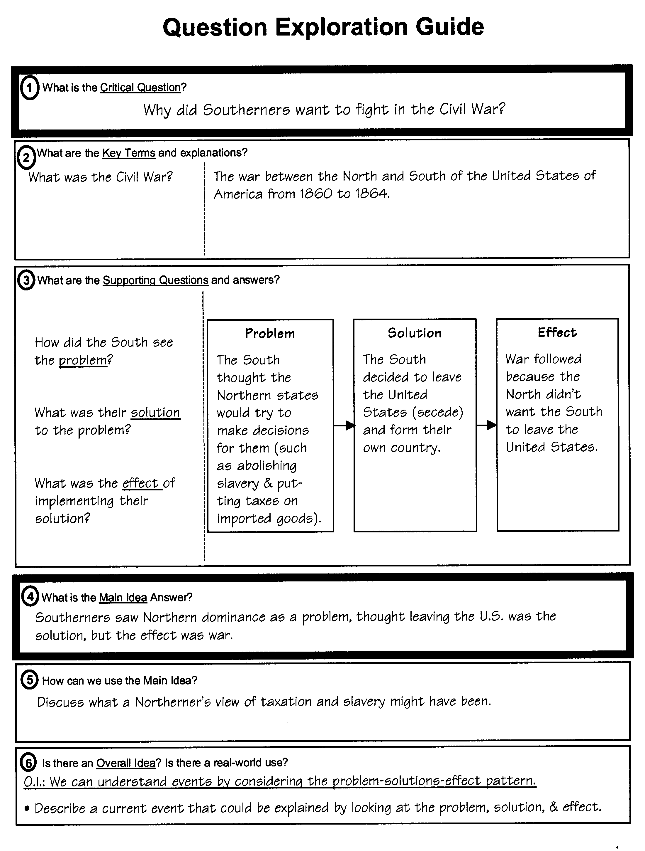
Example of a “Problem-Solution-Effect” QEG

Slide 14
Digging Deeper: Using the Question Exploration Routine to the select other Higher Order Thinking and Reasoning Routines
THIRD LEVEL RESPONSE:
What are the higher order thinking relationships that need to be developed in-depth based on the CO, UO, or QER?

Slide 15
CCSS Thinking Standards & Content Enhancements
Key Ideas and Details:
information, evidence, conclusions Argumentation and Evaluation
critical ideas and themes Question Exploration & Concepts
development, process, causes Cause and Effect
Craft and Structure
meanings and concepts Concept Mastery, Anchoring
structure & relationships Unit Organizer
author’s goals, purpose, point of view Question Exploration, Argumentation
Integrate knowledge and Ideas
evaluation, comparison & integration of info. Question Exploration, Comparison argumentation claims, reasoning Argumentation & Evaluation
comparison and contrast of ideas Concept Comparison
Range

Slide 16
Critical
Concepts
Thinking &
reasoning patterns
Organize Information
Unit Organizer
4
BIGGER PICTURE
NAME
Investigating Problems & Solutions
DATE
2
LAST CHAPTER
1
CURRENT UNIT
3
NEXT CHAPTER
Biosphere
Human Use of Resources
Environmental Solutions
8
CHAPTER SCHEDULE
5
CHAPTER MAP
is about...
12-1
Our Environment
The effects of human use of natural resources on the earth’s environment
p. 635
based on
Understanding of
Our environment
that can result in
12-2 Pollution
must be understood by
p. 641
can result in
Environmental problems
12-3 Resources
p. 646
12-4 Problems
p. 650
12-7 Project Due
12-8 Test
Types of resources
Pollution
in
that are
Air
Land
Water
Renewable
Non-renewable
Critical Questions
7
Why is pollution a problem?
How are renewable and non-renewable resources alike and different?
How does burning a tropical rain forest affect our environment?
How do effects of useful products cause problems for the ozone layer and for humans?
Comparison
Analogy
Cause-Effect
Problem-Solution
6
SELF-TEST QUESTIONS
RELATIONSHIPS

Slide 17
Question Exploration: The bridge between planning and teaching critical questions and Main Idea Answers
Key Ideas and Details:
Determine information, make inferences, cite evidence, draw conclusions
Determine central ideas or themes , their development and summarize
Analyze development of people, events and ideas.
Craft and Structure
Interpret words and phrases
Analyze structure of text to get the big picture
Assess point of view or purpose
Integrate knowledge and Ideas
Integrate and evaluate content in different formats
Identify and evaluate arguments, claims, reasoning and evidence
Compare approaches to different themes or topics
Range

Slide 18
SUMMARIZATION
Of Main Ideas
Critical Questions
QUESTION GENERATION
Critical Questions
Question Exploration Guide
Text Reference
Science
Our Environment
Lydia L.
Name:
Course
12
Title
Human Use of Resources
Unit
4
Critical
Question #:
4
1-25-06
Lesson
Date:
1
What is the Critical Question?
How do effects of useful products cause problems for the ozone layer and for humans ?
2
What are the Key Terms and explanations?
Environment =
Ozone layer =
Ultraviolet (UV) rays =
All the things surrounding us - air, land, water, living things
Invisible layer of gas that shields us from ultraviolet rays
harmful rays from the sun.
Critical
Words & Phrases
Development,
Evidence,
Point of View
3
What are the Supporting Questions and answers?
The ozone layer is being hurt by household products we use on earth.
Products like hair spray contain chemicals that are released into the air.
When chemicals like chlorine are released into they air, they keep ozone from
being formed in the stratosphere.
This is a problem because ozone protects us from UV rays of the sun.
UV rays cause skin cancer and disrupt weather and crop production.
What happens to the ozone layer?
How do products cause problems?
What happens when chemicals are released?
Why is it a problem if ozone is not formed?
What do UV rays of the sun cause?
THE BIG PICTURE,
CONCLUSIONS &
SUMMARIZATION
4
What is the main Idea answer?
Useful products that contain chemicals can disrupt the formation of ozone with bad effects on living things, the weather and crops.
5
How can we use the main idea?
6
Is there an Overall Idea? Is there a real-world use?
How can we explore the effects of chemicals for ourselves?
How can an individual who thinks there is a problem with ozone respond at home?

Slide 19
Deeper Exploration: Concept Mastery & Concept Anchoring
Key Ideas and Details:
Determine information, make inferences, cite evidence, draw conclusions
Determine central ideas or themes , their development and summarize
Analyze development of people, events and ideas.
Craft and Structure
Interpret words and phrases
Analyze structure of text to get the big picture
Assess point of view or purpose
Integrate knowledge and Ideas
Integrate and evaluate content in different formats
Identify and evaluate arguments, claims, reasoning and evidence
Compare approaches to different themes or topics
Range

Slide 20
Acquire big picture
understandings
Knowledge of word & phrases
Apply reasoning & analysis
CONCEPT DIAGRAM
Â
Key Words
À
CONVEY CONCEPT
À
Á
Pollution
Contamination
Á
OFFER OVERALL
Waste
Acid rain
In the air
Causes harm
Smog
Wastewater
Dumps
Recycled by nature
CONCEPT
Â
NOTE KEY WORDS
Ã
CLASSIFY
CHARACTERISTICS
Always Present
Sometimes Present
Never Present
Harm
In air
Decomposition
Presence of wastes
In water
Recycled by nature
Wastes are too great to
On land
be recycled by nature
Ä
EXPLORE EXAMPLES
Examples:
Nonexamples:
Smog
Clouds
Acid rain
Greenhouse
gases?
Treated wastewater
Non-decomposed dumps
Recycled plastics
Main Idea, Conclusion, Summary
Å
PRACTICE WITH NEW EXAMPLE
Pollution is a form of contamination in which harm is caused by the presence of wastes that are too great to be recycled by nature.
Æ
TIE DOWN A
DEFINITION

Slide 21
Main Ideas
Reason by
Analogy, Inference
Comparison
Acquire content
knowledge
Unit:
12
Anchoring Table
12/2/06
3
Name: Hannah B Date:
2
Known Concept
Known
Information
Roof on a house
(from outer to inner)
1
New Concept
Layers of the Atmosphere
(from outer to inner)
insulation
Characteristics of Known Concept
fourth and last
layer before space
4
6
Characteristics Shared
5
Characteristics of New Concept
shingles or tiles
thermosphere
shingles
tiles
third layer
mesosphere
tarpaper
wood
second layer
stratosphere
(contains the ozone layer)
tarpaper
plywood & insulation
wood supports &
rafters
first layer closest
to where we live
troposphere
7
Understanding of the New Concept:
The four layers of the atmosphere have different locations and components.
ANCHORS
Linking
Steps:
1 Announce
the New Concept
2 Name
Known Concept
3 Collect
Known Information
4 Highlight
Characteristics of
Known Concept
5 Observe
Characteristics
of New Concept
6 Reveal
Characteristics
Shared
7 State
Understanding of
New Concept
Notes:
The Challenge

Slide 22
Integrated Higher Order Thinking Type: Concept Comparison
Key Ideas and Details:
Determine information, make inferences, cite evidence, draw conclusions
Determine central ideas or themes , their development and summarize
Analyze development of people, events and ideas.
Craft and Structure
Interpret words and phrases
Analyze structure of text to get the big picture
Assess point of view or purpose
Integrate knowledge and Ideas
Integrate and evaluate content in different formats
Identify and evaluate arguments, claims, reasoning and evidence
Compare approaches to different themes or topics
Range

Slide 23
Integration & Synthesis
Inference &
Generalization
C Communicate targeted concepts
O Obtain the Overall Concept
M Make lists of known characteristics
P Pin down Like Characteristics
A Assemble Like Categories
R Record Unlike Characteristics
I Identify Unlike Categories
N Nail down a summary
G Go beyond the basics
Comparison Table
Comparison
Overall Concept
_{Resources}
2
Concept
Concept
1
_{Non-renewable resources}
(Metals, minerals, fossil fuels)
_{Renewable resources}
_{(Oxygen, water, sunlight)}
1
Characteristics
Characteristics
3
3
_{Part of natural environment}
_{Used by humans}
_{Replaced or recycled by nature}
_{Unlimited}
_{Part of natural environment}
_{Used by humans}
Not replaced or recycled by nature
_{Limited}
Extensions
Like Characteristics
Like Categories
Evaluate the success of recycling efforts on two non-renewable resources
9
4
5
_{Part of natural environment}
_{Used by humans}
_{Where found}
_{Who uses}
_{Unlimited Limited}
Replaced by nature Not replaced by
_{nature}
Unlike Characteristics
Unlike Categories
6
7
_{Availability}
_{Replacement}
Draw Conclusion
Summary
Renewable and non-renewable resources are both part of the natural environment on earth used by humans.
They differ in availability and nature’s ability to replace them.
8

Slide 24
Integrated Higher Order Thinking Type: Causal Reasoning
Key Ideas and Details:
Determine information, make inferences, cite evidence, draw conclusions
Determine central ideas or themes , their development and summarize
Analyze development of people, events and ideas.
Craft and Structure
Interpret words and phrases
Analyze structure of text to get the big picture
Assess point of view or purpose
Integrate knowledge and Ideas
Integrate and evaluate content in different formats
Identify and evaluate arguments, claims, reasoning and evidence
Compare approaches to different themes or topics
Range

Slide 25
Cause-and-Effect Guide
Name:___________________ Date:___________________ Unit: ___________________Topic:________________________
1
2
Restated question:
Key Terms:
What causes farmers in South America to slash and burn the tropical rain forest, and what is the effect of that practice?
Tropical rain forest: dense forest, usually in hot, rainy area
Habitat: natural home
4
Causes & Connections:
3
Event & Background Information:
5
Effects & Connections:
Slashing and burning
the tropical rain forest
Plowing and grazing cause soil erosion
Land quickly loses all nutrients; plants and grass won’t grow
Land is abandoned, and new land has to be slashed and burned for growing more crops and grazing cattle
Unique habitat for plants and animals is lost
People need land for growing crops and raising cattle.
Leading to
Forest trees are cut down (slashed)
Remaining forest foliage is burned
Ashes provide short-term nutrients for growing crops and grazing cattle
Resulting in
6
Answer:
Farmers in South America slash and burn the tropical rain forest to obtain land for farming and cattle grazing. The land quickly becomes unusable, creating the need for slashing and burning more land. The practice destroys the habitat of many plants and animals.
TOOL BOX: Take one of these shapes and drag to use in your organizer.
You can drag, resize and place these shapes however you’d like.
Verb label box
Verb label box
Verb label box
Verb label box
Verb label box
Verb label box
Verb label box
© 2013 Janis Bulgren
Verb label box

Slide 26
Integrated Higher Order Thinking Type: Argumentation & Evaluation
Key Ideas and Details:
Determine information, make inferences, cite evidence, draw conclusions
Determine central ideas or themes , their development and summarize
Analyze development of people, events and ideas.
Craft and Structure
Interpret words and phrases
Analyze structure of text to get the big picture
Assess point of view or purpose
Integrate knowledge and Ideas
Integrate and evaluate content in different formats
Identify and evaluate arguments, claims, reasoning and evidence
Compare approaches to different themes or topics
Range

Slide 27
Argumentation & Evaluation Guide
Topic__________________________________________________
Title___________________________________________________
Source_________________________________________________
Name: _____________________________________
Class: _____________________________________
Date: _____________________________________
1
What is the Claim, including any Qualifiers? Are there qualifiers? Yes/No. (If yes, underline them.)
3
What chain of reasoning (warrant) connects the evidence to the claim? In column 6, identify type of reasoning with the letter(s):
for AUTHORITY (A), THEORY (T), or type of LOGIC: Analogy (AN), Correlation (C), Cause-Effect (CE), Generalization (G)
2
What Evidence is presented?
In column 3, identify the type of evidence with the letter: Data (D), Fact (F), Opinion (O), Theory (T).
5
6
4
Evaluate the quality of the evidence as poor, average or good. Explain your evaluation.
7
Evaluate the quality of the chain of reasoning as poor, average or good. Explain your evaluation.
Reliable
Strength of Authority
Valid
Application of Theory
Objective (no bias)
Type of Logic
Methodology
8
What are your concerns about the believability of the claim? (your counterarguments, rebuttals or new questions)?
9
Accept, reject, or withhold judgment about the claim. Explain your judgment.
© Bulgren & Ellis revised 10/1/2008

Slide 28
Question Exploration Guide
Standard 1
1
What is the critical question?
What is the claim being made?
2
What are the key terms and explanations?
.
3
What are the supporting questions and answers?
What evidence is presented?
What reasoning (warrant) is used?
How good is the evidence and reasoning?
What are counter-arguments or rebuttals?
4
What is the main Idea answer?
5
Explore and use the main idea.
6
Extend the main idea to your world.
Bulgren 2010

Slide 29
Determine information
Argumentation & Evaluation Guide
Identify claim,
evidence, reasoning
1
Assess purpose &
point of view
Topic/Title A Little Lead is Too Much
Source Environmental Health
Name: Teacher
Date: _____________________________________
1
What is the Claim, including any Qualifiers)? (underline qualifiers) If the CDC cut the current acceptable lead level in the blood in half for children up to age 6 and enforced it, they would perform better on intelligence testing.
What Evidence is presented? Identify each as data, fact, theory or opinion.
A published study followed 200 children from 6 months to 6 years testing a total of 8 times and found that children with lead concentrations from 5 to 9.9 micrograms per deciliter preformed an average of 4.9 points lower on their IQ tests. (data)
In 2001, the head of the CDC said the acceptable level would probably be changed from 10 to 5 micrometers per deciliter of blood, but a change in committee changed that decision. (opinion)
Lower rates were requested by the Independent Clean Air Scientific Advisory Committee. (fact)
Eliminating lead in gasoline resulted in a sizeable increase in IQ levels in children throughout the country. (fact)
What type of reasoning proves the evidence supports the claim? (Identify as authority ,analogy, correlation, cause and effect, theory, principles or generalization)
The published study was well designed and cited. (authority)
The assumption was made that what was true for the sample group of 200 children is true for all children. (generalization)
Higher lead levels in the blood reduce IQ performance. (cause and effect)
2
4
3
Evaluate the evidence as poor, average or excellent and explain
(Use reliability, validity, objectivity, well designed experiment).
The published study was valid and well designed. (Excellent)
The other evidence is not well supported by facts, but I have heard of the CASAC (average)
5
Evaluate the source’s reasoning as poor, average or excellent and explain.
(Use logic, accepted ways of thinking, false assumptions)
I think the sources reasoning is excellent. It was based a good source and was logical.
6
What are concerns about (sources of error, counterarguments, questions)? Note if concerns are from source or reader.
Some members of the CDC Advisory Committee are from the lead industry. EPA does not want to enforce lower standards.
7
Conclusion: Accept/reject/withhold judgment. Present and summarize your reasoning. I accept the claim that lead level standards in children should be lowered
based on the arguments in the article. The research cited is an excellent source and earlier changes as a result of removing lead from gasoline seem to support the
Claim.
C Bulgren. Bulgren, J. A., Ellis, J. D., & Marquis, J. (2013). The use and effectiveness of an argumentation and evaluation intervention in science classes. Journal of Science and Technology.

Slide 30
QEG Support for Essay-Writing
Data on essay writing provides support for use of Content Enhancement Routines to also support writing and speaking CONTENT
Pre Post
Control 35% 30 %
Experimental 29% 60%
6-Trait Writing Analysis
Pre Post
Control 52% 49 %
Experimental 51% 65%
Published in Reading and Writing Quarterly, Bulgren, J. A., Marquis, J. G., Lenz, B. K., Schumaker, J. B., & Deshler, D. D. (2009). Effectiveness of question exploration to enhance students' written expression of content knowledge and comprehension. Reading and Writing Quarterly, 25(4), 271-289.
*SWD: Woodcock Johnson Mean Reading Score, 12%

Slide 31
Question Exploration Guide
Text Reference
American Literature
Name:
Course
Critical
Question #:
Title
Our Environment
Unit
1
Date:
1-25-01
Lesson
1
What is the critical question?
How do problems with the ozone layer teach us about our effects on our environment?
2
What are the key terms and explanations?
All the things surrounding us - air, land, living things
Invisible layer of gas that shields us from UV radiation or harmful rays from the sun.
A change one thing has on another such as ozone problems & environment
What is our environment
What is the ozone layer?
What is an effect?
3
What are the supporting questions and answers?
The protective ozone layer around the earth is being destroyed by CFCs.
(Chlorofluorocarbons) - chemicals in products we use cleaning products , foam-type plastic containers, refrigerator coolants and spray cans)
NORMALLY 1 : Oxygen is hit by UV rays. 2 .Oxygen undergoes a change.
3. Protective ozone forms.
BUT NOW: Chlorine in CFCs disrupt the ozone-oxygen balance. (One chlorine atom destroys hundreds of the protective ozone molecules.)
Four effects: 1) physical harm such as skin cancer and cataracts,
2. environmental harm to crops and ocean plants.
3. Change in weather patterns,
4) Greenhouse warming of the earth
1. Voluntary cutbacks of foam products(MacDonalds) & coolants
2 alternatives (HCFCs)
3. World conferences to cut CFCs .
But some still don’t think it’s a problem.
What are problems with the ozone layer?
How does the destruction happen?
What is the effect?
What are solutions?
4
What is the main Idea answer?
People can harm the environment without intending it or even believing it.
5
Explore and use the main idea.
How can we explore the facts ourselves?
Experiments that students can do with construction paper show that darker colors absorb more UV rays and with balloons show that oxygen can be changed to ozone.
How can an individual who thinks there is a problem with ozone help?
An individual can decide not to use products that cause damage to ozone layer and can let their representatives know that they are concerned.
6
Extend the main idea to your world.
Bulgren KU-CRL 2/01
Figure 1

Slide 32
Human Effects on the Ozone Layer Problems with ozone can teach us about human effects on our environment. The ozone layer is an invisible layer of gas that shields us from UV radiation. UV radiation is ultraviolet radiation, or rays of the sun that can harm living things. One problem today is that the protective ozone layer around the earth is being destroyed (PROBLEM). In the past, the ozone layer protected the earth from UV rays. Now, the ozone layer is being destroyed by CFCs (CAUSE), or chlorofluorocarbons, which are chemicals used in products we use. For example, CFCs are used to manufacture cleaning products, foam in plastic containers, refrigerator coolants and spray cans. There are several effects of this destruction (EFFECTS). First, physical harm such as skin cancer and cataracts can happen. Second, there can be environmental damage to crops and also to plants in the ocean food chain. Third, weather patterns can be disrupted. In addition, the Earth can be heating up; this is also called the greenhouse effect. Several solutions have been tried (SOLUTIONS). First, there have been voluntary cutbacks on the use of products containing CFCs. For example, Macdonald’s stopped using foam containers. Second, alternatives are being explored, such as HCFCs. And third, world conferences are being held and agreements are being made to find solutions and reach agreements on limiting the use of CFCs. However, some people still don’t think it’s a problem. Therefore, people can harm the environment without intending to harm it, or even believing it is happening (GENERAL MAIN IDEA STATEMENT). However, they can learn about the situation by conducting experiments such as with balloons to show that oxygen can be changed to ozone, or doing research on products that cause damage to the ozone layer. Figure 2. Sample Essay on “Human Effects on the Ozone Layer”

Slide 33
Similarities to Science Framework and Next Generation
Cross Cutting Concepts: Patterns and Causes & Effects (Framework, selected)
Selected Next Generation Practices:
Asking questions and defining problems
Constructing Explanations
Engaging in argument from evidence
Obtaining, evaluating, and communicating information.

Slide 34
Patterns in Mathematics
Mathematical Practice Standards (Pattern)
Reason abstractly.
Construct arguments.
Critique the reasoning of others.
Look for and make use of structure.
Look for an express regularity in reasoning.
Repeated challenges:
Interpret
Summarize
Understand processes
Evaluate
Make inferences
Understand relationships
Analyze
Apply
Reasoning

Slide 35
PARCC Sample Items Illustrating
Challenges for Thinking & Reasoning and
Responsive Content Enhancement Routine

Slide 36
Literary Analysis Task (Grade 10): Ovid’s “Daedalus and Icarus” and Sexton’s “To a Friend Whose Work Has Come to Triumph”

Slide 37
Texts Worth Reading?
Range: Example of assessing literature and helping to satisfy the 70%-30% split of informational text to literature at the high school grade band.
Quality: The story of Daedalus and Icarus from Ovid's Metamorphoses is a classic of the genre and has proven to be inspirational to painters and poets alike, and no poet’s version is more striking than that of Anne Sexton. Her “To a Friend Whose Work Has Come to Triumph” refashions the themes of the myth in dramatic fashion, providing a powerful counterpoint for students to explore.
Complexity: Quantitatively and qualitatively, the passages have been validated and deemed suitable for use at grade 10.

Slide 38
Understanding the Literary Analysis Task
Students carefully consider two literary texts worthy of close study. (CER: Compare and contrast)
They are asked to answer a few EBSR and TECR questions about each text to demonstrate their ability to do close analytic reading and to compare (CER: Compare and contrast) and synthesize ideas. (CER: Question Exploration)
Students write a literary analysis about the two texts.

Slide 39
Grade 10 Evidence-Based Selected-Response Item
Part A
Which of the following sentences best states an important theme about human behavior as described in Ovid’s “Daedalus and Icarus”? (CER: MAIN IDEA from the QUESTION EXPLORATION GUIDE)
Striving to achieve one’s dreams is a worthwhile endeavor.
The thoughtlessness of youth can have tragic results.*
Imagination and creativity bring their own rewards.
Everyone should learn from his or her mistakes.
Part B
Select three pieces of evidence from Ovid’s “Daedalus and Icarus” that support the answer to Part A. (CER: ARGUMENTATION AND EVALUATION ) “and by his playfulness retard the work/his anxious father planned” (lines 310-311)*
“But when at last/the father finished it, he poised himself” (lines 312-313)
“he fitted on his son the plumed wings/ with trembling hands, while down his withered cheeks/the tears were falling” (lines 327-329)
“Proud of his success/the foolish Icarus forsook his guide” (lines 348-349)*
“and, bold in vanity, began to soar/rising above his wings to touch the skies” (lines 350-351)*
“and as the years went by the gifted youth/began to rival his instructor’s art” (lines 376-377)
“Wherefore Daedalus/enraged and envious, sought to slay the youth” (lines 384-385)
“The Partridge hides/in shaded places by the leafy trees…for it is mindful of its former fall” (lines 395-396, 399)

Slide 40
Aligns to the Standards and Reflects Good Practice
Specific CCSS alignment to:
RL.10.1 (evidence).
RL.10.2 (theme).
RL.10.10 (complex text).
This item helps students gather information and details for use on the Prose Constructed Response; it requires close analytical reading to answer both parts correctly (e.g., Part A of this item is challenging because it requires synthesis of several parts of the myth ? (CER: CONCEPT MASTERY of MYTH or ANALOGICAL ANCHORING)
to determine the answer).
Requires students in Part B to provide evidence for the accuracy of their answer in Part A.
PARCC assessment gives students the opportunity to gain partial credit if their answers reflect genuine comprehension on their part (e.g., they identify the theme correctly ? (CER: MAIN IDEA from the QUESTION EXPLORATION GUIDE)
and are able to identify at least 2 details ).

Slide 41
Grade 10 Evidence-Based Selected-Response Item
Part A
What does the word vanity mean in these lines from the text “Daedalus and Icarus”?
“Proud of his success, the foolish Icarus forsook his guide, and, bold in vanity, began to soar” (lines 345-349) ? (CER: CAUSE AND EFFECT)
arrogance*
fear
heroism
enthusiasm
Part B
Which word from the lines from the text in Part A best helps the reader understand the meaning of vanity?
proud*
success
foolish
Soar

Slide 42
Aligns to the Standards and Reflects Good Practice
Specific CCSS alignment to:
RL.10.1 (use of evidence); RI.10.9 (comparison of authors’ presentation); RL.10.10 (complex texts).
W.10.2 (writing to inform and explain); W.10.4 (writing coherently); W.10.9 (drawing evidence from texts).
L10.1-3 (grammar and conventions).
Measures the ability to explain how one text transforms ideas from another text by focusing on a specific concept presented in the texts (the transformation of ideas with regard to the experience of flying).
Asks students to write to sources rather than write to a de-contextualized prompt.
Focuses on students’ rigorously citing evidence for their answer. (argumentation)
Requires students to demonstrate they can apply the knowledge of language and conventions when writing.

Slide 43
Grade 10 Prose Constructed-Response Item
Use what you have learned from reading “Daedalus and Icarus” by Ovid and “To a Friend Whose Work Has Come to Triumph” by Anne Sexton to write an essay ? (CER: QUESTION EXPLORATION GUIDE writing structure)
that provides an analysis of how Sexton transforms Daedalus and Icarus.
As a starting point, you may want to consider what is emphasized, absent, or different in the two texts ? (CER: COMPARISON), but feel free to develop your own focus for analysis.
Develop your essay by providing textual evidence from both texts. Be sure to follow the conventions of standard English.

Slide 44
Aligns to the Standards and Reflects Good Practice
Specific CCSS alignment to:
RL.10.1 (use of evidence).
RL.10.4 (meaning of words and phrases).
RL.10.10 (complex texts).
Reflects a key advance, namely focusing on the words that matter most, not obscure vocabulary, but the academic language that pervades complex texts.
Rewards careful, close reading rather than requiring students to race through the passage to determine the meaning (by using the context of the text) of an academic word that is important to one of the main characters and to the central themes. Again, this item helps students gather details for use on the Prose Constructed Response.
Credit for Part B (evidence) is given only if Part A is correct, signaling the importance of the connection between the claim and the evidence ? (CER: ARGUMENATION AND EVALUATION ROUTINE using Toulmin’s warrant))
.

Slide 45
WHAT DO THE COMPLEX HIGHER ORDER THINKING AND REASONING DEMANDS MEAN FOR CONTENT ENHANCEMENTS?
“ONE AND DONE” IS NOT INTEGRATED CONTENT ENHANCEMENT – NOT EVEN “TWO AND THROUGH.”
ONE CONTENT ENHANCEMENT ROUTINE SUGGESTS SUBSEQUENT THINKING AND TEACHING NEEDS.
FOCUS IS ON THE TYPE OF THINKING REQUIRED, WHICH LEADS TO THE SELECTION OF THE CER SPECIFICALLY DEVELOPED FOR THAT THINKING.
LESSONS LEARNED FROM ONE CONTENT ENHANCEMENT ROUTINE INFORMS WHICH OTHER CONTENT ENHANCEMENT ROUTINE ARE NEEDED

