Slide 1
Welcome
Please join a table with a blue folder in the center of the table.

Slide 2
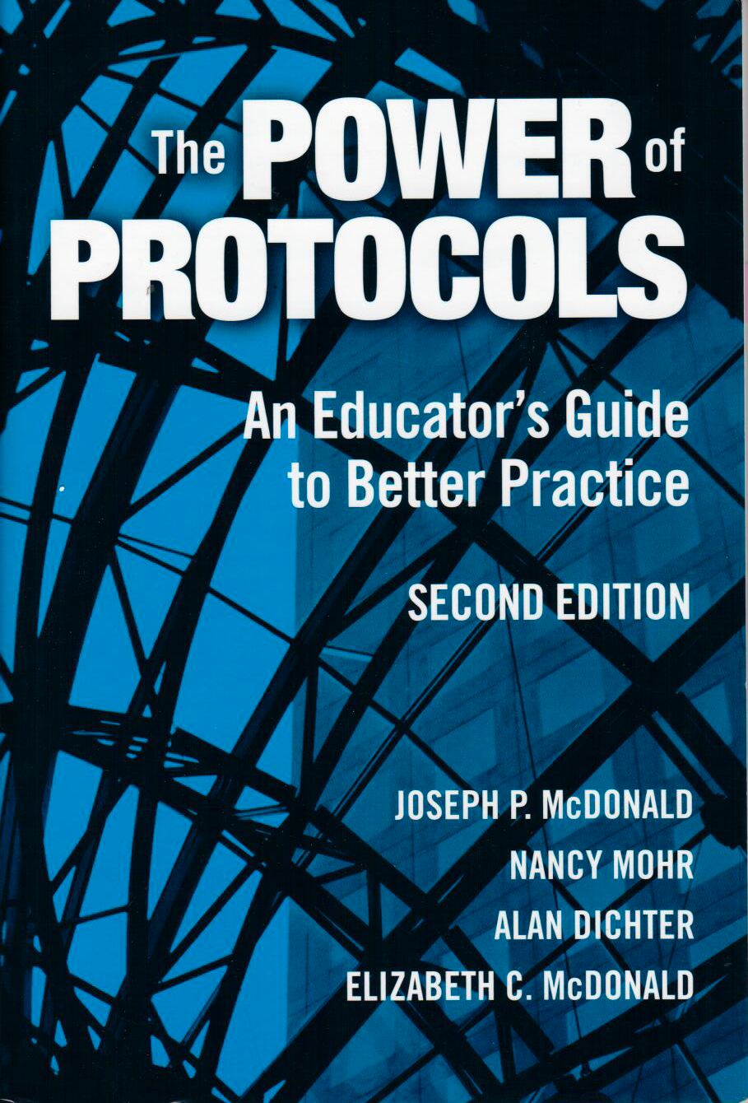
Power of protocols
2013 International SIM Conference
Lawrence, Kansas
Presenter: Cathy Spriggs
scmspriggs@sbcglobal.net
Notes:
Presentation based on the work by the book of the same name by McDonald, Mohr, Dichter and McDonald. Teacher’s College, Columbia University.
Story: This past year I joined a group of California Pders in a PLC to push our thinking about the use of protocols.
We experimented together then used the protocols within our PD sessions and returned to the PLC to discuss
the outcomes.

Slide 3
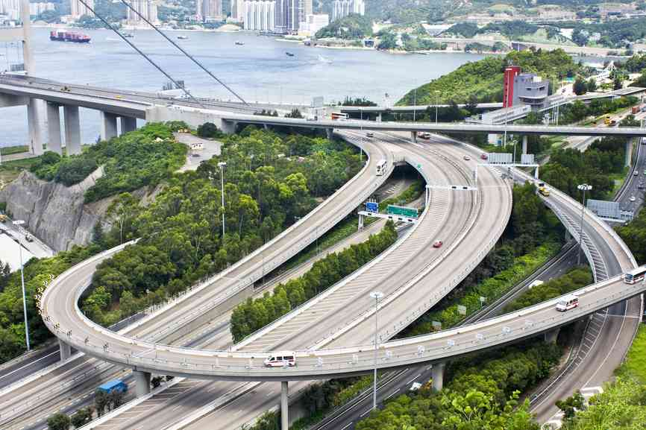
What is a protocol?
A technique for achieving voluntary regulation with a contingent environment.
Photo source: www.depositphotos.com
Notes:
Protocols are used in science, medicine, manufacturing.
Highway system analogy: The highway system is a combination of many different roads available to a person driving from point A to point B. However, en route one is compelled to to stop at red lights, stay between the white lines, follow a reasonable direct path and so on. The set of rules we follow to govern our behavior within a heterogeneous system are what computer scientists call a protocol.
Richard Elmore talks about the importance of teaching teachers how to work together in PLCs.
We assume individuals know how to work together in a collegial manner and talk through the tough problems of practice. He recommends teaching PLC group members how they will work together. Protocols will encourage learning and make the process transparent. Protocols force transparency and teach us the habits we wish we already had.

Slide 4
Why use a protocol?
#1 – We must educate ourselves
#2 – Explore student work
#3 – Protocol based learning
#4 – Professional Communities of
Practice
Notes:
#1: We must educate ourselves:
Protocols provide the structure to engage in open and honest conversation that supports inquiry, dialogue and reflection which leads to collective problem solving. A protocol also provides the facilitator structure to encourage participation, ensure equity and build trust.
#2: Explore student work: Become students of our students by deliberately examining student work.
Capture images of student work; study the images and explore together what they mean.
#3: Protocol based learning: Force transparency by structuring talking and listening; describing and judging; proposing and giving feedback.
#4: Professional Communities of Practice:
Protocols provide the structure for a PLC to consult with colleagues and make changes in order to make the work more effective.
Richard Elmore talks about the importance of teaching teachers the social constructs of
how to work together in PLCs. Protocols enable professional developers to accomplish this task.
Use of protocols ensures that the PLC knows how to
- gather colleagues together for apurpose
-establish effective ground rules
-enforce ground rules
-enable colleagues to share freely
-help them attend to one another’s perspectives
-help group make a collective commitment to group choices.
#4:

Slide 5
What is important to know as a facilitator?
Involves both macro and micro planning
Cross use, improvisation and adaptation are encouraged
Notes:
At the macro level, a PD needs to think about what protocol to use, when and how to open and close a meeting.
At the micro level which is done in the moment, as in how to intervene when something goes wrong or when to change one’s plan.
The authors encourage cross use, improvisation and adaptation.

Slide 6
Protocols for Today
1. Provocative Prompts
2. Collaborative Assessment
Conference
3. Postcards

Slide 7
Our Structure Today
Introduce the protocol
Outline the steps using both the powerpoint and handout
Facilitator at each table will guide group
Engage in protocol
Table “Go-Round”

Slide 8
Go-Around
Each member of the table group will have an opportunity to share their thinking without interruption.
Facilitator will signal when your turn is over.

Slide 9
Provocative Prompts
Read the two pages of quotations.
Choose one quotation and be prepared to share in a Go-Round why you chose it.
Notes:
Purpose: To infuse a conversation about a particular topic with a quick and contrasting set of viewpoints.
This protocol can be used as a lead into a complex issue that is then treated in a more comprehensive way.

Slide 10
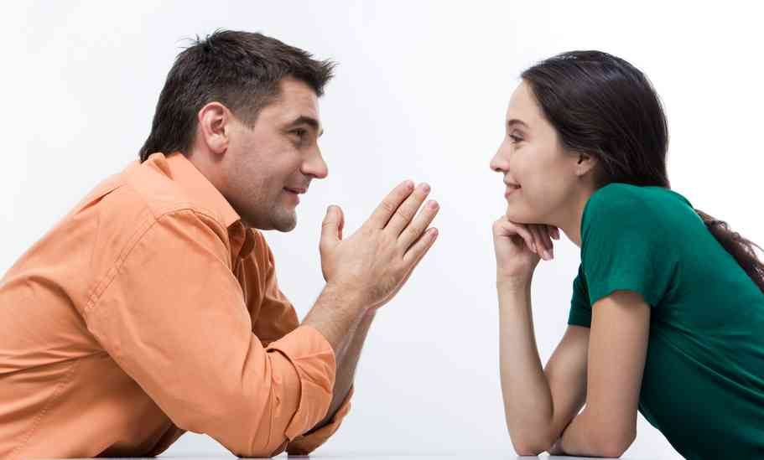
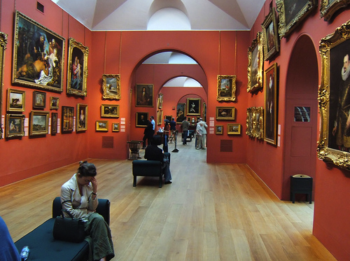
Variations
Listen and summarize back; Switch partners
Read and respond to
a quotation strip.
Gallery Walk
Photo source: www.depositphotos.com
Notes:
Chose a quotation, write a personal reflection. Share with a partner, with the partner reflecting back in their own words what they think they heard. This can be done with several changes of partner.
Each group member is randomly given a strip with one quotation. Each person reads quotation and responds on the spot.
Quotations are printed on large chart paper and tape to the walls of a room. Participants, using Post-its, place comments and questions as they choose, on each of the quotations.

Slide 11
An ADAPTATION of Collaborative Assessment Conference
1. Presenting
2. Describing
3. Raising Questions
4. Speculating
5. Responding
6. Reflecting and discussing
Notes:
Originally designed as a protocol for a PLC group to share and discuss planning and learning through examination of student work.
Purpose: 1) enhance teacher’s perceptions of all their student’s work by honing the teachers’ perceptual skills.
2) encourage depth of perception by demonstrating all that can be seen in a single student’s work
3) Encourage balance in perception – the habit of looking for strength as well as need.
4) encourage conversation about what the work shows
Presenting: student work is presented with minimal context. Grade level. Participants read silently or otherwise examine the work, marking on their copies any sections that hold particular significant for them.
Describing: participants respond to a facilitator question: What do you see? Use a go-around to ensure everyone has opportunity to respond and share.
Raising Questions: P respond to What questions does this work raise for you? During this time teacher/PD listens and takes notes.
Speculating: P respond to What do you think this student is working on? Why do you think this student is working on __________?
Responding: Presenting teacher responds to questions, offers additional context, shares his/her own thoughts about the work and responds to any other questions P may have.
Reflecting and discussing. Open discussion, reflect on the experience of the protocol . Share what was helpful.
The protocol we will use today has been adapted to fit within a professional development session as a means to introduce
teachers to a LS or CER early in the presentation which gives them voice about what they need to understand before they can
Implement.
There responses can be written on chart paper and displayed or written on sheet paper. The important piece is that throughout the workshop the PDer refers to the questions and ensures all questions are answered.
Read through the protocol on your handout.

Slide 12
Postcards
Without looking at it first, deal yourself one of the picture postcards from this deck going around.
Then imagine how it represents your work as a SIM Professional Developer.
Be prepared to share out in a Go-Around
Notes:
Purpose: A quick protocol that can be used to open, close or intervene during the course of a PD session.

Slide 13
Reflection
Use the handout for your personal reflection.
Be prepared to share out in a Go-Around.

Slide 14
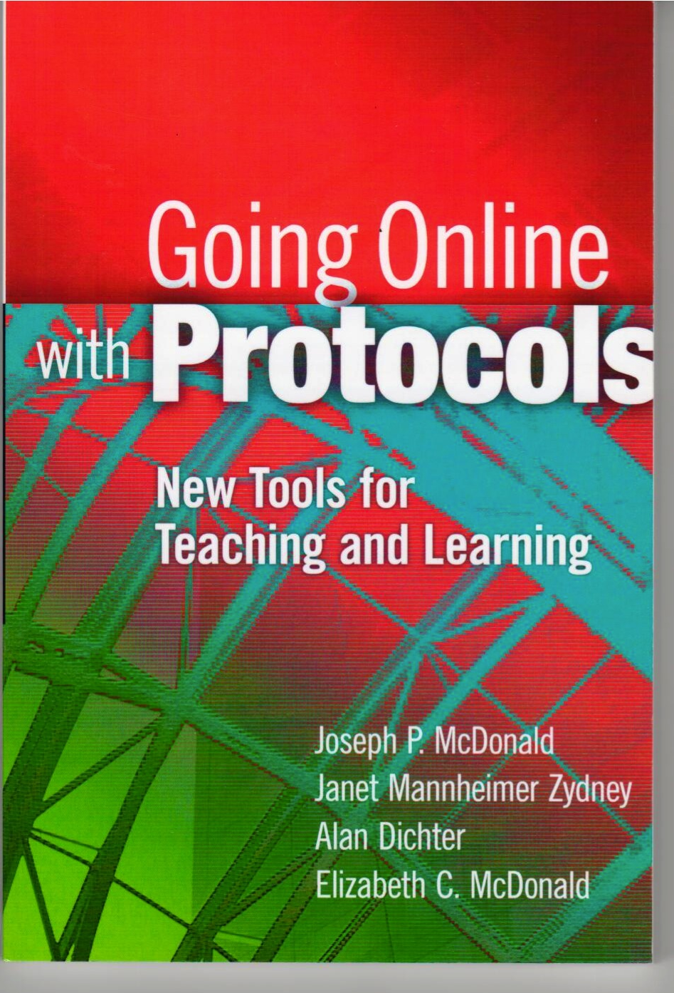
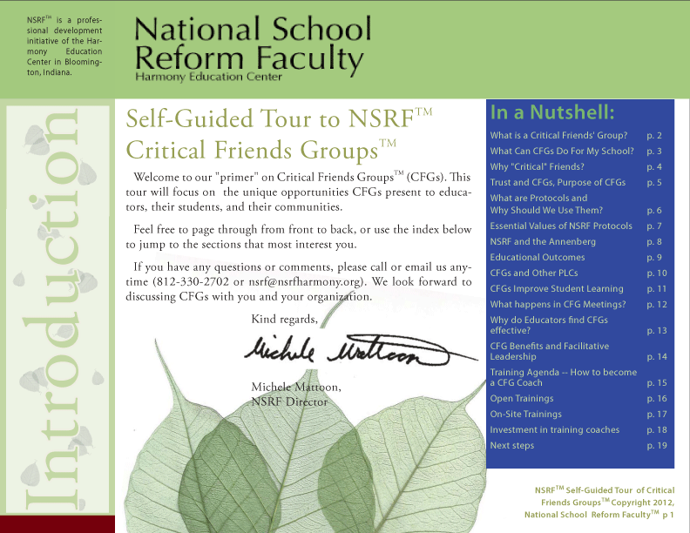
Where can I learn more about protocols?
National School
Reform Faculty
Notes:
Protocols: Teacher’s College at Columbia University
National School Reform Faculty: Adult Learning in the Service of Student Achievement; host Critical Friends Group, Harmony Education Center, Bloomington, Indiana

Slide 15
Please go to the link below to evaluate this session:
Thanks for coming.
http://www.surveymonkey.com/s/2013SIMConfEval

