Slide 2
Professional Learning Facilitated by:
Jocelyn Washburn, Ph.D.,
Director of Professional Development
University of Kansas Center for Research on Learning

Slide 3
Objectives
To continue an overview of Possible Selves
To explore and experience Lessons 5-7
To prepare to implement Lessons 5-7
As you engage in the overview videos and reading the manual, write down your questions and prepare items to share during our live session!

Slide 4
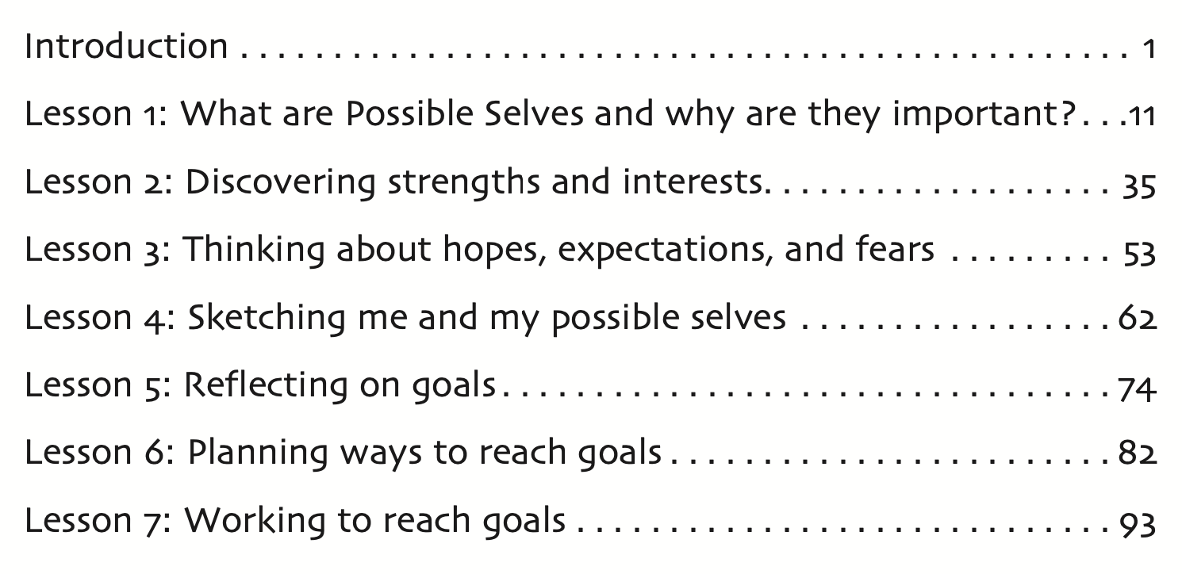
Notes:
Please go to page 93 to follow along with this lesson overview.
Lesson 7 and BEYOND

Slide 5
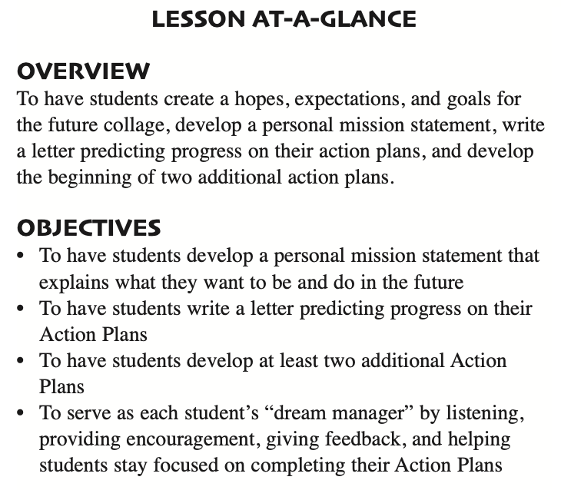
Lesson 7 and beyond: Working to reach goals
How Much Time to Allow:
Estimated at 1 hour and 30 minutes to complete 4 activities across 4-5 class periods
How Am I Doing? form
Notes:
In this lesson, students will complete four activities. These will take approximately 1 hour and 30 minutes and can be divided across 4-5 class periods. Notice that this is called Lesson 7 and beyond. After these four activities are completed, you'll come back to the "How Am I Doing" form when you serve as students' dream manager. This will be a time to listen, encourage, give feedback, and help students work on their action plans for several of their goals.

Slide 6
Lesson 7: Preparing to Implement
Familiarize yourself with this lesson.
Based on the amount of time you have remaining with students to complete Possible Selves, decide if you can complete all of the activities in this lesson. You may decide to skip the Personal Mission Statement and/or the Prediction Letter activities.
Be sure students can complete progress reports on their first Action Plan developed in Lesson 6 and develop at least one more Action Plan and monitor its progress.
Notes:
To get ready, familiarize yourself with the lesson with special attention to how much time you have remaining to teach Possible Selves with students. If you decide you can not complete all of teh activiteis, you may need to skip the personal mission statement and or Prediction letter. However,
the personal mission statement is a measure of progress from the start of the Possible Selves lessons, so you may really want to observe how much they've grown in their thinking about their expected and hoped-for selves. Be sure...

Slide 7
Activity #1: PERSONAL MISSION STATEMENT
A personal mission statement is…
a group of sentences that explains who you intend to become and what you want to accomplish in life. It is something that people can read each day to keep them focused on their goals and their vision of what they want to accomplish.
Notes:
“ To write a mission statement, you basically need to answer three questions. The first question is, ‘What do you want to be?’ In other words, what kind of a career or occupation do you think you’d like to have? The second question is, ‘What do you want to be like?’ In other words, what are the attributes or characteristics that you hope will describe you? Finally, the third question is, ‘What do you want to do?’ This means more than simply what kind of career do you want. It means how do you see yourself spending your free time.”

Slide 8
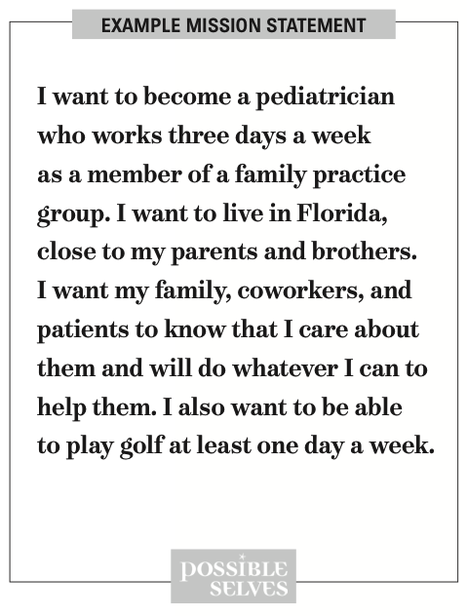
Notes:
Display a visual of the Example Mission Statement. Read the statement aloud. Discuss with students how the different parts of the statement answer the three questions.
What do you want to be?
What do you want to be like?
What do you want to do?
NEXT they write their personal mission statements and be sure to give feedback to each student. Write a brief positive comment to each student on a sticky note. Have students save their mission statement in their Possible Selves folder.

Slide 9
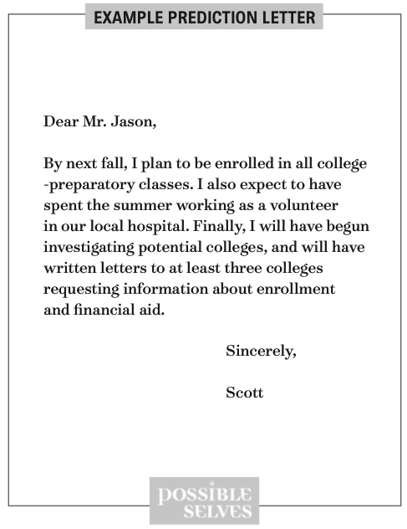
Activity #2: PREDICTION LETTER
A prediction letter is…
a group of statements that describe what you will be like and what you will have accomplished by a certain point in time.
It is a letter that you can look at from time to time to remind yourself what you need to accomplish by that certain time. It will help you to focus on reaching your goals.
Notes:
writing a letter to their mentor (e.g., next year’s teacher, coach, parent, someone they respect) predicting the progress they will have made toward reaching their hopes, expectations, and goals and fulfilling their mission statement by the beginning of the next semester.
Have each student write a prediction letter. Circulate as students write the letters, providing assistance if necessary. When the letters are finished, congratulate the students on a job well done. Remind them to read their letters at least once a month in the future and to share their letters with someone important to them.
Collect and review the prediction letters. Write a brief comment to each student on a sticky note. Return the letters to students during the next class period and have them place them in their Possible Selves Goal Folders. Allow them to give a copy of the letter to the person to whom it is addressed if they wish to do so.

Slide 10
Activity #3: NEW ACTION PLANS
Have students develop Action Plans for Priority Goals 2 and 3 on their Thinking About Possible Selves forms.
Distribute two blank Action Plans to each student. Ask students to get out their completed copies of the Thinking About Possible Selves form and find Items 6 and 7.
Notes:
Have students develop Action Plans for Priority Goals 2 and 3 on their Thinking About Possible Selves forms. Distribute two blank Action Plans to each student. Ask students to get out their completed copies of the Thinking About Possible Selves form and find Items 6 and 7.

Slide 11
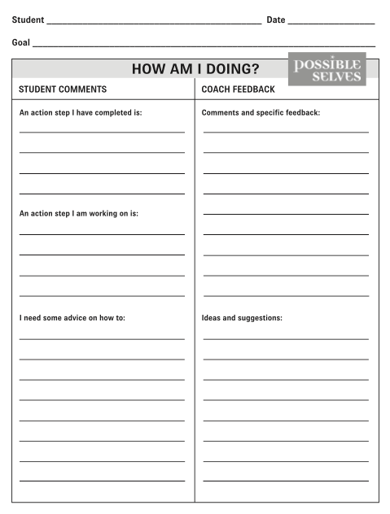
Activity #4: HOW AM I DOING?
Notes:
Every two weeks, ask students to fill out one How Am I Doing? form for each of their action plans.
You may assign this either as homework or as an in-class assignment. Collect and review all forms. Provide specific written feedback on each form under the Coach FEEDBACK Section. Return the forms to students as soon as possible.

Slide 12
What’s Next?
Celebration
Maintenance
Generalization
Notes:
Take time to celebrate progress and goal completion individually with students and as a group. Share with others in the school about products created during Possible Selves. This could take the form of a Gallery Walk or a visit to class from a special guest, such as the principal or guidance counselor.
Have you and your students mark in your planners or on your calendar when to revisit your How Am I Doing forms so you don’t lose track of maintaining progress on your action plans.
Connect their hopes, dreams, and goals to school! Share items with guidance counselors to help in future course selection. Connect specific expectations in school to their personal futures, such as how reading, writing, listening, speaking, and thinking skills will help them in their lives.

