Slide 2
Professional Learning Facilitated by:
Jocelyn Washburn, Ph.D.,
Director of Professional Development
University of Kansas Center for Research on Learning

Slide 3
Objectives
To continue an overview of Possible Selves
To explore and experience Lessons 5-7
To prepare to implement Lessons 5-7
As you engage in the overview videos and reading the manual, write down your questions and prepare items to share during our live session!

Slide 4
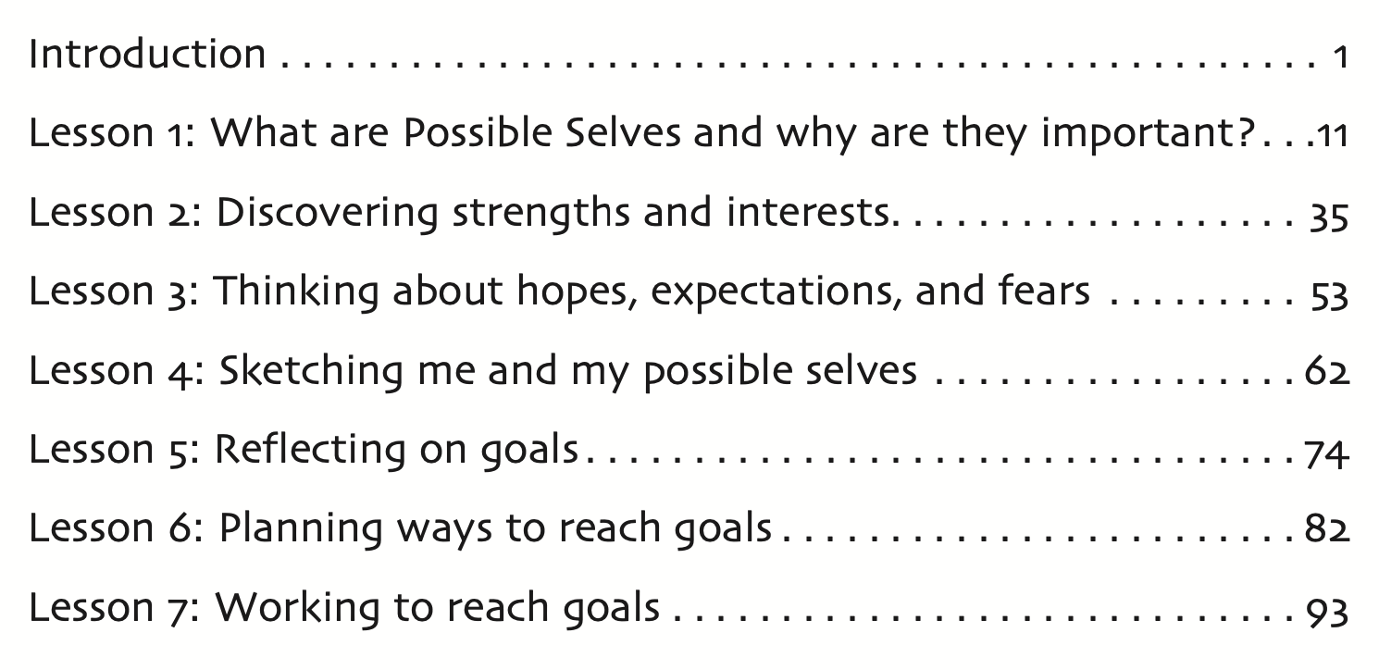
Notes:
In Lesson 6, students will develop action plans to support their goals. Please go to page 82 to follow along with the video overview.

Slide 5
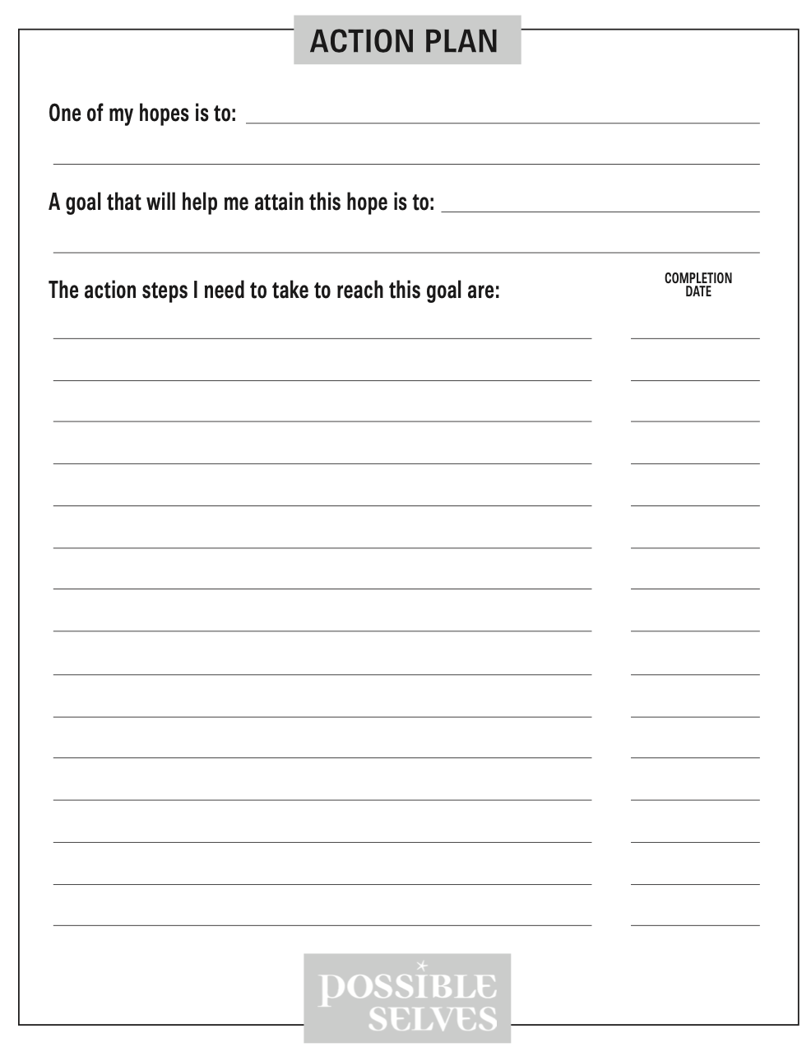
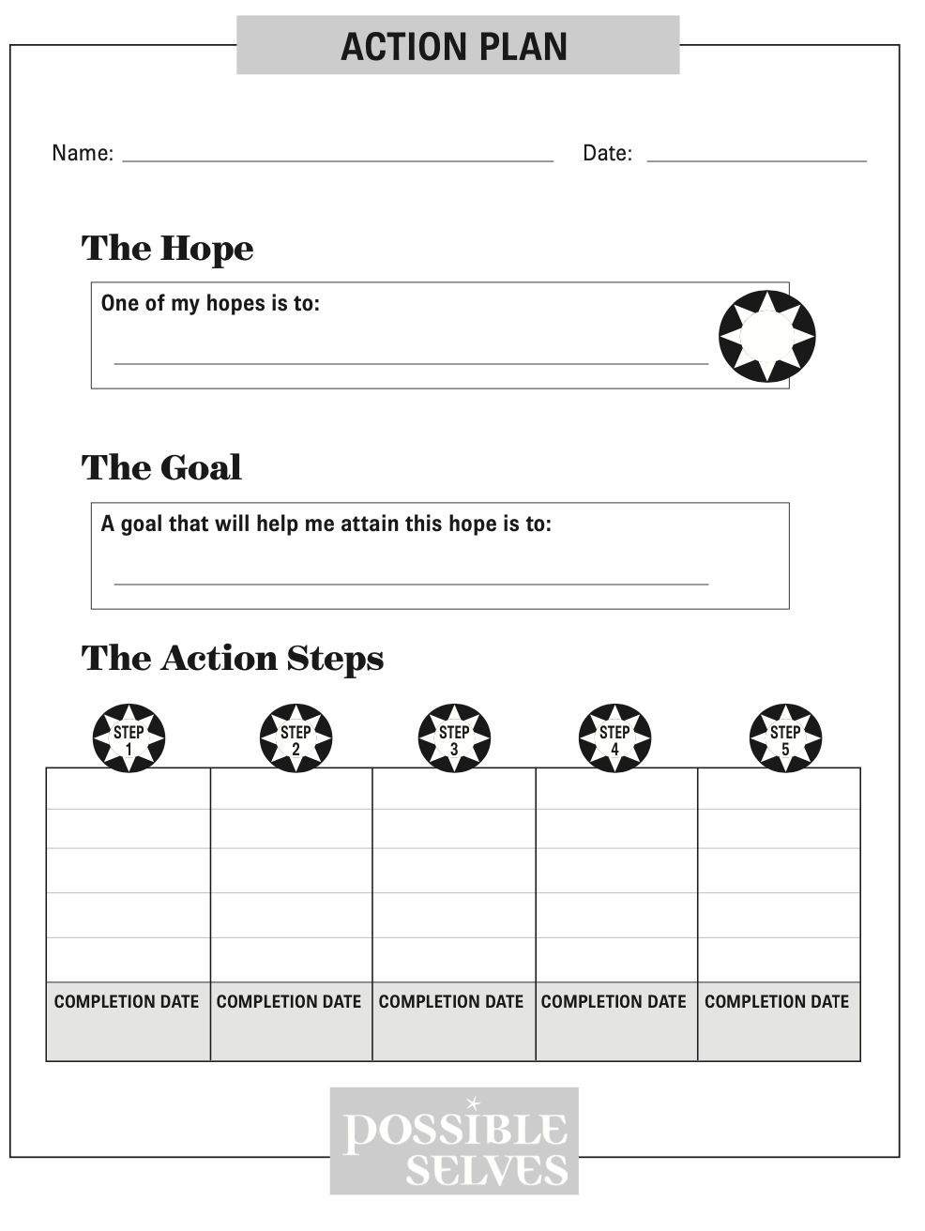
How Much Time to Allow:
Estimated at 46 minutes across 3 mini lessons that take 10-15 minutes each
Lesson 6: Preparing to Implement
Familiarize yourself with this lesson.
Select which format to use for the Action Plan.
Prepare your Action Plan, so you are ready to model how to complete it prior to students preparing theirs.
Notes:
An overview of this lesson is to have students define action plan and to develop an action plan for reaching their goals.
This lesson is organized across 3 mini lessons that add up to a total of 46 minutes, so you may be able to complete this lesson in one class period depending on your schedule.
To prepare...

Slide 7
An action plan…
contains the specific actions a person takes to reach a goal.
An action…
is anything a person does, including thinking and moving.
Examples of Mental Actions
• Planning • Making a decision • Gathering information
Examples of Physical Actions • Mowing lawns • Writing a letter
• Taking a class
Notes:
Ask students what they think an action plan entails. Explain that an action plan contains the specific actions a person takes to reach a goal. Define an action as anything a person does, including thinking and moving. In other words, there are mental actions as well as physical actions. Ask the student to give examples of each.

Slide 8
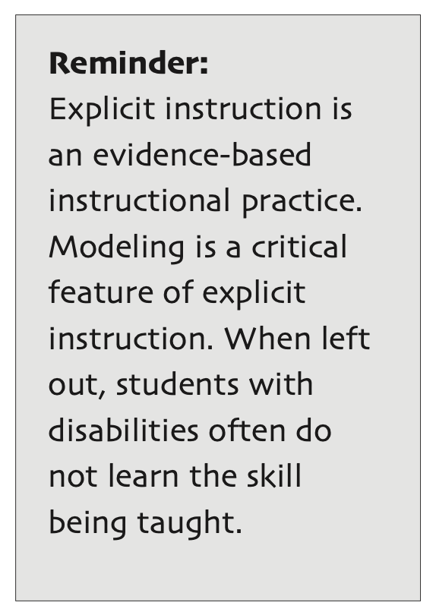
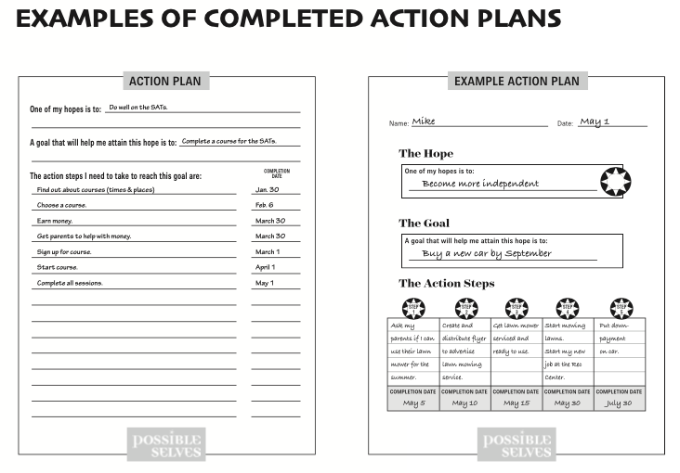
Notes:
Have you noticed how much teacher modeling is incorporated throughout each Possible Selves lesson?
Model with your Action Plan.
Conduct guided practice while they complete their own Action Plan.
Review each student’s action plan. Provide feedback on a sticky note. Be sure to say something positive to each student about his or her plan

