Slide 2
Professional Learning Facilitated by:
Jocelyn Washburn, Ph.D.,
Director of Professional Development
University of Kansas Center for Research on Learning

Slide 3
Objectives
To continue an overview of Possible Selves
To explore and experience Lessons 5-7
To prepare to implement Lessons 5-7
As you engage in the overview videos and reading the manual, write down your questions and prepare items to share during our live session!
Notes:
This video begins the next set of lessons, 5 through 7. This will be a chance to explore these lesson, try out certain activities in each lesson, and prepare to implement the lessons with students.
As you engage in the videos and read the manual, write down your questions and save any activities you try, so you can share these during our live session.

Slide 4
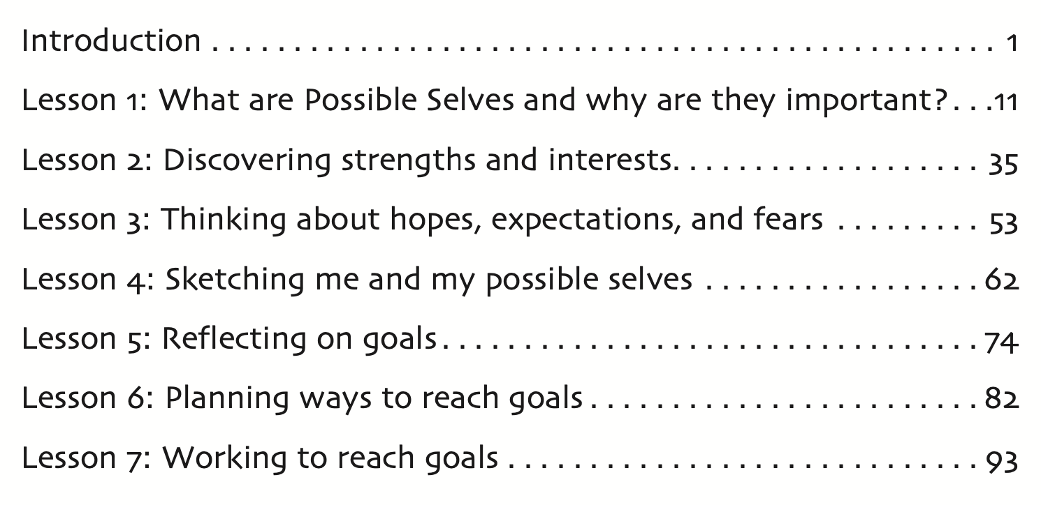
Notes:
So far, you have learned about Lessons 1-4 which focus on having students discover their strenghts and interests, think about their hopes, expectations, and fears, and sketch these on their Possible SElves Tree. With Lessons 5-7, we shift into having students apply their initial ideas with goals. In lesson 5, students will reflect on their goals, set goals, and prioritize their goals.

Slide 5
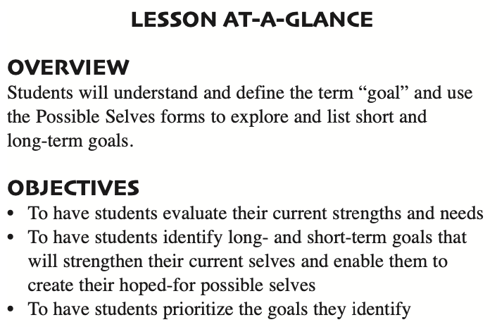
Lesson 5: Reflecting on goals
How Much Time to Allow:
Estimated at 1 hour and 15 minutes across 6 mini lessons that take 10-15 minutes each
Notes:
First, students will understand and define the term goal, including an understanding of short-term and long-term goals. This lesson will take 1 hour and 15 minutes and can be broken up into 6 mini-lessons or a combination that makes sense for your classtime.

Slide 6
Lesson 5: Preparing to Implement
Familiarize yourself with this lesson.
2. Think about the questions on Thinking About Possible Selves in relation to your own Possible Selves Tree, and be prepared to answer the questions for the model.
3. Obtain all materials
Possible Selves Unit Organizer
Thinking About Possible Selves forms (Paper or Electronic
copy)
Goal: definition and examples
A visual of your personal Possible Selves Tree
Possible Selves Goal Folders
Notes:
p. 74

Slide 7
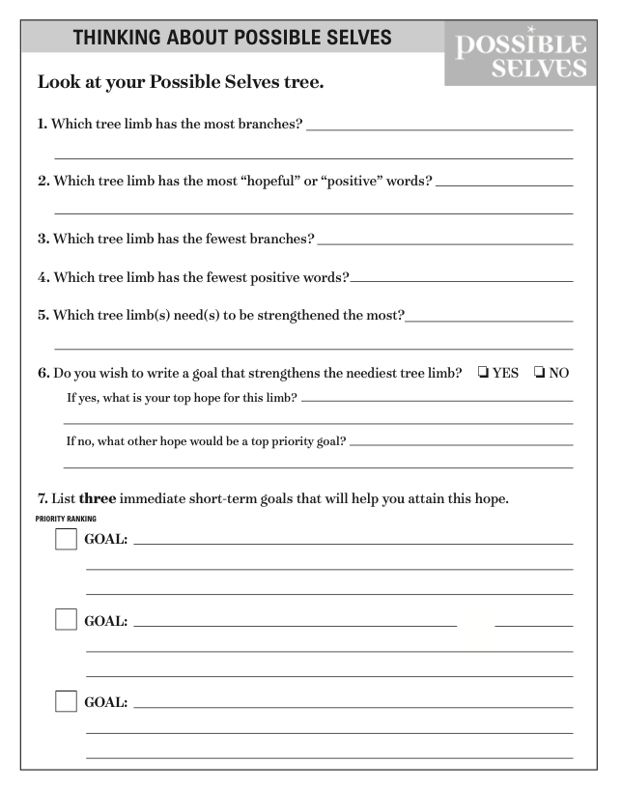
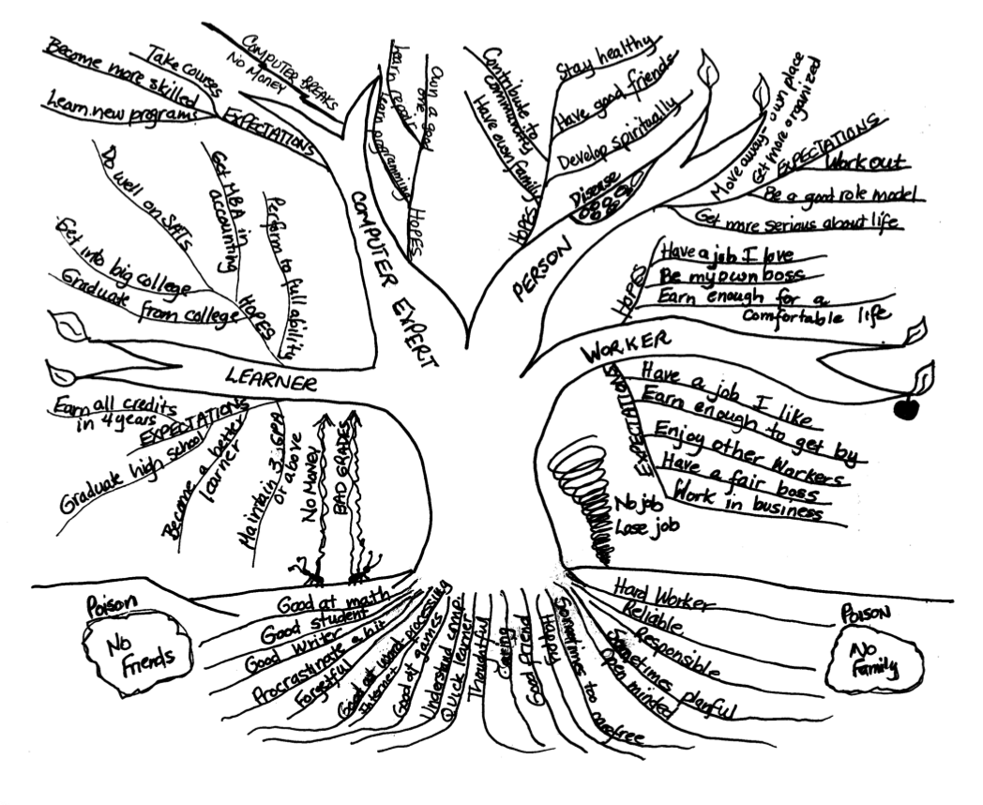
Notes:
the major activity of this lesson is for students to analyze their Possible Selves Trees and come up with some goals that will strengthen their trees and help them reach their expected and hoped-for selves.
On the THinking about Possible SElves form, you and your students will use your Possible SElves trees to answer questions 1-6. First, you will model your answer for each question and then prompt students to answer each question.

Slide 8
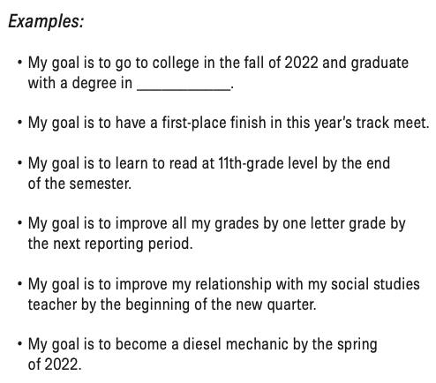
Goal 🎯
a clear statement of what you want to achieve and are working toward, and when you expect to achieve it
Notes:
Introduce the idea of strengthening the Possible Selves Trees.
Make sure students understand that a goal contains two important elements: (a) a clear statement of what they want to achieve, and (b) a date by which they will achieve it.
Clarify that people can have short-term goals—things they want to achieve within the next few months—or long-term goals—things they want to achieve a year or more in the future. Brainstorm different goals with students. Have them tell you whether a goal is a short-term goal or a long-term goal. Write responses on the board under the heading “Short- Term Goals” or “Long-Term Goals.” Depending on the age of the students, examples of short-term goals might include passing algebra for the current quarter, winning Friday night’s basketball game, or finding a summer job by the end of May. Examples of long-term goals might include graduating from high school in three years, owning a home in 15 years, playing professional football after finishing college, being married in 10 years, or joining the Marines upon graduation from high school.

Slide 9
Notes:
Model how to select and list goals (Item 7 on Thinking About Possible Selves).
Prompt students to do so for themselves on their sheet.
Model ranking goals in order of how important they are for you. Next, ask them to do the same.

