Slide 2
Professional Learning Facilitated by:
Jocelyn Washburn, Ph.D.,
Director of Professional Development
University of Kansas Center for Research on Learning

Slide 3
Objectives
To engage in an overview of Possible Selves
To explore and experience the first four lessons
To prepare to implement the first four lessons
As you engage in the overview videos and reading the manual, write down your questions and prepare items to share during our live session!

Slide 4
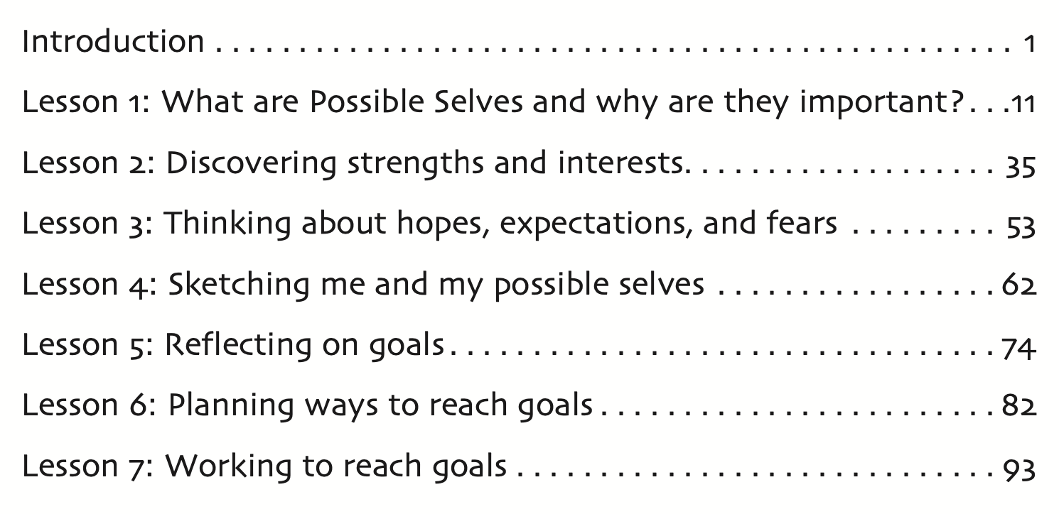

Slide 5
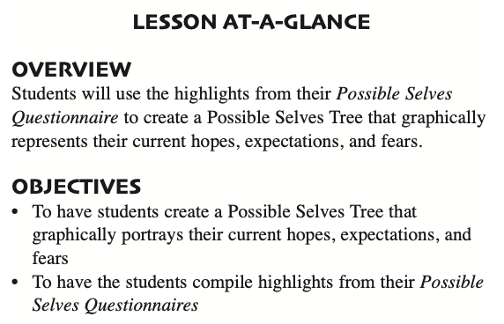
Lesson 4: Sketching me and my possible selves
How Much Time to Allow:
Estimated at 45 minutes across 2 mini lessons that take 10-15 minutes each

Slide 6
Lesson 4: Preparing to Implement
Familiarize yourself with this lesson.
Be sure you have a completed Possible Selves Questionnaire for yourself and for each student (from previous lesson) and that all students can view their answers to the questionnaire (if submitted through a Google form).
Decide if students are creating paper or digital Possible Selves Trees. If paper, gather supplies and examples. If digital, prepare instructions for best method.
Prepare your Possible Selves Tree using the same format as your students.

Slide 7
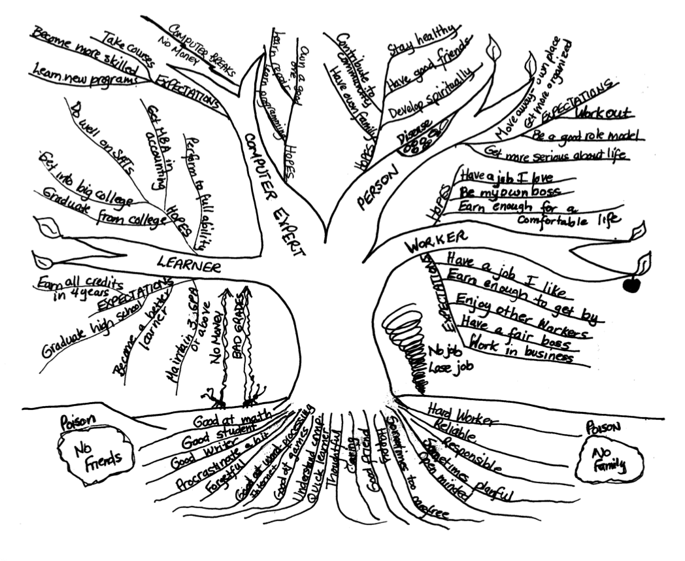
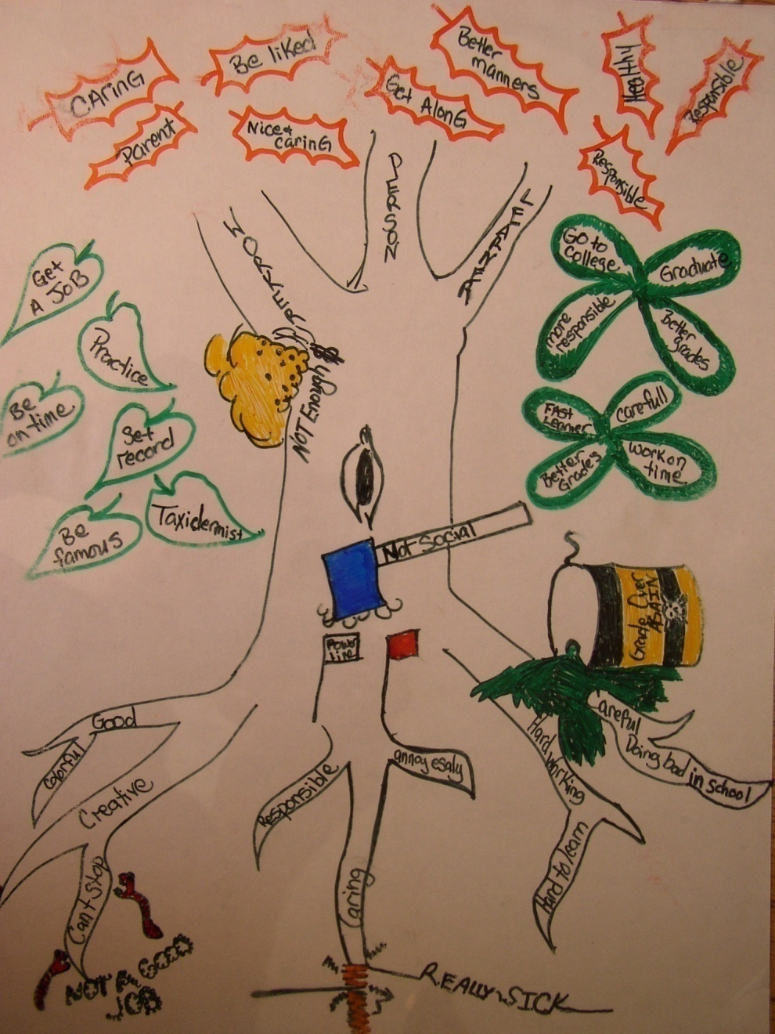
Notes:
Here are a few example Possible Selves Trees. On pp. 65-66 in the manual, there are detailed descriptions on how to guide studnet sto use their questionaire to build their tree. Let's look closely at these examples to see how. Notice how each limb of the tree represents a section from the questionnaire. Strenght area (computer expert), Learner, person, and worker. Hopes and expectations are branches on each limb. Some limbs will be larger or smaller depending on how many hopes and expectations students have for that section.

Slide 8
