Slide 2
Professional Learning Facilitated by:
Jocelyn Washburn, Ph.D.,
Director of Professional Development
University of Kansas Center for Research on Learning

Slide 3
Objectives
To engage in an overview of Possible Selves
To explore and experience the first four lessons
To prepare to implement the first four lessons
As you engage in the overview videos and reading the manual, write down your questions and prepare items to share during our live session!

Slide 4
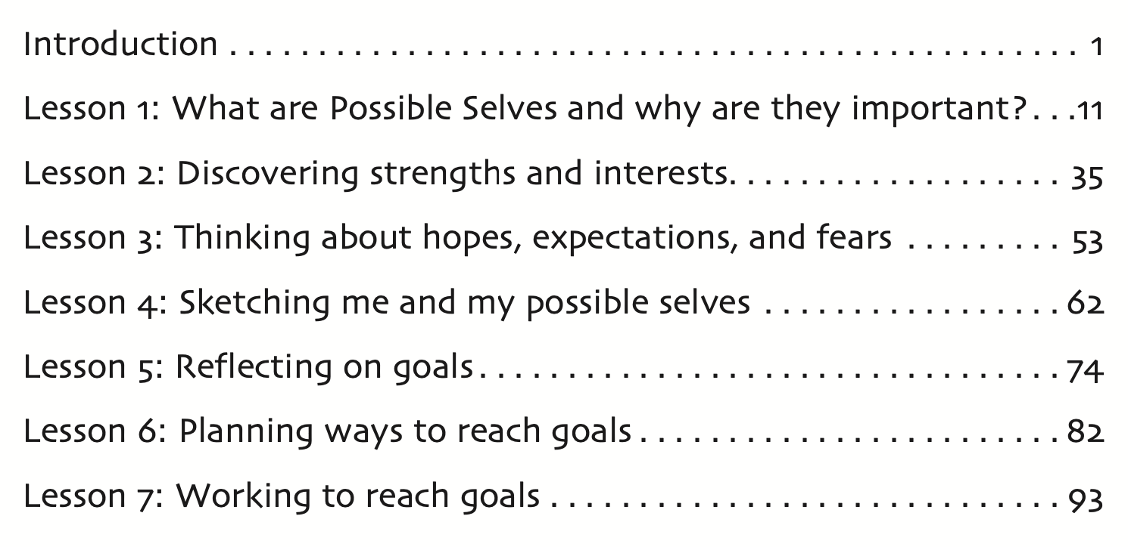

Slide 5
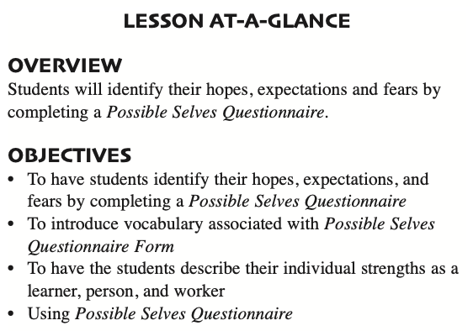
Lesson 3: Thinking about hopes, expectations, and fears
How Much Time to Allow:
Estimated at 46 minutes across 3 mini lessons that take 10-15 minutes each
Tip: Use a Google Form
Notes:
Lesson 3 is estimated to take 46 minutes and can be taught in one lesson or divided across 3 mini lessons.
Students will be identifying their hopes, expectations, and fears, so they will need to learn in more depth what these terms mean.
The main activity for students during this lesson is to complete a Possible Selves questionnaire. This can be completed on paper or by typing on a PDF file in their Google folder, or through a Google form. If you use the last option, be sure you have a way to provide student responses to the questionnaire back to teach student as they will need them for Lesson 4.

Slide 6
Lesson 3: Preparing to Implement
Familiarize yourself with this lesson.
Review and complete the Possible Selves Questionnaire.
All students will complete the individual strength, learner, person, and worker sections of the questionnaire. Start with the strength section as it can act as a springboard for identifying a possible career.
Complete the same sections students will complete. You will use your completed questionnaire during this lesson to show students how to answer the questions. In addition, you will use the completed questionnaire during Lesson 4 as the basis for drawing a Possible Selves Tree.
Review all key terms (e.g., “hopes,” “expectations,” “fears,” “learner”) used in the questionnaire. Be prepared to define them.

Slide 7
Pause and read the definitions of the key words on p. 61.
person
learner
expectation
hope
fear
worker
Individual strengths

