Slide 2
Professional Learning Facilitated by:
Jocelyn Washburn, Ph.D.,
Director of Professional Development
University of Kansas Center for Research on Learning

Slide 3
Objectives
To engage in an overview of Possible Selves
To explore and experience the first four lessons
To prepare to implement the first four lessons
As you engage in the overview videos and reading the manual, write down your questions and prepare items to share during our live session!

Slide 4
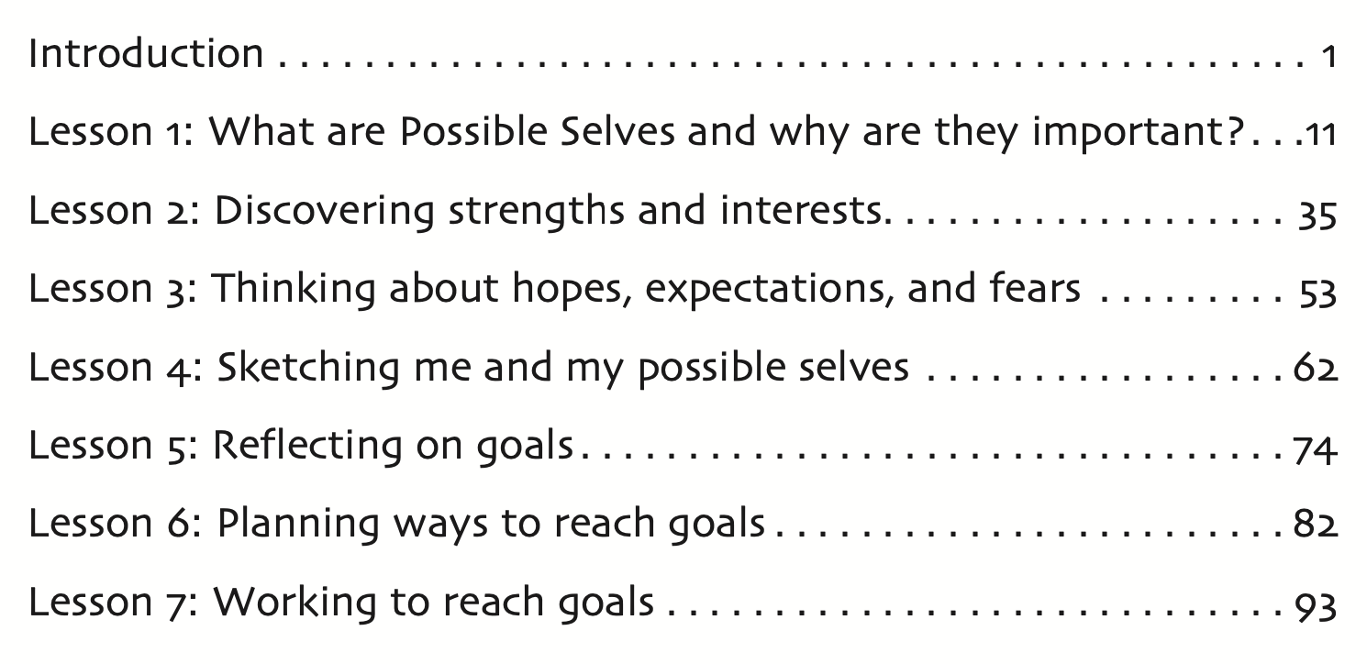

Slide 5
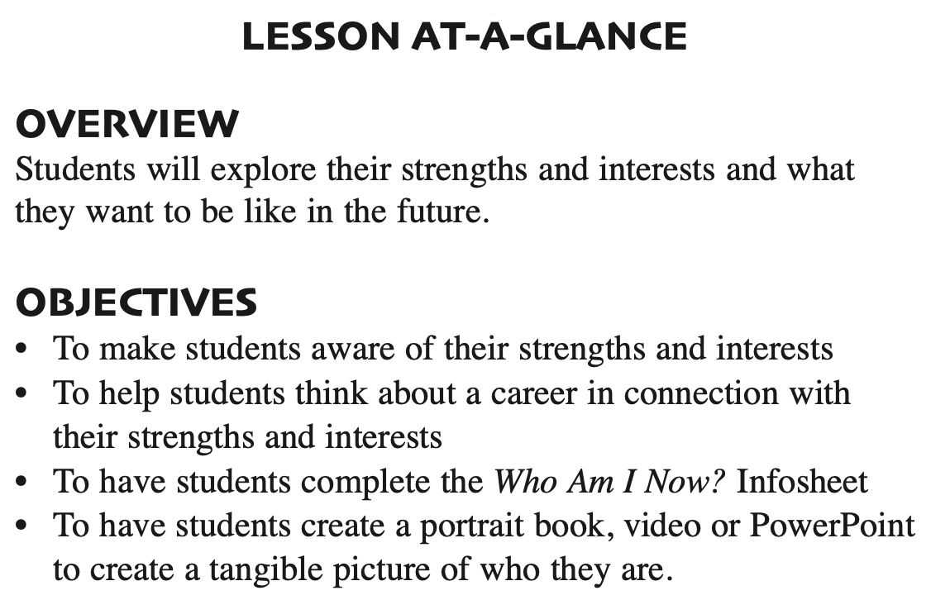
Lesson 2: Discovering strengths and interests
How Much Time to Allow:
Estimated at 1.5-3 hours across 5 mini lessons that take 10-15 minutes each
Time varies due how long students need to create and present their projects
Tip: Invite principals or guidance counselors when students present
Notes:
Lesson 2 is estimated to take 1 and a half to 3 hours across 5 mini lessons as they are organized in the manual. The reason time varies is based on the project students chose to create.
The two main activities students will complete during this lesson are the Who Am I Now Infosheet and their Portrait book, video, or slides. We'll look at these choices in a moment. When students have prepared their Portrait Project, it is a rewarding experience for them to share it with influential adults in the school. For example, principals or guidance counselors could visit to watch students present or participate in a Gallery Walk of projects displayed around the classroom.

Slide 6
Lesson 2: Preparing to Implement
Familiarize yourself with this lesson.
Organize presentation slides to deliver lesson content.
Obtain all materials for the Who Am I Now? Project.
Prepare examples and instructions for the project choices.
Complete the Who Am I Now? Infosheet, so you will have your responses ready to share with students.

Slide 7
Who Am I Now? Project Choices
For students who decide to create a physical Portrait Book, be sure to bring magazines and clip art related to a variety of activities the students might enjoy. Also be sure to bring enough materials for the number of students participating.
For students who decide to create the Power Point Portrait Book, consider adding scaffolded supports with a sentence starter on each slide. Then, students can personalize each slide with their details and some Google images.
For students who decide to create the Portrait video, they will create sentence strips on paper and have someone record them showing each sentence strip for enough time for viewers to read each statement.

Slide 8
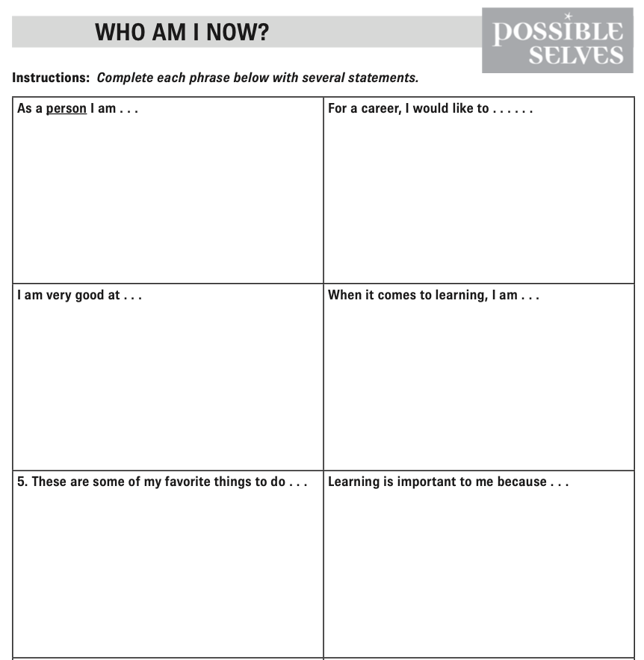
Try it!
Jot down your responses to the ‘Who am I Now’ sentence stems on the Infosheet.
Heads-up! During the lesson with students, you’ll model with your responses.

