Slide 2
Professional Learning Facilitated by:
Jocelyn Washburn, Ph.D.,
Director of Professional Development
University of Kansas Center for Research on Learning

Slide 3
Objectives
To engage in an overview of Possible Selves
To explore and experience the first three lessons
To prepare to implement the first three lessons
As you engage in the overview videos and reading the manual, write down your questions and prepare items to share during our live session!

Slide 4
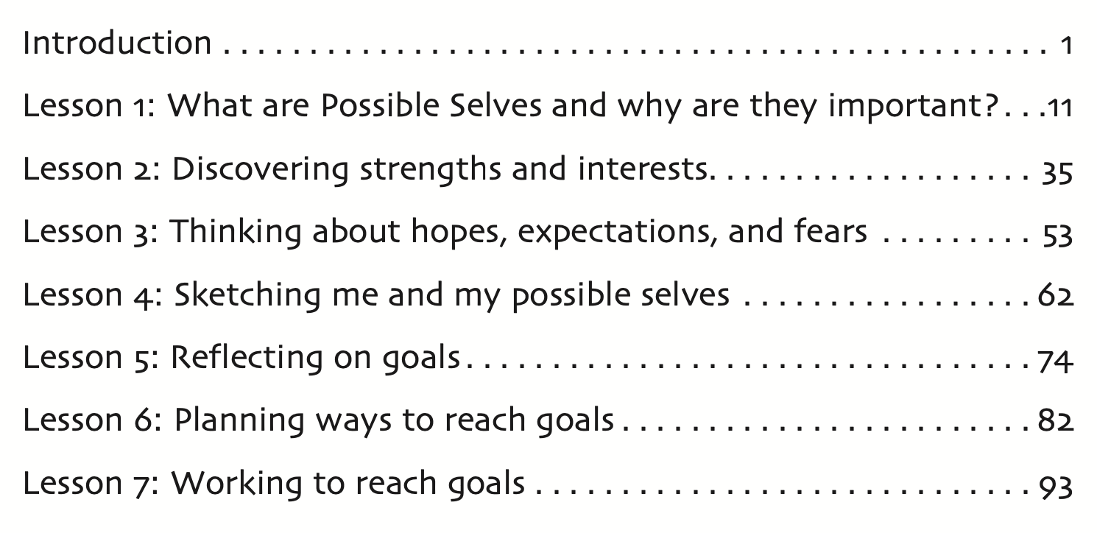

Slide 5
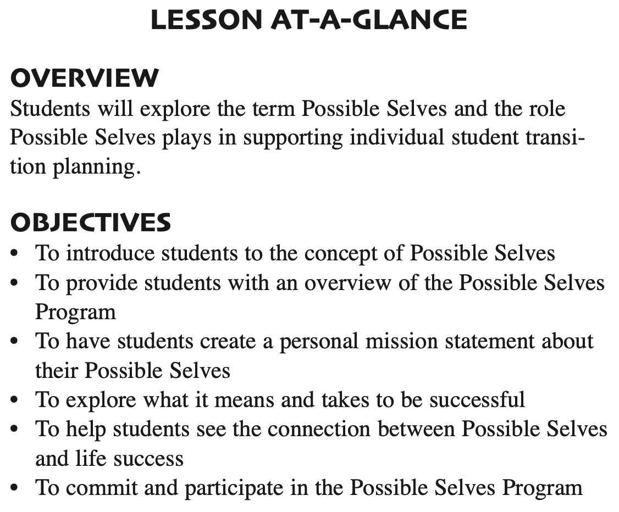
Lesson 1: What are Possible Selves and why are they important?
How Much Time to Allow:
Estimated at 1.5-3 hours across 5 mini lessons that take 10-15 minutes each
Time varies due to the length of the video used for the film study activity
serves as a pre-test

Slide 6
Lesson 1: Preparing to Implement
1. Familiarize yourself with the lesson.
2. Set up Possible Selves Goal Google folders for or with students:
A Possible Selves Goal Folder is made up of three items: a page for creating a collage of strengths, interests, and possible careers (Lesson 2); a page for the Possible Selves Questionnaire (Lesson 3); and a page for drawing a Possible Selves Tree (Lesson 4).
3. Decide whether you will show a movie or movie clip as part of the lesson.
4. Decide if you will use a real or image of a Dream Catcher.
5. Save the Possible Selves Google Folder (includes Teacher Presentation Google Slides, Student Materials, and Google Forms) your Google My Drive.
Notes:
SEE COMMENT ON SLIDE

Slide 7
Pause and skim through Lesson 1, pp. 11-34.
In the far-right column on the overview table (pp. 11 & 12), notice which tasks and activities the Teacher performs or the Students complete.

Slide 8
A personal mission statement is a group of sentences that explains who you intend to become and what you want to accomplish in life. It is something that people can read each day to keep them focused on their goals and their vision of what they want to accomplish.
To write a mission statement, answer three questions:
What do you want to be?
In other words, what kind of a career or occupation do you think you'd like to have?
What do you want to be like?
In other words, what are the attributes or characteristics that you hope will describe you?
What do you want to do?
This means more than simply what kind of a career do you want. It means how do you see yourself spending your free time.

Slide 9
Personal Mission Statements for Student 1
BEFORE
AFTER
I want to be known as a hard worker and strive to be one of the best players in college basketball.
I want to be well respected and loved by my family and friends in everything I do.
I want to live a good life and support my family as well as other family members.
I want to live my life as a caring person who will always help others.
I wish to be a good father, husband and provider.
I want to be a very caring person.
I wish to end up in heaven.
I want to be a professional basketball player.
I want to touch people’s lives.

Slide 10
Personal Mission Statements for Student 2
BEFORE
AFTER
I want to be a basketball player
I want to do dunks
I want to be like Iverson.
I want to be a pro basketball player after I go to college.
I want to use my intelligence to be a good student.
I want to be a good person.

Slide 11
Personal Mission Statements for Student 3
BEFORE
AFTER
I want to be like “Aaliyah” because she was nice and pretty and a singer.
To travel and make my dreams come true like Aaliyah.
I want to be a veterinarian and help take care of animals.
I will go to college for four years and I will use my knowledge in the workplace.

Slide 12
Try it!
Draft your own a personal mission statement.
Heads-up! During the lesson with students, you’ll model with your personal mission statement.

