Slide 2
Professional Learning Facilitated by:
Jocelyn Washburn, Ph.D.,
Director of Professional Development
University of Kansas Center for Research on Learning

Slide 3
Think about one thing you have to do, but you don’t want to.
Why and how do you make yourself do it?
Notes:
Before we begin, think about one thing you have to do, but you don’t want to. For me, it might be going for a run. Why and how do you make yourself do it? First, I think about how it will make me feel better if I exercise. Then, I tell myself what I need to do to just get started. I also remind myself that I might actually enjoy running once I get started. Pause the recording, and answer these questions for yourself.

Slide 4
Objectives
To engage in an overview of Possible Selves
To explore and experience the first four lessons
To prepare to implement the first four lessons
As you engage in the overview videos and reading the manual, write down your questions and prepare items to share during our live session!

Slide 5
Is student motivation a factor in student achievement?
What are the student motivational issues that we face?
Within what parameters must we operate?
(e.g., time, opportunity, support, curriculum)
Notes:
The purpose of the Possible Selves Program is to give teachers and counselors another tool for increasing the academic motivation of students.

Slide 6
“Students are not unmotivated. However, they may not be motivated to do what we want them to do.”
Richard Lavoie
Notes:
Each of us may have said about students “they just aren’t motivated” as if this is a permanant state of being or character trait, when in fact motivation fluctuates.

Slide 7
GOAL THEORY
Students are motivated when they have all of the following:
• a goal they find attractive,
• a belief they can attain the goal, and
• a plan to attain the goal.
Notes:
Possible Selves is built on goal theory.

Slide 8
HOPE THEORY
“Successful people have high hope. Hope can be nurtured.”
Rick Snyder, The Psychology of Hope
HOPE results from having willpower (desire) and way power (a plan) for goals.
Notes:
Possible Selves is also built on Hope Theory.

Slide 9
‘Possible Selves’ are ideas about what one might become in the future (Markus & Nurius, 1986).
One’s vision of the future is motivating.
Future vision includes:
Hoped for selves
Expected selves
Feared selves
Notes:
The noted psychologist William James first introduced the concept of Possible Selves in 1897. James believed that each individual possessed multiple ideas about what they might become, and that these ideas were important to the individual regardless of their actual potential to achieve them. More recently, Hazel Markus (1986) coined the term Possible Selves in reference to motivation. She defined Possible Selves as “ideas about what one might become in the future” (Markus & Nurius, 1986). Ideas about one’s self in the future can be very motivating. That is, individuals with clear ideas and goals about what they want to be often seem willing to put forth the effort needed to attain these goals. Additionally, Markus reported that some individuals will work just as hard to avoid the possible selves that they fear. For example, students who have thought about living on welfare with no money to support a family may be more likely to work hard in school to avoid that future than students who have not seriously considered such an outcome. In either case, the concept of Possible Selves, when put into practice, can increase one’s motivation to work hard to attain specific goals; it is an essential link between self- concept and individual motivation (Cross & Markus, 1994; Leondari, Syngollitou, & Kiosseoglou, 1998; Markus & Nurius, 1986; Oyserman & Markus, 1990a; Oyserman & Markus, 1990b).

Slide 10
TEENS AND SELF-IMAGE: SURVEY RESULTS
Question 8. How much influence does each of the following have on your life?
A lot or Some None
Parents 96% 4%
Teacher 80% 20%
Other Kids 78% 22%
Religion 70% 30%
Girl/Boyfriend 63% 37%
Celebrities 63% 37%
TV Shows 44% 56%
Advertising 36% 64%
If this survey were given today, where would we add social media?
Notes:
In the original research while developing Possible Selves, students answered this survey question.
Note that Teachers have the 2nd highest influence in their lives.

Slide 11
TEENS AND SELF-IMAGE: SURVEY RESULTS
Question 5. Who understands you the most?
Friend 42%
Parent 28%
Girl/Boyfriend 10%
No one 8%
Sibling 5%
Religious Leader 1%
Teacher 1%
Other 5%
Notes:
They also answered this survey question.
Note that teachers are 2nd to last in who understands them most.

Slide 12
All of the lessons in PS are designed to:
Help students define success
Help students define who they are
Guide students through a process to determine who they want to become
Support students as they reflect on their goals
Help students develop action plans for attaining their goals
Monitor students’ action plans and aid in revising them
Notes:
Some researchers have extended the Possible Selves concept as a visual metaphor—a Possible Selves tree that bears the fruit of hopes and dreams (Borkowski et al., 1992; Day et al., 1994; Estrada, 1990). Students are invited to create their Possible Selves Trees as a reflection of themselves and as unique persons whose qualities and fears are depicted as roots and branches. In this way, students understand the connection between learning in school and achieving personal goals.
Additionally, as students explore their Possible Selves, their teachers have an opportunity to truly get to understand them.

Slide 13
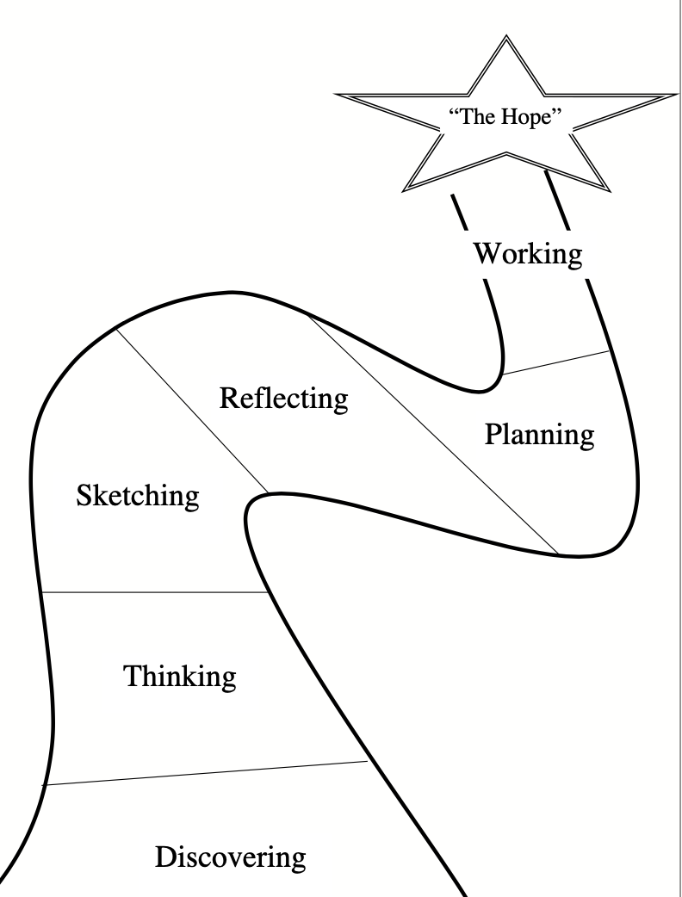
Six Components of Possible Selves
“The Hope”
Lesson 7
Lesson 5
Lesson 6
Lesson 4
Lesson 3
Lessons 1 & 2

