Slide 2
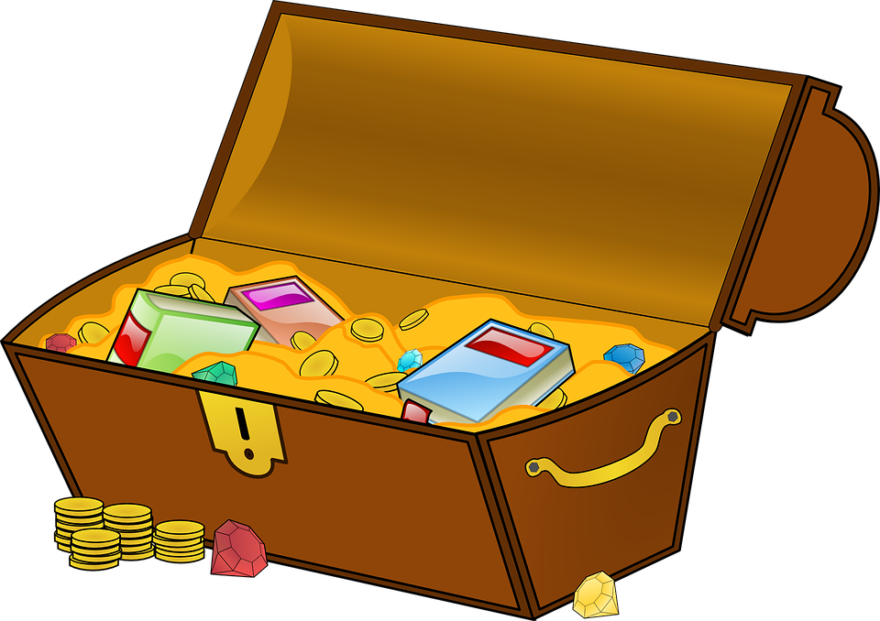
What’s In Your Treasure Chest

Slide 3
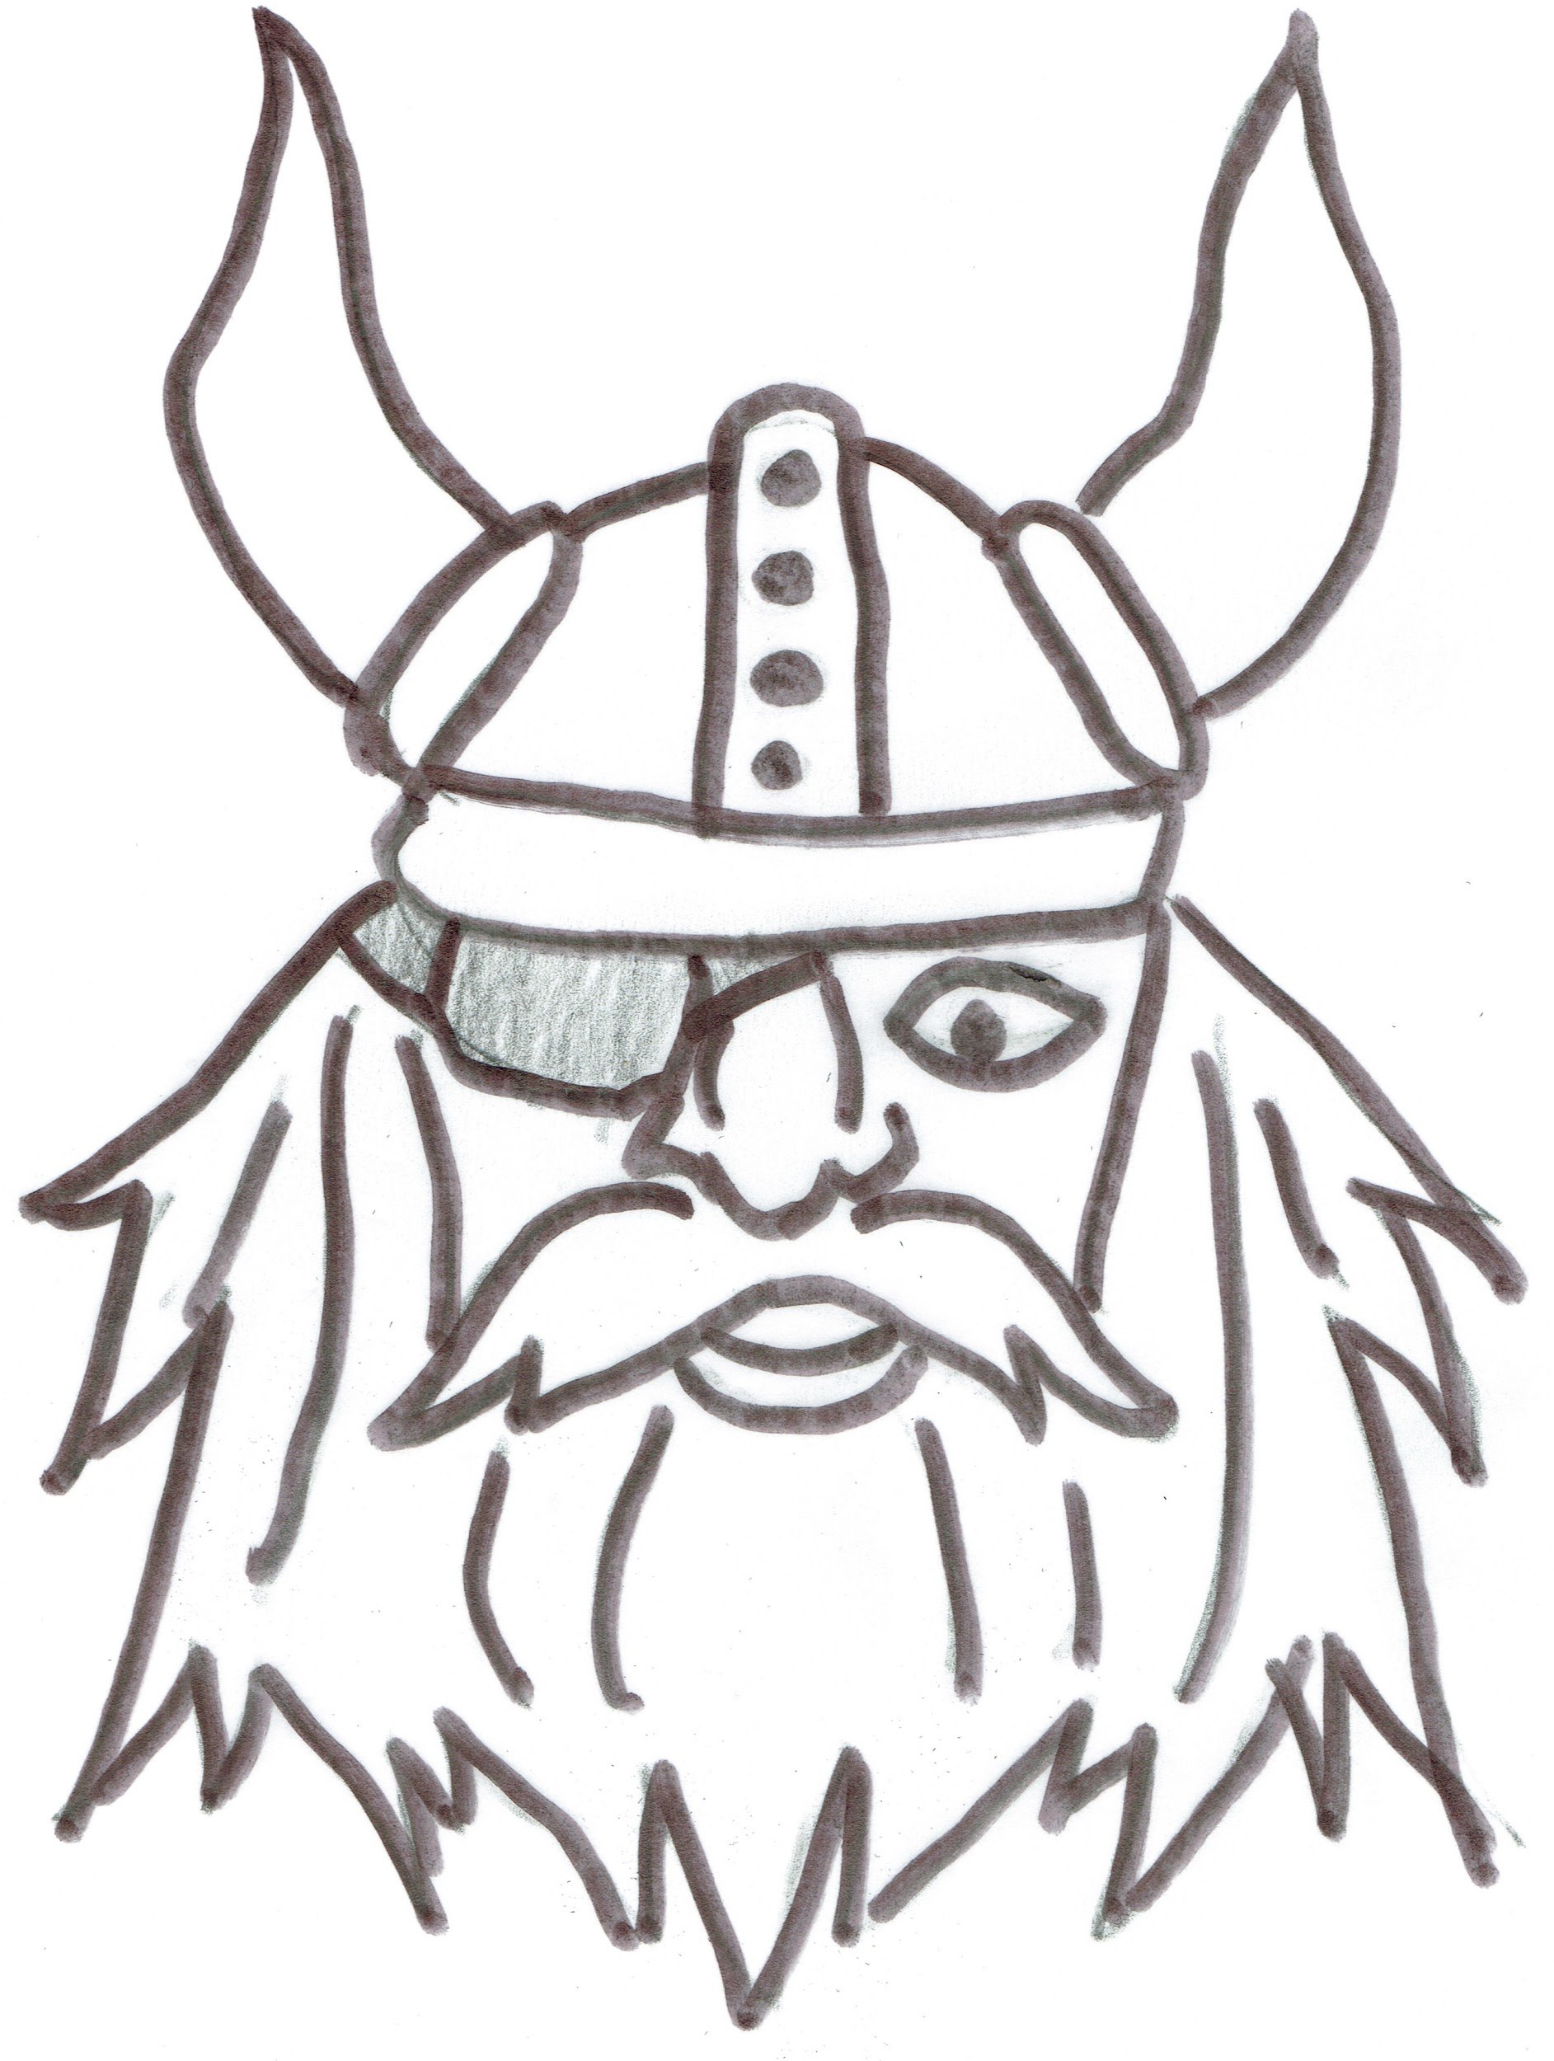
Lantana Viking’s Vision:
To increase student performance and achievement through test taking strategies using a school-wide common language.

Slide 4
What Students Learn...
How to actively attack taking a test in order to earn as many points as possible
How to talk to themselves to promote a healthy positive attitude about taking a test
How to feel confident when taking a test by knowing “HOW” to take a test

Slide 6
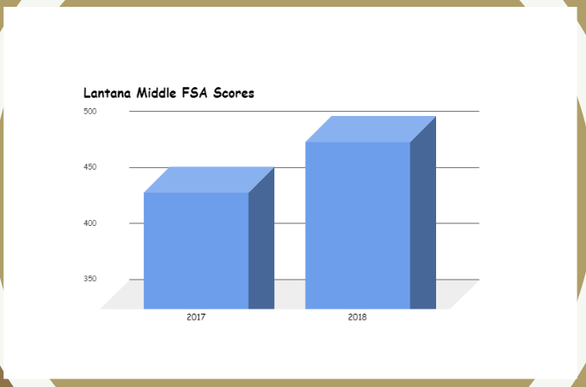

Slide 7
P
I
R
A
T
E
S
Prepare to succeed (PASS)
Inspect instructions (RUN)
Read, Remember, Reduce (/)
Answer or Abandon (.)
Turn Back
Estimate (ACE)
Survey

Slide 8
P
A
S
S
Put your name and pirates on the test.
Allot time and order sections
Say affirmations
Start within 2 minutes

Slide 9
R
U
N
Read instructions carefully
Underline what to do and where to respond
Notice special requirements

Slide 10
When students don’t know the answer
A
C
e
Avoid Absolutes (always, never)
Choose the longest, most detailed answer
Eliminate similar choices

Slide 11
What PIRATES Means...

Slide 12
Pass and run to ace the test

