Slide 1
MANEUVERING THE MICRO-CREDENTIALING PROCESS FOR LS AND CE
FACILITATORS: JOLENE AHLSCHWEDE
DEBI RICE
SEAN STRICKLAND

Slide 2
Essential Questions
What is meant by micro-credentialing?
What is the process to micro-credential?
What services can be performed with a micro-credential?
What is the difference between a certified professional developer and a specialist micro-credential?
What is the Content Literacy Leadership Institute (CLLI)?

Slide 3
https://www.powtoon.com/online-presentation/bfNoGDEiy2v/why-micro-credentials/?mode=movie#/

Slide 4
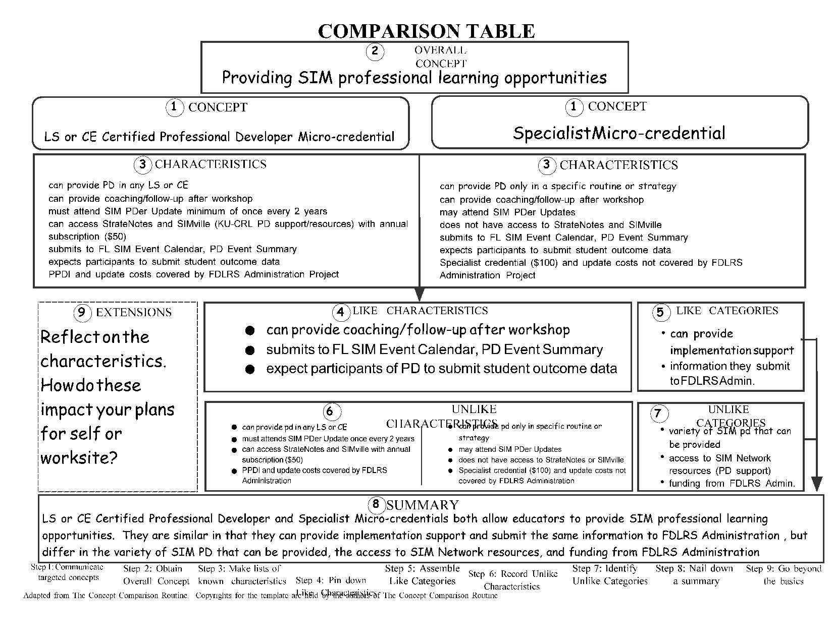

Slide 5
SIM PROFESSIONAL LEARNING
MICRO-CREDENTIALS, COMMONLY KNOWN AS BADGES, RECOGNIZES YOUR INVESTMENT IN PROFESSIONAL LEARNING AND YOUR DEDICATION TO GIVING STUDENTS EVIDENCE-BASED INTERVENTIONS AND TOOLS THAT CAN MAKE A DIFFERENCE IN THEIR LIVES.
UK-CRL

Slide 6
FIVE LEVELS FOR MICRO-CREDENTIALING
Professional Learning Credential
Fidelity of Implementation Credential
SIM Specialist Credential
SIM Professional Developer Credential
SIM Professional Developer Leader Credential

Slide 7
LINKS TO MICRO-CREDENTIAL INFORMATION
BADGELIST (WHERE POTENTIAL SPECIALISTS JOIN AND ENTER DATA IN THE BADGES)
CONTENT ENHANCEMENT: HTTPS://WWW.BADGELIST.COM/SIM-CONTENT-ENHANCEMENT
LEARNING STRATEGIES: HTTPS://WWW.BADGELIST.COM/SIM-LEARNING-STRATEGIES

Slide 8
LEVEL 1: PROFESSIONAL LEARNING
Recipient has: • Participated in a professional learning session to learn how to teach a SIM Learning Strategy (LS) or teach with a Content Enhancement Routine (CER). - Approved by the SIM Professional Developer or Specialist who led the workshop or session - Credential cost: $10 + any workshop/session costs

Slide 9
LEVEL 2: FIDELITY OF IMPLEMENTATION
Recipient has:
Instructed students with fidelity,
Created a portfolio to demonstrate impact and proficient implementation,
Created a narrative log about implementation, and
Recorded a video that demonstrates key behaviors for self-reflection and coaching. - Approved by SIM Professional Developer or Specialist
Credential cost: $40 + coaching fees

Slide 10
LEVEL 3: SIM SPECIALIST
Recipient has: • Demonstrated proficiency in instructing others in the use of a strategy or routine with fidelity,
Guided the new learner to implement the intervention with fidelity. - Approved by SIM Professional Developer or Specialist –
This credential allows the recipient to teach others in one specific LS or CER
Credential cost: $100 + coaching fees

Slide 11
LEVEL 1 – PROFESSIONAL LEARNING CREDENTIAL
Learning Strategies
This credential indicates the recipient has participated in professional learning to learn how to teach a SIM Learning Strategy.
PROVIDE EVIDENCE FOR LEVEL 1: PROFESSIONAL LEARNING (PL)
JOIN THE PL BADGE FOR THE TARGETED LS or CER AND POST EVIDENCE LISTED BELOW:
DATE PROFESSIONAL LEARNING WAS COMPLETED IN THE TARGETED CONTENT ENHANCEMENT ROUTINE or LEARNING STRATEGY & REFLECTION
SIM PROFESSIONAL DEVELOPER(S) WHO LED THE SESSION
COMPLETION

Slide 12
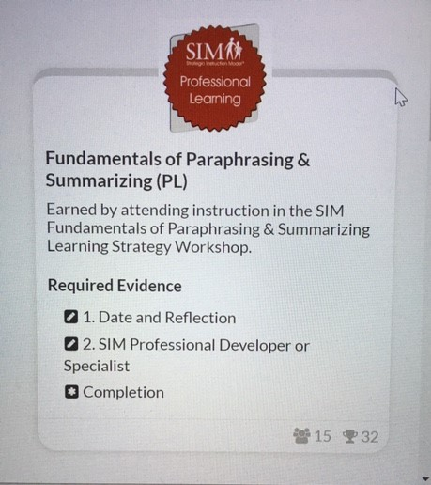

Slide 13
HOW DO I EARN A SPECIALIST MICRO-
CREDENTIAL?
Prerequisites for Specialist Badge (must be completed in order):
1. Choose a Learning Strategy for which you would like to earn the Specialist badge and complete the requirements for the Profession Learning (PL) badge for your chosen LS (directions under #1 below)
2. Complete the requirements for the Fidelity of Implementation (FI) badge for your chosen LS (directions under #2 below)
Earning a Specialist (SP) Badge
3. Complete the requirements for the Level 3: Specialist (SP) badge for your chosen LS (directions under # 3)

Slide 14
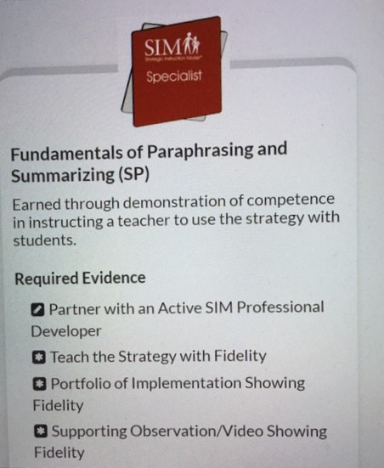
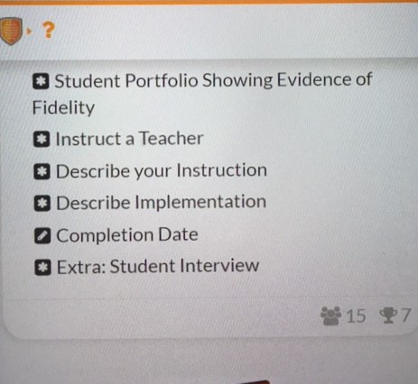

Slide 15
LEVEL 1 – PROFESSIONAL LEARNING CREDENTIAL
Content Enhancement
PROVIDE EVIDENCE FOR LEVEL 1: PROFESSIONAL LEARNING (PL)
JOIN THE PL BADGE FOR THE TARGETED LS or CER AND POST EVIDENCE LISTED BELOW:
DATE PROFESSIONAL LEARNING WAS COMPLETED IN THE TARGETED CONTENT ENHANCEMENT ROUTINE or LEARNING STRATEGY & REFLECTION
SIM PROFESSIONAL DEVELOPER(S) WHO LED THE SESSION
COMPLETION
This credential indicates the recipient has participated in professional learning to learn how to teach a Content Enhancement Routine.

Slide 16
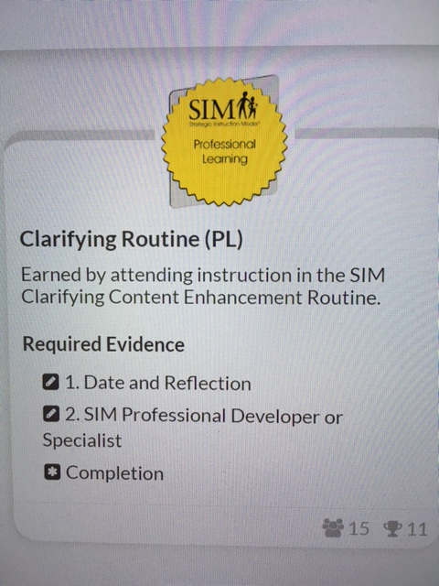
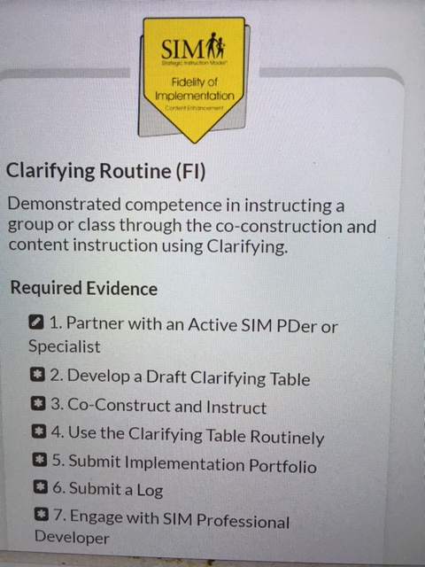

Slide 17
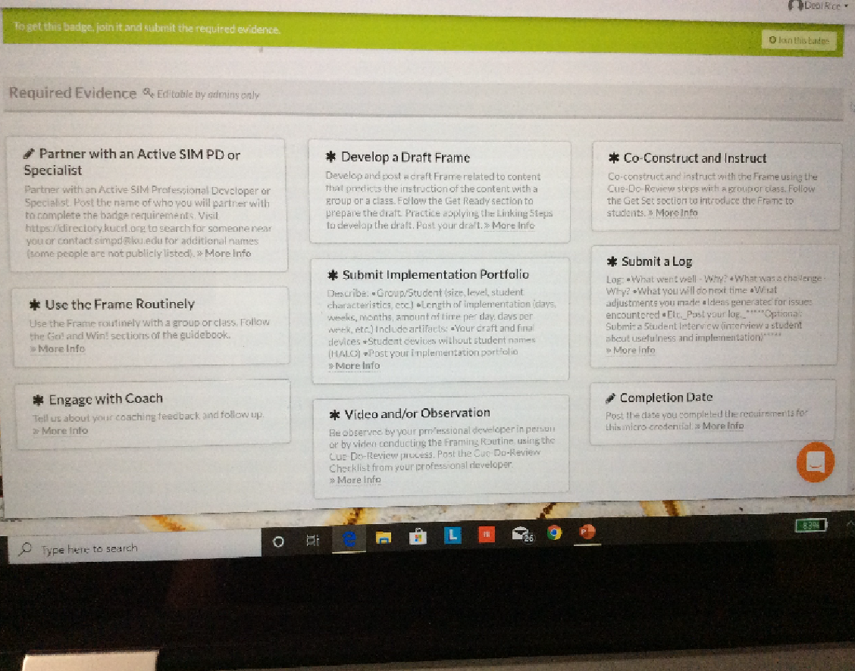
LEVEL 2 - FIDELITY OF IMPLEMENTATION

Slide 18
HOW DO I EARN A SPECIALIST MICRO-
CREDENTIAL?
Prerequisites for Specialist Badge (must be completed in order):
1. Choose a Content Enhancement Routine for which you would like to earn the Specialist badge and complete the requirements for the Profession Learning (PL) badge for your chosen CER (directions under #1 below)
2. Complete the requirements for the Fidelity of Implementation (FI) badge for your chosen CER (directions under #2 below)
Earning a Specialist (SP) Badge
3. Complete the requirements for the Level 3: Specialist (SP) badge for your chosen CER (directions under # 3)

Slide 19
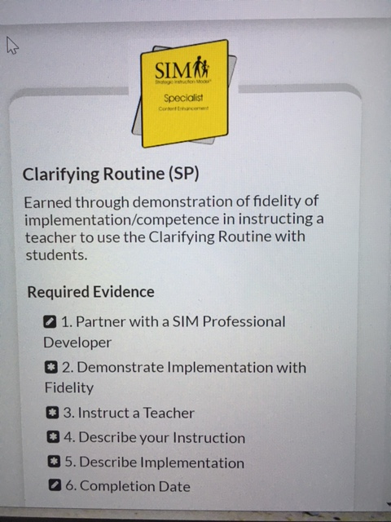

Slide 20
Let’s Review

Slide 21
Level 1 – Professional Learning
Required Evidence for either a Learning Strategy or Content Enhancement Routine:
Attend instruction in a SIM Learning Strategy or Content Enhancement Routine
Time & date
SIM Professional Developer or Specialist
Completion

Slide 22
LEVEL 2-FIDELITY OF IMPLEMENTATION CREDENTIAL
LEARNING STRATEGIES
PROVIDE EVIDENCE FOR LEVEL 2: FIDELITY OF IMPLEMENTATION (FI) (EVIDENCE FROM PREVIOUS IMPLEMENTATION WITH STUDENTS MAY BE USED)
ENGAGE WITH A SIM PROFESSIONAL DEVELOPER
TEACH THE STRATEGY
SUBMIT AN IMPLEMENTATION PORTFOLIO
SUBMIT SUPPORTING OBSERVATION AND/OR VIDEO
SUBMIT A STUDENT PORTFOLIO
COMPLETION DATE
CONTENT ENHANCEMENT ROUTINE
PROVIDE EVIDENCE FOR LEVEL 2: FIDELITY OF IMPLEMENTATION (FI) (EVIDENCE FROM PREVIOUS IMPLEMENTATION WITH STUDENTS MAY BE USED)
ENGAGE WITH A SIM PROFESSIONAL DEVELOPER
DEVELOP A DRAFT DEVICE
CO-CONSTRUCT & INSTRUCT
USE THE SELECTED CER ROUTINELY
SUBMIT AN IMPLEMENTATION PORTFOLIO
SUBMIT A LOG OF YOUR IMPLEMENTATION EXPERIENCES
COMPLETION DATE

Slide 23
LEVEL 3: SIM SPECIALIST CREDENTIAL
Required Evidence for Learning Strategy
1. Partner with a SIM Professional Developer
2. Teach the Strategy with Fidelity
3. Portfolio of Implementation Showing Fidelity
4. Supporting Observation/Video Showing Fidelity
5. Student Portfolio Showing Evidence of Fidelity
6. Instruct a Teacher
7. Describe your Instruction
8. Describe your Implementation
9. Completion Date
Extra: Student Interview
Required Evidence for Content Enhancement
1. Partner with a SIM Professional Developer
2. Demonstrate Implementation with Fidelity
3. Instruct a Teacher
4. Describe your Instruction
5. Describe Implementation
6. Completion Date

Slide 24
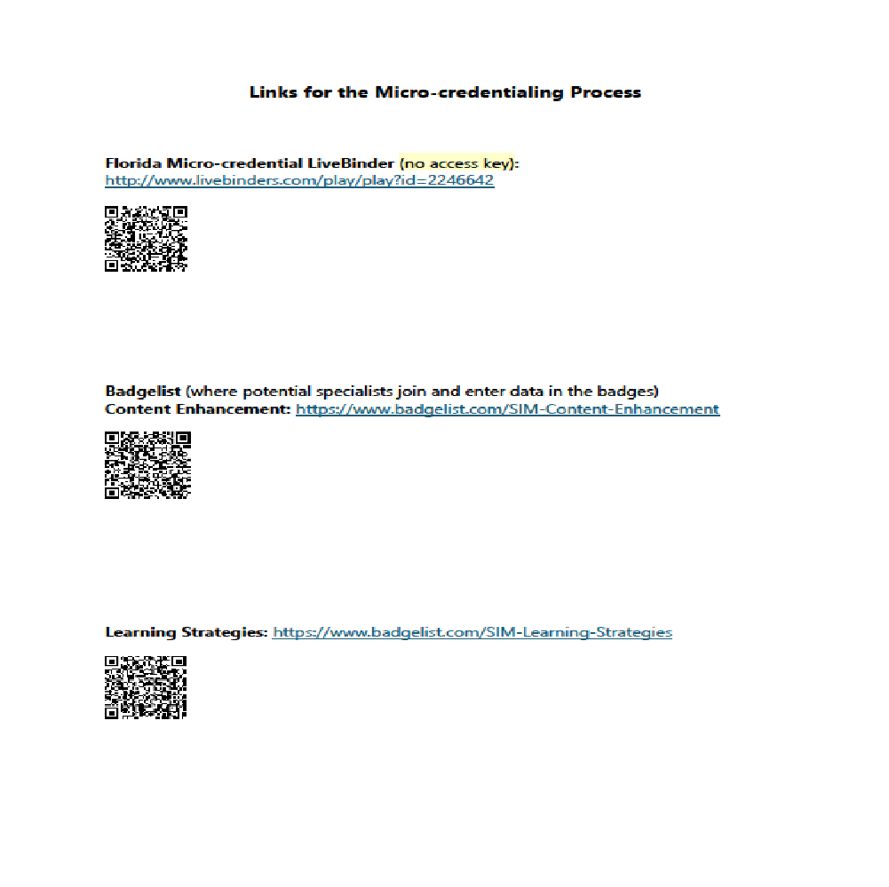
LINKS FOR BADGING

Slide 25
COST
A Specialist badge is $100. If a person chooses to get the Fidelity badge first, that is an additional $40. The Fidelity & Specialist badges can be together for the fee of $100.

Slide 27
Time to Explore
You have 15 minutes to explore the Badgelist
Website. You can:
Create an account
Log in to your existing account
Explore a Badge you may be interested in earning
Explore a new Badge
Look at evidence that has been submitted by others

Slide 28
Debrief
What new knowledge or frustrations did you gain from this experience?
What new questions do you have?

Slide 29
Important PPDI Change
PPDI has now been changed to Content Literacy Leadership Institute (CLLI)
This Photo by Unknown Author is licensed under CC BY-NC

Slide 30
LEVEL 4: PROFESSIONAL DEVELOPER
Recipient has: • Fulfilled all SIM Professional Developer criteria set forth by KUCRL. - This credential allows the recipient to teach others in any LS or CER (depending upon credential) and access to other network benefits
Credential cost: Yearly StrateWorks fee + CLLI Session Cost

Slide 31
LEVEL 5: PROFESSIONAL DEVELOPMENT LEADER
Recipient is: • Credentialed in both Learning Strategies and Content Enhancement Routines, is active and current within the SIM Network, and has met all other requirements set forth by KUCRL. –
Credential cost: Yearly StrateWorks fee

Slide 32
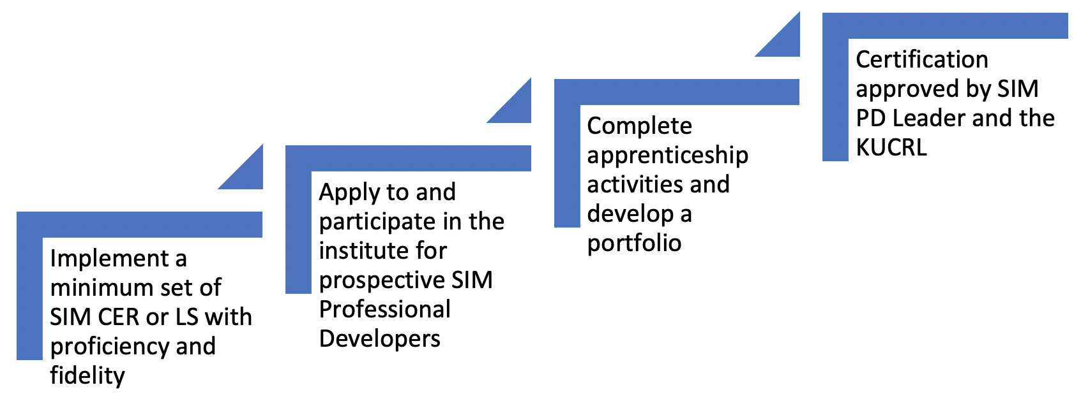
Certification Process for Prospective Strategic Instruction Model (SIM) Professional Developers

Slide 33
Important Dates
Q & A session: Generally in February (sign up to attend)
Intent to Apply Due: March
Application Due: Beginning of April
Notification of Acceptance: Mid-April
Institute Dates: Five 3-hour online synchronous sessions June – October
(3-hours of asynchronous pre-work per live sessions will be required)
Cost: $995

Slide 34
General Overview of Learning Strategies(LS) Application Requirements
1. SIM LS Implementation Experience
Participate actively in professional development of a minimum of 2 Learning Strategies through Generalization (preferably from 2 of 4 strands, Reading, Writing, Studying, Performance)
Implement a minimum of 2 Learning Strategies
Demonstrate proficiency and/or competency with Learning Strategies as verified by a certified SIM Professional Developer

Slide 35
General Overview of Learning Strategies(LS) Application Requirements (cont.)
2. Student Portfolios
Share two student work samples from Controlled Practice, Advanced Practice, Generalization (8-stage) or Learn-by Approach (lesson-based LS)
Learning Strategy 1: _____________________
Learning Strategy 2: _____________________
3. Classroom video recording and checklist conducting Model Stage with students
4. Letters of Support, one from current employer or administrator and one from certified SIM Professional Developer.
5. Application Questions – Download questions

Slide 36
General Overview of Content Enhancement Routines (CER) Application Requirements
1. SIM CER Implementation Experience
Participate actively in professional development of a minimum of 3 Content Enhancement Routines (preferably from 3 of 5 strands, Planning & Leading, Higher Order Reasoning, Concepts, Explaining, and Increasing Performance)
Implement a minimum of 3 Content Enhancement Routines (if one is not a Planning Routine, pre-work will be required prior to attendance)
Implement the CE routines throughout the year to demonstrate proficiency and/or competency as verified by a certified SIM Professional Developer

Slide 37
General Overview of Content Enhancement Routines (CER) Application Requirements (cont.)
2. Compile a Portfolio including:
Evidence of 3 CERs of your choice constructed and used with students in a classroom.
CER #1 _______________________ Be sure to include your draft and samples from 2 students
CER #2 _______________________ Be sure to include your draft and samples from 2 students
CER #3 _______________________ Be sure to include your draft and samples from 2 students
Evidence explaining implementation, such as a course syllabus, journal, or letter that, with the devices, show course-wide implementation of EC Routines

Slide 38
General Overview of Content Enhancement Routines (CER) Application Requirements (cont.)
3. Classroom video recording and checklist – one classroom video and checklist of yourself conducting the Cue-Do-Review Instructional steps.
4. Letters of Support, one from current employer or administrator and one from certified SIM Professional Developer.
5. Application Questions – Download questions

Slide 39
For More Specific Information…
https://sim.ku.edu/clli-content-literacy-leadership-institute

Slide 40
Essential Questions
What is meant by micro-credentialing?
What is the process to micro-credential?
What services can be performed with a micro-credential?
What is the difference between a certified professional developer and a specialist micro-credential?
What is the Content Literacy Leadership Institute (CLLI)?

Slide 41
Ques

