Slide 1
Digital Credentials for Teacher Professional Development
Notes:
I’m going to start by introducing you to the SIM badges, both for the event and for PD, and then give you a walkthrough on how to build badges for your own students.

Slide 2
Digital Open Badges – The new Standard in Credentialing
Notes:
The new standard for digital credentialing has been developed by Mozilla and has now been spun off into a new organization called the Badge Alliance. The Open Badges standard means that each badge contains important metadata so that it can be properly verified including the name of the issue or issuing organization, the earner, the date it was issued, the evidence required to earn it and an expiration date if relevant.

Slide 3
Open Badges are Digital Micro Credentials
http://www.badgelist.com/sim-events

Slide 4
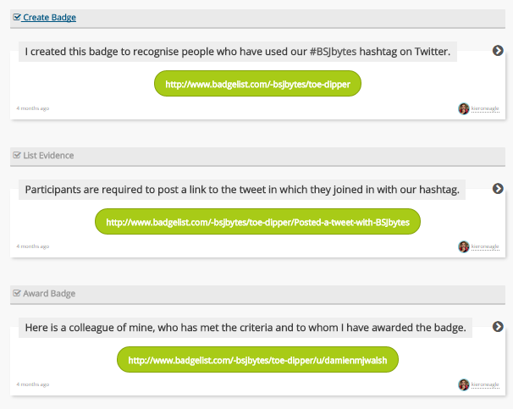
Evidence-Based Credentials
Notes:
The core meaning of any badge is the evidence offered in order to earn it. In Badge List, each badge contains a required evidence list that tells the earner what they need to do to complete it. When the earner submits their evidence, the issuing organization checks to make sure it is complete and then issues the badges. That evidence is now stored with the badge so that it can be viewed by anyone who wants to understand what, exactly that badge means.

Slide 5
Badges for Teacher PD
Notes:
SIM has created an array of badges for each one of its professional development units. You can join the badge, read the instructions in the overview, and then start submitting the evidence to earn the badge all inside of Badge List.

Slide 6
SIM/KUCRL and Badge List
Notes:
You can join any or all the of these groups, get connected with a PD leader, and start earning your badges today.

Slide 7
SIM Badges and You!
http://www.badgelist.com/sim-learning-strategies

Slide 8
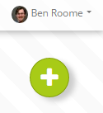
Using Badge List in Your Classroom

Slide 9
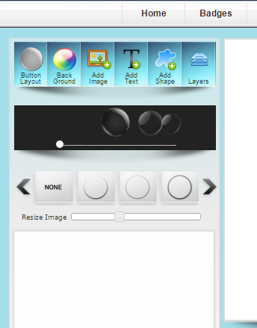
Creating Great Badges
http://www.onlinebadgemaker.com/

Slide 10
Evidence is the key!

Slide 11
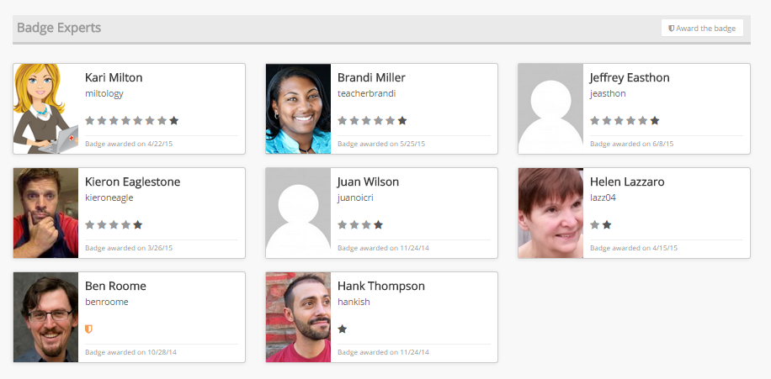
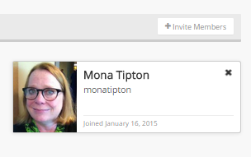
Invite, Guide and Award

Slide 12
Need help? I’m here!
@benjaroome
@badgelist
ben@badgelist.com

Slide 13
Start earning and building your badges today!
http://www.badgelist.com/sim-events

