Slide 1
Step One to Installing SIM in Your School: A SIM Overview
July 13-15, 2021
Jocelyn Washburn, Ph.D.
Director of Professional Development
University of Kansas Center for Research on Learning

Slide 2
Session Objectives
Gain an overview of SIM instructional tools and interventions
Consider the components and features of comprehensive, adaptive, and collaborative professional learning to support SIM implementation
Engage in dialogue about how SIM assists educators meet their school and classroom goals

Slide 3
Course Map
This Course:
Installing SIM
includes
Community
Principles
Learning Rituals
Performance
Options
Equality
Voice
Choice
Reflection
Dialogue
Praxis
Reciprocity
(Knight, 2007)
Have a place to record your thoughts
SIM Overview Nearpod with links to resources
Unmute to share
Ask questions and participate in chat
Get ready to converse in breakout rooms
Use chat or unmute to participate
Watch the recording
Contact us with additional questions
Explore the SIM Overview Nearpod again!
Critical Concepts
Learned in these
Units
Notes:
Put webquest link in Chat: https://sites.google.com/view/2021sim-webquest/home

Slide 4
Who is here and what brought you?
Please share:
Your name
Your position
Your location
What you hope to learn during this session

Slide 5
What are helpful actions to take before selecting SIM, in general?
How can a SIM Professional Developer help you in selecting specific SIM instructional tools and interventions?
What tools, resources, and methods help school decision-makers and teachers evidence-based selections?

Slide 6
Research says…
The translation of research to practice is even more complex than developing evidence-based practices.
Bryk, 2015
Dolle, Gomez, Russell, & Bryk, 2013
Supovitz & Weinbaum, 2008
Notes:
Specifically, Bryk (2015) asserted there is a growing gap between “what works” in improving student outcomes and the ability of educators to implement those practices effectively.

Slide 7
Partner with a SIM Professional Developer

Slide 8
SIM Exploration Planning Questions
Discuss goals
Analyze student learning needs
Identify characteristics of community, school, department, staff
Notes:
https://drive.google.com/file/d/1OI-GyIvoAXVANGOzGnjMeBvHpIz3d_3c/view?usp=sharing

Slide 9
If the teacher is the mediator to reach students, what are required supports for the teacher?
teacher
“If you have more than three priorities, you have no priorities.”
Brené Brown

Slide 10
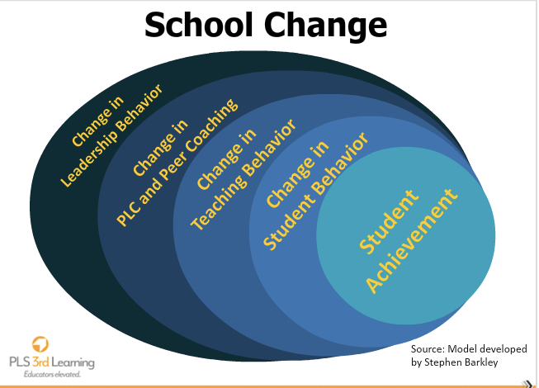

Slide 11
Professional Learning that leads to change!
 | Expected Outcomes
Training Components | Change in Knowledge | Change in Skills | Application to fidelity
Lecture/ Presentations Study of Theory | 10% | 5% | 0%
Demonstrations | 30% | 10% | 0%
Practice (and low risk feedback) | 60% | 60% | 5%
+ Coaching + Admin feedback +Study Teams/Peer Visits | 95% | 95% | 95%
Joyce & Showers, 2002

Slide 13
Steps 2+ Preview
Infrastructure
Alignment and interaction
On-site professional learning lead
Implementation plan
Acquire needed resources
Professional Learning Plan
Determine system to monitor progress

Slide 14
If I were new to SIM, which conference sessions would I attend?
TODAY
2:45-4:00 pm Using Literacy Leadership Teams as a Driving Force During Times of Change
TOMORROW
10:30-11:45 Either the Xtreme Reading or Content Enhancement Routine Session
12:30-2:00 Either the Exploring HOTRR or DVT Session
2:15-3:45 Either the Math or STEM with CORGI Session

Slide 15
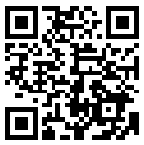
July 13-15, 2021
Don’t forget to complete a session evaluation!
https://www.surveymonkey.com/r/2021SIMposiumEvals
Notes:
https://www.surveymonkey.com/r/2021SIMposiumEvals

