Slide 1
Proficiency in the Theme Writing Strategy:
Informative Writing
By Jean Bragg Schumaker

Slide 2
Types of Writing
Informative Writing
Narrative Writing
Persuasive/Argumentative Writing

Slide 3
Informative Writing
Involves writing about facts
Utilizes the Main idea/Detail Structure
Requires references and in-text citations

Slide 4
Examples of Informative Writing
Straight factual essay
Definitional essay
Character analysis
Theme Analysis

Slide 5
Within all of these types
Compare or Contrast Essays
Causes or Effects Essays

Slide 6
They are all research papers!
(Students have to do research to write them.)

Slide 7
Informative Writing
Note: Research papers can be
about literature!
(Students have to do research to find quotations and information about which to write.)

Slide 8
Informative Writing
Studying a novel deeply,
finding information within it,
and taking notes about it = research.

Slide 9
Argumentative Writing
Involves stating a claim
Involves the discussion of reasons
Involves the presentation of evidence
Utilizes the Main Idea/Detail Structure
Requires references and in-text citations

Slide 10
Examples of Argumentative Writing
Position paper
Think piece
Editorial
Letter written to convince

Slide 11
Narrative Writing
Involves the telling of a story
Focuses on a sequence of events
Utilizes the Sequential Structure
(One event occurs before another)
• Can involve research

Slide 12
Examples of Narrative Writing
Fictional Story
Nonfictional Story/Journalistic Story
Biography
Autobiography
Memoir

Slide 13
Text-Type Exercise
Choose the text type for each title.

Slide 14
Informative Writing
Writing about facts and information that exists
Also called Expository Writing

Slide 15
Prerequisites
The Sentence Writing Strategy
The Paragraph Writing Strategy
Basic Paragraph Parts
Facts Paragraphs
Fundamentals in the Theme Writing Strategy

Slide 16
Prerequisites
During Fundamentals in Theme Writing instruction cover:
The basic parts of a theme
Some Introductory and Concluding Options
The Lead-off/Follow-up Structure
Additional Introductory and Concluding Options and other structures can be covered during Proficiency in the Theme Writing Strategy instruction.

Slide 17
Purpose of Informative Writing
To inform or teach the reader
about something based on research

Slide 18
Lessons
Lesson 1: Review
Lesson 2: Short multi-paragraph Research Essays
Lesson 3: Compare OR Contrast Essays
Lesson 4: Causes OR Effects Essays
Lesson 5: Long Research Essays with sections

Slide 19
Match-ups with
Common Core Standards
Text-type Standards for Informative Writing:
Grade 4: Multiple paragraphs, formatting, & quotations
Grade 6: Compare/Contrast; Cause/Effect
(See Handout)

Slide 20
Lesson 1

Slide 21
Lesson 1
Review of the following:
The TOWER Steps
The Introductory Paragraph
The Detail Paragraphs
The Concluding Paragraph

Slide 22
Lesson 2

Slide 23
Purpose of Lesson 2
To ensure mastery of:
Writing short, multi-paragraph research papers
Creating note cards
Organizing factual information
Using in-text citations
Creating reference lists
Using quotations in text

Slide 24
Describe Stage

Slide 25
Start With Defining
Expository Writing
Informative Writing
To inform = To teach

Slide 26
Review
• Parts of a theme
• Types of paragraphs in a theme
• The TOWER Diagram

Slide 27
Parts of a Theme
Title
Introduction
Introductory Paragraph
Body
Detail Paragraphs
Conclusion
Concluding Paragraph

Slide 28
Review
Parts of a theme
Types of paragraphs in a theme
The TOWER Diagram

Slide 29
Introductory Paragraph
Topic Sentence
Background Sentences
(or Introductory Option)
Thesis Statement

Slide 30
Detail Paragraphs
Topic/Transition Sentence
Pairs or groups of Lead-off and Follow-up Sentences

Slide 31
Concluding Paragraph
Concluding Transition Sentence
Detail Sentences (Concluding Option)
Clincher Sentence

Slide 32
Review (cont.)
Parts of a theme
Types of paragraphs in a theme
The TOWER Diagram

Slide 33
Insert the TOWER Diagram in here

Slide 34
Using Reference Materials
Explain what reference materials are available
Explain how to access them

Slide 35
Making Note Cards
Paper note cards
Digital note cards
(Discuss hardware and software available)

Slide 36
Example Software
Noodle Tools www.noodletools.com
Easy Bib www.easybib.com
ColorNotes www.colornotes.com
Evernote www.evernote.com
Supernotecard www.supernotecard.com

Slide 37
Making Note Cards
On the front of the card:
Write the fact
Write a number on the card

Slide 38
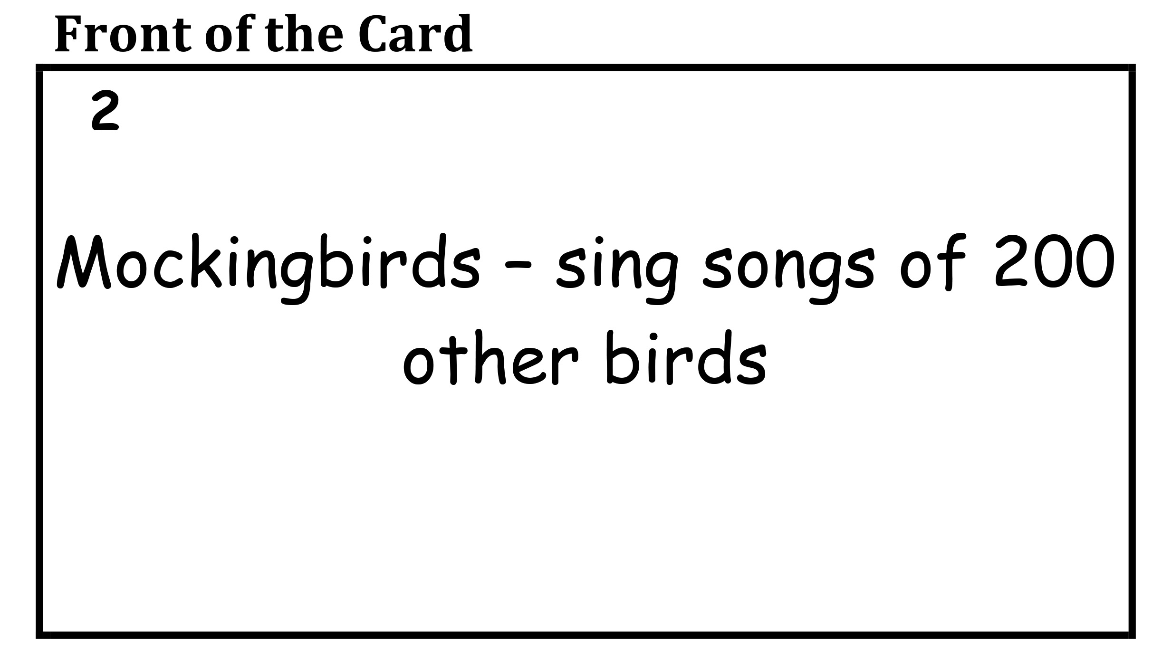
Add example front of a note card here.

Slide 39
Making Note Cards
On the back of the card:
Write the reference or note about the reference
Write a number for the reference number on the reference list
Write the page number where the fact was found

Slide 40
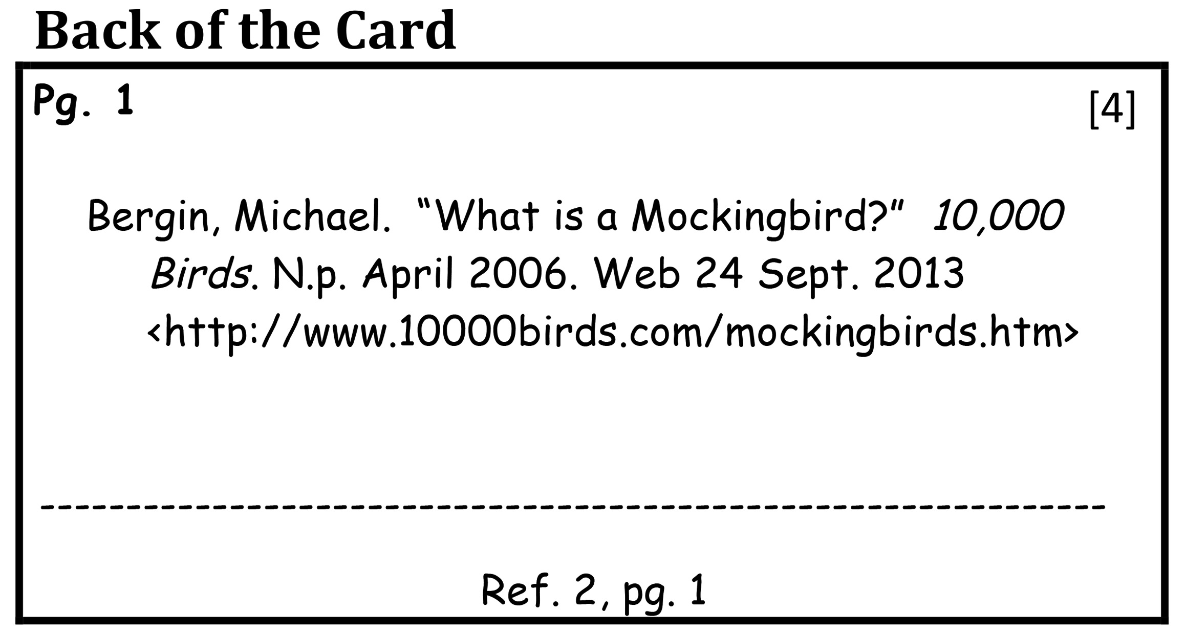
Add example back of a card here

Slide 41
Sorting Note Cards
Make piles or groups of facts
Give each pile a name
These names are potential subtopics
Color code the cards in a pile

Slide 42
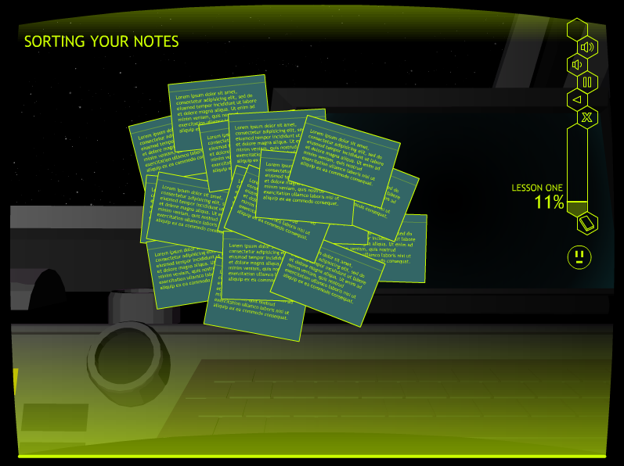
Matt: please put in here at least two slides showing
1. the note cards back and front
2. the sorted cards
These are slides from maybe rows 6 & 7?

Slide 43
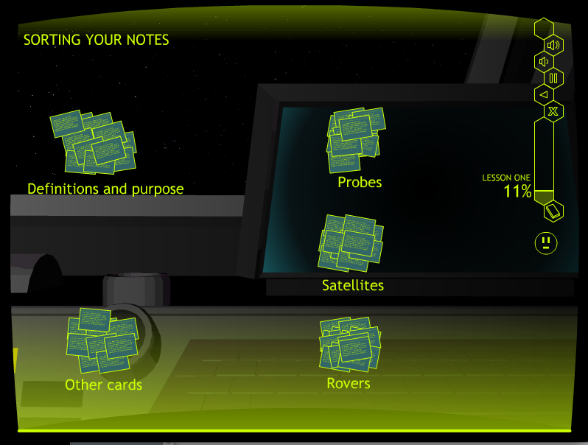
Matt: please put in here at least two slides showing
1. the note cards back and front
2. the sorted cards
These are slides from maybe rows 6 & 7?

Slide 44
Making a Reference List
Make a reference list while making cards
Use the style approved by the school district
Refer to a handout about the style

Slide 45
Example References
MLA Style
Lee, Harper. To Kill a Mockingbird. New York: Grand Central Publishing, 1960. Print.
• APA Style
Lee, H. (1960). To kill a mockingbird. New York: Grand Central Publishing.

Slide 46
Using In-Text Citations
Use after a very specific fact, usually containing numbers or a date.
Mockingbirds are actually harmless medium-sized birds about 10 inches long (Harris, 2006). [APA] OR (Harris 1) [MLA]
Use after a quotation
Scout replies, “Yes, sir, I understand…. It’d be sort of like shootin’ a mockingbird, wouldn’t it?” (Lee, 1960, p. 370) [APA] Or (Lee 370) [MLA]

Slide 47
In-text Citations [MLA]
Harper Lee’s reference to mockingbirds begins with the startling title of her book, To Kill a Mockingbird. Of course, the reader is immediately prompted to wonder why anyone would want to kill a mockingbird. Mockingbirds are actually harmless, medium-sized birds about 10 inches long (Alderfer 1). Their 17 species can be found in North and South America (“Mockingbird” 1). They were given their name because they “mock” or imitate other birds’ songs. Bergin reported that a single mockingbird can sing the songs of as many as 200 other species of birds and even some insects (Bergin 1). Usually, they repeat another bird’s song two or three times before switching to another bird’s song (Bergin 1). They can sing a whole string of other birds’ songs, and thus they are known for their continuous singing. Interestingly, Harper Lee refers to mockingbirds at several points in her novel to communicate one of the main messages of her work.

Slide 48
Block Quotations -
More than 4 lines[MLA]
One of the effects of pesticides is that the numbers of birds are decreasing. One reason for this decrease is that fewer birds are hatching. Phillips reported: In 1999, data collected by the Birdhouse Network showed an unusually high number of unhatched eggs among cavity-nesting birds. At least one egg failed to hatch in more than 20 percent of nests belonging to 7 of the 10 most common cavity-nesting birds, excluding House Sparrows. (1)

Slide 49
Quotations in text-
Less than 4 lines [MLA]
One of the effects of pesticides is that the numbers of birds are decreasing. One reason for this decrease is that fewer birds are hatching. In 1999, members of The Birdhouse Network carefully counted the number of eggs in nests and then the number that hatched. They found that “At least one egg failed to hatch in more than 20 percent of nests belonging to 7 of the 10 most common cavity-nesting birds, excluding House Sparrows.” (Phillips 1)

Slide 50
Signal Words
Words that:
Introduce a quotation
Create a graceful flow between the text and the quotation

Slide 51
Example Signal Words
Conclude
State
Reply
Say
Tell
Ask
Warn
Implore
Report

Slide 52
Using Signal Words
Signal words for text:
Frederick reported that, “…”
The researchers concluded that, “…”
They determined that, “…”
• Signal words for dialogue:
When Atticus found out, he said, “…..”
Then Jem replied, “….”

Slide 53
Model Stage

Slide 54
Model Stage
For example themes and diagrams, go to www.edgeenterprisesinc.com/files/Informative_Writing_files.zip
Or purchase the CD
Choose an example essay and diagram
Print them out
Display them to the students

Slide 55
On the Website or CD
After downloading the files:
• Click on the “Teacher Materials” folder
• Click on the “Example Themes & Diagrams” folder
• Click on the “Lesson 2” folder
• Choose the theme & diagram and print them
Note: Two styles are available: MLA & APA in Word or pdr

Slide 56
Other Alternatives
Display a theme written by you or a student
Demonstrate planning and writing a theme

Slide 57
Example Diagram & Theme

Slide 59
Example Introductory Paragraph
Do No Harm Harper Lee’s reference to mockingbirds begins with the startling title of her book, To Kill a Mockingbird (Lee 1960). Of course, the reader is prompted to wonder why anyone would want to kill a mockingbird. Mockingbirds are actually harmless, medium-sized birds about 10 inches long (Alderfer 1). Their 17 species can be found in North and South America (“Mockingbird” 1). They were given their name because they “mock” or imitate other birds’ songs. Bergin reported that a single mockingbird can sing the songs of as many as 200 other species of birds and even some insects ( Bergin 1). Usually, they repeat another bird’s song two or three times before switching to another bird’s song (Bergin 1). They can sing a whole string of other birds’ songs, and thus they are known for their continuous singing. Interestingly, Harper Lee refers to mockingbirds at several points in her novel about prejudice to communicate one of the main messages of her novel.

Slide 60
Example Detail Paragraph
At the end of the novel, Harper Lee refers once more to the metaphor of the mockingbird. At this point in the novel, Scout and Jem are walking home from the Halloween party together. The night is dark, and they do not have a flashlight. Scout still has on her Halloween costume, and she and Jem cannot see much. Nevertheless, the children hear someone following them. After a few minutes of being followed, they are attacked by someone. Jem is knocked unconscious and his arm is broken. Scout is thrown to the ground in her costume. Suddenly, someone else comes along and saves them by killing the attacker. Scout does not know what happened because she was blinded by her costume, but the sheriff and Atticus reason through what happened. They conclude that Boo Radley, their reclusive neighbor, came out of his house to save the children. They decide not to arrest him and put him on trial for murder although they predict that he would be acquitted for saving the children. Atticus asks Scout whether she understands why they have made that decision. Scout says, “Yes, sir, I understand…. It’d be sort of like shootin’ a mockingbird, wouldn’t it?” (Lee 370)

Slide 61
Example Concluding Paragraph
In the end then, through the use of the mockingbird metaphor, Harper Lee teaches the lesson that people should not harm innocent creatures who do no harm themselves. Mockingbirds are innocent creatures who only make our lives more beautiful by singing lovely songs. They should not be harmed. People like Tom Robinson, the crippled man in the novel who is innocent of the crime with which he is charged, should not be found guilty and sentenced to death. Likewise, people like Boo Radley, the reclusive man who saved the children from vengeful Bob Ewell who was trying to kill them, should not be put on public trial for murder and paraded around for all the world to see. In the most general sense, Harper Lee used the metaphor of the mockingbird to teach the concept of “Do no harm” but takes it a step further to be “Do no harm to those who do no harm.” The metaphor pushes people to carefully consider the possible innocent nature of those around them who might be criticized or punished.

Slide 62
Other Example Essays
Atticus Finch: A Civilized Man
The Guggenheim
Robotic Spacecraft

Slide 64
Atticus Finch Essay
Atticus Finch: A Civilized Man (MLA Style) Atticus Finch is the intriguing protagonist in Harper Lee’s novel, To Kill a Mockingbird. At first, he appears to be a “Casper Milquetoast” kind of guy. He is a middle-aged widower who lives in a fictional Alabama town during the Depression in the 1930s (Lee 274). He has two children, including his son, Jem, and his daughter, Scout. They live in a house with their African American maid, Calpurnia. He is an attorney who walks to his office in the courthouse on the town green each morning and walks home each evening. In fact, Scout thinks he’s pretty unremarkable. She reports that, “Our father didn’t do anything. He worked in an office, not in a drugstore. Atticus did not drive a dump-truck for the county, he was not the sheriff, he did not farm, work in a garage, or do anything that could possibly arouse the admiration of anyone” (Lee 118). In reality, though, Atticus turns out to be a remarkable person because of the ways he treats people as a father, a neighbor, and a citizen.

Slide 66
Spacecraft Essay
Robotic Spacecraft: Can They Do Everything People Can Do? Robotic space vehicles are some of today’s most valuable explorers of the Universe. By way of definition, these spacecraft are ships that travel through space without a live pilot on board. Because no humans are on board, they can go places that are dangerous to people, and they can travel for years without ever returning to base. As a result, they can do several jobs that are helpful to people. These jobs allow people to study and explore new worlds from a distance. Three types of robotic space vehicles that have special jobs that they can do as well as people are probes, satellites, and landers which contain rovers.

Slide 67
Insert Guggenheim Diagram here

Slide 68
Guggenheim Essay
Can a Building Be a Work of Art? (MLA) The Guggenheim Museum in New York City was designed for philanthropist and artist Solomon Guggenheim, a prominent art owner who is the founder of many Guggenheim museums located around the world today. When choosing an architect to design the museum, Solomon and his adviser, Hilla von Rebay, decided that because Solomon’s art was a new style of art, it should be seen in a wholly new kind of space. In June 1943, Frank Lloyd Wright received a letter from Rebay asking the architect to design a new building to house Guggenheim's four-year-old Museum of Non-Objective Painting (Drutt 1). Wright was chosen by Solomon not only because he was a prominent architect at the time, but because he was well known for his unusual and unique buildings which had spaces that fit the purpose of the structures. This claim was proved by Wright when he designed one of his best works, which is now widely known as “The Guggenheim.” The location, interior design, and exterior design of the Guggenheim combine to form a beautiful work of art that, combined with the displayed artwork, creates a very pleasing experience for viewers.

Slide 69
Practice and Feedback

Slide 70
Practice Planning
Students make note cards
Teacher checks note cards & feedback
Students revise note cards
Students make TOWER Diagrams
Teacher scores TOWER Diagrams & feedback
Students revise TOWER Diagrams

Slide 71
Practice Writing
Two instructional options:
Students write with prompts from teacher and using checklists
Students use code list, edit, & refine
Teacher scores themes & gives feedback
Students write independently using checklists
Students use code list, edit, & refine
Teacher scores themes & gives feedback

Slide 72
Trouble Shooting
Difficulty with note cards
Difficulty identifying subtopics
Difficulty translating note cards into diagrams
Difficulty writing Follow-up Sentences that expand on Lead-offs

Slide 73
Extensions
Teach students to:
Use different kinds of transitions
Vary the internal structure of paragraphs
Use a variety of Introductory and Concluding Options
Vary vocabulary usage

Slide 74
Discuss Issues
Number of paragraphs
Creativity
Other issues?

Slide 75
The Remaining Lessons
Utilize the same stages
Describe
Model
Practice and Feedback

Slide 76
Lesson 3:
Compare OR Contrast Essays

Slide 77
Part 1: Compare Essays

Slide 78
Describe Stage

Slide 79
Definitions
To Compare
Means to find similarities.
Key words: alike, similar, same
• Compare Essays
Show how two people, places,
things, ideas, or characters are alike

Slide 80
Introduce a New TOWER Diagram
Has a spot for the two items being compared
Has columns for the details for both items
Has “dimensions” instead of “main ideas” or “subtopics”

Slide 83
Introductory Paragraph
The Topic Sentence
Names the items to be compared
The Detail Sentences
Define the items or provide background info
The Thesis Statement
Names the items, the dimensions for
comparison, and the main message of the theme

Slide 84
Example Introductory Paragraph
Two main girl characters in well-known novels, Scout in To Kill a Mockingbird (Lee 1960) and Lily in The Secret Life of Bees (Kidd 2002), have a lot in common. Most notably, they are both white girls growing up in the midst of Segregation. In To Kill a Mockingbird, Scout tells the story of her attorney father’s attempt to defend a black man who has been falsely accused of raping a white woman. She chronicles the events surrounding the man’s trial and the effects of these events on herself, her family, and her neighbors. In The Secret Life of Bees, Lily tells the story of how she comes to live with a black family of three adult sisters on a bee farm. She chronicles the complex relationships that exist among the sisters, their friends, and society. Both novels take place in the South. Lily is growing up in South Carolina; Scout is growing up in Alabama. Although the time frames of the two novels are different, many of the same issues that are related to prejudice against blacks are similar across the novels. The events in To Kill a Mockingbird take place in the Depression during the 1930s, whereas the events in The Secret Life of Bees take place in 1964 at about the same time that the Civil Rights Act was signed by President Johnson. Nevertheless, the two girls are so similar with regard to their general character, their relationships with their nannies, and their curiosity about Black culture that they might be called “Sisters across time.”

Slide 85
Detail Paragraphs
The Topic/Transition Sentence
Includes a transition, the items, and one dimension for comparison (one way the items are being compared)
Each Lead-off Detail Sentence
Introduces one of the related similarities
The Follow-up Detail Sentences
Provide details related to the similarity
Cover both items

Slide 86
Example Detail Paragraph
Probably because of their close relationships with their black nannies, both Scout and Lily are curious about the black culture. Calpurnia takes Scout and Jem to church with her, which is quite a revelation to them. Later, Scout wants to visit Calpurnia’s home, but her aunt will not allow her to go. During the trial, Scout sits in the courtroom balcony with the black people. She accepts them, and they accept her. Similarly, Lily is curious about Rosaleen’s life. She visits Rosaleen’s home and notices many details about Rosaleen’s daily activities. She moves in with a black family of sisters, and she fully participates in their business and home life. She even participates in their invented religious activities. She meets, becomes friends with, and falls for a black boy.

Slide 87
Concluding Paragraph
Concluding Transition Sentence
Includes a transition & the items & mentions “comparing”
Detail Sentences
Can cover a Concluding Option, AND/OR
Can summarize the dimensions for comparison
Clincher Sentence
Names the two items, mentions they are similar, and
tells the main message of the theme

Slide 88
Example Concluding Paragraph
To conclude, Scout and Lily have a great deal in common. They are both growing up in the South in the midst of Segregation and prejudice for black people. They are smart and fearless, and they are both willing to say what they think and take action when needed, even to the point of beating someone up or breaking the law. Also, they both have black nannies who serve as their substitute mothers. Possibly because of their closeness to their nannies, they are curious about and open to the black culture. They empathize with black people and abhor their persecution. As a result, both girls and both novels illustrate how white and black people can have good relationships with each other. The girls are indeed “Sisters across time.”

Slide 89
Model Stage
Go to the Lesson 3 folder on www.edgeenterprisesinc.com/files/Informative_Writing_files.zip
Choose an example theme and diagram
Print them out
Display them to the students, and discuss them

Slide 91
Example Essay
Two main girl characters in well-known novels, Scout in To Kill a Mockingbird (Lee 1960) and Lily in The Secret Life of Bees (Kidd 2002), have a lot in common. Most notably, they are both white girls growing up in the midst of Segregation. In To Kill a Mockingbird, Scout tells the story of her attorney father’s attempt to defend a black man who has been falsely accused of raping a white woman. She chronicles the events surrounding the man’s trial and the effects of these events on herself, her family, and her neighbors. In The Secret Life of Bees, Lily tells the story of how she comes to live with a black family of three adult sisters on a bee farm. She chronicles the complex relationships that exist among the sisters, their friends, and society. Both novels take place in the South. Lily is growing up in South Carolina; Scout is growing up in Alabama. Although the time frames of the two novels are different, many of the same issues that are related to prejudice against blacks are similar across the novels. The events in To Kill a Mockingbird take place in the Depression during the 1930s, whereas the events in The Secret Life of Bees take place in 1964 at about the same time that the Civil Rights Act was signed by President Johnson. Nevertheless, the two girls are so similar with regard to their general character, their relationships with their nannies, and their curiosity about black culture that they might be called “Sisters across time.”

Slide 92
Another Example

Slide 94
Example Compare Essay
Our Close Relatives? Humans have a relative called the gorilla that displays several similarities to humans. Whether gorillas can be called “close relatives” is an interesting question. Gorillas look so much like humans that explorers thought that gorillas were a tribe of hairy people. They were given their name “gorilla” by an explorer because the word “gorilla” means “tribe of hairy people” (“Gorilla” 2). Like chimpanzees and orangutans, gorillas are anthropoids which means “resembling man” (“Webster’s” 38). In addition to their physical appearance, their social life and their daily activities make gorillas so similar to humans that they might be considered close relatives.

Slide 95
Practice and Feedback

Slide 96
Practice Planning
Students brainstorm & make note cards
Teacher checks note cards & feedback
Students revise note cards
Students make TOWER Diagrams
Teacher scores TOWER Diagrams & feedback
Students revise TOWER Diagrams

Slide 97
Practice Writing
Students write with prompts from teacher and using checklists
Students use code list, edit, & refine
Teacher scores essays & gives feedback
Students write using checklists
Students use code list, edit, & refine
Teacher scores essays & gives feedback

Slide 98
Trouble Shooting
Difficulty with note cards - two items that need to be coded
Difficulty identifying dimensions for comparison (subtopics)
Difficulty including details about each item for each type of similarity
Difficulty using appropriate vocabulary

Slide 99
Extensions
Teach students to:
Use words associated with comparing
Include both items in each set of detail sentences (Ls and Fs)
Use a variety of Introductory and Concluding Options along with comparing (use analogies/metaphors)

Slide 100
Lesson 3
Part 2: Contrast Essays

Slide 101
Describe Stage

Slide 102
Definitions
To Contrast
• Means “to find differences”
• Key words: different, differences,
differ, dissimilar, unlike, in contrast
• Contrast Essays
• Show how two people, places, things,
ideas, or characters are different

Slide 103
Review the New TOWER Diagram
Has a spot for the two items being contrasted
Has columns for the details for both items – the differences
Has “dimensions” instead of “main ideas” or “subtopics”

Slide 105
Introductory Paragraph
The Topic Sentence
Names the items to be contrasted
The Detail Sentences
Define the items or provide background info
Can include an Introductory Option
The Thesis Statement
Names the items, the dimensions, and the main message of the
theme

Slide 106
Example Introductory Paragraph
The two main girl characters in well-known novels, Scout in To Kill a Mockingbird (Lee 1960) and Lily in The Secret Life of Bees (Kidd 2002), illustrate several differences between children who are growing up in the midst of Segregation. In To Kill a Mockingbird, Scout tells the story of her attorney father’s attempt to defend a black man who has been falsely accused of raping a white woman. She chronicles the events surrounding the man’s trial and the effects of these events on herself, her family, and her neighbors. In The Secret Life of Bees, Lily tells the story of how she comes to live with a black family of three adult sisters on a bee farm. She chronicles the complex relationships that exist among the sisters, their friends, and society. Both novels take place in the South. Lily is growing up in South Carolina; Scout is growing up in Alabama. Although the time frames of the two novels are different, many of the same issues that are related to prejudice against blacks are similar across the novels. The events in To Kill a Mockingbird take place in the Depression during the 1930s, whereas the events in The Secret Life of Bees take place in 1964 at about the same time that the Civil Rights Act was signed by President Johnson. Regardless of the similarity of the larger context of their lives, though, the girls are very different with regard to their personal circumstances, their relationships with the people in their lives, their understanding of prejudice, and the actions that they are able to take.

Slide 107
Detail Paragraphs
The Topic/Transition Sentence
Includes a transition, the items, and the dimension
Each Lead-off Detail Sentence
Introduces one of the differences
The Follow-up Detail Sentence
Provide details related to the difference
Cover both items

Slide 108
Example Detail Paragraph
In relation to their personal lives, the two girls have totally different sets of circumstances in which their stories are embedded. Scout, who is only 6 years old at the beginning of her story, has a brother, Jem, who is 10 years old, and a friend Dill, who is 6 years old. During their free time, they play together constantly, and Jem watches over her and protects her. He is constantly interacting with her and giving her his advice and wisdom. Also, because Scout’s family lives in a neighborhood, she is constantly interacting with the neighbors. They also give her advice and interpret people’s actions for her. Thus, Scout is surrounded by people. In contrast, Lily, who is 14 years old, has no brothers or sisters. She has no friends. To add to her isolation, her father requires her to sell peaches in a peach stand by herself at the roadside all day, but she has few customers. She reports this activity is very boring because her father will not allow her to read books. Moreover, because she lives on a peach farm, consisting of many acres, she does not have any nearby neighbors with whom she can communicate. Except for her father and her nanny, Rosaleen, Lily lives an isolated existence.

Slide 109
Concluding Paragraph
Concluding Transition Sentence
Includes a transition & the items & mentions “contrasting”
Detail Sentences
Can summarize the similarities, AND/OR
Can cover a Concluding Option
Clincher Sentence
Names the two items, mentions they are different,& tells the main
message of the theme

Slide 110
Example Concluding Paragraph
In summary, Scout and Lily are very different with regard to their personal circumstances, their relationships, their understanding of prejudice, and their ability to take action. Their personal circumstances set the stage for their stories. Their ages vary enough that they have different opportunities, different understandings, and different access to options in their lives. Scout is surrounded by people who care about her and has roots, but Lily has almost no one who cares about her besides her nanny and no knowledge about her roots. Lily’s isolation and her abusive father add further elements to the situation. Perhaps because of these circumstances and the girls’ differing understandings of prejudice, Lily is willing to take action. She runs away from home, and she acts courageously to save Rosaleen’s life. She is also open to living with a black family. In the process, she saves her own life. Lily is the hero of her story, while Scout is an observer of all the events surrounding her. Although they both narrate their stories, the two girls are possibly as different as night and day. l

Slide 111
Model Stage

Slide 113
Example Introductory Paragraph
The two main girl characters in well-known novels, Scout in To Kill a Mockingbird (Lee 1960) and Lily in The Secret Life of Bees (Kidd 2002), illustrate several differences between children who are growing up in the midst of Segregation. In To Kill a Mockingbird, Scout tells the story of her attorney father’s attempt to defend a black man who has been falsely accused of raping a white woman. She chronicles the events surrounding the man’s trial and the effects of these events on herself, her family, and her neighbors. In The Secret Life of Bees, Lily tells the story of how she comes to live with a black family of three adult sisters on a bee farm. She chronicles the complex relationships that exist among the sisters, their friends, and society. Both novels take place in the South. Lily is growing up in South Carolina; Scout is growing up in Alabama. Although the time frames of the two novels are different, many of the same issues that are related to prejudice against blacks are similar across the novels. The events in To Kill a Mockingbird take place in the Depression during the 1930s, whereas the events in The Secret Life of Bees take place in 1964 at about the same time that the Civil Rights Act was signed by President Johnson. Regardless of the similarity of the larger context of their lives, though, the girls are very different with regard to their personal circumstances, their relationships with the people in their lives, their understanding of prejudice, and the actions that they are able to take.

Slide 114
Another Example Essay
Contrasting Gorillas and Humans

Slide 116
Example Contrast Essay
Our Distant Cousins Humans have a distant relative called the gorilla. Indeed, gorillas look so much like humans that explorers thought that gorillas were a tribe of hairy people. They were given their name “gorilla” by an explorer because the word “gorilla” means “tribe of hairy people” (“Gorilla” 2). Like chimpanzees and orangutans, gorillas are anthropoids which means “resembling humans” (“Webster’s” 38). Nevertheless, gorillas are very different from humans because of some aspects of their appearance, their intelligence, and their eating habits.

Slide 117
Practice and Feedback

Slide 118
Practice Planning
Students brainstorm & make note cards
Teacher checks note cards & feedback
Students revise note cards
Students make TOWER Diagrams
Teacher scores TOWER Diagrams & feedback
Students revise TOWER Diagrams

Slide 119
Practice Writing
Students write with prompts from teacher and using checklists
Students use code list, edit, & refine
Teacher scores essays & gives feedback
Students write independently using checklists
Students use code list, edit, & refine
Teacher scores essays & gives feedback

Slide 120
Trouble Shooting
Difficulty with note cards - two items to be coded
Difficulty identifying contrasting dimensions (subtopics)
Difficulty translating note cards into diagrams
Difficulty including both items in each group of detail sentences (Ls and Fs)

Slide 121
Extensions
Teach students to:
Use words associated with contrasting
Vary the internal structure of paragraphs to include both items in a variety of ways
Use a variety of Introductory and Concluding Options

Slide 122
Lesson 4:
Causes OR Effects Essays

Slide 123
Part 1: Causes Essays

Slide 124
Describe Stage

Slide 125
Definitions
To Cause
Means “to make something happen”
Key words: cause, caused, created,
produced, made
• Causes Essay
Describes the causes of a target event

Slide 126
Definitions (cont.)
Multiple-causes relationship
Where several causes added together (or
separately) trigger an event

Slide 127
Multiple Causes
Multiple Causes Relationship

Slide 128
Definitions (cont.)
Chain-link Relationship
Where one event causes a second event,
the second event causes the third event,
and the third event causes a fourth event

Slide 130
Using the TOWER Diagram
The target event will be the topic
The causes will be the subtopics
Details will provide information about the related cause

Slide 131
Put the blank diagram here

Slide 132
Introductory Paragraph
The Topic Sentence
Names the target event
The Detail Sentences
Can define the target event or provide background info
Can cover an Introductory Option
The Thesis Statement
Names the target event & the causes, and provides the main
message of the theme

Slide 133
Example Introductory Paragraph
Who’s the Culprit? The Tragedy of Romeo and Juliet by William Shakespeare (1992) is a classic play in which the main characters, Romeo and Juliet, fall in love. The play takes place during Elizabethan times in Verona, Italy. Romeo and Juliet are the children of two families, the Montagues and Capulets, who are feuding with each other. The feud is violent; any time a member of one of the families dies in a fight with a member from the other family, his relatives seek revenge. Unfortunately, this scenario leads to the tragic deaths of Romeo and Juliet. Four characters woven throughout this scenario create the circumstances which cause Romeo and Juliet’s tragic deaths: Juliet’s mother and father, Tybalt, and Friar Lawrence.

Slide 134
Detail Paragraphs
The Topic/Transition Sentence
Includes a transition, the target event, and a cause
Each Lead-off Detail Sentence
Introduces a detail related to the cause
The Follow-up Detail Sentences
Provide additional information related to the
detail

Slide 135
Example Detail Paragraph
Another character who adds to the deadly circumstances surrounding Romeo and Juliet is Tybalt, the nephew of Lady Capulet; his hatred, volatile temper, and murderous actions lead to separation between Romeo and Juliet. As a member of the extended family, Tybalt considers himself a protector of the family. He indicates in Act 1 that he hates peace and he especially hates Romeo’s family by stating to Benvolio Montague (Romeo’s cousin), “What, drawn and talk of peace? I hate the word as I hate hell, all Montagues, and thee” (Act 1, Scene 1, Line 71). Later, when Tybalt notices the masked Romeo at the Capulet party, he is incensed that Romeo would attend the party disguised and uninvited. He indicates that he wants to kill Romeo by stating, “By my stock and honor of my kin, to strike him dead I hold it not a sin” (Act 1, Scene 5, 66-67). Still later in the play, Tybalt duels with Mercutio, Romeo’s close friend. When Tybalt stabs Mercutio, Romeo engages Tybalt in a duel and kills him. As a result, Romeo is banished from Verona, and he can no longer be with his beloved Juliet.

Slide 136
Concluding Paragraph
Concluding Transition Sentence
Includes a transition & target event & mentions
“causes”
Detail Sentences
Cover a Concluding Option AND/OR
Can summarize the causes
Clincher Sentence
Names the target event, mentions the causes, tells the
main message of the theme

Slide 137
Example Concluding Paragraph
To conclude, the deaths of Romeo and Juliet, although by their own hands, were also caused by the actions of several of the people in their lives. Juliet’s parents, by insisting that she marry a man that she did not know or love and rejecting Romeo because he is a Montague, created a situation where Juliet would become secretive and resistant. The situation also pushed Romeo to arrange an immediate and secretive wedding. Tybalt, by threatening bodily harm on the Montagues and by inciting duels, made the situation even more dire, which resulted in Romeo being banished and distant from Juliet. Juliet became even more isolated and emotional and was willing to acquiesce to Friar Lawrence’s plan. Friar Lawrence did not analyze the possible wrong turns that his plan might take, and he did not act prudently. As a result of all these people’s emotionally based actions, two young people suffered needless pain and death.

Slide 138
Model Stage

Slide 139
Put the blank diagram here

Slide 140
Example Essay
Who’s the Culprit? The Tragedy of Romeo and Juliet by William Shakespeare (1992) is a classic play in which the main characters, Romeo and Juliet, fall in love. The play takes place during Elizabethan times in Verona, Italy. Romeo and Juliet are the children of two families, the Montagues and Capulets, who are feuding with each other. The feud is violent; any time a member of one of the families dies in a fight with a member from the other family, his relatives seek revenge. Unfortunately, this scenario leads to the tragic deaths of Romeo and Juliet. Four characters woven throughout this scenario create the circumstances which cause Romeo and Juliet’s tragic deaths: Juliet’s mother and father, Tybalt, and Friar Lawrence.

Slide 141
Another Example Essay
Causes of Lung Cancer

Slide 143
Example Essay
Lung Cancer: Something that Can Be Avoided! Lung cancer is the second most common cancer in men and women. In fact, more people die of lung cancer each year than prostate, breast, and colon cancer combined. In 2014, more than 200,000 new cases of lung cancer will be diagnosed in the U.S.; more than 150,000 people will die of lung cancer in the same year. Interestingly, the average age of a person diagnosed with lung cancer is 70 years (“What are the risk factors” 1). Only 43% of those diagnosed with lung cancer survive one year; only 17% survive five years (“Lung Cancer Fact Sheet” 1). Research has discovered several causes for lung cancer. Understanding the causes of lung cancer, including smoking, second-hand smoke, and other pollutants, can help people avoid it.

Slide 144
Practice and Feedback

Slide 145
Practice Planning
Students brainstorm & make note cards
Teacher checks note cards & feedback
Students revise note cards
Students make TOWER Diagrams
Teacher scores TOWER Diagrams & feedback
Students revise TOWER Diagrams

Slide 146
Practice Writing
Students write with prompts from teacher and using checklists
Students use code list, edit, & refine
Teacher scores essays & gives feedback
Students write independently using checklists
Students use code list, edit, & refine
Teacher scores essays & gives feedback

Slide 147
Trouble Shooting
Difficulty identifying causes
Difficulty finding information related to causes
Difficulty using vocabulary related to causes

Slide 148
Extensions
Teach students to:
Use words associated with causes
Vary the internal structure of paragraphs
Use a variety of Introductory and Concluding Options
Vary vocabulary usage

Slide 149
Part 2: Effects Essays

Slide 150
Describe Stage

Slide 151
Definitions
To affect
Means “to cause” or “to make something happen”
Key words: cause, caused, created, produce, make
• An effect
Describes a target event, or the result of the cause
• An Effects Essay
Shows the effects of a single cause

Slide 152
Definitions (cont.)
Multiple-effects Relationship
Where one cause produces several effects

Slide 153
Add Diagram of the relationships in here

Slide 154
Definitions (cont.)
Chain-link Relationship
Where one cause produces the first effect, which produces the second effect, which produces the third effect, and so forth

Slide 156
Using the TOWER Diagram
A cause will be the topic
“The effects of global warming”
“The effects of the Civil War”
The effects will be the subtopics

Slide 158
Introductory Paragraph
The Topic Sentence
Names the target cause
The Detail Sentences
Can define the cause or provide background info
Can cover an Introductory Option
The Thesis Statement
Names the cause, the effects, and the main message of the
theme

Slide 159
Example Introductory Paragraph
What Harm Can One Lie Do? In To Kill a Mockingbird by Harper Lee (1960), one of the characters, Mayella Ewell, tells a “whopper” of a lie to the sheriff. Mayella, a white girl, lives with her father, Bob Ewell, and her siblings in a dilapidated cabin behind the garbage dump in Maycomb, Alabama. The Ewell family is very poor; Bob Ewell is unemployed and known to be a heavy drinker. Nineteen-year-old Mayella takes care of her younger brothers and sisters because their mother is dead. When the sheriff, Mr. Heck Tate, is called to their home by Bob Ewell, he finds that Mayella has been beaten. He later testifies that “…she was pretty bruised up when I got there, and she had a black eye comin’“ (Lee 225). He further testifies that when he asked her who beat her up, she told him that Tom Robinson, a black man, attacked her and raped her. This lie sets in motion events that have serious consequences for other characters in the novel, including Tom Robinson, Atticus Finch, Bob Ewell, and their families.

Slide 160
Detail Paragraphs
The Topic/Transition Sentence
Includes a transition, names the cause, and names
one effect (or one group of effects)
Each Lead-off Detail Sentence
Introduces a detail related to the effect
The Follow-up Detail Sentences
Provides additional information related to the effect

Slide 161
Example Detail Paragraph
Tom Robinson is, of course, the character who is most severely affected by this lie because he is innocent. Predictably, after Mayella tells the sheriff that Tom attacked her, the sheriff arrests Tom and charges him with raping Mayella. Tom is put in jail and then placed on trial. Unfortunately, an all-white jury finds him guilty of the crime, a capital offense. He is sentenced to death. While he awaits his appeal, Tom is sent to the Enfield Prison Farm. This prison is located 70 miles from his home, and he continues to be isolated from his family. This set of circumstances causes Tom to lose hope. One of his friends claims that the last thing he said to his attorney before going to the prison farm was, “Goodbye Mr. Finch, there ain’t nothin’ you can do now, so there ain’t no use tryin’ ” (Lee 314). Unfortunately, soon after arriving at the prison, Tom tries to escape by running across the exercise field and scaling the fence. He is shot and killed by the guards.

Slide 162
Concluding Paragraph
Concluding Transition Sentence
Includes a transition & the cause & mentions “effects”
Detail Sentences
Cover a Concluding Option AND/OR
Summarize the effects
Clincher Sentence
Names the cause, mentions the effects, tells the main message of the
theme

Slide 163
Example Concluding Paragraph
To conclude, Mayella’s lie seriously affects many of the people in Maycomb, Alabama. Even though the lie was probably designed originally by her and her father to cover up his attack on her, Mayella perpetuated the lie by testifying in court against Tom. Tom, an innocent man who had generously helped Mayella numerous times around her home, is dead. Tom’s children are fatherless. Atticus and his children have endured ridicule and attack. The children’s lives were put in danger. Bob is dead, and his children are fatherless. Thus, the ripples that have extended outward from this lie have touched numerous folks, probably not even in Mayella’s mind or realm of experience at the time she told it. Certainly, lies can be deadly, and cover ups should be avoided.

Slide 164
Model Stage

Slide 166
Example Essay
What Harm Can One Lie Do? In To Kill a Mockingbird by Harper Lee, one of the characters, Mayella Ewell, tells a “whopper” of a lie to the sheriff. Mayella, a white girl, lives with her father, Bob Ewell, and her siblings in a dilapidated cabin behind the garbage dump in Maycomb, Alabama. The Ewell family is very poor; Bob Ewell is unemployed and known to be a heavy drinker. Nineteen-year-old Mayella takes care of her younger brothers and sisters because their mother is dead. When the sheriff, Mr. Heck Tate, is called to their home by Bob Ewell, he finds that Mayella has been beaten. He later testifies that “…she was pretty bruised up when I got there, and she had a black eye comin’. “ (Lee, 1960, p. 225). He further testifies that when he asked her who beat her up, she told him that Tom Robinson, a black man, attacked her and raped her. This lie sets in motion events that have serious consequences for other characters in the novel including Tom Robinson, Atticus Finch, Bob Ewell, and their families.

Slide 167
Another Example Essay
The effects of pesticides

Slide 169
Example Essay
Silent Killer Warning: Pesticides are deadly, and not only for pests! Pesticides are chemicals that are used by farmers, home owners, and landscapers to kill insect pests that harm plants in farmlands, backyards, golf courses, parks, and other public lands. Although they were originally thought to be helpful, the public became aware that pesticides are generalized killers when Rachel Carson published her book Silent Spring in 1962. The problem is that 98% of the pesticides used today reach destinations for which they were not intended (“Environmental…” 1), and they are deadly to more than the pests they were designed to kill (“Problem…” 1). Wind blows pesticides away from the targeted land; rain washes pesticides into the soil and into our waterways; and people spill pesticides which create puddles that soak into the ground. As a result, pesticides create harmful effects on the environment which in turn affect plants, humans, and many other creatures.

Slide 170
Practice and Feedback

Slide 171
Practice Planning
Students brainstorm & make note cards
Teacher checks note cards & feedback
Students revise note cards
Students make TOWER Diagrams
Teacher scores TOWER Diagrams & feedback
Students revise TOWER Diagrams

Slide 172
Practice Writing
Students write with prompts from teacher and using checklists
Students use code list, edit, & refine
Teacher scores essays & gives feedback
Students write independently using checklists
Students use code list, edit, & refine
Teacher scores essays & gives feedback

Slide 173
Trouble Shooting
Difficulty identifying effects or groups of effects (subtopics)
Difficulty finding information in literature about effects
Difficulty using vocabulary related to “effects”

Slide 174
Extensions
Teach students to:
Use words associated with effects
Vary the internal structure of paragraphs
Use a variety of Introductory and Concluding Options

Slide 175
Lesson 5: Long Research Papers

Slide 176
Describe Stage

Slide 177
Explain the differences between short & long papers
Long papers have more paragraphs.
The paragraphs are organized in sections.
Each section has a name.
Each section has two or more paragraphs.
Transitions between the sections need to be written in addition to transitions between paragraphs.

Slide 178
Insert any cue Cards in here

Slide 179
Explain the TOWER Diagram

Slide 180
Insert the Diagrams in here-all the pages for all

Slide 181
Insert the Diagrams in here-all the pages for all

Slide 182
Insert the Diagrams in here-all the pages for all

Slide 183
Diagrams for Compare/Contrast

Slide 184
Insert the Diagrams in here-all the pages for all

Slide 186
What’s Different?
The number of paragraphs
The Thesis Statement
The Topic/Transition Sentences

Slide 187
Thesis Statement
Includes the topic of the theme
Includes the names of the sections
Includes the main message of the theme

Slide 188
Topic/Transition Sentences for Transitions between Sections
Include a transition
Include the topic
Include the section name
Include the subtopic name
Note: Two sentences might be needed!

Slide 189
Topic/Transition Sentences for Transitions between Paragraphs
Include a transition
Include the topic
Include the subtopic name

Slide 190
Determining Section Names
Make note cards and sort them OR
Think of section names first, and research them
Note: Both methods require a lot of cards!

Slide 191
Model Stage
Display a completed TOWER Diagram
Display a completed essay

Slide 192
Example TOWER Diagram
Negative Effects of
Climate Change

Slide 193
Example Research Paper Diagrams in here

Slide 194
Example Research Paper Diagrams in here

Slide 195
Example Research Paper Diagrams in here

Slide 196
Example Research Paper Diagrams in here

Slide 197
Example Essay
Warning: The changing climate could be hazardous! A warning such as this one should be posted everywhere for everyone to see because climate change is a reality (Rayfield 1). It has been defined as a “significant and lasting change in weather patterns over periods ranging from decades to millions of years” (Wikipedia 1). Within the last few years, the major climate change that is occurring is an increase in temperatures throughout the world. Scientists have pinpointed the cause of this rise in temperatures to be the release of carbon dioxide into the atmosphere. Because this temperature increase, on the surface, seems to be small (only two to three degrees) (Thompson 1), people have not paid much attention to it, and some people have argued that it is not important. Nevertheless, the change in temperature is causing serious changes on the planet and increased numbers of natural disasters. Super storms, tornados, earthquakes, tsunamis, droughts, floods, wildfires, and other disasters are occurring more frequently than in the past. All of these changes in weather patterns and climate are affecting the lives of humans, animals, and plants in a negative way.

Slide 198
Other Example Essays
Compare and contrast Lily and Scout
Compare and contrast gorillas and humans
Robotic Spacecraft

Slide 202
Example Theme-
First Intro Paragraph
Different as Night and Day? Two main girl characters in well-known novels, Scout in To Kill a Mockingbird (Lee 1960) and Lily in The Secret Life of Bees (Kidd 2002), have a lot in common, but some critical differences make a huge distinction between them. A most notable similarity is that they are both white girls growing up in the midst of Segregation. In To Kill a Mockingbird, Scout tells the story of her attorney father’s attempt to defend a black man who has been falsely accused of raping a white woman. She chronicles the events surrounding the man’s trial and the effects of these events on herself, her family, and her neighbors. In The Secret Life of Bees, Lily tells the story of how she comes to live with a black family of three adult sisters on a bee farm. She chronicles the complex relationships that exist among the sisters, their friends, and society.

Slide 203
Example Essay-
Second Intro Paragraph
Both novels take place in the South. Lily is growing up in South Carolina; Scout is growing up in Alabama. Although the time frames of the two novels are different, many of the same issues that are related to prejudice against blacks are similar across the novels. The events in To Kill a Mockingbird take place in the Depression during the 1930s, whereas the events in The Secret Life of Bees take place in 1964 at about the same time that the Civil Rights Act was signed by President Johnson. Nevertheless, although the girls have certain similarities with regard to their general character, their relationships with their Black nannies, and their curiosity about Black culture, the circumstances surrounding the girls and their understanding of racism are so very different that they set the stage for how the girls actually take action within their stories.

Slide 208
Example Essay
Robotic Spacecraft: Can They Do Everything People Can Do? Robotic space vehicles are some of today’s most valuable explorers of the Universe. By way of definition, these spacecraft are ships that travel through space without a live pilot on board. Because no humans are on board, they can go places that are dangerous to people, and they can travel for years without ever returning to base. As a result, they can do several jobs that are helpful to people. These jobs allow people to study and explore new worlds from a distance. Three types of robotic space vehicles that have special jobs that they can do as well as people are probes, satellites, and landers, and examples of each type demonstrate the tasks that they can do.

Slide 209
Another Diagram
Four sections can be seen
on one sheet of paper

Slide 210
Insert the Diagrams in here-all the pages for all

Slide 211
Practice and Feedback

Slide 212
Practice Planning
Students make note cards
Teacher checks note cards & feedback
Students revise note cards
Students make TOWER Diagrams
Teacher scores TOWER Diagrams & feedback
Students revise TOWER Diagrams

Slide 213
Practice Writing
Students write with prompts from the teacher and using checklists
Students use code list, edit, & refine
Teacher scores essays & gives feedback
Students write independently using checklists
Students use code list, edit, & refine
Teacher scores essays & gives feedback

Slide 214
Trouble Shooting
Difficulty finding enough information in reference materials
Difficulty finding information in literature
Difficulty translating notes into diagrams

Slide 215
Contents of the Manual
Introduction
Lesson 1: Review
Lessons 2 – 5
Appendix A: Evaluation Guidelines
Appendix B: Cue Cards, etc.

Slide 216
Additional Teacher Materials
http://www.edgeenterprisesinc.com/files/Informative_Writing_files/zip
Cue Cards
Blank TOWER Diagrams
Example themes and Diagrams
Feedback & Scoring Documents
Management Documents
Common Core State Standards

Slide 217
Student Materials
General handouts
Blank TOWER Diagrams
Code Lists
Content Lists
Citation formats
Reference formats
Prompting Sheets

Slide 218
A Word About Prompts
Teachers’ prompts can be poorly written
Example: Which of the short stories we read this year was your favorite story?
This prompt does not help the students identify subtopics, specify the format, specify the type of theme, or indicate anything about the length of the theme.

Slide 219
A Helpful Prompt
Choose your favorite among the short stories that we read this semester. Write an Informative Theme that describes elements of the story that make it worth reading. Cover areas such as the setting, the characters, and the events within the plot.
Be sure to write at least six paragraphs. Include at least four quotations, in-text citations, and a reference list. Use the MLA Style.

Slide 220
Dimensions of a Prompt
Targets the type of writing: informative, narrative, argumentative.
Can specify at least some subtopics (or sections)
Specifies the length of the product (paragraph, theme, long theme)
Specifies the minimum number of paragraphs or sections
Includes specific requirements like style, references, in-text citations, quotations

Slide 221
Example Prompt
Write an Informative Theme about who caused Romeo and Juliet’s deaths. Choose at least three characters besides Romeo and Juliet on whom you will focus. Within your explanation, include at least two quotations from the play and in-text citations. Include at least six paragraphs. Also include a reference list.

Slide 222
Big Ideas about What Is Being Taught
Finding information
Organizing information (main ideas/subtopics)
Thinking about information (main message)
Utilizing new vocabulary (comparing, contrasting, cause, effect and all the words associated with these processes)
Varying the structure

