Slide 1
EXPLORING HIGHER ORDER THINKING AND REASONING ROUTINES
Janis Bulgren, Ph.D.
Author of Several Content Enhancement Routines
Research Professor, KUCRL
Sarah Davidson
Professional Staff Developer, SIM Professional Developer
St. Petersburg, FL
Barb Millikan, M.Ed. M.S.
SIM Professional Developer & Instructional Coach
Retired Principal, Portland, OR
Darren Minarik, Ph.D.
Associate Professor, Radford University
https://bit.ly/ExploreHOTR.
Notes:
Welcome everyone. We’re so glad you’ve joined us for this session about HOTR.

Slide 2
Session Objectives
Participate in an overview of Higher Order Thinking Routines
Engage in a dialogue about Higher Order Thinking Routines
Provide feedback about ways to expand the use of Higher Order Thinking Routines

Slide 3
Course Map
This Course:
Presenters:
CER Webinar Series
Barb & Darren
includes
Community
Principles
Learning Rituals
Performance
Options
Partnership Principles
Active Engagement
Use chat or unmute to participate
Watch the recording later
Contact us with additional questions
Attend more sessions
Have a place to record your thoughts
Unmute to share
Ask questions and participate in chat
Critical Concepts
~Understanding Reasoning
~Types of Reasoning
~Answering questions that include different kinds of reasoning.
Notes:
Maybe this can be posted in advance as a reorganizer

Slide 4
What are Higher Order Thinking Routines?
Notes:
Ask people to type answers into the chat.

Slide 5
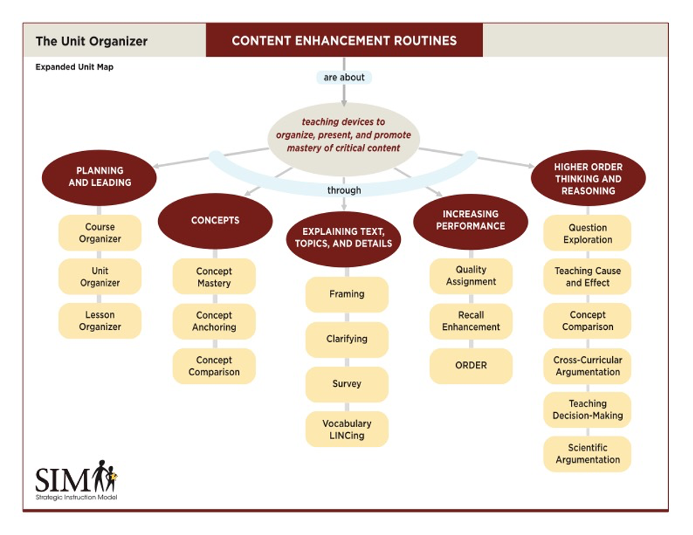
Notes:
Ask folks to raise hands-
Brand new to CER.
Regularly use CER.
Want to use CER, but haven’t yet.

Slide 6
Let’s Demystify REASONING
WHY is understanding reasoning important?
WHAT are types of reasoning?
HOW do we understand and answer questions that require different types of reasoning?
© J. Bulgren 2021
Notes:
First let’s look at these 3 * questions.

Slide 7
Why is understanding reasoning important?
Response to national standards
Performance on assessments
Learning in the modern world
Use in the real world, everyday life
Job requirements
Recognizing misinformation
© J. Bulgren 2021
Notes:
Start with question for them to answer - opened up or in the chat depending on size of group.
This is what’s pushing the movement.
Early on in public education higher order reasoning wasn’t at the top of the chain, creating factory workers. Today’s society exact opposite. Automation takes care of basic skill, but need folks who can make judgements. Script flipped.
THIS IS AN ADULT POINT OF VIEW
REASONING IS NOT A BIG MYSTERY
WE USE OR HEAR REASONING EVERY DAY
WE MAY USE DIFFERENT WORDS (SYNONYMS) BUT THE REASONING IS THE
SAME.

Slide 8
Why is understanding reasoning important?
What motivates students to want
to learn more?
Why does this matter?
So what? Why am I learning this?
© J. Bulgren 2021
Notes:
COMPELLING QUESTIONS.
Group discussion or break outs
STUDENTS DON’T NECESSARILY SEE WHY IT’S IMPORTANT.
I need to know it for the test
I solve problems in life.

Slide 9
Don’t Be a Leap Frog
Because I believe it.
Because we believe it.
Because I want to believe it.
Because I have always believed it.
It’s in my selfish interest to believe it.
Notes:
Example: Susie Orman, investments
People who vote like their family members do.

Slide 10
What are the types of higher order reasoning?
1. Explaining a main idea
2. Tracing causes and effects
3. Comparing and contrasting
4. Making a decision
5. Identifying a claim with an argument
Other related terms such as Critical Thinking and Problem Solving often require use of one or more type of higher order thinking and reasoning.
© J. Bulgren 2021

Slide 11
Demystifying Higher Ordering Thinking & Reasoning
I think what you are saying is …..
Explaining a main idea
We had three inches of rain, so the river will rise.
Tracing causes and effects
We should buy this brand of cookie because it is cheaper than this brand.
Comparing and contrasting
Let’s discuss two suggestions for where to go on vacation.
Making a decision
Here’s a report from the CDC with data and expert commentary that proves the value of vaccines.
Identifying a claim with an argument
© J. Bulgren 2021

Slide 12
How do we Deconstruct Questions?
Notes:
This is HOW do we understand and answer questions that require different types of reasoning?

Slide 13
How do we deconstruct questions?
Simplify – remove extra information
Synonyms-use words with similar meanings
Paraphrase – put into your own words
Break apart – isolate those sentences that present the question.
© J. Bulgren 2021
Notes:
Make this slide a build
So when students encounter questions, they are able to deconstruct the question to determine the type of thinking involved in answering it. This process provides clarity of thought and scaffolds their learning to lift them up to higher levels of thinking and reasoning.

Slide 14
What is this question really asking?
Deforestation has reached levels of about 40 million acres each year. More than 50 percent of the rain forests have been cut. About 2% of the rest of the rain forests are destroyed in each succeeding year. What brought about deforestation, and what could result?
© J. Bulgren 2021
Notes:
If time….Let’s try it!
Put in the chat what this question is really asking. What four skills were you using to figure out the heart of the question?

Slide 15
MORE COMPELLING QUESTIONS
https://padlet.com/pygqsmqkcq/tt2ndjwmpu630pp8

Slide 17
Presentation located at:
https://bit.ly/ExploreHOTR
How does this image relate to today’s discussion?
Notes:
How does this image relate to today’s discussion?
Let’s go out and use these hotter routines-develop our superhero brains.

Slide 18
Additional Slides
The slides which follow provide additional information about Higher Order Thinking Routines.
They may be used in your presentations.
Please feel free to modify them to fit the needs of the group you’re working with.

Slide 19
Options for Co-constructing Digitally
in classroom or in Zoom Room
CORGI
Tech-Enhanced CER Instruction
Notes:
In Classroom or in Zoom Room
Co-Organize Your Learning (CORGI) is a google application for students and teachers to use to collaboratively answer questions requiring higher order reasoning. The CORGI guides are adapted from Strategic Instruction Model (SIM) routines developed by Janis A. Bulgren, B. Keith Lenz, Donald D. Deshler, & Jean B. Schumaker at the University of Kansas. CORGI is funded by the Investing in Innovation (i3) Development Grant awarded to SRI International (#U411C14003).

Slide 20
Content
Based on student needs, school demands, and learning standards.
Enhancement
Employs visual devices.
Explicitly states key content language.
Embeds “linking” steps
Routine
Follows an instructional sequence “Cue-Do-Review”
Teachers and students use regularly
Notes:
Give example from summer school-used 4 routines regularly: frame, concept mastery, plus two others-KWL

Slide 21
Let’s try it! Select one question. Type in the chat what HOTR CER would help students deconstruct the question. Word Bank: Concept Comparison, Cause and Effect, Question Exploration (main idea), Argumentation, Decision-making
What are similarities and differences in independent and dependent variables?
How did the war of 1812 affect the United States?
How did Jefferson argue his political points?
Explain qualitative and quantitative data.
What is the difference between exponential and logistic population growth?
How do mutations in the cell cycle lead to uncontrollable cell division (cancer)?
How is light energy converted to chemical energy?
Take a position on whether the President of the US should have a 2-term limit.
How does DNA mutation affect protein function?
How did Darwin’s observations lead to his conclusions on natural selection?
How is the structure of the plasma membrane related to its function?
Explain the position that Alexander Hamilton took regarding federal powers.
How were Jefferson and Hamilton’s views alike and different?
© J. Bulgren 2021
Notes:
Does this question ask me to _____ (fill in the blank with the type of reasoning required to answer the question).
Select one question and type in the chat which HOTR CER would help students deconstruct the question in order to answer it thoroughly.

Slide 22
What types of questions do we need to deconstruct (take apart)?
HIGHER ORDER THINKING AND REASONING QUESTIONS such as those that ask students to:
Explore and explain an important Main Idea
Trace Causes and Effects of an event or idea
Compare and Contrast two or more event or ideas
Make a Decision about choosing among options.
Analyze a Claim and Argument and its evidence, reasoning
© J. Bulgren 2021
Notes:
Main Idea: core understanding; central theme
Cause-and-Effect: bring about/result; give rise to/outcome; initiator/consequence
Compare-and-Contrast: differentiate, alike/unalike; similar/dissimilar
Decision-making: options; alternatives; choices; judge between; pro/con
Argumentation: claim & evidence; debate position; assertion; conclusion with supports; line of reasoning

