Slide 1
The Star Writer Program: COMPUTERIZED
PARAGRAPH-WRITING STRATEGY INSTRUCTION
Jean Schumaker
Summer, 2019

Slide 2
TODAY’S GOALS
To familiarize you with:
The Star Writer Program content for beginning Paragraph Writing
The program structure
Your role as a teacher
The instructor’s guide
How to get organized
The research

Slide 3
Lessons in the Program
Introduction
Lesson 1: Complete Sentences
Lesson 2: Topic Sentences
Lesson 3: Planning Diagram
Lesson 4: Detail Sentences
Lesson 5: Clincher Sentences

Slide 4
The program is based on strategic instruction
  The Paragraph Writing Strategy
  Instructional Methods for teaching strategies

Slide 5
CONTENT OF THE PROGRAM
Parts I, II, III of the Paragraph Writing Strategy Program
The program builds across the lessons so that students are writing whole paragraphs in Lesson 5

Slide 6
Basic Instructional Methods for Teaching Strategies
Describe
Model
Verbal Practice
Controlled Practice
Advanced Practice

Slide 7
LESSON FORMAT
Learn It
(Describe)
Watch It
(Model)
Study It
(Verbal Practice)
Practice It
(Controlled Practice)
(Advanced Practice)

Slide 8

Matt: Please insert in here several slides showing the icons and folders they will see when they open the program, open the printable materials, open the instructor’s guide, etc.

Slide 10
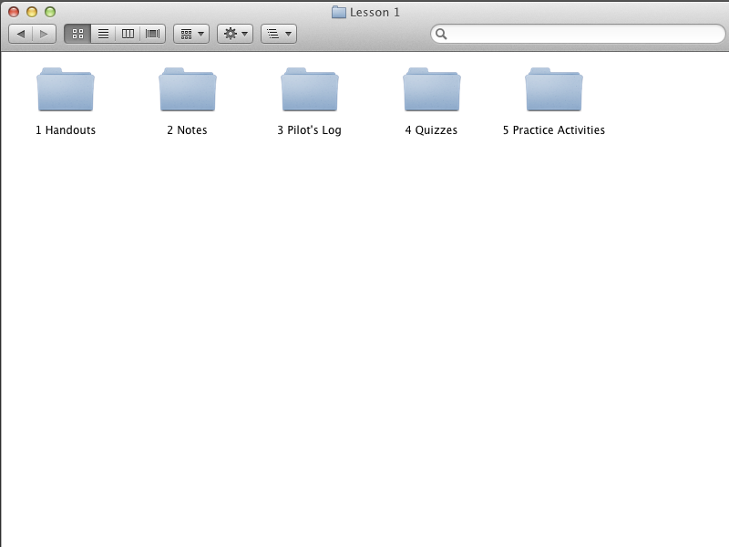

Slide 13
INTRODUCTION

Slide 14
INTRODUCTION
Introduces the purpose of the program
Provides navigation instructions
Begins the plot
Provides an overview of the lessons
a

Slide 18
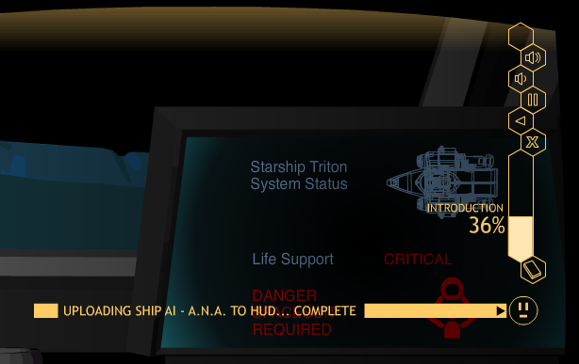
Matt: Put a screen shot in here of Row 4 with the navigation buttons enlarged.

Slide 19
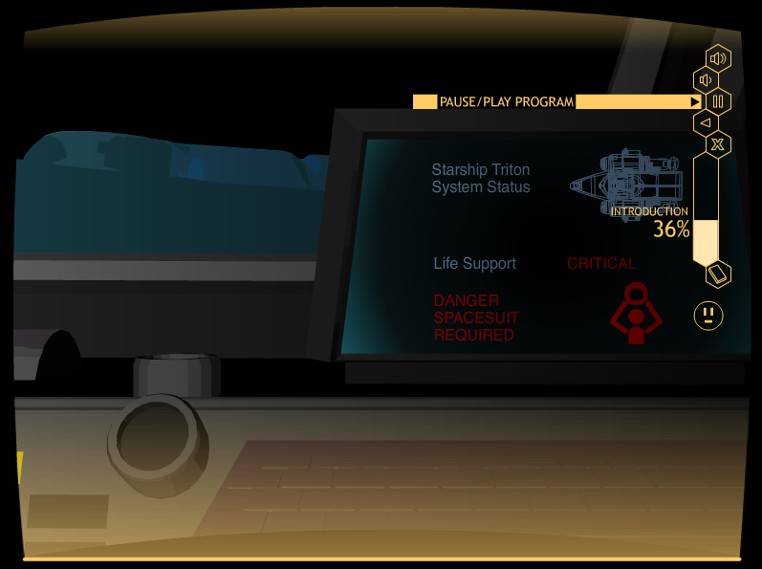
Matt: Please insert in here several slides showing the
Navigation buttons, like exit, restart, etc.

Slide 20
Matt: Please insert in here several slides showing the
Navigation buttons, like exit, restart, etc.

Slide 21
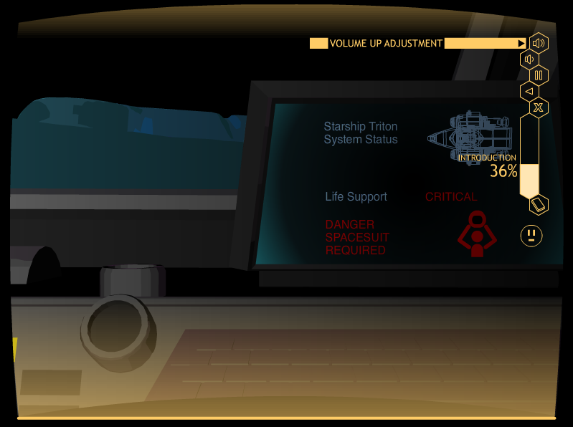
Matt: Please insert in here several slides showing the
Navigation buttons, like exit, restart, etc.

Slide 22
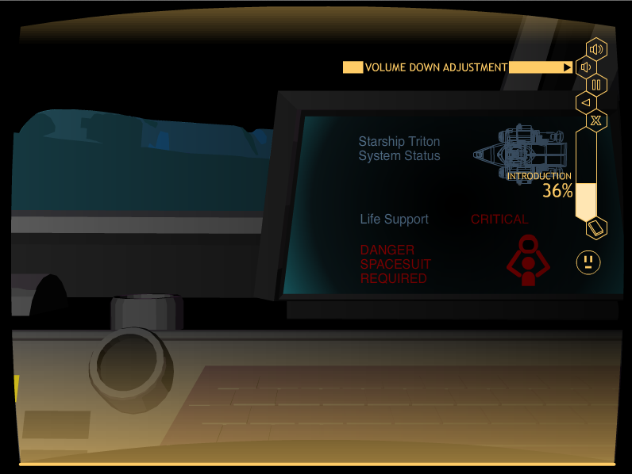
Matt: Please insert in here several slides showing the
Navigation buttons, like exit, restart, etc.

Slide 23
Matt: Please insert in here several slides showing the
Navigation buttons, like exit, restart, etc.

Slide 24
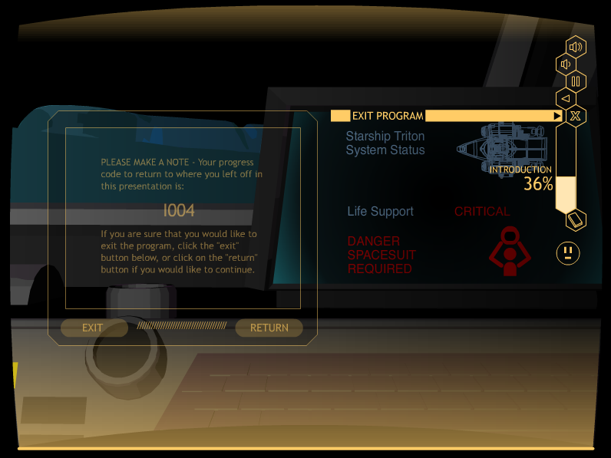
Matt: Please insert in here several slides showing the
Navigation buttons, like exit, restart, etc.

Slide 26
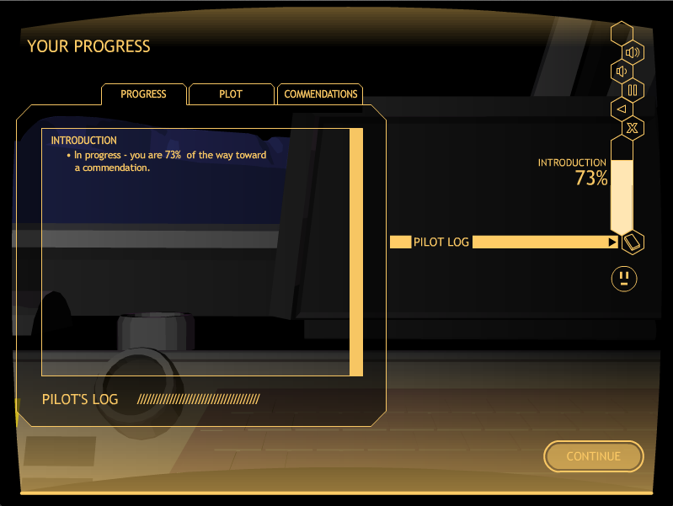
Matt: Please put a screen shot of the Pilot’s log in here at the point of the last screen of the intro.

Slide 27
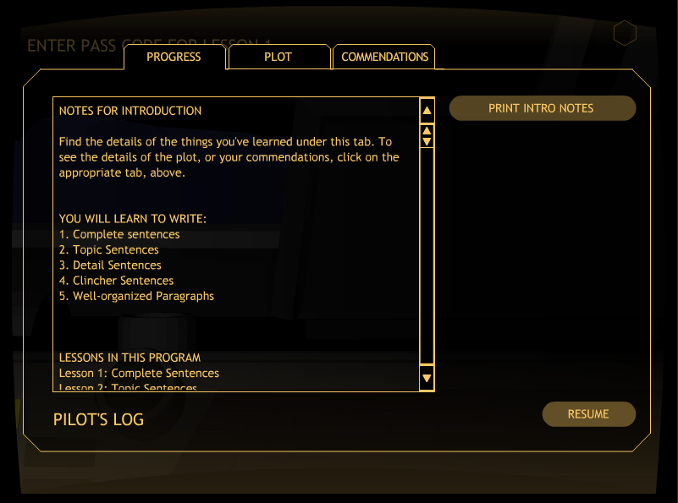

Slide 28
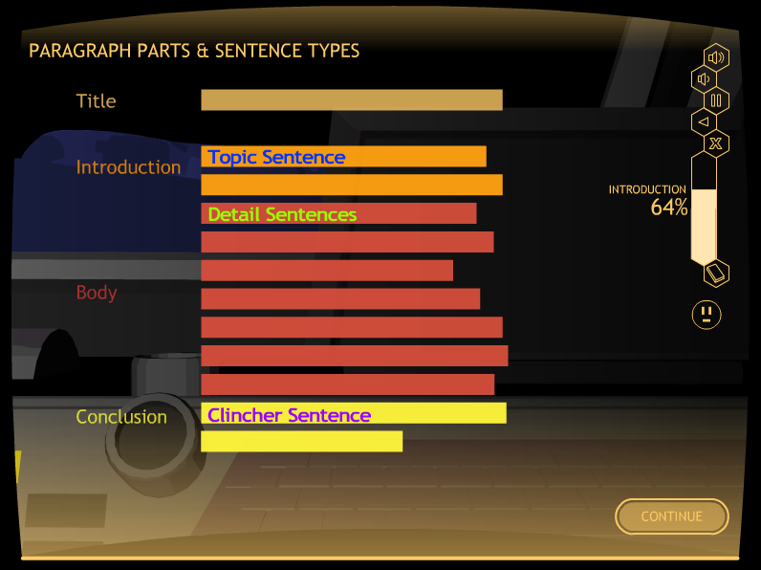

Slide 29
Let’s Look at the instructor’s guide

Slide 31
Notice the Pass Codes!

Slide 32
The Lessons
Lesson 1: Complete Sentences
Lesson 2: Topic Sentence
Lesson 3: Planning a Paragraph
Lesson 4: Detail Sentences
Lesson 5: Clincher Sentences

Slide 33
LESSON STRUCTURE
            Learn It
            Watch It
            Study It
            Practice It

Slide 34
Lesson 1

Slide 35
LESSON 1: COMPLETE SENTENCES
Major Concepts:
Complete sentence
Subjects and verbs
Simple Sentences
Compound Sentences

Slide 36
Lesson 1: Learn it

Slide 37
Lesson Format FOR Learn It
Introduction
Concept #1
Definition
Examples
Practice Activity
Concept #2
Definition
Examples
Practice Activity
Concept #N
Definition
Examples
Practice Activity
Closing
Notes:
Lesson format: Learn It [Does this look okay??? Shall I change it to one column, even thought it will be much smaller font?]

Slide 38
EXAMPLE LEARN IT SCREEN

Slide 39
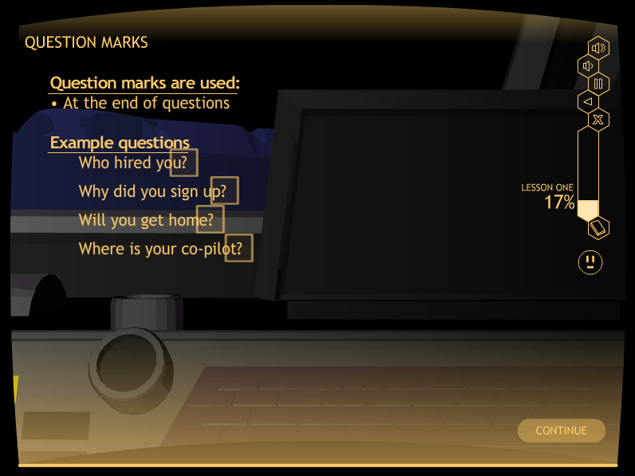
Matt: Please add a slide in here showing the instruction for end punctuation. I’m thinking screen A018

Slide 40
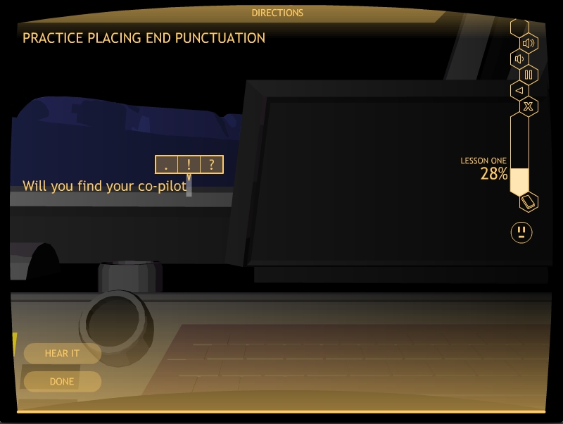
Matt: Please put a screen shot from A029 in here showing the three option choices for punctuation

Slide 41
Let’s Look at A simple Activity
Go to A029
Stop when you have completed 3 sentences

Slide 42
Subjects and verbs

Slide 43
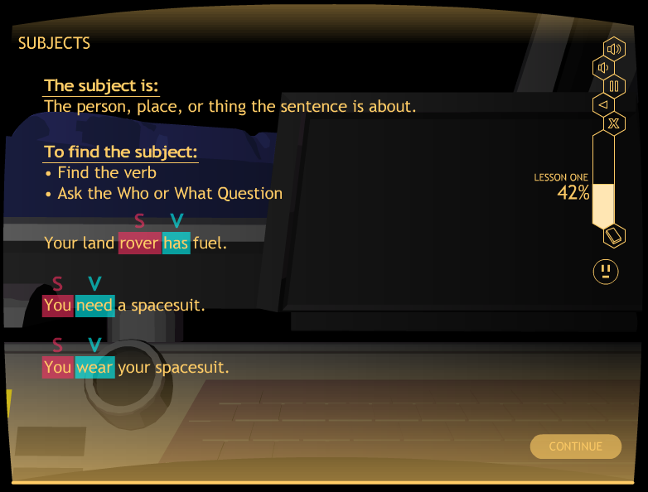

Slide 44
Lesson 1: Watch It

Slide 45
EXAMPLE WATCH IT SCREEN

Slide 46
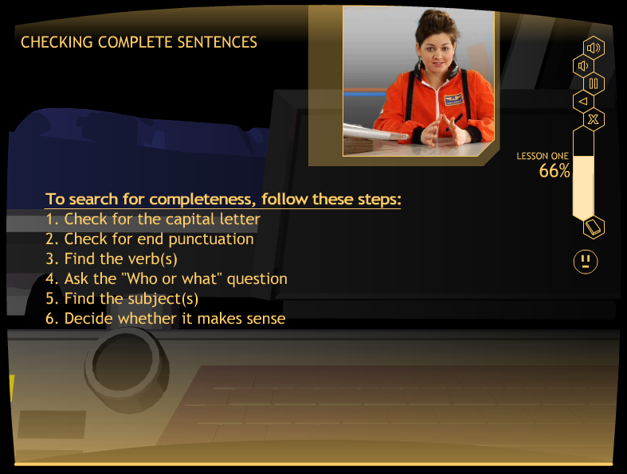

Slide 47
Lesson 1: Study It

Slide 48
EXAMPLE STUDY IT SCREEN

Slide 49
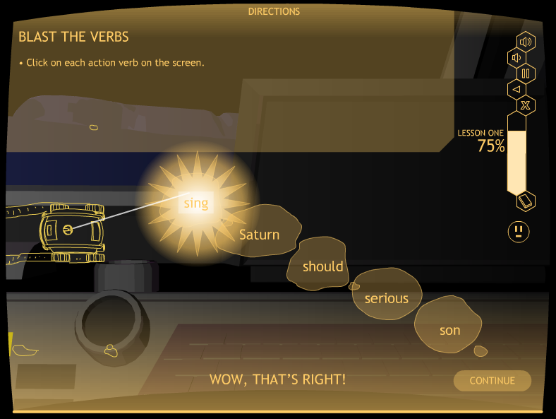

Slide 50
QUIZ TIME!
At the end of Study It, students take a quiz.
They can print it out, or you can give them a paper copy.
This replaces the Verbal Practice Quiz in the strategy programs.
Mastery is 100%
First time, a short oral quiz of one or two questions is recommended to see if the student is ready.
If not, have the student repeat Study It.

Slide 52
A Caution about the first quiz!!
Briefly quiz (one or two oral questions) to make sure the student is ready to take the quiz.
Have the student repeat Study It when not ready.
Next time, the student will be ready.

Slide 53
Lesson 1: Practice It

Slide 54
Practice It Levels 1-6
Level 1: Identifying a subject and a verb
Level 2: Identifying more subjects and verbs
Level 3: Finishing simple sentences
Level 4: Writing simple sentences
Level 5: Finishing compound sentences
Level 6: Writing compound sentences

Slide 55
EXAMPLE PRACTICE IT SCREENS

Slide 56
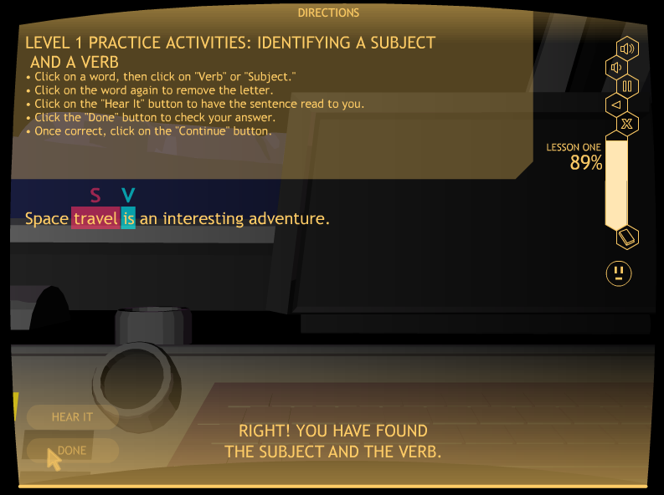

Slide 57
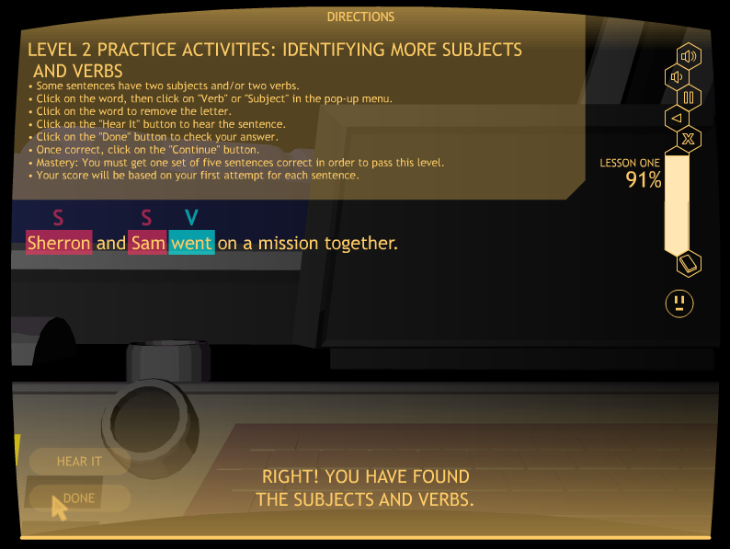
Matt: Please insert a Level 2 slide in here showing the
Little subject
Verb screen.

Slide 58
Let’s look at practice It
Level 2
Go to A098 (Level 2)
Click on “subject” or “verb” for each subject and verb
Click on the “Hear It,” “Done,” & “Continue” buttons
Stop after one set of five sentences
Click on the “Exit” button

Slide 59
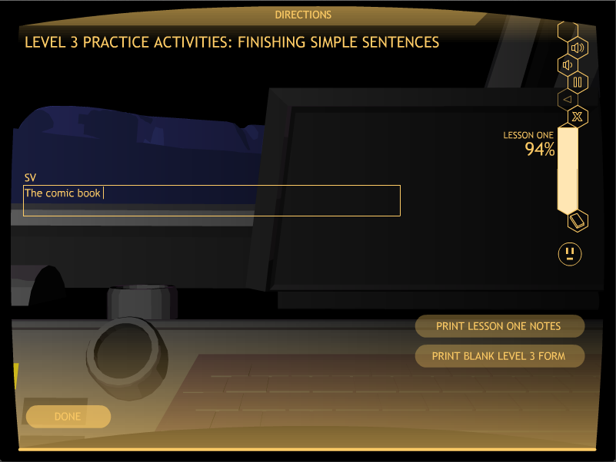
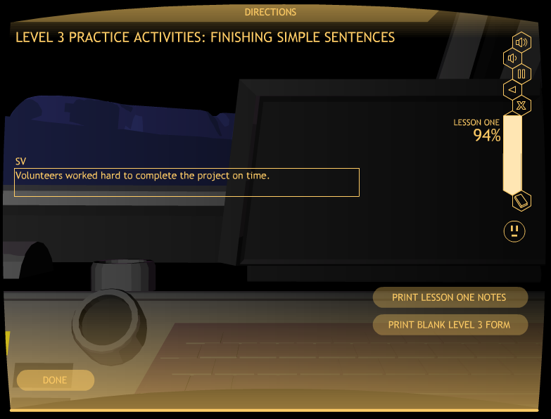

Slide 60
Look at practice It
Level 3
Go to A099 (Level 3)
Finish five simple sentences
Stop after editing one set of five sentences
Click on the “Exit” button

Slide 61
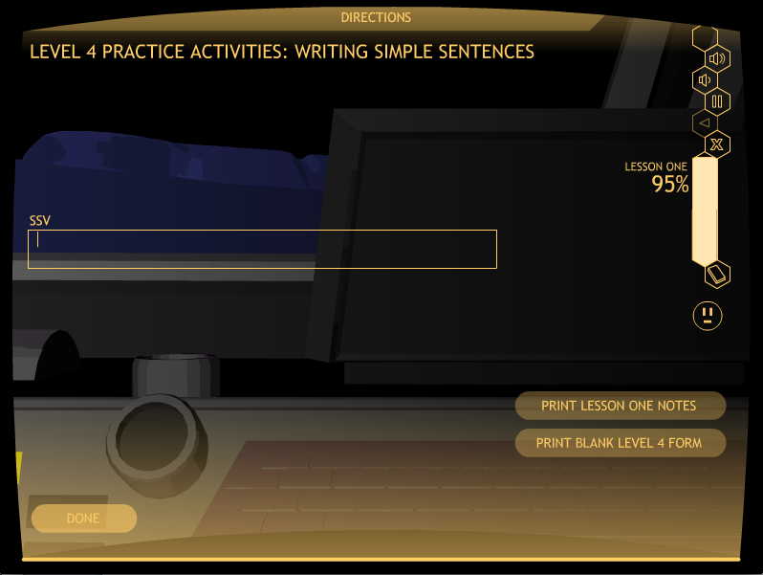

Slide 62
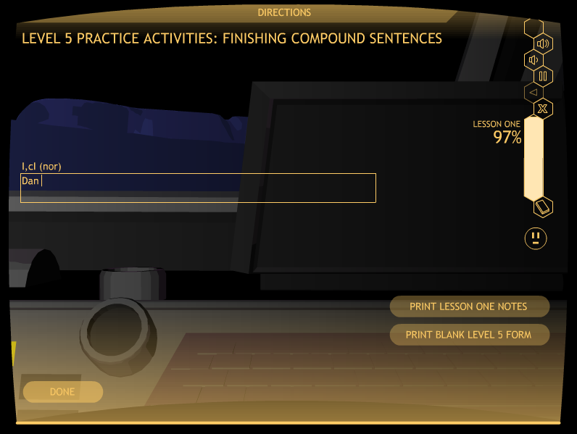

Slide 63


Slide 64
Lesson 1 practice It
Mastery
Level 1: 100%, two sets
Level 2: 100%, one set
Level 3: 80%, one set
Level 4, 80%, one set
Level 5: 80%, one set
Level 6: 80%, one set

Slide 65
Let’s Look at the printable materials folder
Go to the program folder
Click on the Printable Materials Folder

Slide 66
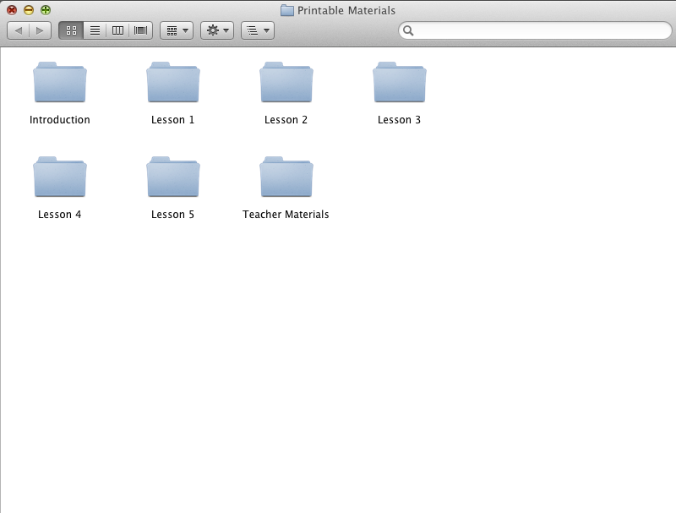

Slide 68
Lesson 2

Slide 69
LESSON 2: TOPIC SENTENCES
The Concepts:
Three types of Topic Sentences
          General
          Clueing
          Specific

Slide 70
Lesson 2: Learn It

Slide 71
Lesson Format FOR Learn It
Introduction
Concept #1
Definition
Examples
Practice Activity
Concept #2
Definition
Examples
Practice Activity
Concept #N
Definition
Examples
Practice Activity
Closing
Notes:
Lesson format: Learn It [Does this look okay??? Shall I change it to one column, even thought it will be much smaller font?]

Slide 72
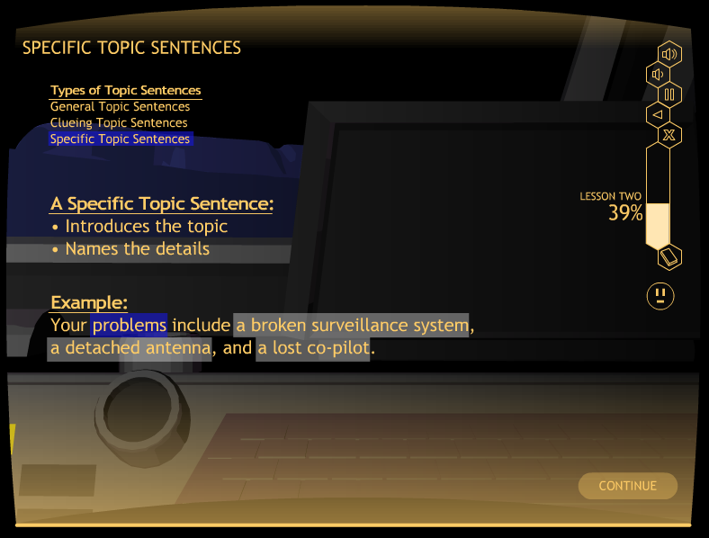

Slide 73
Lesson 2: WATCH IT

Slide 74
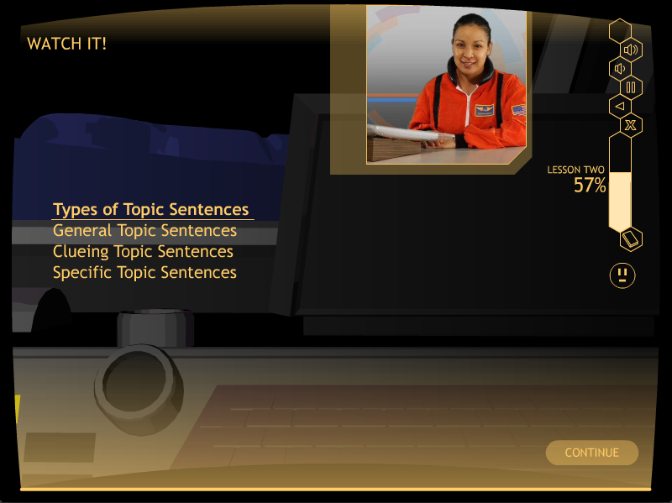
Matt: Please put a Watch It slide in here

Slide 75
Lesson 2: Study it

Slide 76
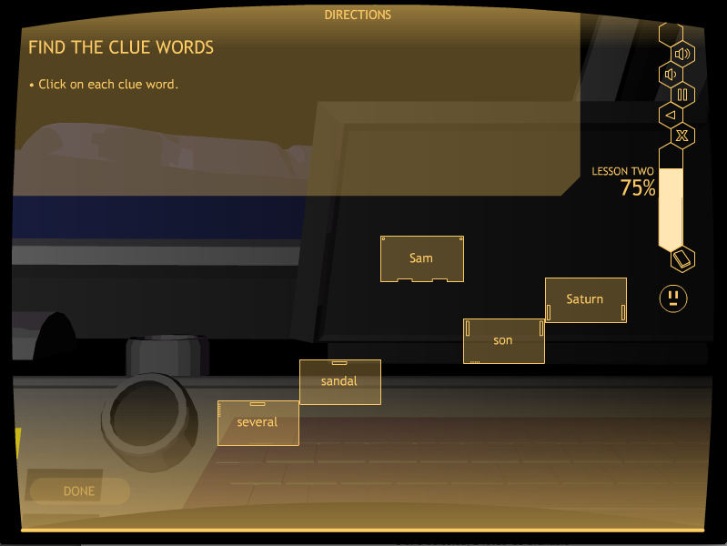
Matt: put a screen shot of Bo38 in here

Slide 77
QUIZ TIME!
At the end of Study It, students take a quiz.
They can print it out, or you can give them a paper copy.
This replaces the Verbal Practice Quiz in the strategy programs.
Mastery is 100%
First time, recommend a short oral quiz of one or two questions to see if the student is ready.
If not, have the student repeat Study It.

Slide 79
Lesson 2: PRACTICE IT

Slide 80
Lesson 2: Practice it levels
Level 1: Identifying types of Topic Sentences
Level 2: Finishing Topic Sentences
Level 3: Writing Topic Sentences

Slide 81
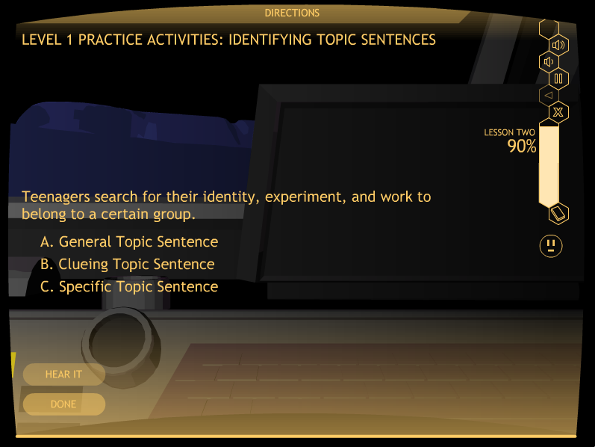
Matt: Please put a Level 1 screen shot in here

Slide 82
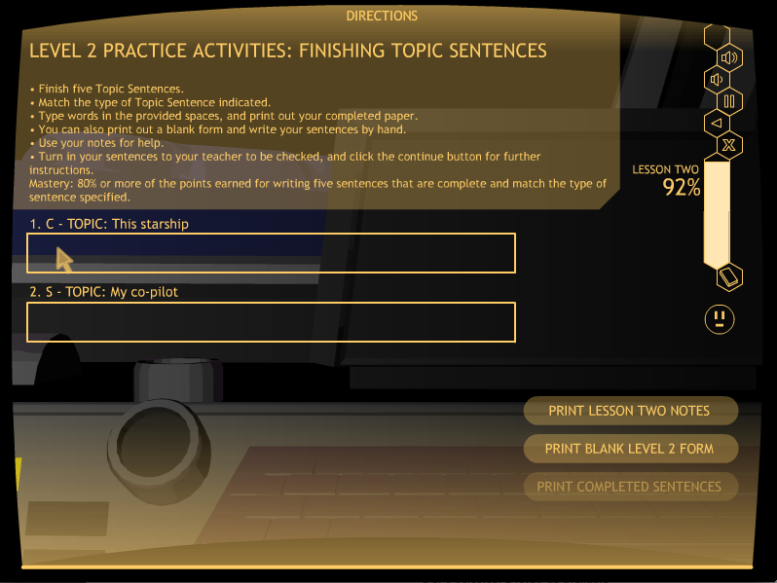
Matt: Put a screen shot of a B047 activity in here: Level 2 Practice It Activity
There should be part of a sentence in the box.

Slide 83
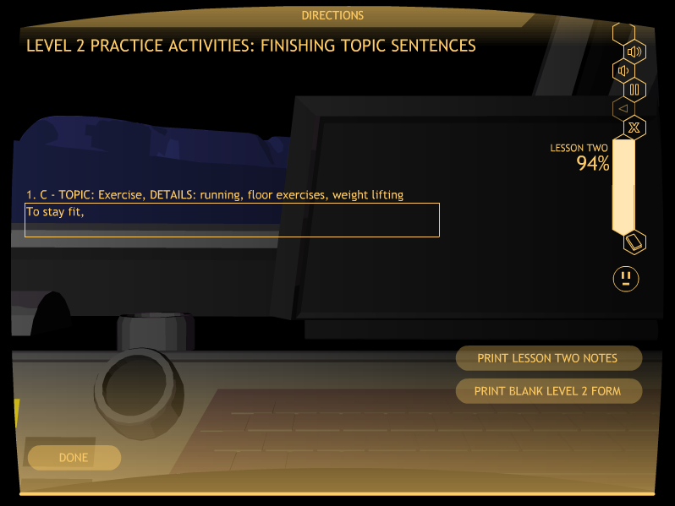

Slide 84

Matt: Please add in here the Level 3 slide showing the box where they write their own Topic sentence.

Slide 85

Matt: Please add in here the Level 3 slide showing the box where they write their own Topic sentence.

Slide 86
Lesson 2 practice It
Mastery
Level 1: 100%, two sets
(Computer scored)
Level 2: 80%, one set
(Computer scored)
Level 3: 80%, one set
(Computer scored)

Slide 87
Lesson 3

Slide 88
LESSON 3: PLANNING DIAGRAM
The Concepts taught:
The topic
The details
The sequences and transitions
The points of view
The tenses
The order of the details
The Topic Sentence (reviewed)

Slide 89
Lesson 3: learn it

Slide 90
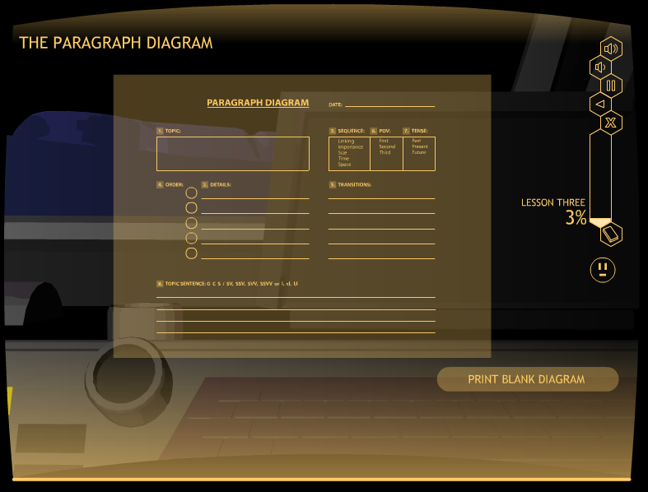

Slide 91
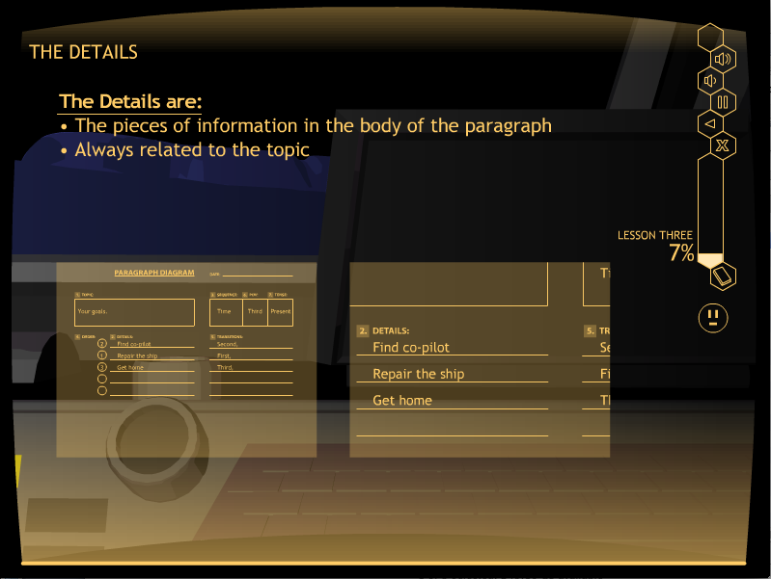
Matt: Please put a screen shot in here from
Learn it that shows a major section of the Paragraph
Diagram being explained.

Slide 92
LESSON 3: WATCH IT

Slide 93
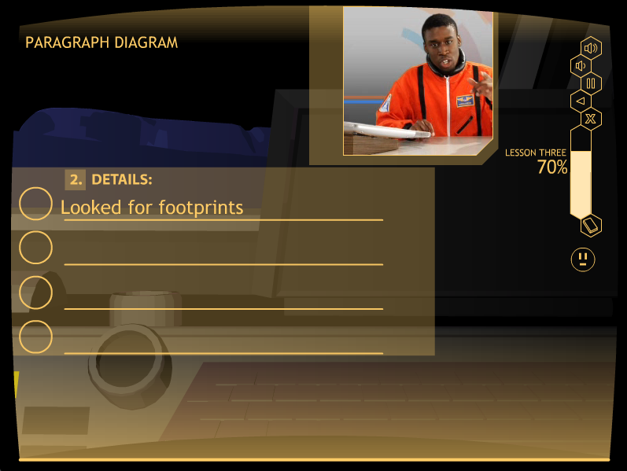
Lesson 3: Watch it
Matt: Please replace the next screen with a Watch it Screen that spells all the words correctly on the first line of details.

Slide 94
Lesson 3: Study It

Slide 95
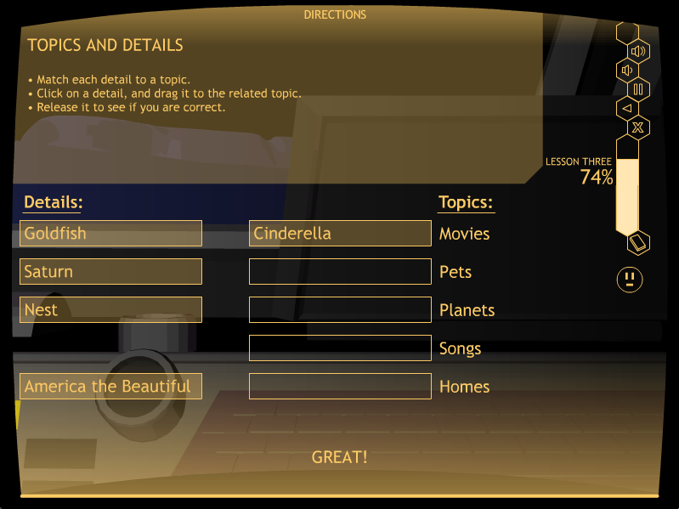
Matt: put a screen shot of Bo38 in here

Slide 96
QUIZ TIME!
At the end of Study It, students take a quiz.
They can print it out, or you can give them a paper copy.
This replaces the Verbal Practice Quiz in the strategy programs.
Mastery is 100%
A short oral quiz of one or two questions is recommended to see if the student is ready.
If not, have the student repeat Study It.

Slide 98
Lesson 3: Practice It
Level 1: Identifying point of view
Level 2: Identifying tense
Level 3: Identifying sequence
Level 4: Planning a paragraph

Slide 99
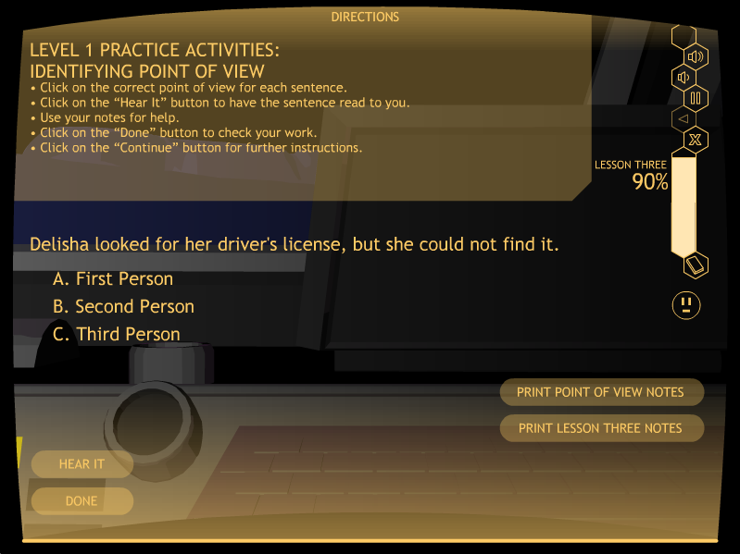
Matt: Please put a Level 1 screen shot in here

Slide 100
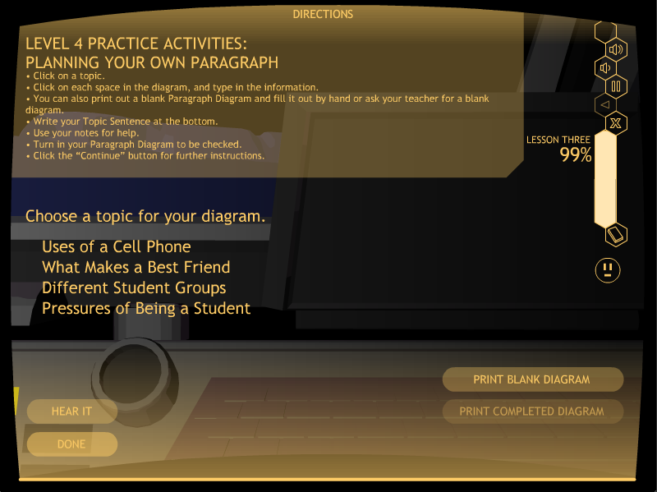
Matt: Put a screen shot of the Level 4 Practice It Activity in here
The topics should show here.

Slide 101
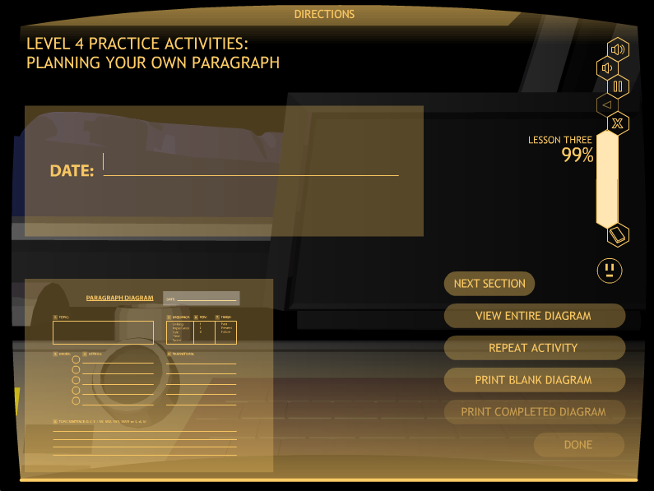
Matt: Please put in here a screen shot of the paragraph diagram that is to be filled out, with all the buttons on the right-hand side so they can be explained.

Slide 102
LET’S Look at Practice It
Go to C068
Stop when you have planned a paragraph
Click on “Exit”

Slide 103
Lesson 3 practice It
Mastery
Level 1: 80%, two sets
Level 2: 80%, two sets
Level 3: 80%, two sets
Level 4: 90%, one diagram

Slide 104
Lesson 4

Slide 105
LESSON 4: DETAIL SENTENCES
Two types of Detail Sentences
Lead-off Sentences
Follow-up Sentences

Slide 106
Lesson 4: Learn it

Slide 107
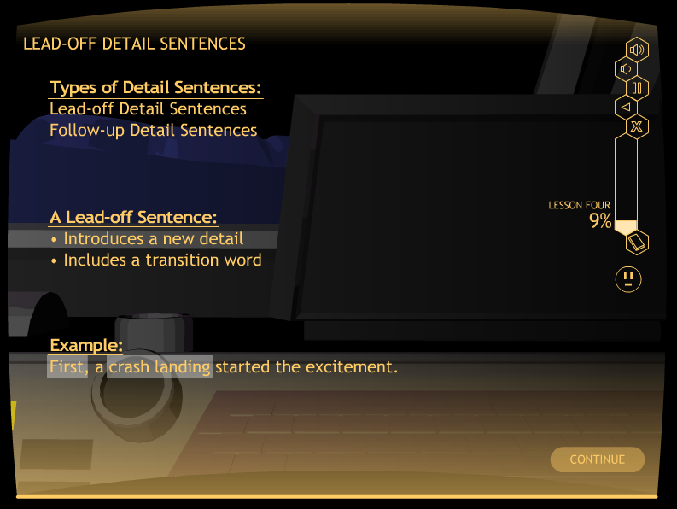

Slide 108
Lesson 4: Watch it

Slide 109
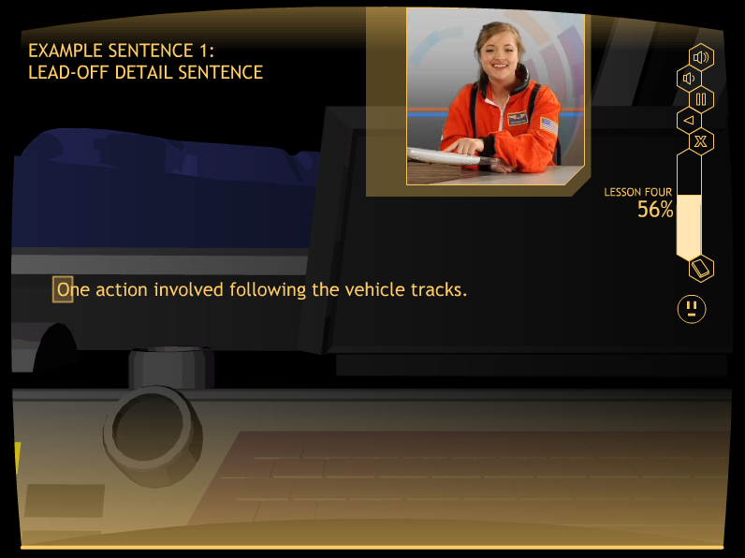
Matt: Please put a Watch It slide in here: Maybe D027 where you can see the
Lead-off sentence that she has written

Slide 110
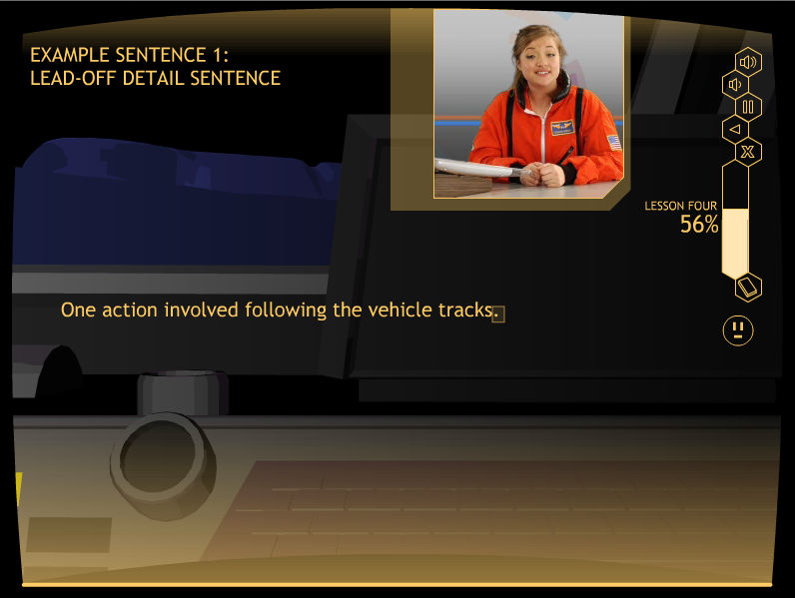
Matt: Please put a Watch It slide in here: Maybe D027 where you can see the
Lead-off sentence that she has written

Slide 111
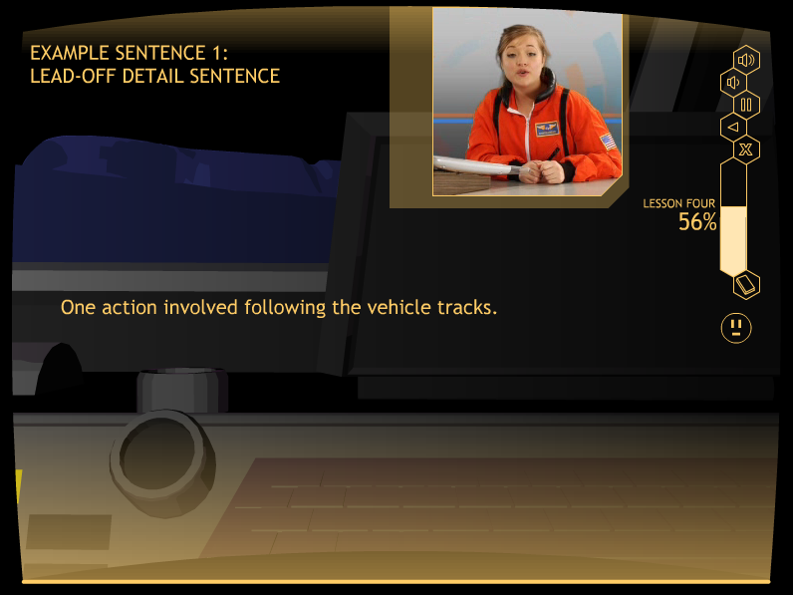
Matt: Please put a Watch It slide in here: Maybe D027 where you can see the
Lead-off sentence that she has written

Slide 112
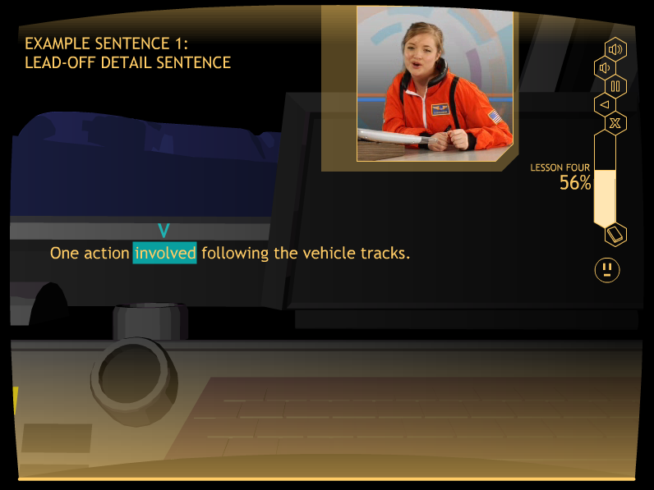
Matt: Please put a Watch It slide in here: Maybe D027 where you can see the
Lead-off sentence that she has written

Slide 113
Lesson 4: Study it

Slide 114
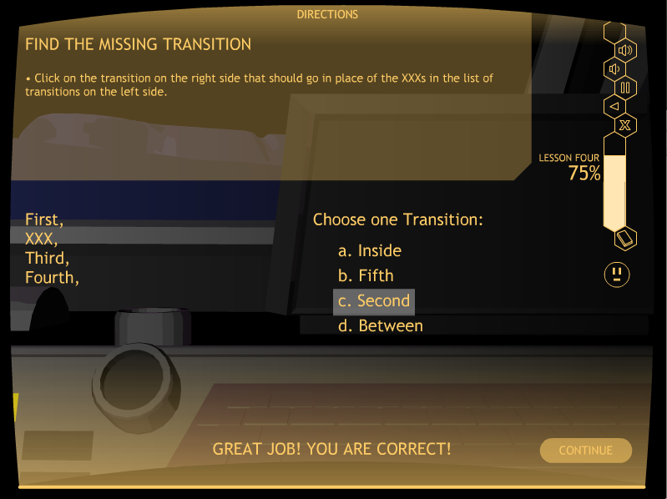
Matt: put a screen shot of D036 in here

Slide 115
QUIZ TIME!
At the end of Study It, students take a quiz.
They can print it out, or you can give them a paper copy.
This replaces the Verbal Practice Quiz in the strategy programs.
Mastery is 100%

Slide 117
Lesson 4:
The practice Activities
Level 1: Identifying Lead-off and Follow-up Sentences
Level 2: Completing Lead-off and Follow-up Sentences
Level 3: Writing Lead-off and Follow-up Sentences
Level 4: Creating a Paragraph Diagram
Level 5: Writing a partial paragraph:
Topic Sentence and Detail Sentences

Slide 118
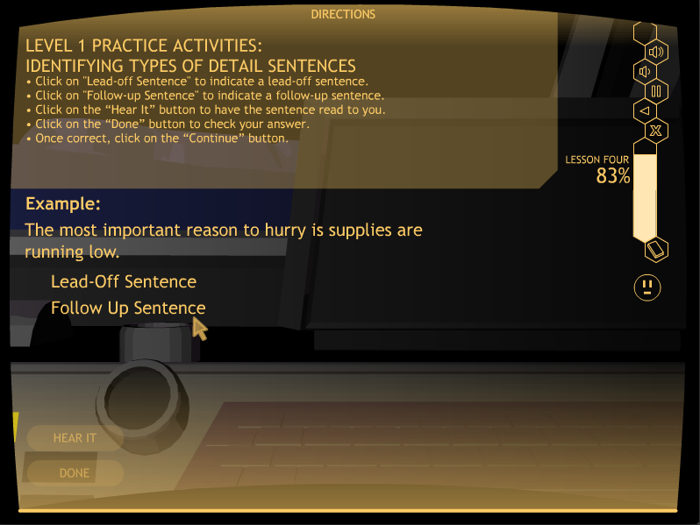
Matt: Please put a Level 1 screen shot in here for Lesson 4

Slide 119
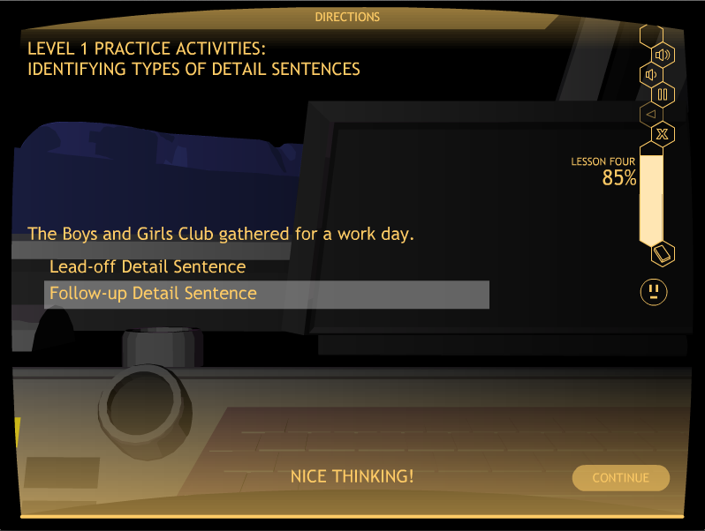

Slide 120
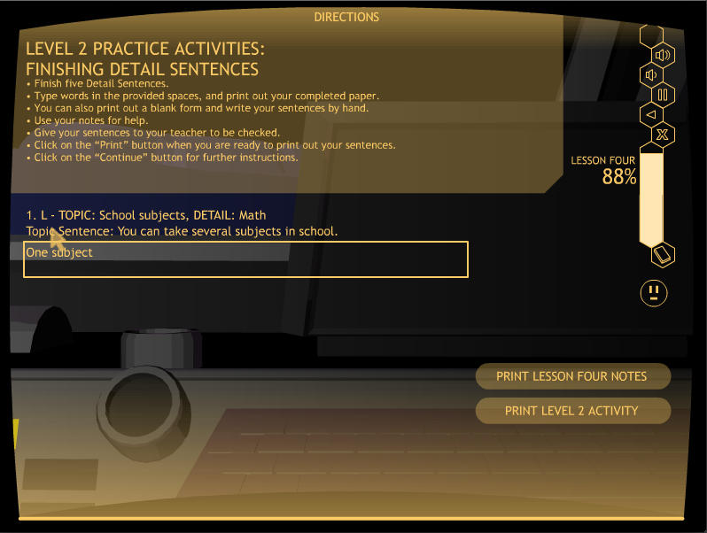
Matt: Put a screen shot of a D042 activity in here: Level 2 Practice It Activity
There should be part of a sentence in the box.

Slide 121
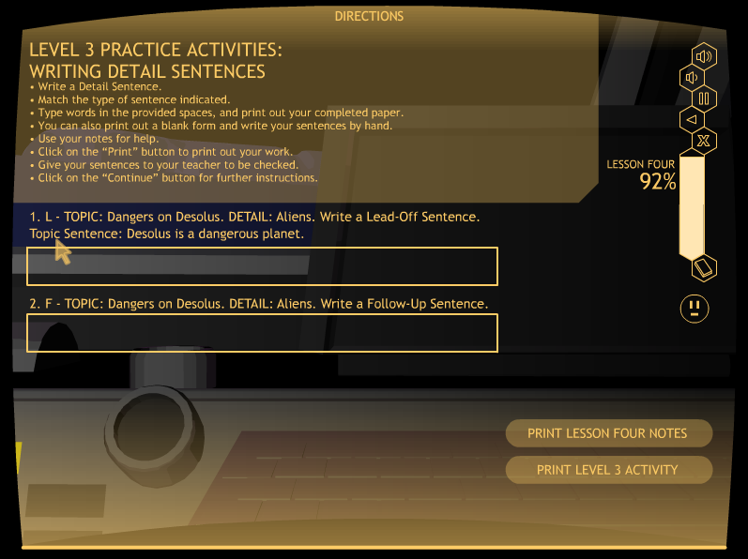
Matt: Please put in here slides for levels 3 & 4

Slide 122
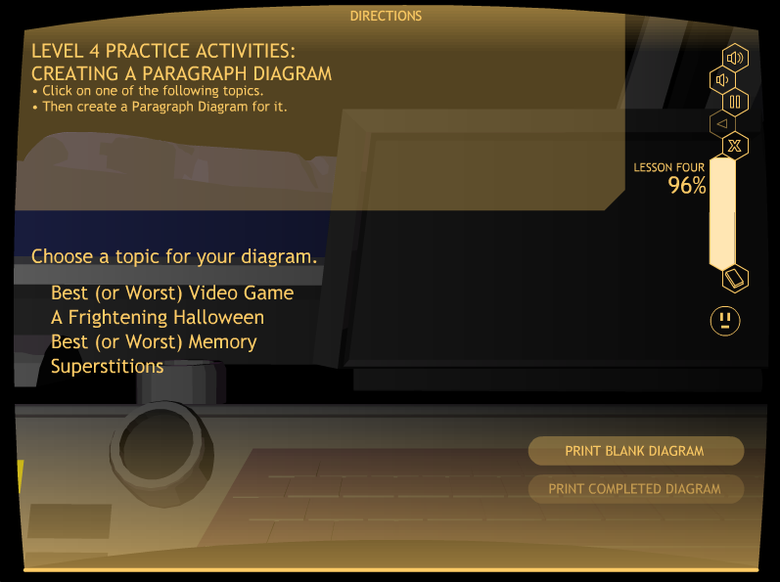
Matt: Please put in here slides for levels 3 & 4

Slide 123
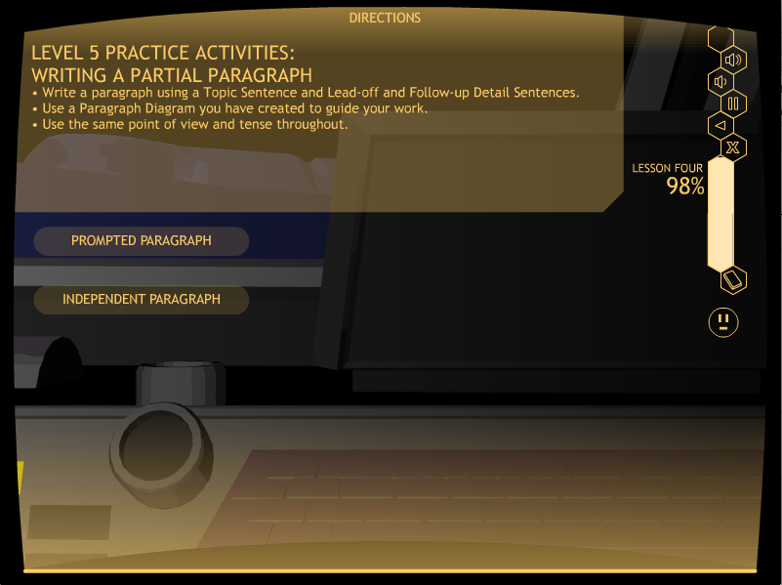
Matt: Please put a screen shot in here of the Level 4 screen where the two buttons are shown: Prompted, Indep.

Slide 124
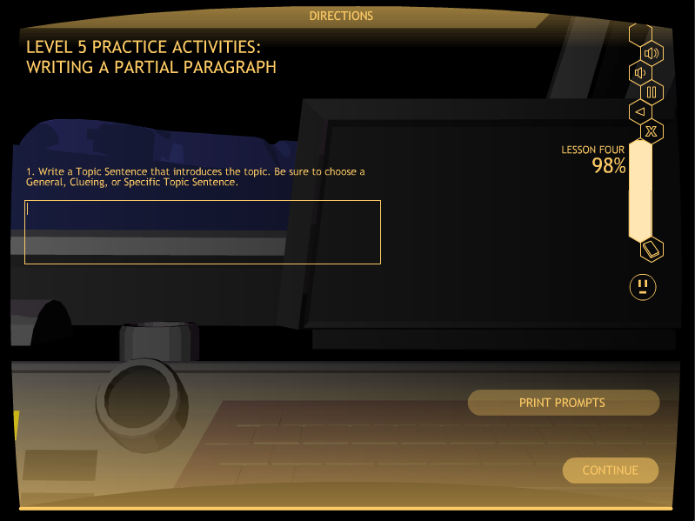
Matt: Put a screen shot in here of a Prompted sentence, Like first Lead-off

Slide 125
Let’s Look at Practice It
Go to D047
Click on the “Prompted Activity” button
Stop at the end of this activity
Click on “Exit”

Slide 126
Lesson 4 practice It
Mastery
Level 1: 100%, two sets
Level 2: 80%, one set
Level 3: 80%, one set
Level 4: 90%, one diagram
Level 5: 80%, one paragraph

Slide 127
Lesson 5

Slide 128
LESSON 5: CLINCHER SENTENCES
    Three types of Clincher Sentences:
    General
    Clueing
    Specific

Slide 129
Lesson 5: Learn It

Slide 130
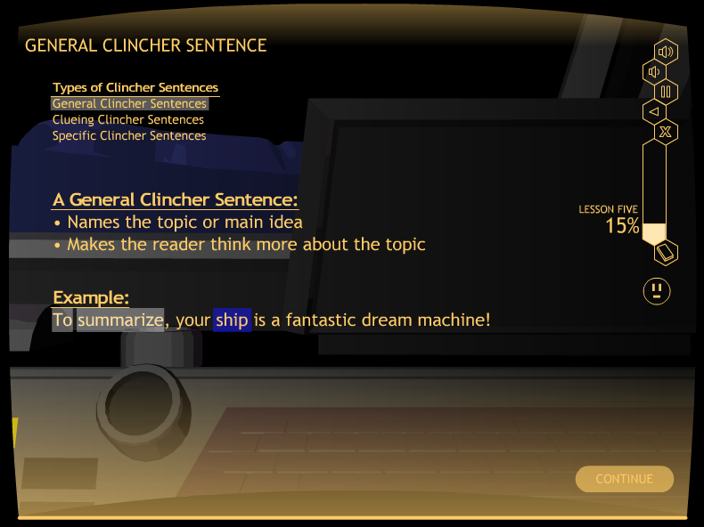

Slide 131
Lesson 5: watch It

Slide 132
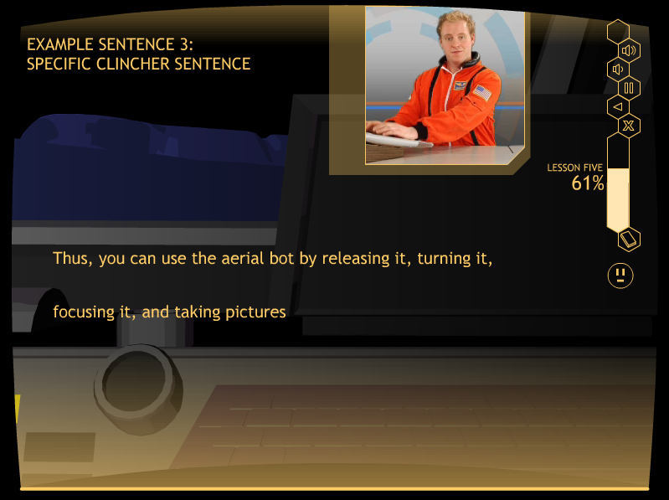
Matt: Please put a Watch It slide in here. E038 It should show the
Clincher Sentence that the pilot has written.

Slide 133
Lesson 5: Study It

Slide 134
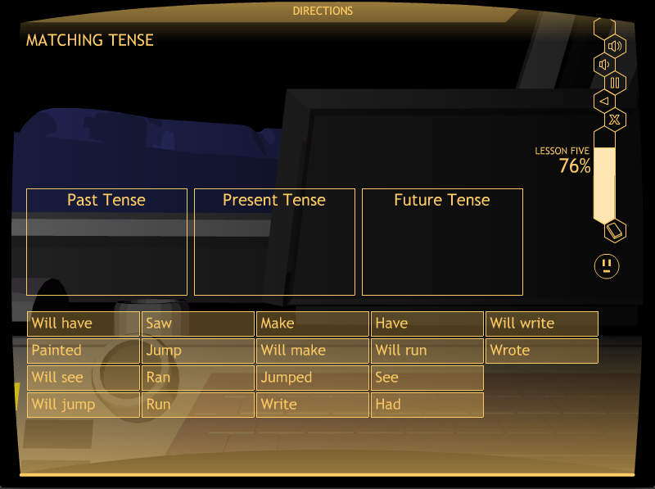
Matt: put a screen shot of E047 in here

Slide 135
QUIZ TIME!
At the end of Study It, students take a quiz.
They can print it out, or you can give them a paper copy.
This replaces the Verbal Practice Quiz in the strategy programs.
Mastery is 100%

Slide 137
Lesson 5:
The practice Activities
Level 1: Identifying Clincher Sentences
Level 2: Completing Clincher Sentences
Level 3: Writing Clincher Sentences
Level 4: Creating a Paragraph Diagram
Level 5: Writing a whole paragraph

Slide 138

Matt: Please put a Level 1 screen shot in here- E052

Slide 139

Matt: Put a screen shot of a E054 activity in here: Level 2 Practice It Activity
There should be part of a sentence in the box.

Slide 140

Matt: Please add in here the slides for Levels 3 and 4 for Lesson 5

Slide 141

Matt: Please add in here the slides for Levels 3 and 4 for Lesson 5

Slide 142

Matt: Please add in here the slides for Levels 3 and 4 for Lesson 5

Slide 143

Matt: Please add in here the slides for Levels 3 and 4 for Lesson 5

Slide 144

Matt: Please put a screen shot in here of the Level 4 screen where the two buttons are shown: Prompted, Indep.

Slide 145

Matt: Put a screen shot in here of a Prompted sentence, Like Clincher sentence

Slide 146

Matt: Please insert the screen for the Independent paragraph here where the kid writes the paragraph in the box.

Slide 147
Lesson 5 practice It
Mastery
Level 1: 100%, two sets
Level 2: 80%, one set
Level 3: 80%, one set
Level 4: 90%, one diagram
Level 5: 80%, one paragraph

Slide 148

Matt: Please insert in here a colorful slide as a transition slide

Slide 149
Study 1 DETAILS
18 Students
9 Junior-high students
9 Senior-high students
Multiple-baseline across-students design

Slide 150
PARAGRAPH Test: percent of COMPLETE SENTENCES
Repeated Measures ANOVA Result: F(1,16)=46.41, p <.0005, Eta Squared=.74 (very large)
Notes:
The ANCOVA compared the posttest scores of School A to the posttest scores of School B, while controlling for the pretest scores in each school. School A posttest scores on this measure were significantly higher than the School B posttest scores. The effect size is very large.

Slide 151
Sentence Test: percent of Prompts matched
Repeated Measures ANOVA Result: F(1,16) = 306.95, p < .0005, Eta squared = .95 (very large)
Notes:
The ANCOVA compared the posttest scores of School A to the posttest scores of School B, while controlling for the pretest scores in each school. School A posttest scores on this measure were significantly higher than the School B posttest scores. The effect size is very large.

Slide 152
Study 2 DETAILS
Control-group design with randomly selected groups (experimental and control groups)
Plus a normative group

Slide 153
More Study Details
STRUGGLING WRITERS
Junior high writing group = 24 students
Junior high reading group = 17 students
Senior-high writing group = 18 students
Senior-high reading group = 18 students
NORMAL LEARNERS
• Junior-high group = 24 students
• Senior-high group = 21 students

Slide 154
Sentences Test: percent of COMPLETE SENTENCES
ANCOVA Result: F(1,68)=32.645, p <.001, Eta Squared=.331 (large)
Notes:
The ANCOVA compared the posttest scores of School A to the posttest scores of School B, while controlling for the pretest scores in each school. School A posttest scores on this measure were significantly higher than the School B posttest scores. The effect size is very large.

Slide 155
Sentence Test: percent of Prompts matched
ANCOVA Result: F(1,68) = 203.541, p < .001, Eta squared = .755 (very large)
Notes:
The ANCOVA compared the posttest scores of School A to the posttest scores of School B, while controlling for the pretest scores in each school. School A posttest scores on this measure were significantly higher than the School B posttest scores. The effect size is very large.

Slide 156
Paragraph Test:
% of pts earned on Organization
ANCOVA Result: F(1,68) = 76.239, p < .001, Eta squared = .536 (very large)
Notes:
The ANCOVA compared the posttest scores of the writing group with the reading group.

Slide 157
Paragraph Test:
% pts earned on Planning Diagram
ANCOVA Result: F(1,68) = 412.112, p < .001, Eta squared = .862 (very large)
Notes:
The ANCOVA compared the posttest scores of the writing group with the reading group.

Slide 158
Results summary
All experimental group students met mastery on the sentence writing and paragraph writing skills.
All experimental group students made statistically significant and socially significant gains on all measures of sentence writing, paragraph planning, and paragraph organization.
The control students made no gains on any measures of writing.

Slide 159
Results summary (continued)
There were no significant differences between the experimental junior-high and senior-high students’ scores on the posttests while controlling for the pretest scores. (Junior-high and senior-high students learned equally well from the program.)
There were significant differences between the experimental and control students’ posttest scores while controlling for the pretest scores, with very large effect sizes for each measure.
The experimental students’ mean posttest scores exceeded the mean end-of-year scores of the normal students.

Slide 160
For more information about the writing strategy programs, contact Edge Enterprises, Inc. at 785-749-1473 or go to www.edgeenterprisesinc.com .

