Slide 1
Note:
Three of the Routines we will address are available to anyone to purchase and implement. One benefit of attending a session with a knowledgeable SIM professional developer or with the author, Jan Bulgren, is that the implementer will have a deeper understanding of how to use the routine effectively. Of the four we will address, only Question Exploration requires PD.
Having your own copy of the Routines will help you to participate more fully in this session. We will not address the routines explicitly but will work out additional recommendations to implementers for how to produce an effective theme.

Slide 2
Deep Dive: Implementing Writing with the Higher Order Thinking and Reasoning Routines
Patricia Sampson Graner, PhD
SIMposium 2019

Slide 3
A session for professional developers to consider & generate PD options

Slide 4
Which are the Higher Order Thinking & Reasoning Routines?
Teaching Cause & Effect
Scientific Argumentation
Decision-Making
Question Exploration

Slide 5
Standards
In which classes would these routines be useful or expected?

Slide 6
Document prepared by M. Beech, FL

Slide 7
Purpose
Teaching Cause-and-Effect Routine is a package of instructional methods that teachers can use to help students engage in higher order reasoning.
Enables students to not only acquire content knowledge, but to explore, analyze, and evaluate causal relationships within the content area.
“Reasoning” has many definitions. It is used here to describe thinking about a relationship in which one thing either leads to another or results from another.

Slide 8
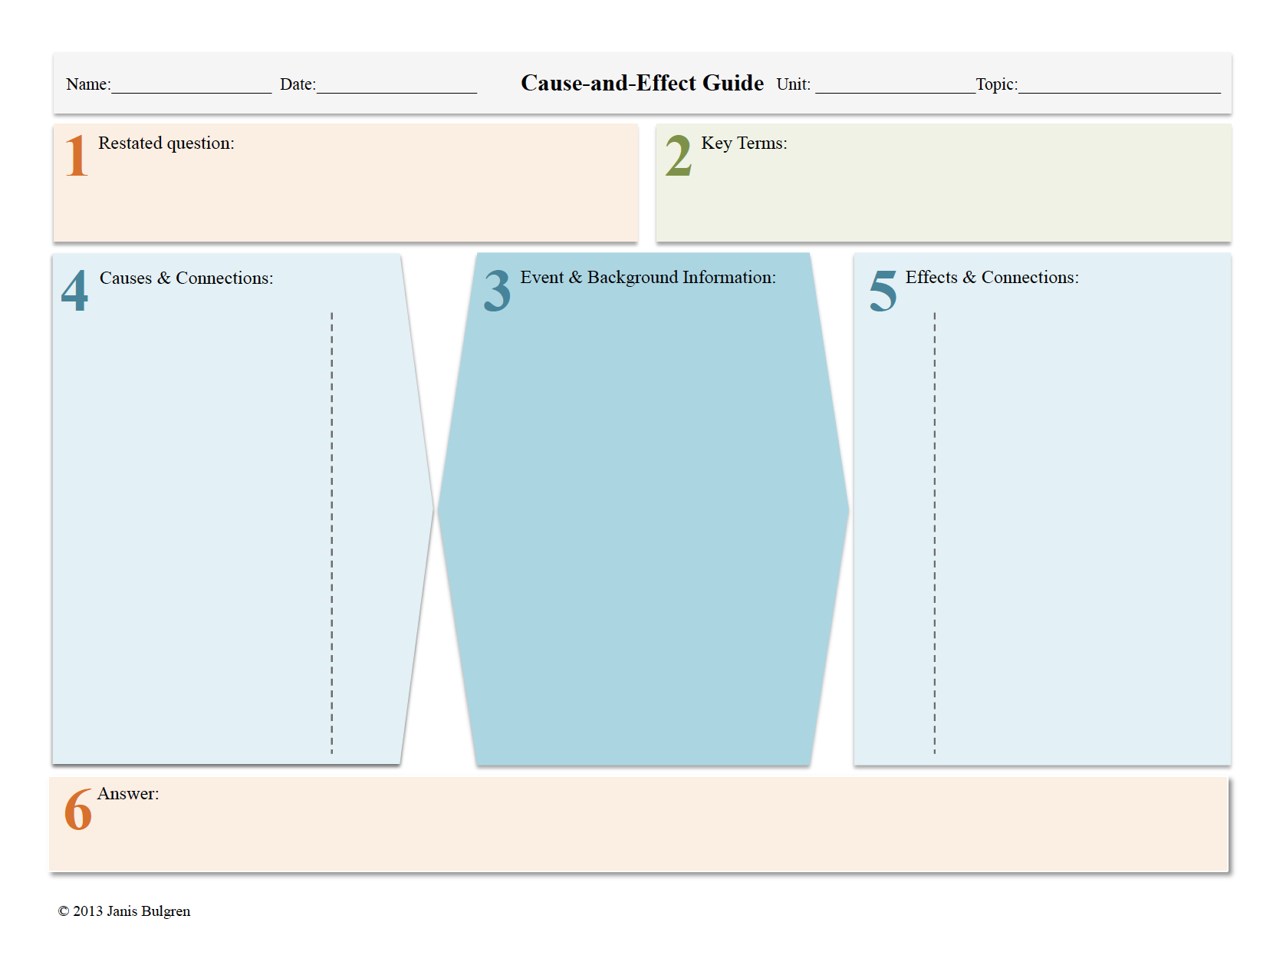
Where does this fit into Standards?

Slide 9
Purpose
The Scientific Argumentation Routine is a package of instructional methods that teachers can use to help students engage in higher order reasoning and critical thinking.
It helps students analyze a claim that has been made, and evaluate whether the evidence and reasoning would make you believe the claim.

Slide 10
Determine information
Identify claim,
evidence, reasoning
1
Argumentation & Evaluation Guide
Assess purpose &
point of view
Topic/Title A Little Lead is Too Much
Source Environmental Health
Name: Teacher
Date: _____________________________________
1
What is the Claim, including any Qualifiers)? (underline qualifiers) If the CDC cut the current acceptable lead level in the blood in half for children up to age 6 and enforced it, they would perform better on intelligence testing.
What Evidence is presented? Identify each as data, fact, theory or opinion.
A published study followed 200 children from 6 months to 6 years testing a total of 8 times and found that children with lead concentrations from 5 to 9.9 micrograms per deciliter preformed an average of 4.9 points lower on their IQ tests. (data)
In 2001, the head of the CDC said the acceptable level would probably be changed from 10 to 5 micrometers per deciliter of blood, but a change in committee changed that decision. (opinion)
Lower rates were requested by the Independent Clean Air Scientific Advisory Committee. (fact)
Eliminating lead in gasoline resulted in a sizeable increase in IQ levels in children throughout the country. (fact)
What type of reasoning proves the evidence supports the claim? (Identify as authority ,analogy, correlation, cause and effect, theory, principles or generalization)
The published study was well designed and cited. (authority)
The assumption was made that what was true for the sample group of 200 children is true for all children. (generalization)
Higher lead levels in the blood reduce IQ performance. (cause and effect)
2
4
Where does this fit into Standards?
3
Evaluate the evidence as poor, average or excellent and explain
(Use reliability, validity, objectivity, well designed experiment).
The published study was valid and well designed. (Excellent)
The other evidence is not well supported by facts, but I have heard of the CASAC (average)
5
Evaluate the source’s reasoning as poor, average or excellent and explain.
(Use logic, accepted ways of thinking, false assumptions)
I think the sources reasoning is excellent. It was based a good source and was logical.
6
What are concerns about (sources of error, counterarguments, questions)? Note if concerns are from source or reader.
Some members of the CDC Advisory Committee are from the lead industry. EPA does not want to enforce lower standards.
7
Conclusion: Accept/reject/withhold judgment. Present and summarize your reasoning. I accept the claim that lead level standards in children should be lowered
based on the arguments in the article. The research cited is an excellent source and earlier changes as a result of removing lead from gasoline seem to support the
Claim.
C Bulgren revised 2/15/2008

Slide 11
Purpose
“Teaching Decision-Making” is a package of instructional methods that teachers can use to help students engage in reasoning.
Although “reasoning” has many definitions, it is used here to identify an issue, options that could respond to the issue, ranking those options, considering other options, and making and explaining that decision

Slide 12
1. Decide the issue
3. Create important information | 2. Enter Option A |  | 2. Enter Option B
 | 4. Identify reasons for option A | 5. Set Rank | 4. Identify reasons for option B | 5. Set Rank
6. Identify compromises/alternatives
7. Offer a decision
8. Name reasons for the decision
Decision-Making Guide
Name: Date: Class: Topic:
Where does this fit into Standards?
© Teaching Decision-Making by Janis A. Bulgren. University of Kansas Center for Research on Learning (2018).

Slide 13
Purpose
The Question Exploration Guide is designed to enhance student ability to:
Explore existing background knowledge
Explore difficult questions
Build a repertoire of strategies to unpack critical content

Slide 14
Question Exploration Guide
Text Reference
Name:
Course
Critical
Question #:
Title
Unit
Lesson
Date:
1
What is the critical question?
2
What are the key terms and explanations?
3
What are the supporting questions and answers?
Where does this fit into Standards?
4
What is the main Idea answer?
5
How can we use the main idea again?
6
Is there an Overall Idea? Is there a real-world use?

Slide 15
How can we ensure that content teachers can guide students to produce an essay from the devices?

Slide 16
Support for Writing
See Chapter 4 for Guide to Write an Essay
Introductory paragraph
Body of Essay
Concluding Paragraph

Slide 17
Let’s Write a Theme – Scientific Argumentation P. 12
Paragraph 1 – Section 1 – Use the Claim
Paragraph 2 – Sections 2, 3, 4 Discussion of the Evidence
Paragraph 3 – Sections 5,6,7 Discussion of the Reasoning
Paragraph 4 – Section 8, The Rebuttals or New Questions
Paragraph 5 – Section 9, the Conclusion to explain whether the reasoning process led students to accept, reject or withhold judgement about the claim. Also the students explanation for this decision.

Slide 18
Let’s Write a Theme – Teaching cause & effect P. 9
Paragraph 1 – Section 1, Intro – use Critical Question to develop a topic sentence identifying C&E relationship of interest
Paragraph 2 – Sections 3, The Critical Event
Paragraph 3 – Section 4, The Cause(s) of the Event
Paragraph 4 – Section 5, The Effect(s) of the Event
OR cause/effect, cause/effect, cause/effect
Paragraph 5 – Section 6, The Conclusion justifying any claims, insights, or generalizations

Slide 19
Let’s Write a Theme – Decision-Making P. 30
Paragraph 1 – Introductory Paragraph – An Issue of Interest & Important Information about the Issue
Paragraph 2 – Step 2, Option A & Step 4, Reasons to Support Option A & Step 5, Among these reasons
Paragraph 3 – Step 2, Option B & Step 4 Reasons to Support Option B & Step 5, Among these reasons
Paragraph 4 –Step 6, Compromises or Alternatives to these Options include
Paragraph 5 – In conclusion, Step 7, the Best Response is to & Step 8, the Best Response for these Reasons

Slide 22
Read Aloud
What do you notice about your theme?
How will teachers find this helpful?
Are there specific content areas with which this will resonate?
What insights will you include in your PD?

Slide 23
Generate ideas/suggestions for PD

Slide 24
Thank you for diving in!

