Slide 1
COACHING SIM: How to Meet Teachers Where They Are to Support Them in Moving Forward
Janice Creneti
Assistant Manager, Florida SPDG SIM Project

Slide 2
What do you want to know?
If there is something specific you are interested in learning about or discussing during this session, please write it on a sticky note and hand it to Janice.

Slide 3
Our Learning Journey around Coaching
What (it is and is not)
Why?
Who?
How
Current Reality & Goals
Florida SPDG Coaching Structures
Necessary Conditions
Advocacy
Wrap-up
HLP Connections
Evaluations

Slide 4
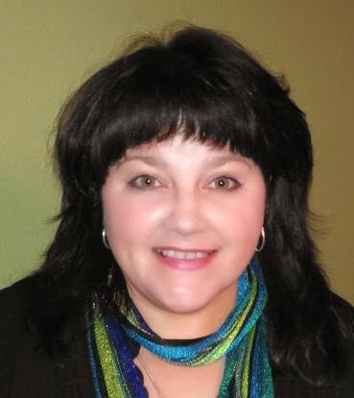
Expertise: Instructional Coaching, Adult Learning Principles, SIMTM Content Enhancement Routines,
Content Areas: Science, Math, CTE
Favorite Routines: Course Organizer, Unit Organizer, Clarifying, Concept Mastery, Question Exploration
Passions: Empowering educators & students, Championing change, The Strategic Instruction ModelTM (SIM), Equity, Theater - acting, directing, Nature & Animals
Janice Creneti
Assistant Manager, SPDG SIM Project, SIM CE PDer
Office: (727)588-6523 Cell: (941)518-5718
crenetij@pcsb.org

Slide 5
What are your experiences with coaching?
The good and the not so good...
Notes:
Chalk talk

Slide 6
Coaching...
looks like
does not look like
Job embedded professional learning driven by the learner
A journey to best practice (fidelity)
Decision making guided by data
One peer supports another peer in identifying and reaching (or moving toward) a goal around implementation of a practice
A reciprocal relationship based on trust
An expert telling a novice what to do
Evaluating (summative) practice
Decision making guided by emotion
Enforcing, spying, coercing, bribing, commiserating
Notes:
Put on your C&C or SIM hat as we discuss coaching

Slide 7
What do effective coaches do?
Listen first
and most of the time
Notes:
Put on your C&C or SIM hat as we discuss coaching

Slide 8
Clarifying Table – Instructional Coaching
Be prepared to educate others on coaching
This may involve myth busting
Notes:
Co-construct

Slide 9
Coaching is about preserving
(or reinstating)
educator
Voice & Choice*
*Partnership Principles, Jim Knight, www.instructionalcoach.org

Slide 10
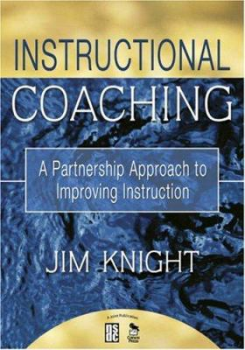
Jim Knight & the Instructional Coaching Group
Instructional Coaching
High Impact Instruction
The Impact Cycle
Focus on Learning
Better Conversations
Radical Learners Blog
www.instructionalcoaching.com/radical-learners/
Notes:
Tie into listening skills in mentor training

Slide 11
Why Coaching?
State of the profession
High turnover = lots of new teachers
Career Changers
Hierarchical system when collaboration is needed
Teachers are buried under multiple expectations
Adult learner needs
Job embedded PD
Praxis

Slide 12
Who Coaches Instruction?
Instructional Coaches
SIM PDers
Administrators
Fellow Teachers!!!

Slide 13
What does coaching for SIM look like?
What have you seen?
Think, Pair, Square

Slide 14
Support the teacher in getting a clear picture of current reality
(gotta know where you are to know where to go…)

Slide 15
Coach around the
teacher’s goal
(and support the journey to get there)

Slide 16
Talk about what worked and what to change up next time
(the teacher drives this discussion)
Check out Jim Knight’s The Impact Cycle for details on his model.

Slide 17
Coaching Structures used by the Florida SPDG SIM Project
Florida SPDG SIM Coaching Resources LiveBinder
https://www.livebinders.com/b/2569356
Access Key: SPDGSIMIC

Slide 18
Face-to-face Coaching Cycles
2 days
Coach is a SIM PDer
Day 1: coach meets w/ teacher during planning
Goal setting
Decisions about what to try in class the next day
Day 2: coach is with teacher in the classroom
Modeling or observation
Debrief afterwards or plan is made to debrief
Pros: relationship building, real time support
Cons: hard to schedule, not always enough manpower

Slide 19
Evidence Submission Coaching
Coach is a SIM PDer
Content Enhancement Evidence:
Teacher draft
Student Sample
Reflection
Learning Strategies Evidence
Scored Learning Sheets
Reflection
Pros: able to coach teacher on application, coaches can work any time
Con: feedback may be delayed

Slide 20
Implementation Observations
Pros: video is easy to schedule, teachers have a clear target
Con: may be perceived as evaluative
Only after 1 full year of implementation
Coach is a SIM PDer
In person or video
CE: Guided by the Cue Do Review checklist
LS: Guided by modeling checklist or student folder checklist

Slide 21
Face-to-face Coaching Cycles
2 days
Coach is a SIM PDer
Day 1: coach meets w/ teacher during planning
Goal setting
Decisions about what to try in class the next day
Day 2: coach is with teacher in the classroom
Modeling or observation
Debrief afterwards or plan is made to debrief
Pros: relationship building, real time support
Cons: hard to schedule, need manpower

Slide 22
Facilitated Planning
During or after contract hours
Facilitator is a SIM PDer/Specialist
Content Enhancement:
Teachers develop or revise devices, extensions
Reflect on and plan for Cue-Do-Review
Troubleshoot concerns
Learning Strategies:
Teachers score or review scoring of pretests, learning sheets
Reflect on and plan for think alouds, modeling, 3 to 1 interactions
Troubleshoot concerns including managing materials
Pros: relationship building, real time support
Cons: may require $$$

Slide 23
Lesson Study
Pros: builds collegiality, allows teachers to watch students
Cons: time and resource intensive
Group of teachers who teach the same or similar class + invested other
Facilitator is a SIM PDer/Specialist
Done over 1 or 2 days
Whole team involved in planning the lesson
Whole team OBSERVES the lesson (data collection including the instructional sequence)
Often our facilitator teaches the lesson

Slide 24
Coaching Summits & Seminars
Why:
Build capacity for coaching by supporting teachers and instructional coaches in coaching SIM even if they are not PDers
Build a common vocabulary, skill set and clear picture of effective coaching
What:
Provide PD on Instructional Coaching
1.5 – 2 days
Cross district
Opportunities to practice coaching SIM
Adding Systems Coaching

Slide 25
Talk at Your Tables
Did you see a model you might want to explore?
How might you tweak it for your situation?
How might you address the“cons”?
Choose a table member to share your team brilliance with the whole group
Share outs

Slide 26
Building Trust
True coaching only happens inside a positive, safe relationship SO...
Be reliable
Be honest
Be caring/practice empathy
Maintain confidentiality
Hold and nurture the “possible”

Slide 27
Coaching success requires a system
(including leadership)
that creates safe space

Slide 28
7 Success Factors for Coaching (the environment in which coaching happens)
Coaching Cycle (how will coaching happen?)
Understanding Adults
Playbook (what are we coaching around?)
Using Data
Communication
Leadership – Responsive & Reliable
System Support
Knight, Jim. “Seven Success Factors for Instructional Coaching Programs.” Principal Leadership, March 2015: pgs 24-27
Notes:
Participants rank 1-7 where they think their “environment” is, talk with a neighbor - consensogram

Slide 29
Advocating for Coaching
Why this is necessary
May involve myth busting and clarifying
Draw connections to professional development
Use data
as local as you can
as recent as you can
Use stories
from teachers
from students

Slide 30
Connections to HLPs for Special Education
HLP 11 Instruction: Identify and prioritize long and short term learning goals
HLP 12 Instruction: Systematically design instruction toward a specific learning goal
HLP14 Teach cognitive and metacognitive strategies to support learning and independence.
HLP15 Provide scaffolded supports.
HLP16 Use explicit instruction.
HLP18 Use strategies to promote active student engagement.
HLP20 Provide positive and constructive feedback to guide students’ learning and behavior.
HLP21 Teach students to maintain and generalize new learning across time and settings.
HLP22 Provide intensive instruction.
HLP1 Collaborate with professionals to increase student success.
HLP2 Collaboration: Organize and facilitate effective meetings with professionals and families
HLP5 Interpret and communicate assessment information with stakeholders to collaboratively design and implement educational programs.
HLP6 Use student assessment data, analyze instructional practices, and make necessary adjustments that improve student outcomes.

Slide 31
Connections to HLPs for General Education
HLP 2: Explaining and modeling content, practices, and strategies
HLP 4: Diagnosing particular common patterns of student thinking and development in a subject-matter domain
HLP 5: Implementing norms and routines for classroom discourse and work
HLP 6: Coordinating and adjusting instruction during a lesson
HLP 8: Implementing organizational routines
HLP 13: Setting ling and short term learning goals for students
HLP 14: Designing single lessons and sequences of lessons
HLP 16: Selecting and designing formal assessments for student learning
HLP 17: Interpreting the results of student work, including routine assignments, quizzes, test, projects, an standardized assessments
HLP 19: Analyzing instruction for the purpose of improving it

Slide 32
What are you wondering now?

Slide 33
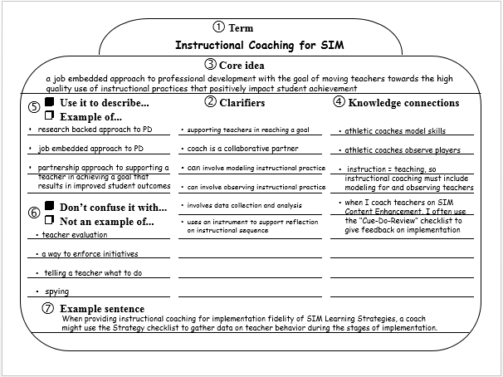

Slide 35
Exit Ticket
Please reflect on today and tell us...
What's working for you?
What adjustments would you like us to make?

