Slide 1
The Content Enhancement Approach
The only instructional method for content classes shown to improve the performance of ALL students

Slide 2
Definitions
“Research based” program (or “evidence-based”)
A program containing a package of instructional methods, some of which have been shown to be effective (e.g., reinforcement).
• “Empirically validated” program
A program which has been validated in a methodologically sound research study which has been published.

Slide 3
Three Ways to Determine Value
Statistical significance
Effect size
Social significance

Slide 4
Statistical Significance
Probability is less than .05 that two groups are the same

Slide 5
Cohen’s d Effect Size
d = .2 to .4 is small
d = .5 to .7 is medium
d = above .8 is large

Slide 6
Social Significance
Use what you know about the world to make a decision about whether something is socially significant.

Slide 7
Four Content Enhancement Routines
Concept Mastery Routine
Concept Comparison Routine
Concept Anchoring Routine
Question Exploration Routine

Slide 8
Concept Anchoring Routine

Slide 9
Anchoring Known Information to New Information

Slide 10
Anchoring Table
Unit:_________________
Name:_________________
Date:
3.
Known
Information
2. Known Concept
Clique
New Concept
Articles of Confederation
Group
Friends
Chosen
Join
Kicked out
Not
Required
Popular
4. Characteristics
Members come/go
6.Characteristics Shared
Loose association
5. Characteristics of New Concept
Some states joined
Picked/choose
Voluntary
participation
States joined/left
Leader(s) may have some power
Limited power
Little central power
Limited benefits
States saw few benefits from conf.
Members may get support/perks
7. Understanding of the New Concept:
The Articles of Confederation were like a clique because the states were in a loose association, participation was voluntary (states could decide to join or leave), central power was very limited, and benefits were limited.
ANCHORS 1. Announce 2. Name 3. Collect 4. Highlight 5. Observe 6. Reveal 7. State
Linking Steps: the New Concept Known Concept Known Information Characteristics of Characteristics Characteristics Understanding
Known Concept of New Concept Shared of New Concept

Slide 11
Research Study 1
83 students
In 8 inclusive science classes
Classes assigned randomly to conditions
4 classes in each condition

Slide 12
Four Types of Students
High Achievers (HA): GPAs above 3.5
Normal Achievers (NA): No more than 1 “C,” GPAs below 3.49
Low Achievers (LA): 2 grades below “C” in one semester in previous year
Students with LD (LD): Formally classified

Slide 13
Two Concepts Taught
Commensalism
Pyramid of Numbers

Slide 14
Conditions
Condition 1: Pyramid of Numbers was enhanced with the routine
Condition 1: Commensalism was taught as usual (lecture)
Condition 2: Commensalism was enhanced
Condition 2: Pyramid of Numbers was taught as usual (lecture)

Slide 15
Figure 1: Design for the Concept Anchoring Routine Study
Condition 1: Sub-Groups of Students
Concept | LD | LA | NA | HA
Pyramid of Numbers | Enhanced | Enhanced | Enhanced | Enhanced
Commensalism | Not Enhanced | Not Enhanced | Not Enhanced | Not Enhanced
Condition 2: Sub-Groups of Students
Concept | LD | LA | NA | HA
Pyramid of Numbers | Not Enhanced | Not Enhanced | Not Enhanced | Not Enhanced
Commensalism | Enhanced | Enhanced | Enhanced | Enhanced

Slide 16
Figure 2: Results for Student Subgroups
Condition 1
(Commensalism Enhanced)
Condition 2
(Pyramid of Numbers Enhanced)

Slide 17
Statistical Significance for Study 1
Whole group differences:
Commensalism enhanced:
p < .000
• Pyramid of numbers enhanced:
p < .001

Slide 18
Statistical Significance for Study 1
Subgroup differences:
Commensalism
LAs: p < .05
NAs: p < .05
HAs: p < .05
Pyramid of numbers
LDs: p < .05
NAs: p < .05

Slide 19
Effect Sizes for Study 1
To be added when calculated

Slide 20
Social Significance (Pyramid of Numbers)
77% LDs passed in enhanced condition vs. 27% in the non-enhanced condition
86% of LAs passed in enhanced condition vs. 50% in the non-enhanced condition
93% of NAs passed in the enhanced condition vs. 64% in the non-enhanced condition
100% of HAs passed in the enhanced condition vs. 100% in the non-enhanced condition.

Slide 21
Research Study 2
43 preservice teachers
Assigned randomly to conditions
Actual Workshop = Live instruction
Virtual Workshop = CD instruction
Everyone got Concept Anchoring Instruction

Slide 22
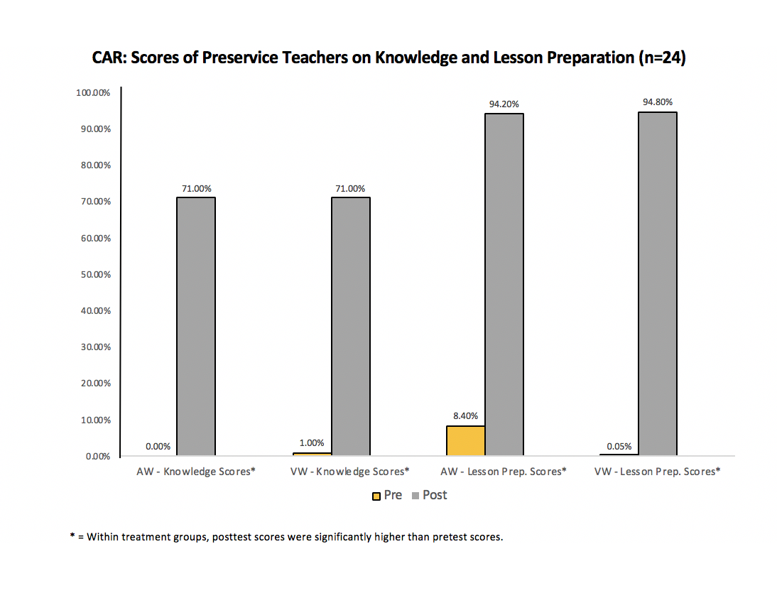
CAR: Scores on Preservice Teachers on Knowledge & Lesson Preparation Tests (n = 43)

Slide 23
No Differences Between the Groups
VW is as powerful as
AW instruction

Slide 24
Cohen’s d Effect Sizes between pretest and posttest for both groups
Knowledge Test
d = 7.5 (very large)
Preparation Test
d = 12.8 (very large)

Slide 25
Research Study 3
24 teachers
Assigned randomly to conditions (12/group)
Actual Workshop (AW) = Live instruction
Virtual Workshop (VW) = CD instruction
244 students in their classes
26 students w/ LD in VW classes
36 Students w/LD in AW classes

Slide 26
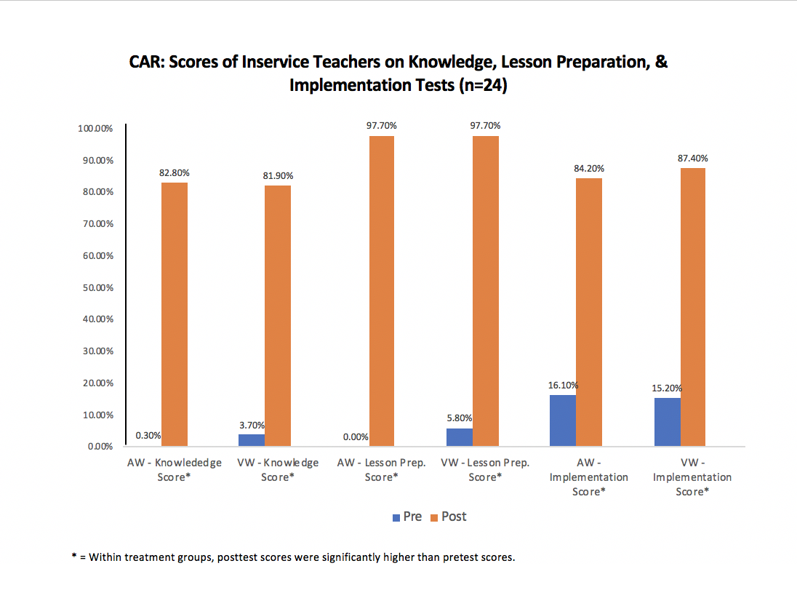

Slide 27
No Differences Between the Teacher Groups
VW is as powerful as
AW instruction

Slide 28
Cohen’s d Effect Sizes between pretest and posttest for both groups
Knowledge Test
d = 10.0 (very large)
Preparation Test
d = 29.7 (very large)
• Implementation
d = 13.0 (very large)

Slide 29
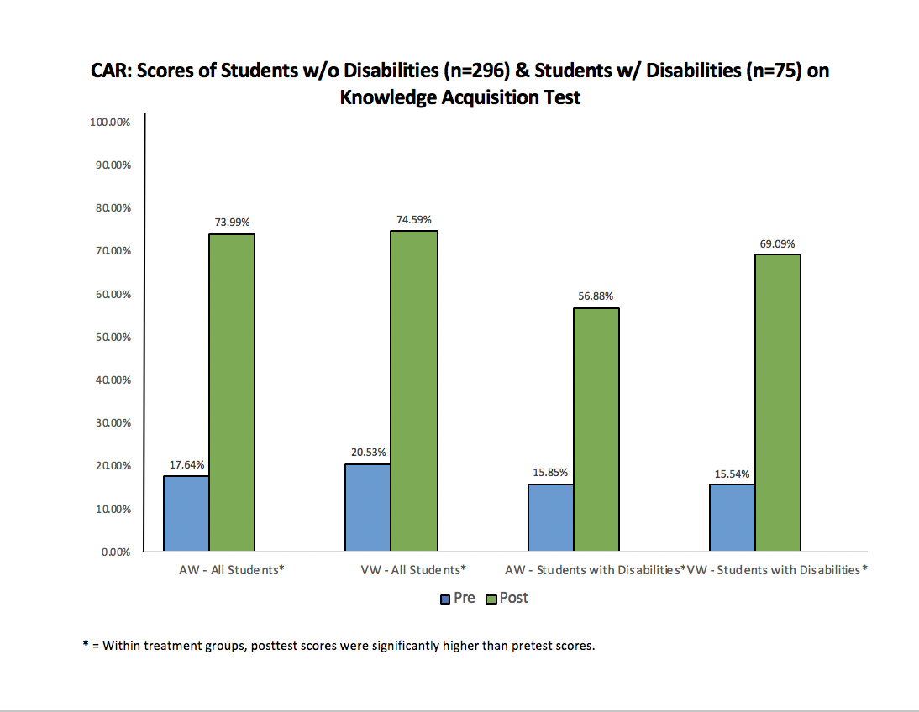
CAR: Scores of All Students (n = 244) & Students with Disabilities (n = 62) on
Knowledge Acquisition Test

Slide 30
Differences Between the Whole Student Groups
VW students earned significantly higher scores than AW students
d = .38 (small effect)

Slide 31
Cohen’s d Effect Sizes between pretest and posttest
VW students
d = 1.49 (very large)
AW students
d = .949 (large)

Slide 32
Differences Between the LD Groups
VW LD students earned higher scores than AW LD students
d = .387 (small effect)
Notes:
The groups were small, so the difference only approached significance.

Slide 33
Cohen’s d Effect Sizes between pretest and posttest - students w/ LD
VW students
d = 1.3 (very large)
AW students
d = 1.0 (very large)

Slide 34
Question Exploration Routine

Slide 35
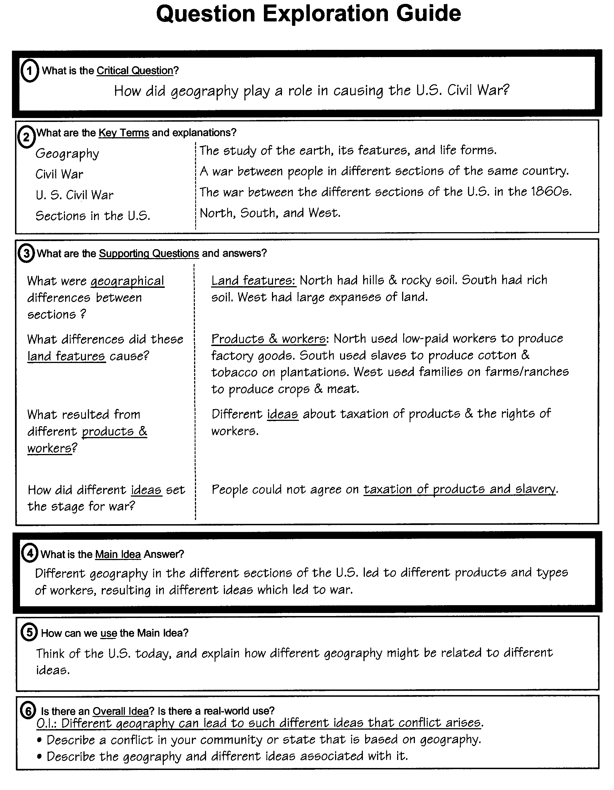

Slide 36
Research Study 1
134 students
Grade 9, ELA classes
Classes randomly assigned to conditions: Lecture method
Question Exploration Routine

Slide 37
Four Types of Students
High Achievers (HA): GPAs above 3.5
Average Achievers (AA): No more than 1 “D” or “F” in previous year
Low Achievers (LA): at least 2 “Ds” or “Fs” in previous year
Students with Disabilities (SWDs): Formally classified as LD, OHI, or ADD

Slide 38
Experimental Design
Two Topics Related to Romeo & Juliet:
Prejudice
Impetuous Behavior
Pretest/Posttest Control Group Design
Students in the Control Classes-Lecture
Students in the Experimental Classes- Question Exploration Routine & Guide

Slide 42
Teacher Satisfaction
(Sw/LD)= students with learning disabilities (S) = students with out learning disabilities

Slide 43
Statistical Significance for Study 1
Whole group differences on whole test:
Prejudice enhanced:
p < .007
• Impetuous Behavior enhanced:
p < .0007

Slide 44
Effect Sizes for Study 1
Whole group differences for the whole test:
Prejudice enhanced:
d = .94 (large)
Impetuous behavior enhanced:
d = 1.23 (very large)

Slide 45
Social Significance
Prejudice mean test score differences
For LAs: 15% points
For AAs: 20% points
For HAs: 24% points
• Impetuous Behavior mean test score differences
For SWDs: 17% points
For LAs: 19% points
For AAs: 26% points
For HAs: 23% points

Slide 46
Research Study 2
20 preservice teachers
Assigned randomly to groups (10/group)
Actual Workshop = Live instruction
Virtual Workshop = CD instruction
Everyone got Question Exploration Instruction

Slide 47
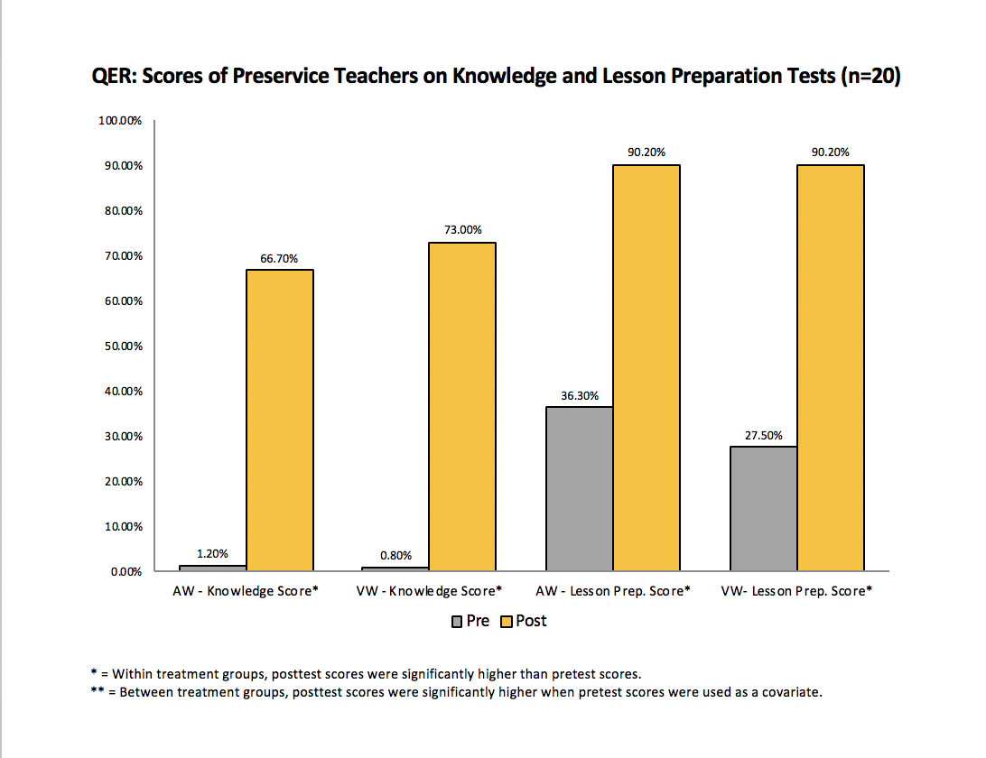

Slide 48
No Differences Between the Groups
VW is as powerful as
AW instruction

Slide 49
Cohen’s d Effect Sizes between pretest and posttest
Knowledge Test
VW: d = 7.73 (very large)
AW: d = 9.69 (very large)
Preparation Test
VW: d = 9.44 (very large)
AW: d = 6.89 (very large)

Slide 50
Research Study 3
20 inservice teachers
Assigned randomly to groups (10/group)
Actual Workshop (AW) = Live instruction
Virtual Workshop (VW) = CD instruction
243 students in their classes
32 students w/ LD in VW classes
38 Students w/LD in AW classes

Slide 51
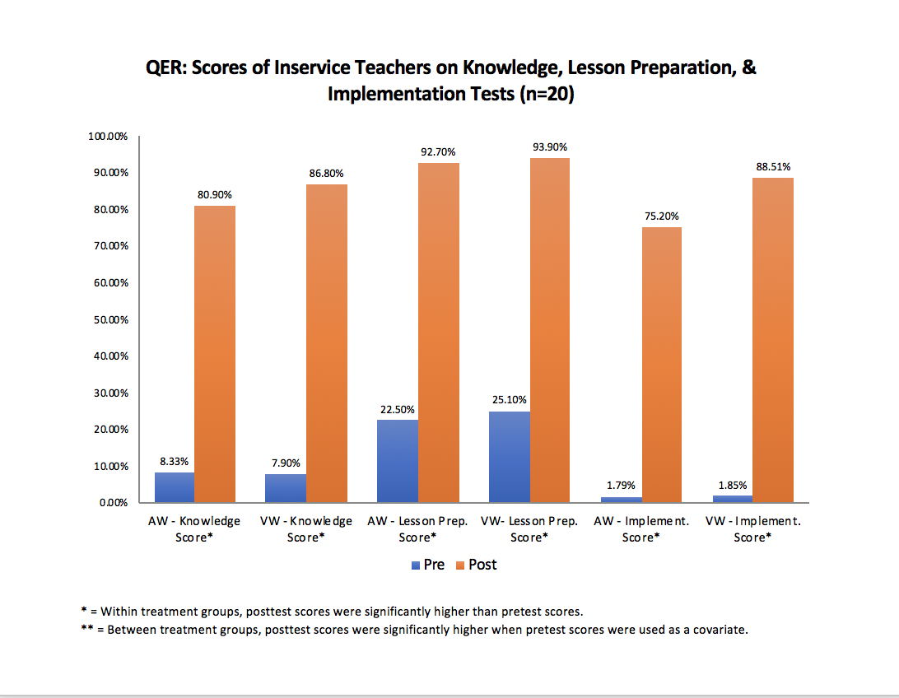

Slide 52
No Differences Between the Groups
VW is as powerful as
AW instruction

Slide 53
Cohen’s d Effect Sizes between pretest and posttest
Knowledge Test
VW: d = 14.43 (very large)
AW: d = 13.92 (very large)
Preparation Test
VW: d = 8.10 (very large)
AW: d = 8.49 (very large)

Slide 54
Cohen’s d Effect Sizes between pretest and posttest
Implementation
VW: d = 13.71 (very large)
AW: d = 9.31 (very large)

Slide 55
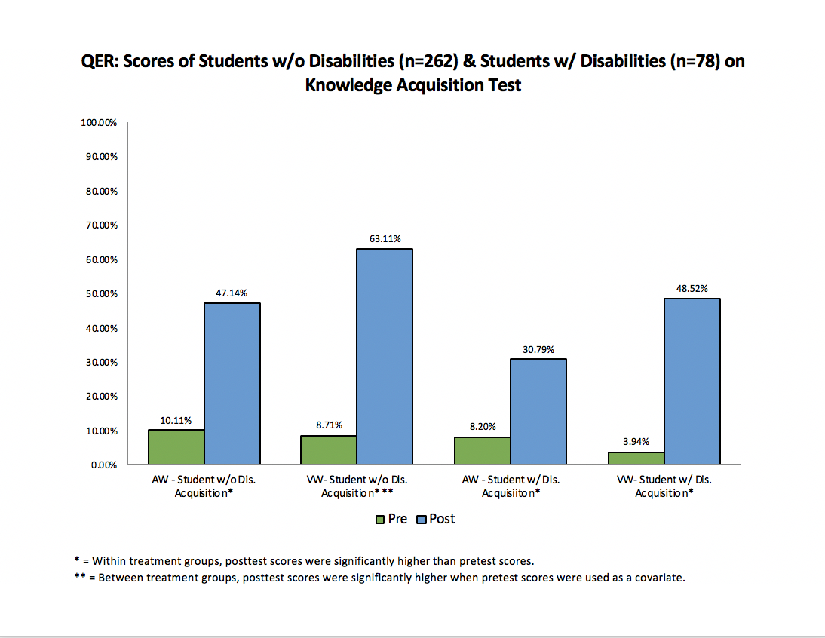

Slide 56
Between-group Differences
No differences between the
Whole groups of VW and AW students

Slide 57
Cohen’s d Effect Sizes between pretest and posttest
VW students
d = 2.514 (very large)
AW students
d = 1.539 (very large)

Slide 58
Differences Between the LD Groups
No differences between the LD groups of students
Notes:
The groups were small, so the difference only approached significance.

Slide 59
Cohen’s d Effect Sizes between pretest and posttest - students w/ LD
VW students
d = 1.0 (very large)
AW students
d = .76 (medium)

Slide 60
Conclusions
Content Enhancement Routines produce enhanced learning for subgroups of students.
Multimedia instruction works as well as live instruction for teachers.
Teachers taught with multimedia instruction produce the same (or better) gains in student learning as teachers taught with live instruction.

