Slide 1
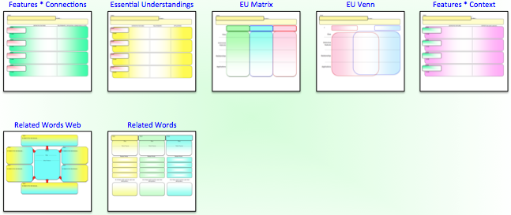
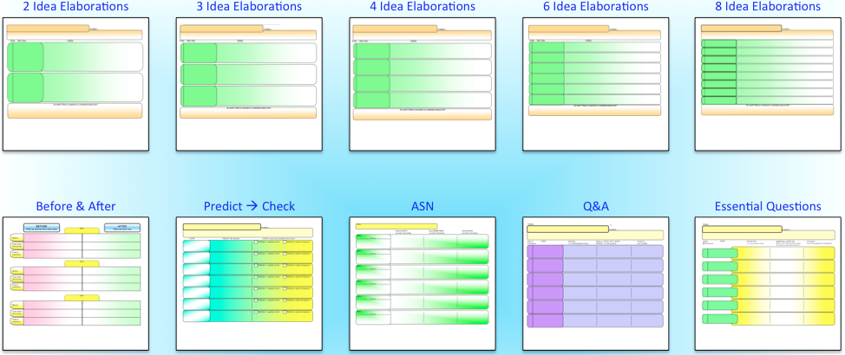
© Edwin Ellis All Rights Reserved MakesSenseStrategies.com
Framing Vocabulary
Edwin Ellis Linda Ellis
Vocabulary Frames for terms with
CONCISE definitions
Vocabulary Frames for terms with
ELABORATED definitions
For terms that address very specific concepts (often technical terms) that have a limited set of distinguishing characteristics
For terms that address broad concepts that have multiple essential understandings
Feature 4 types of vocabulary knowledge…
Feature use of metacognitive strategies…
Class
Analyzing & summarizing
Critical features
Forming inferences & predictions
Relationship Connections
Self-evaluation
Applications
Questioning

Slide 2
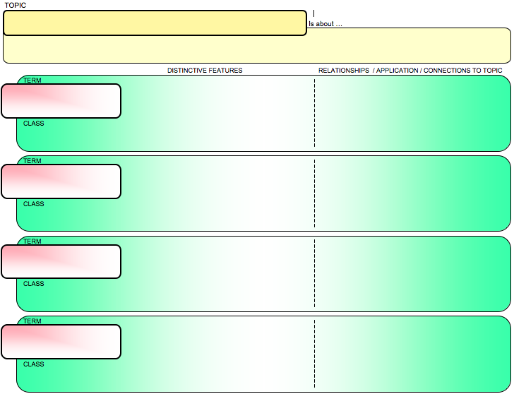
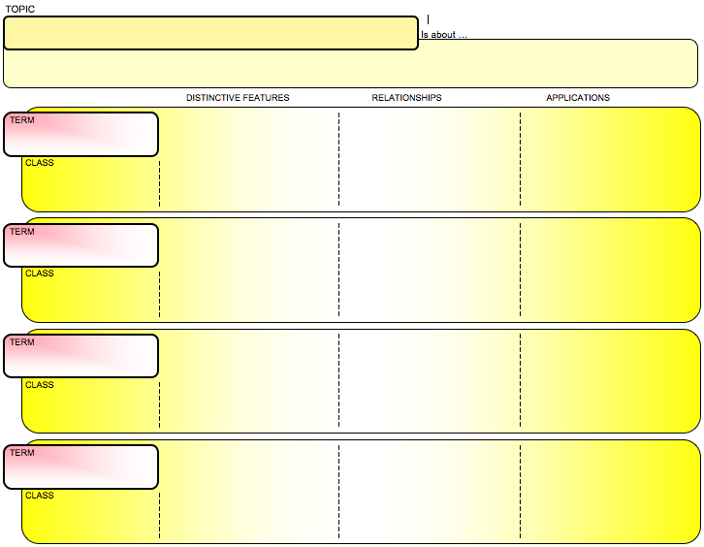
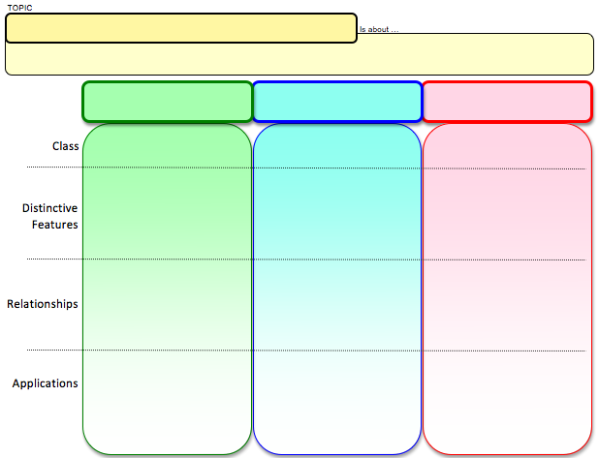
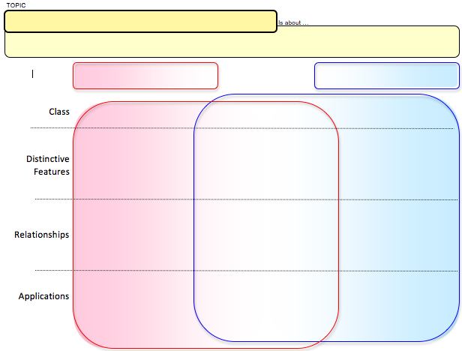
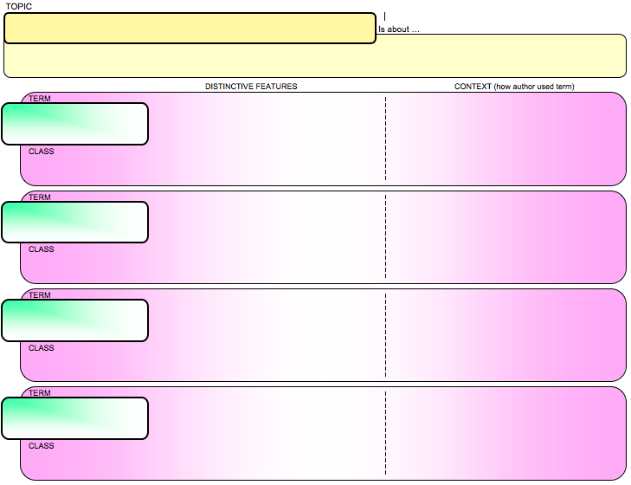
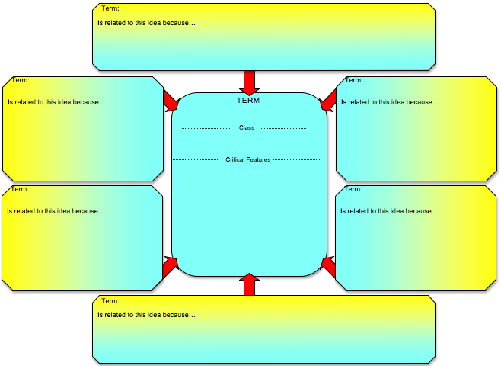
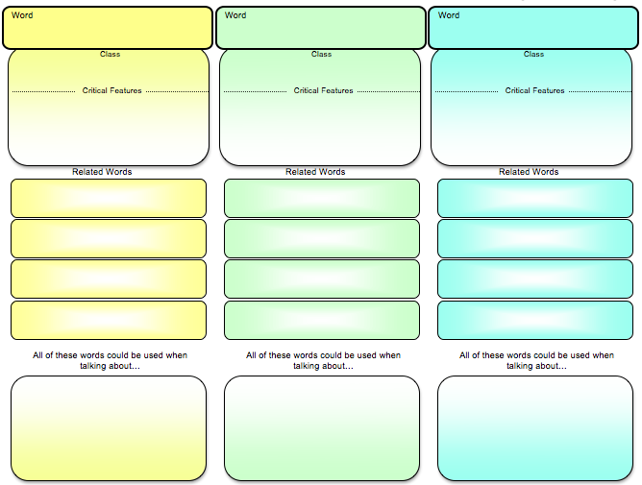
smart visual tools
© Edwin Ellis All Rights Reserved MakesSenseStrategies.com
features * connections
Vocabulary frames for terms with CONCISE definitions
Features * Connections
Essential Understandings
EU Matrix
EU Venn
Features * Context
.
Related Words Web
Related Words
.
.

Slide 3
smart visual tools
© Edwin Ellis All Rights Reserved MakesSenseStrategies.com
CONCISE DEFINITIONS: features * connections
TOPIC
The Diary of Anne Frank
Is about …
TOPIC
DISTINCTIVE FEATURES RELATIONSHIPS / APPLICATION / CONNECTIONS TO TOPIC
TERM
Topic of lesson
May be derived from one of the unit subtopics
May be the category representing all of the targeted terms
CLASS
TERM
CLASS
TERM
CLASS
TERM
CLASS

Slide 4
smart visual tools
© Edwin Ellis All Rights Reserved MakesSenseStrategies.com
CONCISE DEFINITIONS: features * connections
TOPIC
The Diary of Anne Frank
Is about …
a young Jewish girl’s life in Amsterdam, Holland as she and her family hide from the Nazis during World War II.
DISTINCTIVE FEATURES RELATIONSHIPS / APPLICATION / CONNECTIONS TO TOPIC
TERM
Is about…
May be “definition” of topic
May be brief description, summary, or gist of topic
May be statement of relevance or importance
CLASS
TERM
CLASS
TERM
CLASS
TERM
CLASS

Slide 5
smart visual tools
© Edwin Ellis All Rights Reserved MakesSenseStrategies.com
CONCISE DEFINITIONS: features * connections
TOPIC
The Diary of Anne Frank
Is about …
a young Jewish girl’s life in Amsterdam, Holland as she and her family hide from the Nazis during World War II.
DISTINCTIVE FEATURES RELATIONSHIPS / APPLICATION / CONNECTIONS TO TOPIC
TERM
distraught
CLASS
TERM
TERM
Term should be…
Critical for all to know in order to understand key ideas of lesson
Critical to remember
CLASS
TERM
CLASS
TERM
CLASS

Slide 6
smart visual tools
© Edwin Ellis All Rights Reserved MakesSenseStrategies.com
CONCISE DEFINITIONS: features * connections
TOPIC
The Diary of Anne Frank
Is about …
a young Jewish girl’s life in Amsterdam, Holland as she and her family hide from the Nazis during World War II.
DISTINCTIVE FEATURES RELATIONSHIPS / APPLICATION / CONNECTIONS TO TOPIC
TERM
distraught
CLASS
an emotion
TERM
CLASS
CLASS
The category of the word
Supra-ordinate concept
Group of which the term is a member
When possible…
Use student friendly language that helps narrow the term to a specific class or group
TERM: Joiner
POOR: A noun
BETTER: A person who…
BEST: A type of carpenter who…
TERM
CLASS
TERM
CLASS

Slide 7
smart visual tools
© Edwin Ellis All Rights Reserved MakesSenseStrategies.com
CONCISE DEFINITIONS: features * connections
TOPIC
The Diary of Anne Frank
Is about …
a young Jewish girl’s life in Amsterdam, Holland as she and her family hide from the Nazis during World War II.
DISTINCTIVE FEATURES RELATIONSHIPS / APPLICATION / CONNECTIONS TO TOPIC
TERM
distraught
Distinctive Features
CLASS
an emotion
Distinctive details about the term that separate it from other similar concepts.
May share some features with other terms in same class, but the targeted term will also have exclusive features
BOTTOM LINE… critical thing students need to remember about the term
TERM
CLASS
TERM
Be sure to…
Use student-friendly language
Avoid defining terms using other terms that also need defining
Avoid using derivatives of the term to define the term.
CLASS
TERM
CLASS

Slide 8
smart visual tools
© Edwin Ellis All Rights Reserved MakesSenseStrategies.com
CONCISE DEFINITIONS: features * connections
TOPIC
The Diary of Anne Frank
Is about …
a young Jewish girl’s life in Amsterdam, Holland as she and her family hide from the Nazis during World War II.
DISTINCTIVE FEATURES RELATIONSHIPS / APPLICATION / CONNECTIONS TO TOPIC
TERM
extremely
distraught
emotionally upset
to the point of being disabled or
CLASS
an emotion
unable to act
TERM
When possible…
Separate each feature to make them more distinguishable
CLASS
TERM
CLASS
TERM
CLASS

Slide 9
smart visual tools
© Edwin Ellis All Rights Reserved MakesSenseStrategies.com
CONCISE DEFINITIONS: features * connections
TOPIC
The Diary of Anne Frank
Is about …
a young Jewish girl’s life in Amsterdam, Holland as she and her family hide from the Nazis during World War II.
DISTINCTIVE FEATURES RELATIONSHIPS / APPLICATION / CONNECTIONS TO TOPIC
TERM
extremely
distraught
emotionally upset
Relationships / Applications / Connections to Topic
to the point of being disabled or
CLASS
an emotion
unable to act
Addresses the meaningful relationships between the term and…
CONTENT CONNECTIONS
Like…
the topic of study
other terms, examples, applications. phenomena, relevance, etc.
TERM
CLASS
TERM
CLASS
and/or
PERSONAL CONNECTIONS
Like…
related background knowledge
personal experiences
TERM
CLASS

Slide 10
CONCISE DEFINITIONS: features * connections
TOPIC
The Diary of Anne Frank
Is about …
a young Jewish girl’s life in Amsterdam, Holland as she and her family hide from the Nazis during World War II.
DISTINCTIVE FEATURES RELATIONSHIPS / APPLICATION / CONNECTIONS TO TOPIC
TERM
extremely
Many Jews were so distraught about what the Nazis were doing
to Jews that they couldn’t think of ways to save themselves .
distraught
emotionally upset
to the point of being disabled or
CLASS
an emotion
unable to act
TERM
…unpleasant, irritable, sour
- some act sullen on purpose as a way to punish people they are mad at or to get what they want
Dussel was acting very sullen – he didn’t speak to Ann for two days and avoided her whenever he could.
sullen
CLASS
a behavior
TERM
…so bad that
others think
the person will never learn
to behave
Nazis viewed all Jews as incorrigible people who were dirty and dishonest and would pollute their “master race.”
incorrigible
CLASS
a behavior
TERM
…move from one country to a
new country and
settle there
permanently
Many Jews tried to immigrate to other countries, but most of the countries would not let them come. They had nowhere to go.
immigrate
CLASS
An action

Slide 11
smart visual tools
© Edwin Ellis All Rights Reserved MakesSenseStrategies.com
TIPS…
features * connections
Use at the BEGINNING of a lesson to pre-teach or review key vocabulary.
Use DURING a lesson for guided note-taking
Use at the END of the lesson to review and anchor key terms taught during the lesson.
Good choice for first-time users of Vocabulary Frames™
Ideally, each feature should be noted on a separate line, (assuming space allows)
person who…
Immigrant =
moves from one country
to a new country and
settles there
permanently
Most difficult = identifying the CLASS
(dictionary definitions often omit this component)

Slide 12
smart visual tools
© Edwin Ellis All Rights Reserved MakesSenseStrategies.com
SIMPLE
SOPHISTICATED
Features * Connections
Essential Understandings

Slide 13
smart visual tools
© Edwin Ellis All Rights Reserved MakesSenseStrategies.com
essential understandings
Vocabulary frames for terms with CONCISE definitions
Features * Connections
Essential Understandings
EU Matrix
EU Venn
Features * Context
.
Related Words Web
Related Words
.
.

Slide 14
smart visual tools
© Edwin Ellis All Rights Reserved MakesSenseStrategies.com
CONCISE DEFINITIONS: essential understandings
TOPIC
Is about …
CRITICAL FEATURES
CONNECTIONS
APPLICATIONS
Content and/or Personal Connections
How author used term, how term applies in other situations or real world
TERM
CLASS
TERM
CLASS
TERM
CLASS
TERM
CLASS

Slide 15
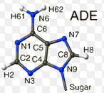
smart visual tools
© Edwin Ellis All Rights Reserved MakesSenseStrategies.com
CONCISE DEFINITIONS: essential understandings
TOPIC
Genetic fundamentals
Is about …
A coding system that is passed from parents to offspring that provides detailed instructions about not just traits but also how organs are developed and how everything in the body works
CRITICAL FEATURES
CONNECTIONS
APPLICATIONS
Content and/or Personal Connections
How author used term, how term applies in other situations or real world
TERM
In cell nucleus
Cells → Nucleus → Nucleic acids
NUCLEIC ACIDS
contains hereditary info
CLASS
type of molecule
essential for life
TERM
Connections
Content and/or Personal Connections
CLASS
TERM
CLASS
TERM
CLASS

Slide 16
smart visual tools
© Edwin Ellis All Rights Reserved MakesSenseStrategies.com
CONCISE DEFINITIONS: essential understandings
TOPIC
Genetic fundamentals
Is about …
A coding system that is passed from parents to offspring that provides detailed instructions about not just traits but also how organs are developed and how everything in the body works
CRITICAL FEATURES
CONNECTIONS
APPLICATIONS
Content and/or Personal Connections
How author used term, how term applies in other situations or real world
TERM
In cell nucleus
Cells → Nucleus → Nucleic acids
Provide information for regulating body functions like digestive system
NUCLEIC ACIDS
contains hereditary info
CLASS
type of molecule
essential for life
TERM
Applications
How author used term, how term applies in other situations or real world
CLASS
TERM
CLASS
TERM
CLASS

Slide 17
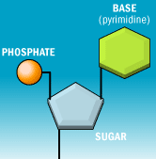
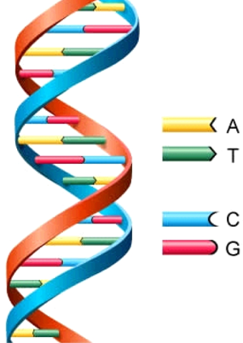
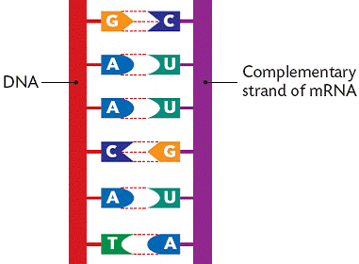
CONCISE DEFINITIONS: essential understandings
TOPIC
Genetic fundamentals
Is about …
A coding system that is passed from parents to offspring that provides detailed instructions about not just traits but also how organs are developed and how everything in the body works
CRITICAL FEATURES
CONNECTIONS
APPLICATIONS
Content and/or Personal Connections
How author used term, how term applies in other situations or real world
TERM
In cell nucleus
Cells → Nucleus → Nucleic acids
Provide information for regulating body functions like digestive system
NUCLEIC ACIDS
contains hereditary info
CLASS
type of molecule
essential for life
TERM
Makes up a nucleic acid-
3 parts:
* 5-carbon sugar
* nitrogen-containing base,
* phosphate
Cells → Nucleus → Nucleic acids → Nucleotides
“Code” in a nucleic acid that creates a blueprint of instructions in DNA & RNA
NUCLEOTIDE
CLASS
type of monomer
DNA
(deoxyribonucleic acid)
Contains sugar deoxyribose
2 strands of nucleotides
Spiral staircase shaped
Contains these bases: adenine, quinine, cytosine, thymine
Cells → Nucleus → Nucleic acids → Nucleotides
→ DNA
Carries instructions →controls cell activities
DNA inherited =instructions passed to offspring
DNA molecules duplicate themselves
TERM
CLASS
type of
nucleic acid
RNA
(ribonucleic acid)
Contains sugar ribose
Single-stranded nucleic acid molecule
Contains these bases: adenine, quinine, cytosine, uracil
Messenger RNA caries coded instructions for protein synthesis from
DNA to ribosome
order
Transfer RNA brings amino acids to ribosome in correct order to be built into protein
Ribosomal RNA make up structure of a ribosome
TERM
CLASS
type of
nucleic acid

Slide 18
smart visual tools
© Edwin Ellis All Rights Reserved MakesSenseStrategies.com
TIPS…
essential understandings
Easy to add pictures
GOOD idea to have students draw the pictures
Scaffolding instruction is REALLY important!
“gradual release”
I do it
We do it
Y’all do it
You do it

Slide 19
smart visual tools
© Edwin Ellis All Rights Reserved MakesSenseStrategies.com
essential understandings matrix
Vocabulary frames for terms with CONCISE definitions
Features * Connections
Essential Understandings
EU Matrix
EU Venn
Features * Context
.
Related Words Web
Related Words
.
.

Slide 20
CONCISE DEFINITIONS: essential understandings matrix
smart visual tools
© Edwin Ellis All Rights Reserved MakesSenseStrategies.com
TOPIC
Blood cells
Is about …
Three types of cells found in mammal’s blood, their roles, and what happens when there are problems
Platelets
White Blood Cells
Red Blood Cells
Class
Pieces of cells
found in blood
Type of cell
found in blood
Type of cell
found in blood
Surface contains proteins that allow them to stick to breaks in blood vessel wall & stick to each other. Contain granules that secrete proteins - creates firm plug to seal blood vessel breaks
Found both blood & lymphatic system
Most produced in bone marrow
Live 3-4 days
1% of the total blood volume
Change according to situation
Rich in hemoglobin, an iron-containing molecule that binds oxygen (why they are red)
All produced in bone marrow
Live 100-120 days
About 25% of cells in body
Distinctive Features
If # of platelets is TOO LOW, excessive bleeding can occur. If # too high, blood clots can form → obstruct blood vessels →stroke, heart attack or the blockage of blood vessels
# of white blood cells in the blood can indicate disease. Leukemia (type of cancer) can result when they do not form correctly & their numbers increase too quickly
Sickle cell anemia = deformed
red blood cells shaped like
crescents…. hard for them to
get through the blood vessels,
& do not carry oxygen well.
Relationships
2 roles… (1) Platelets form blood clots by clumping together and sticking to the edges of the cut, which helps stop bleeding.
(2) Affect growth + repair of connective tissue
2 roles in the immune system…
(1) Fight bacterial, fungal & parasitic infections
(2) Deal with allergic and antigen (immune) responses
Absorb oxygen in the lungs & release it while squeezing through the body's capillaries.
Lack a nucleus & most organelles, in order to allow maximum space for hemoglobin.
Applications

Slide 21
smart visual tools
© Edwin Ellis All Rights Reserved MakesSenseStrategies.com
TIPS…
essential understandings matrix
Side-by-side comparisons less cognitively demanding than similarities & differences, so EU Matrix is preferable when…
* Terms being compared are really complex
* Ideas have little in common other their CLASS or relationship to the topic of the lesson
Use …
* BEGINNING of a lesson when reviewing previously taught terms
* DURING the lesson via guided note taking
* END of the lesson to ‘anchor’ the essential understandings of new vocabulary taught during the lesson.

Slide 22
smart visual tools
© Edwin Ellis All Rights Reserved MakesSenseStrategies.com
essential understandings venn
Vocabulary frames for terms with CONCISE definitions
Features * Connections
Essential Understandings
EU Matrix
EU Venn
Features * Context
.
Related Words Web
Related Words
.
.

Slide 23
CONCISE DEFINITIONS: essential understandings venn
smart visual tools
© Edwin Ellis All Rights Reserved MakesSenseStrategies.com
Democracy
Theocracy
Class
System of
government where…
System of
government where…
Laws, policies, & regulations based on desires of the majority of voting citizens.
Supreme government power is in possession of the people (or their elected representatives)
Both may use constitutions or other documents (Bible, Koran) as their system of laws.
Ultimately, both forms of government serve at the will of the people.
leaders believed to have a direct connection to God & interpret His will accordingly.
Distinctive Features
Effectiveness of a Democracy based on degree of citizen’s involvement, education & knowledge of true current events and news.
Gov. leaders are changed when new ones are voted in.
Some democratic government constitutions incorporate religious principles (US Constitution incorporates Christian & Jewish principles).
Gov. leaders are changed when they die, deposed (over-thrown) by dissatisfied revolutionaries or competitors, or are selected by a group of religious leaders.
Relationships
Citizens vote for representatives who in turn vote on new laws & policies
True Democracy
All citizens vote on every new
law or policy
Some leaders attempt to create illusion of democracy by rigging elections (e.g., Iran, 2013)
Some democratic countries elect
religious leaders to be their
government head of state
Ayatollah Khomeini.
The Vatican City is technically a country ruled by the Catholic Pope
Applications

Slide 24
smart visual tools
© Edwin Ellis All Rights Reserved MakesSenseStrategies.com
TIPS…
essential understandings venn
Best used when comparing a new concept with a familiar concept
Terms compared on a Venn must be parallel or from the same category of information.)
EXAMPLE
DEMORACRACY vs. THEOCRACY
(both are a form of government)
Terms being compared on a Venn should share multiple similarities.
NON-EXAMPLE
PRESIDENT (a type of leader) vs. THEOCRACY (a form of government)
1st focus on differences
(brain is wired to look for contrast)

Slide 25
smart visual tools
© Edwin Ellis All Rights Reserved MakesSenseStrategies.com
features * context
Vocabulary frames for terms with CONCISE definitions
Features * Connections
Essential Understandings
EU Matrix
EU Venn
Features * Context
.
Related Words Web
Related Words
.
.

Slide 26
CONCISE DEFINITIONS: features & context
smart visual tools
© Edwin Ellis All Rights Reserved MakesSenseStrategies.com
TOPIC
Is about …
DISTINCTIVE FEATURES CONTEXT (how author used term)
TERM
CLASS
TERM
CLASS
TERM
CLASS
TERM
CLASS

Slide 27
CONCISE DEFINITIONS: features & context
smart visual tools
© Edwin Ellis All Rights Reserved MakesSenseStrategies.com
TOPIC
American History, Chapter 8
Is about …
How the US government started supporting the development of manufacturing industry in US
DISTINCTIVE FEATURES CONTEXT (how author used term)
TERM
Something that is quickly developing
Congress also acted to promote the burgeoning manufacturing section of America's economy that the war had stimulated.
Burgeoning
adjective
describing
CLASS
TERM
CONTEXT
(how the author used term)
CLASS
Using the term, students compose their own sentence that addresses the same topic and context in which the author used the term
(may be a paraphrase of the author’s sentence).
TERM
CLASS
TERM
CLASS

Slide 28
CONCISE DEFINITIONS: features & context
smart visual tools
© Edwin Ellis All Rights Reserved MakesSenseStrategies.com
TOPIC
American History, Chapter 8
Is about …
How the US government started supporting the development of manufacturing industry in US
DISTINCTIVE FEATURES CONTEXT (how author used term)
TERM
Something that is quickly developing
Congress also acted to promote the burgeoning manufacturing section of America's economy that the war had stimulated.
Burgeoning
adjective
describing
CLASS
TERM
wanted to protect
US industry
from foreign competition
Protectionists in Congress passed a tariff law that limited competition abroad on a wide range of items (including cotton cloth).
Protectionists
Group of Congressmen
CLASS
TERM
Fee on imported goods
to make them more expensive
in order to help local producers sell similar goods at a fair price
While local producers (farmers, manufacturers) liked tariffs, importers were angry about tariffs because it cut into their profits
Tariff
CLASS
Kind of tax
TERM
Created ability to do something
Steamboats stimulated the agricultural economy of the West and South, as they enabled eastern manufacturers to send finished goods to these places much more easily.
enabled
CLASS
Action people do

Slide 29
smart visual tools
© Edwin Ellis All Rights Reserved MakesSenseStrategies.com
TIPS…
features * context
Excellent tool for addressing Common Core Standards related to…
* Summarizing key ideas
* Citing text evidence
* Drawing Conclusions
Best used DURING an in-class text-to-notes reading activity.
Also effective to use at the END of the lesson to review and anchor key terms
Best to have students compose original sentences about context rather than copying the sentence from the text.

Slide 30
smart visual tools
© Edwin Ellis All Rights Reserved MakesSenseStrategies.com
related words web
Vocabulary frames for terms with CONCISE definitions
Features * Connections
Essential Understandings
EU Matrix
EU Venn
Features * Context
.
Related Words Web
Related Words
.
.

Slide 31
smart visual tools
© Edwin Ellis All Rights Reserved MakesSenseStrategies.com
CONCISE DEFINITIONS: related words web
Term:
Is related to this idea because…
Term:
Term:
Progressive Era 1890-1920
Is related to this idea because…
TERM
Is related to this idea because…
exploitation
TERM
Class
An act that occurs when…
Critical Features
When people / groups with power take advantage of others with less power to get what they want
Examples… Powerful countries exploit weaker countries to get their natural resources…Management exploits workers to get cheap labor… racists exploit minorities, men exploit women…
Term:
Term:
Is related to this idea because…
Is related to this idea because…
Term:
Is related to this idea because…

Slide 32
smart visual tools
© Edwin Ellis All Rights Reserved MakesSenseStrategies.com
CONCISE DEFINITIONS: related words web
Term:
Is related to this idea because…
Term:
Term:
Progressive Era 1890-1920
Is related to this idea because…
TERM
Is related to this idea because…
Period when many tried to stop
widespread exploitation in US. …believed that social problems (poverty, violence, greed, racism, class warfare) best addressed by good education & safe environment
exploitation
Class
Type of treatment of people
Critical Features
When people / groups with power take advantage of others with less power to get what they want
Examples… Powerful countries exploit weaker countries to get their natural resources…Management exploits workers to get cheap labor… racists exploit minorities, men exploit
women…
Term:
Term:
Is related to this idea because…
Is related to this idea because…
Is related to this idea because…
Term:
Is related to this idea because…

Slide 33
smart visual tools
© Edwin Ellis All Rights Reserved MakesSenseStrategies.com
CONCISE DEFINITIONS: related words web
Term:
Muckrakers
Is related to this idea because…
Social-reform journalists /reporters reported facts about problems, abuses, etc. to get the public to support changes …Published articles @ corporate greed, abusive child-labor practices, etc.- encouraged citizens to vote to force politicians to pass better laws
Term:
Term:
Progressive Era 1890-1920
Immigration
Is related to this idea because…
TERM
Is related to this idea because…
Period when many tried to stop
widespread exploitation in US. …believed that social problems (poverty, violence, greed, racism, class warfare) best addressed by good education & safe environment
exploitation
Many immigrants were exploited by businesses (very low pay, long hours, unsafe conditions, etc.). Relief
societies tried to help by getting immigrant children in school, access to hospitals, better living conditions, etc.
Class
Type of treatment of people
Critical Features
When people / groups with power take advantage of others with less power to get what they want
Examples… Powerful countries exploit weaker countries to get their natural resources…Management exploits workers to get cheap labor… racists exploit minorities, men exploit women…
Term:
Term:
TR Roosevelt
Suffrage Movement
Is related to this idea because…
Is related to this idea because…
He was a president who supported anti-monopoly legislation to open up competition – results would be higher quality products at lower prices. Also supported use of arbitration b/w unions & management during labor disputes
Organizations supporting women’s suffrage (right to vote) became much more powerful – resulted in 19th Amendment (prohibits any US citizen from being denied the right to vote on the basis of gender).
Term:
Labor Unions
Is related to this idea because…
Individual workers have little power = easily exploited, but when they organize in unions, they create the power to force management to improve working conditions. Unions aggressively advocated radical social reform to reduce worker exploitation.

Slide 34
smart visual tools
© Edwin Ellis All Rights Reserved MakesSenseStrategies.com
TIPS…
related words web
Best used at the END of the lesson to review and anchor key terms and their relationships.
Can also be used at the BEGINNING of the lesson to review previously taught terms
Phase 1: Students work in pairs or teams of four as they collaborate to complete the web.
Phase 2: Students practice explaining to each other…
…the definition of the target term (class & critical features)
…why/how the words they noted as ‘related words’ are connected to the targeted term.

Slide 35
smart visual tools
© Edwin Ellis All Rights Reserved MakesSenseStrategies.com
related words frame
Vocabulary frames for terms with CONCISE definitions
Features * Connections
Essential Understandings
EU Matrix
EU Venn
Features * Context
.
Related Words Web
Related Words
.
.

Slide 36
smart visual tools
© Edwin Ellis All Rights Reserved MakesSenseStrategies.com
CONCISE DEFINITIONS: related words frame
Word
Word
Word
Verdure
Indignant
Sallied
Class
Class
Class
Part of a plant
an emotion
an action
Critical Features
Critical Features
Critical Features
new leaves on plants
that have fresh green color
Feeling anger
about something unfair
To rush out or say something suddenly
(sometimes to attack)
Related Words
Related Words
Related Words
Foliage
Irate
Embark
Lush
Mad
Eruption
Flourishing
Infuriated
Attack
Vegetation
Injustice
Outburst
All of these words could be used when talking about this topic…
All of these words could be used when talking about this topic…
All of these words could be used when talking about this topic…
The Amazon jungle or an island in the Caribbean
My sister taking my clothes, wearing them and returning them dirty
A group of kids that find the courage and then step up to a bully

Slide 37
smart visual tools
© Edwin Ellis All Rights Reserved MakesSenseStrategies.com
TIPS…
related words frame
Best used at the END of the lesson to review and anchor key terms and their relationships.
Can also be used at the BEGINNING of the lesson to review previously taught terms
Phase 1: Students work in pairs or teams of four as they collaborate to complete the web.
Phase 2: Students practice explaining to each other…
…the definition of the target term (class & critical features)
…why/how the words they noted as ‘related words’ are connected to the targeted term.
…how the “related words” can be used within context of discussing the lesson topic

