Slide 1
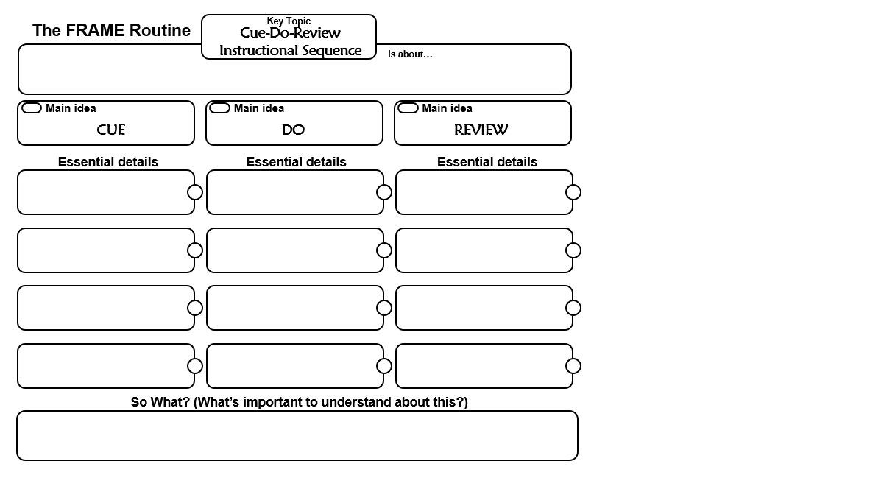
How do I do it?
1) Check understanding of content on the routine
What is it? Telling students what they are doing & why they are doing it
What is it? The Linking Steps – how you go through the routine
What is it? Showing students how to use the device as a learning tool
How do I do it?
1) Implement the Linking Steps
How do I do it?
1)Name the Routine
2) Explain how it will help them learn (ie. improve comprehension, study tool, track progress, etc.)
2) Prompt the students in construction, get student friendly language
2) Ask questions about the learning process and how the device works
3) Model how to use the device as a study tool, guide for doing other work
3) Provide positive and corrective feedback if necessary
3) Tell them how they should participate (ie. make your paper look like mine

