Slide 1
A 35-Year Review Jean B. Schumaker, Ph.D. B. Keith Lenz, Ph.D.

Slide 2
A New Milestone
14 published studies in peer-reviewed journals
Covering 4 Content Enhancement Routines
Concept Mastery Routine
Concept Comparison Routine
Concept Anchoring Routine
Question Exploration Routine

Slide 3
The Review Articles
35 Years on the Road from
Research to Practice, Part I & Part II

Slide 4
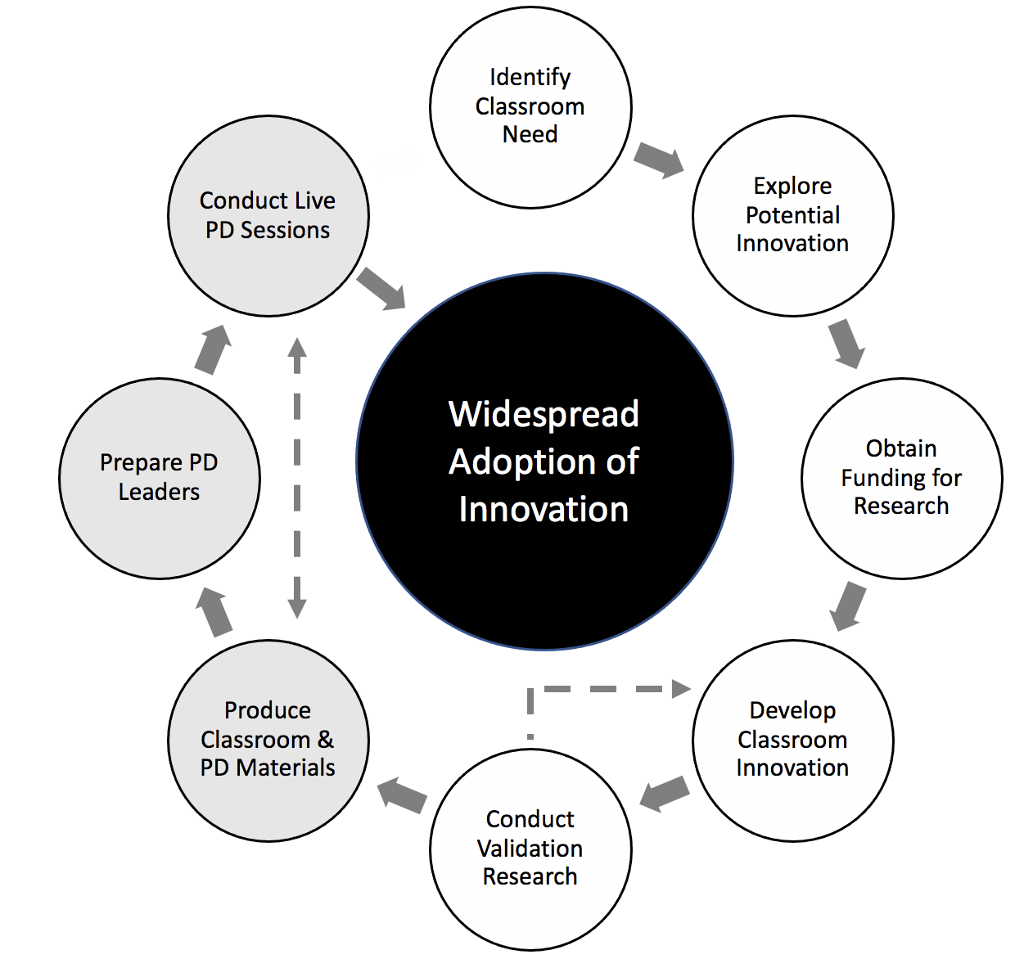
Part I
Stages of the Research-to-Practice Process

Slide 5
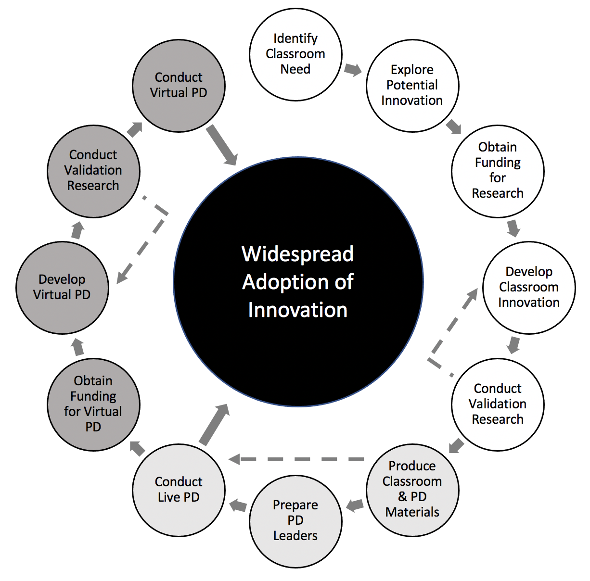
Part II
Stages of the Research-to-Practice Process

Slide 6
Today’s Agenda
A review of what we’ve learned
A review of what we still don’t know
A review of the necessary elements of PD
Suggestions for future PD

Slide 7
What have we learned?
From the Validation Studies (Part I)
From the Professional Development Studies (Part II)

Slide 8
The overarching research question is, “how can we mov e explicit instruction into the general education classroom?”
We know that direct explicit instruction is an effective teaching practice for reaching students with disabilities.
We know that general education teachers are more likely to implement interventions that will work with all learners.
Tier 1 instruction requires interventions that are palatable and aligned with the critical content targeted by state and national standards.
The line of research on Content Enhancement Routines addresses these demands.

Slide 9
Learned from the Validation Studies
Rigorous studies can be conducted in inclusive secondary subject-area classes.
Use of a CE Routine results in significantly enhanced learning for whole classes of students enrolled in inclusive classes.
Use of a CE Routine results in enhanced learning for subgroups of students enrolled in inclusive classes .
Use of a CE Routine results in substantially more students passing the test.

Slide 10
Learned from the Validation Studies
Teachers can learn to implement a routine and apply it to their own subject-area content (Bulgren et al., 1988).
Enhanced student learning can result on both publisher-made tests and researcher-made tests (Bulgren et al., 1988).
Student gains in performance are substantial and socially significant as well as statistically significant.
Some studies suggest that students can learn to use strategies when a CE Routine is used several times.*
* These studies are not in the review

Slide 11
We know that we can move the use of explicit instruction into general education classrooms.
We now know that the explicit, direct instruction required to implement CERs can be effective in the general education classroom and can meet the demands of general education teachers.

Slide 12
What questions come next?
The next overarching research question is how do we prepare teachers to implement CERs?
What types of teacher learning experiences are required to ensure that teachers implement with fidelity?
How well does the use of multimedia programs, live PD, online inservice/preservice courses influence teacher learning?

Slide 13
Learned from the PD Studies
A multimedia program can be used to educate teachers to use a CE Routine with fidelity within 3 hours.
A live workshop can be used to educate teachers to use a CE Routine with fidelity within 3 hours.
The teacher outcomes of multimedia and live workshops are about the same.
Where there are differences between the types of workshops, the multimedia workshop produced better teacher results.

Slide 14
Learned from the PD Studies
Teachers can learn to use a CE Routine at high levels of planning and implementation fidelity in a variety of subject areas in just 3 hours.
Students of teachers who received multimedia instruction performed better than students of teachers who received live instruction in some studies.
In no study did the teachers who received live instruction and their students perform better than the teachers who received multimedia instruction and their students.

Slide 15
Questions about the reviews?
Open discussion

Slide 16
The next overarching research question is, “How do we best prepare teachers to integrate the use of CERs into “enhanced courses” that can be sustained over time and school conditions?”
The problem of sustaining the implementation 0f effective practices at a high level of fidelity is a systemic issue that cuts across all areas of education.

Slide 17
What we still don’t know
What happens when different elements of PD are added to multimedia or live workshops?
What happens when several teachers who are teaching the same course use the same devices/routines as integrated parts of each unit?
How many devices/routines can a teacher feasibly integrate and maintain throughout a course?
What happens in the second/third/fourth year of a teacher using CE Routines in a course?

Slide 18
What we still don’t know
What are the results of teachers sharing devices that they have not created themselves?
What happens when teachers are given incentives to continue to use CE Routines?
What role does “learning community” (e.g., discussions, sharing problems and successes) play in sustaining use of CE Routines?
How does the use of CE Routines affect the use of other unrelated evidence-based programs?

Slide 19
What did we learn about the necessary elements of PD?
In the PD studies, both multimedia and live workshops included:
Explicit instruction
Clearly specified parts of the routine
Multiple models of the devices
Videotaped models in actual classrooms of each part of the routine
Videotaped models in actual classrooms of the whole routine
Videotaped models in different subject areas at different grade levels
Written quizzes
Written activities (i.e., creating two devices)
A written instructor’s manual

Slide 20
How can we use this knowledge for future PD?
During Workshops:
Break down the routines into parts
Use lots of models (videotapes are available)
Use written quizzes (or structured notes?)
Use device assignments

Slide 21
What else can be done?
Assignments after the workshop:
Choosing topic(s)
Creating devices
Implementing the routine
Recording implementation

Slide 22
What else can be done?
Follow-up and support activities
Instructional coaching
Principal walkthroughs
Learning community
PALs

Slide 23
What do we know about online PD/Preservice learning?
How is online PD different from Live PD?
How is asynchronous PD different from a live workshop?
What are the essential components of online PD/preservice learning?
What additional resources should be developed for live and online PD/preservice learning?
What elements of live online PD/preservice learning need to be researched?

Slide 24
Professional evaluation activities
Formal checklists for implementation
Formal checklists for devices
Student data
Student reactions
Student interviews/focus groups about their experiences with CERs

Slide 25
How can we use these CE reviews?
Share them with other researchers
Share them with administrators
Discuss findings in courses
Link other CER studies to the reviews

Slide 26
What should be the direction of future research on strategic instruction in general education classes?
Open Discussion

Slide 27
Session Evaluation
Please evaluate this session at:
https://www.surveymonkey.com/r/2021SIMposiumEvals

Slide 28
References
Schumaker, J. B., & Fisher, J. B. (2021). 35 Years on the Road from Research to Practice: A Review of Studies on Four Content Enhancement Routines for Inclusive Subject-Area Classes, Part I. Learning Disabilities Research & Practice.
Fisher, J. B., & Schumaker, J. B. (2021). 35 Years on the Road from Research to Practice: A Review of Studies on Four Content Enhancement Routines for Inclusive Subject-Area Classes, Part II. Learning Disabilities Research & Practice.

