Slide 1
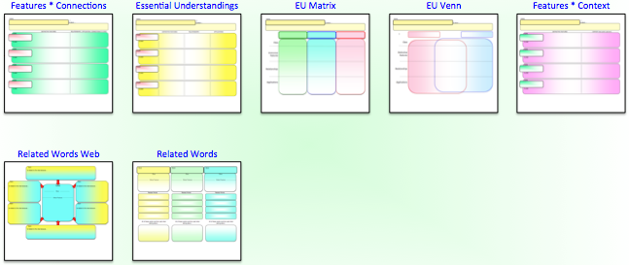
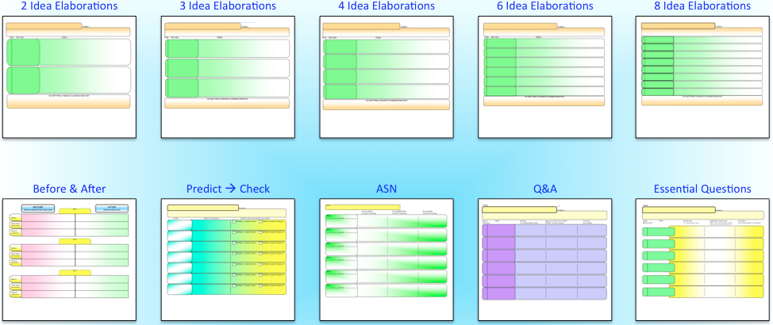
smart visual tools
© Edwin Ellis All Rights Reserved MakesSenseStrategies.com
Big Ideas
about teaching with Vocabulary Frames
Edwin Ellis
Vocabulary Frames for terms with
CONCISE definitions
Vocabulary Frames for terms with
ELABORATED definitions

Slide 2
Big Ideas about Teaching with Vocabulary Frames
smart visual tools
© Edwin Ellis All Rights Reserved MakesSenseStrategies.com
BIG IDEA #1
Vocabulary rules!
Vocabulary knowledge = best predictors of…
* reading comprehension
* writing fluency and clarity
* ease in learning new content-area subjects
On-going systematic instruction in vocabulary is very important!

Slide 3
Big Ideas about Teaching with Vocabulary Frames
smart visual tools
© Edwin Ellis All Rights Reserved MakesSenseStrategies.com
BIG IDEA #2
How well you teach vocabulary = how much vocabulary students learn, use, and remember.
The real measure of vocabulary learning is long-term retention
Questionable tactics…
Having students look up and write definitions
Using flash cards to memorize definitions
The instructional tools and routines that you use to teach vocabulary make a significant difference.

Slide 4
Big Ideas about Teaching with Vocabulary Frames
smart visual tools
© Edwin Ellis All Rights Reserved MakesSenseStrategies.com
BIG IDEA #4
Effective vocabulary instruction is INTENTIONAL, ACTIVE and ENGAGING and occurs
BEFORE, DURING, & AFTER lessons.
Vocabulary Frames for terms with
CONCISE definitions
Vocabulary Frames for terms with
ELABORATED definitions

Slide 5
Big Ideas about Teaching with Vocabulary Frames
smart visual tools
© Edwin Ellis All Rights Reserved MakesSenseStrategies.com
BIG IDEA #4
Effective vocabulary instruction is INTENTIONAL, ACTIVE and ENGAGING and occurs
BEFORE, DURING, & AFTER lessons.
BEFORE the lesson Use Vocabulary Frames™ when…
Assessing students’ vocabulary knowledge & to ascertain any erroneous understandings
Reviewing critical previously learned vocabulary
Previewing (introducing) new vocabulary
Activating background knowledge to form definition predictions (that will be subsequently checked, verified, or modified as appropriate)
Using peer-supported (collaborative learning) activities

Slide 6
Big Ideas about Teaching with Vocabulary Frames
smart visual tools
© Edwin Ellis All Rights Reserved MakesSenseStrategies.com
BIG IDEA #4
Effective vocabulary instruction is INTENTIONAL, ACTIVE and ENGAGING and occurs
BEFORE, DURING, & AFTER lessons.
DURING the lesson Use Vocabulary Frames™ when…
Providing explicit, intentional instruction about the meanings of new terms
Guiding note-taking
Using peer-supported (collaborative learning) activities

Slide 7
Big Ideas about Teaching with Vocabulary Frames
smart visual tools
© Edwin Ellis All Rights Reserved MakesSenseStrategies.com
BIG IDEA #4
Effective vocabulary instruction is INTENTIONAL, ACTIVE and ENGAGING and occurs
BEFORE, DURING, & AFTER lessons.
DURING the lesson Use Vocabulary Frames™ when…
Anchoring or reviewing meanings of new terms addressed during the lesson
Having students engage in research about the meanings of new terms
Using peer-supported (collaborative learning) activities

Slide 8
Big Ideas about Teaching with Vocabulary Frames
smart visual tools
© Edwin Ellis All Rights Reserved MakesSenseStrategies.com
BIG IDEA #4
Effective vocabulary instruction is INTENTIONAL, ACTIVE and ENGAGING and occurs
BEFORE, DURING, & AFTER lessons.
Scaffolding instruction is REALLY important!
“gradual release”
I do it
We do it
Y’all do it
You do it

Slide 9
Big Ideas about Teaching with Vocabulary Frames
smart visual tools
© Edwin Ellis All Rights Reserved MakesSenseStrategies.com
BIG IDEA #4
Effective vocabulary instruction is INTENTIONAL, ACTIVE and ENGAGING and occurs
BEFORE, DURING, & AFTER lessons.
TEACHER-ASSISTED routines
Review Core Terms
PEER-ASSISTED routines
Preview New Terms
Before & After
Direct Explanation → Directed Note Taking
Best Guess Encounters
Guided Note Taking: Co-constructing Definitions
Vocabulary WIKI
Guided Note Taking: Pause / Pair / Share
Rotated Frames
Vocabulary Comparisons
Defining Research: Jigsaw
Defining Research: Pair - Share
Rank & Share

Slide 10
Big Ideas about Teaching with Vocabulary Frames
smart visual tools
© Edwin Ellis All Rights Reserved MakesSenseStrategies.com
BIG IDEA #5
Effective vocabulary instruction is strategic, so be selective about the vocabulary terms you teach.
Target three sets of terms…
Set 1: Terms to review.
Terms that you anticipate will be used frequently during the lesson
Prerequisite, highly germane knowledge that is critical to know for the up-coming lesson

Slide 11
Big Ideas about Teaching with Vocabulary Frames
smart visual tools
© Edwin Ellis All Rights Reserved MakesSenseStrategies.com
BIG IDEA #5
Effective vocabulary instruction is strategic, so be selective about the vocabulary terms you teach.
Target three sets of terms…
Set 1: Terms to review.
Set 2: Terms ALL students will know by lesson-end
Terms that success of all of your students in future learning of your subject will depend upon.
Limited quantity (e.g., about 7)

Slide 12
Big Ideas about Teaching with Vocabulary Frames
smart visual tools
© Edwin Ellis All Rights Reserved MakesSenseStrategies.com
BIG IDEA #5
Effective vocabulary instruction is strategic, so be selective about the vocabulary terms you teach.
Target three sets of terms…
Set 1: Terms to review.
Set 2: Terms ALL students will know by lesson-end
Set 3: Alternative terms that advanced students will learn
Specialized knowledge that would not be expected of typical-achieving learners.

Slide 13
Big Ideas about Teaching with Vocabulary Frames
smart visual tools
© Edwin Ellis All Rights Reserved MakesSenseStrategies.com
BIG IDEA #6
Effective use of a Vocabulary Frame™ is an acquired skill
Keep in mind…
Initially, Vocabulary Frames may be harder to create than you might expect
…and require more time & mental energy
It gets MUCH easier with experience!

