Slide 1
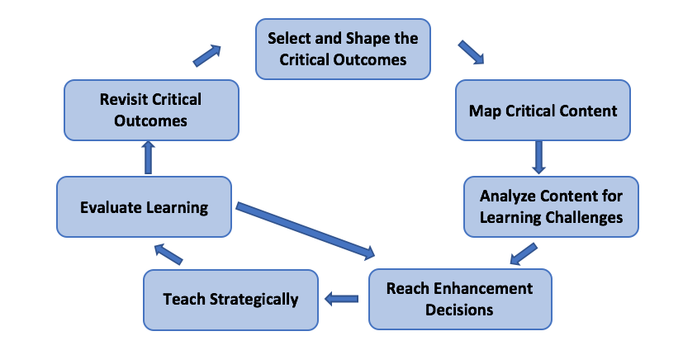
SMARTER WRITING
Dr. Jean Schumaker & Janet Atallah
Notes:
90 min

Slide 2
Fist to Five -
How familiar are you with the Writing Strategies Curriculum?
0 – I have not heard of it
1 – I have heard of it
2 – I could talk about what it is, who it is for, and the impact on students
3 – I have attended professional development in the SIM Writing Learning Strategies
4 – I have implemented instruction in one or more Learning Strategy in the Writing Curriculum with students
5 – I know the Writing Strategies Curriculum well, and have provided professional development for teachers in these strategies
Notes:
If we have a large group, have them line up 1-5, then fold the line. Set the timer for 1 minute and share information about what they know about the writing strategies. Move everyone down one (different partner) set the time for 1 minute, and respond to “What practices are you using or know of that work well with teaching writing? Move down one more time Question “What are concepts in writing that student struggle with?

Slide 3

Strategic Instruction Model
Is about
research-validated
practices for standards-aligned
planning and data-driven
teaching
developed by
organized through the
SMARTER
Instructional Cycle
And may include co-construction of learning with
And may include intervention for academic skills with the
Content Enhancement
Routines
Learning Strategies
Curriculum

Slide 4
Problem
We need writing interventions to support struggling learners at all levels of writing, from sentences to themes…right now!

Slide 5
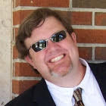

SMARTER WRITING
Sequencing professional development for teachers in the Writing Strategies
Allowing for differentiation of instruction
Maintaining the integrity of the strategies and strategic instruction.
Solution
Notes:
First Tell Stephens story of being in an ESE Special Diploma class,and enrolling himself in LS with Sue Capilia to get a regular diploma. learning the Sentence Writing Strategy saved him..went to college, edited others papers, became an ESE teacher..now a Pder…..Describe how Stephen runs his ESE LS 6-8 class. Every year, new 6th graders, some older new to school. Everyone gets a pre-test and looks at writing data from previous years. Stephen teaches FSW to students who need it through direct instruction, other who mastered sentence writing go on to Star Writer Fund. of Paragraph Writing, those who have mastered Fund. of Paragraph Writing go on to Proficiency in paragraph Writing. As the year goes on, students move when mastery is reached. FSW-Star Writer Compound, maybe the Commas CD. Stephen does direct instruction in Fundamentals of

Slide 6
SMARTER Planning and Instructional Cycle
Notes:
S: Start with Standards: Looking at the standards, what do I want my students to know, understand and do? Where are the gaps?
M: How are the strategies organized and sequenced?
A: What are the pre-requisite skills? Pre-Test, reading levels, etc…
R: Determine the best strategy to meet student needs. How do I deliver the instruction through differentiation? Does the whole class need it? Small Group? Individual? How often, how much time?
T: Critical Teaching Behaviors: Explain, show, and model for students how information will be taught and learned, set individual goals, dialogue with gen ed teachers. Work with students in a partnership to arrive at learning outcomes. Monitor Progress. Teach students how to give feedback to each other, REQURIE MASTERY!! PROTOTE GENERALIZATION
E: Progress monitoring & feedback, is a student bogging down. Are students progressing? Are they generalizing? What should I do differently?
R: What do I need to re-teach, or what is the next strategy? Do I need to move some students along…back to M, A &R!
Round to how you plan now? Different? How did this cycle impact your decision to come this week?

Slide 7
Strategic Instruction Model (SIM)
is about
research-validated
practices for standards-aligned
planning and data-driven
teaching
developed
by
www.sim.ku.edu
organized through the
and may include
co-construction of learning with
SMARTER
Instructional Cycle
and may include intervention for academic and social skills with
Content Enhancement
Routines
Learning Strategies
Curriculum
that support teachers in making
that empower students with
mastery of course standards accessible to ALL students
effective and efficient approaches to performing academic and social skills
Notes:
Discuss Tier I, II & II..talk about how a strategy can be effective, but not efficient, such as studying by writing spelling words 300 times.

Slide 8
SMARTER Planning and Instructional Cycle
Notes:
SMARTER HO”
Critical Outcomes: Handouts: Text Type Standards for Narrative Writing, Informative Writing & Opinion and Argumentative. Writing
Map Content

Slide 9
Select and Shape Critical Outcomes
What are the standards???????
Notes:
Critical Outcomes: Handouts: Text Type Standards for Narrative Writing, Informative Writing & Opinion and Argumentative writing..sentences…paragraphs..themes…etc…….

Slide 10
Map Critical Content
Sentences
Editing
Fundamentals in the Sentence Writing Strategy
Proficiency in the Sentence Writing Strategy
The Paragraph Writing Strategy
The EDIT Strategy
The Error Monitoring Strategy
The Inspect Strategy
Paragraph and Theme Writing
The Paragraph Writing Strategy
Fundamentals in the Theme Writing Strategy
Proficiency in the Theme Writing Strategy: Narrative Writing
Proficiency in the Them Writing Strategy: Persuasive & Argumentative Writing
Proficiency in the Theme Writing Strategy: Informative Writing
Writing Mechanics
The Capitalization Strategies
The Punctuation Strategies
The Commas Strategies
Fundamentals in Paragraph Writing
Paragraph and Theme Star Writer Programs
Proficiency in Paragraph Writing
Fundamentals in Theme Writing
Proficiency in Theme Writing
Notes:
How are the strategies organized or sequenced? : Already done! Examine SIM Writing Strategies brochure for descriptions. Spend some time here. Activity: cut up brochure in segments. Assign numbers, jigsaw participants share out in groups.

Slide 11
Analyze Content for Learning Challenges
Do all students have the fundamental writing skills to write a variety of sentences with correct grammar and punctuation?
Do all students have the fundamental writing skills to write a basic paragraph?
Do all students have the fundamental writing skills to write a variety of paragraphs?

Slide 12
Analyze Content for Learning Challenges
Do all students have the fundamental writing skills to write a basic theme?
Do all students have the writing skills to write a variety of themes?
What is the instructional level for each student?
How will I compensate for lack of students’ background knowledge or skills?

Slide 13


How do you meet the needs of the diverse learners in your classroom?
The Million Dollar Question:

Slide 14
According to students’
Readiness –
Readiness for a given skill, concept, or way of thinking.
Interests and Attitudes –
Those things that learners find relevant, fascinating, or worthy of their time.
Learning Profile & Needs –
Learning styles and preferences, how the student processes information, and how the learner sees him/herself in the relation to the rest of the world.
Notes:
Talk about self-directed kids, expectations, partnership learning, sharing the learning responsibilities, setting goals

Slide 15

According to students’
Affect -
  How students feel about themselves, their work, and the classroom as a whole.
Learning Environment -
  Both the operation and the tone of the classroom. It is the “weather” that affects virtually everything that transpires in the classroom.

Slide 16

Notes:
Reflect: –” People differ in their gifts and talents….to teach them start where they are” CONFUCIUS

Slide 17

Notes:
BOBBIE – Arabic – Unknown -”Talk to an individual in a way that they can hear you”

Slide 18
Chanoch
et
Ha
Naar
Al Pi
Darcho
Quote from:
King Solomon
“Educate the child according to his way.”
Notes:
Adult Version of Fairness – Every person gets what they need Child’s version – Everyone gets the same.

Slide 19
CREATING AN OPTIMAL MATCH
Too Difficult
Causes Frustration
TASK DIFFICULTY
Flow of Instruction
Too Easy
Can Cause Boredom
READINESS LEVEL
Notes:
How do we structure the learning so that everyone is on his mental tiptoes?

Slide 20
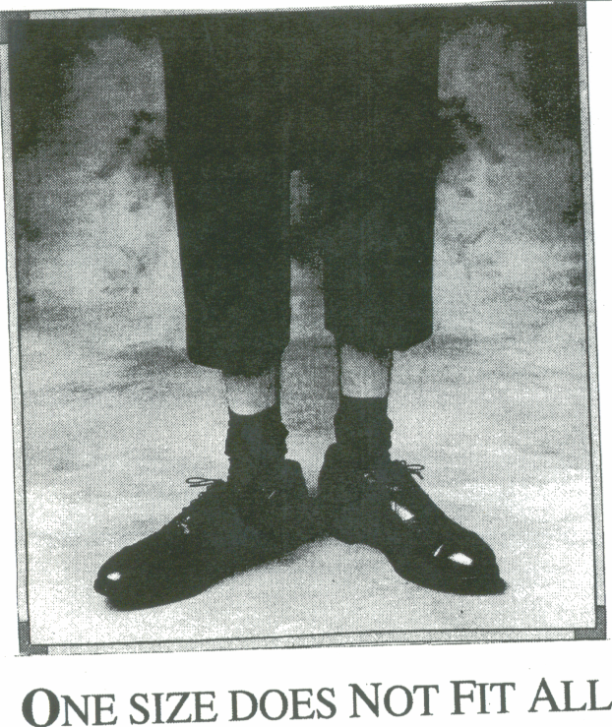
What do YOU think?
Notes:
Corners activity for processing so far…..brainstorm ideas….

Slide 21
Reach Enhancement Decisions
Decide:
Which strategies?
How do I teach them?
Whole Class?
Small Group?
Individual?
Notes:
How do we decide which strategies to teach? Pre-tests refer to SMARTER HO for Pre-test options.

Slide 22
What are ideal settings for Learning Strategies?
  Learning Strategies Class
  Intensive Remediation Class
  General Education Class
  Elective Class
  After-School Support Class
  Other Support Classes
4th Grade
Reading level
Minimum: 30 minutes per day 3-5 days per week
Notes:
Teaching what each kid needs the most Emphasize Dosage, Feedback, Generalization

Slide 23
ESE Learning Strategies Class
ESE teacher provides modeling, controlled practice & feedback to groups others may work independently through programs such as Star Writer or the Writing Mechanics series. all students receive instruction and feedback from the teacher through individual or small-group instruction.
Notes:
Explain, show, and model for students how information will be taught and learned, set individual goals (small group, computers, whole group
Work with students in a partnership to arrive at learning outcomes
Communicate to students the value of learning how to learn
Monitor Progress
Teach students how to provide feedback to each other
Require Mastery
Promote Generalization

Slide 24
ESE Support Teacher in the General Education Classroom
Either teacher may provide modeling, controlled practice & feedback to small groups or individuals in the class or Either teacher may provide instruction in a strategy and supplement the instruction with the computerized programs All students receive instruction and feedback from both teachers through individual or small-group instruction.

Slide 25
Options for 2 Teachers
Station Teaching: Divide class into groups of 3-4. 1 group with each teacher for direct instruction/modeling/Feedback 1 group on computers, one group doing controlled or advanced practice. Parallel Teaching: Class is divided in half. Teachers teach content to each half for half the period then flip. Teachers utilize computers.
Pros/Cons?

Slide 26
An0ther Option
Alternative Teaching: 1 teacher teaches the part of the class, 1 teacher takes groups to computer lab for alternative instruction (decisions are made on the needs of the students, others may be working independently. Make sure the everyone gets instruction and feedback when needed.
Pros/Cons?
Notes:
Note: The ESE teacher and the Gen. Ed teacher works with ALL sudents!

Slide 27
One More Option
Combining Classrooms or Teaming: Two teachers combine classes to group and move the students as they achieve mastery in the strategies. All strategies can be taught, and the computerized programs can be utilized. All students receive instruction and feedback from the teacher through individual or small-group instruction.
Pros/Cons?

Slide 28
Teach Strategically and Work in a Partnership with students and other staff
Explain, show, and model for students how information will be taught and learned (small group, whole group, computers, individual), set individual goals
Work with students in a partnership to arrive at learning outcomes
Communicate to students the value of learning how to learn
Monitor progress
Teach students how to provide feedback to each other

Slide 29
Teach Strategically and Work in a Partnership with students and other staff
Robust gradual release
Mastery required at each stage
Master the use of the strategy & increase complexity
Post-test
Promote Generalization
Celebrate!!!!!!!!!
Notes:
Where have you heard this before?

Slide 30
Evaluate Learning
Is this working for every student?
What can I change or adjust to improve?
Are students becoming more independent?
Are students taking charge of their own learning?
What are students saying about their learning?
What has changed?

Slide 31
Revisit
Critical
Outcomes
What is the next strategy for each student? Do I need to re-teach or readjust? Back to………
Establish whether the learning targets and activities were aligned with and supported students in meeting the standards

Slide 32
SMARTER Planning and Instructional Cycle
Notes:
Back to……Reach Enhancement Decisions!!!!!!!!!!!

Slide 33
Grading Considerations
How Do We Grade?
What is Fair?
Notes:
Tell Lavoie heart attack story….Hand out Ideas for Grading Students Learning the Theme Writing Strategy. Cut up sections of handouts. Each person at the table reads a section aloud, then each person in table group may respond. Round robin until all 6 sections are shared and addressed.

Slide 34
Some Ideas for Professional Development in Writing…A Four-Day Plan
What do YOU think?
Notes:
Hand out 4 day PD Plan. Set timer for 15 minutes. Share Ideas. Have each group write ideas for improvement on post-it notes.

Slide 35

Optimistic Closure
A word or a phrase that reflects how I feel about moving forward with teaching or providing professional development for teachers in the Writing Strategies Curriculum
If you are coming to the next session, please sign up for Star Writer or PD Activities.
Notes:
Post 2 posters on the wall for next session: Star Writer; specific which program Other: Specify which program
2nd poster PD activities

