Slide 1
Leveraging SIMTM in Culturally Responsive Teaching
Janice Creneti
Assistant Manager, Florida SPDG SIM Project
SIMposium 2019
Lawrence, Kansas
Notes:
Welcome, Intros, Ways of work (norms, call & response, classroomscreen) (5 mins), JC

Slide 2
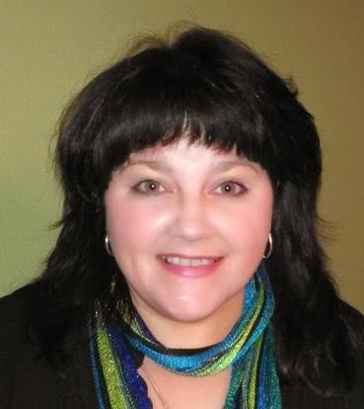
Expertise: Instructional Coaching, Adult Learning Principles, SIMTM Content Enhancement Routines,
Content Areas: Science, Math, CTE
Favorite Routines: Unit Organizer, Clarifying, Concept Mastery, Question Exploration
Passions: Empowering educators & students, Championing change, Strategic Instruction ModelTM, Equity, Theater - acting, directing, Nature & Animals
Districts: Charlotte, DeSoto, Hendry, Hernando, Lee
Pinellas, Polk
Janice Creneti
Assistant Manager, SPDG SIM Project, SIM CE PDer
Office: (727)588-6523 Cell: (941)518-5718
crenetij@pcsb.org

Slide 3
Why are you here? (let me know)

Slide 4
My biggest FAIL as an educator
And why I’m on this path....

Slide 5
Our Learning Journey...
Exploring why we’re here and implications
Exploring our understanding of Culturally Relevant/ Responsive Teaching
Exploring Student-centered vs Teacher-centered Instruction
Exploring how SIM supports a student-centered classroom
Exploring what’s next
Evaluation

Slide 6
HLP Connections
Special Education HLPs:
General Education HLPs:
HLP 3 Collaboration: Collaborate with families to support student learning and secure needed services
HLP 6 Assessment: Use student assessment data, analyze instructional practices, and make necessary adjustments that improve student outcomes
HLP 7 Social/Emotional/Behavioral Practices: Establish a consistent, organized and respectful learning environment
HLP 18 Instruction: Use strategies to promote active student engagement
HLP 3: Eliciting and interpreting individual students' thinking
HLP 7: Specifying and reinforcing productive student behavior
HLP 8: Implementing organizational routines
HLP 10: Building respectful relationships with students
HLP 11; Talking about a student with parents of other caregivers
HLP 12: Learning about students' cultural, religious, family, intellectual, and personal experiences and resources for use in instruction

Slide 7
Our Five Agreements (NORMS)
Stay Engaged
Speak Your Truth
Experience Discomfort
Expect and accept non-closure….
Listen for Understanding.

Slide 8
What is “Culturally Relevant Teaching”?
I believe...
From the strips on the table, choose a definition that matches your current understanding of CRT
Think, Write, Pair

Slide 9
What is “Culturally Relevant Teaching”?
I wonder...
Now from the strips on the table, choose a definition that makes you wonder or challenges some of your understanding about CRT
Think, Write, Square – oh, and introduce yourselves

Slide 10
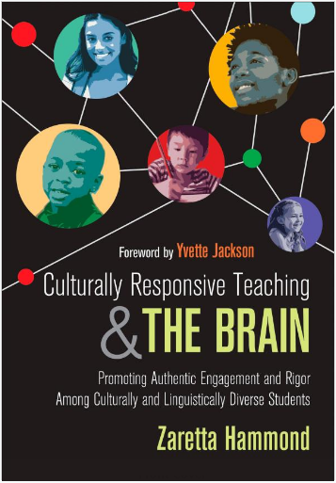
Zaretta Hammond & CULTURALLY RESPSONSIVE TEACHING
TEDtalks
Blog
https://crtandthebrain.com/resources
The Ready for Rigor Frame
The Warm Demander Chart
5 Key CRT Moves

Slide 11
Levels of Culture
Observable elements:
food, music, dress, holidays
low emotional charge
Unspoken rules, social norms:
nonverbal communication, eye contact,
personal space
strong emotional charge
Worldview, core beliefs, group values
Cultural archetypes such as collective vs. individual
Mental models, funds of knowledge
INTENSE emotional charge
Surface
Shallow
Deep
“What's Culture Got to Do With It?” Culturally Responsive Teaching and the Brain: Promoting Authentic Engagement and Rigor among Culturally and Linguistically Diverse Students, by Zaretta Hammond and Yvette Jackson, Corwin, a SAGE Company, 2015.

Slide 12
Sociopoltical Context
Systemic Racism and impacts on economics, education, health, opportunity, political power
Poverty is a cycle not a culture
The Achievement Gap:
Dependent vs Independent Learners

Slide 13
Types of Learners
Dependent
Independent
Heavily reliant on the teacher for cognitive lift
Unsure how to tackle new tasks
Needs multiple scaffolds to complete tasks
Becomes passive when stuck until teacher intervenes
Struggles to retain and retrieve from long-term memory
Reliant on the teacher for some cognitive lift
Uses strategies, process to perform new tasks
Attempts new tasks without scaffolds
Has strategies for getting unstuck
Can retrieve from long-term memory
In SIM, we typically say “efficient and effective” learners
Figure 1.1 Dependent Learner Characteristics vs. Independent Learners, Culturally Responsive Teaching and the Brain: Promoting Authentic Engagement and Rigor among Culturally and Linguistically Diverse Students, Hammond and Jackson, 2015.

Slide 14
Let’s Reflect
For each item:
Honoring the needs of deep vs surface, shallow culture
Acknowledgement of systemic racism and its impacts
Beliefs around and supports provided to address poverty
Practices around moving dependent learners to independence
1)Reflect on where you are
2) Reflect on where the system around you is
2) Capture some thoughts
3) Discuss with a table partner

Slide 15
Challenging the bigotry of low expectations...

Slide 16
Culturally Responsive Teaching
From low expectations to high expectations
From apathy, antagonism to awareness to alliance
From Learned Helplessness* to Empowerment (effective, efficient, independent learners) by building intellective capacity
* Defined as student belief of no control over ability to improve as a learner (Martin Seligman, 2006)
* Research shows teachers unconsciously reinforce this in low-performing students of color

Slide 17
“Culturally Responsive Teaching”
Use it to describe...
Don’t confuse it with
A MINDSET of curiosity about
what makes your students tick & how to connect with them
what your students need to succeed
Multicultural Education*
Social Justice Education*
Building self-esteem by lowering the bar
A checklist/set of strategies
*still important, it’s just not CRT
From “Culturally Responsive Teaching: 4 Misconceptions,” Cult of Pedagogy, September 10, 2017, Jennifer Gonzalez interviewing Zaretta Hammond

Slide 18
CRT in Secondary Classrooms
Essential to the success of EVERY SINGLE STUDENT.
It looks like:
A safe and inviting place of learning, mistakes allowed - think productive struggle
A student centered learning environment where critical thinking is encouraged – think support, scaffolding
A place with high expectations of rigor and relevance for ALL
A place where culture, race, ethnicity, gender identity, sexual orientation, etc. is valued/considered as important to individuals
DID I MENTION STUDENT CENTERED???

Slide 19
Comparison Table
2
Types of Instruction
Overall Concept
1
Concept
1
Concept
Teacher Centered
Student Centered
3
Characteristics
3
Characteristics
Content/pacing is determined by standards, curriculum guides, teacher calendar
Students engage in academic practice of skills, knowledge
Students are given a problem and the way to solve it
Assessment/feedback is summative only
Content/pacing is determined by standards, curriculum guides, student interest, student proficiency
Students engage in real-world application of skills, knowledge
Students have opportunities for productive struggle
Assessment/feedback is summative

Slide 20
Comparison Table
2) Overall Concept
Types of Instruction
1) Concept
Teacher Centered
1) Concept
Student Centered
3
9) Extension
4) Like Characteristics
5) Like Categories
Content/pacing is determined by standards, curriculum guides
Students engage in practice of skills, knowledge
Standards-driven
Include Practice
Justify how the use of SIM could support teachers in moving from a Teacher Centered Instructional Model to a more Student Centered Instructional Model.
6) Unlike Characteristics
6) Unlike Characteristics
7) Unlike Categories
Content/pacing is determined by, teacher calendar
Practice is academic only
Students are given a problem and the way to solve it
Assessment/feedback is summative only
Content/pacing is determined by student interest, student proficiency
Practice is real-world application Students have opportunities for productive struggle
Assessment/feedback is summative
How content/pacing is determined
Types, purpose of practice
Degree of learning flexibility
Methods, purpose, frequency of feedback
8) Summary: Teacher Centered and Student Centered are types of instruction that are alike in being standards-driven and including practice but differ in how content/pacing is determined, the types and purpose of practice, degree of learning flexibility and the methods, purpose, and frequency of feedback.

Slide 21
SIM EMPowers...
STUDENTS
Educators
Families
Invested Others
Countering the bigotry of low expectations with HIGH EXPECTATIONS & HIGH SUPPORT

Slide 22
SIMTM and CRT
Supporting a student-centered environment
Meaning Making
Creating a positive classroom culture
Multiple approaches to acquisition and practice
Notes:
10 minutes

Slide 23
SIMTM and CRT:
Creating positive classroom culture
Content Enhancement
Course Organizer
Clarifying
Concept Mastery
Concept Comparison
Learning Strategies
Community Building Series
Socially Wise
Possible Selves
Self-Advocacy
Notes:
10 minutes

Slide 24
SIMTM and CRT
Scaffolding with SIM
High expectations for thinking
Scaffolded interactions with content
Explicitly taught collaboration strategies
Notes:
10 minutes

Slide 25
How could SIM be leveraged to empower students and educators at home?
How might SIM support efforts around CRT & shifts towards Student Centered Instruction?
GET SPECIFIC!
Talk at your table...

Slide 26
The Unit Organizer
Your Headline Here
NAME
DATE
9
Expanded Unit Map
is about...
group size
how we deepen our understanding by talking together
and creating a
final product
with a
of
using
following
of a
3 or 4
resources
using a
headline (10 words or less) & graphic
collaboration process
set times
including
3 CRT articles
Graphic organizer (Frame)
supported by
for each step of
following steps
talking stems: (blue paper)
By yourself, silently read and mark each article for main points
With your group, create a headline for each article
Share what you create with the class, teacher selects one group member to share
5 mins
5 mins
1 min per
group
and
group norms
10
NEW
UNIT
SELF-TEST
QUESTIONS

Slide 27
The Unit Organizer
NAME
Your Headline Here
DATE
9
Expanded Unit Map
is about...
group size
and creating a
final product
with a
of
using
following
of a
resources
using a
(10 words or less) &
collaboration process
set times
including
supported by
for each step of
following steps
(blue paper)
By yourself, silently read and mark each article for
With ______ ______ create a headline for each article
Share what you create with the class, ______ selects one group member to share
__ mins
__ mins
__ min
per group
and
group
10
NEW
UNIT
SELF-TEST
QUESTIONS

Slide 28
Wonderings?
VERY Next Step?
Thank you for joining me!
Feel free to reach out to continue the conversation...
Notes:
5 minutes with classroomscreen.com

Slide 29
Please go to the link below to evaluate this session:
https://www.surveymonkey.com/r/2019SIMposium
Or scan the Evaluation barcode (also found on your SIM Conference Program)

Slide 30
Materials
Post-its, highlighters, chart paper, markers, videos, ABC cards,

Slide 31
Websites
Padlet:
https://padlet.com/lancherosi/CRT
https://padlet.com/lancherosi/games
www.classroomscreen.com

Slide 32
Copies
Agenda (include Lucy’s padlets)
Self-Audit
Articles
Unit Organizers:
6Ms – Conage, 2014 ©
Headlines TV
Headlines SV
Frame

Slide 33
Agenda
Notes:
Welcome, Intros, Ways of work (norms, call & response, classroomscreen) (5 mins), JC
Urge participants to jot down notes and save their questions for the Q & A period.

Slide 34
Call and Response
Clap or snap in patterns
Sing or play a song or rhyme.
Use regional or sports team call-and responses.
Incorporate traditional call-and-responses from various world cultures.
Put a twist on the old “If you can hear me, put your hands on your head.”
Refer to the school motto or theme.
Reinforce character education and life lessons. i.e., Work hard…Do right!
Ask your students to come up with their own.
Notes:
JC Welcome, Intros, Ways of work (norms, call & response, classroomscreen) (5 mins), JC
JH Call-and-response is a time-tested technique for getting attention, not just in classrooms but in the military, in churches, at sports events, and in traditional cultures in various parts of the world. Instead of repeating yourself, train students to respond to a fun or inspiring statement!

Slide 35
Culturally Relevant Teaching
What is Culturally Relevant Teaching?
What does it look like?
What does it sound like?
What does it feel like?
How will you know when you have a Culturally Relevant Classroom?
Notes:
Lucy1 Minute

Slide 36
Our Identity
One Minute Partner Share
Choose a partner
Partners will look at each other for 30 seconds, in silence
Each partner takes turns sharing what you learned about them, for 1 minute
What do you know about your partner just by looking at them?
CRT encourages us to investigate our perceptions, stereotyping and views of others around us and how those
beliefs and feelings influence teaching and learning.
Notes:
Janet 30 minutes

Slide 37
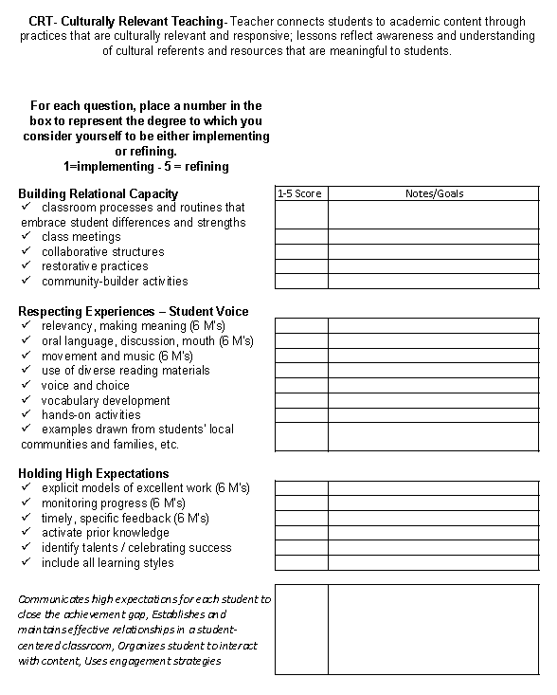
Reflection - CRT Self Audit
Include in your dialogue …
how a safe, CR and interactive learning environment can be created through…
body language,
words and language,
physical arrangement,
and instructional design.
Notes:
Lucy Provide 5 minutes for this part of the activity. In small groups, participants discuss the following items (found on handout): Wrap – up/ debrief audit.
“Please read and jot down your thoughts and reflections next to each item on the handout. Place a star on 2 items you wish to share with a partner.”

Slide 38
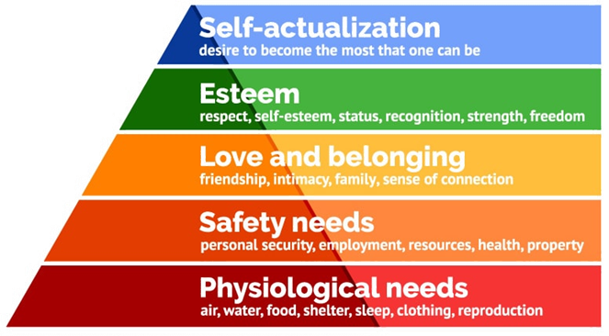
What is Culturally Relevant Teaching?
supports the achievement of all students
uses the cultural knowledge, prior experiences, frames of reference, and performance styles of ethnically diverse students to make learning encounters more relevant to and effective for them
teaches to and through the strengths of these students
(Gay, 2010)
Notes:
Lucy CRT is about building the learning capacity of the individual student. Leveraging the affective and cognitive scaffolding that students bring.
It’s not so much what’s on the walls, It’s how you interact. CRT builds a community where a student feels connected or has a sense of belonging in the classroom.
1 minute

Slide 39
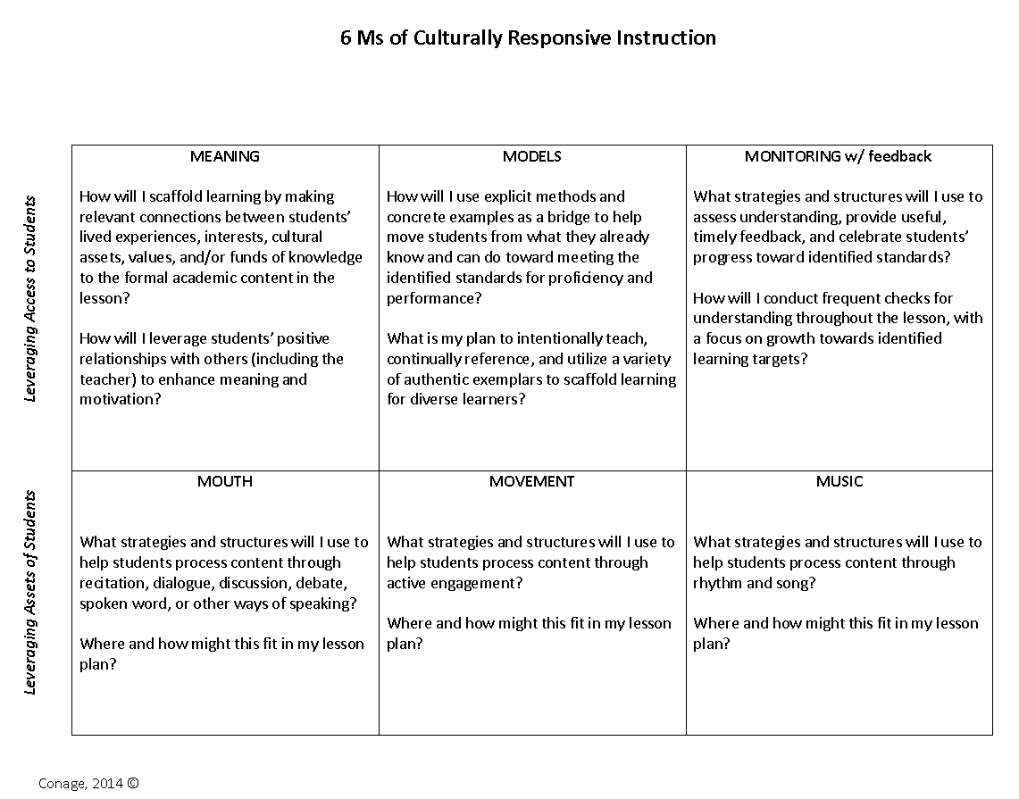
Dr. Conage’s 6Ms for CRT
While watching: How does the teacher answer questions from the 6Ms?
After watching: What examples of the Ms are present?
https://www.youtube.com/watch?v=K1U6wj-5K1I
https://www.youtube.com/watch?v=a7MlKUlE4b8&feature=youtu.be
https://www.youtube.com/watch?v=WGelyLq8s2s
Notes:
Lucy Read through the 6Ms as a group L As we watch, think about what you would have to know to determine if culturally relevant learning had taken place before this video.
CRT is about instruction at the core. It requires planning and embedding 6Ms into rigorous learning tasks.
V1: 6.35
V2: 2:25
V3: 2.10

Slide 40
What’s In A Name
Think about your name and what it means to you
Who gave it to you?
Is there a sentimental value?
Does it have a specific meaning?
Now, consider if someone changed it, without your permission
Are you okay with that
Do you like what it was changed to
Does it impact your relationship with that person
Can you still learn from that person

Slide 41
How will you know when you have a culturally relevant classroom?
3 standards of culturally relevant pedagogy
All students experience academic success
(2) Students develop and/or maintain cultural competence
(3) Students develop a critical consciousness through which they challenge the status quo of the current social order
(Ladson-Billings, 1995).
Notes:
Lucy‘ Teachers cannot change our student’s home lives and economic circumstances, but most of us can control our instructional strategies in the classroom. We control what happens between the bells.”
1 minute

Slide 42
The Unit Organizer
4
BIGGER PICTURE
NAME
DATE
inclusive and equitable learning communities
2
LAST UNIT
/Experience
CURRENT UNIT
3
NEXT UNIT
/Experience
Culturally Responsive Mindset
1
CURRENT UNIT
Alignment with SIPs
Culturally Relevant Teaching & SIM
8
UNIT SCHEDULE
5
UNIT MAP
is about...
using the diverse cultural strengths and experiences of students to increase their learning with the Strategic Instruction ModelTM (SIM)
processing, storing & retrieving of information
gathering of information
through
by ensuring
6Ms
SIM STYLE
strengthened
by
collaboratively making
strengthened
by
leveraging
through
through
assessed
and
celebrated through
Mouth*
through
Music*
Meaning*
Models*
Monitoring* for understanding
Movement*
*the 6Ms of Culturally Responsive Instruction , Copyright © 2014, Conage
How can I use SIM Content Enhancement Routines (CERs) to make the “gathering of information” phase of teaching more meaningful to students?
Why is effective modeling critical in Culturally Responsive Instruction and how can SIM support it?
How can the use of SIM CERs support effective monitoring?
How can the use of SIM CERs scaffold student processing, storing and retrieving of information through to support success with rigorous learning demands?
How does the use of culturally relevant instructional strategies help to build inclusive and equitable classrooms?
6
Describe
UNIT SELF-TEST QUESTIONS
Explain
RELATIONSHIPS
Analyze
UNIT
7
Justify

Slide 43
The Unit Organizer
Culturally Relevant Teaching & SIM
9
Expanded Unit Map
processing, storing & retrieving of information
strengthened by collaboratively
making
gathering of information
is about...
through
using the diverse cultural
strengths and experiences of students to increase their learning with the Strategic Instruction ModelTM (SIM)
differentiated through
Meaning
through
strengthened by leveraging
Mouth
with
By building
assessed and celebrated through
relevant connections
positive relationships
through
Models
Monitoring
for understanding
Movement
between
and teaching
academic content
to explicitly bridge
frequently with
through
community participation skills
formative assessment
Music
(rhythm & song)
and students’
using
experiences
interests
funds of knowledge
cultural assets
values
using the
concrete to abstract thinking
Community Principles & Learning Rituals sections of the Course Organizer
to give
completed CERs as the scaffold
effective feedback
using
that supports
and intentionally
SIM’s Content Enhancement Routines (CERs)
student
self-reflection
through the
celebrating progress
prompted by the
during
which are
Cue, paraphrase, connection & extension sections of CERS
with
with the
extensions for and review of CERs
research-validated tools that support planning and delivering instruction to allow all students in accessing course standards
Cue-Do-Review Instructional Sequence of CERs including co-construction
CER Course Organizer Progress Graph
questions and extensions on CERs
10
NEW
UNIT
SELF-TEST
QUESTIONS

Slide 44
WHAT IS CULTURE?
Veg.
Animal Lover
Actor
JC
A combination of thoughts, feelings, attitudes, beliefs, values, behavior patterns, and practices that are shared by racial, ethnic, religious, or social groups
Who
are
You?
Low Risk
Traditions
Words
Phrases
Nicknames
Food
Music
High Risk
Ethnicity (ies)
Home
Surroundings/Neighborhood
Race
First Language
Religion/Spirituality
Conflict
You
2005 Shelley Zion and Elizabeth B. Kozleski
Notes:
Lucy When you hear the word “culture” what comes to mind?
> How would you describe your cultural background?
Each person is culturally unique.
Each person has a different combination of thoughts, feelings, attitudes, beliefs, values and behavior patterns. Complex and diverse. Not monolithic.
Draw a circle, list the elements that make you, you.
2 minutes

Slide 45
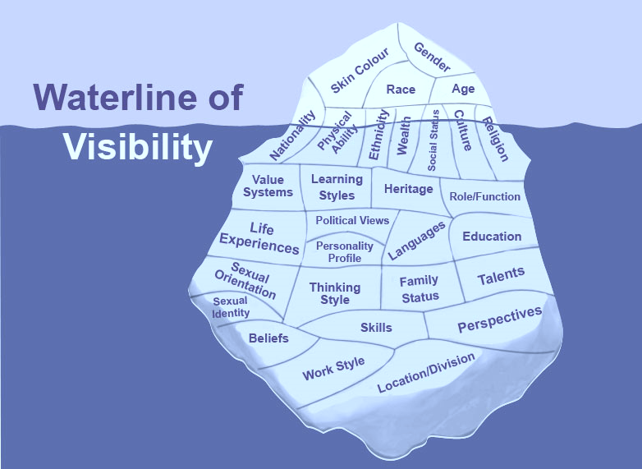
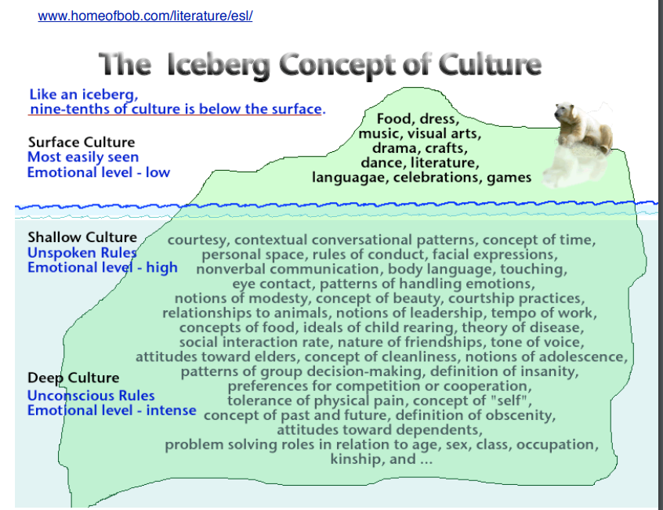
Like us…
our students are complex and offer a vastness of depth to our class culture.
Beyond Culture (1976) by Edward T. Hall
Notes:
Lucy How do you show up so that you’re building a relationship with this student?
How are you at offering a high trust, low stress environment?
1 Minute

Slide 46
Why are you here? (let me know) Why I’m here...
My background
Cecilia
My dad’s players
My early teaching years
Jon
Chris
The hallway
Fractions
My later teaching years
DJJ & Waxter’s
Jared & David
Greg

Slide 47
4 Corners:
Go to the corner that represents your stretch
Discuss why the item is your stretch & introduce yourselves
Return to your tables when finished discussing
Exploring why we’re here and implications
Exploring our understanding of Culturally Relevant Teaching
Exploring Student-centered vs Teacher-centered classrooms
Exploring how SIM can support student-centered classrooms

