Slide 1
Simple Sentence
A sentence that has
one independent clause
University of Kansas | Center for Research on Learning

Slide 2
Independent Clause
A group of words that:
makes a complete statement
has a subject and a verb
University of Kansas | Center for Research on Learning

Slide 3
The Subject of a Sentence
The subject is the:
person
place
thing
quality
or idea
that the sentence is about.
Nouns
University of Kansas | Center for Research on Learning

Slide 4
Example Subjects
John went for a walk. (Person)
Towns are quiet after snowfalls. (Place)
Eggs rolled off the counter. (Things)
Silence is golden. (Quality)
Peace is at hand. (Idea)
University of Kansas | Center for Research on Learning

Slide 5
Verbs
A verb is a word that shows the
state of being
or
action
of the subject of the sentence.
University of Kansas | Center for Research on Learning

Slide 6
Verbs
Examples:
Sally sneezed. (Physical action)
John thinks. (Mental action)
Jesse is my friend. (State of being)
University of Kansas | Center for Research on Learning

Slide 7
Verb-Subject Identification Procedure
Step 1: Look for the action or state-of-being word to find the verb.
Example: Miguel won an award.
Step 2: Ask yourself "Who or what (verb)?” to find the subject
Example: Mae is an astronaut.
University of Kansas | Center for Research on Learning

Slide 8
Example Set I
1. Ava went to the pool.
2. Travis is a very nice guy.
3. Cakes lined the store window.
4. I love chocolate ice cream.
5. Bikes are very expensive.
6. Dad is strict.
7. Bananas taste good.
8. Kara has a son named Jackson.
9. Raccoons raid our garbage can every night.
10. Flowers are in bloom everywhere.

Slide 9
Example Set II
1. The old gray mare limped down the lane.
2. The silver-winged plane soared.
3. Caleb’s baby sister cried for hours.
4. The first three girls giggled.
5. Fourteen good pilots died in the war.
6. The chairman of the meeting left early.
7. The chrome-plated motorcycles glistened in the sun.
8. The pioneers in our family fled from England.
9. The dog’s buried bones rotted in the ground.
10. Sophia’s best china plate broke into a hundred pieces.

Slide 10
Helping Verbs
am
are
is
can
could
do
does
did
may
might
must
shall
should
has
have
had
was
were
be
been
being
will
would

Slide 11
Example Set III
1. The bus must have gone by now.
2. My best friend could not work tonight.
3. The light green grapes have been eaten.
4. The committee of environmentalists is working to solve the smog problem.
5. Steven’s aunt is not following her new diet.
6. The old rickety wagon should not have been filled to the top
7. The merry pied piper would have played a happy tune.
8. A stray sunbeam could have pierced the clouds.
9. The paint on the old gray house was peeling.
10. The peace treaty might have been signed today.

Slide 12
Example Set IV
1. Bill and Sue want to go to the movies.
2. Jason and his friends work together.
3. Are the car and truck parked outside?
4. The park and sidewalk are covered with snow.
5. Hiding and seeking are fun activities.
6. The old man and his black cat have lived long lives.
7. The station and its surrounding parking lot become dangerous after 9:00 p.m.
8. Artie, Karen, and Ty went to buy a new van.
9. Peace and war are direct opposites.
10. Did Marty and Kathy travel 500 miles just to speak at the conference?

Slide 13
Example Set V
1. Sally swam and played all afternoon.
2. The dogs had barked all night and slept all day.
3. Michelle came home yesterday and did not work all day today.
4. The basketball team rode on a bus and flew in a plane to attend the game.
5. The park is dark and spooky at night and can be delightful on sunny days.
6. Did Jane call her father and tell him the news?
7. I miss my sister and want to see her again soon.
8. Children should not be allowed to watch T.V. and should be encouraged to play.
9. Will you sit by the sea and paint the ships?
10. The books were stacked on the floor and were ruined by the flood.

Slide 14
Example Set VI
1. The ponies and calves scampered and played in the field.
2. Kathy and her father do not like to play tennis and hate to jog.
3. The Army and the Navy had a football game and filled the stadium.
4. The two boys and their fathers were sick and did not attend the Father-Son Banquet.
5. Parties and dances are usually fun and can be thrilling.
6. Cards and dice were used at the party and had been scattered everywhere.
7. Radio towers and tall buildings must have lights and must be visible at night.
8. Candles and flowers can brighten the table and can make guests feel special.
9. Tape and ribbon are needed to secure packages and can be used for other things.
10. The graduates and their parents posed for pictures and celebrated with a party.

Slide 15
Steps for Sentence Writing
Step 1: Pick a Formula
Step 2: Explore Words to Fit the Formula
Step 3: Note the Words
Step 4: Search and Check
University of Kansas | Center for Research on Learning

Slide 16
Steps for Sentence Writing
Step 4: Search and Check
Search:
Look for the action or state-of-being word(s) to find the verb(s).
Ask the "Who or What Question" to find the subject(s).
Check:
Capital letters
End punctuation
Makes sense
University of Kansas | Center for Research on Learning

Slide 17
Student Materials
Volume I Examples

Slide 18
Student Materials (Vol. I) Walkthrough
Formula Card After Simple Sentences
Simple Verbal Practice Checklist
Sentence Assignment Sheet
Lesson Sequence for Controlled Practice
Vol. I Simple Sentence Progress Chart
Vol. I Simple Sentence Lessons 1A-4A Examples
Vol. I Simple Sentence Checklist Example
Vol. I Sentence Score Sheet Example
University of Kansas | Center for Research on Learning

Slide 19
Notes:
The Challenge

Slide 20
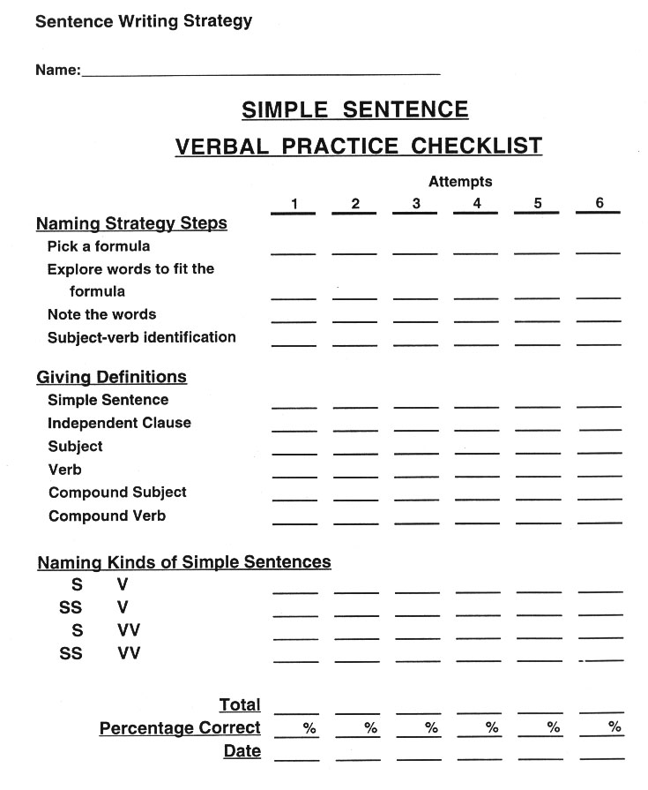
Notes:
The Challenge

Slide 21
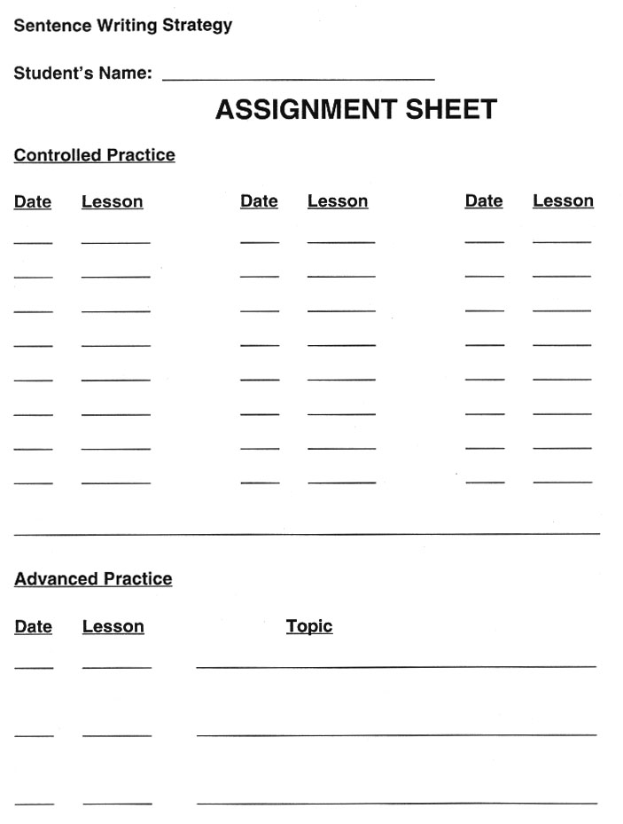
Notes:
The Challenge

Slide 22
Lesson Sequence for Controlled Practice (Vol. I)
90% or above 1 2 3
Below 90% A B C D
University of Kansas | Center for Research on Learning

Slide 23
Lesson Sequence for Controlled Practice (Vol. I)
Example: Student Progress
Lesson % correct
1A 90%
2A 70%
2B 80%
2C 95%
3A 85%
3B 90%
University of Kansas | Center for Research on Learning

Slide 24
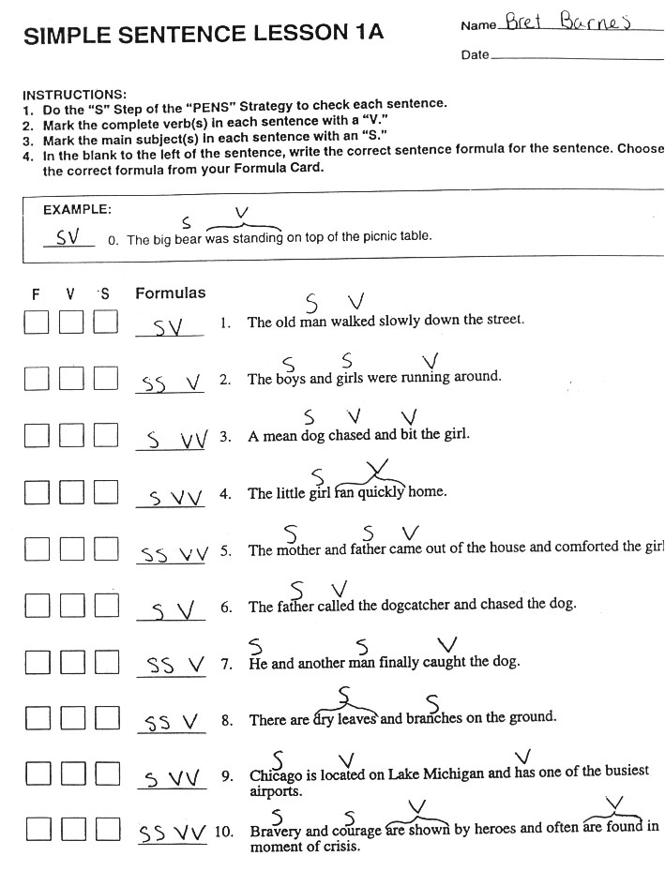
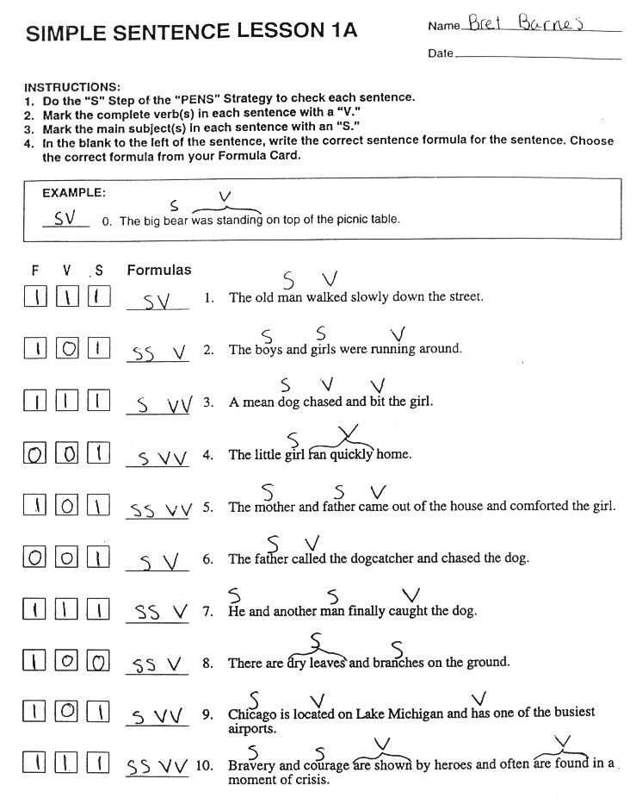
Notes:
The Challenge

Slide 25
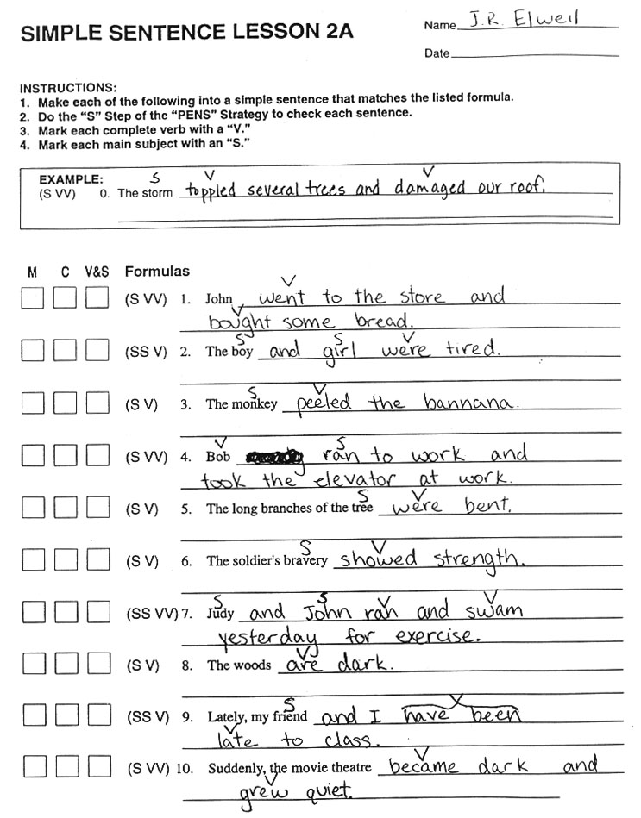
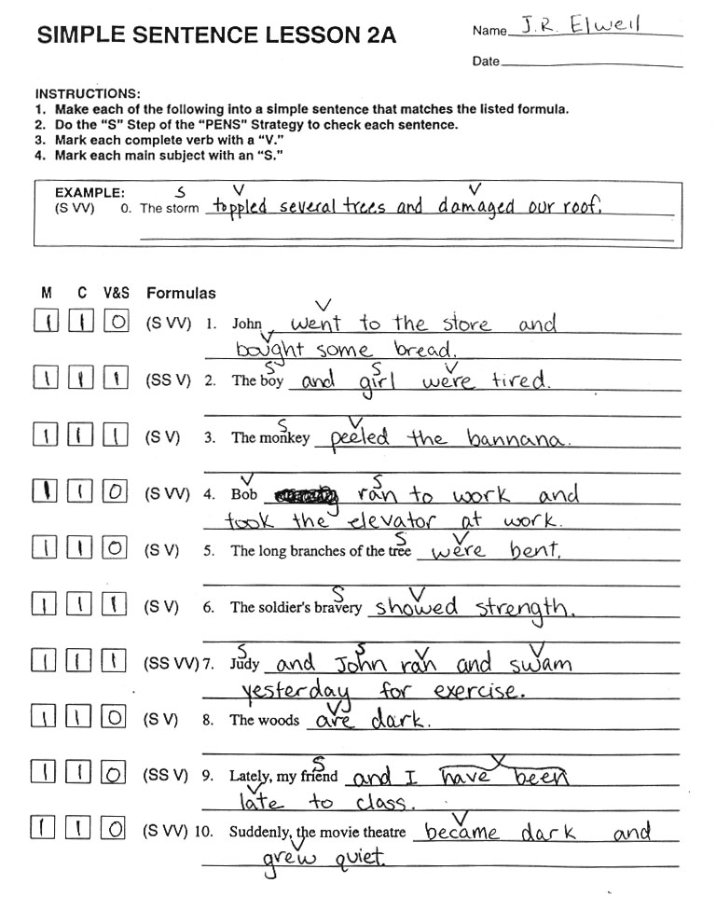
Notes:
The Challenge

Slide 26
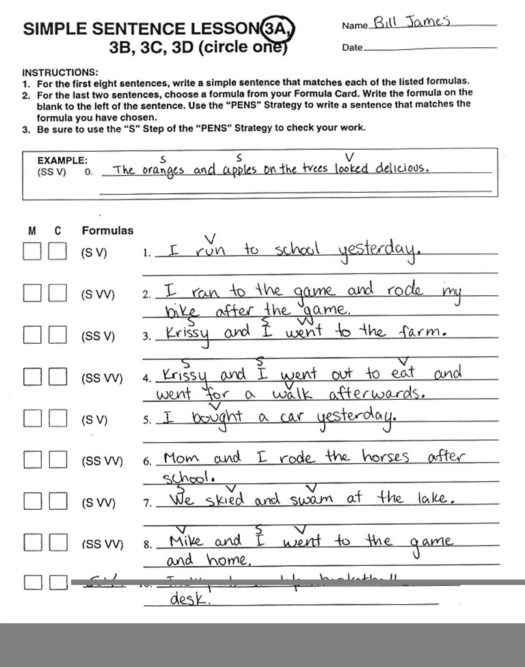
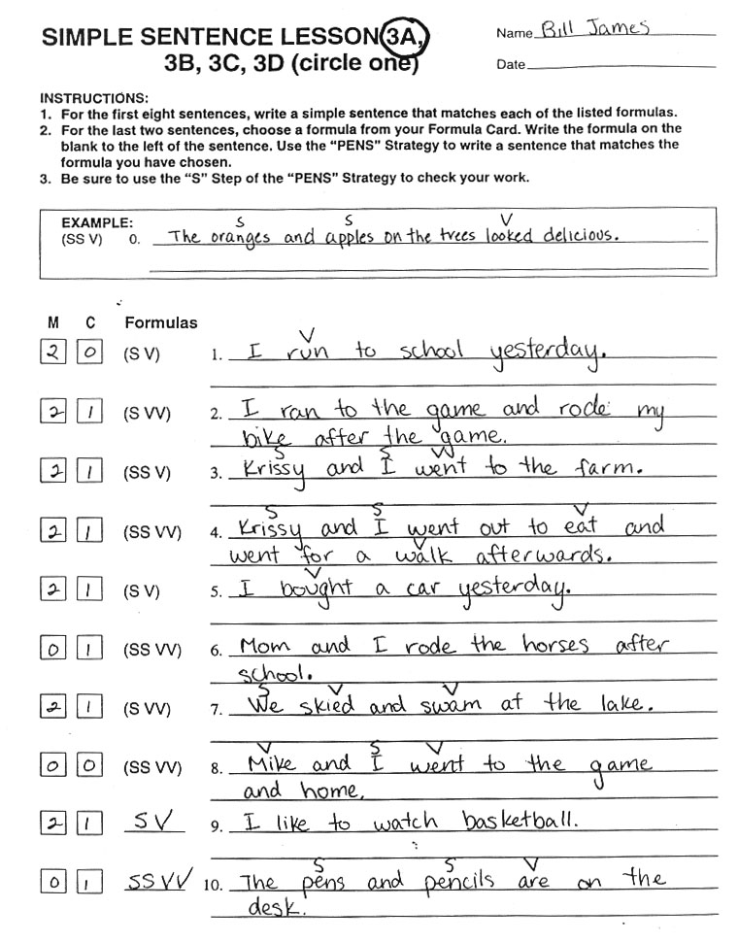
Notes:
The Challenge

Slide 27
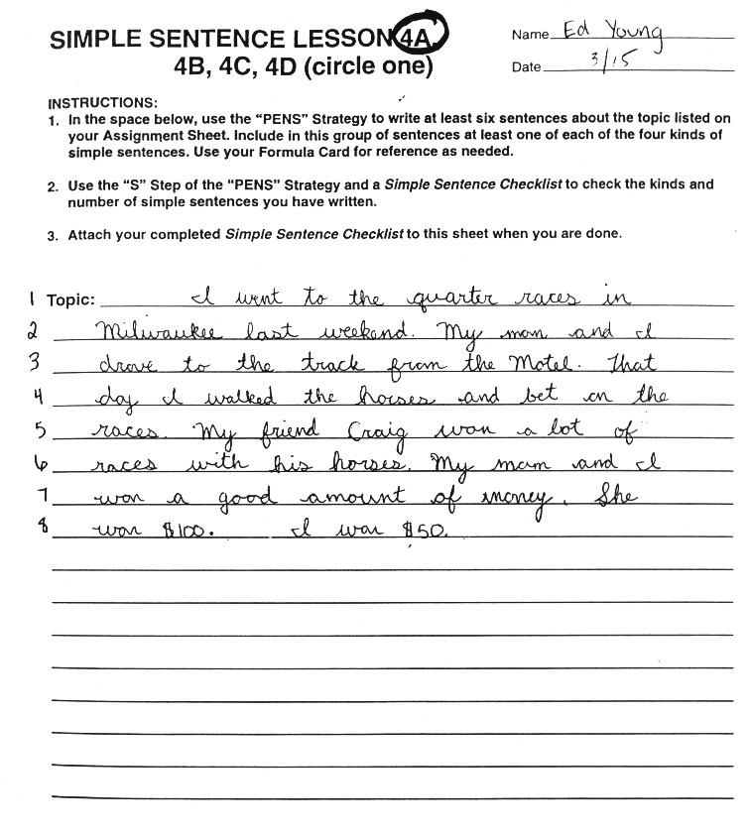
Notes:
The Challenge

Slide 28
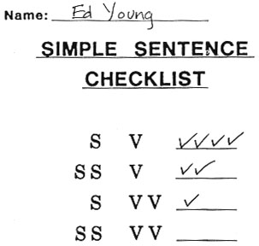
Notes:
The Challenge

Slide 29
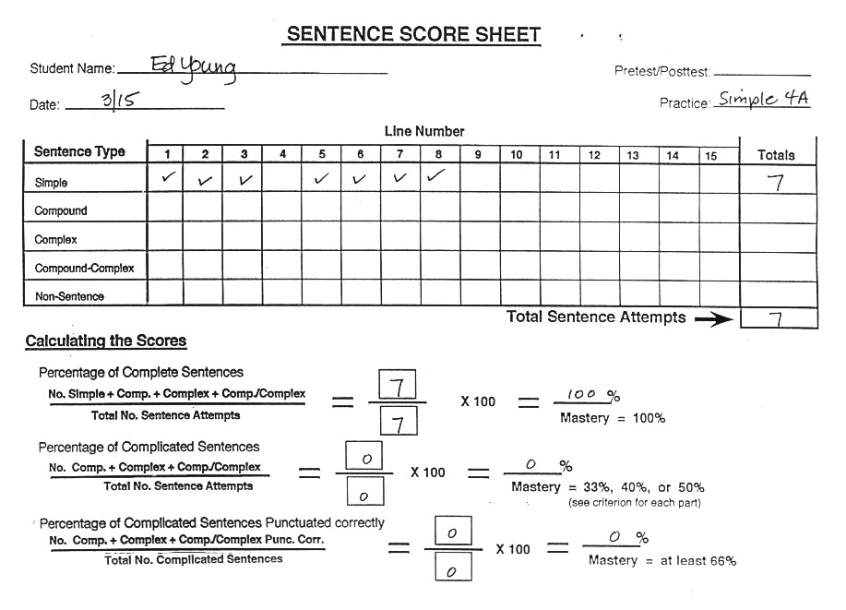
Notes:
The Challenge

Slide 30
Student Materials
Volume II Examples

Slide 31
Student Materials (Vol. II) Walkthrough
Formula Card After Simple Sentences
Simple Verbal Practice Checklist
Sentence Assignment Sheet
Lesson Sequence for Controlled Practice
Vol. II Simple Sentence Progress Chart
Vol. II Simple Sentence Lessons 1A-4A Examples
Vol. II Simple Sentence Checklist Example
Vol. II Sentence Score Sheet Example
University of Kansas | Center for Research on Learning

Slide 32
Notes:
The Challenge

Slide 33
Notes:
The Challenge

Slide 34
Notes:
The Challenge

Slide 35
Lesson Sequence for Controlled Practice (Vol. II)
85% or above 1 2 3
Below 85% A B C D
University of Kansas | Center for Research on Learning

Slide 36
Lesson Sequence for Controlled Practice (Vol. II)
Example: Student Progress
Lesson % correct
1A 85%
2A 70%
2B 80%
2C 95%
3A 85%
4A 90%
University of Kansas | Center for Research on Learning

Slide 37
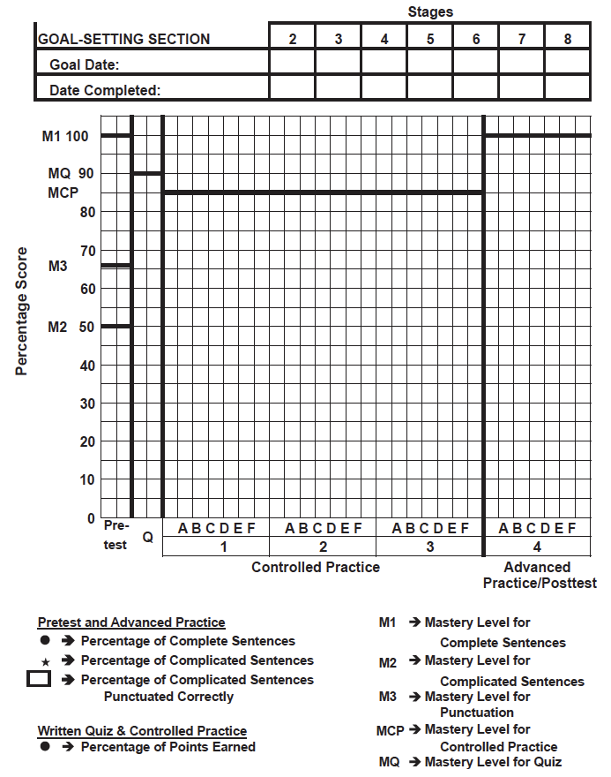
Simple Sentence Progress Chart (from Student Lessons Vol. II)
Student Name: ___________________
Notes:
The Challenge

Slide 38
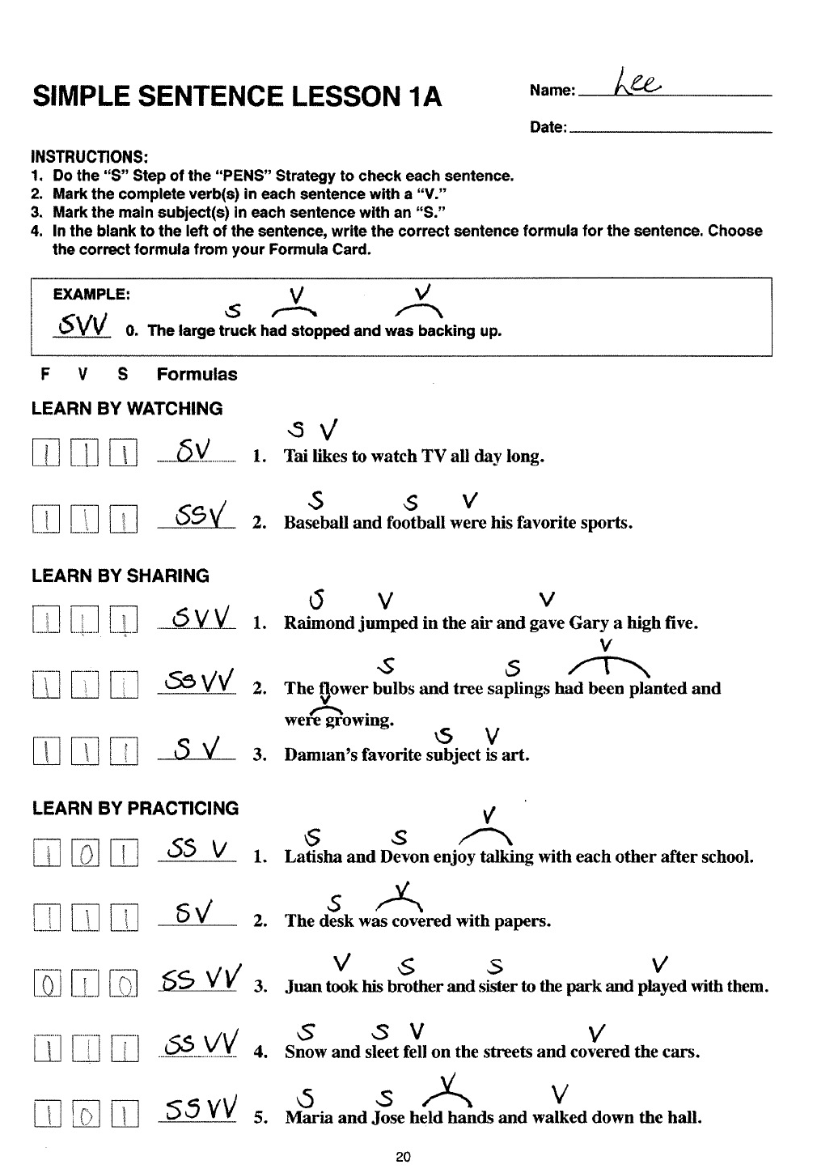
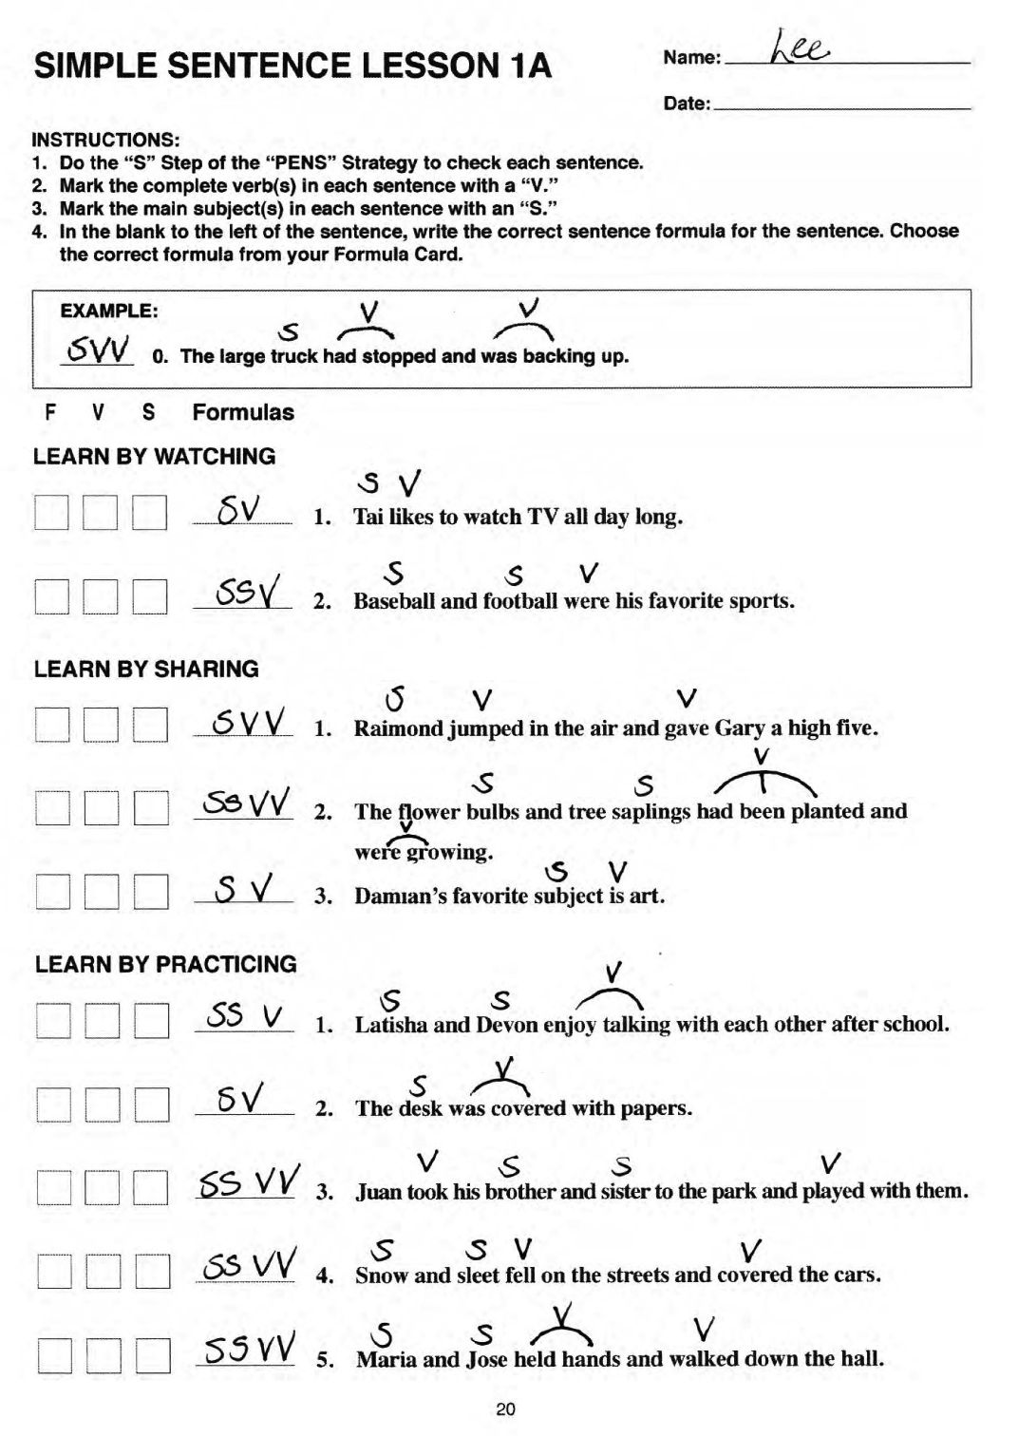
Notes:
The Challenge

Slide 39
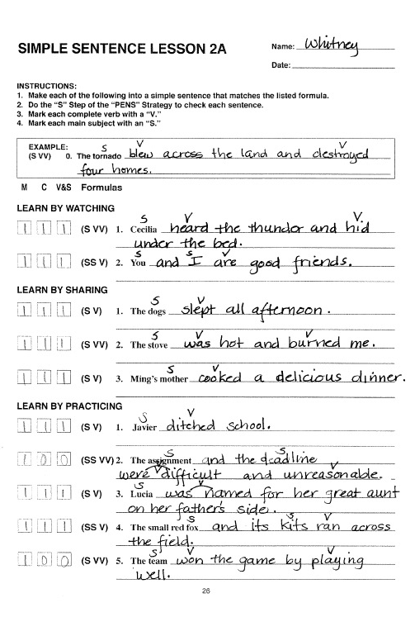
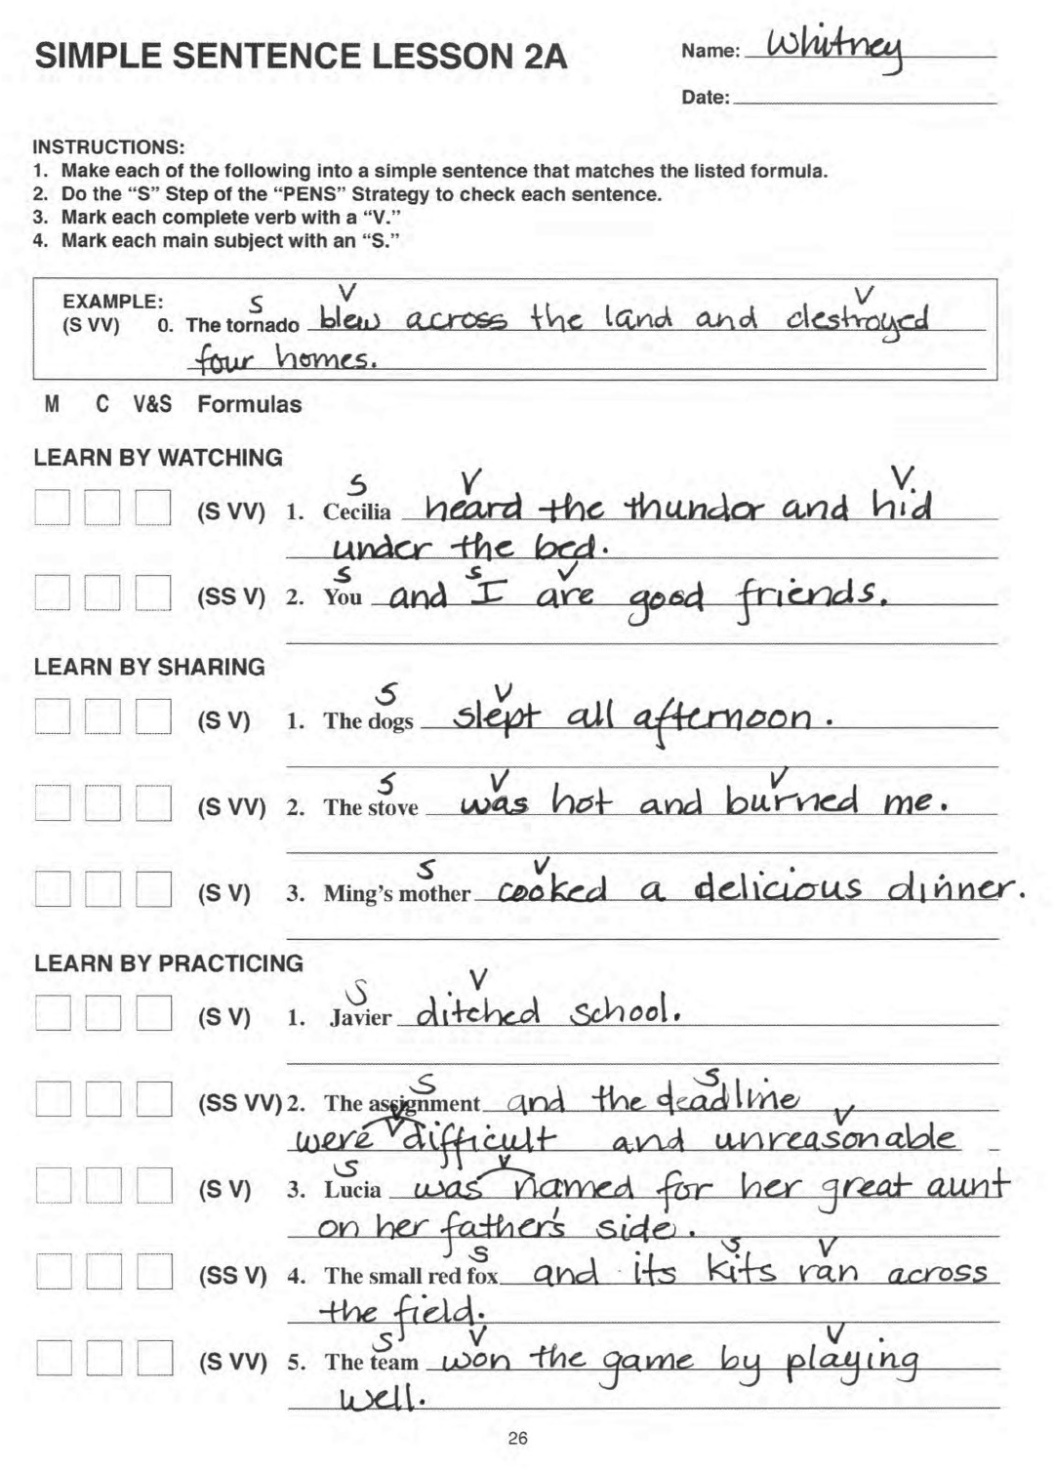
Notes:
The Challenge

Slide 40
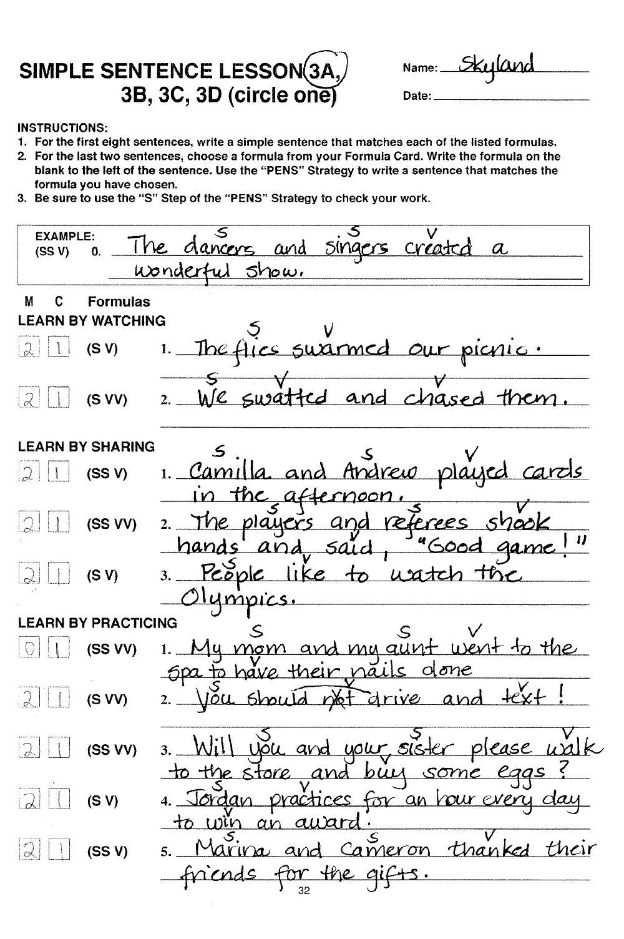
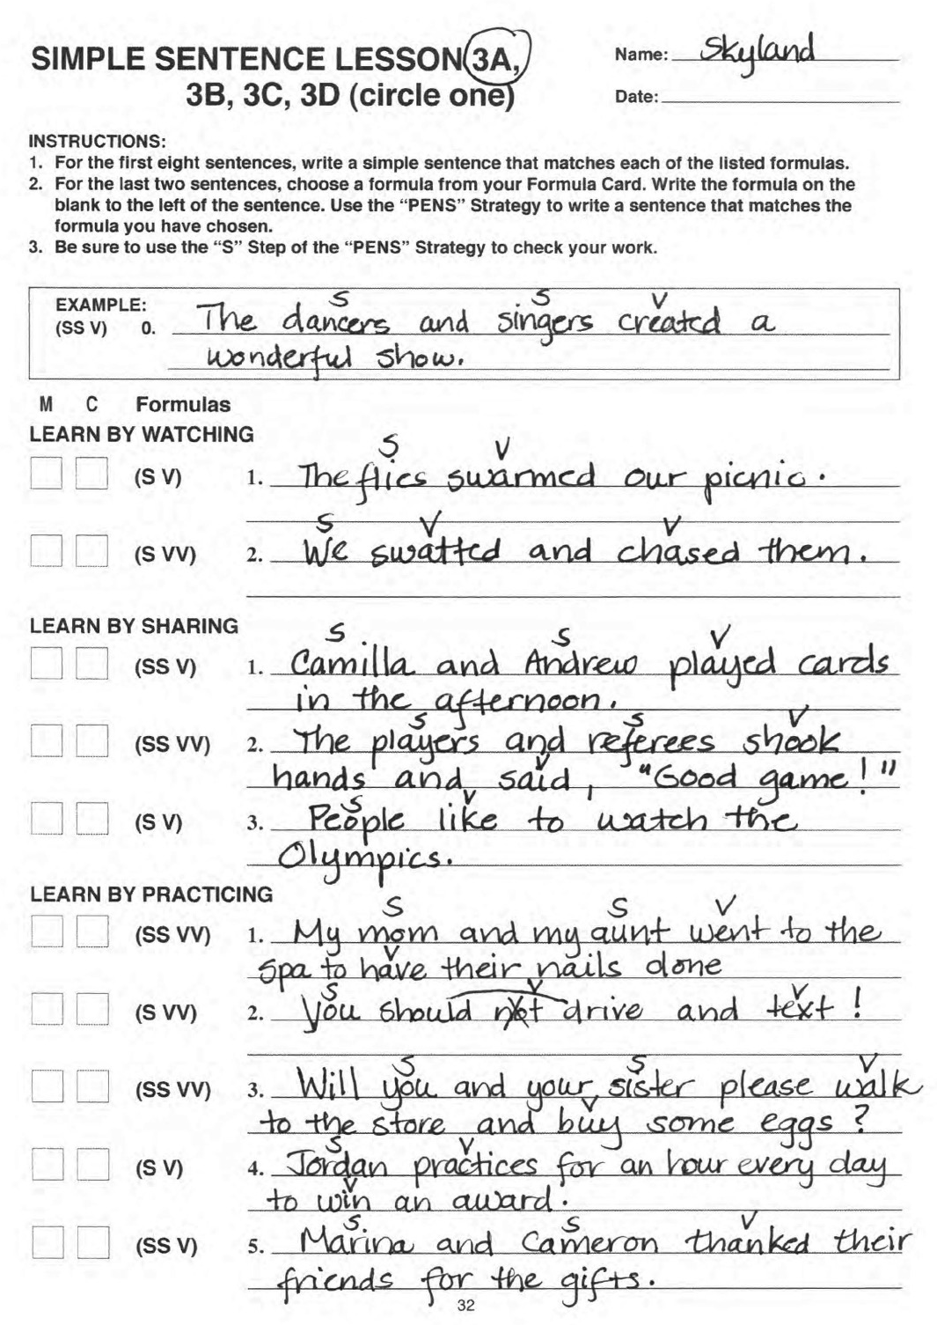
Notes:
The Challenge

Slide 41
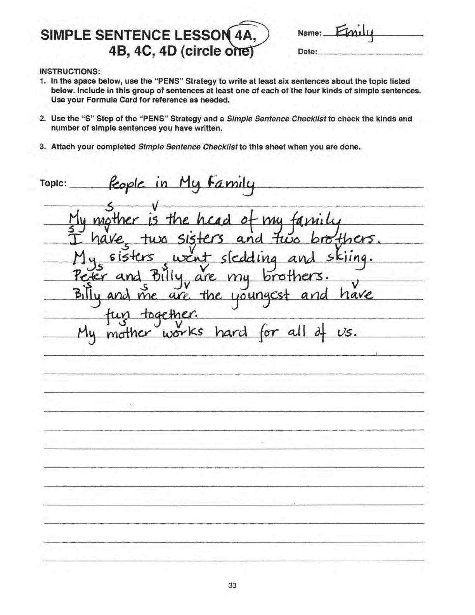
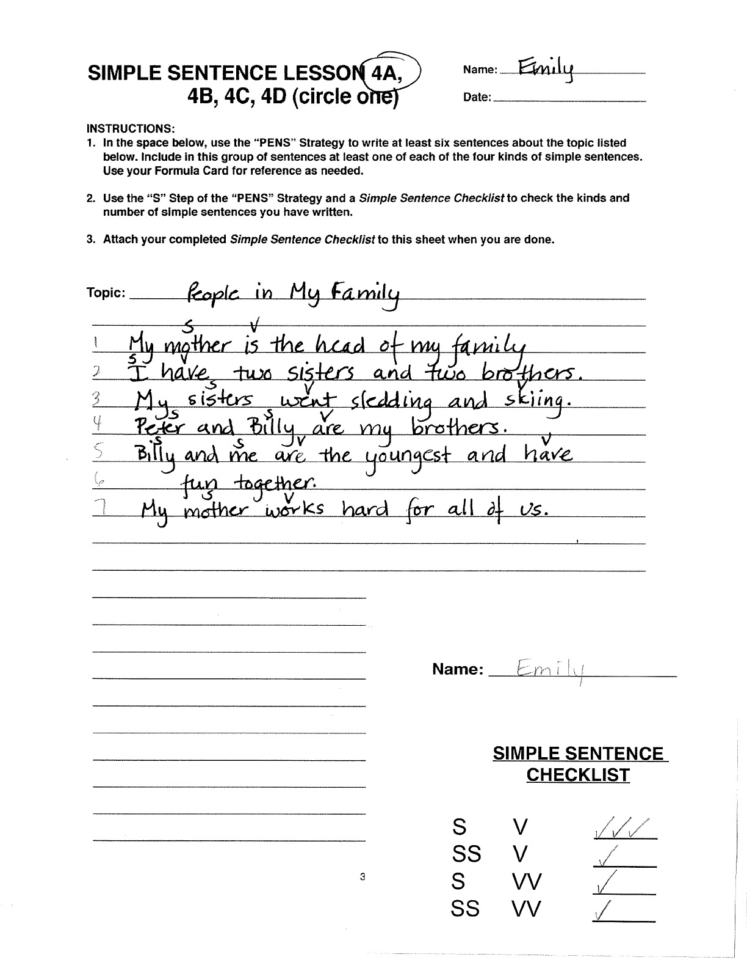
Notes:
The Challenge

Slide 42
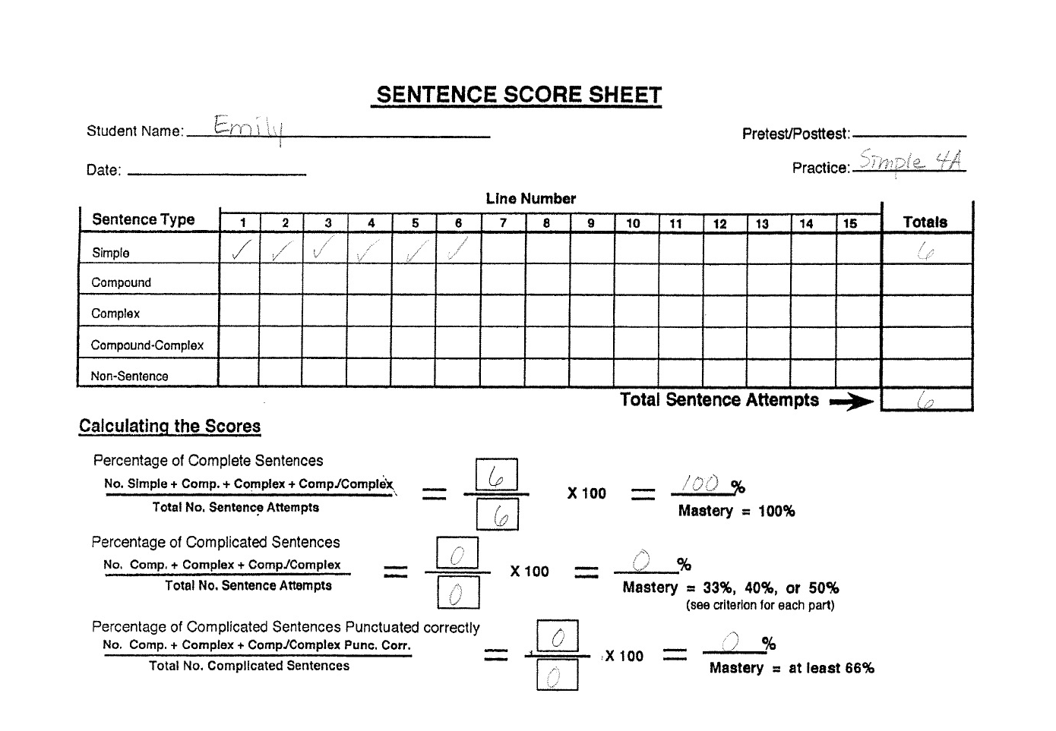
Notes:
The Challenge

