Slide 1
Compound-Complex Sentence
A compound-complex sentence has two or more independent clauses and at least one dependent clause.
Examples:
  When you are ready, I will call the store, and we can talk to Isaiah.
  Before the trick-or-treaters came, Megan made candied apples; they were delicious.

Slide 2
Sequencing Compound-Complex Sentences
Dependent Clause First
  After the party was over, Taylor had a headache, so Travis cleaned up the house.
  When Jennifer feels sad, she calls Chris; she cheers her up.

Slide 3
Sequencing Compound-Complex Sentences
Dependent Clause Second
  Taylor had a headache after the party was over, so Travis cleaned up the house.
  Sky hates to sleep while their parents are awake, because they might miss something.
  Jennifer calls Chris whenever she feels sad; she cheers her up.
  The sky was gray when the volcano erupted; ash was falling everywhere.

Slide 4
Sequencing Compound-Complex Sentences
Dependent Clause Third
  Taylor had a headache, so Travis cleaned up the house after the party was over.
  The employer made Nhan a good offer, and she accepted as long as he gave her a travel allowance.
  The doctors were busy with the serious cases; the slightly wounded soldier quietly waited while they worked.
  Caleb gave an excellent report; his instructor thanked him after the rest of the class had left the room.

Slide 5
Student Materials (Vol. I) Walkthrough
Formula Card After Compound-Complex Sentences
Compound-Complex Verbal Practice Checklist
Vol. I Compound-Complex Sentence Progress Chart
Vol. I Compound-Complex Sentence Lessons 1A-6A Examples
Vol. I Compound-Complex Sentence Checklist Example
Vol. I Sentence Score Sheet Example

Slide 6
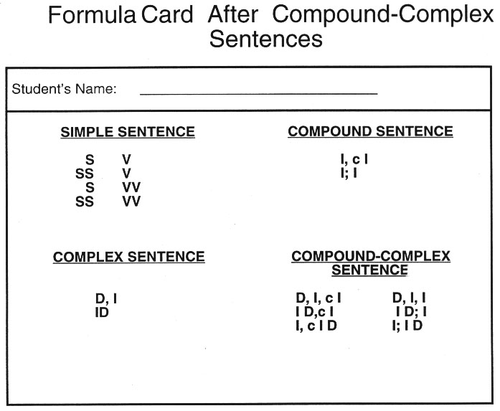
Notes:
The Challenge

Slide 7
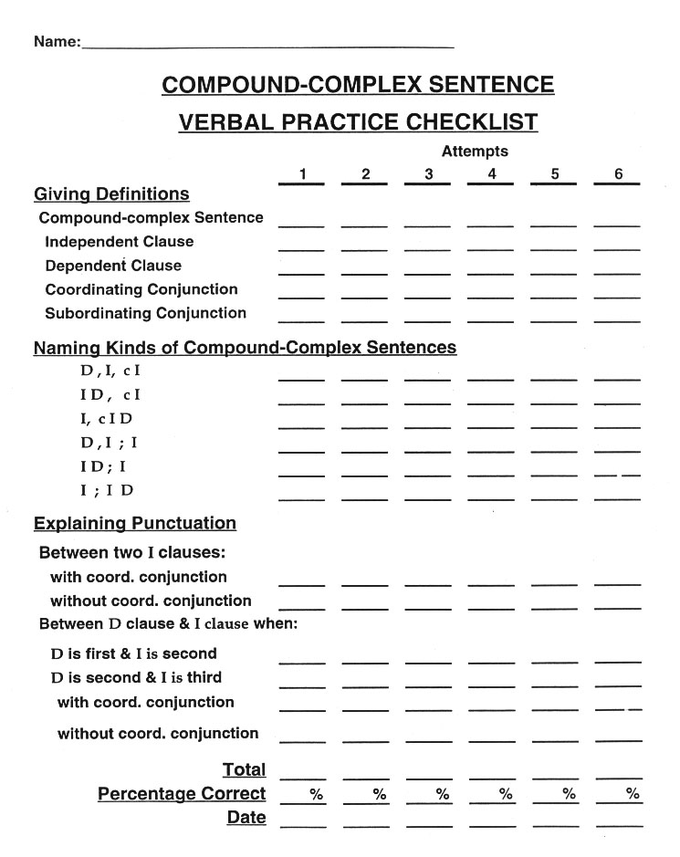
Notes:
The Challenge

Slide 8
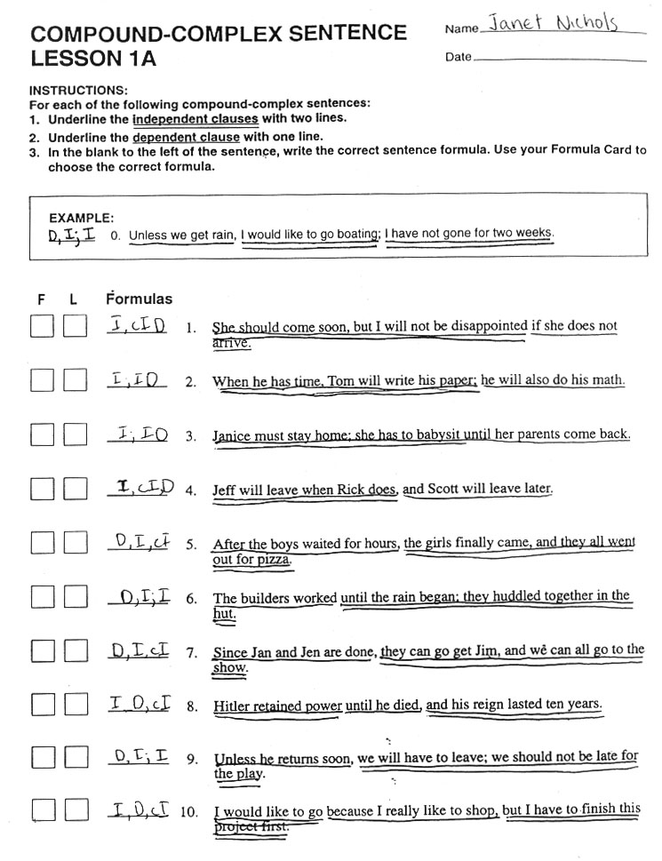
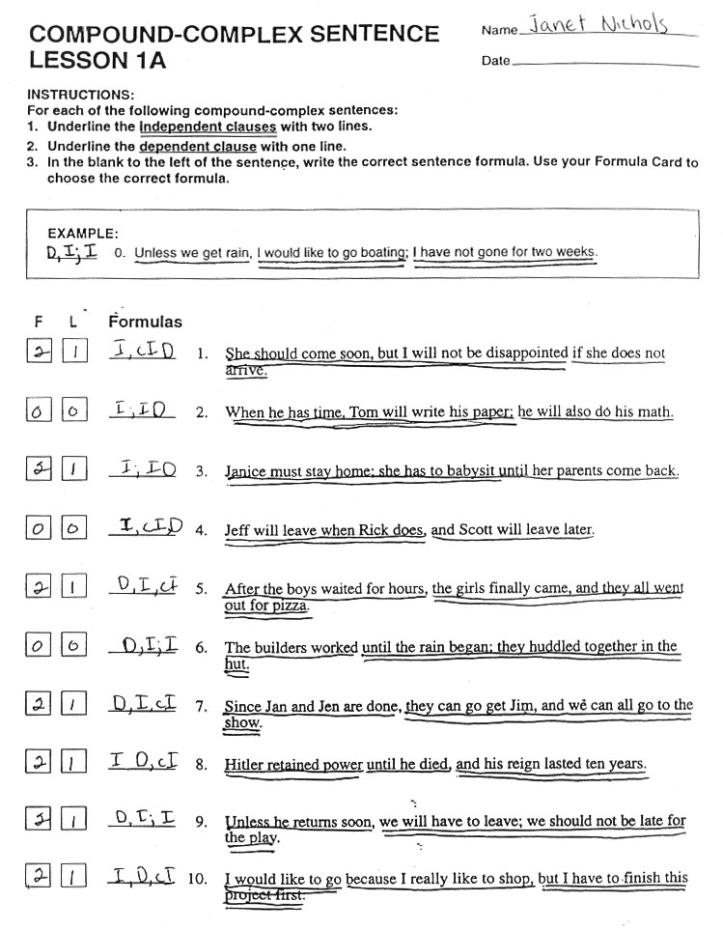
Notes:
The Challenge

Slide 9
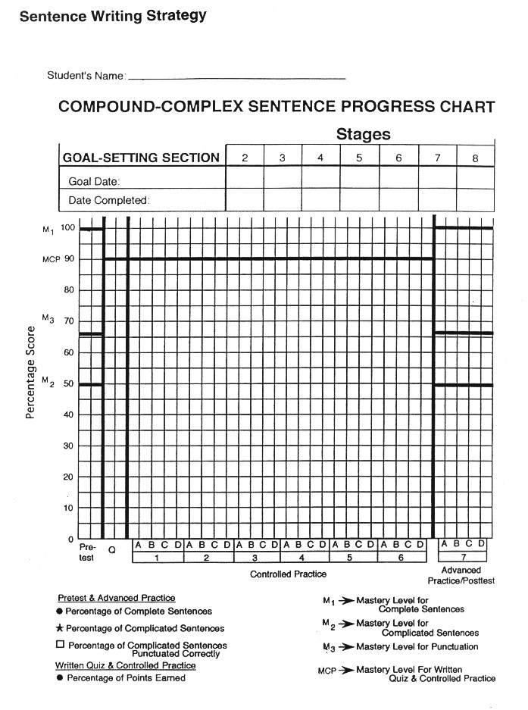
Notes:
The Challenge

Slide 10
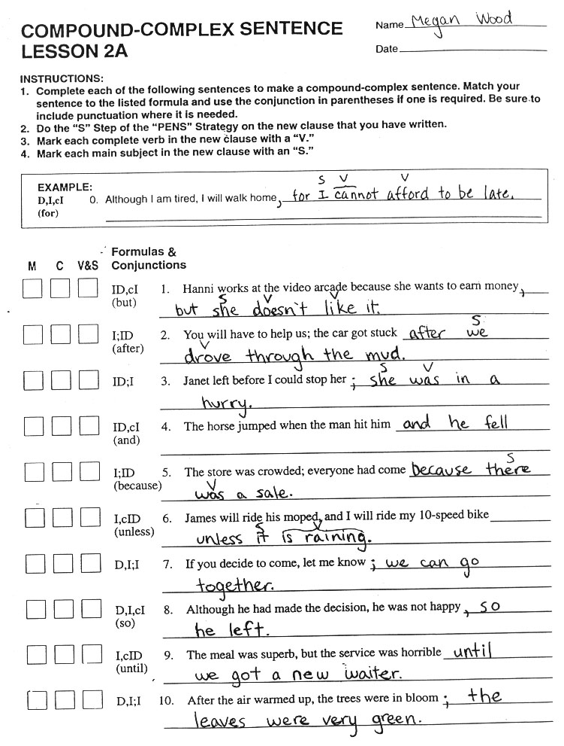
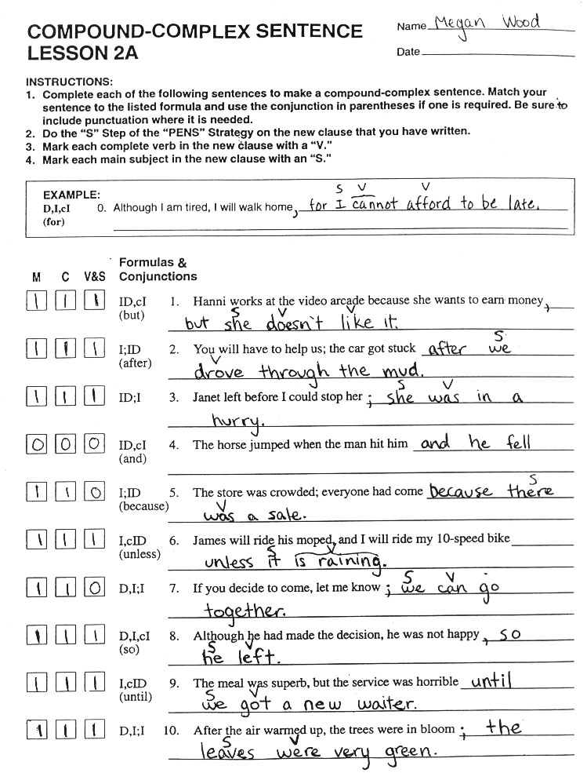
Notes:
The Challenge

Slide 11
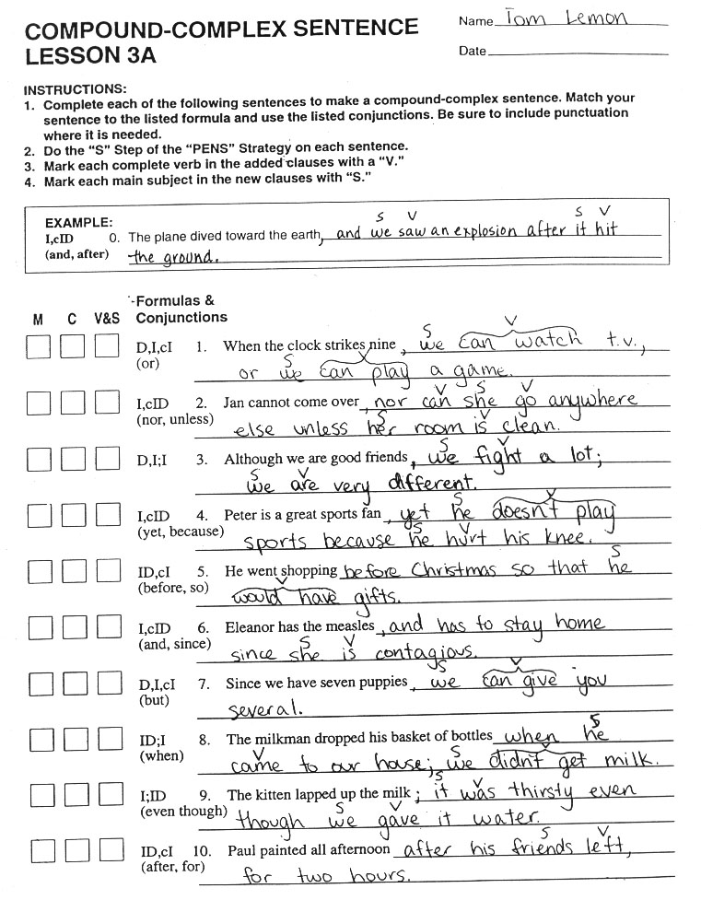
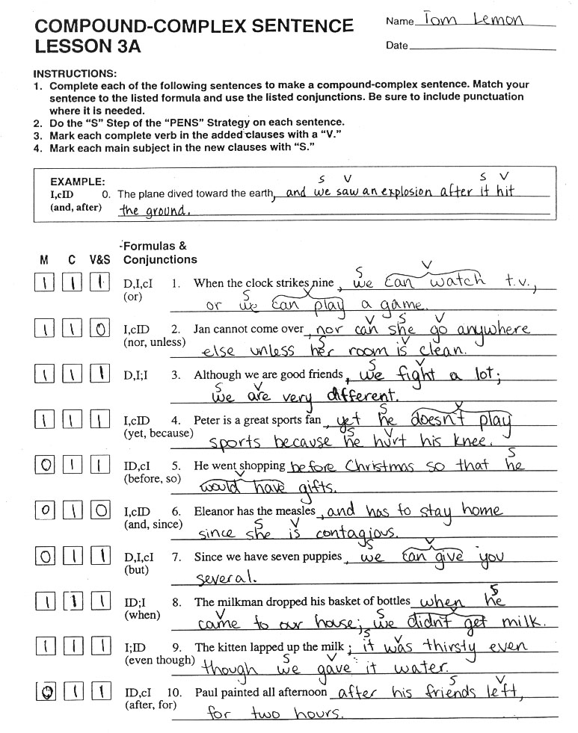
Notes:
The Challenge

Slide 12
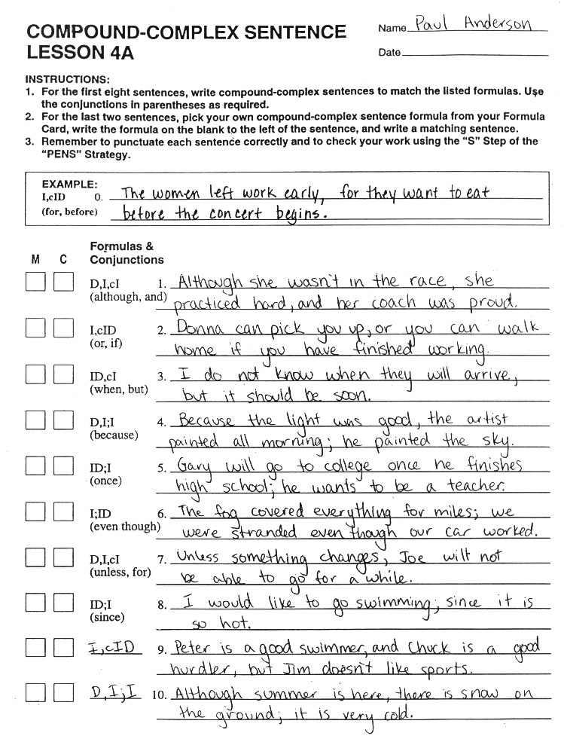
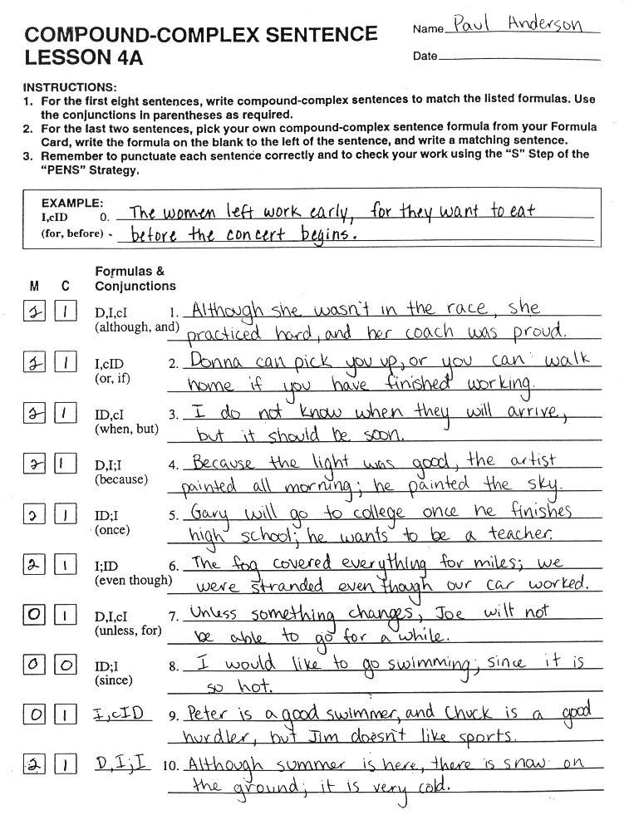
Notes:
The Challenge

Slide 13
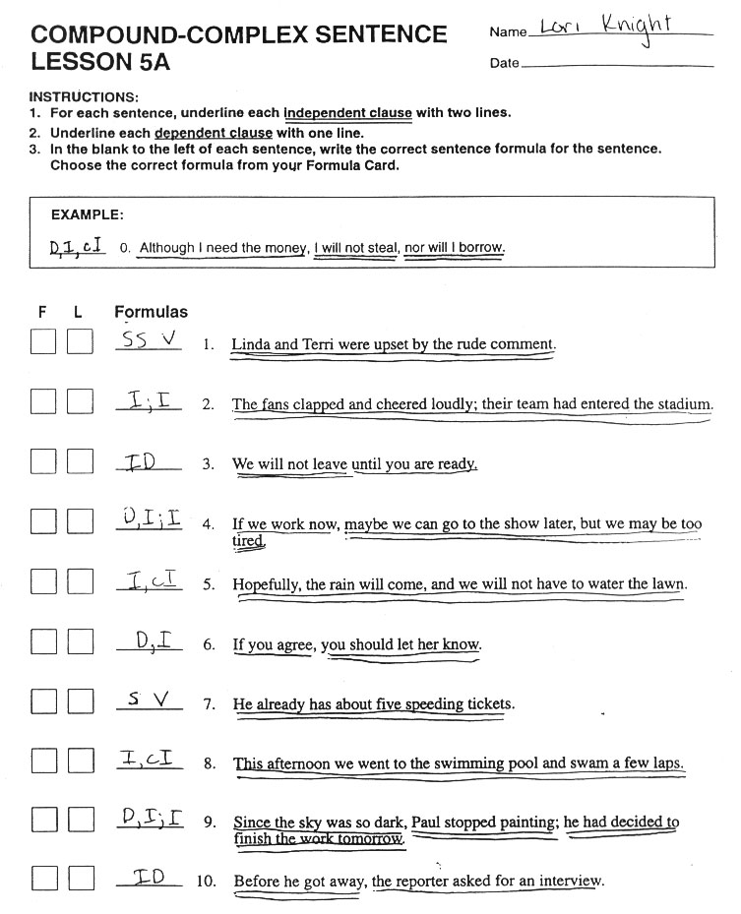

Notes:
The Challenge

Slide 14
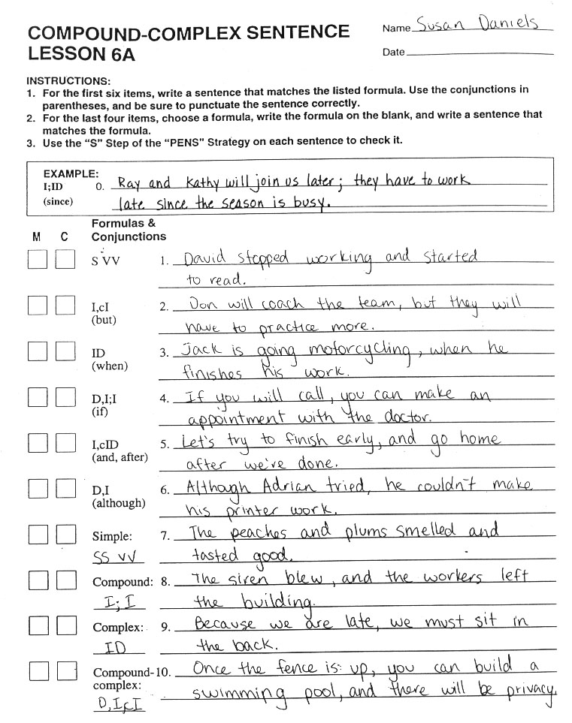

Notes:
The Challenge

Slide 15
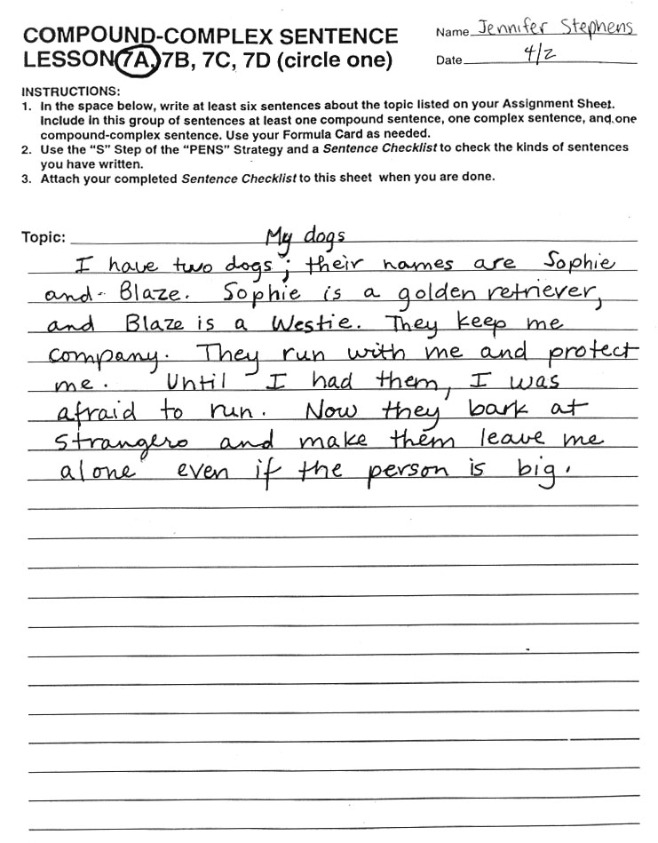
Notes:
The Challenge

Slide 16
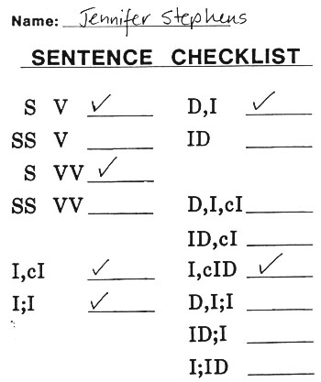
Notes:
The Challenge

Slide 17
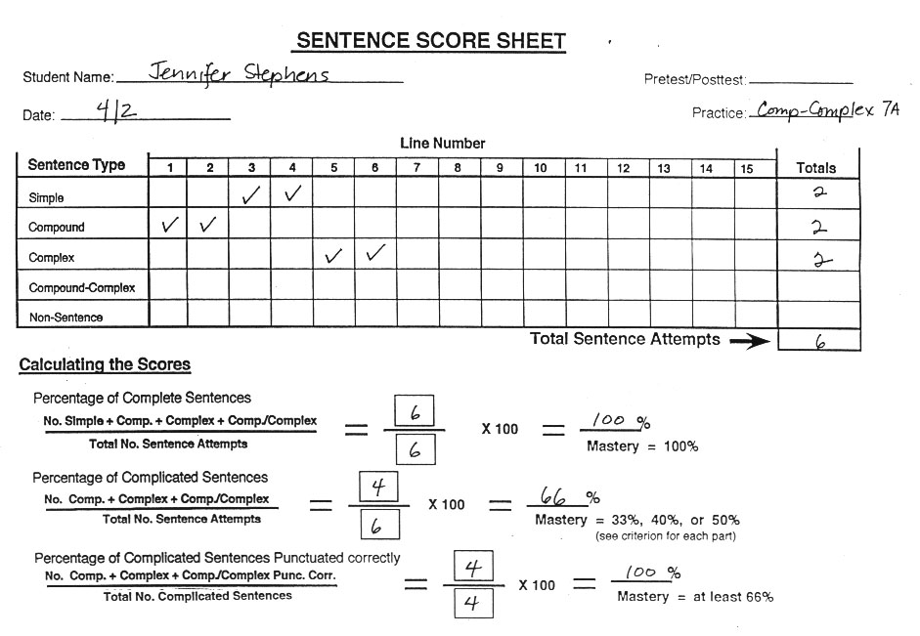
Notes:
The Challenge

Slide 18
Student Materials (Vol. II) Walkthrough
Formula Card After Compound-Complex Sentences
Compound-Complex Verbal Practice Checklist
Vol. II Compound-Complex Sentence Progress Chart
Vol. II Compound-Complex Sentence Lessons 1A-6A Examples
Vol. II Compound-Complex Sentence Checklist Example
Vol. II Sentence Score Sheet Example

Slide 19
Notes:
The Challenge

Slide 20
Notes:
The Challenge

Slide 21
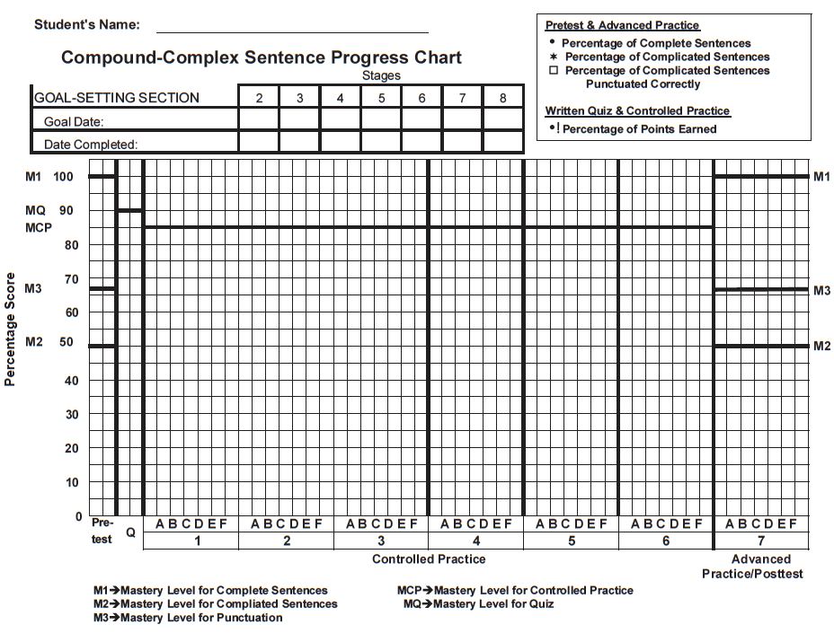
Compound-Complex Sentence Progress Chart
(from Student Lessons Vol. II)
Notes:
The Challenge

Slide 22
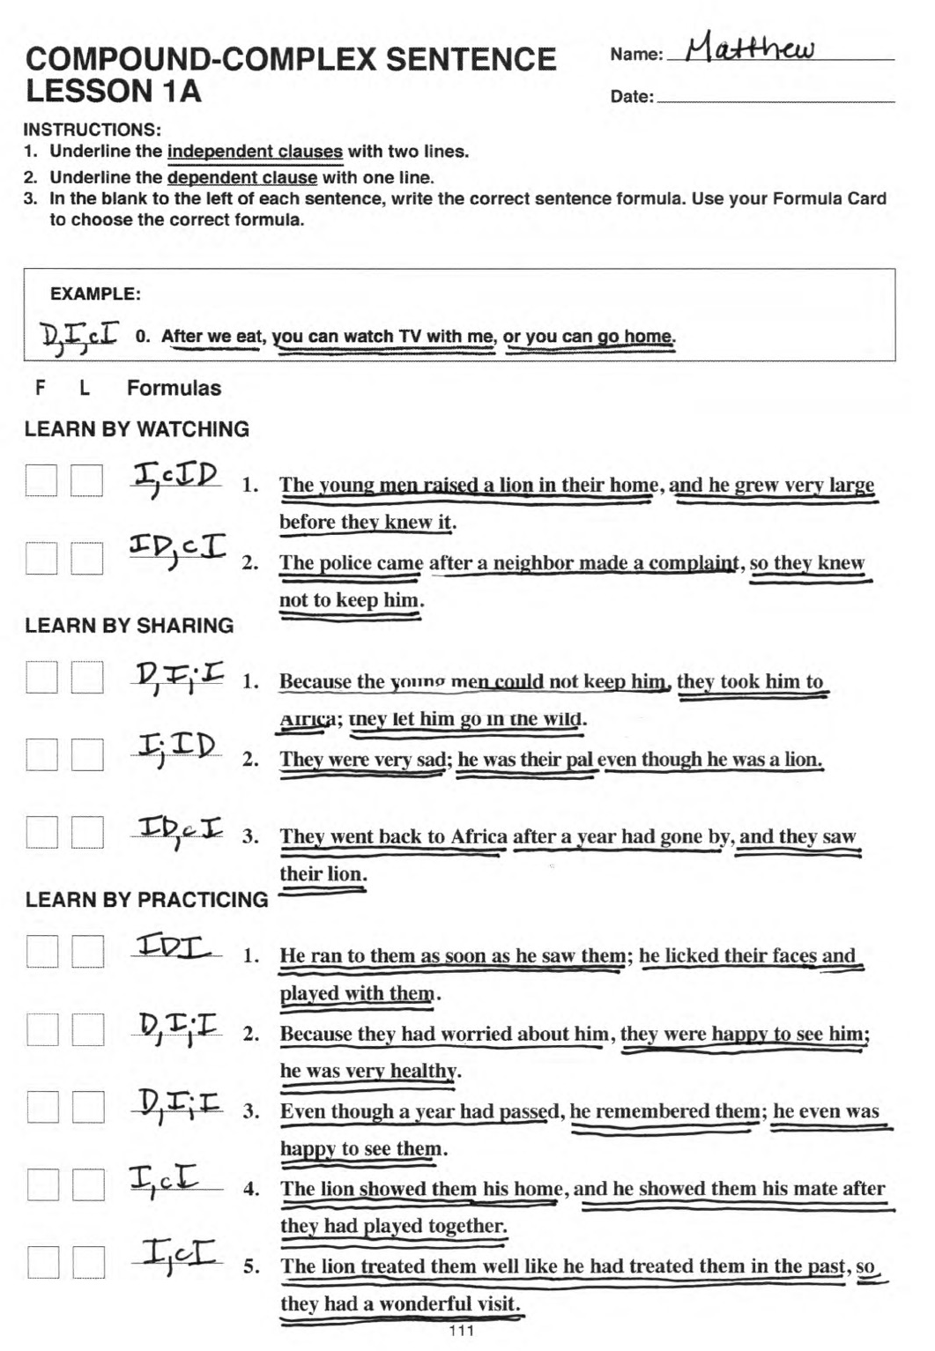
Notes:
The Challenge

Slide 23
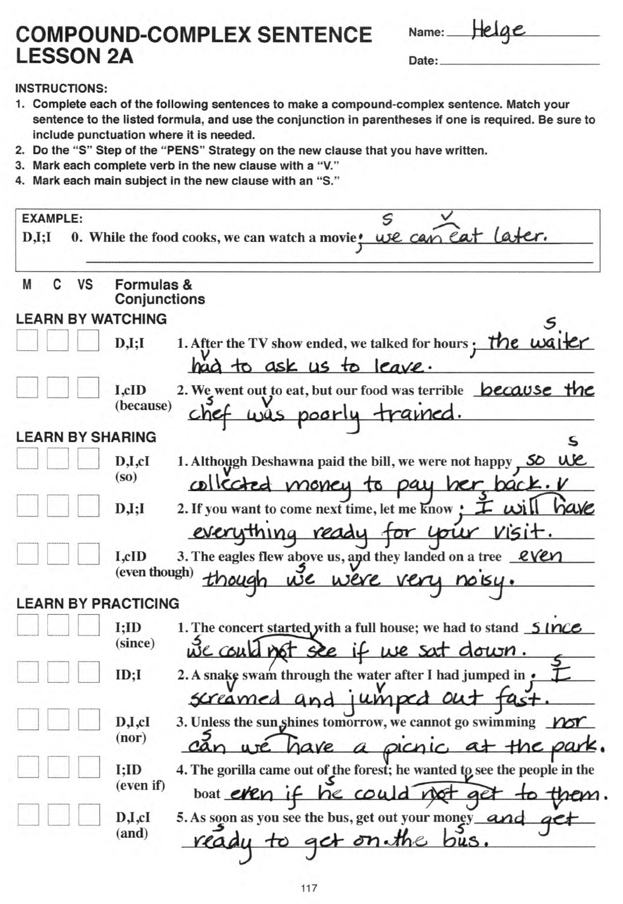
Notes:
The Challenge

Slide 24
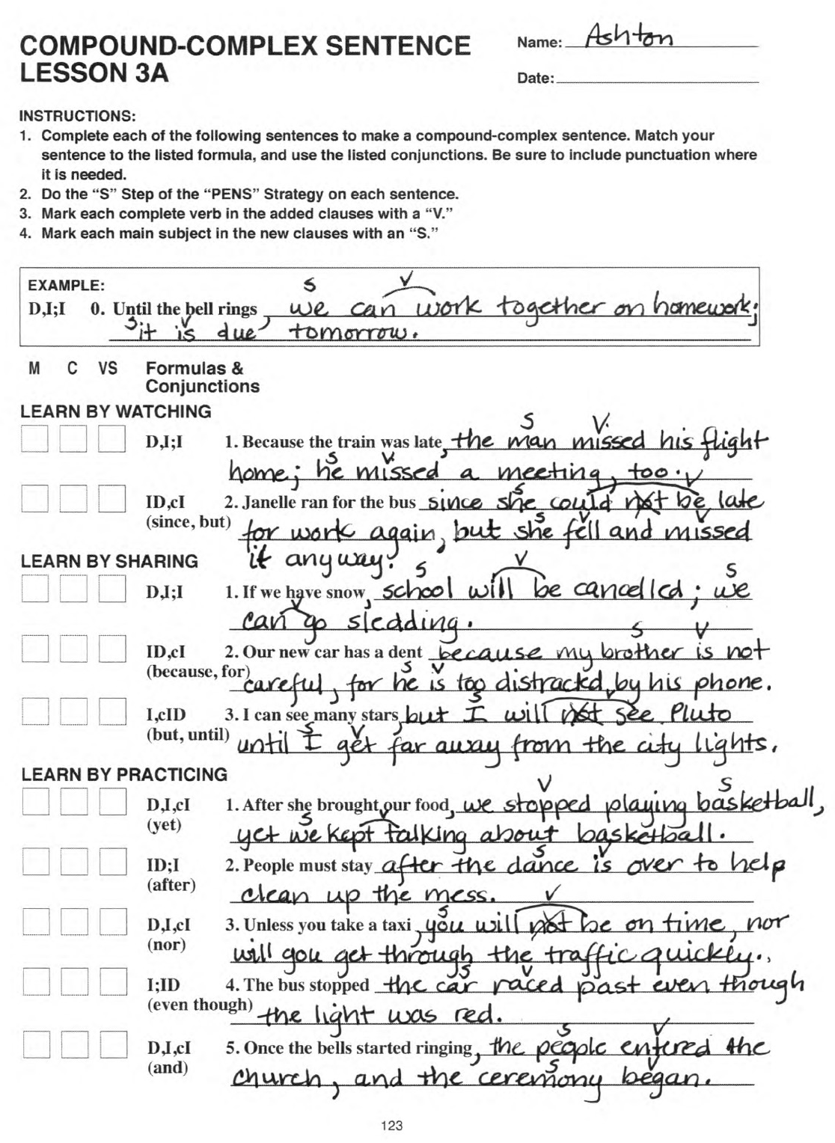
Notes:
The Challenge

Slide 25
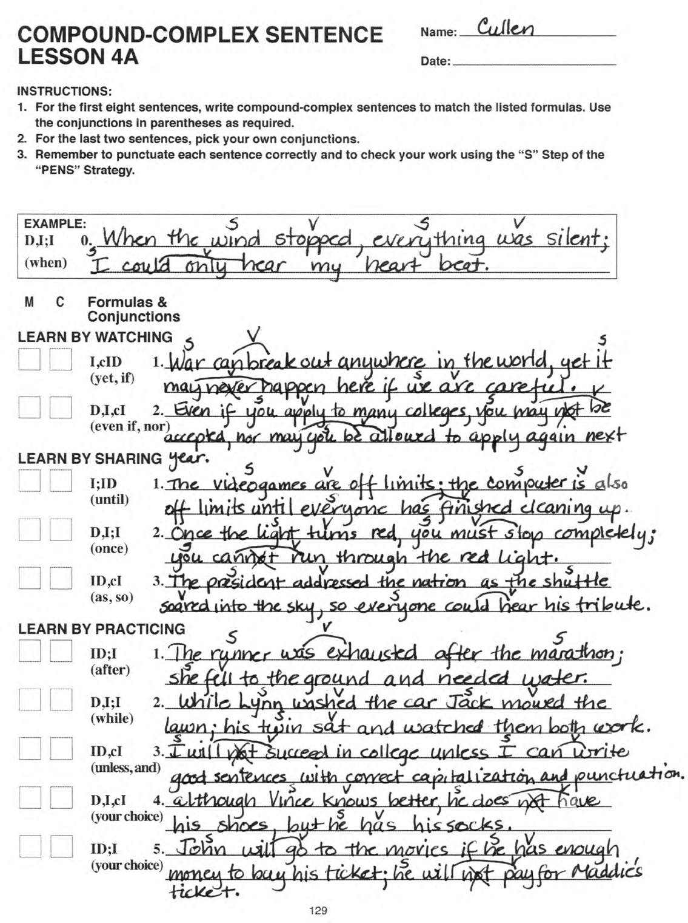
Notes:
The Challenge

Slide 26
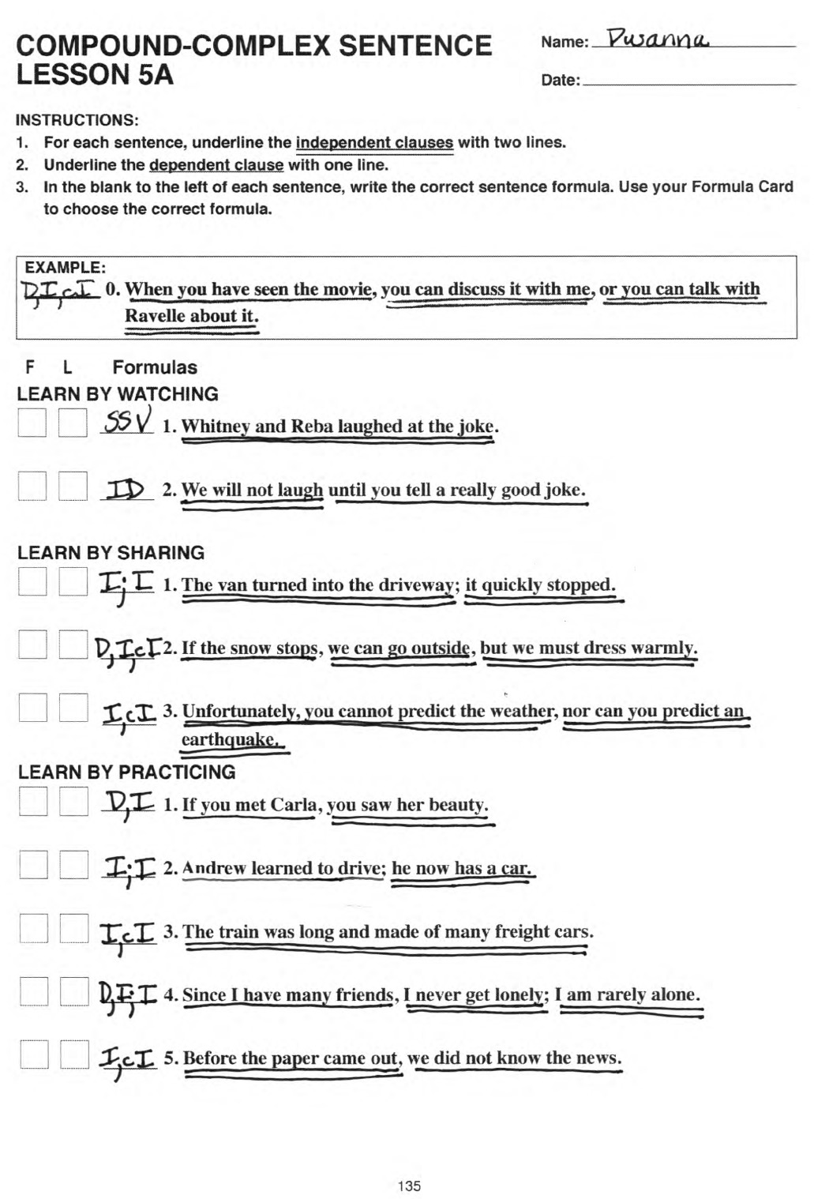
Notes:
The Challenge

Slide 27
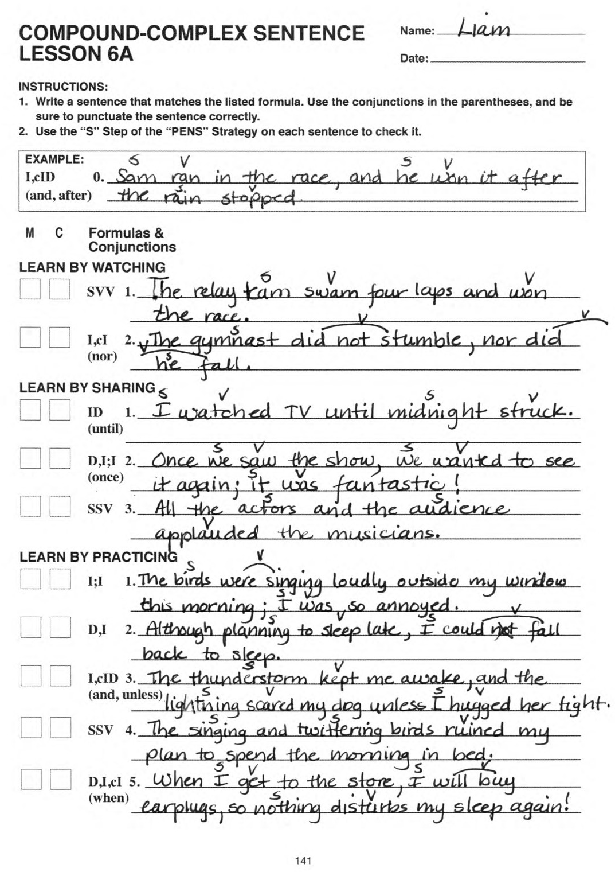
Notes:
The Challenge

Slide 28
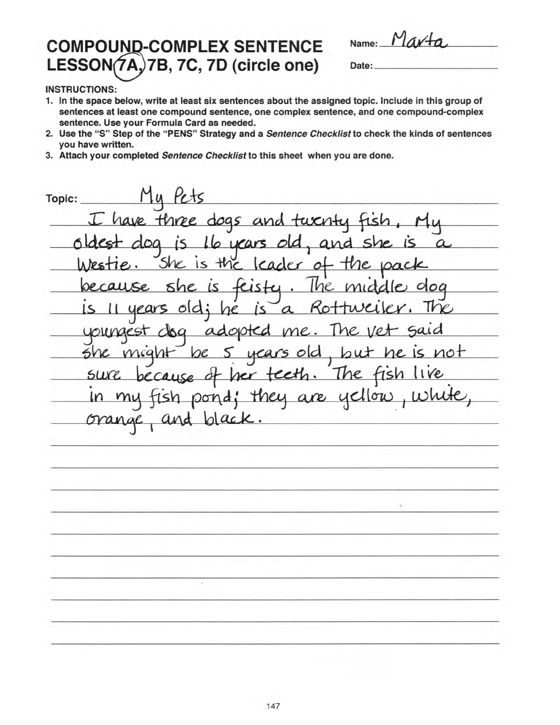
Notes:
The Challenge

