Slide 1
Compound Sentence
A compound sentence has two or more independent clauses.
Examples:
  The students finished class, and they went to lunch.
  Miguel did not want to hurt Katie's feelings, so he said nothing about her mistake.
  I want to see my sister soon, for she has been in Switzerland for two years.
Notes:
The Challenge

Slide 2
Comparing Compound Sentences to Simple Sentences with Compound Subjects and Compound Verbs
Simple Sentence:
The men and women met at the station and went to dinner.
Compound Sentence:
The men met at the station, and the women went to dinner.
Notes:
The Challenge

Slide 3
Comparing Compound Sentences to Simple Sentences with Compound Subjects and Compound Verbs
Simple Sentence:
The ducks and geese squawked and fluttered their wings.
Compound Sentence:
The ducks squawked, and the geese fluttered their wings.
Notes:
The Challenge

Slide 4
Comparing Compound Sentences to Simple Sentences with Compound Subjects and Compound Verbs
Simple Sentence:
Sophia and Lucas ate ice cream and drank pop.
Compound Sentence:
Sophia ate ice cream, and Lucas drank pop.
Notes:
The Challenge

Slide 5
Coordinating Conjunction
A word that is used with a comma to join two independent clauses.
, for , but
, and , or
, nor , yet
, so
Notes:
The Challenge

Slide 6
Coordinating Conjunction
Examples:
  Baseball is my favorite sport to watch, but football is my favorite sport to play.
  The children ran all the way to school, yet they were late any way.
  You will have to finish the project, or your group will get a failing grade.
  Hanni was not at the game, nor was she at the party.
  We did not see Mike at the movie, nor did we see him at the restaurant.
Notes:
The Challenge

Slide 7
Semicolons
Semicolons (;) can also be used to join the two independent clauses of a compound sentence.
Examples:
  Susie loves to swim; her brother likes to dive.
  Jackson was highly respected; he was always such a responsible person.
  The meeting was over; it was already midnight.
Notes:
The Challenge

Slide 8
Student Materials (Vol. I) Walkthrough
Formula Card After Compound Sentences
Compound Verbal Practice Checklist
Vol. I Compound Sentence Progress Chart
Vol. I Compound Sentence Lessons 1A-6A Examples
Vol. I Compound Sentence Checklist Example
Vol. I Sentence Score Sheet Example
Notes:
The Challenge

Slide 9
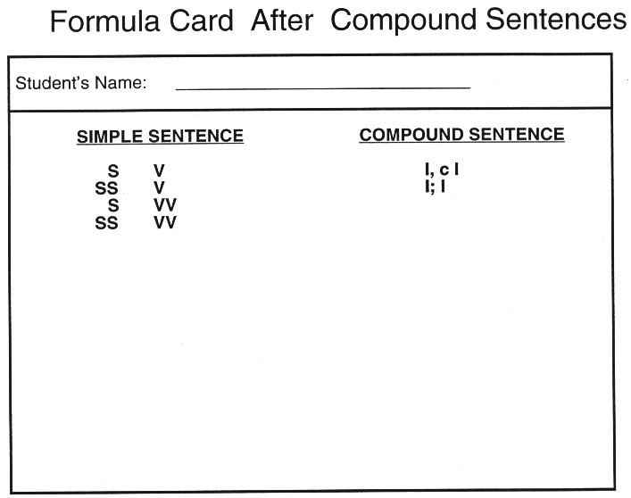
Notes:
The Challenge

Slide 10
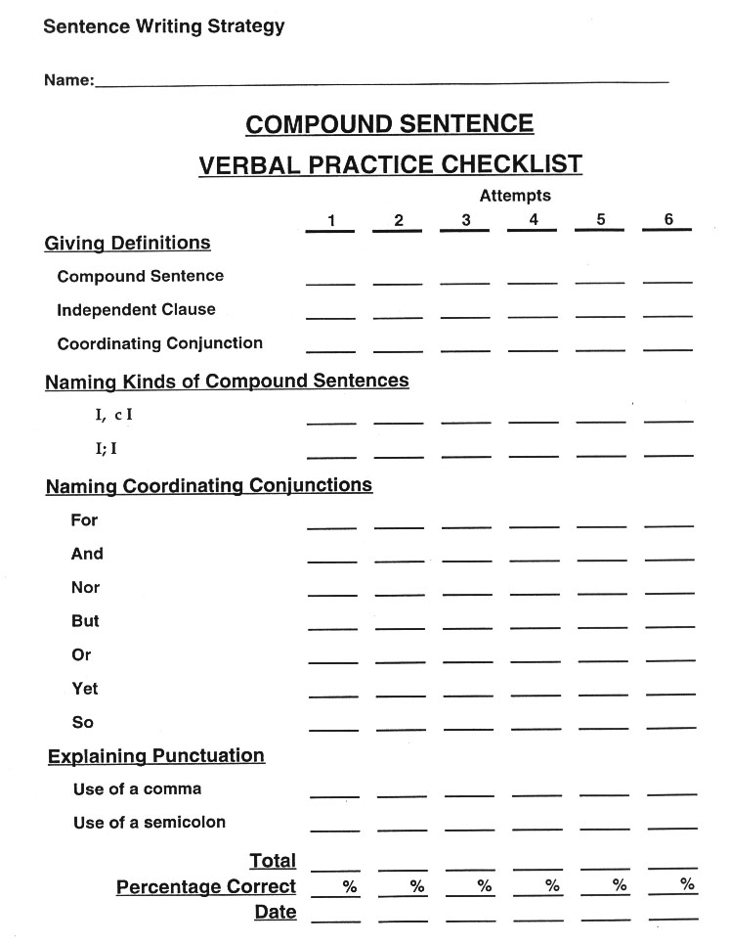
Notes:
The Challenge

Slide 11
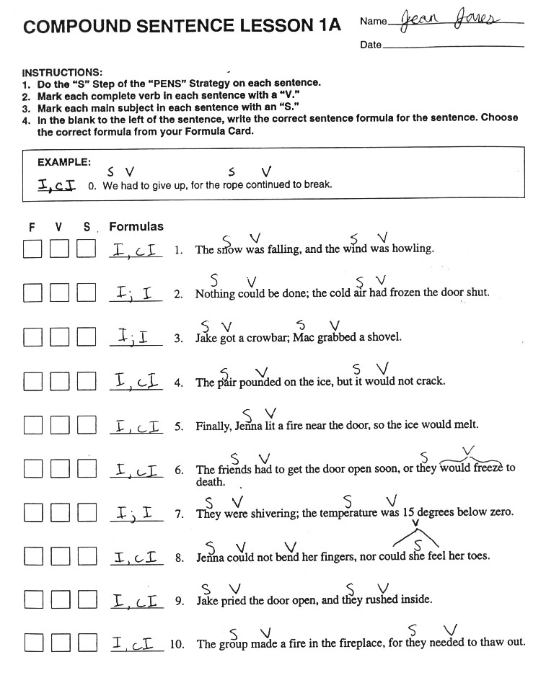
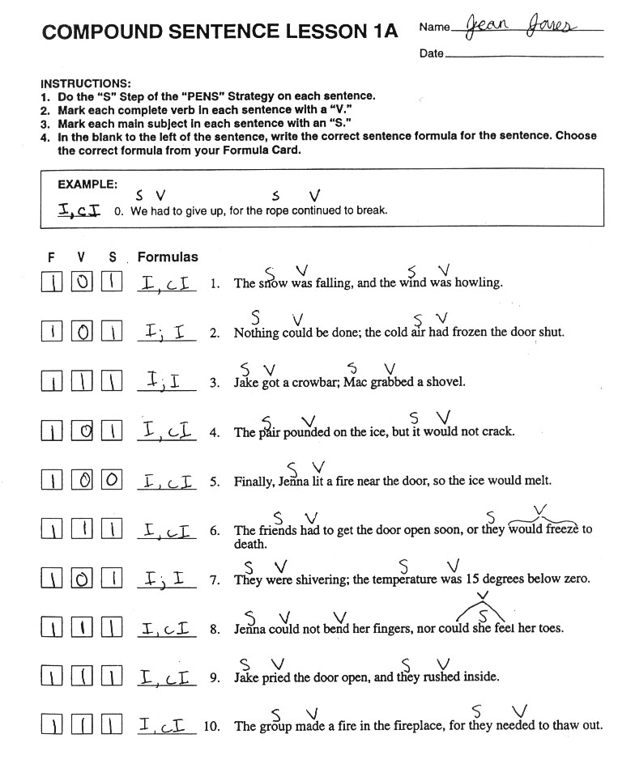
Notes:
The Challenge

Slide 12
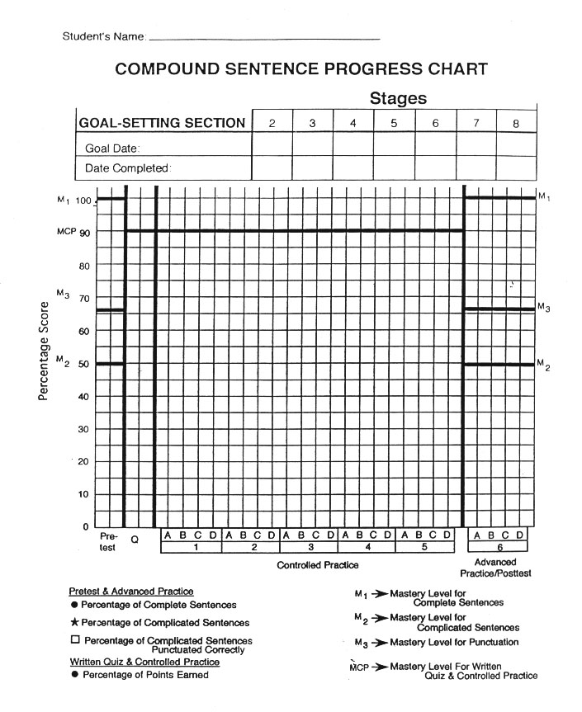
Notes:
The Challenge

Slide 13
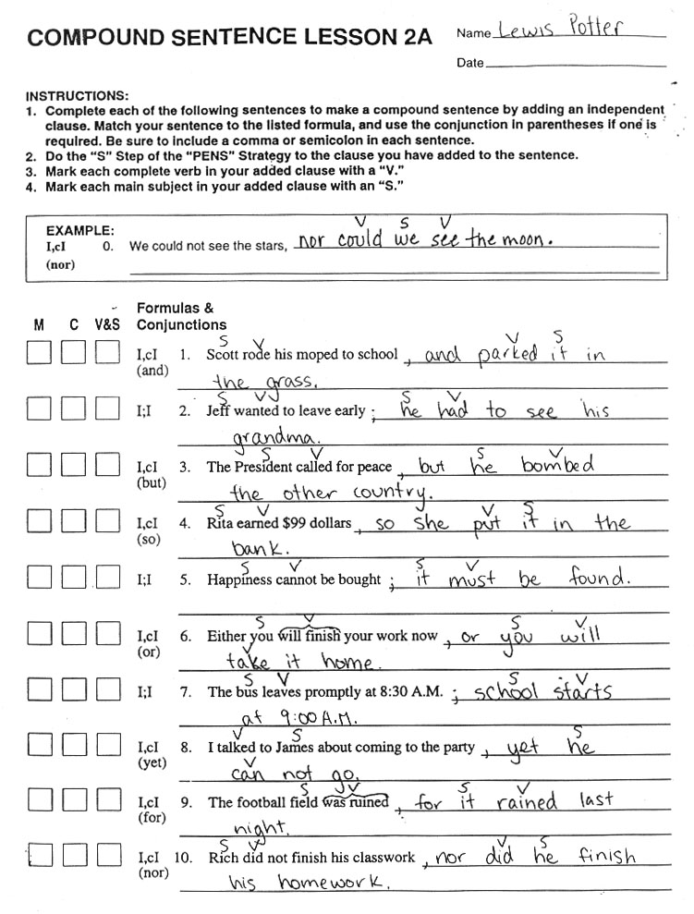
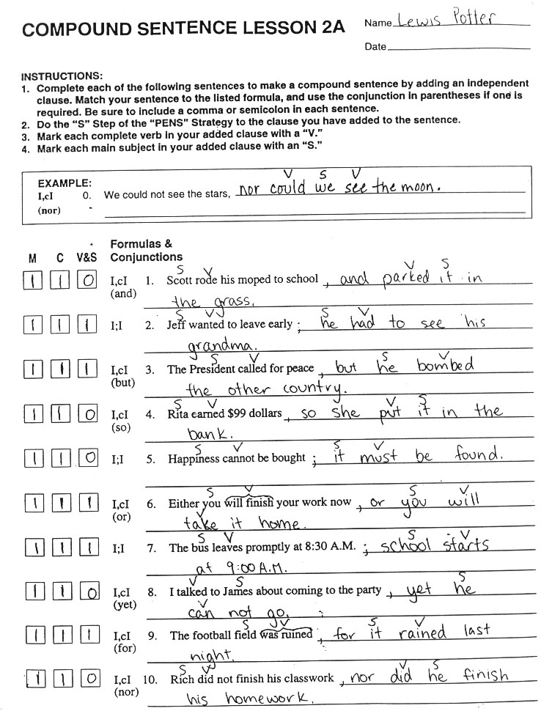
Notes:
The Challenge

Slide 14
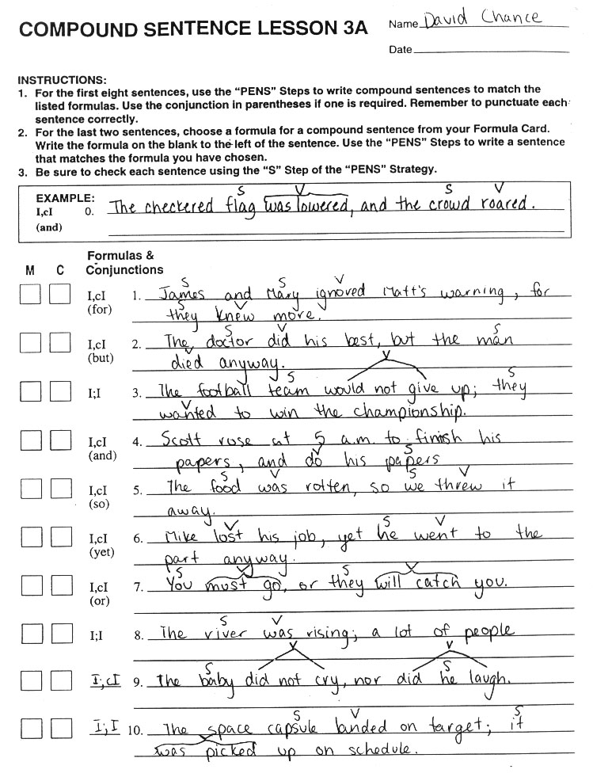
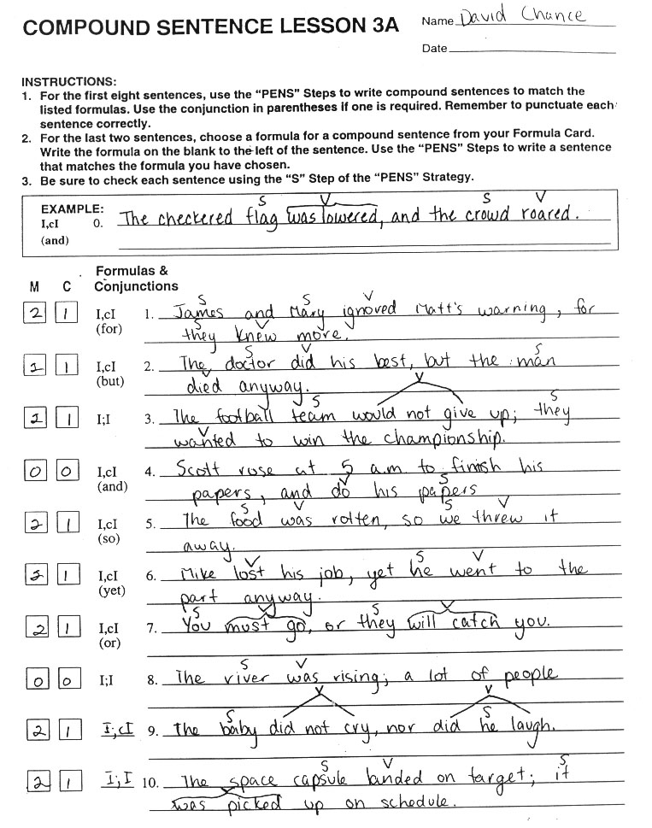
Notes:
The Challenge

Slide 15
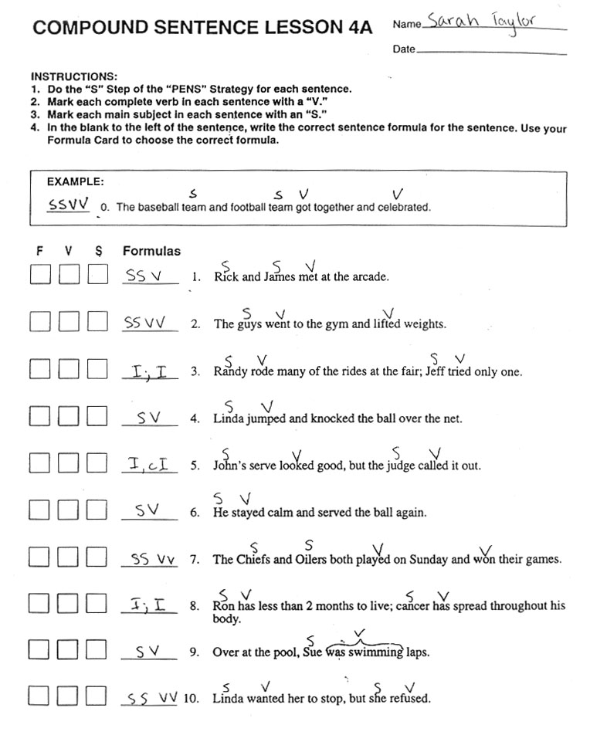
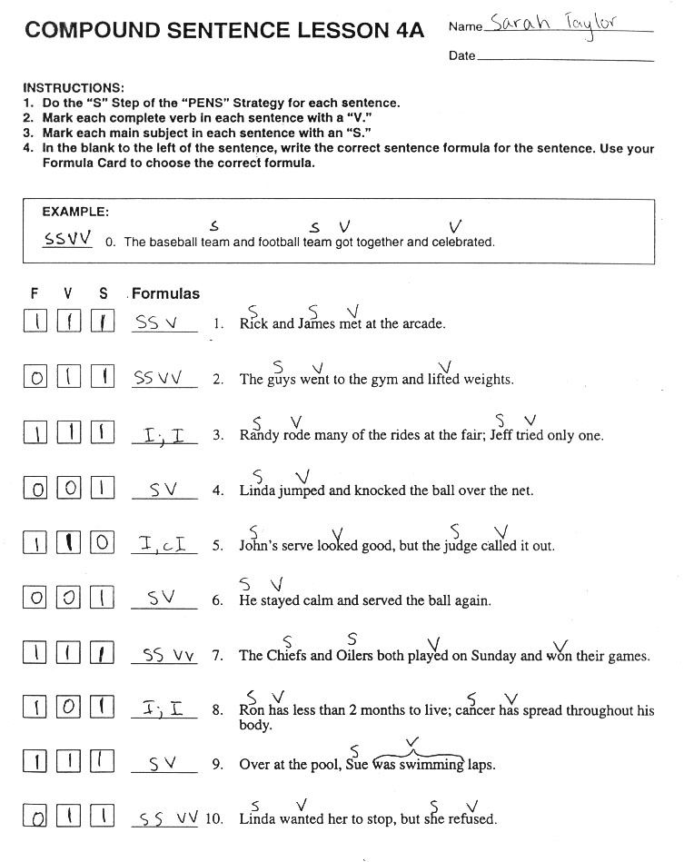
Notes:
The Challenge

Slide 16
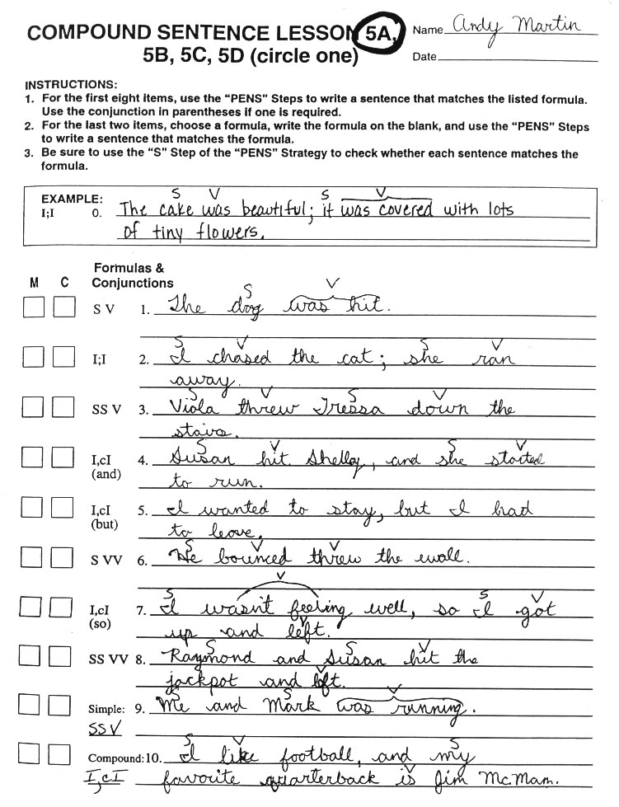
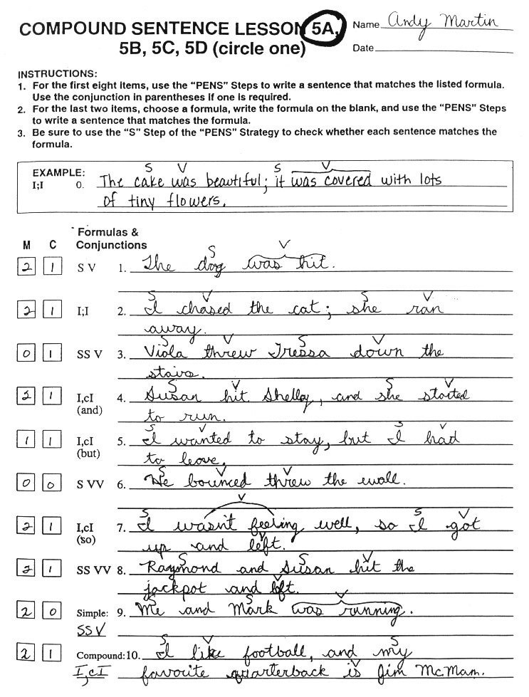
Notes:
The Challenge

Slide 17
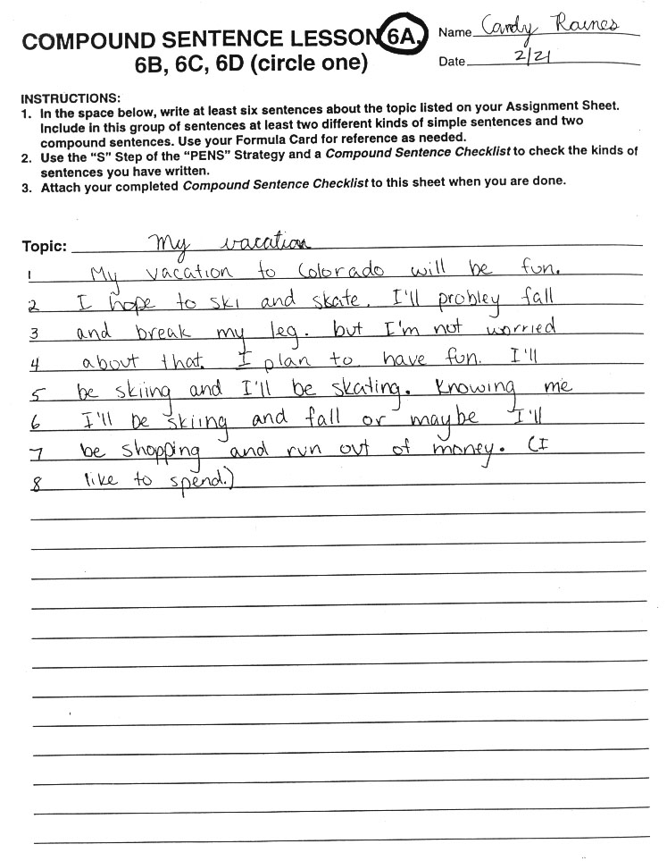
Notes:
The Challenge

Slide 18
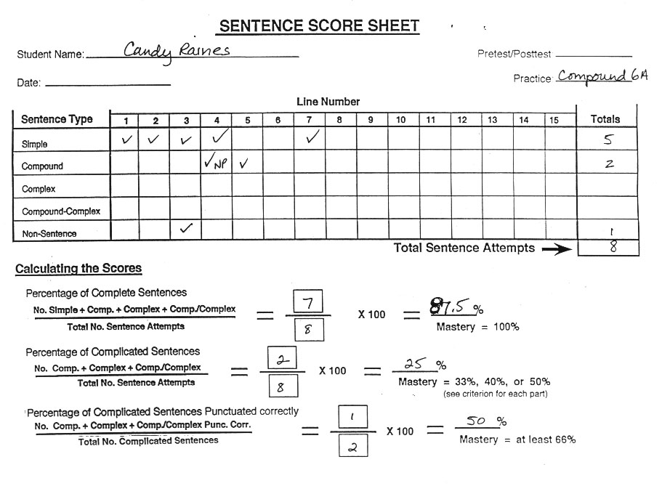
Notes:
The Challenge

Slide 19
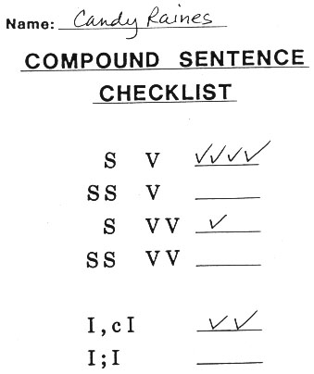
Notes:
The Challenge

Slide 20
Student Materials (Vol. II) Walkthrough
Formula Card After Compound Sentences
Compound Verbal Practice Checklist
Vol. II Compound Sentence Progress Chart
Vol. II Compound Sentence Lessons 1A-6A Examples
Vol. II Compound Sentence Checklist Example
Vol. II Sentence Score Sheet Example
Notes:
The Challenge

Slide 22
Notes:
The Challenge

Slide 23
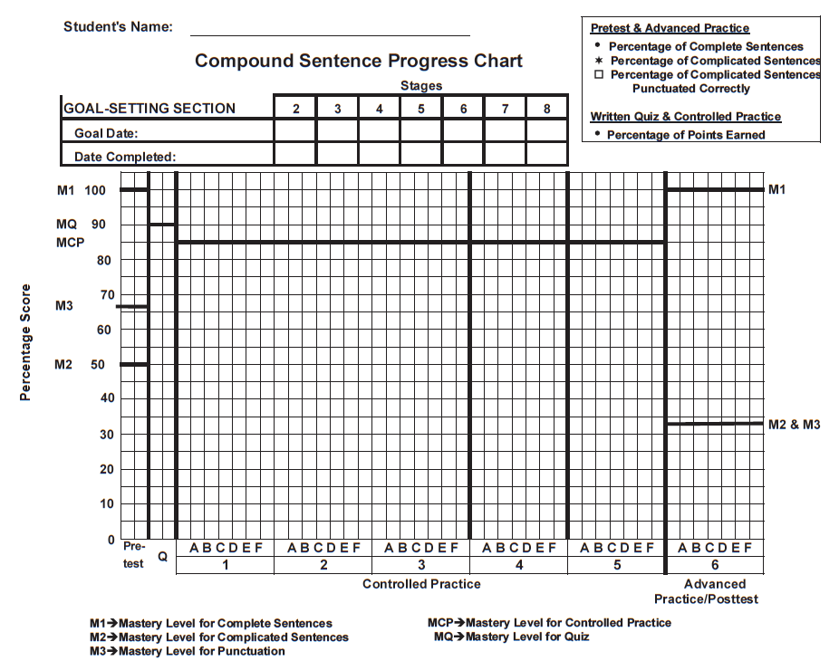
Compound Sentence Progress Chart (from Student Lessons Vol. II)
Notes:
The Challenge

Slide 24
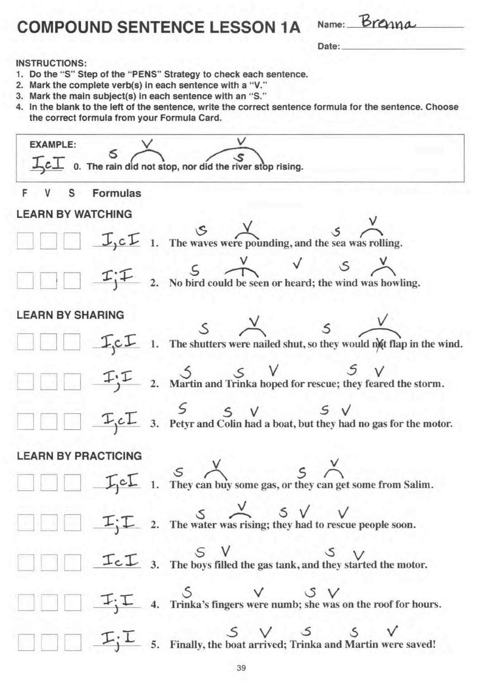
Notes:
The Challenge

Slide 25
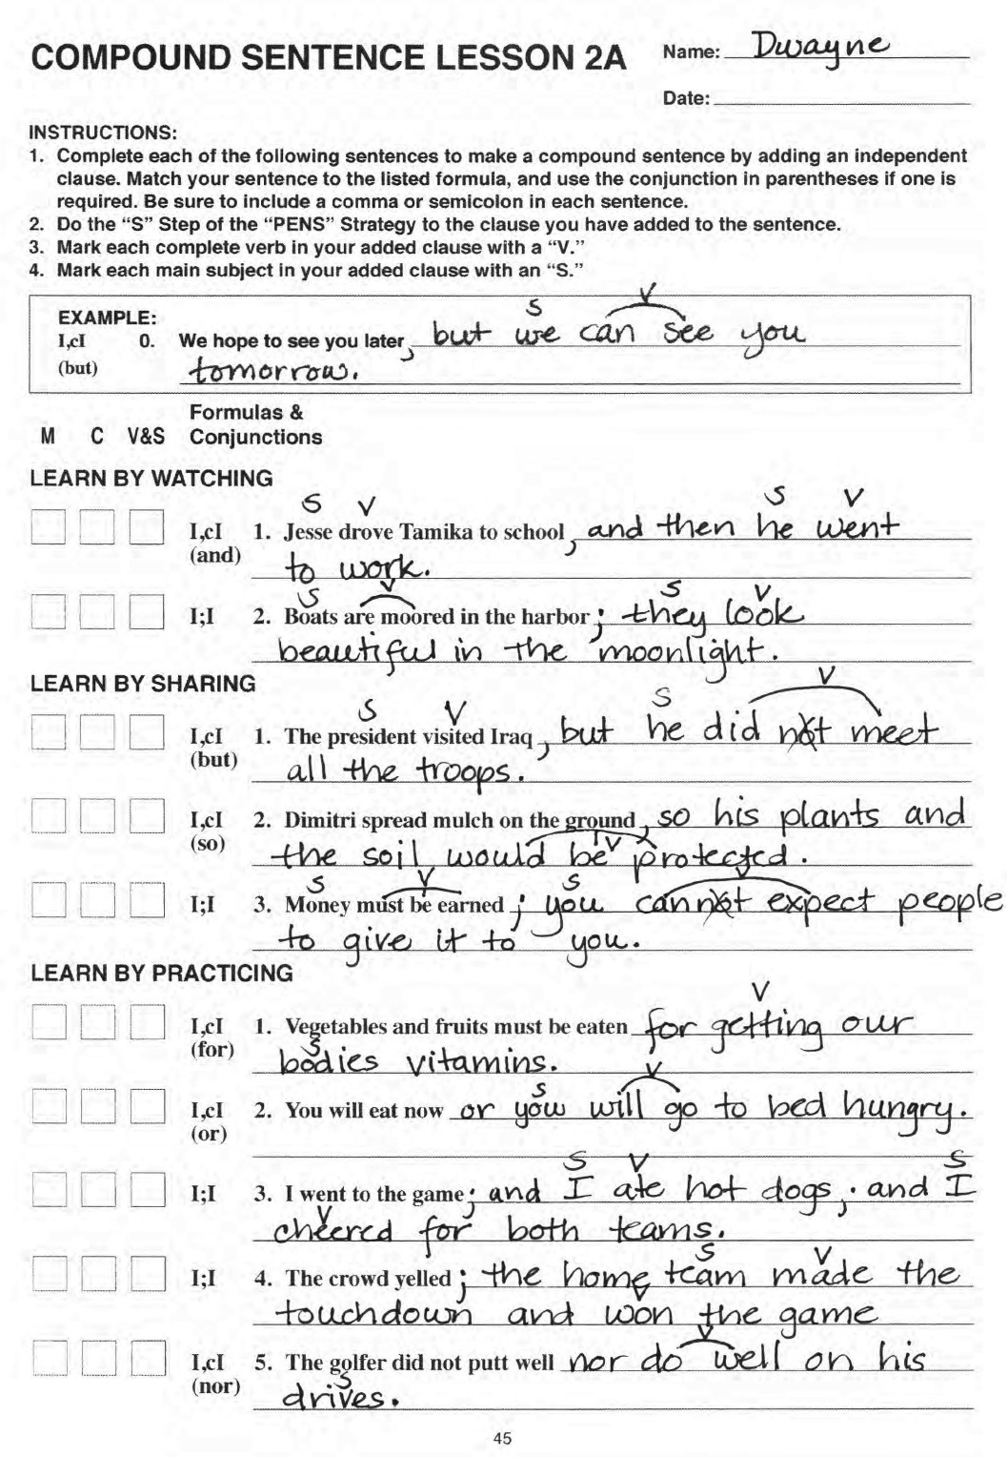
Notes:
The Challenge

Slide 26
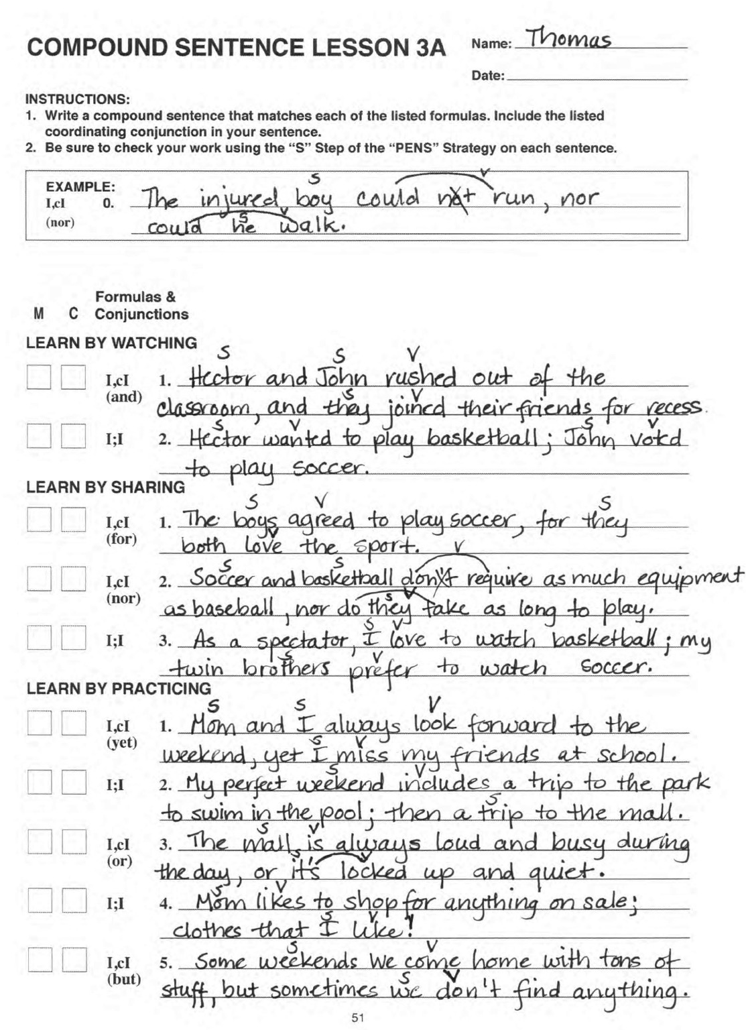
Notes:
The Challenge

Slide 27
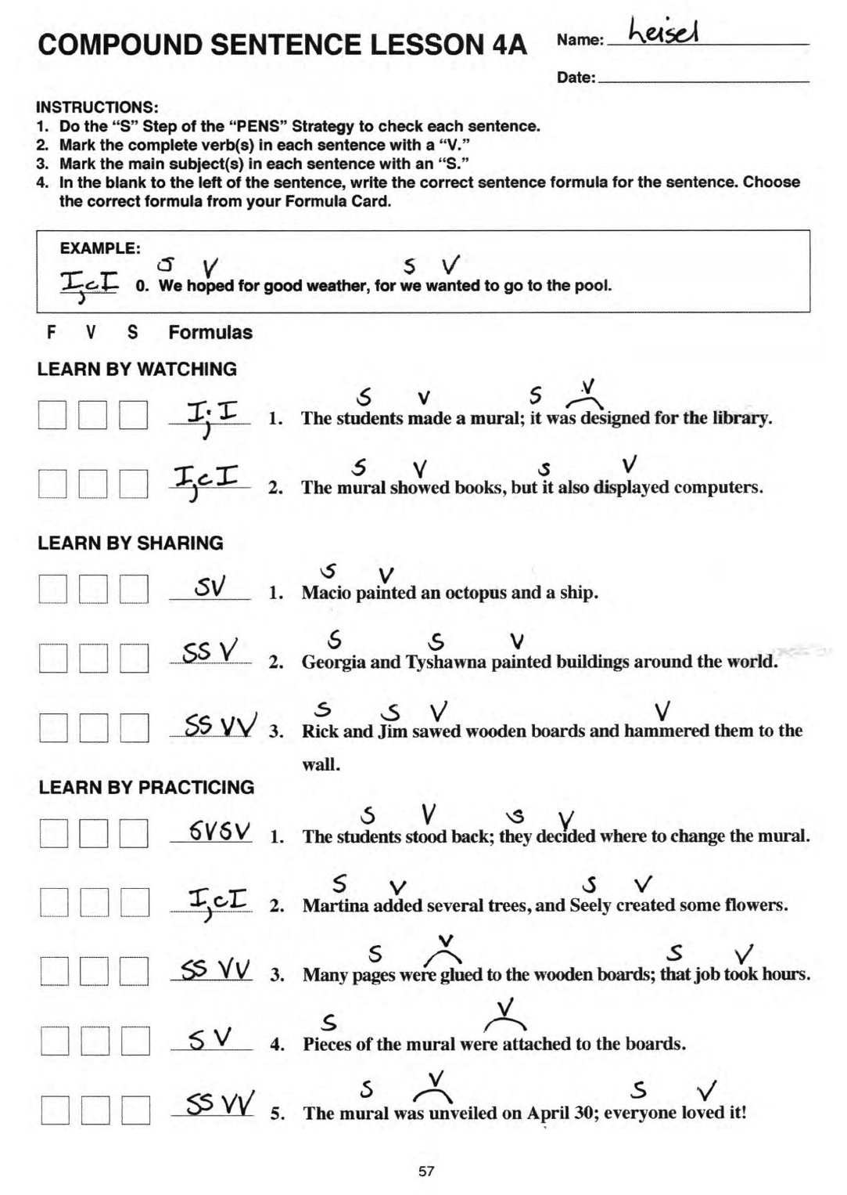
Notes:
The Challenge

Slide 28
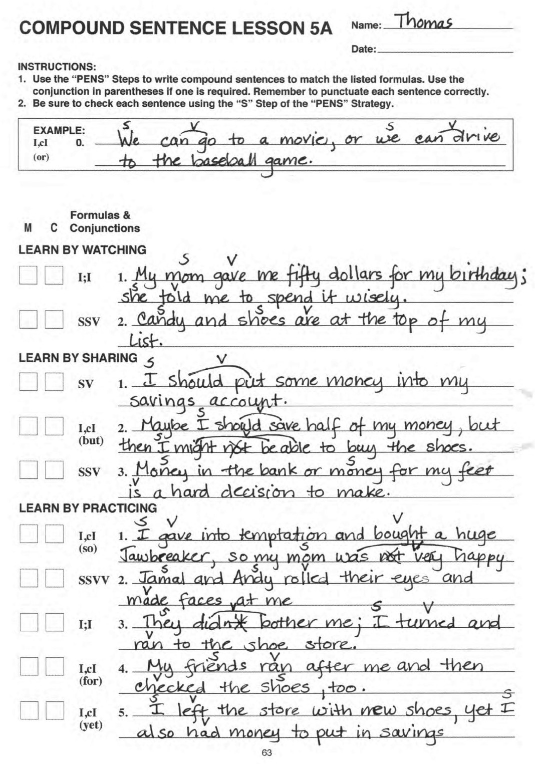
Notes:
The Challenge

Slide 29
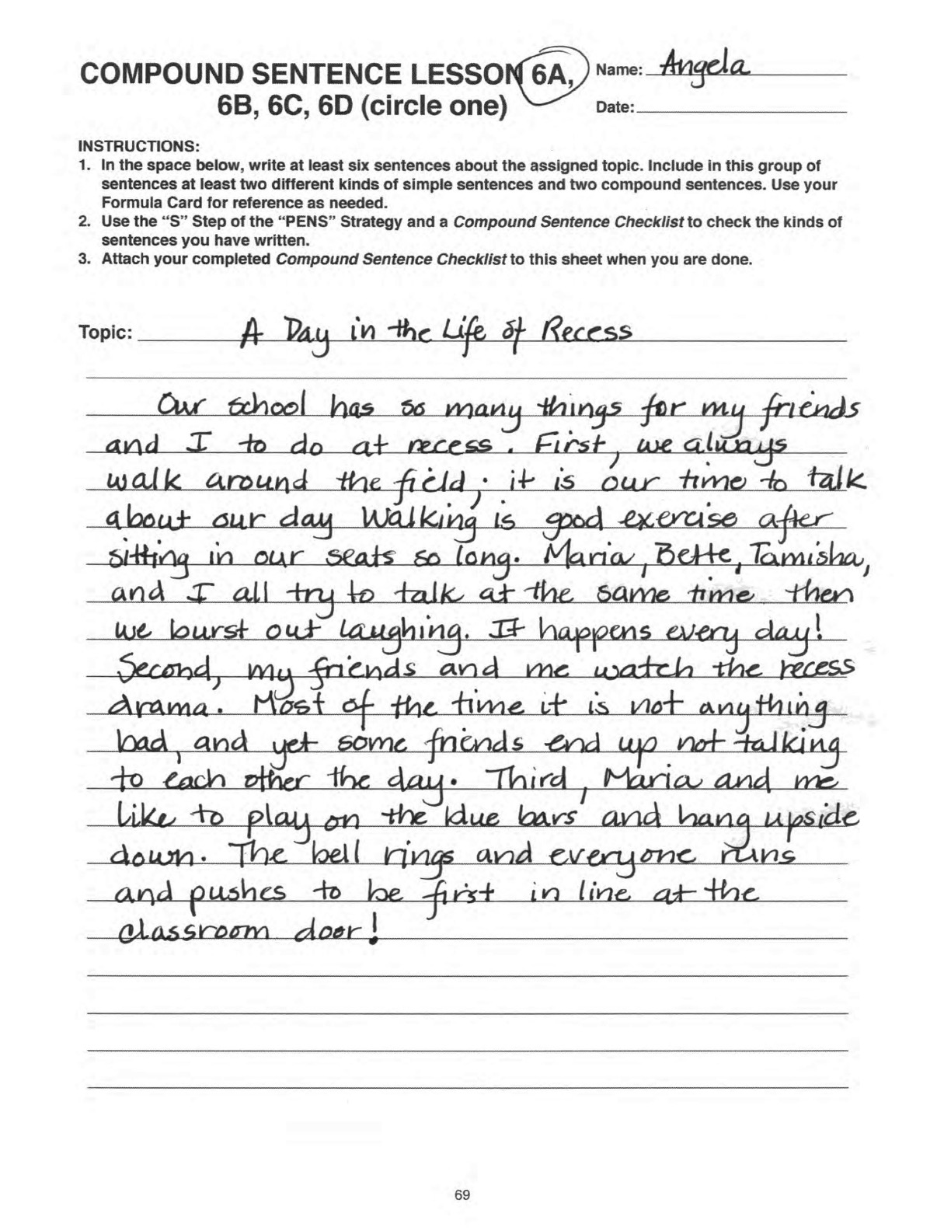
Notes:
The Challenge

