Slide 1
Complex Sentence
A complex sentence
has one independent clause
and one or more dependent clauses.
Notes:
The Challenge

Slide 2
Dependent Clause
A dependent clause
is a group of words
with a subject and verb
that cannot stand alone.
Examples:
I like Luis because he is funny.
Katie will be late for dinner since the meeting is still in progress.
The game will end when one team scores.
Notes:
The Challenge

Slide 3
Subordinating Conjunction
Subordinating conjunctions
are words that show the relationship
of the dependent clause
to the independent clause.
Notes:
The Challenge

Slide 4
Subordinating Conjunctions
Some words that can be used as subordinating conjunctions are:
after even if since
although even though so that
as if than
as if in order that though
as long as just as unless
as soon as like until
as though once when
because provided whenever
before rather than while
Notes:
The Challenge

Slide 5
Sequencing Complex Sentences
Dependent Clause First (comma needed):
  When I get to Phoenix, you will be sleeping.
  After the players practiced, they went out for a pizza.
  Until the storm is over, we will not know about the damage.
Notes:
The Challenge

Slide 6
Sequencing Complex Sentences
Independent Clause First (comma not needed):
  You will be sleeping when I get to Phoenix.
  The players went out for a pizza after they practiced.
  We will not know about the damage until the storm is over.
Notes:
The Challenge

Slide 7
Student Materials (Vol. I) Walkthrough
Formula Card After Complex Sentences
Complex Verbal Practice Checklist
Vol. I Complex Sentence Progress Chart
Vol. I Complex Sentence Lessons 1A-6A Examples
Vol. I Complex Sentence Checklist Example
Vol. I Sentence Score Sheet Example
Notes:
The Challenge

Slide 8
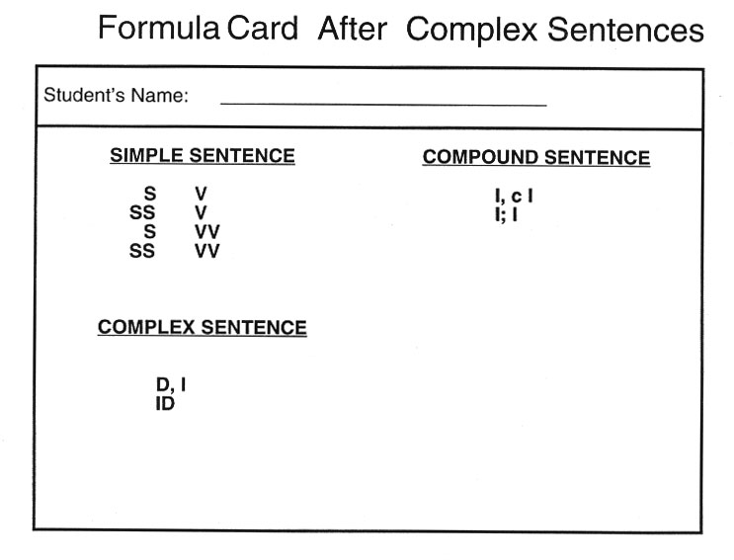
Notes:
The Challenge

Slide 9
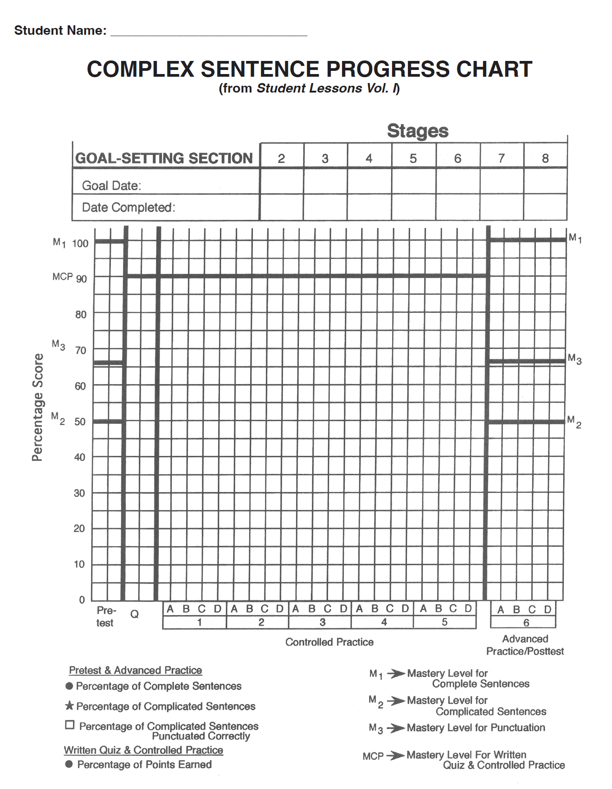
Notes:
The Challenge

Slide 10
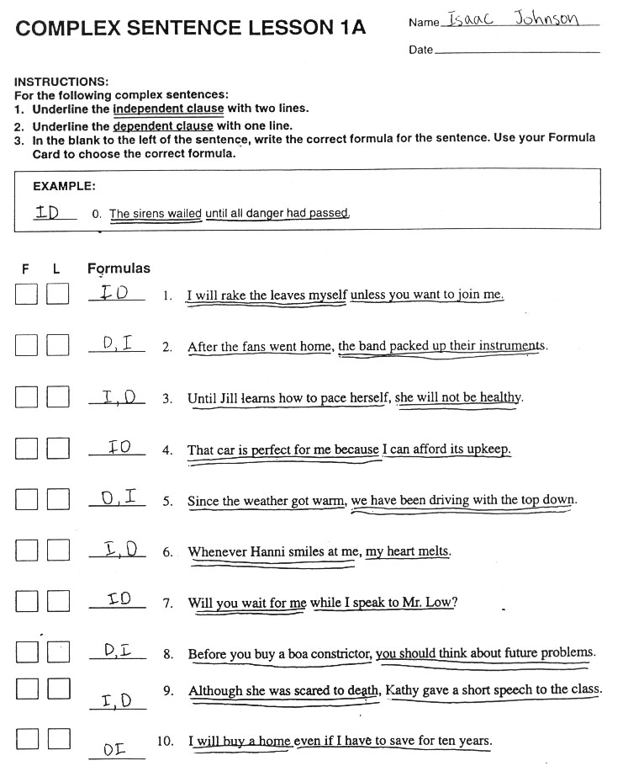
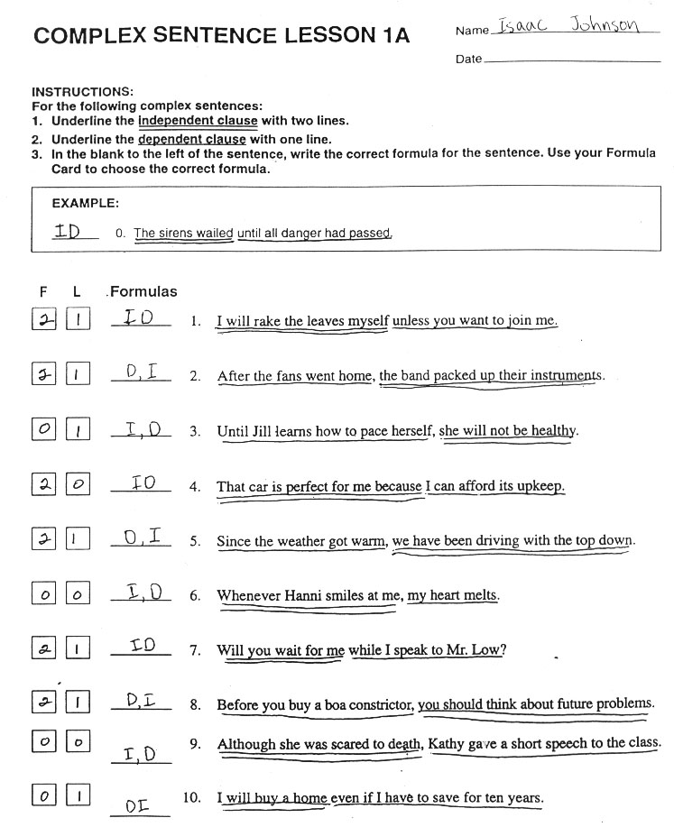
Notes:
The Challenge

Slide 11
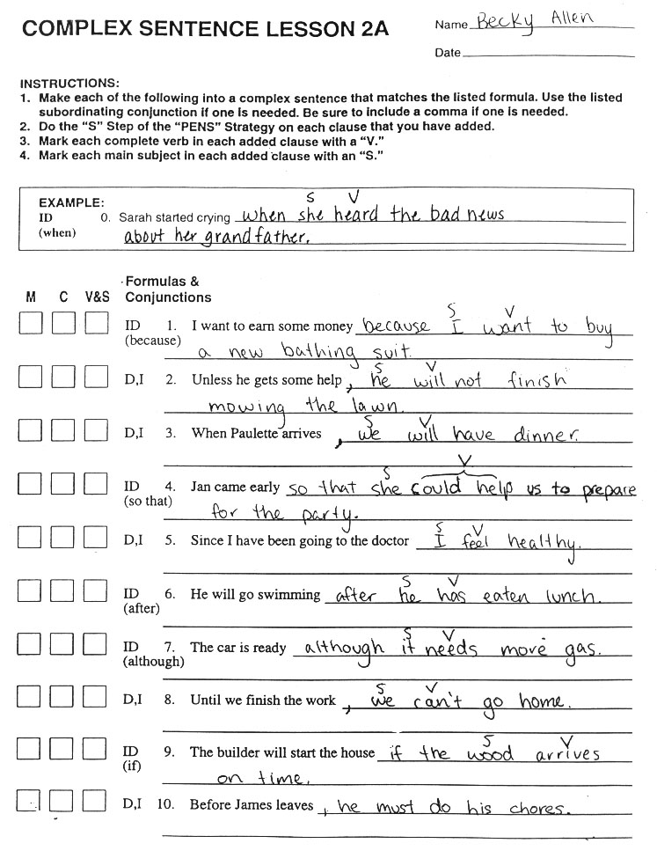
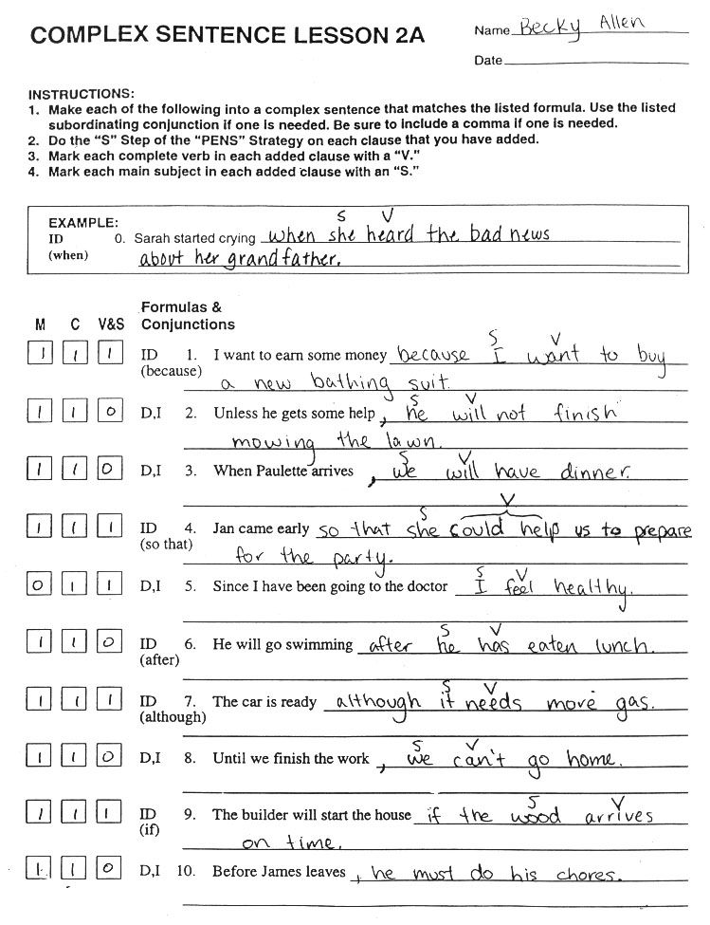
Notes:
The Challenge

Slide 12
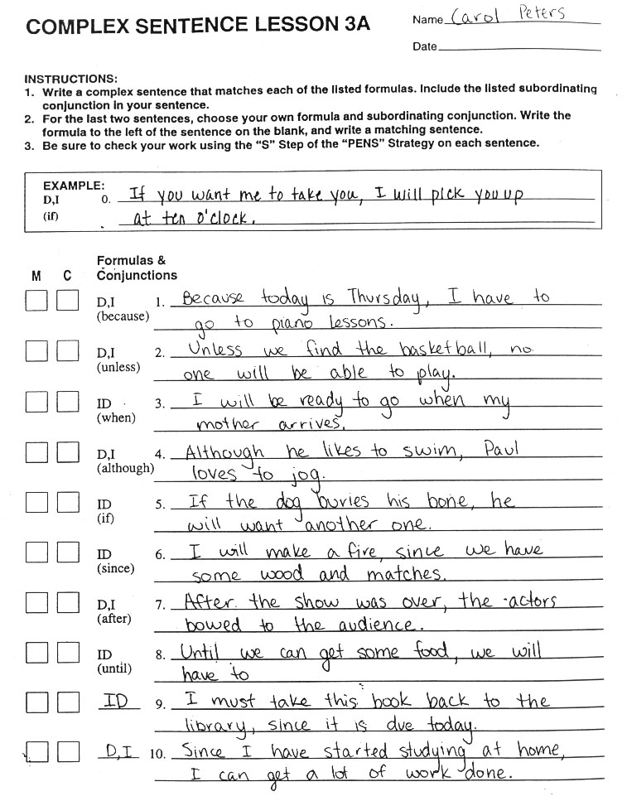
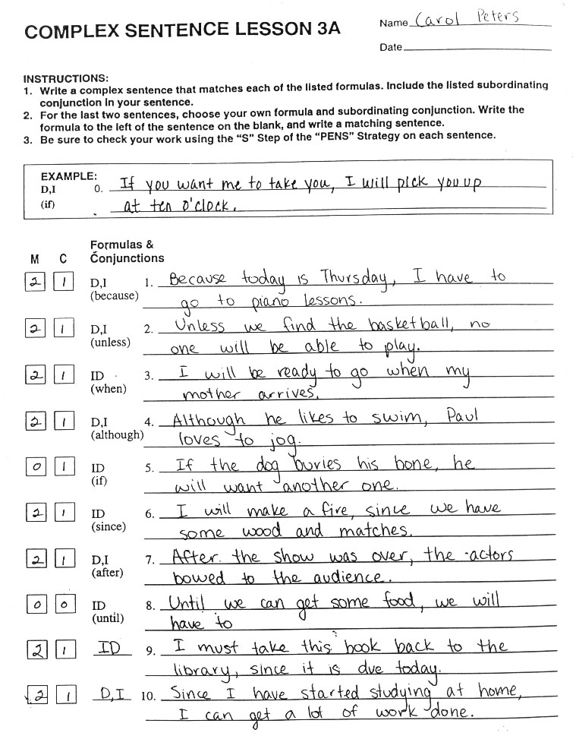
Notes:
The Challenge

Slide 13
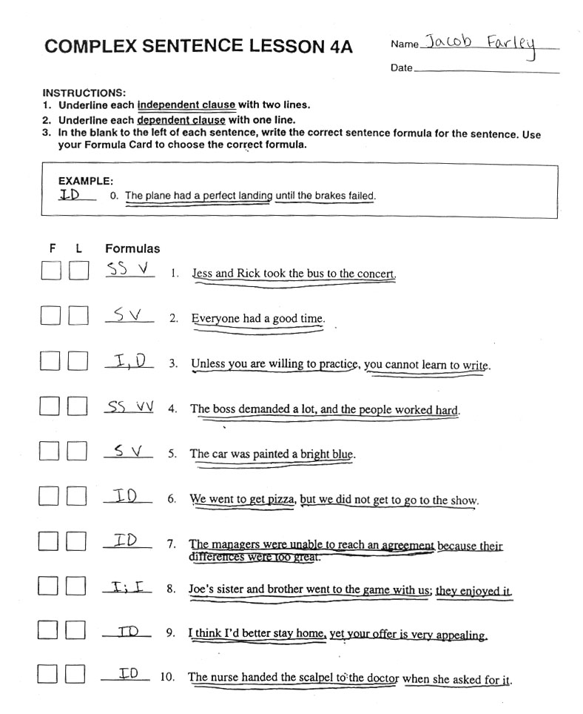
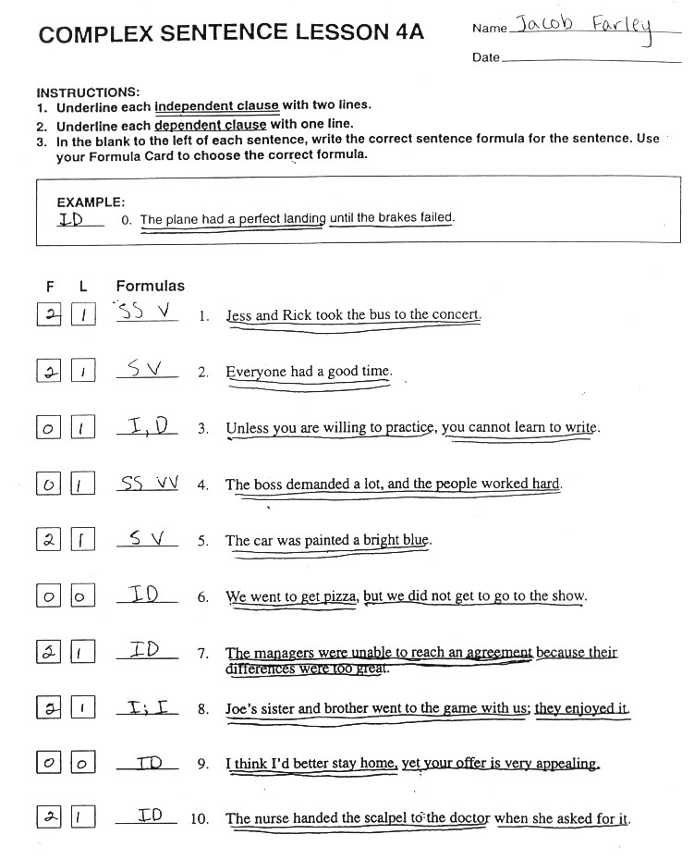
Notes:
The Challenge

Slide 14
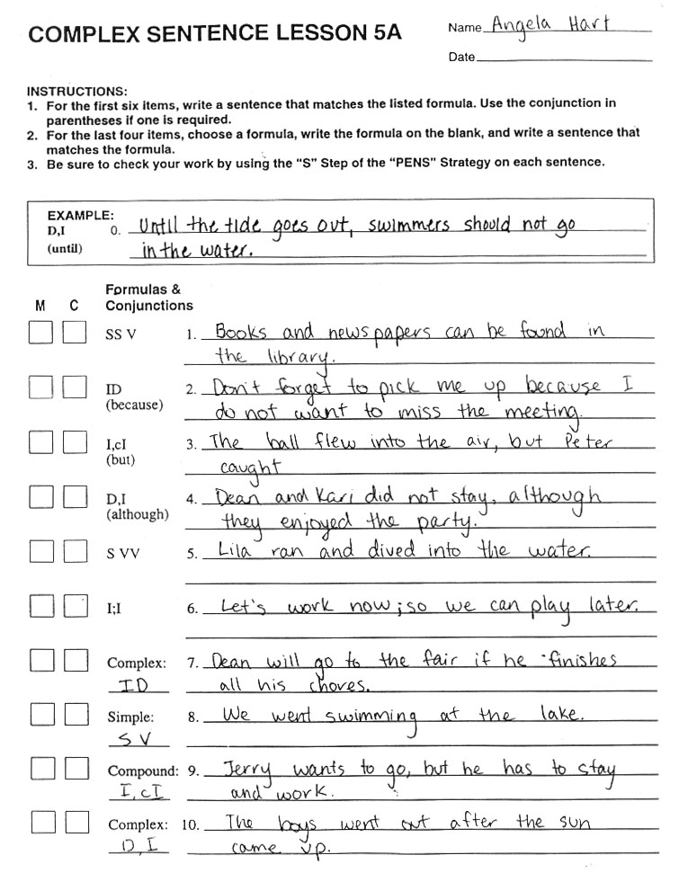
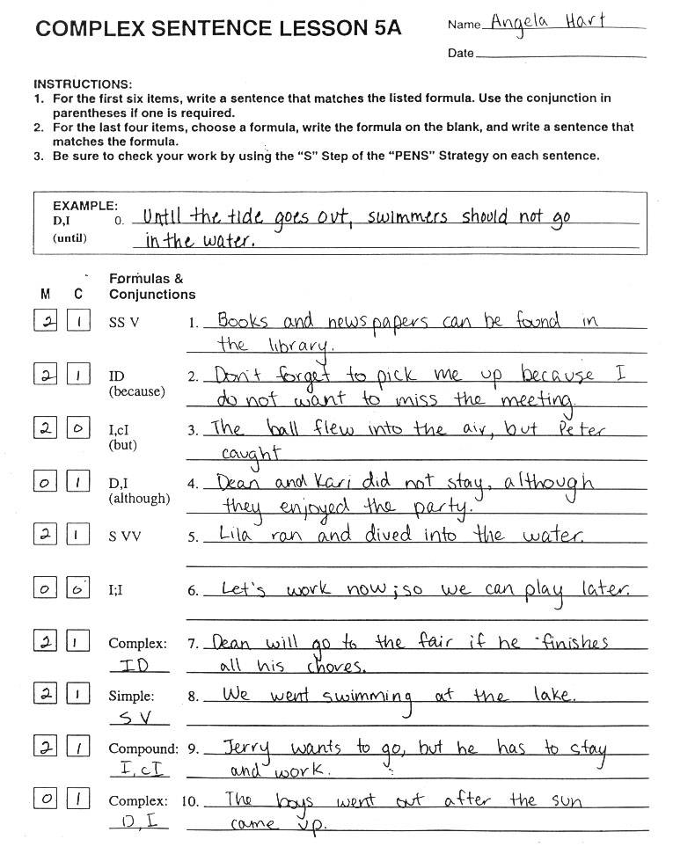
Notes:
The Challenge

Slide 15
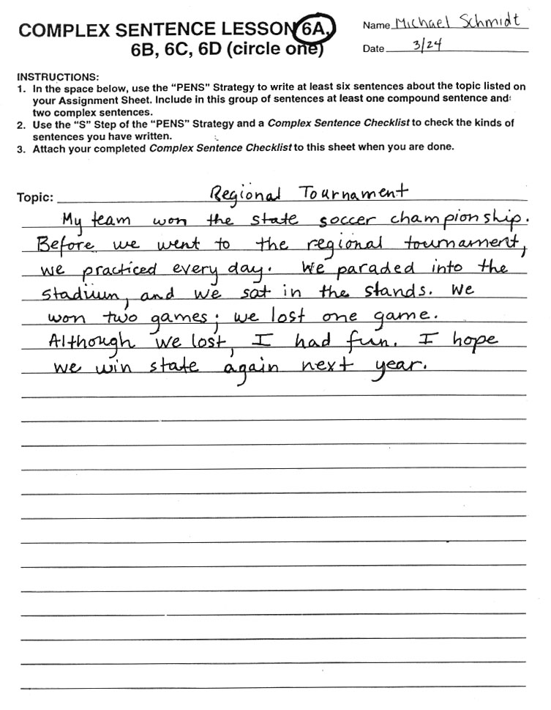
Notes:
The Challenge

Slide 16
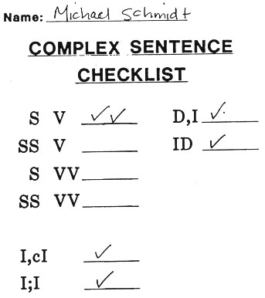
Notes:
The Challenge

Slide 17
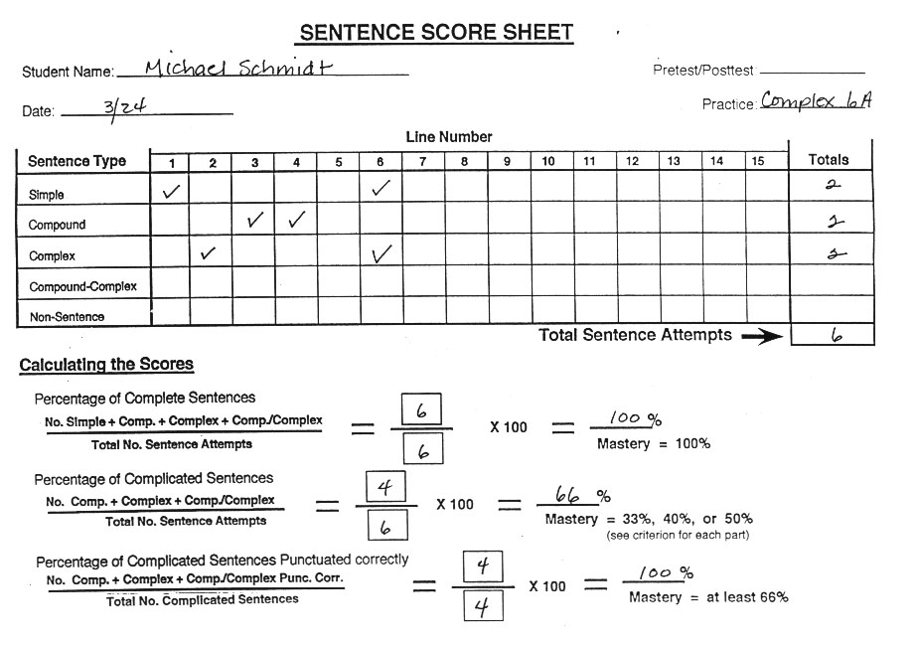
Notes:
The Challenge

Slide 18
Student Materials (Vol. II) Walkthrough
Formula Card After Complex Sentences
Complex Verbal Practice Checklist
Vol. II Complex Sentence Progress Chart
Vol. II Complex Sentence Lessons 1A-6A Examples
Vol. II Complex Sentence Checklist Example
Vol. II Sentence Score Sheet Example
Notes:
The Challenge

Slide 19
Notes:
The Challenge

Slide 20
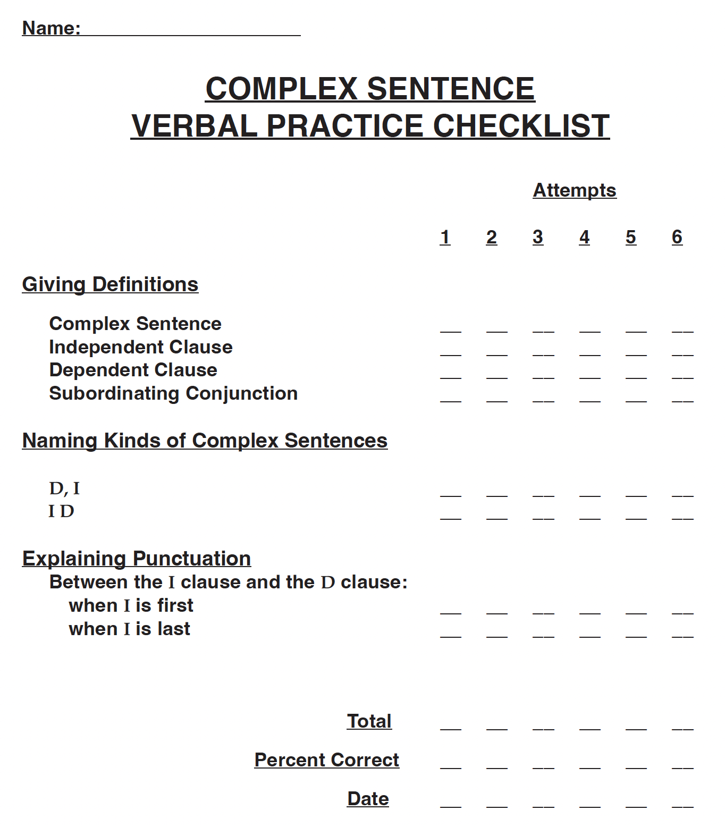
Notes:
The Challenge

Slide 21
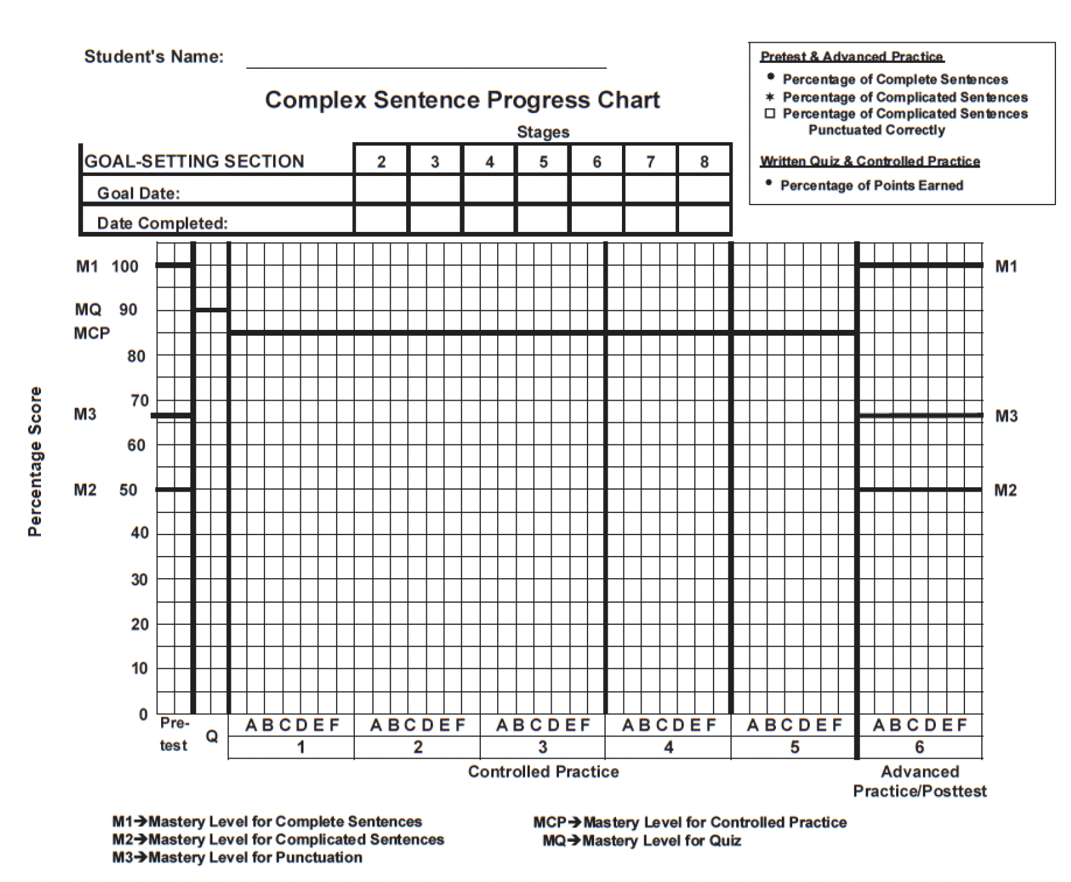
Complex Sentence Progress Chart (from Student Lessons Vol. II)
Notes:
The Challenge

Slide 22
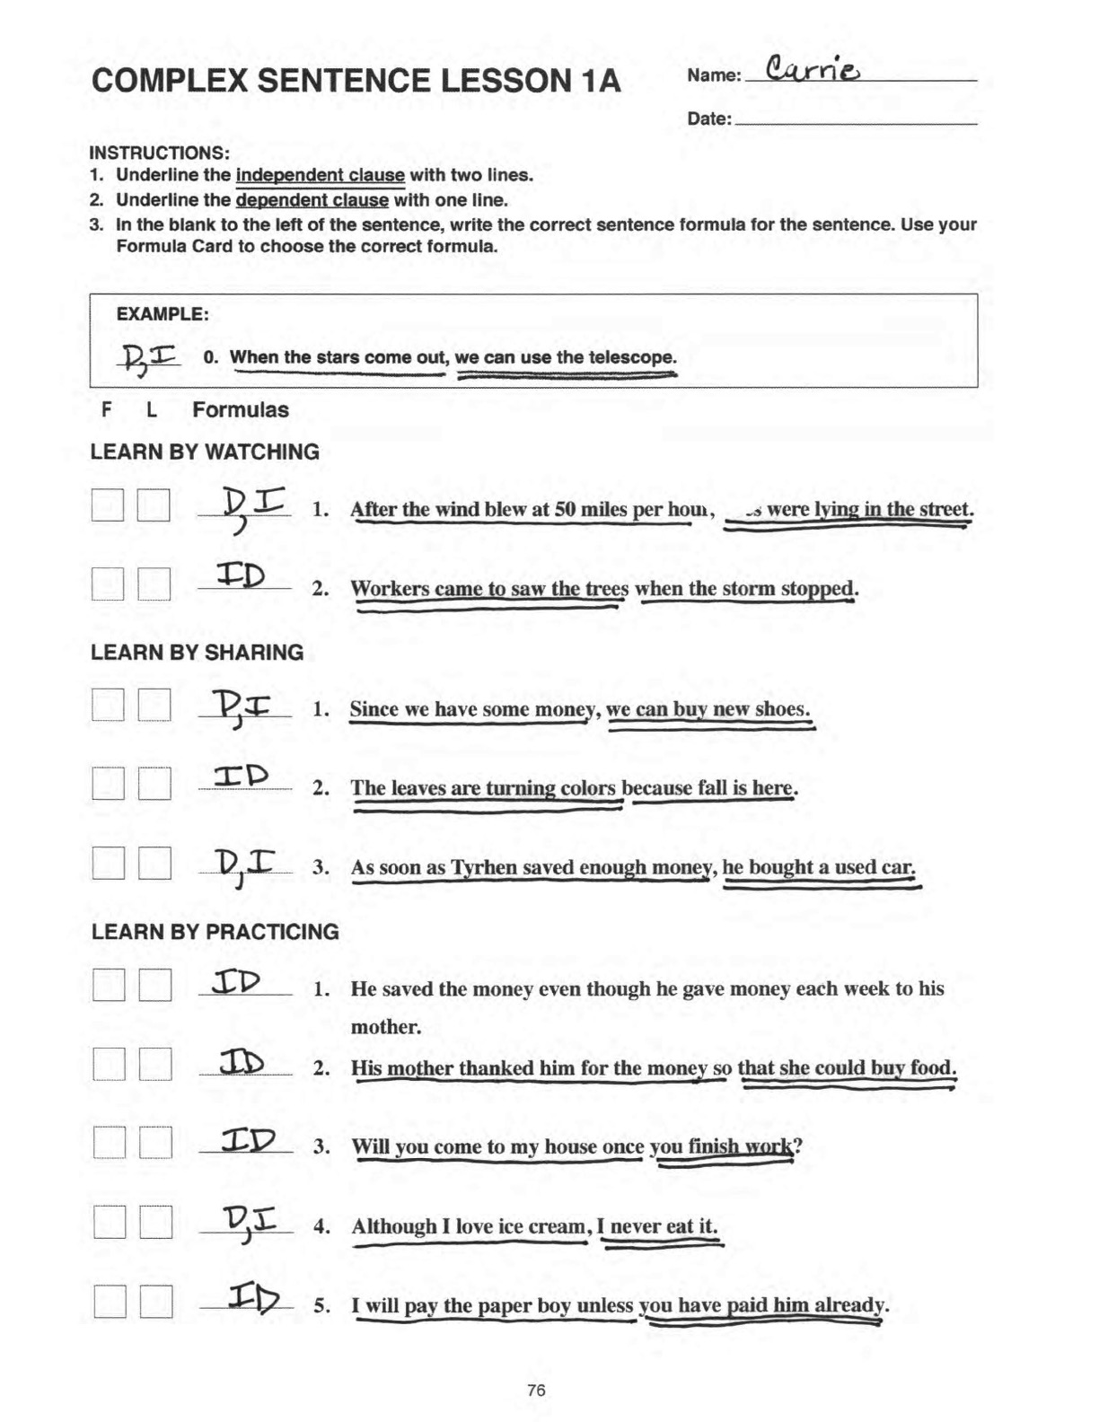
Notes:
The Challenge

Slide 23
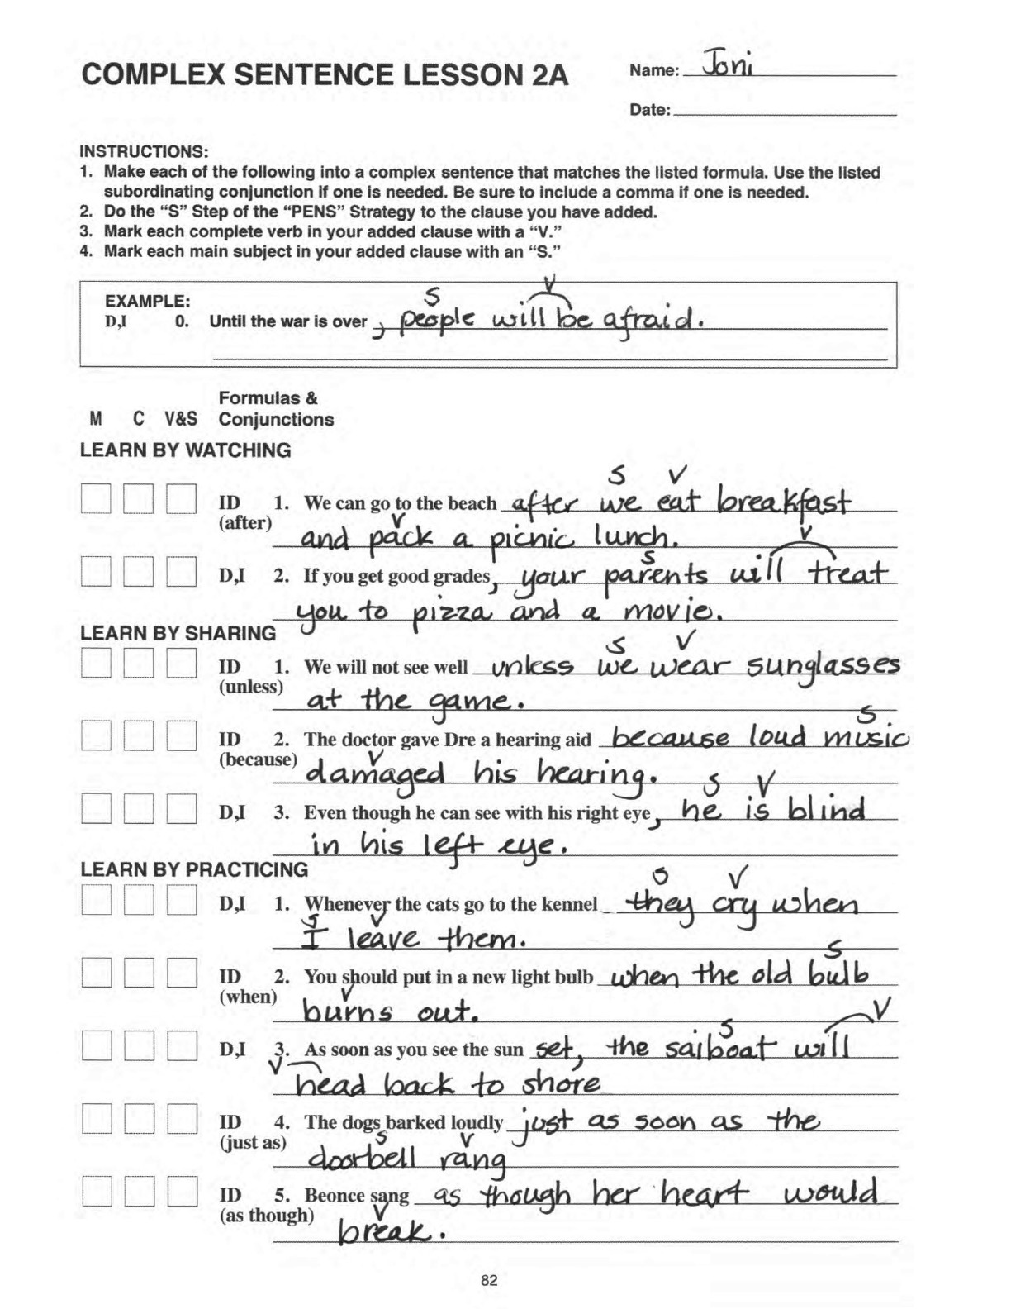
Notes:
The Challenge

Slide 24
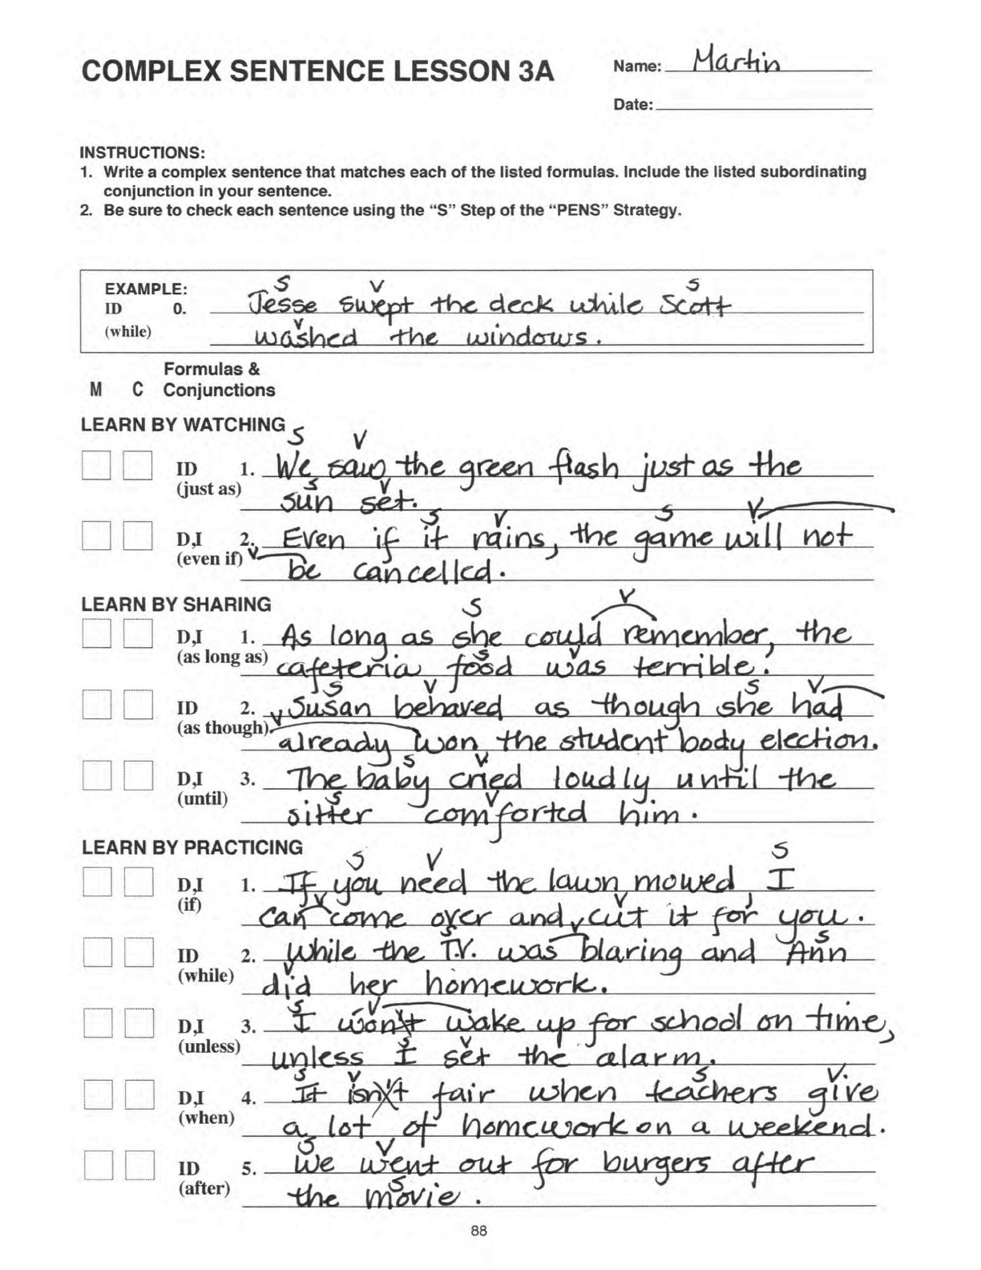
Notes:
The Challenge

Slide 25
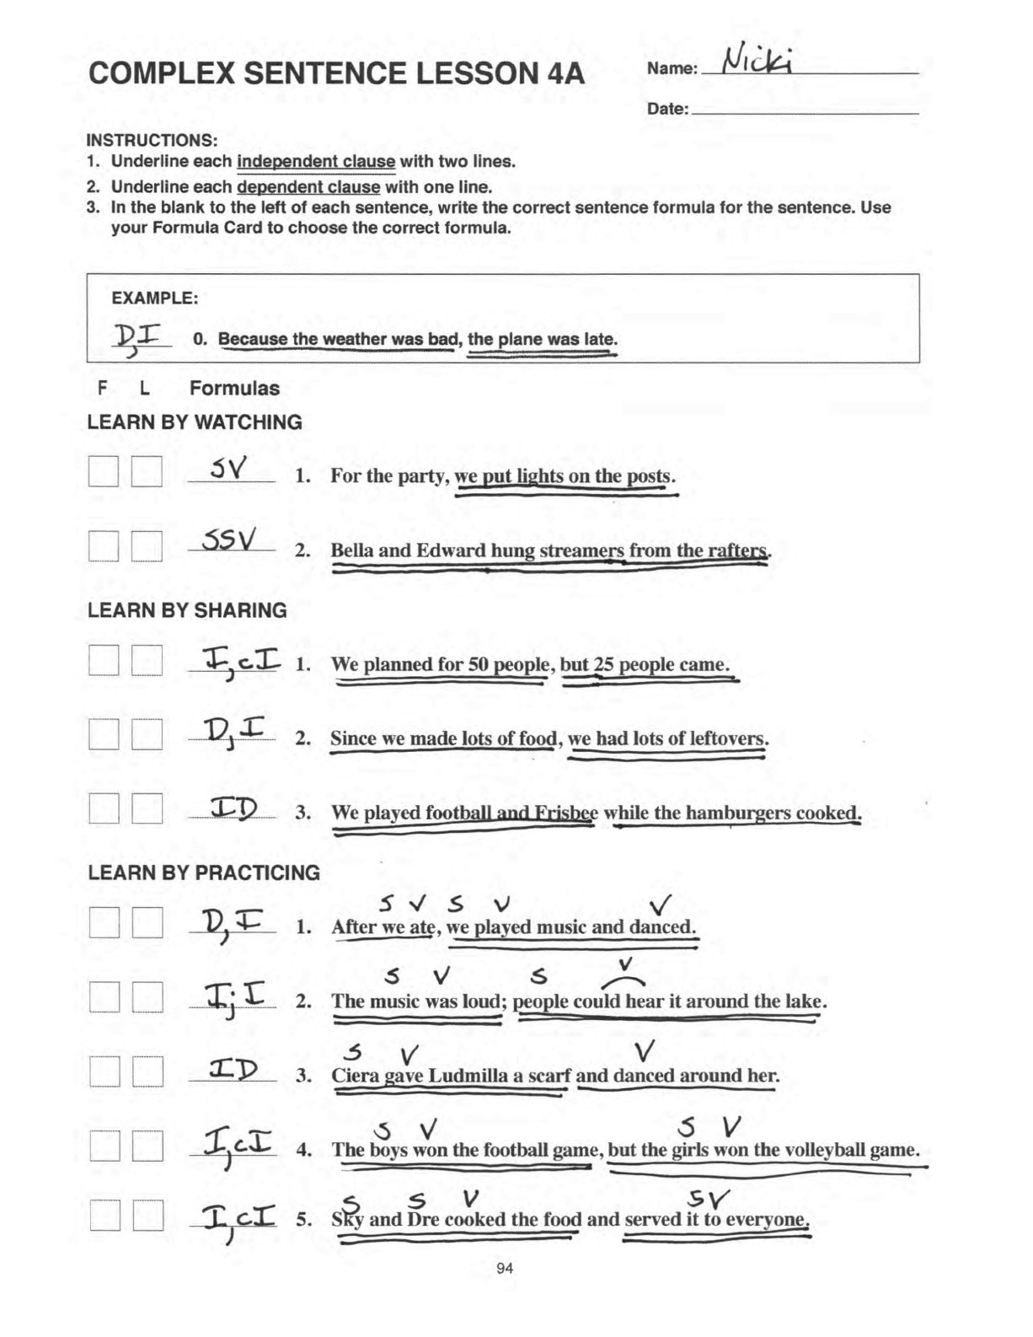
Notes:
The Challenge

Slide 26
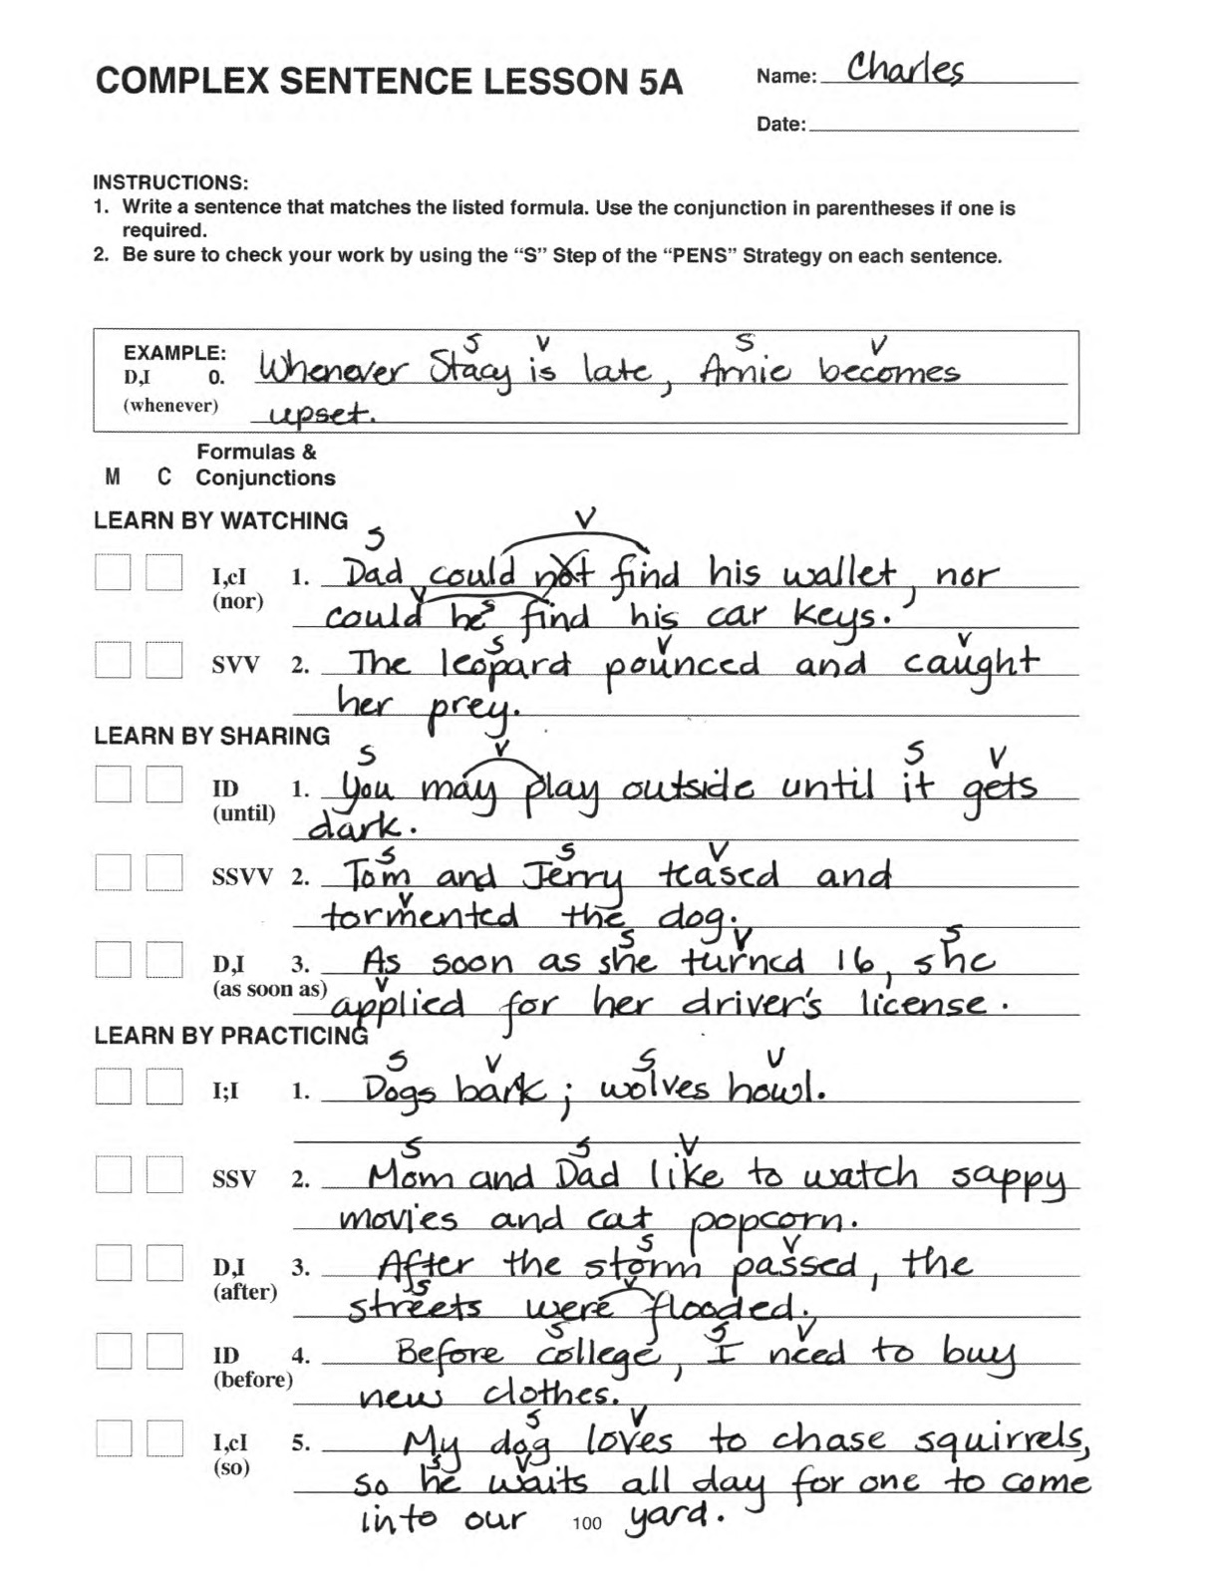
Notes:
The Challenge

Slide 27
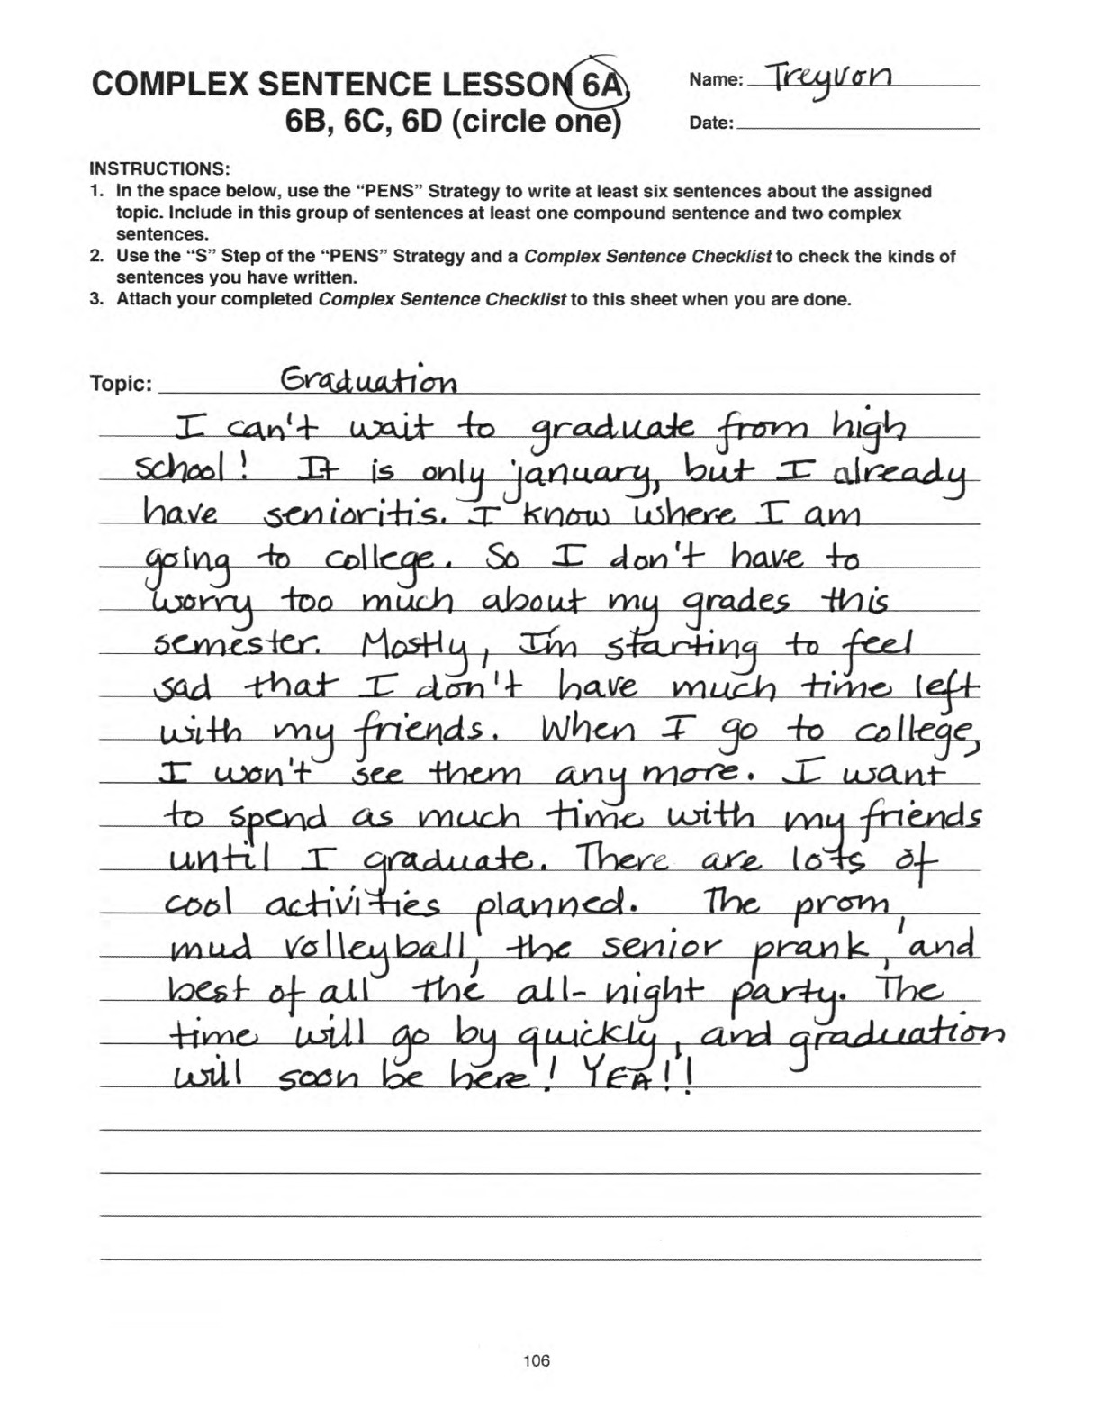
Notes:
The Challenge

