Slide 1

Professional Learning Standards
Learning Forward is an international association of learning educators focused on increasing student achievement through more effective professional learning.
Learning Forward’s purpose is ensuring that every educator engages in effective professional learning every day so every student achieves.
To learn more about the impact of high-quality professional learning, visit www.learningforward.org
https://youtu.be/skD2hr-Z4VM
Notes:
What other standards do we have? LF established in 1995; renamed as Standards for Staff Development in 2001; video we’ll be watching is the revision in 2011 for the standards we currently have. PLS have been adopted in 35 states and many districts across North America and the globe. Have video ready without ads; remember to pause it.

Slide 2
About MetLife Foundation
MetLife Foundation is committed to building a secure future for individuals and communities worldwide through a focus on empowering older adults, preparing young people, and building livable communities.
In education, MetLife Foundation seeks to strengthen public schools through effective teaching and collaborative leadership, and to prepare students for access to and success in higher education, particularly during the crucial first year. The foundation’s grant making is informed by findings from the annual MetLife Survey of the American Teacher. More information is available at www.metlife.org.

Slide 3
The Role of the Standards
What they are:
A description of the attributes of effective professional learning
A template for organizing professional learning
A consumer’s guide for all educators
What they are not:
A workbook
A tool kit
Technical assistance guide
A way to address every issue related to professional learning
A road map
Notes:
As with all of our other standards, we have criteria for consideration. The change from PD to PL signals the importance of educators taking an active role in their continuous development and places emphasis on their learning. Widespread attention to the standards increases equity of access to high-quality education for every student. We now know that the stem statement for all 7 standards purposefully lists the 4 key elements –educators, effectiveness, results and all students

Slide 4
Learning Communities: Professional learning that increases educators’ effectiveness and results for all students occurs within learning communities committed to continuous improvement, collective responsibility and goal alignment.
Engage in Continuous Improvement
Develop Collective Responsibility
Create Alignment and Accountability
Implementation
How do learning communities select learning designs that contribute to building collective responsibility while maintaining accountability and alignment?
Which learning designs support continuous improvement?
Notes:
You read about the standards and the goals involved for each- let’s comment about implementation.

Slide 5
Leadership: Professional learning that increases educators’ effectiveness and results for all students requires skillful leaders who develop capacity, advocate, and create support systems for professional learning.
Develop Capacity for Learning and Leading
Advocate for Professional Learning
Create Support Systems and Structures
Implementation:
How do leaders contribute to decisions about learning designs?
What are leaders expected to know about learning designs?
What types of support systems and structures are needed for the more frequently used learning designs?

Slide 6
Resources: Professional learning that increases educators’ effectiveness and results for all students requires prioritizing, monitoring and coordinating resources for educator learning.
Prioritize Human, Fiscal, Material, Technology and Time Resources
Monitor Resources
Coordinate Resources
Implementation:
• Which learning designs require more resources? Fewer resources?
• How can technology enhance learning designs to extend learning and results?
• What resources exist within a school to support various learning designs?

Slide 7
Data: Professional learning that increases educators’ effectiveness and results for all students uses a variety of sources and types of student, educator and system data to plan, assess and evaluate professional learning.
Analyze Student, Educator, and System Data
Assess Progress
Evaluate Professional Learning
Implementation:
How can data about educators, students, and systems contribute to the selection of learning designs?
What other data are helpful in selecting learning designs?
What data are useful to assess the effectiveness of selected learning designs?

Slide 8
Learning Designs: Professional learning that increases educators’ effectiveness and results for all students integrates theories, research and models of human learning to achieve its intended outcomes.
Apply Learning Theories, Research and Models
Select Learning Designs
Promote Active Engagement
Implementation:
What factors are important to consider when selecting learning designs?
Which learning designs contribute to active engagement of learners?
What theories and principles about learning guide the selection of learning designs?

Slide 9
Implementation: Professional learning that increases educators’ effectiveness and results for all students applies research on change and sustains support for implementation of professional learning for long-term change.
Apply Change Research
Sustain Implementation
Provide Constructive Feedback
Implementation:
What learning designs advance implementation?
How can selected learning designs be enhanced to integrate frequent constructive feedback?
Which learning designs are more appropriate for various stages of implementation?

Slide 10
Outcomes: Professional learning that increases educators’ effectiveness and results for all students aligns its outcomes with educator performance and student curriculum standards.
Meet Performance Standards
Address Learning Outcomes
Build Coherence
Implementation:
How do designers of professional learning use performance standards and student learning outcomes as they design learning?
How can designers link past learning with current and future learning through their choice of learning designs?

Slide 11
Relationship between Professional Learning and Student Results
1..Standards based professional learning
2. Changes in educator knowledge, skills, and dispositions
4. Changes in student results
3. Changes in educator practice
Notes:
For most educators working in schools, professional learning is the singular most accessible means they have to develop new knowledge, skills and practices necessary to better meet students’ learning needs. Changes in practice – student results –and in reverse . Refer to chart

Slide 12
Professional Learning that leads to change!
 | Expected Outcomes
Training Components | Change in Knowledge | Change in Skills | Application to fidelity
Lecture/ Presentations Study of Theory | 10% | 5% | 0%
Demonstrations | 30% | 10% | 0%
Practice (and low risk feedback) | 60% | 60% | 5%
+ Coaching + Admin feedback +Study Teams/Peer Visits | 95% | 95% | 95%
Joyce & Showers, 2002
Notes:
Jocelyn

Slide 13
100%
95% Change in Knowledge
95% Change in Skills
95% Change in Practice
Professional Learning That Transfers to Classroom Practice
60% Change in Knowledge
60% Change in Skills
30% Change in Knowledge
10% Change in Knowledge
10% Change in Skills
5% Change in Skills
5% Change in Practice
Professional Development (PD)
Coaching and Infrastructure
PD session with lecture, presentation, theory
PD session with demonstration
PD session with practice and low-risk feedback
coaching, administrator feedback, and collaboration with colleagues
Notes:
Jocelyn

Slide 14
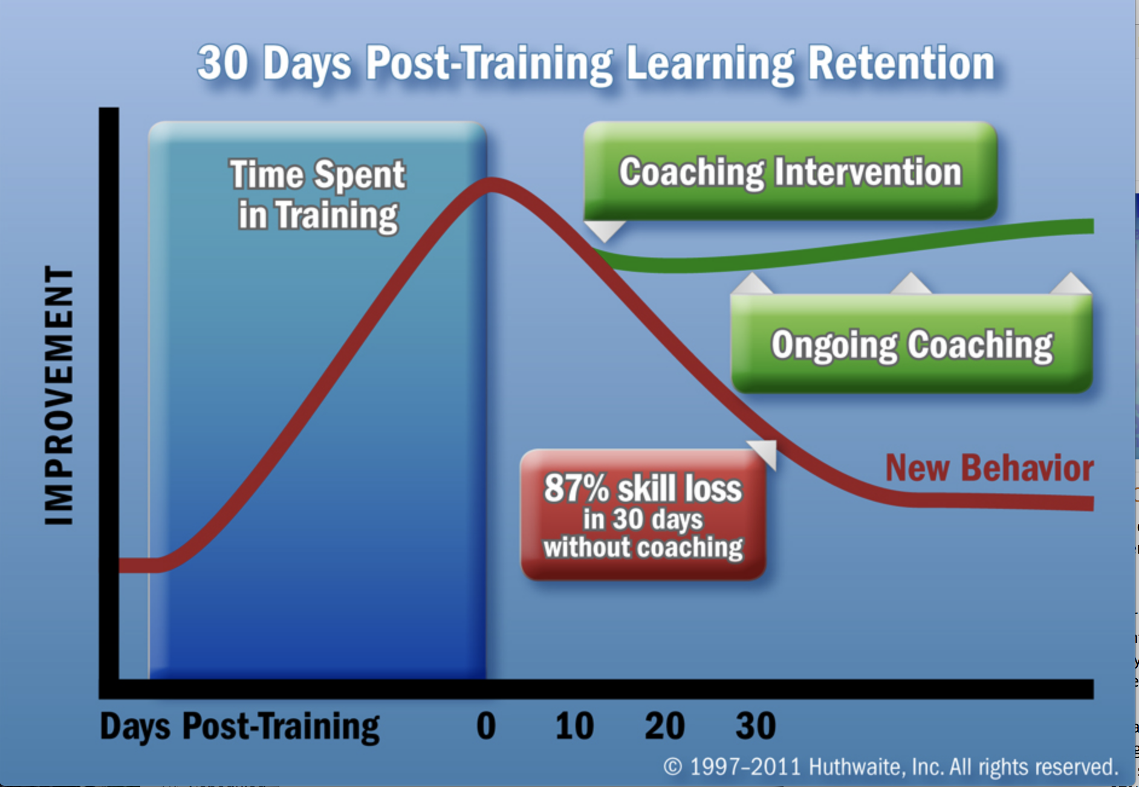
Notes:
Jocelyn

Slide 15
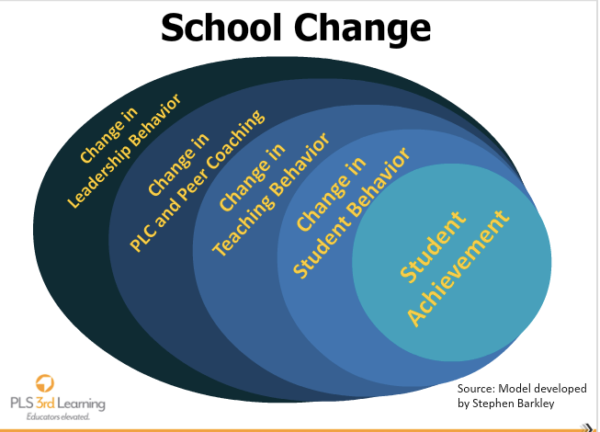
Notes:
Jocelyn:

Slide 16
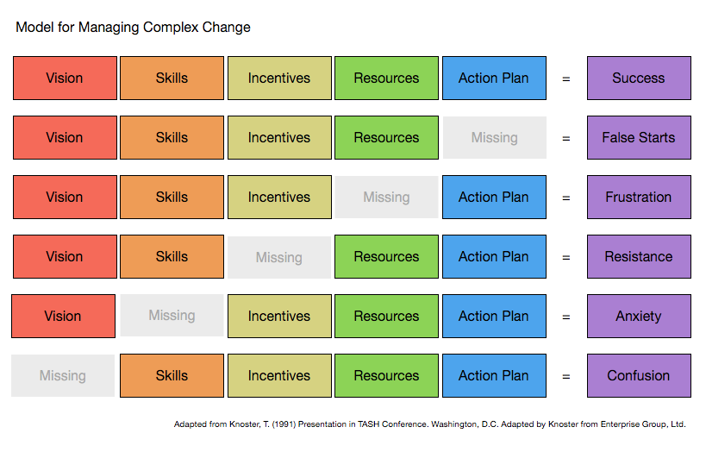
Notes:
We know everyone’s been involved in initiative that’s failed for different reasons
Activity: Do you have a story that is explained by this model?
Keep these in mind as we begin to talk implementing change.
Chatfall: Pick one Standard in depth

Slide 17
Managing Changes in Practice
Learning communities | Leadership | Resources | Data | Learning Designs | Implementation | Outcomes | Educator effectiveness and student results
 | Leadership | Resources | Data | Learning Designs | Implementation | Outcomes | Pockets of excellence
Learning Communities |  | Resources | Data | Learning Designs | Implementation | Outcomes | Lack of support
Learning Communities | Leadership |  | Data | Learning Designs | Implementation | Outcomes | Resistance
Learning Communities | Leadership | Resources |  | Learning Designs | Implementation | Outcomes | Lack of focus
Learning Communities | Leadership | Resources | Data |  | Implementation | Outcomes | Inadequate learning
Learning Communities | Leadership | Resources | Data | Learning Designs |  | Outcomes | Unsustained change
Learning Communities | Leadership | Resources | Data | Learning Designs | Implementation |  | Misalignment of goals
Learning Communities Leadership Resources Data Learning Designs Implementation Outcomes Educator effectiveness and student results Leadership Resources Data Learning Designs Implementation Outcomes Pockets of excellence Learning Communities Resources Data Learning Designs Implementation Outcomes Lack of support Learning Communities Leadership Data Learning Designs Implementation Outcomes Resistance Learning Communities Leadership Resources Learning Designs Implementation Outcomes Lack of focus Learning Communities Leadership Resources Data Implementation Outcomes Inadequate learning Learning Communities Leadership Resources Data Learning Designs Outcomes Unsustained
Notes:
We know everyone’s been involved in initiative that’s failed for different reasons
Activity: Do you have a story that is explained by this model?
Keep these in mind as we begin to talk implementing change.
Chatfall: Pick one Standard you would like to focus on in your PD.
Reflection – what standards have you noted Elizabeth and I implement today?

Slide 18

Questions?
Notes:
What PLS have you seen so far today?

Slide 19

Notes:
University of Kansas Center for Research on Learning
10.29.10
pgraner@ku.edu. KUCRL
19

