Slide 1
Using and Extending the Strategic Math Series to Teach Rigorous Elementary Mathematics Standards
Margaret M. Flores, Ph.D. BCBA-D
Auburn University

Slide 2
Session Overview
Review Strategic Math Series components and current standards for practice
Show how each component of the series addresses current standards and practices
Show how instruction within each component of the series can be extended to meet additional standards and practices
Show current research in complex operations

Slide 3
Strategic Math Series
Level 1
Addition Facts 0 to 9
Subtraction Facts 0 to 9
Place Value: Discovering Tens and Ones
Addition Facts 10 to 18
Subtraction Facts 10 to 18
Multiplication Facts 0 to 81
Division Facts 0 to 81
Level 2
Addition With Regrouping
Subtraction With Regrouping

Slide 4
Guiding Principles
The Concrete-Representational-Abstract (C-R-A) Teaching Method
Concrete: use objects
Representational: use drawings and tallies
Abstract: use numbers
Explicit Instruction and learning to mastery
Use of Strategies

Slide 5
Standards for Mathematical Practice
Building blocks for expertise in mathematical thinking
Combination of processes and proficiencies that apply to students across grade levels
Make sense of problems and persevere in solving them.
Reason abstractly and quantitatively
Construct viable arguments and critique the reasoning of others.
Model with mathematics.
Use appropriate tools strategically.
Attend to precision.
Look for and make use of structure.
Look for and express regularity in repeated reasoning.

Slide 6
Strategic Math Series Addition and Subtraction Facts 0-9
Standard: represent addition and subtraction with objects, drawings, equations
Mathematical Practice: make sense of problems
Concrete level instruction (SMS lessons1-3)
Explicit instruction in representation of equations with objects
Development of language and communication through “think alouds”

Slide 7
Strategic Math Series Addition and Subtraction Facts 0-9
Standard: represent addition and subtraction with objects, drawings, equations
Mathematical Practice: make sense of problems
Representational level instruction (SMS lessons4-6)
Explicit instruction in representation of equations with drawings
Development of language and communication through “think alouds”
3
+
2
=

Slide 8
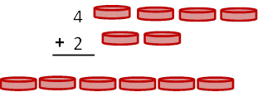
Strategic Math Series Addition Facts 0-9
Extensions of SMS (concrete level)
Standard: Understand meaning of equal sign

Slide 9
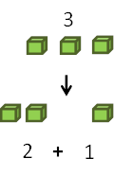
Strategic Math Series Addition and Subtraction Facts 0-9
Extensions of SMS (concrete level)
Standard: Decompose numbers

Slide 10
Strategic Math Series Addition and Subtraction Facts 0-9
Extensions of SMS (concrete level)
Standard: Relate counting to addition and subtraction
1
5

Slide 11
Strategic Math Series Basic Facts
Using Strategic Instruction Model and CRA sequence helps students meet standards for practice
Discover the sign
Read the problem
Answer or draw and check
Write the answer

Slide 12
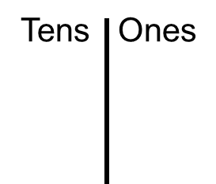
Strategic Math Series Place Value
Standard: Understand that two digits of two-digit number represent tens and ones
Concrete level instruction (SMS lessons1-3)
Explicit instruction in identification and representation of ones & tens
Development of language and communication through “think alouds”
37 =
3
7

Slide 13
Strategic Math Series Place Value
Standard: Understand that two digits of two-digit number represent tens and ones
Representational level instruction (SMS lessons5-8)
Explicit instruction in identification and representation of ones & tens
1
4
14
15 =
1
5
= _______

Slide 14
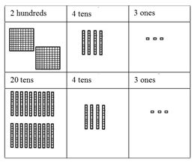
Strategic Math Series Place Value
Standard: understand relations between numbers, use strategies based on properties of place value
Extension of SMS (concrete level)

Slide 15
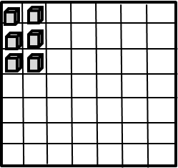
Strategic Math Series Multiplication Facts 0-81
Standard: represent and solve problems involving multiplication
2 X 3 =2 groups of 3 concrete: 2 plates with 3 objects
Extension: make grouping consistent with general education methods using arrays
groups
2 groups of 3 objects
of
2 columns of 3 objects

Slide 16
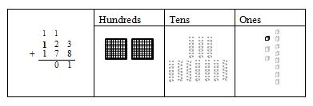
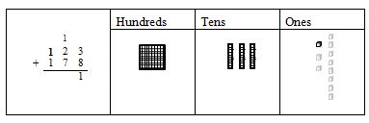
Strategic Math Series Addition with Regrouping
Standard: Add within 1000 using algorithms
Concrete level instruction (SMS lessons1-3)
Explicit instruction in representation of traditional algorithm using base ten blocks

Slide 17
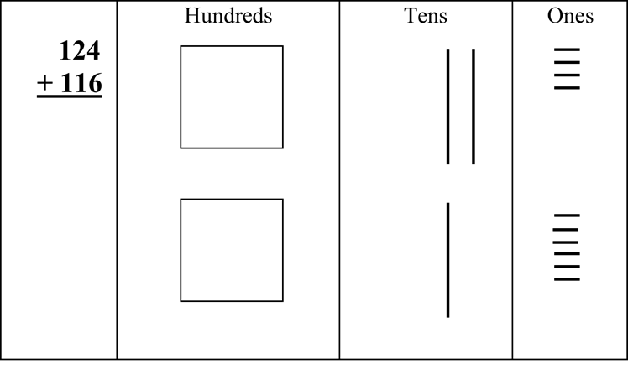
Strategic Math Series Addition with Regrouping
Standard: Add within 1000 using algorithms
Representational level instruction (SMS lessons 4-6)
Representation of traditional algorithm using drawings

Slide 18
Strategic Math Series Addition with Regrouping
Using Strategic Instruction Model and CRA sequence helps students meet standards for practice
Read the problem
Examine the ones (if more next door…)
Note the ones
Address the tens (if more next door..)
Mark the tens
Examine the hundreds and exit with check

Slide 19
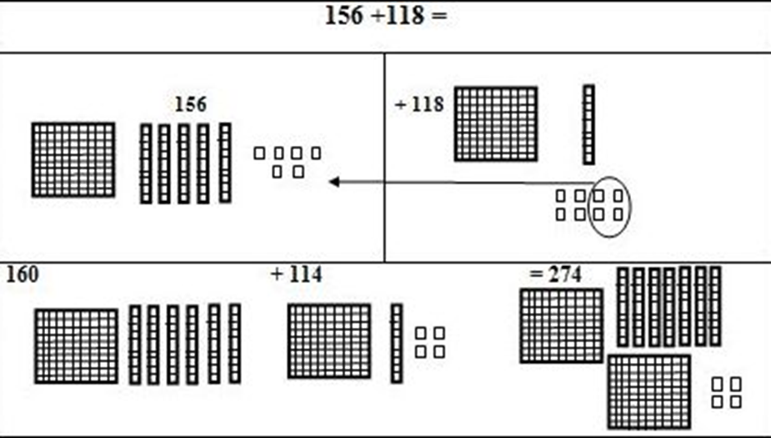
Strategic Math Series Addition with Regrouping
Extensions of SMS
Standard: Add using strategies based on place value, properties of operation, and relationship between addition and subtraction
Shift Numbers
Subtract 4 from118
Add 4 to 156
tools to
complete
problem
mentally
160+114
Easier Problem

Slide 20
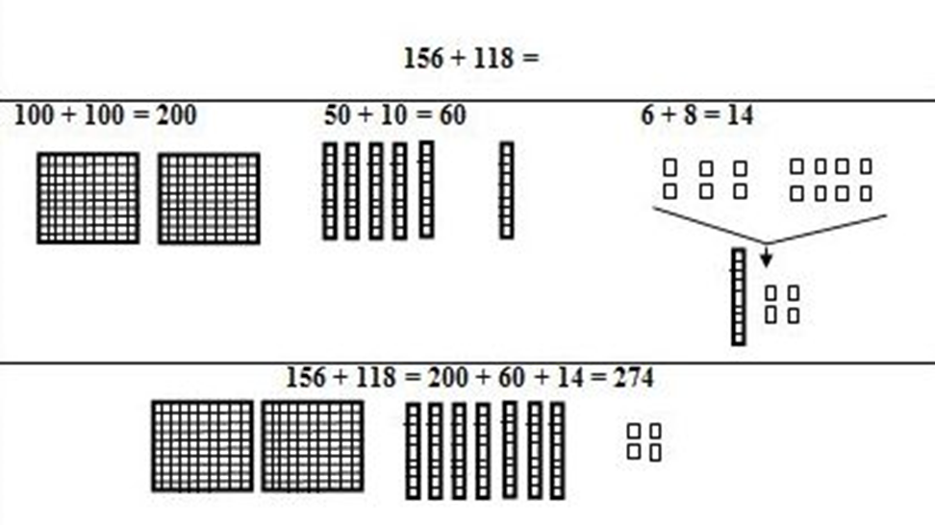
Strategic Math Series Addition with Regrouping
Extensions of SMS (continued)
Decompose each number
118
100+50+6 100+10+8

Slide 21
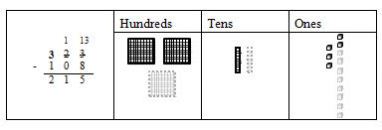
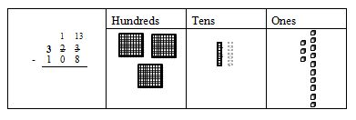
Strategic Math Series Subtraction with Regrouping
Standard: Subtract within 1000 using algorithms
Concrete level instruction (SMS lessons1-3)
Explicit instruction in representation of traditional algorithm using base ten blocks

Slide 22
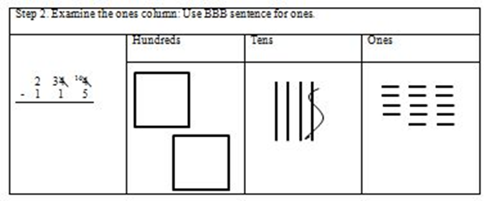
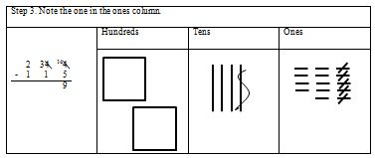
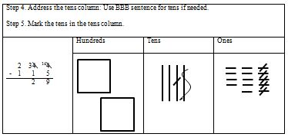
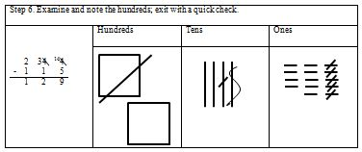
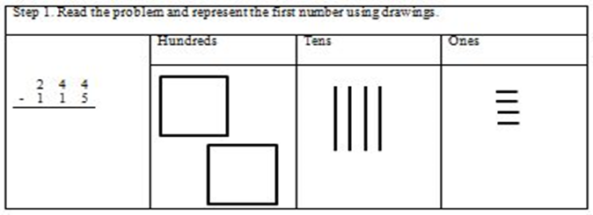
Strategic Math Series Subtraction with Regrouping
Standard: Subtract within 1000 using algorithms
Representational level instruction (SMS lessons 4-6)
Explicit instruction in representation of traditional algorithm using drawings

Slide 23
Strategic Math Series Subtraction with Regrouping
Using Strategic Instruction Model and CRA sequence helps students meet standards for practice
Read the problem
Examine the ones (BBB sentence)
Note the ones
Address the tens (BBB sentence)
Mark the tens
Examine the hundreds and exit with check

Slide 24
Strategic Math Series Subtraction with Regrouping
Extension
Standard: Subtract using strategies based on place value, properties of operation, and relationship between addition and subtraction
Count on,
begin with 46 (subtrahend),
add to arrive at 103 (minuend)

Slide 25
Current CRA-SIM Multiplication With Regrouping Research
Explicit instruction using traditional algorithm
Model and represent numbers
Emphasis on relationships between numbers
Provides students with concrete models that assist with explanation of problem solving

Slide 26
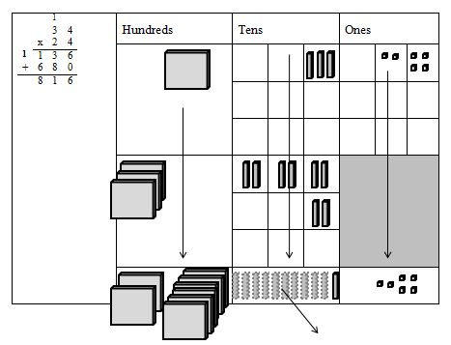
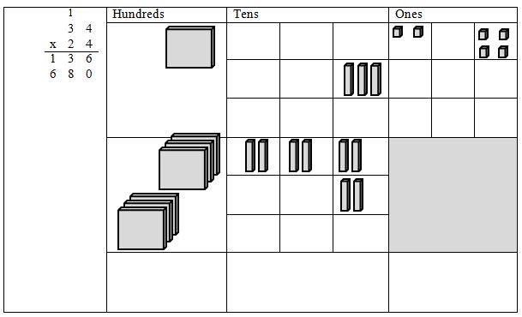
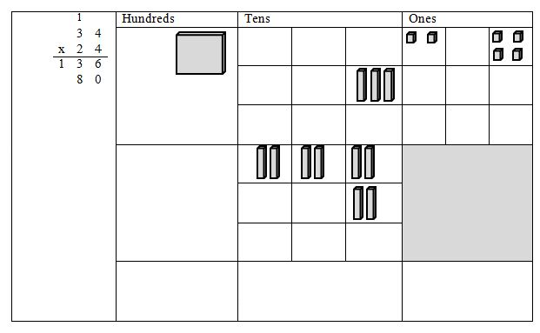
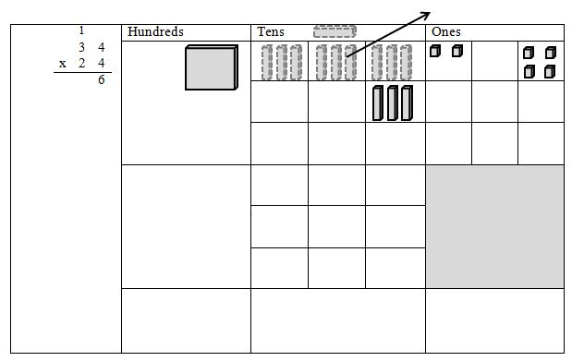
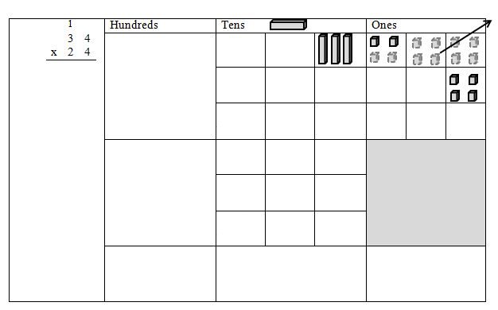
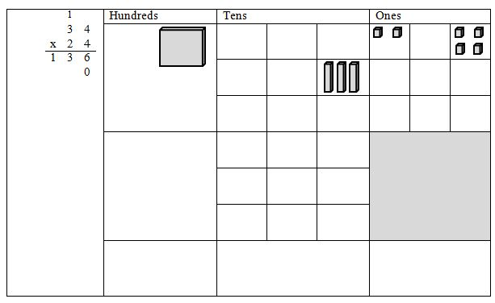
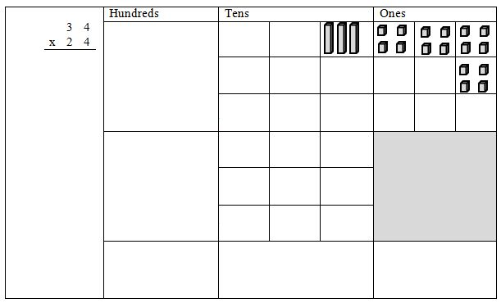
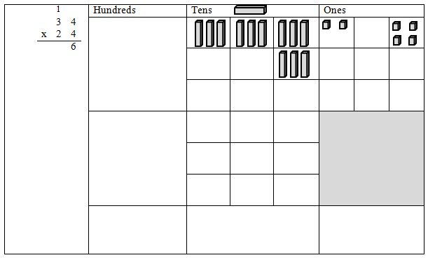
CRA-SIM Multiplication With Regrouping (concrete)

Slide 27
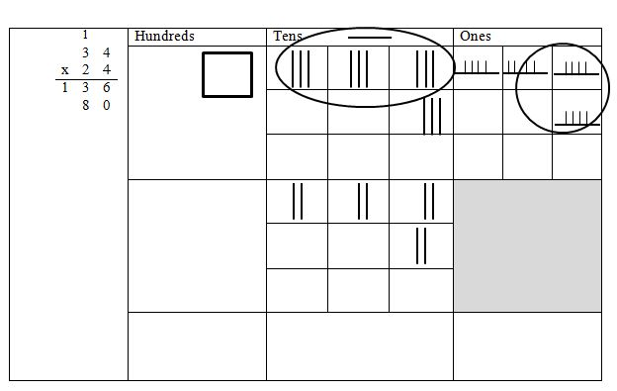
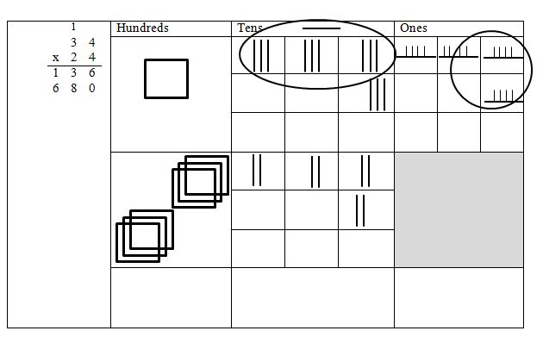
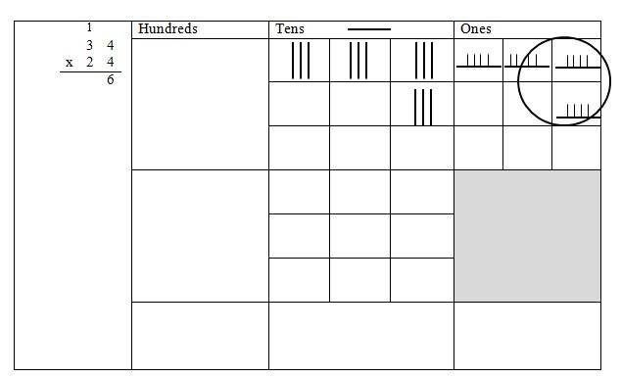
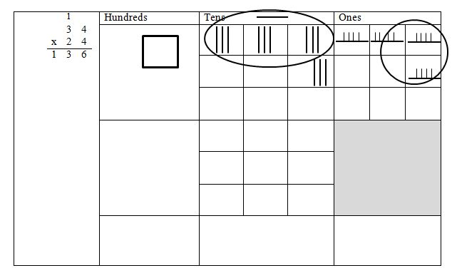
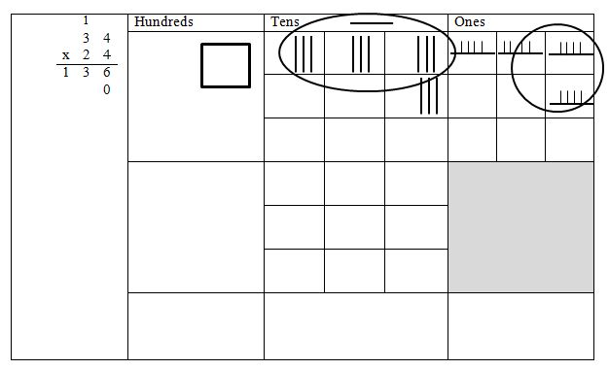
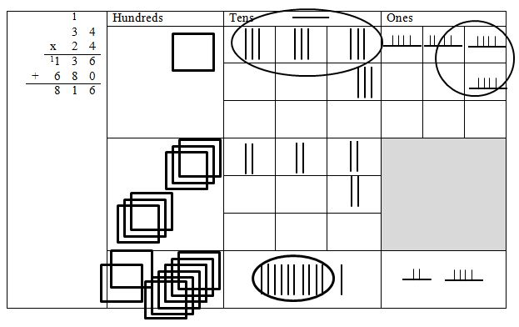
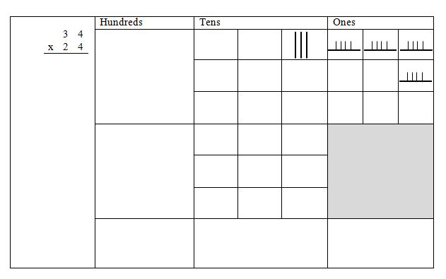
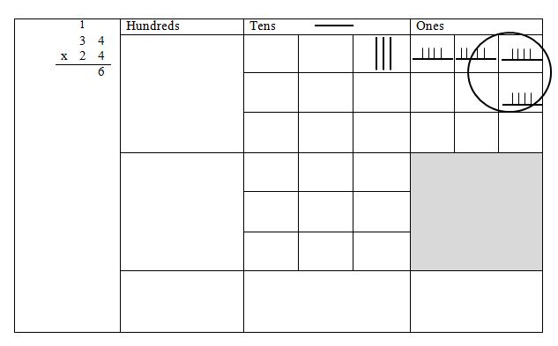
CRA-SIM Multiplication With Regrouping (representational)

Slide 28
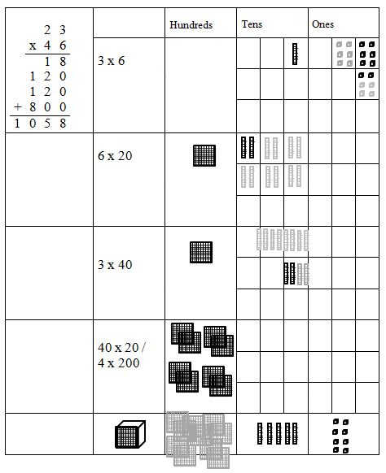
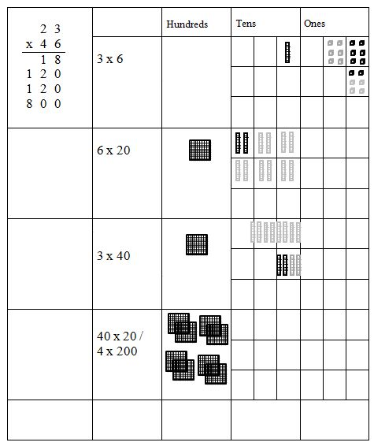
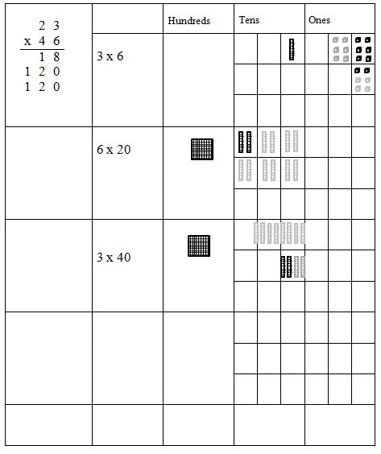
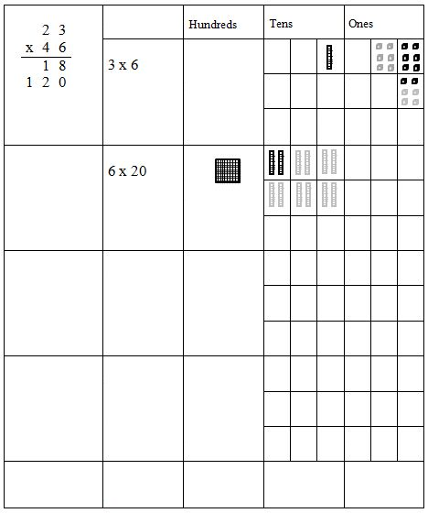
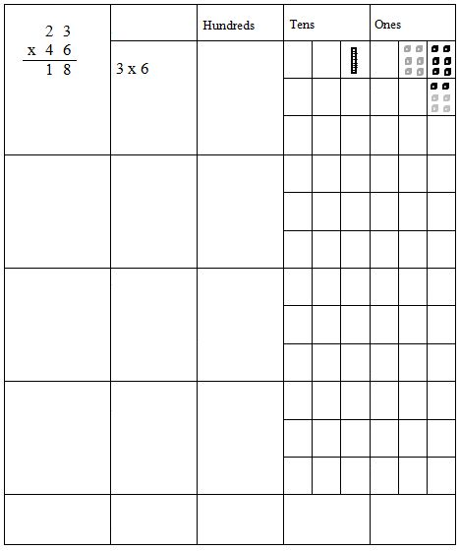
Multiplication With Regrouping
Extension:
partial
products

Slide 29
Summary and Conclusions
Strategic Math Series provides students with the mathematics knowledge and skills to
think mathematically
demonstrate conceptual understanding
complete operations with automaticity
Extensions using SMS methods and principles
deepen students’ mathematics understanding
lead to more flexible mathematical thinking
Information & updates within SMS can be found at www.facebook.com/strategicmathseries

Slide 30
Questions?

Slide 31
Please go to the link below to evaluate this session:
https://www.surveymonkey.com/s/2015SIMConf
Or scan the Evaluation barcode on your SIM Conference Program

