Slide 1
Road Trip!
The Unit Organizer Routine
Notes:
Travel analogy – Discuss with a partner the last time you went on a trip with an itinerary (i.e. not the beach). Where did you go, who planned the trip, how were the plans shared?
CUE: The UO is a leaning map and itinerary that you develop and share with your students so they get the most out of the journey through each unit in your course.
As such, using it involves 4 distinct stages: 1) planning the trip, 2) sharing the map and itinerary before or as you begin the journey, 3) referring to, and, if necessary, modifying the itinerary together as you travel together, and finally, 4) reflecting on and remembering where you’ve been.

Slide 2
4 Distinct Stages/Uses
Planning the trip: designing your unit
Sharing the map and itinerary with your students before or as you begin the journey
Referring to, and, if necessary, modifying the itinerary together as you travel together
Reflecting on and remembering where you’ve been.
Notes:
Planning the unit – you may already be using something your school or district requires for this step; that’s fine
Sharing – this is where you’ll find the UOR has a profound impact on your students – not only will see where you’re going, they’ll see how major concepts relate to each other, how to think about the concepts, they’ll know what they’ll need to know at the end of the unit, and they’ll understand how classroom activities and assignments will help them to get there.

Slide 3
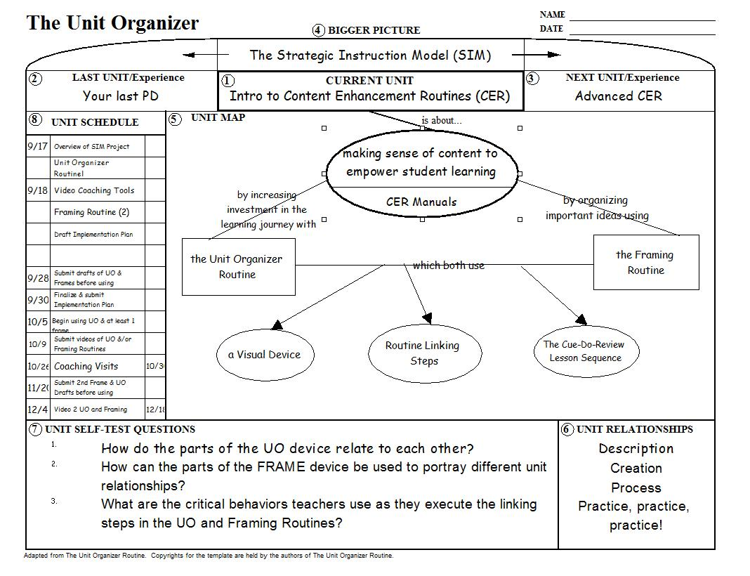
Notes:
Here’s a partial map and itinerary of the journey we’ll be taking together. I spent many hours thinking about how best to present the learning we’ll be doing over the next couple of days together, as well as over the next few months as we work together to make these routines a natural part of your instructional repertoire.

Slide 4
Notes:
DO: Let’s first create a context for where this learning comes in. So far this morning we’ve taken a look at the Strategic Instruction Model, the SIM project in DE, and where you fit in. Today, tomorrow, and for the next few months, we’ll be in what I call an Introduction to CER – you’ll learn how to use 2 of the most basic and useful routines developed by the Center on Research in Learning at the University of Kansas. Go ahead and write in CER so you’ll recognize that in future slides and documents as an abbreviation for CER. The Strategic Instruction Model, the big picture we’re beginning today, is probably new to you, so your last unit – your last professional development topic, wasn’t part of the same overall picture. Think back to what that was and fill it in the box for your last unit/experience. Now your next unit will be part of the same big picture – Advanced CER. When we all come back together next during the 1st week of March, you’ll expand your repertoire with 2 or 3 more routines that show students how to engage in higher order thinking skills around concepts and how to unpack and insightfully answer the big questions about the unit.

Slide 5
Notes:
Now we’re ready to Recognize the Content Structures for this unit. Let’s look at the map. Bottom line, if you use these routines, well, routinely, you will find that all your students – your high performing students as well as your students who traditionally struggle in class – will perform better. The reason is that these 2 routines will really help to make sense of your content, thus empowering student learning. I know that sounds flowery, but I’ve lived it and it is true. I first used this routine in a Chemistry class for students who had failed chemistry before, or who had IEPs and histories that indicated that chemistry would be a real challenge. The UOR turned out to be a highly motivational tool – they relied on it, referred to it regularly, used it to ask and answer questions. At the end of the year, survey, blah blah blah. So it truly increased their investment in the learning journey. Meanwhile, we used the framing routine initially as a replacement for standard notes, and the reaction was immediate. I remember Rebecca, in particular, who came up to us after class the first time we used it and said something to the effect of – I get this. Why haven’t my teachers used this before – I could never figure out what was important before – I wrote everything down but it didn’t make any sense when I went back to my notes to study. I’ll bet if they’d been using this I wouldn’t even be LD. That’s the power of organizing those important ideas the way you’ll be able to using the Framing Routine – and the best part about it is as you use it over and over, students will begine to internalize those organizational skills. One of the most rewarding things I saw happen – not once, but many times through the years, was students who would show me how they were using their own hand-drawn FRAMES in other classes, where the teachers weren’t using them.

Slide 6
Notes:
As we continue to Recognize the Content Structures, you can see that I wanted to highlight the similarities between the UOR and the FR, and, in fact, all CER. All CER use some sort of visual device – like a graphic organizer, but more sophisticated. They all use a mnemonic device for teachers that leads them through the steps for using the device in a way that will give the most bang for the buck – that will be the most effective for student achievement. These steps are called the routine linking steps. Finally, each time you use any of the routines and devices, whether in the beginning of a unit, during, or as you wrap up the unit at the end, you follow a lesson design called Cue-Do-Review – we’ll learn what’s involved in that & how to ensure that you’re using it for the biggest impact.

Slide 7
Notes:
Next, so that you’ll know how we’ll be thinking about and using these ideas, I want to Acknowledge the Unit Relationships. First is description – I’ll be describing each of the parts of the Unit Organizer and FRAME Devices to you and then (I added this after I wrote the draft). Next is Process. We’ll be learning the linking steps and cue-do-review sequence, or the process of using the devices in your classrooms. The second P stands for practice, practice, practice. As with anything, the first time you try the process, it won’t be perfect, but each time you use the routines, you’ll get better and I will be involved as much as you want to help make that happen.
So let’s next Frame the Unit Questions. By the end of tomorrow you’ll begin to understand the answers to all these questions, and your understanding will continue to grow as you create new devices and practice the routines with your students. Take a look at the questions. If I’ve done a good job in framing these, you should see a direct link between the questions and the parts of the map and the unit relationships. Take a moment right now, working alone or with a partner, See if you can draw lines between each question and the part(s) of the map and the unit relationship(s) they relate to.

Slide 8
Notes:
I think I’ve covered everything, but this list of questions is not static. You may have other questions you want to explore and we can add those. Did any occur to anyone when you were reading and connecting them to content?

Slide 9
Notes:
Finally, I want to help you see how we will accomplish our learning by Tying the Content to Specific Tasks. Again, if we wanted to, we should be able to draw lines from each task to the map item and/or question and/or unit relationship that it will help us understand or accomplish. Let’s add dates in the left-hand column.
REVIEW:
To review – what are the 2 routines we’ll be learning?
What 3 things do all CER have in common?
Which part of the organizer so far do you find the most helpful? Discuss with a partner.
Get up and move – sit with contend-specific peers.

Slide 10

Imagining Your Destination
Notes:
So, as promised, today we’re going to create a draft Unit Organizer for the Unit you are teaching right now, unless you are giving the final exam on Monday – then use your upcoming unit. It’s often best when planning to begin with the end in mind, so we’re going to use the Unit Organizer Pre-Planning Guide just to think about your Unit before we start. Use any of the current unit planning documents you have to complete the guide over the next few minutes. Keep in mind it’s not necessarily a linear process, so read all the items first, then feel free to jump back and forth between them. I’ll give you 20 minutes. If you finish before then, feel free to use the rest of the time as a break.

Slide 11


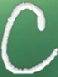
Components of All CER
Visual Device
Linking Steps – a set of procedures teachers use to guide students to understand the content
Cue-Do-Review Teaching Sequence
D
R
Notes:
Ask teachers if they remember – click to reveal.

Slide 12
Components of the Unit Organizer
Visual Device
Linking Steps – a set of procedures teachers use to guide students to understand the content
Notes:
Now we’re going to look in-depth at the Unit Organizer Device and the Linking Steps you’ll use to use it with your students.

Slide 13
The Unit Organizer
4
BIGGER PICTURE
NAME
DATE
2
LAST UNIT
/Experience
CURRENT UNIT
3
NEXT UNIT
/Experience
1
CURRENT UNIT
8
UNIT SCHEDULE
5
UNIT MAP
is about...
6
UNIT SELF-TEST QUESTIONS
RELATIONSHIPS
UNIT
7
Notes:
You’ll need 2 of these forms in front of you. On one, write “Notes” at the bottom. Use this one to take notes about each part of the device and its associated linking step. (pass around Stephanie’s?) The other blank you’ll use to actually create a draft of a unit organizer you could use for your current unit, using the pre-planning guide and any other printed or on-line resources you need. For each part, I’ll describe it and the corresponding linking step, then give you time to work on your draft unit organizer. You may not have time to finish every part today, but I’ll ask you to finish it next week and send your final version to me for feedback before you actually use it with your students.

Slide 14
The CRAFT Linking Steps
reate a context
ecognize content structures
cknowledge unit relationships
rame unit questions
ie content to tasks
Notes:
These are the steps you’ll use as you share the UO with your students. You may recognize them from the way I introduced the unit organizer for our learning earlier this morning. I’ll talk about each one a little as we construct your first organizer, then we’ll take a look at each of them in greater depth and see how you’ll use them when introducing a new unit, when using the UO during the unit, and at the end of the unit.

Slide 15
The Unit Organizer
4
BIGGER PICTURE
NAME
Elida Cordora
DATE
1/22
The roots and consequences of civil unrest.
2
LAST UNIT
/Experience
1
CURRENT UNIT
3
NEXT UNIT
/Experience
CURRENT UNIT
The Civil War
Growth of the Nation
The Causes of the Civil War
8
UNIT SCHEDULE
5
UNIT MAP
is about...
1/22 Cooperative groups -
over pp. 201-210
Sectionalism
1/28 Quiz
was based on
was influenced by
1/29 Cooperative groups -
pp. 201-236
over pp. 210-225
SECTIONS:
Leaders
Areas of
emerged because of
became greater with
across the
the U.S.
U.S.
"Influential Personalities"
1. CURRENT UNIT
projectdue
Differences
Events in
1/30 Quiz
2. LAST UNIT
between
the U.S.
2/2 Cooperative groups -
the areas
over pp. 228-234
3. NEXT UNIT
4. BIGGER PICTURE
2/6 Review for test
2/7 Review for test
2/6 Test
What was sectionalism as it existed in the U. S. of 1860?
descriptive
6
UNIT SELF-TEST
QUESTIONS
compare/contrast
How did the differences in the sections of the U.S. in 1860 contribute to the start of the Civil War?
UNIT
RELATIONSHIPS
cause/effect
7
What examples of sectionalism exist in the world today?
Pages 21, 54-57
Notes:
Note the page numbers at the bottoms of select slides refer teachers to pages in the manual where they can find more information and examples.
Have teachers fill in on their UOs.
As you construct, it may help to look at the examples on pages 54-57 in your UO manual, at the samples I’ve provided in your handout, and at samples in the content-specific books I’ve passed around.
As you construct, it may help to look at the examples on pages 54-57 in your UO manual, at the samples I’ve provided in your handout, and at samples in the content-specific books I’ve passed around.

Slide 16
The Unit Organizer
4
BIGGER PICTURE
NAME
Elida Cordora
DATE
1/22
The roots and consequences of civil unrest.
2
LAST UNIT
/Experience
1
CURRENT UNIT
3
NEXT UNIT
/Experience
CURRENT UNIT
The Civil War
Growth of the Nation
The Causes of the Civil War
8
UNIT SCHEDULE
5
UNIT MAP
is about...
1/22 Cooperative groups -
over pp. 201-210
Sectionalism
1/28 Quiz
was based on
was influenced by
1/29 Cooperative groups -
pp. 201-236
over pp. 210-225
Linking Step:
Create a context
Leaders
Areas of
emerged because of
became greater with
across the
"Influential Personalities"
the U.S.
U.S.
projectdue
Differences
Events in
1/30 Quiz
between
Help students see how the current unit is related to other units and to course ideas.
the areas
the U.S.
2/2 Cooperative groups -
over pp. 228-234
2/6 Review for test
2/7 Review for test
2/6 Test
What was sectionalism as it existed in the U. S. of 1860?
descriptive
6
UNIT SELF-TEST
QUESTIONS
compare/contrast
How did the differences in the sections of the U.S. in 1860 contribute to the start of the Civil War?
UNIT
RELATIONSHIPS
cause/effect
7
What examples of sectionalism exist in the world today?
Pages 10, 13 (30-36)
Notes:
Page numbers in blue are about the section and how to create it. Page numbers in yellow describe the linking step and give an example script. You’ll find another example script for each of the steps on pages 30-36.

Slide 17
The Unit Organizer
4
BIGGER PICTURE
NAME
Elida Cordora
DATE
1/22
The roots and consequences of civil unrest.
2
LAST UNIT
/Experience
1
CURRENT UNIT
3
NEXT UNIT
/Experience
CURRENT UNIT
The Civil War
Growth of the Nation
The Causes of the Civil War
8
UNIT SCHEDULE
5
UNIT MAP
is about...
1/22 Cooperative groups -
over pp. 201-210
Sectionalism
1/28 Quiz
was based on
was influenced by
1/29 Cooperative groups -
pp. 201-236
Leaders
over pp. 210-225
Areas of
across the
the U.S.
emerged because of
became greater with
U.S.
"Influential Personalities"
projectdue
Differences
Events in
1/30 Quiz
between
the U.S.
2/2 Cooperative groups -
the areas
over pp. 228-234
SECTION:
2/6 Review for test
2/7 Review for test
5. UNIT MAP
2/6 Test
What was sectionalism as it existed in the U. S. of 1860?
descriptive
6
A Unit Paraphrase of the big idea of the unit and a Content Map are used to show students how to think about and structure the information in the unit.
UNIT SELF-TEST
QUESTIONS
compare/contrast
How did the differences in the sections of the U.S. in 1860 contribute to the start of the Civil War?
UNIT
RELATIONSHIPS
cause/effect
7
What examples of sectionalism exist in the world today?
Notes:
Next we’re going to give students a picture of the big ideas in the unit and how they fit together by drawing a unit map.
Let’s take a look at the 3 main parts of the map.

Slide 18
Parts of the Unit Map
Unit Paraphrase
  Reveals central meaning of title
  “Kidspeak”
  Examples:
    Fractions . . . how numbers are used to express/name part of a whole or part of a group
    Matter . . . what everything is made of
    Citizenship . . . thoughtful and effective participation in civic life
    Poetry . . . how writers use limited words, patterns of writing & literary devices to create an emotional experience
Pages 22, 54-57
Notes:
It may also help to think of the paraphrase as the underlying theme of the unit. This helps students to see the purpose of learning this content beyond the memorization of facts. Sometimes teacher make this a relevancy statement – something that applies to the unit but also to student’s lives.

Slide 19
Parts of the Unit Map
Content Map (Shapes)
  Key concepts/words written in geometric shape
  No more than 7 parts
  Usually 1 layer
    If additional layers are used, make each a different shape
    Additional layers count as part of the 7 parts
Pages 22-23, 54-57
Notes:
This is where you really need to think about the big ideas in your unit and the best way to present them. You may want to use the questions in your pre-planner to guide you on this.
Keep it simple – stick with the big ideas. You’ll have the opportunity to elaborate later using the expanded unit organizer on the back. (Click)

Slide 20
Later
Expanded Unit Map (reverse)
  Expands and elaborates concepts on page 1
The Unit Organizer
The Causes of the Civil War
9
Expanded Unit Map
is about...
Sectionalism
was influenced by
was based on the
Areas of the
pp. 201-236
Leaders of
U.S.
change
developed because of
became greater with
such as
-Henry Clay
Differences
Events in the
-Stephen Douglas
between the
U.S.
-Zachary Taylor
which included the
areas
-Harriet Beecher Stowe
and included
and included
and included
such as
-Douglas Filmore
which included the
-John Brown
which included the
Social
Political
Economic
-1820 Missouri Compromise
-Jefferson Davis
Differences
Differences
Differences
-1846 Mexican War
-Abraham Lincoln
-1850 Compromise of 1850
West
-1850 Fugitive Slave Law of 1850
-1852
Uncle Tom's Cabin
-1854 Kansas-Nebraska Act
-1854 Republican Party formed
South
-1854 Bleeding Kansas
-1857 Dred Scott Case
-1858 Lincoln Douglas Debates
-1859 John Brown's Raid
North
-1860 Lincoln Elected
-1860 South Carolina Secedes
-1861 Confederacy formed
10
NEW
UNIT
SELF-TEST
QUESTIONS
How did national events and leaders pull the different sections of the U.S. apart?

Slide 21
Parts of the Unit Map
Was influenced by
Leaders
Across
the US
Content Map (Content Connections)
  Indicate relationships between the parts and the main idea paraphrase
  Paraphrase + content connection + words in connected shape = complete sentence
  Research:
    Students who are given stem labels remember substantially more about a unit than student who are given a unit map without them
Pages 23, 54-57
Notes:
These are key, and one of the critical elements that sets the Unit Map apart from most other graphic organizers. Don’t leave these out!

Slide 22
The Unit Organizer
4
BIGGER PICTURE
NAME
Elida Cordora
DATE
1/22
The roots and consequences of civil unrest.
2
LAST UNIT
/Experience
1
CURRENT UNIT
3
NEXT UNIT
/Experience
CURRENT UNIT
The Civil War
Growth of the Nation
The Causes of the Civil War
8
UNIT SCHEDULE
5
UNIT MAP
is about...
1/22 Cooperative groups -
over pp. 201-210
Sectionalism
1/28 Quiz
was based on
was influenced by
1/29 Cooperative groups -
pp. 201-236
Leaders
over pp. 210-225
Areas of
across the
the U.S.
emerged because of
became greater with
U.S.
"Influential Personalities"
projectdue
Differences
Events in
1/30 Quiz
between
the U.S.
2/2 Cooperative groups -
the areas
over pp. 228-234
Linking Step:
Recognize content structures
2/6 Review for test
2/7 Review for test
2/6 Test
Talk about how information in unit is organized.
Have structures and line labels already drawn. Have students fill in all or part of bubble contents as you talk about them.
Later
Use to track progress, expand (side 2), review.
What was sectionalism as it existed in the U. S. of 1860?
descriptive
6
UNIT SELF-TEST
QUESTIONS
compare/contrast
How did the differences in the sections of the U.S. in 1860 contribute to the start of the Civil War?
UNIT
RELATIONSHIPS
cause/effect
7
What examples of sectionalism exist in the world today?
Pages 10, 13-14
Notes:
Once your map is drawn, you share it with students using the R step of CRAFT. It might look something like this: (p. 13-14) with a clementine.
Pass out samples.
Give teachers time to create unit maps.

Slide 23
The Unit Organizer
4
BIGGER PICTURE
NAME
Elida Cordora
DATE
1/22
SECTION:
The roots and consequences of civil unrest.
2
LAST UNIT
/Experience
1
CURRENT UNIT
3
NEXT UNIT
/Experience
CURRENT UNIT
The Civil War
Growth of the Nation
The Causes of the Civil War
6. UNIT RELATIONSHIPS
How students will need to think about information in this unit, such as:
Text structure (compare/contrast, sequence, hierarchical)
Order of thinking (classification, analysis, investigation)
Activity (practice, creation, invention)
8
UNIT SCHEDULE
5
UNIT MAP
is about...
1/22 Cooperative groups -
over pp. 201-210
Sectionalism
1/28 Quiz
was based on
was influenced by
1/29 Cooperative groups -
pp. 201-236
Leaders
over pp. 210-225
Areas of
across the
the U.S.
emerged because of
became greater with
U.S.
"Influential Personalities"
projectdue
Differences
Events in
1/30 Quiz
between
the U.S.
2/2 Cooperative groups -
the areas
over pp. 228-234
2/6 Review for test
2/7 Review for test
2/6 Test
What was sectionalism as it existed in the U. S. of 1860?
descriptive
6
UNIT SELF-TEST
QUESTIONS
compare/contrast
How did the differences in the sections of the U.S. in 1860 contribute to the start of the Civil War?
UNIT
RELATIONSHIPS
cause/effect
7
What examples of sectionalism exist in the world today?
Pages 23-24, 53
Notes:
Let’s look at the next 2 sections, Unit Relationships and Unit self-test questions together because they are often dependent upon each other. Think about the questions you will want your students to be able to answer at the end of the unit and the assignments you’ll make during the unit and what relationships students will need to understand to be successful. The chart on page 53 can be very helpful. You don’t need to list every relationship – in many units you could make a successful argument that any of these relationships would apply – for this box, you want to identify the 2 or 3 most prevalent or important.
When you present this section to students in the Acknowledge Relationships step, you can identify the relationships for students, but you can also guide them to hypothesize the relationships based on what you’ve shared on the unit map, or as you move through the unit.
One of the reasons this piece is so critical is the strongly established correlation between students’ knowledge of text structure and reading comprehension, and quality of writing.
Text Organization and Its Relation to Reading Comprehension: A Synthesis of the Research. Technical Report No. 17.
Dickson, Shirley V.; And Others
1995, National Center To Improve the Tools of Educators, Eugene, OR
The benefits fo text structure instruction for reading comprehension have strong empirical support. Research also supports the causal relationship between text structure instruction and improvement in composition skills.
Dickson, Simmons, Kame-enui, 1995

Slide 24
The Unit Organizer
4
BIGGER PICTURE
NAME
Elida Cordora
DATE
1/22
Linking Step:
Acknowledge unit relationships
First few UO: provide for students and explain how & why you chose them
Then: gradually get students to suggest, first from a list, later in groups or pairs
Always have your own list on YOUR draft, but be willing to add to or alter
The roots and consequences of civil unrest.
2
LAST UNIT
/Experience
1
CURRENT UNIT
3
NEXT UNIT
/Experience
CURRENT UNIT
The Civil War
Growth of the Nation
The Causes of the Civil War
8
UNIT SCHEDULE
5
UNIT MAP
is about...
1/22 Cooperative groups -
over pp. 201-210
Sectionalism
1/28 Quiz
was based on
was influenced by
1/29 Cooperative groups -
pp. 201-236
Leaders
over pp. 210-225
Areas of
across the
the U.S.
emerged because of
became greater with
U.S.
"Influential Personalities"
projectdue
Differences
Events in
1/30 Quiz
between
the U.S.
2/2 Cooperative groups -
the areas
over pp. 228-234
2/6 Review for test
2/7 Review for test
2/6 Test
What was sectionalism as it existed in the U. S. of 1860?
descriptive
6
UNIT SELF-TEST
QUESTIONS
compare/contrast
How did the differences in the sections of the U.S. in 1860 contribute to the start of the Civil War?
UNIT
RELATIONSHIPS
cause/effect
7
What examples of sectionalism exist in the world today?
Pages 10, 14-15
Notes:
Let’s look at the next 2 sections, Unit Relationships and Unit self-test questions together because they are often dependent upon each other. Think about the questions you will want your students to be able to answer at the end of the unit and the assignments you’ll make during the unit and what relationships students will need to understand to be successful. The chart on page 53 can be very helpful. You don’t need to list every relationship – in many units you could make a successful argument that any of these relationships would apply – for this box, you want to identify the 2 or 3 most prevalent or important.
When you present this section to students in the Acknowledge Relationships step, you can identify the relationships for students, but you can also guide them to hypothesize the relationships based on what you’ve shared on the unit map, or as you move through the unit.
One of the reasons this piece is so critical is the strongly established correlation between students’ knowledge of text structure and reading comprehension, and quality of writing.
Text Organization and Its Relation to Reading Comprehension: A Synthesis of the Research. Technical Report No. 17.
Dickson, Shirley V.; And Others
1995, National Center To Improve the Tools of Educators, Eugene, OR
The benefits fo text structure instruction for reading comprehension have strong empirical support. Research also supports the causal relationship between text structure instruction and improvement in composition skills.
Dickson, Simmons, Kame-enui, 1995

Slide 25
The Unit Organizer
4
BIGGER PICTURE
NAME
Elida Cordora
DATE
1/22
The roots and consequences of civil unrest.
2
LAST UNIT
/Experience
1
CURRENT UNIT
3
NEXT UNIT
/Experience
CURRENT UNIT
The Civil War
Growth of the Nation
The Causes of the Civil War
SECTION:
8
UNIT SCHEDULE
5
UNIT MAP
is about...
1/22 Cooperative groups -
7. UNIT SELF-TEST QUESTIONS
Essential questions that students should be able to answer by the end of the unit.
Big ideas, higher order thinking
Should reflect all major concepts in map and involve unit relationships.
over pp. 201-210
Sectionalism
1/28 Quiz
was based on
was influenced by
1/29 Cooperative groups -
pp. 201-236
Leaders
over pp. 210-225
Areas of
across the
the U.S.
emerged because of
became greater with
U.S.
"Influential Personalities"
projectdue
Differences
Events in
1/30 Quiz
between
the U.S.
2/2 Cooperative groups -
the areas
over pp. 228-234
2/6 Review for test
2/7 Review for test
2/6 Test
What was sectionalism as it existed in the U. S. of 1860?
descriptive
6
UNIT SELF-TEST
QUESTIONS
compare/contrast
How did the differences in the sections of the U.S. in 1860 contribute to the start of the Civil War?
UNIT
RELATIONSHIPS
cause/effect
7
What examples of sectionalism exist in the world today?
Pages 24, 54-57
Notes:
Here is where you list 3-6 overarching questions for the unit. These should be higher order questions that require students to relate concepts throughout the unit, not just recalling isolated facts. Look at the relationship between the questions and the unit relationships.
#1- asks for a description
2 cause & effect
3compare & contrast and describe
When presenting this part of the UO in the F step – Frame Unit Questions, you should definitely have questions planned before presenting, but even before presenting your questions you can lead students to predict what those questions might be, based on the map and relationships. The more you use this routine, the better they’ll be able to do this. Tomorrow, we will learn another CER that will help you and your students get the most out of these questions and develop their ability to write thorough and well-though out answers higher order questions like this.
Give teachers time to add relationships and questions.

Slide 26
The Unit Organizer
4
BIGGER PICTURE
NAME
Elida Cordora
DATE
1/22
The roots and consequences of civil unrest.
2
LAST UNIT
/Experience
1
CURRENT UNIT
3
NEXT UNIT
/Experience
CURRENT UNIT
The Civil War
Linking Step:
Frame unit questions
First few UO: provide for students and explain how & why you chose them
Then: gradually encourage students to add to yours, suggest their own
Always have your own list on YOUR draft, but be willing to add to or alter
Growth of the Nation
The Causes of the Civil War
8
UNIT SCHEDULE
5
UNIT MAP
is about...
1/22 Cooperative groups -
over pp. 201-210
Sectionalism
1/28 Quiz
was based on
was influenced by
1/29 Cooperative groups -
pp. 201-236
Leaders
over pp. 210-225
Areas of
across the
the U.S.
emerged because of
became greater with
U.S.
"Influential Personalities"
projectdue
Differences
Events in
1/30 Quiz
between
the U.S.
2/2 Cooperative groups -
the areas
over pp. 228-234
2/6 Review for test
2/7 Review for test
2/6 Test
What was sectionalism as it existed in the U. S. of 1860?
descriptive
6
UNIT SELF-TEST
QUESTIONS
compare/contrast
How did the differences in the sections of the U.S. in 1860 contribute to the start of the Civil War?
UNIT
RELATIONSHIPS
cause/effect
7
What examples of sectionalism exist in the world today?
Pages 10, 15
Notes:
Here is where you list 3-6 overarching questions for the unit. These should be higher order questions that require students to relate concepts throughout the unit, not just recalling isolated facts. Look at the relationship between the questions and the unit relationships.
#1- asks for a description
2 cause & effect
3compare & contrast and describe
When presenting this part of the UO in the F step – Frame Unit Questions, you should definitely have questions planned before presenting, but even before presenting your questions you can lead students to predict what those questions might be, based on the map and relationships. The more you use this routine, the better they’ll be able to do this. Tomorrow, we will learn another CER that will help you and your students get the most out of these questions and develop their ability to write thorough and well-though out answers higher order questions like this.
Give teachers time to add relationships and questions.

Slide 27
The Unit Organizer
4
BIGGER PICTURE
NAME
Elida Cordora
DATE
1/22
The roots and consequences of civil unrest.
2
LAST UNIT
/Experience
1
CURRENT UNIT
3
NEXT UNIT
/Experience
CURRENT UNIT
The Civil War
Growth of the Nation
The Causes of the Civil War
8
UNIT SCHEDULE
5
UNIT MAP
is about...
1/22 Cooperative groups -
over pp. 201-210
SECTION:
Sectionalism
1/28 Quiz
was based on
was influenced by
1/29 Cooperative groups -
pp. 201-236
7. UNIT SCHEDULE
List of learning activities & assessments with dates penciled in – activities and dates STC
May add column for ✓ or grade
over pp. 210-225
Leaders
Areas of
emerged because of
became greater with
across the
"Influential Personalities"
the U.S.
U.S.
projectdue
Differences
Events in
1/30 Quiz
between
the U.S.
2/2 Cooperative groups -
the areas
over pp. 228-234
2/6 Review for test
2/7 Review for test
2/6 Test
What was sectionalism as it existed in the U. S. of 1860?
descriptive
6
UNIT SELF-TEST
QUESTIONS
compare/contrast
How did the differences in the sections of the U.S. in 1860 contribute to the start of the Civil War?
UNIT
RELATIONSHIPS
cause/effect
7
What examples of sectionalism exist in the world today?
Pages 24-25, 54-57
Notes:
The final piece is the unit schedule, where you will list learning activities, assignments and homework.
During the T step of CRAFT, Tie content to tasks, etc.
The columns on either side can be used for a variety of things. We filled in dates for the 1st couple of assignments and penciled in a date for the test. This section can be modified as you proceed, but you can make students part of the discussion as to why.
The right hand column can be used to check off completed assignments or even to record grades (ED example)
Next Slide

Slide 28



Unit Schedule
Remember – Learning is Not a Spectator Sport . . .
Some of my favorite resources
  Cooperative Learning Structures
  (www.Kaganonline.com)
  Tools for Promoting Active, In-Depth Learning (www.thoughtfuleducationpress.com)
  Instruction for All Students by Paula Rutherford
Notes:
Next slide

Slide 29
The Unit Organizer
4
BIGGER PICTURE
NAME
Elida Cordora
DATE
1/22
The roots and consequences of civil unrest.
2
LAST UNIT
/Experience
1
CURRENT UNIT
3
NEXT UNIT
/Experience
CURRENT UNIT
The Civil War
Growth of the Nation
The Causes of the Civil War
8
UNIT SCHEDULE
5
UNIT MAP
is about...
1/22 Cooperative groups -
over pp. 201-210
Linking Step:
Tie content to tasks
As you explain, show them how task is related to content
Later ask them to
Still later, students may give input as to preferred learning activities.
Sectionalism
1/28 Quiz
was based on
was influenced by
1/29 Cooperative groups -
pp. 201-236
Leaders
over pp. 210-225
Areas of
across the
the U.S.
emerged because of
became greater with
U.S.
"Influential Personalities"
projectdue
Differences
Events in
1/30 Quiz
between
the U.S.
2/2 Cooperative groups -
the areas
over pp. 228-234
2/6 Review for test
2/7 Review for test
2/6 Test
What was sectionalism as it existed in the U. S. of 1860?
descriptive
6
UNIT SELF-TEST
QUESTIONS
compare/contrast
How did the differences in the sections of the U.S. in 1860 contribute to the start of the Civil War?
UNIT
RELATIONSHIPS
cause/effect
7
What examples of sectionalism exist in the world today?
Pages 10-11, 15
Notes:
The final piece is the unit schedule, where you will list learning activities, assignments and homework.
During the T step of CRAFT, Tie content to tasks, etc.
The columns on either side can be used for a variety of things. We filled in dates for the 1st couple of assignments and penciled in a date for the test. This section can be modified as you proceed, but you can make students part of the discussion as to why.
The right hand column can be used to check off completed assignments or even to record grades (ED example)
Next Slide

Slide 30
Previous Unit
The Chemistry Lab
Math & Measurement in Chem Tech
Next Unit
Properties of Matter
is about
measuring & recording the amount of matter involved in chemical reactions
in terms of
using special
and knowing how to do
using
most commonly used metric units
laboratory methods
metric conversions
scientific notation
by understanding
using the ratio method to change
to write
such as
kilograms ⬄ grams ⬄ milligrams
liters ⬄ milliliters
very large numbers (10⁵)
very small numbers (10⁻⁵)
g (mass)
mL (volume)
liquid displacement
tare
9. EXPANDED UNIT MAP
EXTENDED UNIT SELF TEST:
Explain how to measure liquids and solids in the chemistry lab. Be sure to include what unit you would probably use to measure each and the laboratory method you might need to use to get an accurate measurement.
Be able to convert kilograms to grams to milligrams and liters to milliliters.
As the unit progresses, the basic UNIT
MAP from the first page of the Unit
Organizer is expanded with key summary
information about the
content of the unit.
Pages 25-26

Slide 31
Previous Unit
The Chemistry Lab
Math & Measurement in Chem Tech
Next Unit
Properties of Matter
10. NEW UNIT SELF-TEST QUESTIONS
is about
As the unit progresses, new questions
measuring & recording the amount of matter involved in chemical reactions
that seem important about the content of
using special
the unit are listed or old questions can be
in terms of
and knowing how to do
using
most commonly used metric units
modified.
metric conversions
scientific notation
laboratory methods
by understanding
using the ratio method to change
to write
such as
kilograms ⬄ grams ⬄ milligrams
liters ⬄ milliliters
very large numbers (10⁵)
very small numbers (10⁻⁵)
g (mass)
mL (volume)
liquid displacement
tare
EXTENDED UNIT SELF TEST:
Explain how to measure liquids and solids in the chemistry lab. Be sure to include what unit you would probably use to measure each and the laboratory method you might need to use to get an accurate measurement.
Be able to convert kilograms to grams to milligrams and liters to milliliters.
Pages 26-27, 54-57

Slide 32
Time to Work Together
Explore, compare, contribute

Slide 33

Components of the Unit Organizer
Visual Device
Linking Steps – a set of procedures teachers use to guide students to understand the content
Cue-Do-Review Teaching Sequence
D
R

Slide 34
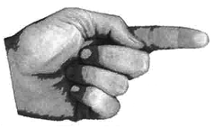

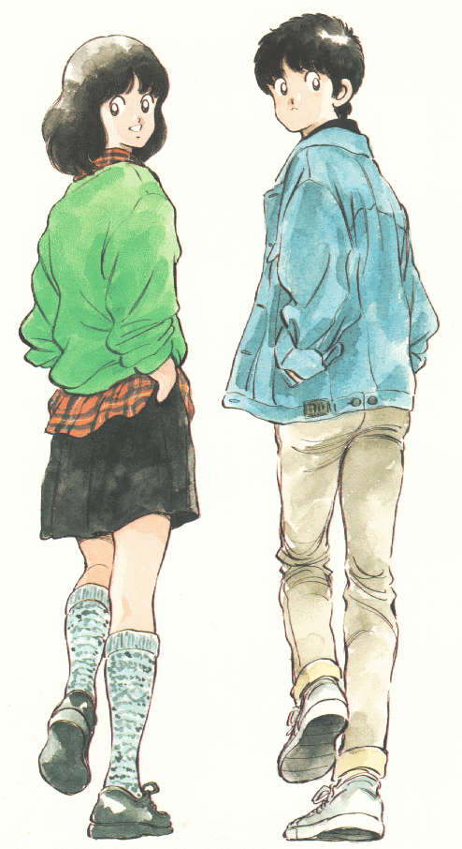
The Cue-Do-Review Sequence
Cue
  Students that the routine will be used.
Do
  The routine.
Review
  The information and process.
Notes:
Important to emphasize the difference between CER and mnemonics: the Cue-Do-Review Sequence is a systematic approach which allows students to eventually be able to create the devices on their own.

Slide 35

The Cue-Do-Review Sequence
Cue
  Name the device
  Explain how the device helps students
  Tell students what they will do and what’s expected (take notes, ask & answer questions, contribute)
Pages 28-30

Slide 36
The Cue-Do-Review Sequence
Do
  C
  R
  A
  F
  T
reate a context
ecognize content structures
cknowledge unit relationships
rame unit questions
ie content to tasks
Pages 31-35

Slide 37
The Cue-Do-Review Sequence
Do
  Use the linking steps as appropriate for launching, floating or tying up
  Elicit responses from students
  Shape student responses by asking questions & leading students to evaluate the accuracy of information
  Display information on the device clearly and legibly

Slide 38

The Cue-Do-Review Sequence
Review
  Ask questions about contents of device & how they can guide learning
  Review content by asking questions about what’s written on organizer
  Remind students to use the device during instruction and/or
  for assessments
Page 35

Slide 39
Exploring the CRAFT Linking Steps
reate a context
ecognize content structures
cknowledge unit relationships
rame unit questions
ie content to tasks

Slide 40
Scaffolding Instruction
I DO IT
Teacher Constructed
WE DO IT Class Constructed
Y’ALL DO IT Group Constructed
YOU DO IT Individual Constructed
Notes:
I do it- awareness
We do it- Conceptual understanding
Y’ll do it- Skill acquisition
You do it- Skill application

Slide 41
Scaffolding CRAFT
Always begin with a completed draft in mind
I do it
  First unit – teach the thinking behind a completely teacher- generated UO (p 31-35)

Slide 42
Scaffolding CRAFT
Always begin with a completed draft in mind
We do it
  Next few units –
    Involve students in generating previous unit, big picture, & predicting next unit, if practical
    Leave blanks in teacher-constructed bubble contents; guide students in anticipating what will go in blanks

Slide 43
Scaffolding CRAFT
Always begin with a completed draft in mind
We do it more
  Next few units –
    Same as before, AND
    Model for students how to predict unit relationships from map
      Post list – have them generate ideas
      Check with each other
      Check with you

Slide 44
Scaffolding CRAFT
Always begin with a completed draft in mind
And more . . .
  Next few units –
    Same as before, AND
    Model & teach students how to predict questions based on map & relationships
    Involve students in choosing preferred learning routines

Slide 45
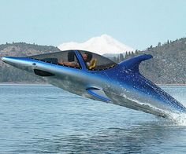
Every day . . .
Launch – beginning of the unit
  At a minimum
    Creat context
    Recognize content structures
    Acknowledge unit relationships
  By 2nd day
    Frame unit questions
    Tie content to tasks

Slide 46
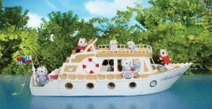
Every day . . .
Float – during the unit
  Check progress
  Review
  Discuss questions
  Add details to expanded 2nd page

Slide 47
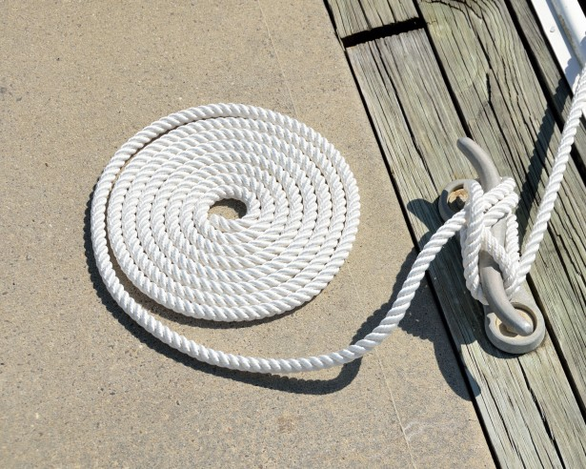
Every day . . .
Tie Up at the end of the unit
  Review and/or reflect on unit map – would students change anything?
  Check knowledge of self-test questions
  Evaluate effectiveness of learning activities
  Students use as study guide*
* Make sure that test questions are tied to UO questions and relationships!

Slide 48
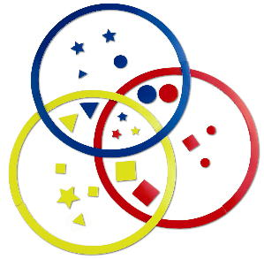
Partner Sort

Slide 49

Use the Cue Do Review Checklist to study this teacher’s use of the Unit Organizer Routine in the Float stage of instruction (2nd page)
Search: Unit Organizer Vimeo

Slide 50
General Use Tips
Use colored paper to print Unit Organizers and/or
Have students use different colors to distinguish parts or levels.
Use different geometric shapes to distinguish levels of information.
As a review during floating or tying up, draw empty geometric shapes on a blank Unit Organizer and have students see how much they can fill in from memory, working individually or in pairs
Have a stack of blank Unit Organizers available for students use in other classes

Slide 51
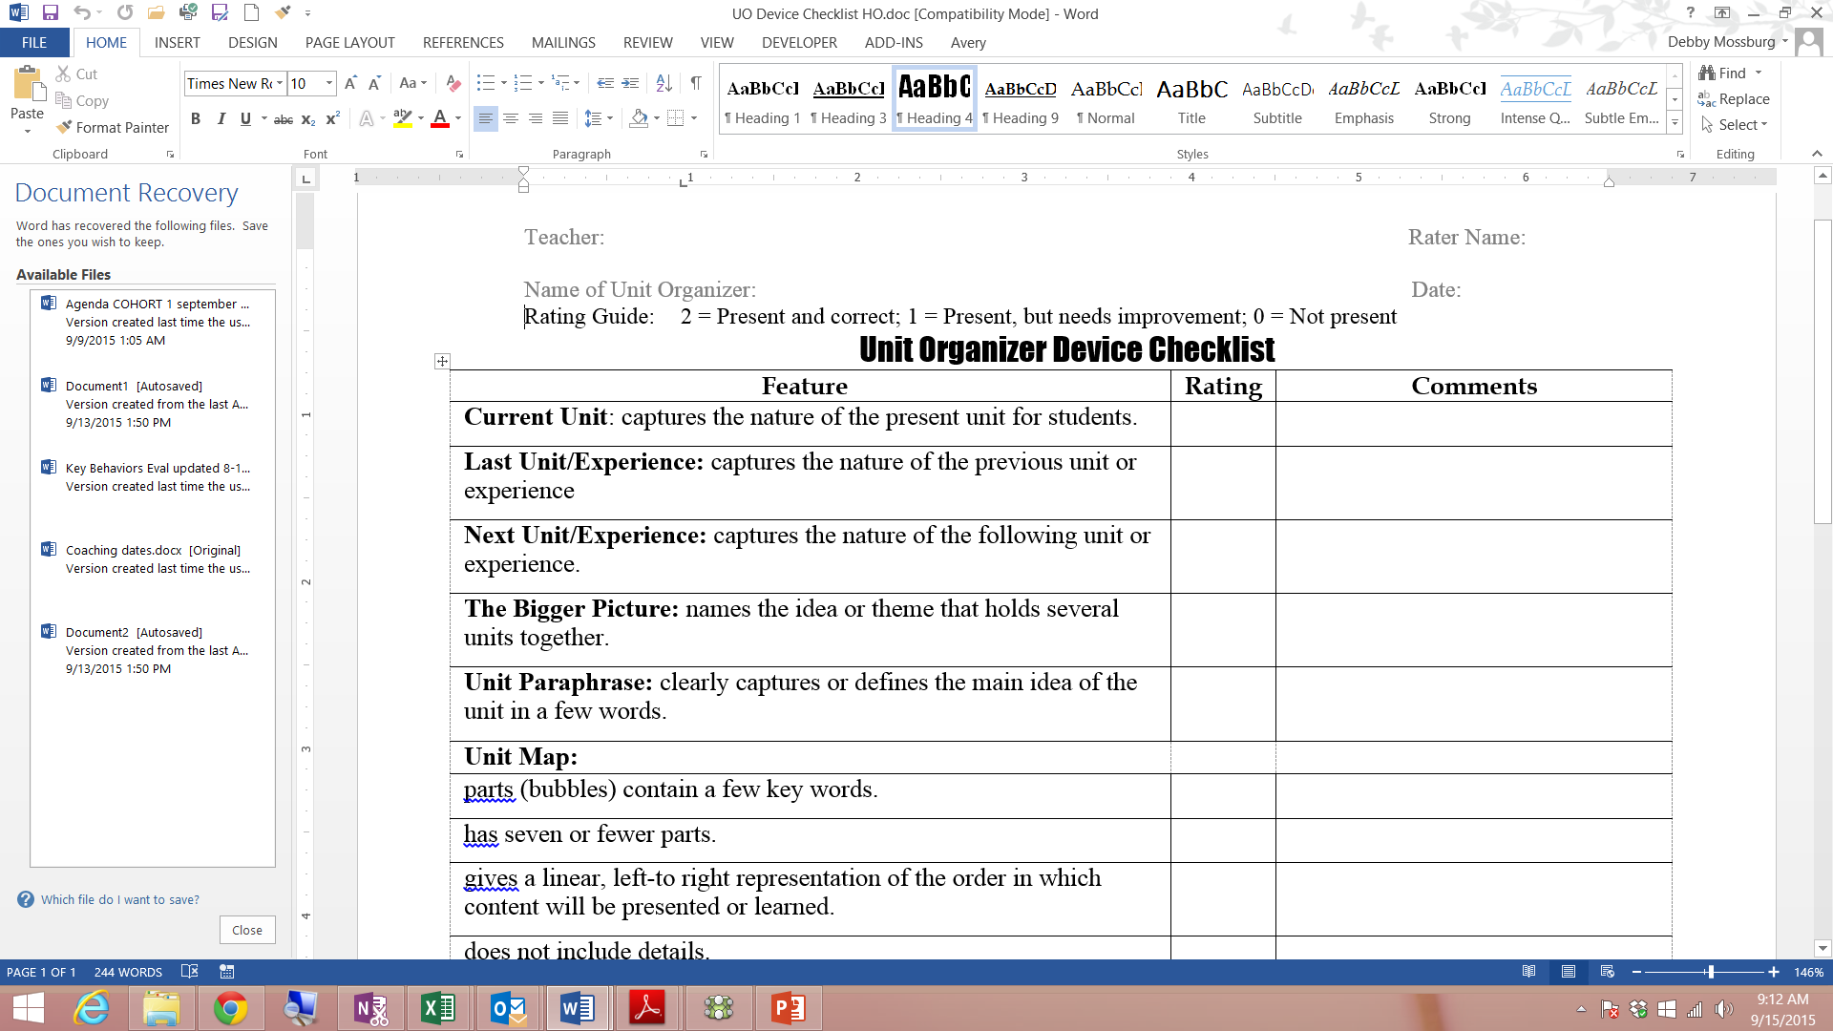
UO Device Checklist

Slide 52
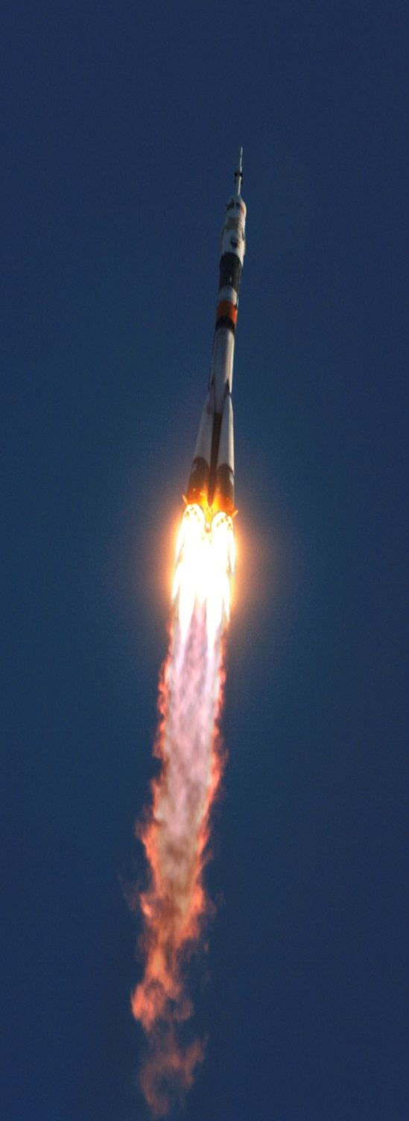
Planning Your Launch
How will you grab your students’ interest?
  Question
  Story
  Analogy
  ???????

Slide 53
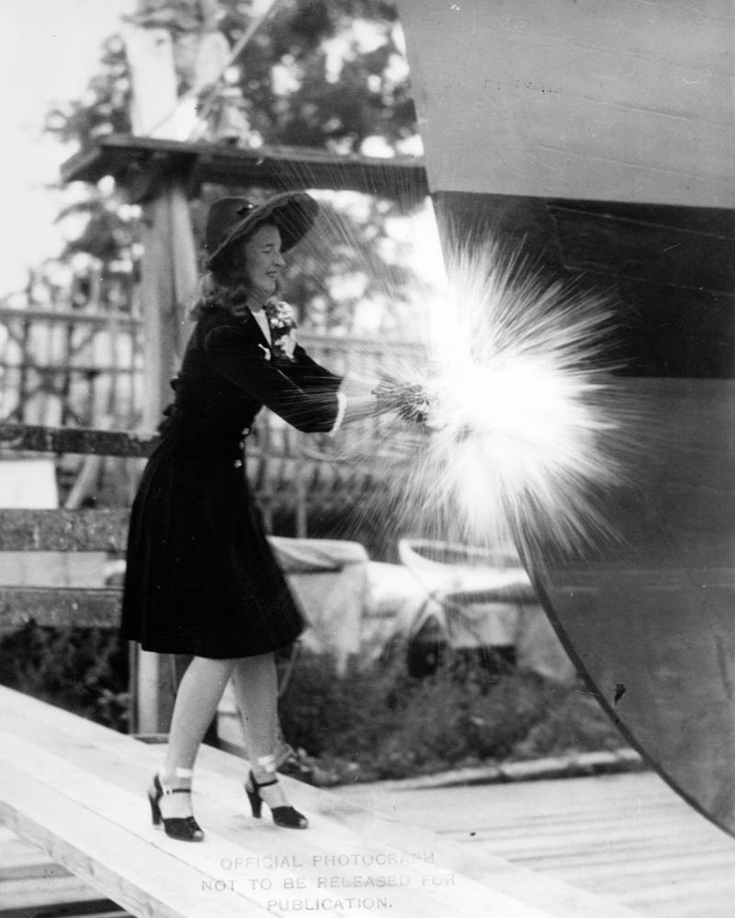
Maiden Voyage
You will have 12 minutes to practice presenting your 1st lesson to a peer
3 minutes of
feedback

Slide 54
CRAFT during the Unit
Use UO to illustrate what’s been covered, what’s yet to come
Assign self-test questions as ticket out the door (y’all)
Add extended UO or other graphic organizers (we)
Give details and have students sort them under main concepts (you or y’all)
Have students fill in stem labels

Slide 55
CRAFT at the end of the Unit
Use as study guide
Provide blanks, have students sort or provide details for entire unit
Use as part of assessment
Have students use as guide for writing unit summaries & reflections
Have students provide visual representations for what they’ve learned under each major topic

Slide 56
Implementing the Unit Organizer Routine
Launching the Unit
Floating the Unit
Tying Up the Unit
The new unit is introduced to
Attention is drawn to unit ideas
The Unit Organizer is used to
GOAL
students using the Unit
as each unit section is
review unit content and promote
Organizer Routine.
completed or introduced.
student confidence.
C
The CURRENT UNIT is related
Each unit section is reviewed
The UNIT MAP, the
to the LAST UNIT, the NEXT
and in conjunction with the
EXPANDED UNIT MAP, and
UNIT, and to a BIGGER IDEA in
UNIT MAP.
relationships to other units and
the course.
ideas are reviewed.
R
The UNIT MAP is revealed
Key information is added to the
Students construct personal unit
through a Unit Paraphrase
EXPANDED UNIT MAP as part
maps without looking at the Unit
and a Content Map.
of section review or introduction.
Organizer and then check
accuracy.
A
The UNIT MAP is explored
UNIT RELATIONSHIPS are
Students explain, edit, and
and UNIT RELATIONSHIPS
confirmed and highlighted on
revise personal content maps
are identified.
the EXPANDED UNIT MAP.
with others.
F
UNIT QUESTIONS reflecting
UNIT QUESTIONS are answered
Students answer the UNIT
central ideas of the unit are
and answers to previously
QUESTIONS and generate
constructed.
answered questions are
new self-test questions.
improved.
T
The UNIT SCHEDULE is
Status of task progress,
Class discusses how unit tasks
constructed and explained.
completion, and student
promoted learning and how
satisfaction with learning is
learning could have been
checked.
improved.

Slide 57
Expert Groups
Assign readings (Launch, Float, Tie Up)
Read your parts
In your group, summarize
(in order)
Note the most important points to share

Slide 58
Teaching Groups
Proceed in order C, R, A, F, T
Share what each step might look like in
  Launching
  Floating
  Tying Up
Ask questions to
clarify
The Unit

Slide 59
Reflection and Break
How will I sail my Craft?
Complete # 1 & # 2 before taking a break
Return by

