Slide 1

Structured Literacy & SIM
Notes:
We created these slides as a way to introduce Structured Literacy and its correlation to SIM.
Slides 2 - 3 could be a thinking prompt for teachers to consider how they might use their literacy strategies and skills for new words
Slide 4 - The Definition of Structured Literacy as defined by the International Dyslexia Association
Slides 5 - 7 The Structured Literacy Infographic created by the International Dyslexia Association
Slides 8 - 9 An edited list from the Educator Training Initiatives Brief on Structured Literacy
Slide 10 - The SIM & Structured Literacy Crosswalk
Possible PD Flow:
Begin with these slides and a discussion about structured literacy.
SIM Overview
Specific PD in a strategy or routine

Slide 2
What do you do when you come to an unknown word?
Carriwitchet
Pogonophile
Baggataway
Scapulimancy
Trichobezoar
Notes:
PDers may want to use this activity to begin a discussion about having a strategic approach while you are reading (similar to numbers activity).
You may want to use something more comprehension based if that is the PD you are providing.

Slide 3
DEFINITIONS
Carriwitchet – A pun or a riddle
Pogonophile – A person who loves or collects beards
Baggataway – An early form of lacrosse
Scapulimancy – Divination of the future by using shoulder blades
Trichobezoar – A hairball in the stomach

Slide 4
Structured Literacy
Structured Literacy refers to both the content and principles of instruction, emphasizing explicit, systematic teaching of foundational skills such as phoneme awareness, decoding, spelling, and syntax, as well as higher-level literacy components like vocabulary, comprehension, and written expression.
Content and Principles of Instruction
Notes:
This is the definition of structured literacy as defined by the International Dyslexia Association.
Structured Literacy Works, But What Is It? - International Dyslexia Association

Slide 5
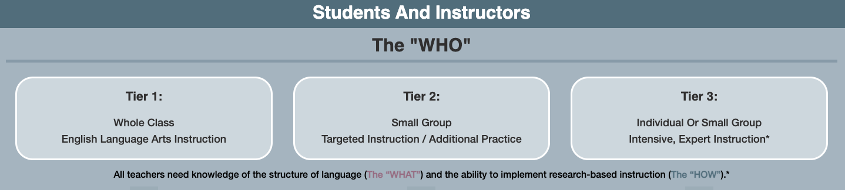


THE “WHAT”
(MORE DETAILS ON SLIDE 6)
THE “HOW”
(MORE DETAILS ON SLIDE 7)
Notes:
This slide shows the overall organization for how the IDA defines structured literacy as “What” and “How.” The “Why” is the importance of using scientific evidence for instructing literacy. The “Who” represents that the students will learn and practice literacy in different settings.
» Structured Literacy Education Infographic - International Dyslexia Association
www.DyslexiaLibrary.org

Slide 6
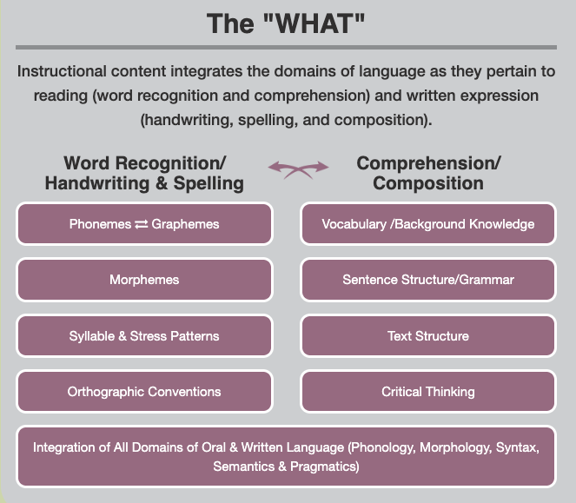
Notes:
https://dyslexialibrary.org/structured-literacy-education-infographic/

Slide 7
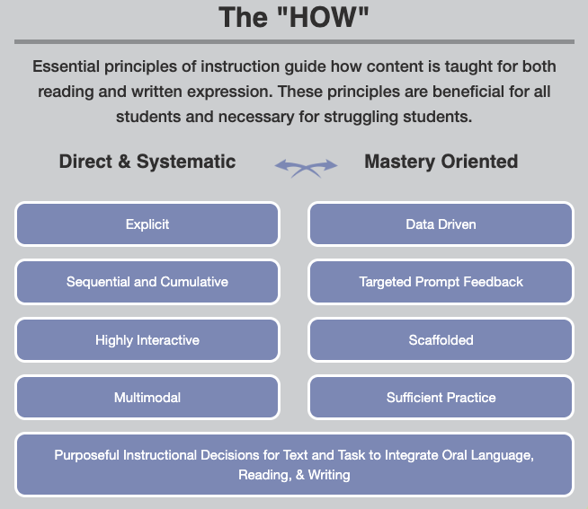
Notes:
Consider all the ways SIM meets these “hows” in both direct & systematic instruction as well as mastery oriented instruction.
https://dyslexialibrary.org/structured-literacy-education-infographic/

Slide 8
The following instructional principles are hallmark features of a Structured Literacy approach to reading:
1. Instructional tasks are modeled and clearly explained.
2. Highly explicit instruction is provided (in decoding, spelling, syntax, reading comprehension, and text composition).
3. Important prerequisite skills are taught before students are expected to learn more advanced skills.
4. Meaningful interactions with language occur during the lesson.
5. Multiple opportunities are provided to practice instructional tasks.
Notes:
This edited list comes from the Educator Training Initiatives Brief on Structured Literacy - An Introductory Guide (https://app.box.com/s/mvuvhel6qaj8tghvu1nl75i0ndnlp0yz).
On the instructional principles list, the blue bolded words are examples of what is recommended in structured literacy and also exists within SIM Learning Strategies and Routines.

Slide 9
6. Well targeted corrective feedback is provided
7. Student effort is encouraged.
8. Lesson engagement during teacher-led instruction is monitored and scaffolded.
9. Lesson engagement during independent work is monitored and facilitated.
10. Students successfully complete activities at a high criterion level of performance before moving on to more advanced skills.
Notes:
https://app.box.com/s/mvuvhel6qaj8tghvu1nl75i0ndnlp0yz
Edited version in slide deck

Slide 10
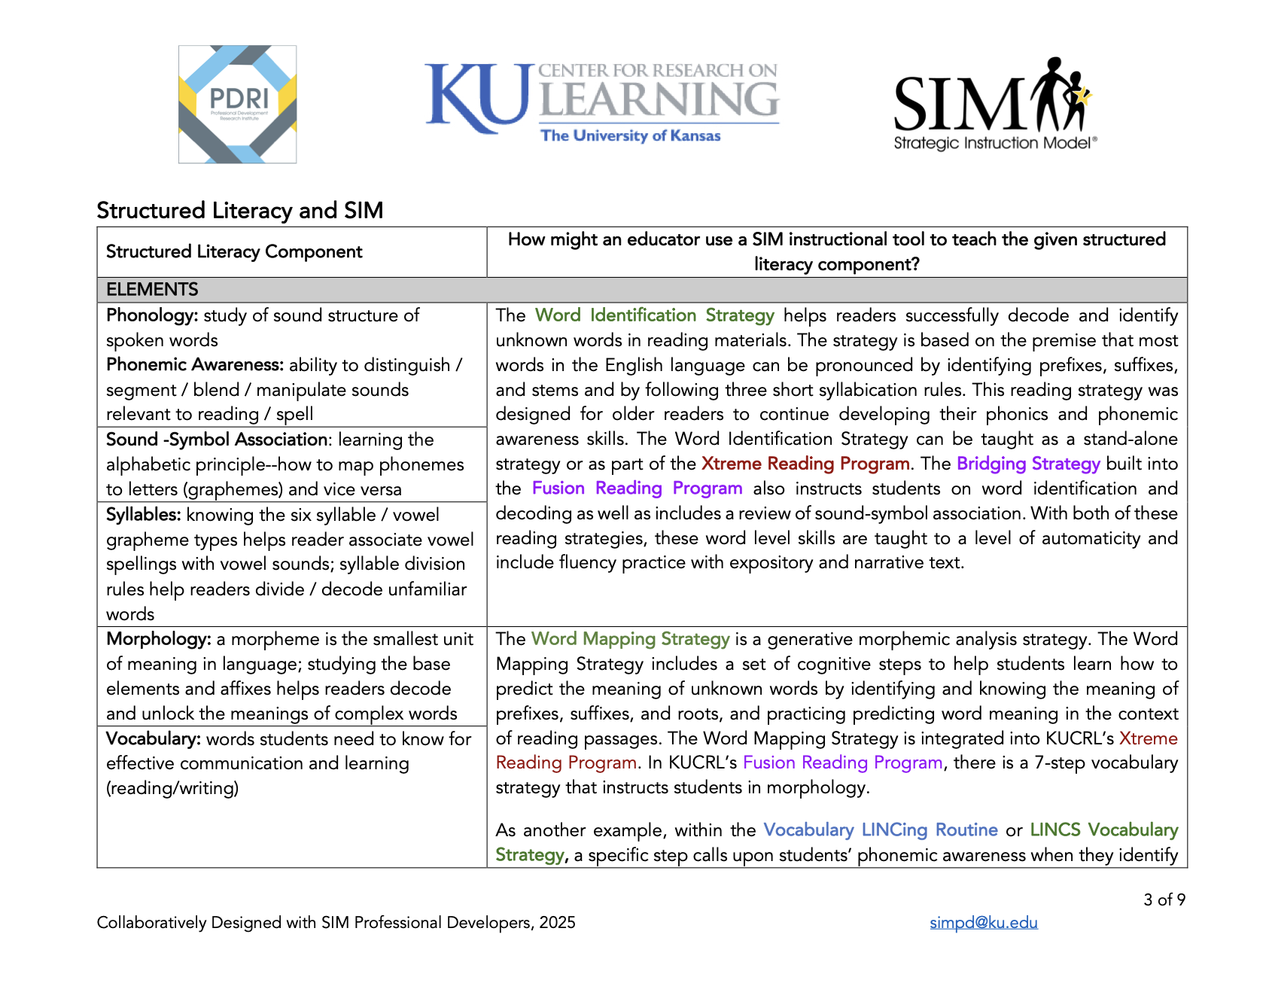
Notes:
https://sim.ku.edu/sites/sim/files/files/Articles/Structured%20Literacy%20and%20SIM%20Crosswalk%202025.pdf
A SIM PDer might want to pose a question to the group, such as “Where does the strategy that we are about to learn fit on the crosswalk?”

