Slide 1
SMARTER
THE SMARTER INSTRUCTIONAL CYCLE, CUE-DO-REVIEW, AND THE LINK TO HIGH LEVERAGE INSTRUCTIONAL PRACTICES
Keith Lenz, Ph.D.
Lawrence Ks, July 16, 2019

Slide 2
Purpose
The session will discuss the evolution of key instructional elements in SIM, how they align with standards and the emphasis on collaboration and highly engaged learning.
It will examine how each step of the SMARTER instructional process has evolved as SIM professional developers have used it to integrate the use of high-leverage instructional practices.
The results of a study on the use of Cue-Do-Review in university courses to increase student learning will also be discussed.

Slide 3
How have key instructional elements in SIM evolved?
The Planning Studies
Presentation or co-construction – the power of engagement
Operationalizing informed explicit instruction
Operationlizing idea of advance organizer research
How do teach SWDs Evaluation Walk-throughs (engagement/hOT)

Slide 4
How they align with standards and the emphasis on collaboration and highly engaged learning.

Slide 5
How have SIM Professional Developers shaped Cue-Do Review

Slide 6
A study on the use of Cue-Do-Review in university courses to increase student learning

Slide 8
How have key instructional elements in SIM evolved?
How they align with standards and the emphasis on collaboration and highly engaged learning.

Slide 9
Cue Do Review
Patty Kohler-Evans, Morgan Bullard, Chayla Rutledge

Slide 10
Resources
Best Recipe for Teaching Reflection
HOT Content Enhancer Planning Guide
Article: The Effects of Cue-Do-Review on Teaching Assistant and Student Perceptions of Learning by Chayla D. Rutledge, Morgan B. Bullard, Patricia Kohler-Evans, and Janet Filer: University of Central Arkansas
CDR Cue Cards
Applying CDR to Classroom Activities J. Hines & F. Schultz, Florida’s SPDG SIM Project, 2017

Slide 11
Content for Presentation
Introductions
Purpose of Study
Sequence
Results
Cue-Do-Review Model
Processing Time
Questions/Thoughts/Comments

Slide 12
Purpose of Study
Purpose:
Examine effects of Cue Do Review sequence on teaching assistant and student perceptions of learning
Process:
TAs complete survey
Students complete survey
TAs participate in short professional development session
TAs implement Cue Do Review sequence
TAs are provided a fidelity checklist
Both TAs and students complete a final survey
ALL responses are anonymous

Slide 13
Cue Do Review Sequence
Cue
Provide students with what routine/process will be used.
Do
The routine/process.
Review
The information and process.

Slide 14
Results of Student Perceptions Before and After Cue-Do-Review
No significance
How well the student believed they would retain the material taught in class that day
Significant Differences Before and After Implementation
Students’ perceptions of their understanding of the class material
Students’ perceptions of degree to which the instructor helped the student understand the processes and expectations of the classroom
The degree to which the instructor helped the students understand the content
The perceived effectiveness of the instructors teaching methods

Slide 15
Results of Teaching Assistant Perceptions Before and After Cue-Do-Review
No significance
Teaching assistant perceptions in the students’ ability to retain the information presented
Teaching assistants’ perceptions of degree to which the students understood the materials presented in class
The teaching assistants’ perceptions of how helpful the course was for advancing students’ subject matter
The teaching assistants’ perceptions of the degree to which the students understood the class expectations
The teaching assistants’ perceptions of the degree to which the teacher helped the students understand the content
The teaching assistants’ perceptions of how effective they believed their teaching methods

Slide 16
Overall Conclusions
Increased Student Perceptions of Learning
Did not increase teaching assistant perceptions; however, teaching assistants may not have realized the overall impact that Cue-Do-Review was having
Future Directions
Do this study with a larger sample size
Do this study with experienced classroom teachers across disciplines

Slide 17
Cue
Name the process you will be using
Identify what is about to be learned
Connect current learning to previously learned information
Explain how the process(es) will enhance learning
Specify what students need to do to participate in class
Engage students in discussion
Examples of ideas to introduce class:
Pre-assessment
Video to generate interest: https://www.youtube.com/watch?v=9l-YYqjhVi4&feature=player_embedded
Model
KWL chart
Pose question to think about throughout lesson
411 Activity (4 things you know, 1 question you have, 1 thing you are unsure of)
Notes:
Pre-assess-Turn to your neighbor and identify one thing you know about anxiety in children, caterpillars, taking care of aging parents, cue do review etc.
Show me 1-5 fingers how confident you are in knowing about….
Draw an illustration to represent your understanding of …..
4 corners…..
Model-Bring a picture or 3D model of what you will discuss, ask someone to act out, use a drawing on the board
KWL chart
Note-taking guide

Slide 18
Do
Teach the content using the processes you named in Cue
The Do part of the lesson is the part that gets most of your attention
Do includes activities, lectures, labs, discussions, group work etc.

Slide 19
Review
Check understanding of the content
Ask questions about how processes used helped them learn
Get feedback regarding unresolved concerns, areas of misunderstanding
Examples of ideas to wrap up class:
Ticket out
Write the big idea and a question
Complete discovery card
Work in small group to develop summary statement
Use group response to indicate level of comfort
Complete “L” section of KWL chart

Slide 20
Processing Time

Slide 21
Wrap-Up and Questions

Slide 22
Cue Do Review
Patty Kohler-Evans, Morgan Bullard, Chayla Rutledge

Slide 23
Content for Presentation
Introductions
Purpose of Study
Sequence
Results
Cue-Do-Review Model
Processing Time
Questions/Thoughts/Comments

Slide 24
Purpose of Study
Purpose:
Examine effects of Cue Do Review sequence on teaching assistant and student perceptions of learning
Process:
TAs complete survey
Students complete survey
TAs participate in short professional development session
TAs implement Cue Do Review sequence
TAs are provided a fidelity checklist
Both TAs and students complete a final survey
ALL responses are anonymous

Slide 25
Cue Do Review Sequence
Cue
Provide students with what routine/process will be used.
Do
The routine/process.
Review
The information and process.

Slide 26
Results of Student Perceptions Before and After Cue-Do-Review
No significance
How well the student believed they would retain the material taught in class that day
Significant Differences Before and After Implementation
Students’ perceptions of their understanding of the class material
Students’ perceptions of degree to which the instructor helped the student understand the processes and expectations of the classroom
The degree to which the instructor helped the students understand the content
The perceived effectiveness of the instructors teaching methods

Slide 27
Results of Teaching Assistant Perceptions Before and After Cue-Do-Review
No significance
Teaching assistant perceptions in the students’ ability to retain the information presented
Teaching assistants’ perceptions of degree to which the students understood the materials presented in class
The teaching assistants’ perceptions of how helpful the course was for advancing students’ subject matter
The teaching assistants’ perceptions of the degree to which the students understood the class expectations
The teaching assistants’ perceptions of the degree to which the teacher helped the students understand the content
The teaching assistants’ perceptions of how effective they believed their teaching methods

Slide 28
Overall Conclusions
Increased Student Perceptions of Learning
Did not increase teaching assistant perceptions; however, teaching assistants may not have realized the overall impact that Cue-Do-Review was having
Future Directions
Do this study with a larger sample size
Do this study with experienced classroom teachers across disciplines

Slide 29
Cue
Name the process you will be using
Identify what is about to be learned
Connect current learning to previously learned information
Explain how the process(es) will enhance learning
Specify what students need to do to participate in class
Engage students in discussion
Examples of ideas to introduce class:
Pre-assessment
Video to generate interest: https://www.youtube.com/watch?v=9l-YYqjhVi4&feature=player_embedded
Model
KWL chart
Pose question to think about throughout lesson
411 Activity (4 things you know, 1 question you have, 1 thing you are unsure of)
Notes:
Pre-assess-Turn to your neighbor and identify one thing you know about anxiety in children, caterpillars, taking care of aging parents, cue do review etc.
Show me 1-5 fingers how confident you are in knowing about….
Draw an illustration to represent your understanding of …..
4 corners…..
Model-Bring a picture or 3D model of what you will discuss, ask someone to act out, use a drawing on the board
KWL chart
Note-taking guide

Slide 30
Do
Teach the content using the processes you named in Cue
The Do part of the lesson is the part that gets most of your attention
Do includes activities, lectures, labs, discussions, group work etc.

Slide 31
Review
Check understanding of the content
Ask questions about how processes used helped them learn
Get feedback regarding unresolved concerns, areas of misunderstanding
Examples of ideas to wrap up class:
Ticket out
Write the big idea and a question
Complete discovery card
Work in small group to develop summary statement
Use group response to indicate level of comfort
Complete “L” section of KWL chart

Slide 32
Processing Time

Slide 33
Wrap-Up and Questions

Slide 34
A SMARTER Presentation

Slide 35
The SMARTER Instructional Cycle
B. Keith Lenz, Ph.D.
March 8, 2017

Slide 36
The SMARTER Instructional Cycle is about …
Planning,
Teaching,
Evaluating, &
Revising

Slide 37
SMARTER: Reflaction
Planning and evaluating activities are integrated throughout teaching, and comprised of both reflection and action i.e., reflaction ( Bulgren & Lenz, 1996).

Slide 38
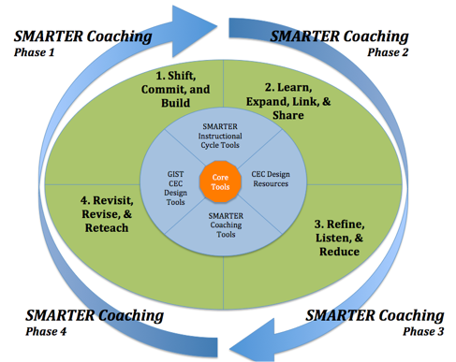

Slide 39
S
Shape the critical questions.
Questions are shaped, by design, to
show coherence between the standards, how the standards will be addressed in a course, where and how progress towards building fluency in knowledge and skills will be embedded in units, and how standards-informed instruction affects lessons.

Slide 42
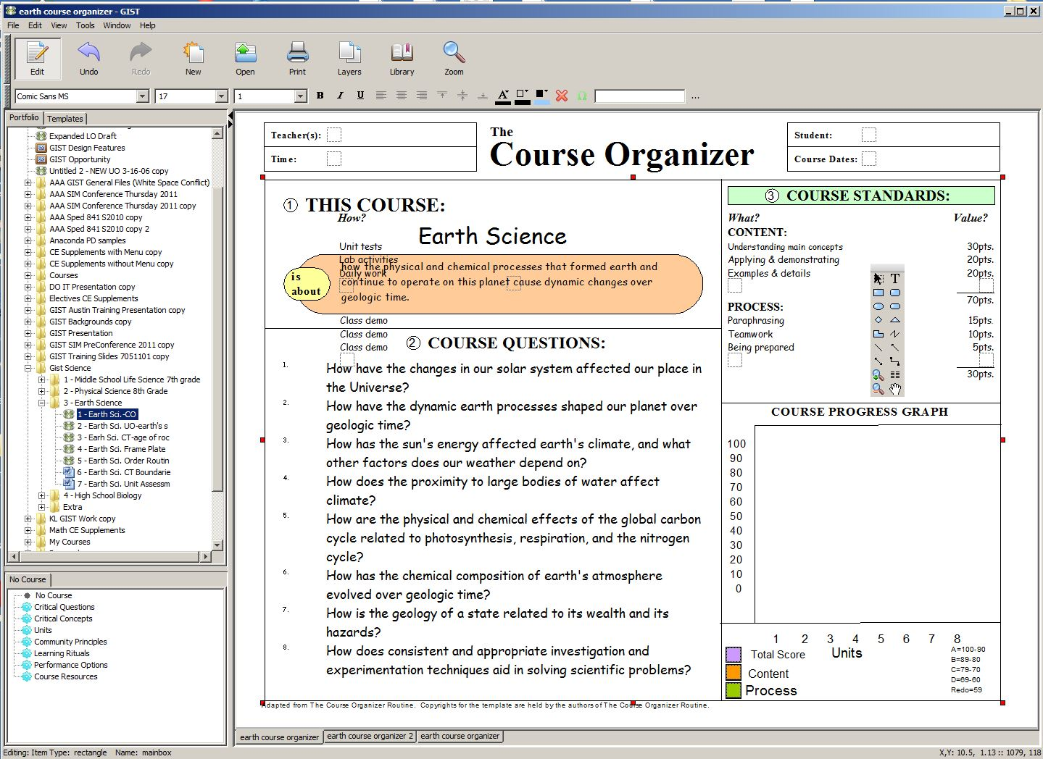

Slide 43
M
Map the critical content and relationships
Mapping the structure of the critical content in a way that shows relationships and uses “sign posts” to signal or suggest the type of thinking, in terms of both breadth and depth, establishes a “playing field” for exploring possibilities and defines the “problem space” for learning is prompted in this step.

Slide 44
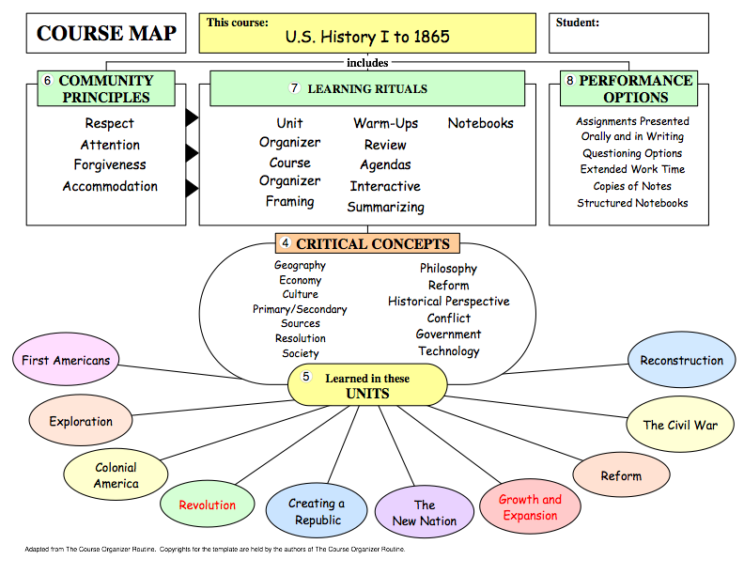

Slide 45
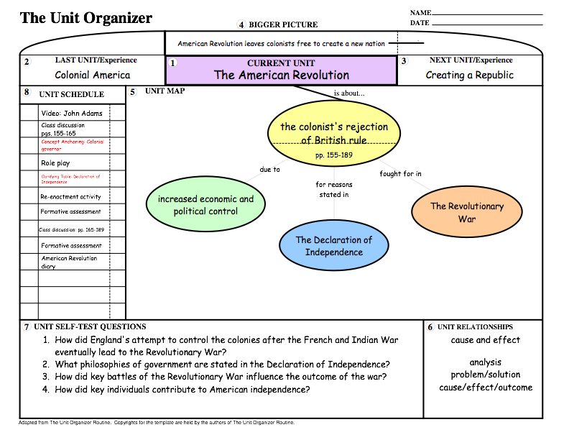

Slide 46
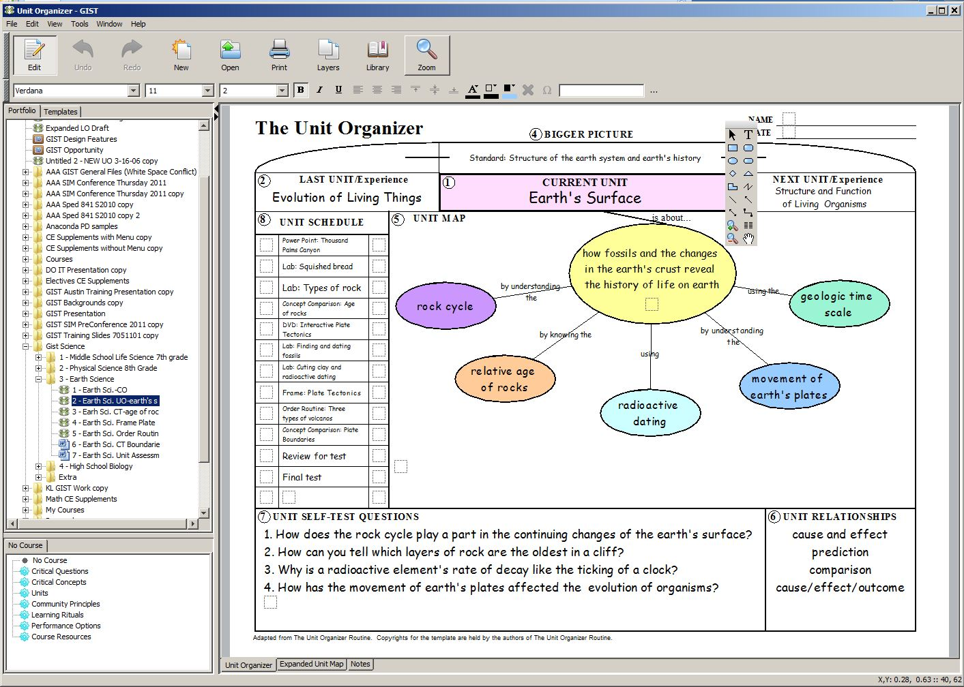

Slide 47
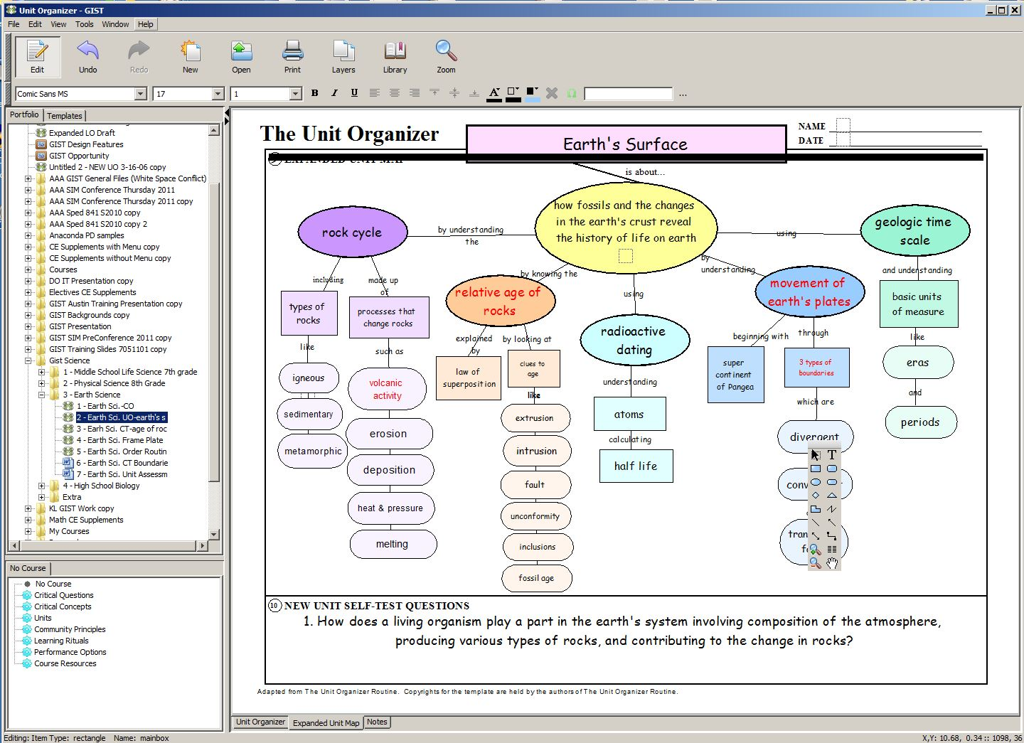

Slide 49
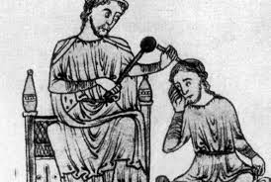
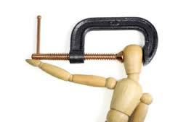

Slide 50
A
Analyze how learning of critical content might be difficult, made apparent, and measured.

Slide 52
Learning difficulties related to the cognitive, behavioral,
social, and emotional demands of learning experiences,
including the use of new technologies, are identified along
with the difficulties anticipated in learning critical content.

Slide 53
R
Reach instructional
enhancement decisions
Using evidenced-based pedagogies, teachers work together to plan how to move away from traditional, less successful instructional practices, and toward those practices that enhance learning in ways that increase both what and how standards-informed critical content and relationships are learned.

Slide 54
Types of Evidenced Based Enhancement Decision Options
Teaching Routines
Learning Strategies
Interaction/Community/Social Strategies
Individual and Group Accommodations
Communication Systems
Engagement - Collaboration - Co-construction

Slide 55
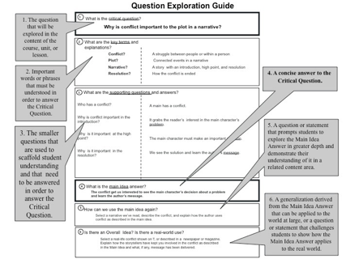

Slide 56
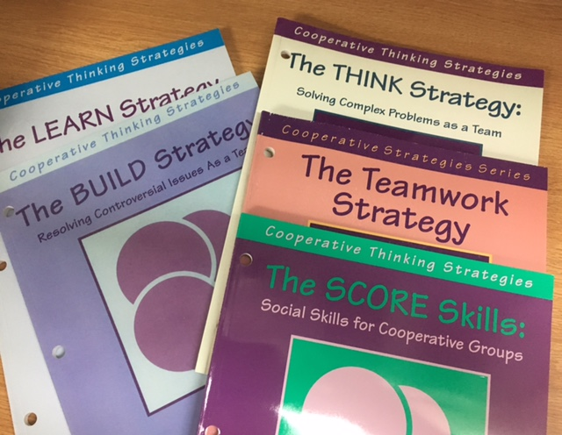

Slide 58
T
Teach
Strategically
The Cue-Do-Review process is the basis for the use of an intentional, generative, collaborative, co-constructed pedagogy that should evolve beyond the use of enhancements to virtually all forms of instructional practices.

Slide 59
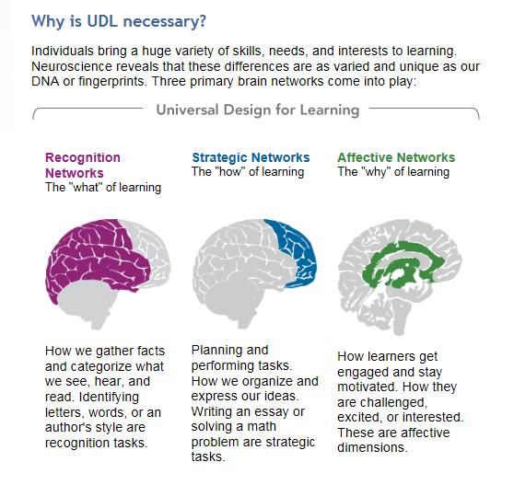

Slide 61
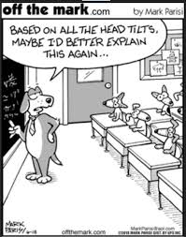
E
Evaluate Learning
Evaluation is daily and occurs upon classroom entry, during class, and upon classroom exit. Course, unit, and lesson assignments should be viewed as formative assessments leading to and supporting demonstration of content fluency and an overall strategic approach to learning on summative measures.

Slide 64
R
Revisit learning outcomes and critical questions
If student learning and performance on summative measures are not aligned with formative measures and the targeted critical questions, then teaching decisions and actions must be reevaluated.

