Slide 1
Proficiency in the Sentence Writing Strategy
The Learning Strategy Series
2024
The University of Kansas
Center for Research on Learning
Lawrence, Kansas

Slide 2
Purpose
To explain, model, and practice the Sentence Writing Strategy.

Slide 3
Objectives
After this session, you will be able to:
Explain the Sentence Writing Strategy.
State rationales for teaching the Sentence Writing Strategy to low-achieving students and students with learning disabilities.
Describe and model the Sentence Writing Strategy.
Score student pretests, practice lessons, and posttests.
Implement the Sentence Writing Strategy instruction.

Slide 4
Sentence Writing Strategy Outline
Advance Organizer
I. Sentence Writing Strategy Overview
II. Materials and Organization
III. Step-by-Step run through the Sentence Writing Strategy
Role-play practice
Scoring Practice

Slide 5
Sentence Writing Strategy Outline
IV. Incorporation into IEPs
V. Problem Solving
VI. Planning for Implementation
Post Organizer

Slide 6
Setting Demands
Students must
Express their ideas
Express their opinions
Demonstrate their knowledge in writing in:
Book reports
Themes
Research papers
Answers to chapter questions
Answers on tests

Slide 7
Purpose of the Sentence Writing Strategy Program
To teach students basic vocabulary associated with sentence writing.
To enable students to write a variety of sentences with fluency.
To give students the prerequisite skills for more advanced writing strategies.

Slide 8
Learning Strategies Curriculum
Acquisition
Word Identification
Paraphrasing
Fundamentals of Paraphrasing & Summarizing
Self-Questioning
Visual Imagery
Word Mapping
Inference

Slide 9
Learning Strategies Curriculum
Storage
First-Letter Mnemonic
Paired Associates
Listening and Note-Taking
LINCS

Slide 10
Learning Strategies Curriculum
Expression and Demonstration of Competence
Sentences
Paragraphs
Error Monitoring
Themes
Assignment Completion
Test Taking
Essay Test-Taking
InSPECT
EDIT

Slide 11
The Strategy in a Nutshell
By using the strategy, students:
Use formulas to form the sentences they write
Decide on the wording of a sentence before they write it
Write the sentence using appropriate
Capitalization at the beginning
Punctuation at the end
Punctuation throughout
Check their work

Slide 12
Rationales Behind the Sentence Writing Strategy
Students often do not know how to structure their sentences. The formulas give them this structure.
Students often do not know how to approach a writing task. The strategy gives them a simple, 4-step approach to a writing task.
Writing is often a difficult task for students. Students learn through practice to write fluently and to get pleasure from writing activities.

Slide 13
Sentence Writing Results
Percentage
Complete
Sentences
Percentage
Complicated
Sentences
Pretest in
support class
70% 18%
Regular classroom products after Generalization Stage
98% 58%

Slide 14
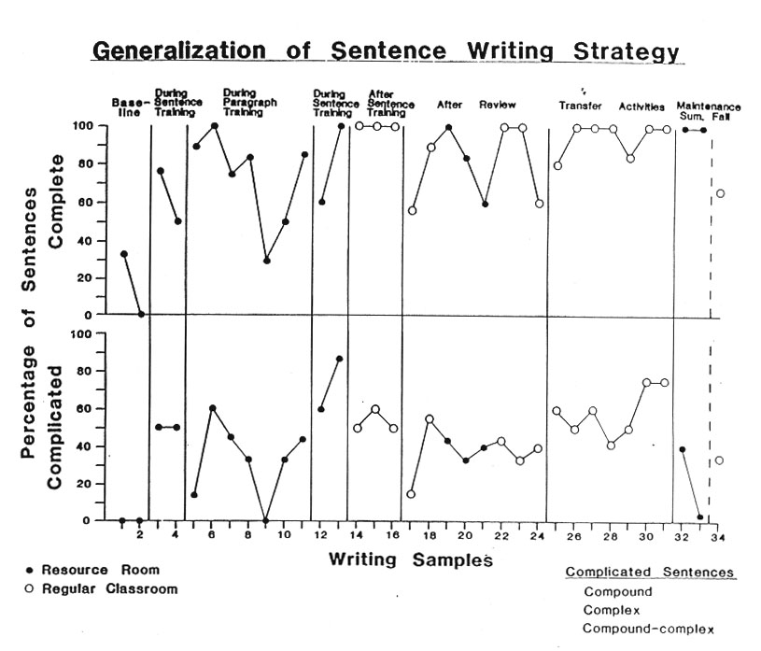
Notes:
The Challenge

Slide 15
Adaptation of Instruction
Instruction can be adapted:
Within one grade level
Across grade levels
To individual instruction
To small group instruction
To large group instruction
To the elementary level
To the secondary level
To the post-secondary level

Slide 16
Instructor’s Manual Contents
Introduction
Instructional Methods
Appendix A: Evaluation Guidelines
Appendix B: Instructional Materials
Appendix C: Enrichment Activities

Slide 17
Instructor’s Manual Contents
Instructional Methods
Stage 1: Pretest and Make Commitments
Stage 2: Describe
Stage 3: Model
Stage 4: Verbal Practice
Stage 5: Controlled Practice and Feedback
Stage 6: Advanced Practice/Post-test and Feedback

Slide 18
Instructor’s Manual Contents
Instructional Methods (cont.)
Stage 7: Make Commitments for Generalization
Stage 8: Generalization
Phase I: Orientation
Phase II: Activation
Phase III: Adaptation
Phase IV: Maintenance

Slide 19
Instructor’s Manual Contents
Instructional Methods
Stage 1: Pretest and Make Commitments
Stage 2: Describe
Stage 3: Model
Stage 4: Verbal Practice
Stage 5: Controlled Practice and Feedback
Stage 6: Advanced Practice/Post-test and Feedback
Stage 7: Make Commitments for Generalization
Stage 8: Generalization
For Parts
I, II, III,
and IV.

Slide 20
Student Folder Contents
Envelope
Pretest
Part I
Part II
Part III
Part IV

Slide 21
Student Folder Contents
Part I: Simple Sentences
Progress Chart
Assignment Sheet
Tabs for:
Cue Cards
Controlled Practice Attempts
Advanced Practice Attempts
Generalization Attempts

Slide 22
Student Folder Contents
Part II: Compound Sentences
Progress Chart
Assignment Sheet
Tabs for same items as Part I

Slide 23
Student Folder Contents
Part III: Complex Sentences
Progress Chart
Assignment Sheet
Tabs for same items as Part I

Slide 24
Student Folder Contents
Part IV: Compound-Complex Sentences
Progress Chart
Assignment Sheet
Tabs for same items as Part I

Slide 25
Instructional Sequence
for the Sentence Writing Strategy
Pretest for all Sentence Types
Go to Another Strategy
Mastery
Yes
No
Part I:
Simple Sentences
Mastery
No
Yes
Part II:
Compound Sentences
(Review Simple & Compound)
Mastery
No
Yes
Continue to Part III
Notes:
The Challenge

Slide 26
Instructional Sequence
for the Sentence Writing Strategy
Part III:
Complex Sentences
(Review Simple, Compound, & Complex)
Mastery
No
Yes
Part IV:
Compound-Complex Sentences
(Final Review)
Mastery
No
Yes
Go to Another Strategy
Notes:
The Challenge

Slide 27
Parts of the Instruction
Parts # of Types
Simple Sentences 4
Compound Sentences 2
Complex Sentences 2
Compound-Complex Sentences 6

Slide 28
Stages of Instruction
Stage 1:
Pretest
Go to Another Strategy
Mastery
Yes
No
Stage 2:
Describe
Stage 3:
Model
Stage 4:
Verbal Practice
Mastery
No
Yes
Continue to Stage 5
Notes:
The Challenge

Slide 29
Stages of Instruction
Stage 5:
Controlled Practice
Mastery
No
Yes
Stage 6:
Advanced Practice and Posttest
Mastery
No
Yes
Continue to Stage 7
Notes:
The Challenge

Slide 30
Stages of Instruction
To Stage 2
To Stage 6
Make Commitments
for Generalization
Stage 7:
During Activation Activities, students can start instruction on another sentence type.
Goal Set
No
Yes
Generalization
Orientation
Activation
Adaptation
Maintenance
Stage 8:
Mastery
No
Yes
Go to Another Strategy
Notes:
The Challenge

Slide 31
Selecting Students for the Proficiency in the Sentence Writing Strategy Program
Students must be able to write words legibly in print or script.
Students must be able to spell enough words such that a sentence can be deciphered by a teacher.
Students should be able to identify subjects and verbs.

Slide 32
Acquisition Stages
Stage 1: Pretest and Make Commitments
Obtain measures of current abilities
Make the student aware of inefficient/ineffective habits
Obtain student’s commitment to learn
Make a commitment to help the student learn

Slide 33
Acquisition Stages
Stage 2: Describe
Give rationales for using the strategy
Give general characteristics of situations
Solicit example situations
Describe results that can be expected
Supervise goal setting
Describe the steps of the strategy

Slide 34
Acquisition Stages
Stage 3: Model
Demonstrate the entire strategy “Thinking Aloud”
Involve the students in the demonstration

Slide 35
Acquisition Stages
Stage 4: Verbal Practice
Lead verbal elaboration exercise
Lead rapid-fire verbal rehearsal exercise
Require mastery

Slide 36
Acquisition Stages
Stage 5: Controlled Practice and Feedback
Supervise practice on writing sentences on worksheets
Provide positive and corrective feedback to individuals
Require mastery

Slide 37
Acquisition Stages
Stage 6: Advanced Practice, Posttest, and Feedback
Supervise practice on writing sentences about a topic
Provide positive and corrective feedback to individuals
Require mastery

Slide 38
Acquisition Stages
Stage 7: Make Commitments for Generalization
Review individual measures of progress
Make the student aware of progress
Obtain the student’s commitment to generalize

Slide 39
Topic List
My Favorite Superhero
The Best Movie Ever
Great Video games
Funny TikTok Videos
The Best TV Series
My Favorite Sport
My Favorite Subject in School
An Online Influencer I Like
Current Events
The Best Music

Slide 40
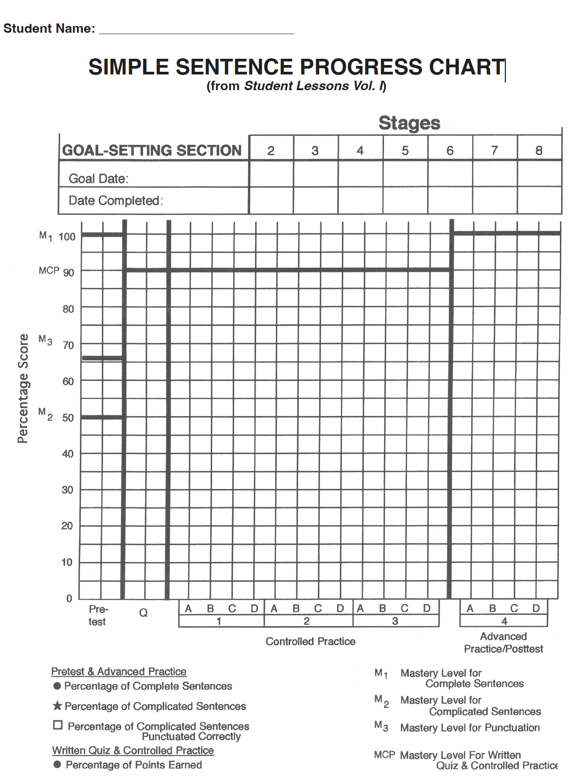
Notes:
The Challenge

Slide 41
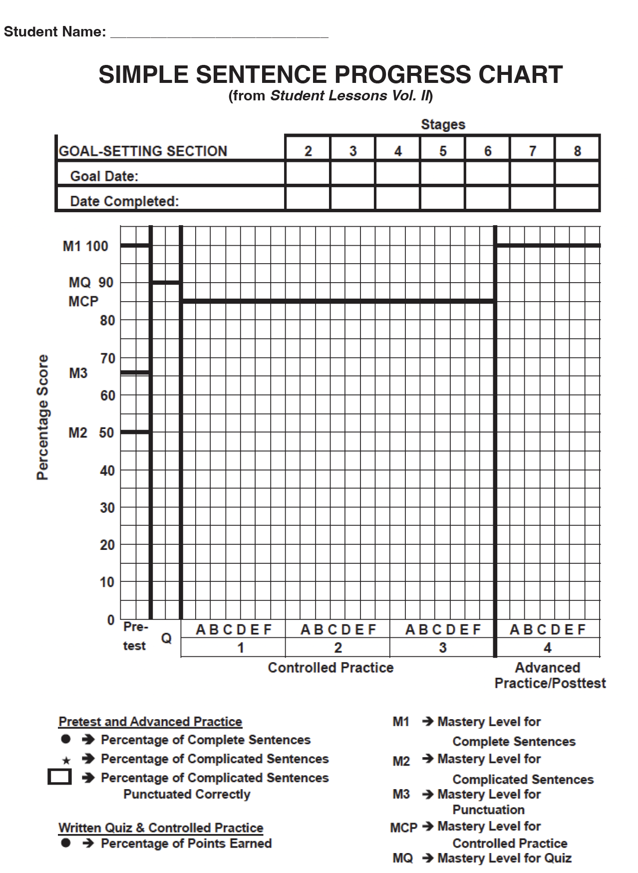

Slide 42
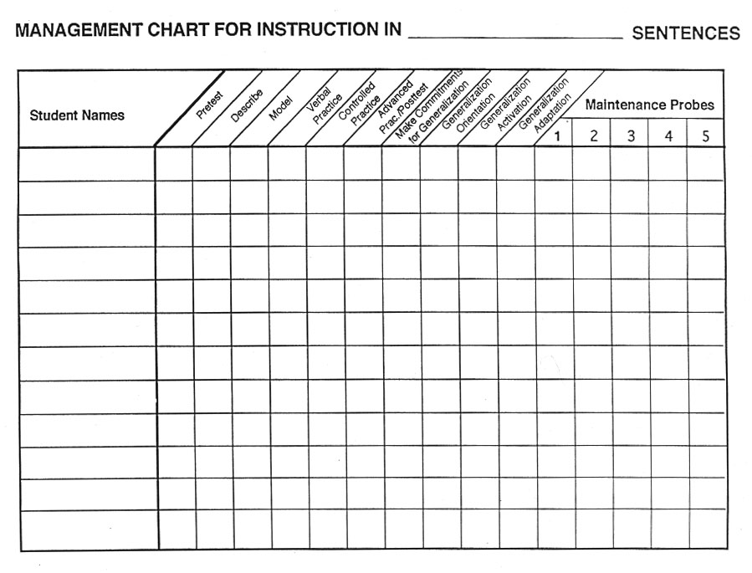
Notes:
The Challenge

