Slide 1
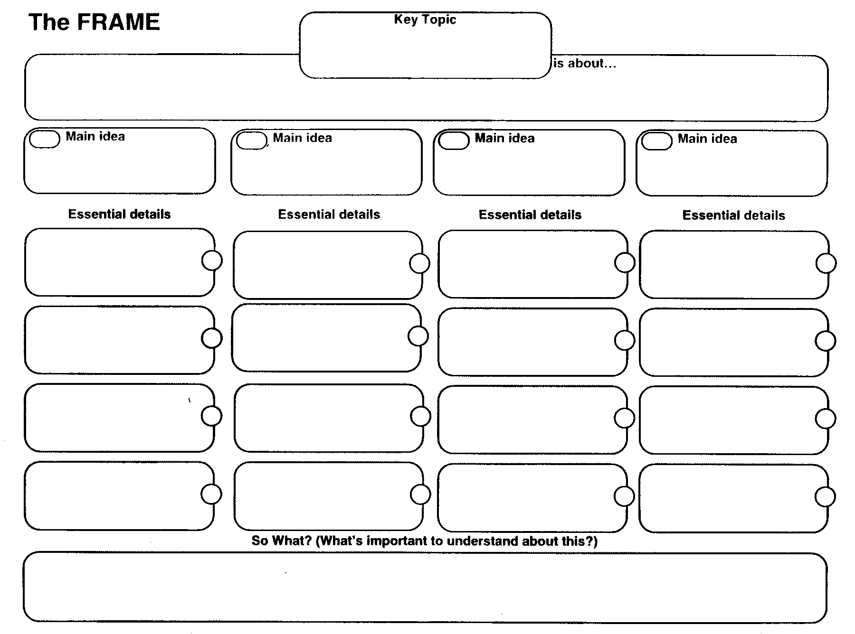
Realities of Adol. Lit.

