Slide 1
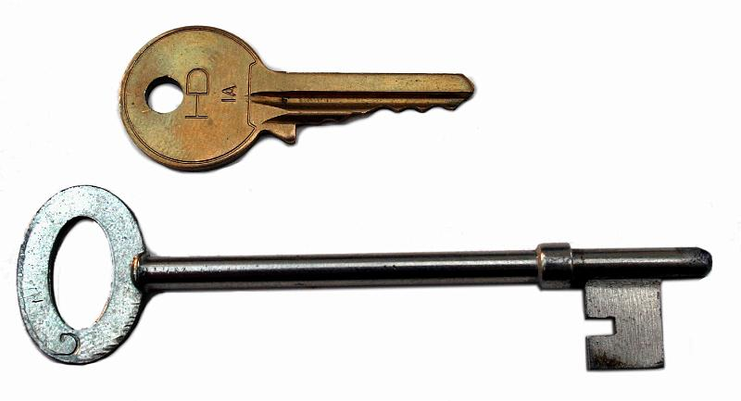
The Strategic Instruction Model Content Enhancement Routines Keys to Success
Deb Fagan, SIM Professional Developer
Source: StrateNet article (2000)

Slide 2
The Keys:
The routine is explicitly introduced to the whole class.
The routine is used regularly.
The routine is adapted to meet the needs of students, the teacher’s style, and the content of the lesson or course.
The use of the routine is varied to keep it motivating.

Slide 3
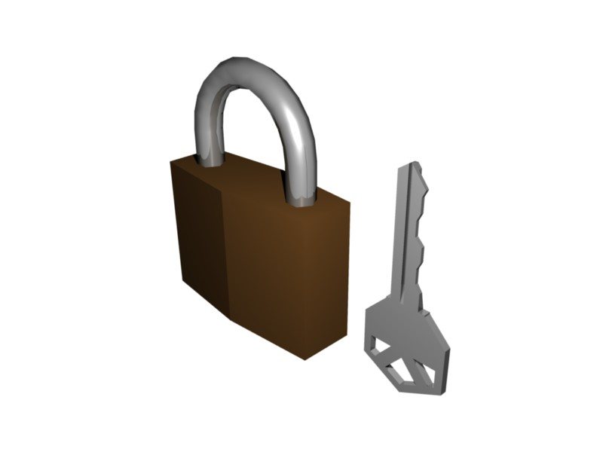
More Keys:
The routine is integrated with other powerful teaching tools to create synergy.
Students become active partners with the teacher in improving learning.

Slide 4
How to use classroom research to spread CER:
Select a concept, lesson, or unit that you will be teaching.
Select an experimental group; other sections of the same course can serve as your control group.
Plan implementation of a selected teaching routine.
Implement the teaching routine with your experimental group.

Slide 5
Collect data and log observations.
Share your results and findings with others!
Colleagues, administrators, specialists, department heads, curriculum directors etc..

Slide 6
Teacher generalization of CER +++Good signs:
Preparation of the device is part of regular planning and devices are immediately and naturally considered as part of the overall teaching approach.
The device is used for helping students understand different levels of the content.
Class discussions emerge about how learning is taking place; why learning is easy or difficult, and how learning could be enhanced.
The teacher talks with the students about how the device helps them use strategies for learning.

Slide 7
+++Good signs:
The device is used consistently throughout the year; students tend to see the routine as a “comfort zone” for learning and taking risks to learn.
Students know about the device and immediately know how to collaborate with the teacher.
Extensive use of the routines promote reflective planning and more successful teaching.
The information on the device is used repeatedly in important ways during instruction.
The information on the device is a part of the evaluation of learning.

Slide 8
Student generalization of CER +++Good signs:
Students know all about the devices after several uses and don’t need directions on how the routine will be used in class (questions are about content).
Students are jumping ahead and predicting what is coming next.
Students plan how the device could be used to help them learn the content where the teacher is NOT using the routine.
Students are excited at the opportunity to study and understand important and difficult content.
Students can lead the teacher through the routine.

Slide 9
+++Good signs:
Students can explore the content using the process without having to use the specific device.
Students can take the information presented on the device to complete assignments and tasks that demonstrate competence and understanding.
Students recognize the value of a device and even request that the teacher use one to help them learn.
Every student in a class sees a way to use the device to promote learning.

Slide 10
Warning Signs…
Students are lost when the device is used.
Students are not aware that the device is being used to help them learn: they must be dragged through by the teacher; only some students are participating/partnering.
Students moan when teacher cues the routine.
Students complain that the routine is a waste of time or too hard.
Students make few attempts to take notes or complete any work related to the device.

Slide 11
---Warning signs:
Students cannot explore the content without the use of a specific graphic, manipulation of the CER device by the teacher confuses them.
Students cannot explain the information on the device; they cannot take the information from the device and use it in different ways.
Students do not see the device as a tool they can use to help organize information and perform learning tasks.
Students do not see the strategy behind the use of the device and the routine; they see them as useful only to other students.

