Slide 1
The Listening and Note-Taking Strategy
Gwen C. Berry, Ph.D.
Donald D. Deshler, Ph.D.
Jean B. Schumaker, Ph.D.

Slide 2
In this strategy, students learn to…
Identify important information during a lecture,
Write quickly while listening to a lecture,
Sort main ideas and details as they write, and
Study the information so they can earn the best test grades possible.

Slide 3
Unique features of the strategy
Provides an organized system for taking and studying notes
Can be learned in a short period of time (5, 50-minute sessions)
Designed for use in any classroom
Subject-matter classes (e.g. science, social studies, English, math, art, music)
Supplemental skill-based classes (resource room, supplemental reading class, ELL class)

Slide 4
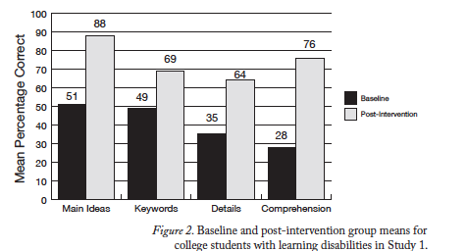
Major research findings (College students with LD)
College students with LD can significantly improve their comprehension and note-taking performance after four hours of instruction.

Slide 5
Major research findings (9th graders in general and special education)
After learning the strategy, all students improved the mean number of main ideas recorded in their notes
 | Pretest (Mean % Correct) | Posttest 2 (Mean Percent Correct)
Gen Ed Experimental | 11% | 99%
Gen Ed Comparison | 16% | 97%
SPED Experimental | 11% | 97%
SPED Comparison | 8% | 96%

Slide 6
Major research findings (9th graders in general and special education)
After learning the strategy, all students improved the mean number of key words recorded in their notes
 | Pretest (Mean % Correct) | Posttest 2 (Mean Percent Correct)
Gen Ed Experimental | 62% | 82%
Gen Ed Comparison | 72% | 83%
SPED Experimental | 52% | 66%
SPED Comparison | 62% | 72%

Slide 7
Major research findings (9th graders in general and special education)
After learning the strategy, all students improved the mean number of details recorded in their notes
 | Pretest (Mean % Correct) | Posttest 2 (Mean Percent Correct)
Gen Ed Experimental | 43% | 70%
Gen Ed Comparison | 55% | 72%
SPED Experimental | 34% | 54%
SPED Comparison | 47% | 57%

Slide 8
Learning Strategies Curriculum

Slide 9
Overview of the manual
Manual consists of 4 lessons
Lessons 1-3 provides instruction in taking notes (the NOTeS Strategy)
Lesson 4 provides instruction in studying notes (the GRADE Strategy)
Appendix A: Instructional materials (cue cards)
Appendix B: Practice materials (lectures, quizzes)
Appendix C: Quiz answer keys

Slide 10
Each lesson contains…
An advance organizer
A describe and model sequence
Guided practice
Generalization practice
An opportunity to extend learning outside the class
An opportunity to discuss how students should be thinking as they use the strategy (“Metacognitive Moment”)

Slide 11
Lesson 1: Notice the Introduction and Observe Cues
What you’ll do:
Establish a purpose for learning the strategy
Set up folders for storing strategy materials
Provide an overview of the NOTeS Strategy
Learn the N and O Steps

Slide 13
NOTeS: Step 1 Notice the Introduction
Emphasize the importance of being present at the beginning of a class or lecture.
Discuss specific actions students should take when teachers:
Review information from a previous lecture
Make announcements
Begin a new lecture

Slide 14
NOTeS: Step 2: Observe Cues
Define a “cue” (a hint or clue)
Introduce & model Mannerism Cues (Cue Card # 2)
Introduce & model Organizational Cues (Cue Card #3)
Introduce and model Emphasis Cues (Cue Card #4)

Slide 16
