Slide 1
Why strategies?

Slide 2
Good afternoon Dr. Deshler. My name is Samantha, and I am emailing you because, as a part of my PhD program at the University of Central Florida, I am taking a Current Issues in Special Education course with Dr. Lisa Dieker. We have been given an assignment to interview a legend in the field. Your name was the first that came to mind.
First, I have to tell you about myself for you to understand why you came to mind so quickly. I was diagnosed SLD in my third grade year, about 1983. I was in a self-contained classroom in elementary, middle school, and in most of my high school classes. In high school, the state of Florida mandated in the 1990's that all SLD students take two years of SIM/ Kansas Model. Those two years taught me more than any in my high school career. For the first time, I know where to put the comma because of sentence writing strategy. I used LINCS for vocabulary.
I gave community college a shot. I did pretty well, and when I had to declare a major, it was, of course, exceptional education. In my first five years of teaching, I was trained to teach Kansas Model as well. Since that time, I have taught student with mild disabilities, high school English for 15 years and obtained a masters, also in special education. I have taught English in four countries outside of the US, and I am now working on my PhD in Exceptional Education. You have had an impact on my life, so when asked what legend in the field I would choose; it was you. If you have time and are able to participate in a short interview, whether it be on Skype, on the phone, or be email, I would be honored to speak with you.
Project LEAD Scholar Doctoral Student University Of Central Florida

Slide 3


The Word Mapping Strategy
Presented by
Patricia Sampson Graner, Ph.D.
Delaware SPDG Work Session, Sept. 18 & 19, 2014

Slide 4
Problem
Struggling adolescent readers and writers do not possess all of the foundational skills and strategies to be proficient with disciplinary literacy

Slide 5
Solution?
Content teachers, literacy and other specialists collaborate to improve instruction first through general strategy instruction that can be ‘kicked up’ to transdisciplinary instruction.
Notes:
By transdisciplinary, we mean that there are several strategies that can be applied successfully across disciplines.

Slide 6
Who are Struggling Adolescent Learners?
70% of 8th and 12 graders scoring at or below basic in reading and writing on the NAEP (Graham & Hebert, 2010; NCES, 2009).
Students with adequate word recognition & fluency skills yet struggling with comprehension (Compton et al., 2008)
Students with an overall reading skill profile at or below the 40th percentile (Hock, Brasseur, Deshler, Catts & Marquis, 2005).
Students whose first point of service delivery is in the Tier 1 or GE classroom ( e.g., Graner, Faggella-Luby, & Fritschmann, 2005).
Notes:
Students may or may not have IEPs. The role of the SLP, however, is in Ensuring Education Relevance and Providing Unique Contributions to Curriculum. While their first concern is for the students addressed in regulations, the notion that SLPs impact many students is du to their ability to provide linguistic and metalinguistic foundations of curriculum learning.
http://www.asha.org/policy/PI2010-00317/

Slide 7



Our Students?

Slide 8





How many words a year do 5th graders who read at the 10th percentile read?
0
60,000
100,000
180,000
250,000
1 | 2 | 3 | 4 | 5 | 6 | 7 | 8 | 9 | 10 | 11 | 12 | 13 | 14 | 15 | 16 | 17 | 18 | 19 | 20
21 | 22 | 23 | 24 | 25 | 26
  (Hayes & Ahrens, 1988)

Slide 9
How many words a year do 5th graders who read at the 50th percentile read?
0
250,000
400,000
600,000
900,000
1 | 2 | 3 | 4 | 5 | 6 | 7 | 8 | 9 | 10 | 11 | 12 | 13 | 14 | 15 | 16 | 17 | 18 | 19 | 20
21 | 22 | 23 | 24 | 25 | 26
  (Hayes & Ahrens, 1988)

Slide 10
How many words a year do 5th graders who read at the 90th percentile read?
0
1,800,000
2,500,000
3,000,000
4,000,000
1 | 2 | 3 | 4 | 5 | 6 | 7 | 8 | 9 | 10 | 11 | 12 | 13 | 14 | 15 | 16 | 17 | 18 | 19 | 20
21 | 22 | 23 | 24 | 25 | 26
  (Hayes & Ahrens, 1988)
Notes:
These exponential differences do not bode well for students who are challenged by the

Slide 11
Focus: Vocabulary underpinnings
One of five core components of reading instruction (National Reading Panel, 2000).
Word knowledge varies:
  Socioeconomic background
  Home language
  Community language
  Language learning disability
      (Beck, McKeown & Kucan, 2002)
Notes:
Hello. Thank you for attending today.
Vocabulary undergirds learning for all of throughout lie. Indeed it is identified as one of the core components of reading. The others: phonics (connection between sounds and letter symbols), phonemic awareness (understanding that words are created from small units of sound in language) , reading comprehension (understanding what the text is all about) and fluency (speed, accuracy and expression) work with vocabulary to create the reading experience.
Vocabularies can be limited by socioeconomic standing, or home language or community language, or because of a learning disability. Establishing some ways to shore it up will be helpful in academic or work situations. In fact, many jobs have specific vocabulary requirements for success in the work. Real word ability and vocabulary are correlated.
The Armed Forces Qualification Test is used to predict real word job performance fairly accurately when the two verbal section scores (vocabulary size and paragraph comprehension) are doubled.

Slide 12
Focus: Vocabulary underpinnings
Word knowledge growth is slow and incremental (Hirsch, 2003; Stahl, 2004)
Multiple exposures to words in multiple contexts is required for understanding, remembering, and application (Nagy, 2005)
Knowledge of 90-95% of words in text necessary for adequate reading comprehension (Hirsch, 2003).
Notes:
Because vocabulary development requires multiple exposures to words in many contexts or in various ways, growth is incremental and can take time. When reading comprehension is key to success of understanding or to being successful in a job, vocabulary study needs to be effective and efficient.
When you picture a page in a book that you have recently read, think about how many of the words you knew to support your comprehension of what you read. Now think about adults in your programs and consider how they are faring in the reading of text when it is very unlikely that they possess sufficient vocabulary to read adequately. How does this limit their life goals?
These make the case for establishing a way to study vocabulary. – improving life’s chances.

Slide 13
Focus: Vocabulary underpinnings
“Matthew Effect” good readers continue to improve, poor readers fall farther behind (Stanovich, 1986).
Students should add about 2,000 to 3,000 new words per year (Beck, McKeown & Kucan, 2002; Hayes & Ahrens, 1988).
Students entering school with limited vocabulary may possess four times fewer words than high-performing students by 12th grade (Hart & Risley, 1995).
Notes:
Three last points about vocabulary:
Unfortunately, with reading and vocabulary, the ‘Matthew Effect’ can occur – the rich get richer and the poor get poorer. In other words, good readers easily profit from exposure to vocabulary words. They have a schema for where to store and how to use new words for later use. Their comprehension and understanding of the context of new vocabulary is not as challenging for them.
During school years, students typically add many new words to their vocabulary, and if they arrive without the previously named limits, then they will usually be successful in school and beyond. However, students entering school with the limits pointed out earlier will start with fewer words in their vocabulary, may be less likely to have a schema for where new vocabulary fit, and may not be able to keep up and add those 2000-3000 new words each year.
If this is the case, that student will struggle in school and beyond into their careers. In fact, it may limit their careers they can pursue or limit their advancement in their careers (re: CNA to LPN and beyond; beginning chef to master chef or sous chef; passing licensing to be an electrician or plumber).

Slide 14
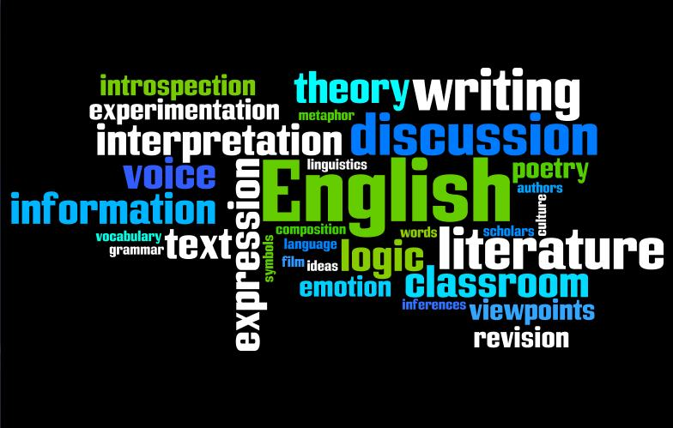

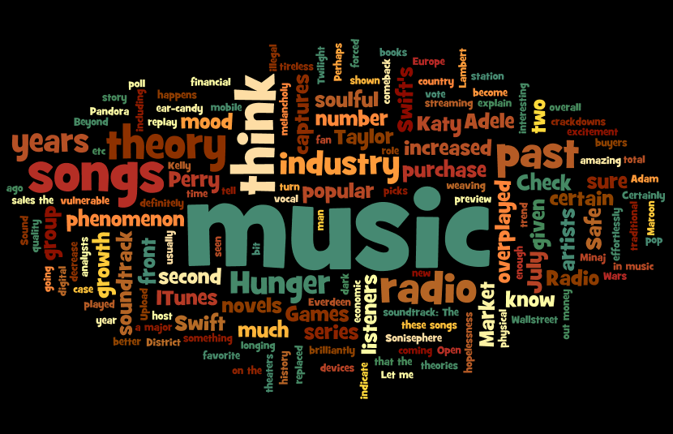
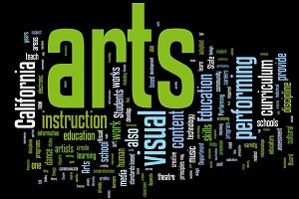
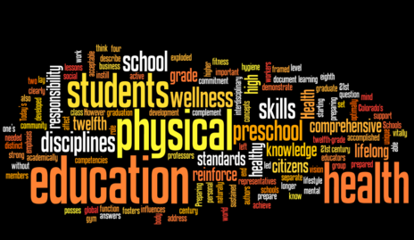



Slide 15
Every course has critical vocabulary …
exponent, logarithm, inverse, radius, postulate, polynomial, vector, transversal, rotation, algorithm
immigration, maritime, segregation, transformation, climate, diffusion, foreign
conservatism, exodus,
evaporation, recycle, chemical, homeostasis, oxidization, organism, radioactive, decibel spontaneous, seismic
muscular, nutrition, freestyle, endurance, resistance, opponent, flexibility, equilibrium,
cardiorespiratory
improvisation, tempo contemporary, choreographic, complementary, projection, meter
thesis, rhetorical, satire, allegory, context, mythology, inflection, narrator,
salutation, dialect
Math
English Language Arts
Social Studies
Science
Physical Education
The Arts

Slide 16

Research: Understanding words is the key to comprehension
IF students do not adequately and steadily grow their vocabulary knowledge, reading comprehension will be affected. Chall and Jacobs, 2003

Slide 17
Your Assignment:
Use your advanced skills as readers to read the following passage silently.
When you are finished reading, write the main idea of the passage on the back of your handout. You will have 2 minutes to finish the task.

Slide 18
A new variant of Creutzfeldt-Jakob Disease (CJD) with a unique clinicopathological presentation may be linked to the disease bovine spongiform encephalopathy (BSE) in British cattle. Similar clinical, molecular, and neuropathological features have been observed in three BSE-infected macaque monkeys and 12 human cases of vCJD. In the human cases, spongiosis was evident in the striatum and thalamus, and was present in cortical areas and in the cerebellum. Abundant florid plaques, large cortical deposits of pathological prion protein, were present in both the macaques and the humans. The study provides evidence that the BSE agent in macaques is identical to that of vCJD in humans.

Slide 19

The
WORD MAPPING STRATEGY
will help students
UNDERSTAND
Notes:
See next slide

Slide 20

Let’s start by looking at parts of words

Slide 21
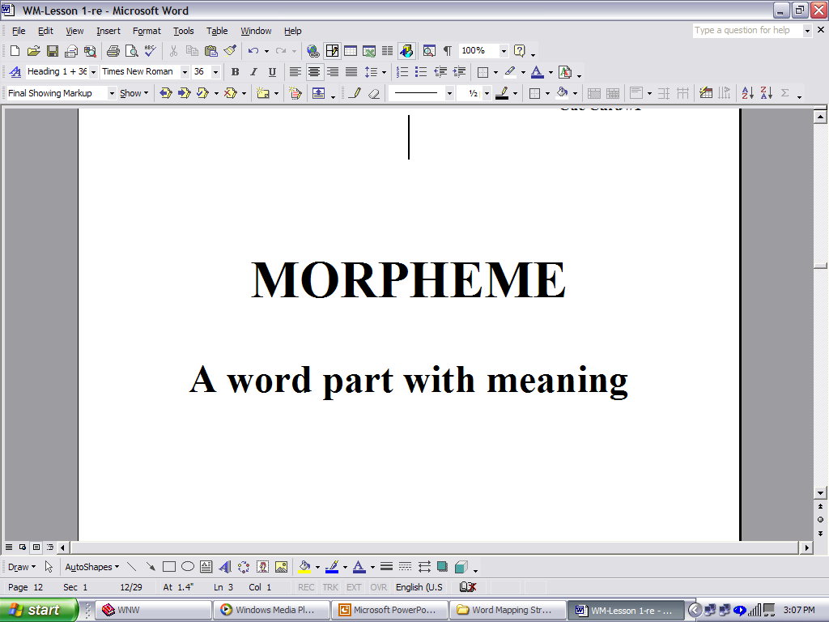
Words are made of word parts called morphemes.

Slide 22
“un-” is a common morpheme; we see it in a lot of words.
Unable
Unafraid
Unreal
Uncluttered
Unexpected
Unbuttoned
What does the morpheme “un-” mean?

Slide 23
Morphemes are different from syllables.
Syllables are word parts centered on a vowel sound that have no meaning.

Slide 24
Morphemes vs. Syllables
Let’s look at the word “Unladylike”
Syllables
un- la- dy- like
Morphemes
un lady like
4 syllables
3 morphemes

Slide 25
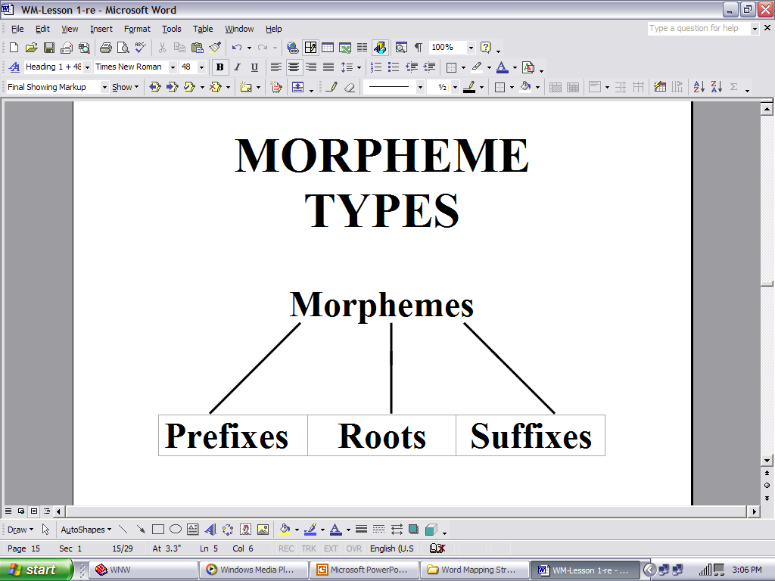
unamicable
un- amic -able

Slide 26
The Word Mapping Strategy
Is the name of the strategy
that will help students
learn all about
prefixes, suffixes and roots.

Slide 27
Let’s start with Prefixes
Prefixes are placed at the
beginning of a word.
Prefixes change the meaning of the word.

Slide 28
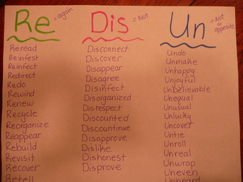
Some common prefixes are
“-re”, “-dis”, and “-un”
Each has a meaning

Slide 29
Challenge Question:
How many prefixes can you think of in one minute?

Slide 30

Watch for Tricksters!
Tricksters
Words that start with the same letters as prefixes but don’t really have prefixes.

Slide 31
Check out this word …
READ
It looks like it has the prefix “re” ………but does it?

Slide 32
Compound Prefix
words containing two or more prefixes.
These words have compound prefixes:
un•re•fillable
un•im•pressed

Slide 33
Activity
Turn to your
neighbor
and note some
words with
compound prefixes.

Slide 34

Let’s take a Suffix

Slide 35
Suffixes
Are morphemes that are at the
end of a word.

Slide 36
A word that has the suffix “-able” is
Loveable
The suffix “-able” means can do or can be done.

Slide 37

There
are
Types
Of
suffixes
Inflectional
Derivational

Slide 38
Inflectional suffixes are morphemes that change:
Number
Point of view
Tense
OR show
Possession (ownership) or comparison

Slide 39
The suffix “s” means more than one.
Book Books
Teacher Teachers
Banana Bananas
Police Car Police cars

Slide 40
Inflectional suffixes do not change the meaning of the word.
Book Books
Teacher Teachers
Banana Bananas
Police car Police cars

Slide 41
Derivational suffixes create a different form of a word, so the meaning of the word is changed.
Teach Teacher
Diction Dictionary
Victor Victory

Slide 42

-er
-en
-ing
There
are
Suffixes
that are
both
Inflectional
and
derivational
Er – Belonging to, associated with (Farmer, smaller)
En – To become, or made of (Lengthen, wooden)
Ing – Something used in the action or process of (Lining, sleeping)

Slide 43

When adding suffixes remember these
(or Guidelines?)

Slide 44
When adding suffixes to words that end in “y”
If the letter before a final y is a vowel, the y doesn’t change when you add a suffix.
(Example: Play Playing)
If the letter before a final y is a consonant, the y changes to an i before you add the suffix.
(Example: Carry Carried)
EXCEPT when the suffix begins with an i.
(Example: Carry Carrying)

Slide 45
When adding suffixes to words that end in a single consonant with a single vowel in front of it (VC) …
Double the consonant if the suffix begins with a vowel.
(Example: Fit Fitting)
Don’t double the consonant if the suffix begins with a consonant.
(Example: Fit Fitness)

Slide 46
Another word that fits the
“consonant doubling guideline” is:
Run

Slide 47
The term compound suffix refers to more than one suffix at the end of the word.
Helplessness
Endlessly
Loveliness
Professionalism
Respectability

Slide 48
Challenge Question:
Can you think of two more words with a compound suffix?

Slide 49

Let’s
The 3 types of Morphemes

Slide 50
The 3 types of morphemes are:
Prefixes
Roots
Suffixes

Slide 51
Roots
Can be at the:
Beginning,
Middle,
End of a word.
or
Roots can be the entire word.

Slide 52
Roots can be located at the beginning, middle, or end of a word.
A root can stand alone as the whole word.
SCOPE
Scoped Microscopic Telescope

Slide 53

If you are wondering about a word’s meaning …
(Hint: Look for the root. Each root gives a word it’s main meaning.)

Slide 54

For example: Root words
“Aster” or “astro” mean star.
Asteroid
Astronaut
Astrosphere
Astronomy
Asterisk

Slide 55
One morpheme can have several meanings.
“Arch” can mean chief, most important or rule.
Examples:
Archbishop, Archenemy, Matriarch

Slide 56
Different morphemes can have the same meaning but different forms.
(Example: “micro” and “min” both mean small.)
Different morphemes can have the
same meaning
but similar forms.
(Example: “aster” and “astro” both mean space.)

Slide 57
Practice in Manual
• Guided practice identifying prefixes, roots, & suffixes (Worksheet #1)
• Independent practice identifying prefixes, roots, & suffixes (Worksheets #2, 3, 4)

Slide 58
Your Practice with Manual
Examine Lesson 3 – p. 28 -32
Complete Word Mapping Notes Sheet # 3 (p. 136)
  Key p.188
Complete first 2 rows of Identifying Morphemes Worksheet #1 – p.140
  Key p. 191
How did you do?

Slide 59

Now let’s check out the strategy.
at the strategy steps listed in your KLP handout.

Slide 60
Word Mapping Strategy
Map the word parts
Attack the meaning of each part
Predict the word’s meaning
See if you’re right!

Slide 61
means that you find the word’s prefixes, suffixes, and roots.
Map the word parts

Slide 62
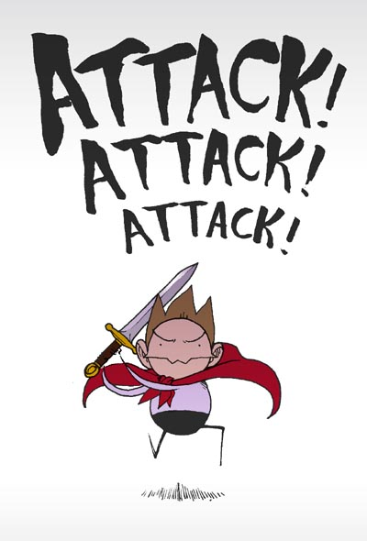
means that you translate each word part into its meaning.
Attack the meaning

Slide 63
means that you put the three meanings together and make your best guess.
Predict the word’s meaning

Slide 64

means check whether the definition fits in the context of the sentence
See if you’re right

Slide 65
The mnemonic device to remember the steps is:
M
A
P
S

Slide 66
Word Mapping Strategy
Map the word parts
Attack the meaning of each part
Predict the word’s meaning
See if you’re right!

Slide 67
You use a Word Map anytime you want to figure out a word’s meaning.
Word
Prefix
Root
Suffix
M Step
A Step
P Step
See if you’re right!
Meaning
Meaning
Meaning
Prediction
Definition

Slide 68
Word Map
Word
synchronize
Prefix
Root
Suffix
M Step
A Step
P Step
S ee if you’re right!
syn
chron
ize
Meaning
Meaning
Meaning
with, together
time
make
Definition
Making time together
Let's do one!

Slide 69
Use the Word Mapping worksheet to map three of the following words:
Immobile
Vitality
Cognition
Collect
Reloaded
Uncomfortable
Bisection
Hydrophobia

Slide 70
Tips for Success:
Focus on the use of high frequency prefixes, suffixes, and roots.
Use roots with large word families.

Slide 71
Tips for Success:
Track progress together with the Progress Chart – p. 120

Slide 72
How can you do on the Post-test?
Post test A
Try without the Prefix, Root, and Suffix lists
Check yourself
What will students find challenging?
What will you find challenging?

Slide 73
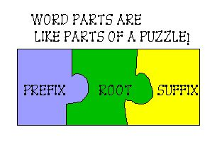
Figuring out the puzzle of words will give students POWER over words.

Slide 74

Is yours with the Word Mapping Strategy

Slide 75
Other resources:
www.myvocabulary.com
  Provides vocabulary tests and games.
www.quizlet.com
  Develops tools to study vocabulary..
www.edhelper.com
  Teaching worksheets in a variety of areas including vocabulary.
www.flocabulary.com
  Educational hip-hop that includes vocabulary units.
www.wordsmyth.net
  Leveled dictionaries – quizzes and games
  Google Membean
  Studystack
  Wordsift
  App - Wordstack

Slide 76
References
Beck, I. L, McKeown, M. G., & Kucan, L. (2002). Bringing words to life: Robust vocabulary instruction. New York: The Guilford Press.
Biemiller, A. (2001). Teaching vocabulary, early, direct and sequential. American Educator, 25, 24-28.
Chall J. S. & Jacobs, V. A. (2003). Poor children’s fourth-grade slump. American educator. American Federation of Teachers.
Ellis, E.S. (1992). The vocabulary (LINCS) strategy. Lawrence, KS. Edge Enterprises, Inc.
Ellis, E. S. (2001). The vocabulary LINCing routine. Lawrence, KS. Edge Enterprises, Inc.
Harris, M.L., Schumaker, J.B., & Deshler, D. D. (2011). The effects of strategic morphological analysis instruction on the vocabulary performance of secondary students with and without disabilities. Learning Disabilities Quarterly, 34(1), 17-33.
Hart, B., & Risley, T. (1995). Meaningful differences in the everyday lives of young American children. Baltimore: Paul H. Brookes.
Hirsch, E. D. (2003). Reading comprehension requires knowledge – of words and the world. American Educator, American Federation of Teachers.
Marzano, R. J. (2004). Building background knowledge for academic achievement: Research on what works in schools. Alexandria, VA: ASCD.
Nagy, W. E. (2005). Why vocabulary instruction needs to be long-term and comprehensive. In E. H. Hiebert & M. L. Kamil (Eds.), Teaching and learning vocabulary: Bringing research to practice (pp. 27–44). Mahwah, NJ: Erlbaum.National Reading Panel (2000). Report of the National Reading Panel. Washington, DC: NICHD.
Stahl, S.T. (2004). Vocabulary learning and the child with learning disabilities. Perspectives, 30,1. The International Dyslexia Association.
Stanovich, K. E. (1986). Matthew effects in reading: Some consequences of individual differences in the acquisition of literacy. Reading Research Quarterly, 21.
Notes:
I want to thank my colleague Devona Dunekack at the University of Kansas for the work that she has shared from a DOL project in the past. She was the lead in the effort to build a vocabulary module. We referred back to that work for the examples used here since they were developed for adults in that project.

Slide 77
Contact
Patty Graner
University of Kansas Center for Research on Learning
1122 West Campus Road
517 JRP
Lawrence, KS 66044
785-864-0622
785-864-0626
pgraner@ku.edu

