Slide 1
Word Mapping Strategy
By Monica Harris, Jean B. Schumaker, and Donald D. Deshler
This PowerPoint for teaching the Word Mapping Strategy was developed by the FL SPDG SIM Project to support implementing teachers.
Notes:
These materials are intentionally left plain, so that teachers can add their own personalities to the presentation.

Slide 2
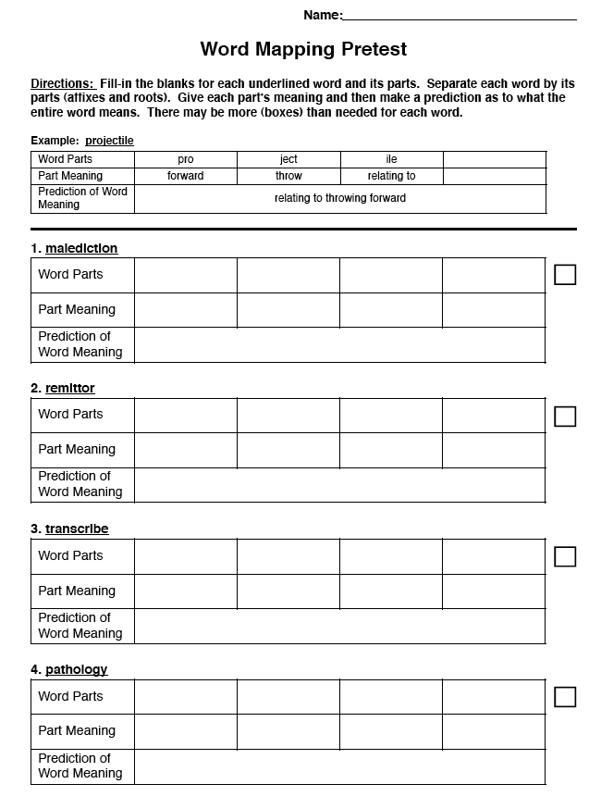
Pretest
Purpose: to determine how well you can identify word parts, know the meaning of word parts, and can predict the meaning of words
Notes:
Instructor Manual pg. 11

Slide 3
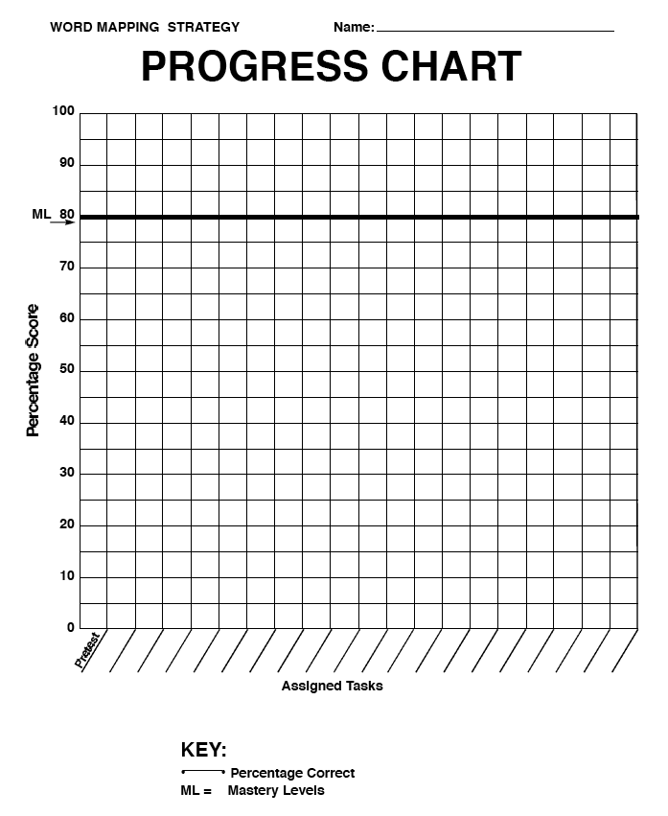
Plot your pretest score
with a filled in circle
Notes:
Instructor Manual pg. 12

Slide 4
Lesson 1: Intro and Prefixes
Essential Questions
What is the Word Mapping Strategy?
What is the definition of a morpheme?
How is a morpheme different than a syllable?
What are the 3 types of morphemes?
What is the definition of a prefix?
What are some examples of prefixes?
What is a compound prefix?
How do you identify and pronounce common prefixes?
Notes:
Pg. 14

Slide 5
Notes:
Pg. 15

Slide 6
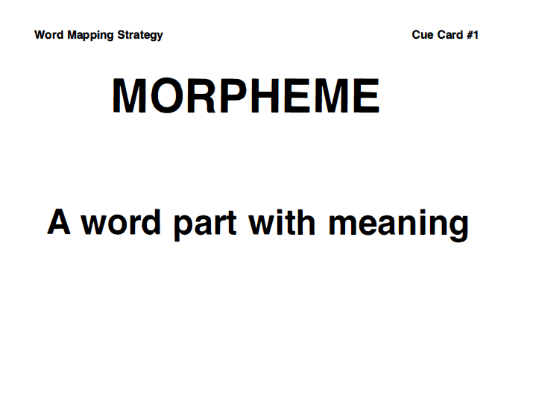
Notes:
Pg. 15

Slide 7
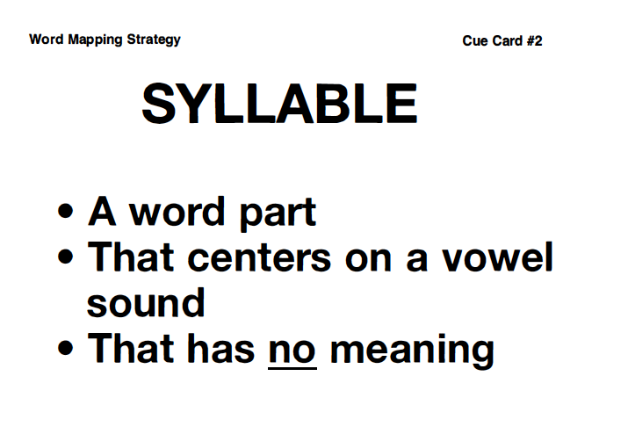

Slide 8
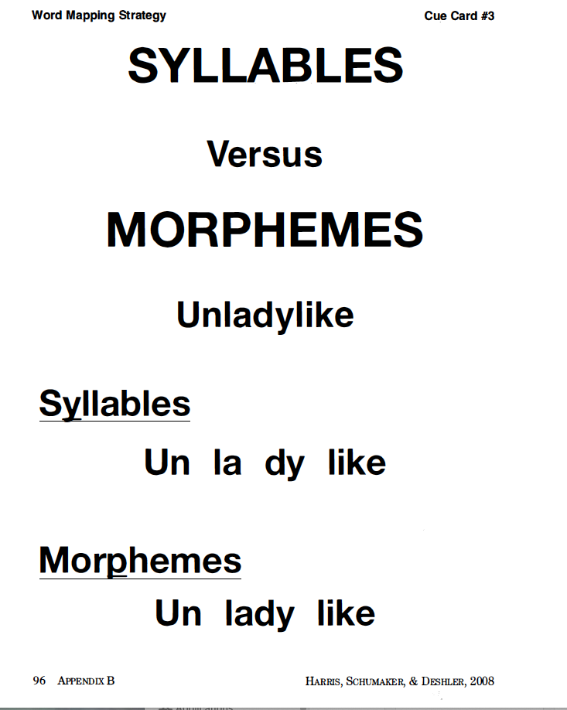
Notes:
Pg. 15

Slide 9
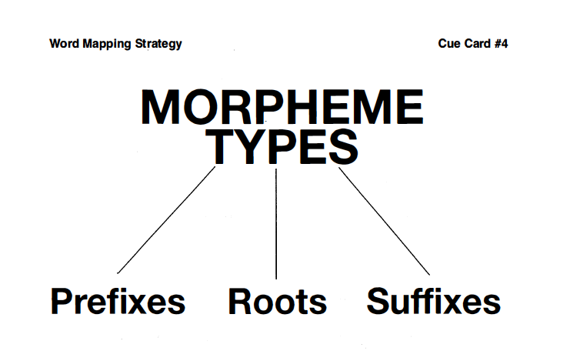
Notes:
Pg. 16

Slide 10
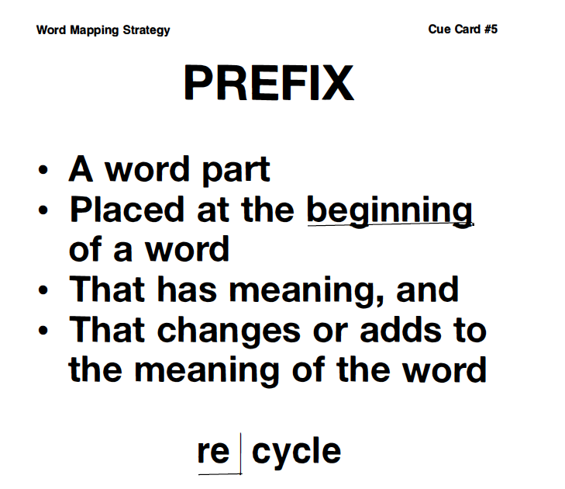
Notes:
Pg. 16

Slide 11
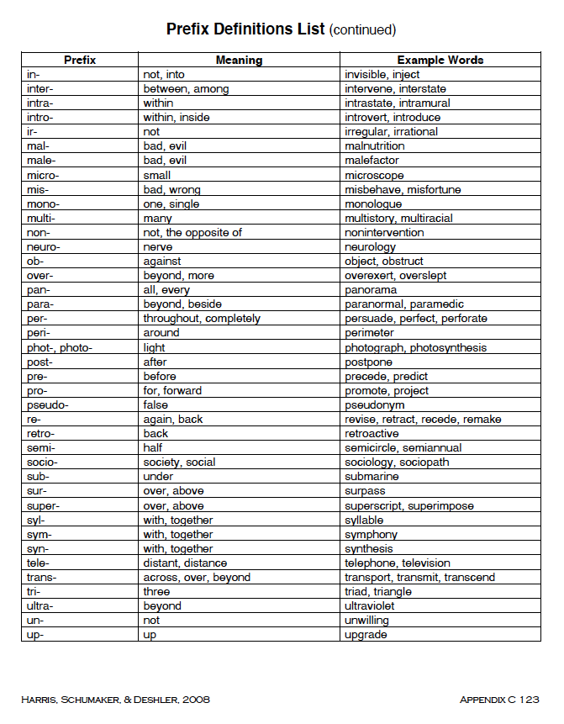
Notes:
Pg. 16

Slide 12
Tricksters?
Red Return Recycle Real
Notes:
Pg. 18

Slide 13
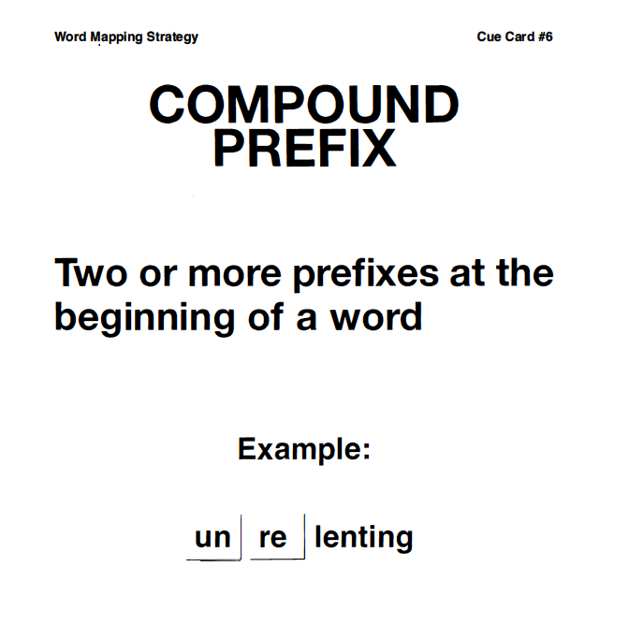
Notes:
Pg. 18

Slide 15
Plot Isolate the Prefix Worksheet Scores
Notes:
Instructor Manual pg. 19

Slide 16
Pronouncing Prefixes
Mastery is 90%
Notes:
Pg. 19

Slide 17
Review of previous information
What is the definition of “morpheme”?
What are three types of morphemes?
What is the definition of “prefix”?
What is the definition of “compound prefix”?
What are some example prefixes?
What are some example words with prefixes?
Notes:
Pg. 22

Slide 18
Lesson 2: Suffixes
Essential Questions
What is a suffix?
What are some common suffixes?
What are the two types of suffixes?
What are compound suffixes?
Notes:
Pg. 21

Slide 19
Notes:
Pg. pg. 22

Slide 20
Notes:
Pg. 22

Slide 21
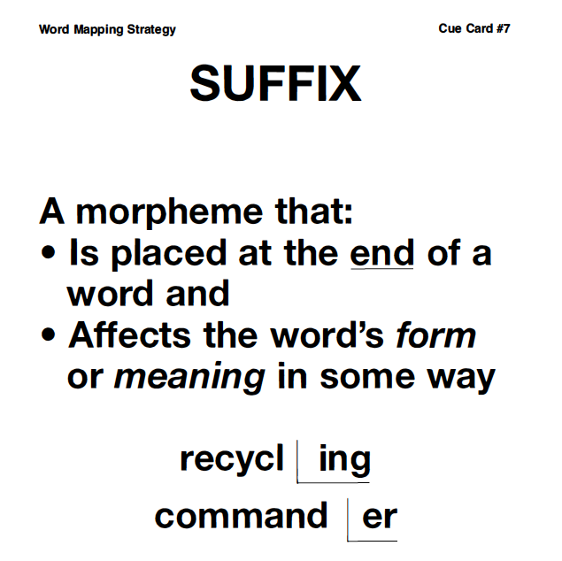

Slide 22
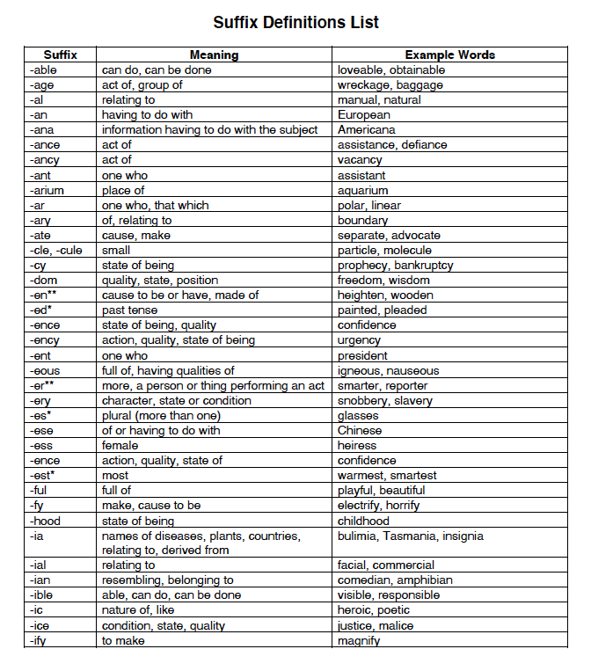
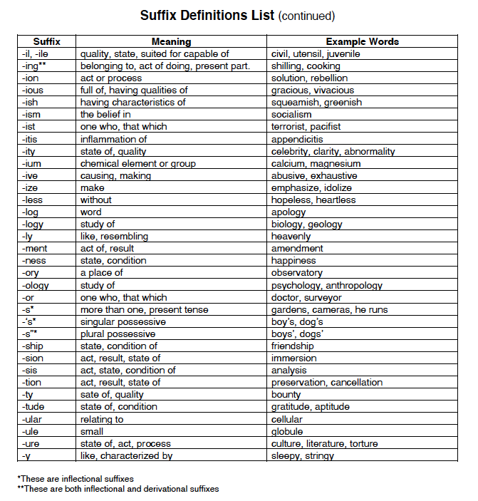
Notes:
Pg. 22

Slide 23
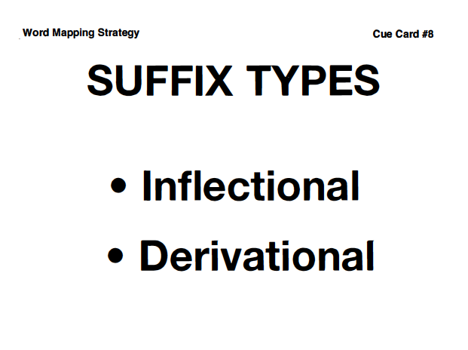
Notes:
Pg. 23

Slide 24
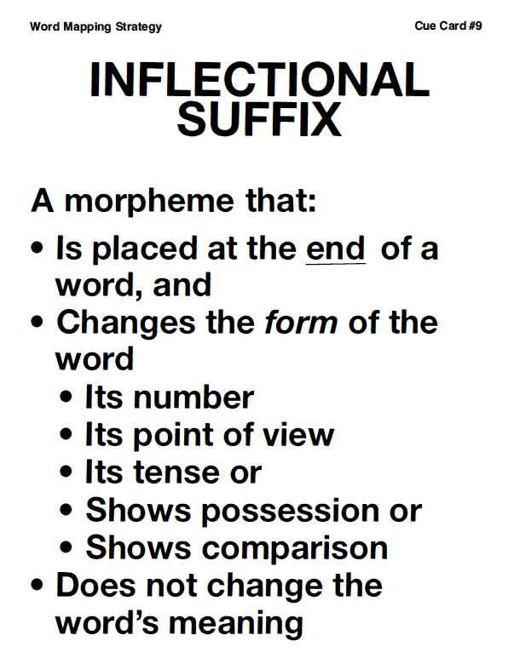
Notes:
Pg. 23

Slide 25
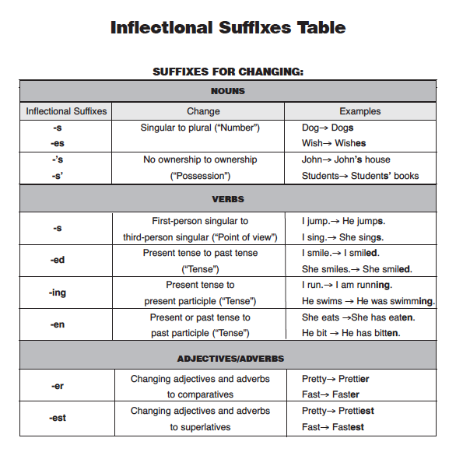
Notes:
Pg. 23

Slide 26
Notes:
Pg. 24

Slide 27
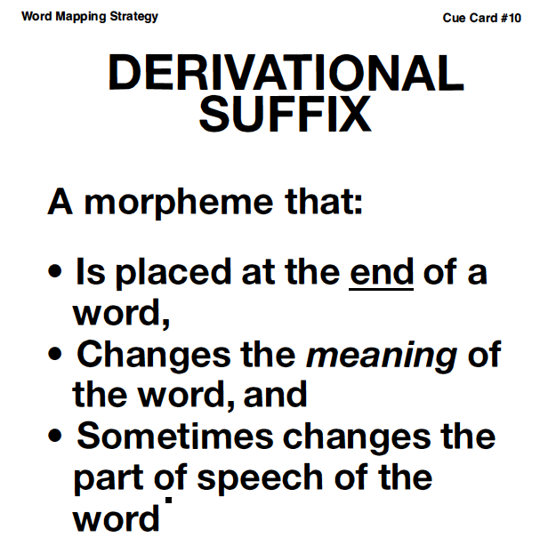
Notes:
Pg. 24

Slide 28
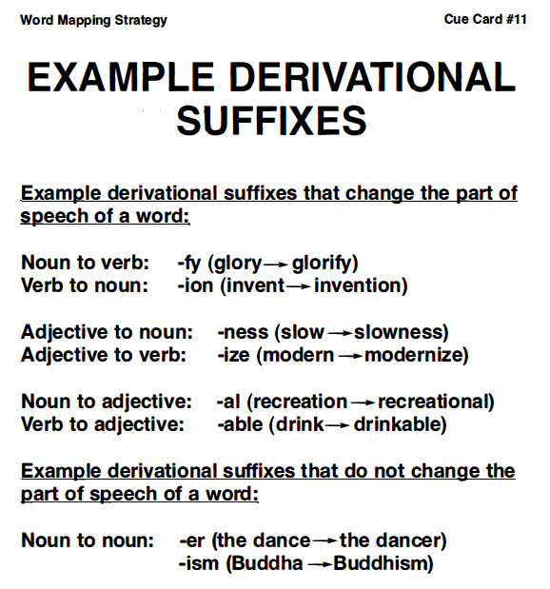
Notes:
Pg. 24

Slide 29
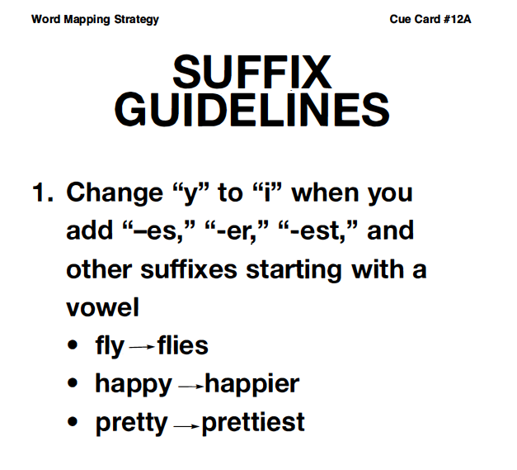
Notes:
Pg. 25

Slide 30
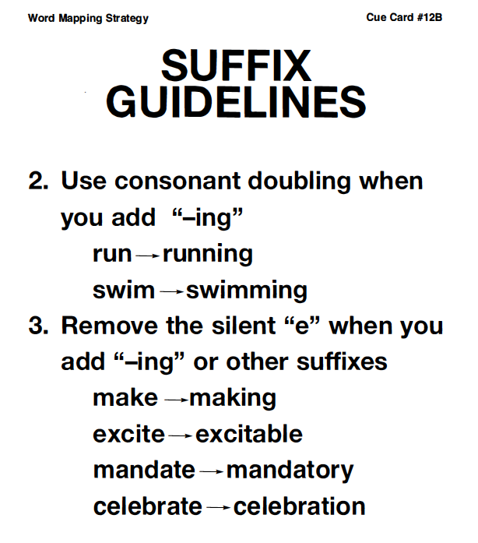
Notes:
Pg.25

Slide 31
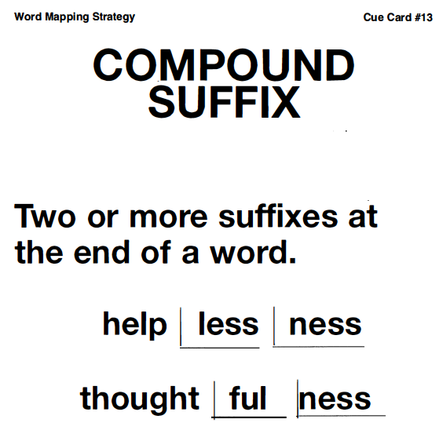
Notes:
Pg. 25

Slide 32
Notes:
pg. 25

Slide 33
Plot Isolate the Suffix Worksheet Scores
Notes:
Instructor Manual pg. 26

Slide 34
Pronouncing Suffixes
Mastery is 90%
Notes:
Pg. 26

Slide 35
Review of previous information
What is the definition of “morpheme”?
What are three types of morphemes?
What is the definition of “prefix”?
What is the definition of “suffix”?
What is the definition of “compound prefix” and “compound suffix”?
What are some example prefixes?
What are some example words with prefixes?
What are some example suffixes?
What are some example words with suffixes?
Notes:
Pg. 29

Slide 36
Lesson 3: Word Roots
Essential Questions
What is a root?
How are roots useful?
What are the rules for morphemes?
How do you identify morphemes?
Notes:
Pg. 28

Slide 37
Notes:
Pg. 29

Slide 38
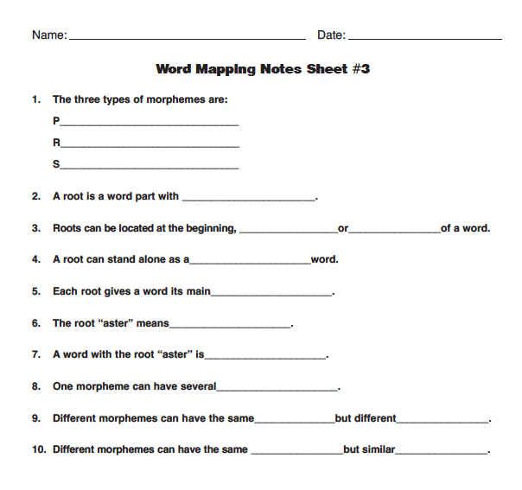

Slide 39
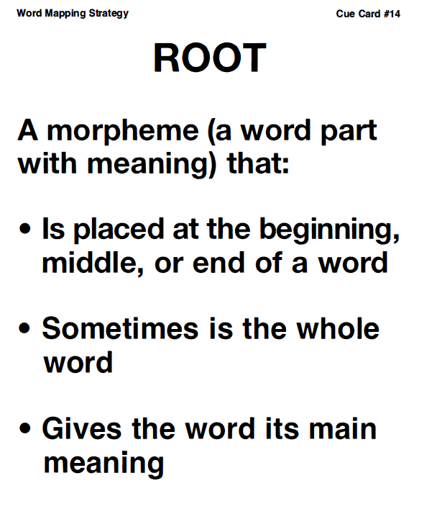
Notes:
Pg. 29

Slide 40
Notes:
Pg.29

Slide 41
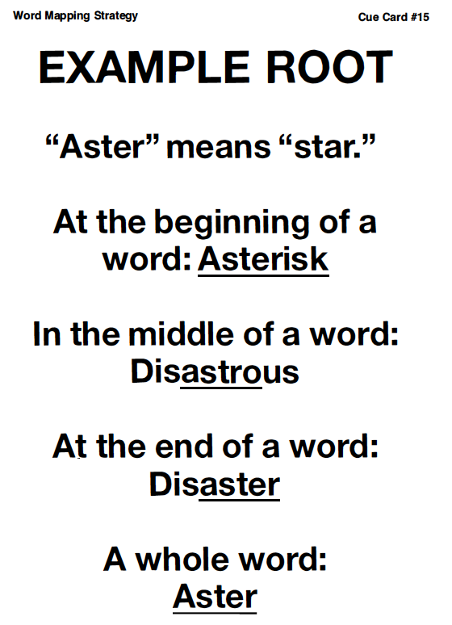
Notes:
Pg. 29

Slide 42
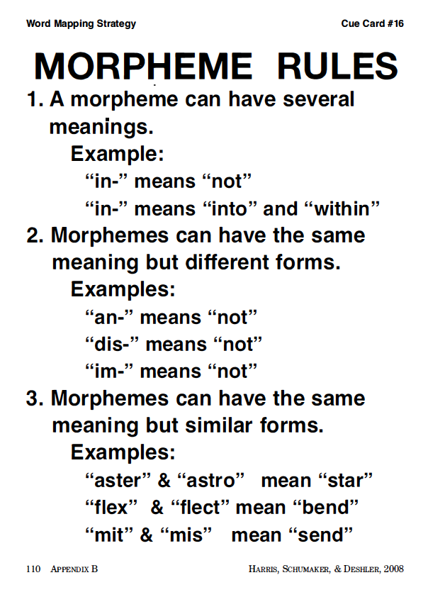
Notes:
Pg.30

Slide 44
Plot your Identifying Morphemes Worksheet score(s)
Notes:
Instructor Manual pg. 31

Slide 45
Review of previous information
What is the definition of “morpheme”?
What are three types of morphemes?
What is the definition of “prefix”?
What is the definition of “suffix”?
What is the definition of “root”
What is the definition of “compound prefix” and “compound suffix”?
What are some example prefixes?
What are some example words with prefixes?
What are some example suffixes?
What are some example words with suffixes?
What are some example roots?
What are some example words with prefixes, suffixes, and roots?
Notes:
Pg. 34

Slide 46
Lesson 4: The Word Mapping Strategy
Essential Questions
What are the steps for the Word Mapping Strategy?
How do you map words?
How do you use the memory tables to support remembering the meanings of word parts?
Notes:
Pg. 34

Slide 47
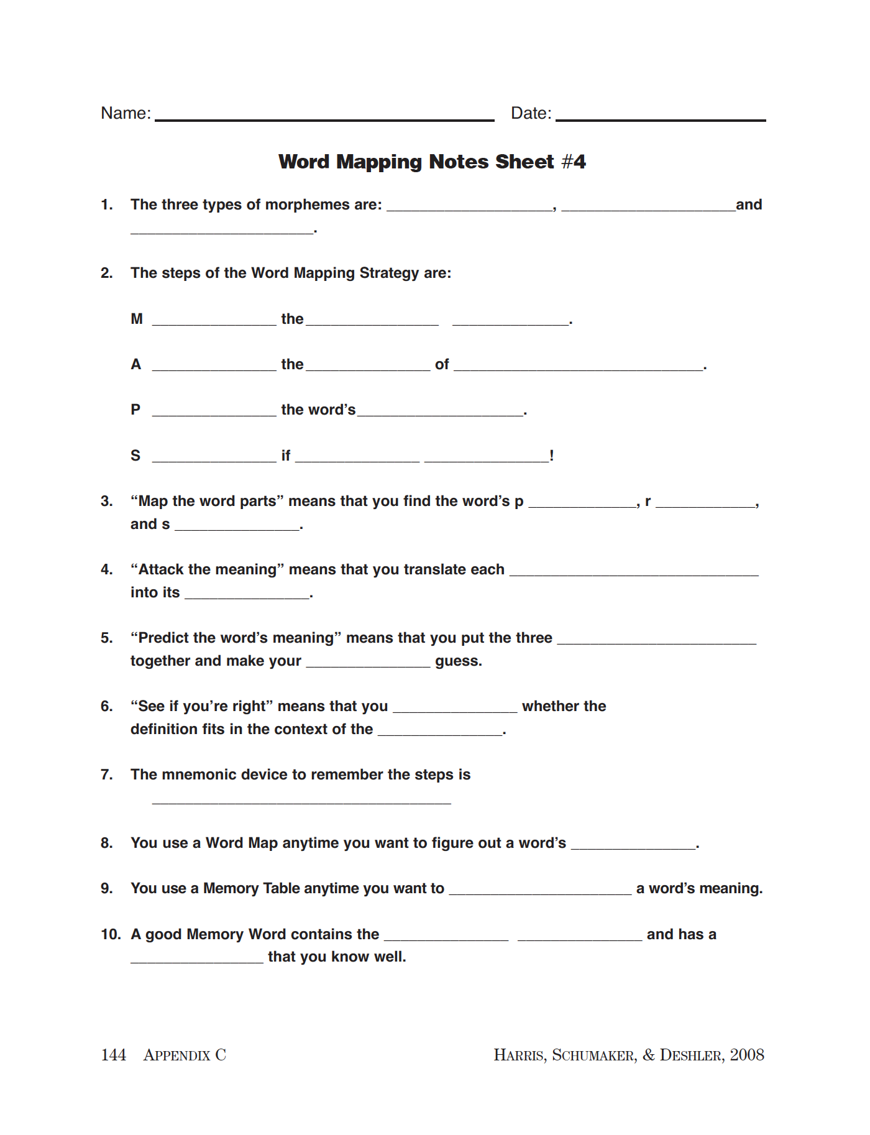

Slide 48
Notes:
Pg. 34

Slide 49
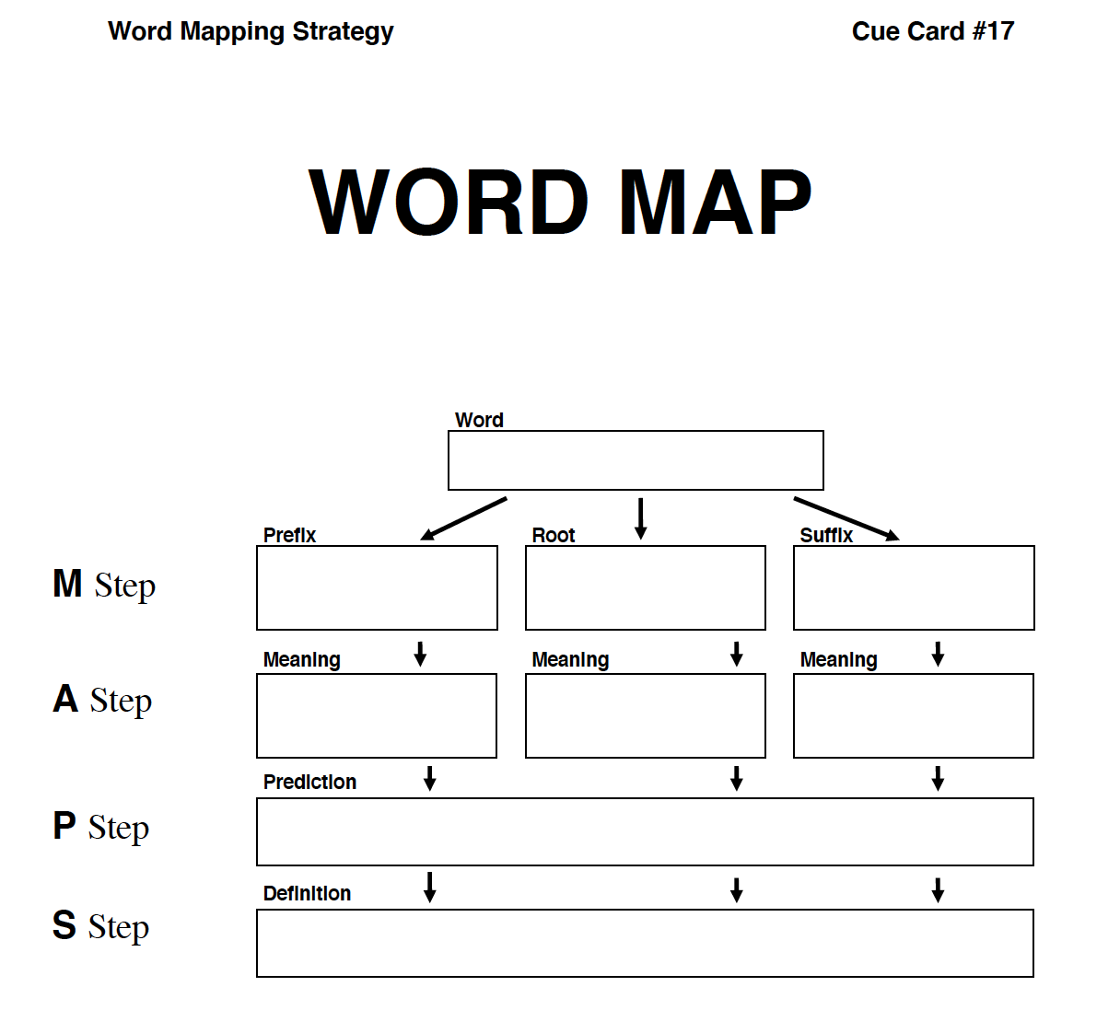
Notes:
Pg. 34

Slide 50
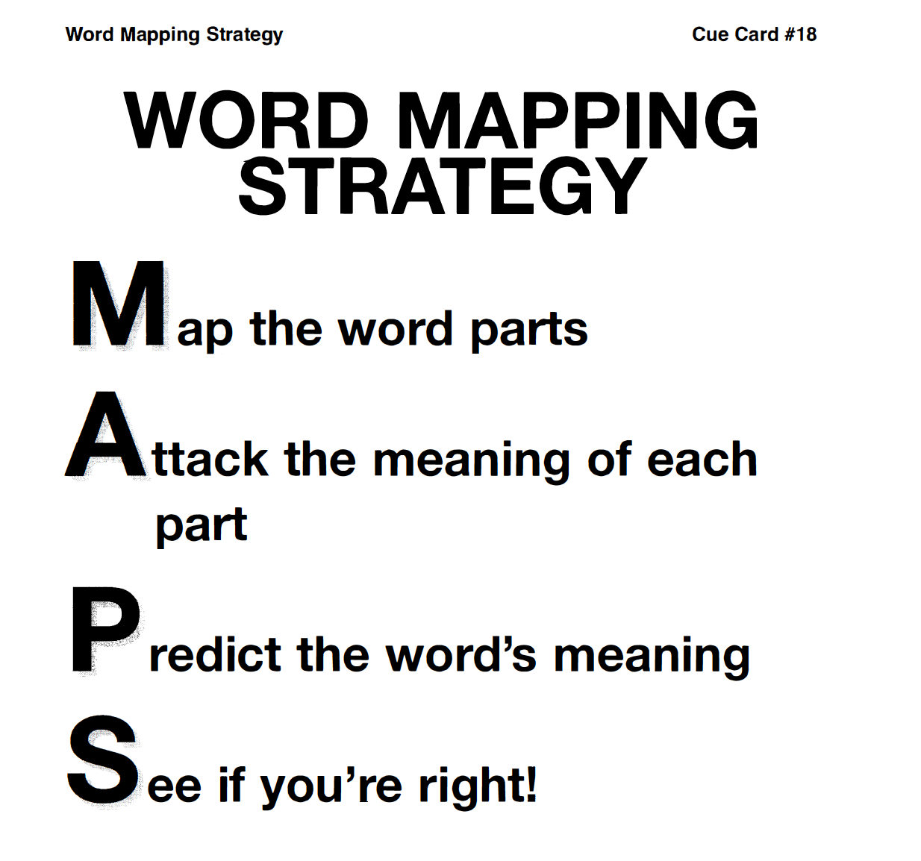
Notes:
Pg.35

Slide 51
Word Maps Activity
reloaded
indescribable
discovering
uncomfortable
unintentional
telepathy
Notes:
Pg. 36

Slide 52
WORD MAP
Word
Prefix
Root
Suffix
M Step
A Step
P Step
S Step
Meaning
Meaning
Meaning
Prediction
Definition

Slide 53
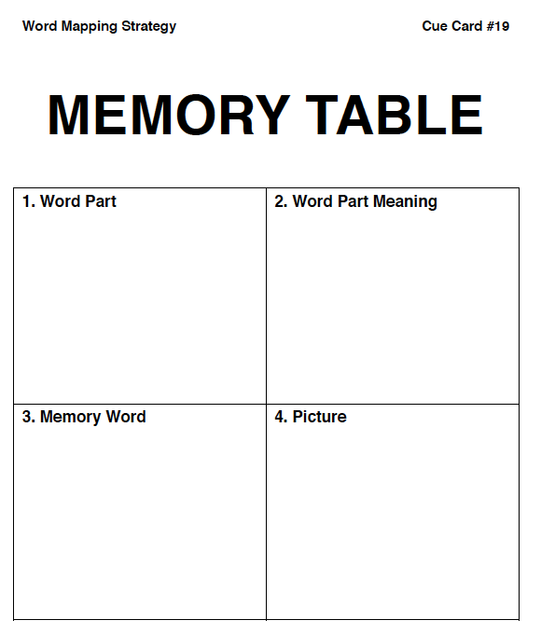
Notes:
Pg. 37

Slide 54
Memory Table Activity
anti-
hydro-
-ology
-ful
aster
mater
Notes:
Pg. 38

Slide 55
Notes:
Pg. 37

Slide 56
Practicing the Strategy
Notes:
Pg. 40

Slide 57
Prefix Practice Lesson 1
Notes:
Pg. 41 and pg. 45

Slide 58
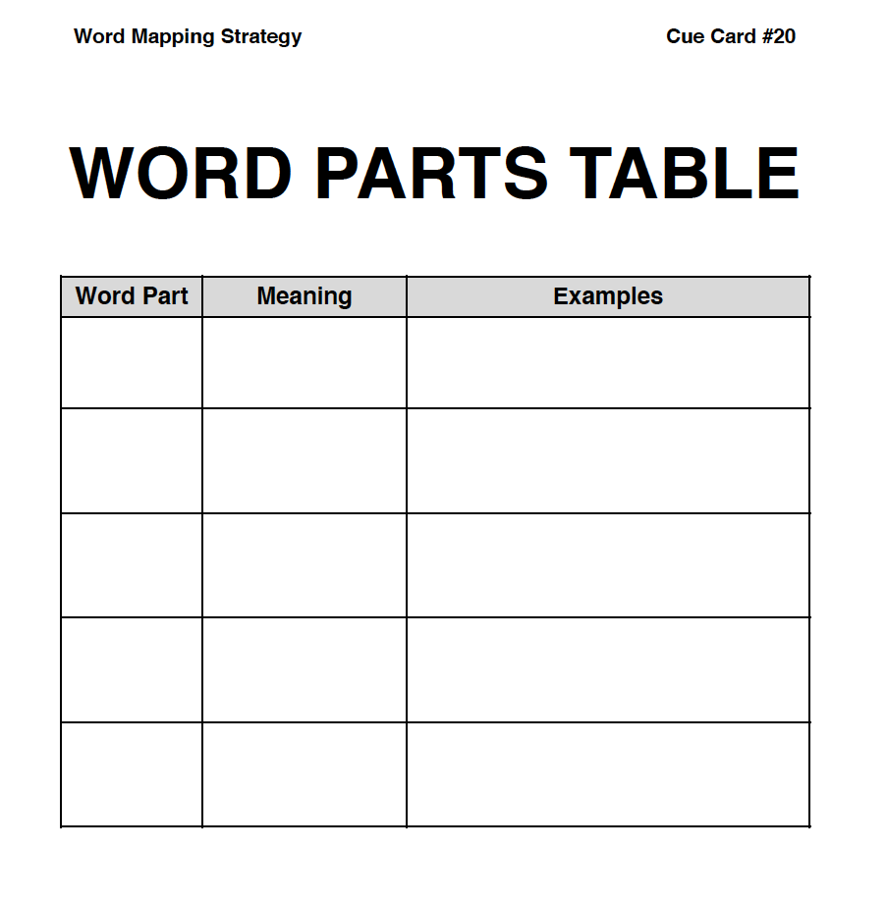
un- not unhappy, unanswered, unhealthy
in-, im-,
il-, ir-
not
indirect, impossible, illegal, irregular
not, apart, away
dis-
disability, dislocate, discard
Notes:
Pg. 45

Slide 59
Notes:
Pg. 45

Slide 60
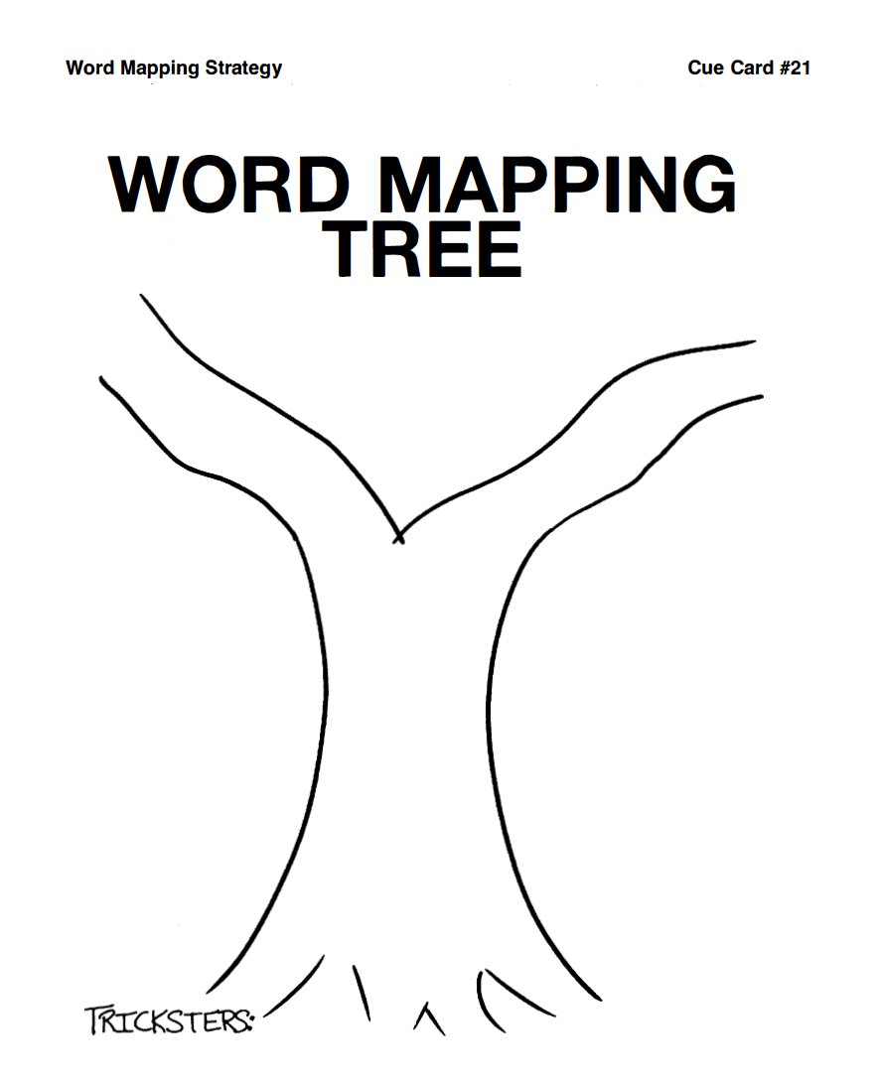
Notes:
Pg. 42 & 46

Slide 61
Notes:
Pg. 42 & 46

Slide 62
WORD MAP
Word
Prefix
Root
Suffix
M Step
A Step
P Step
S Step
Meaning
Meaning
Meaning
Prediction
Definition

Slide 63
Prefix Quiz 1
Notes:
Pg. 44 & 165

Slide 64
Plot your Lesson and Quiz score(s)
Notes:
Instructor Manual pg. 44

Slide 65
Prefix Practice Lesson 2
Notes:
Pg. 41 and pg. 47

Slide 66
in, into, make, do
enslave, entangle
en-
em-
in, into
embrace, empower
in-, im-,
il-,
into
inject, implant, involve, illuminate
Notes:
Pg. 47

Slide 67
Notes:
Pg. 47

Slide 68
Notes:
Pg. 42 & 48

Slide 69
Notes:
Pg. 42 & 48

Slide 70
WORD MAP
Word
Prefix
Root
Suffix
M Step
A Step
P Step
S Step
Meaning
Meaning
Meaning
Prediction
Definition

Slide 71
Prefix Quiz 2
Notes:
Pg. 44 & 166

Slide 72
Plot your Lesson and Quiz score(s)
Notes:
Instructor Manual pg. 44

Slide 73
Prefix Practice Lesson 3
Notes:
Pg. 41 and pg. 49

Slide 74
mis-
bad, wrong
misbehave, misfortune, misprint
re-
back, again
rewind, report, reject
trans-
across, over, beyond
transport, transformation, transmit
Notes:
Pg. 47 & 49

Slide 75
Notes:
Pg. 49

Slide 76
Notes:
Pg. 42 & 50

Slide 77
Notes:
Pg. 42 & 50

Slide 78
WORD MAP
Word
Prefix
Root
Suffix
M Step
A Step
P Step
S Step
Meaning
Meaning
Meaning
Prediction
Definition

Slide 79
Prefix Quiz 3
Notes:
Pg. 44 & 167

Slide 80
Plot your Lesson and Quiz score(s)
Notes:
Instructor Manual pg. 44

Slide 81
Prefix Practice Lesson 4
Notes:
Pg. 41 and pg. 51

Slide 82
de-
down, opposite, away, from
descend, defunct, decompose
non-
not, opposite
nonpartisan, nonsense, nontoxic
Notes:
Pg. 47 & 51

Slide 83
Notes:
Pg. 51

Slide 84
Notes:
Pg. 42 & 52

Slide 85
Notes:
Pg. 42 & 52

Slide 86
WORD MAP
Word
Prefix
Root
Suffix
M Step
A Step
P Step
S Step
Meaning
Meaning
Meaning
Prediction
Definition

Slide 87
Prefix Quiz 4
Notes:
Pg. 44 & 168

Slide 88
Plot your Lesson and Quiz score(s)
Notes:
Instructor Manual pg. 44

Slide 89
Prefix Practice Lesson 5
Notes:
Pg. 41 and pg. 53

Slide 90
over-
beyond, more
overexert, overage, overslept
sub-
under
submarine, submit, substitute
super-
above, over
superscript, supercede, superimpose
Notes:
Pg. 47

Slide 91
Notes:
Pg. 53

Slide 92
Notes:
Pg. 42 & 54

Slide 93
Notes:
Pg. 42 & 54

Slide 94
WORD MAP
Word
Prefix
Root
Suffix
M Step
A Step
P Step
S Step
Meaning
Meaning
Meaning
Prediction
Definition

Slide 95
Prefix Quiz 5
Notes:
Pg. 44 & 169

Slide 96
Plot your Lesson and Quiz score(s)
Notes:
Instructor Manual pg. 44

Slide 97
Prefix Practice Lesson 6
Notes:
Pg. 41 and pg. 55

Slide 98
inter-
between
interstate, interlude, intervene
fore-
before, front
forefather, forecast, foreshadow
Notes:
Pg. 55

Slide 99
Notes:
Pg. 55

Slide 100
Notes:
Pg. 42 & 56

Slide 101
Notes:
Pg. 42 & 56

Slide 102
WORD MAP
Word
Prefix
Root
Suffix
M Step
A Step
P Step
S Step
Meaning
Meaning
Meaning
Prediction
Definition

Slide 103
Prefix Quiz 6
Notes:
Pg. 44 & 170

Slide 104
Plot your Lesson and Quiz score(s)
Notes:
Instructor Manual pg. 44

Slide 105
Root Practice Lesson 1
Notes:
Pg. 41 and pg. 57

Slide 106
aud
hear
audible, audition, auditorium
phon
sound
microphone, phonics, telephone
dic/dict
say, speak
predict, dictator, diction
Notes:
Pg. 57

Slide 107
Notes:
Pg. 57

Slide 108
Notes:
Pg. 42 & 58

Slide 109
Notes:
Pg. 42 & 58

Slide 110
WORD MAP
Word
Prefix
Root
Suffix
M Step
A Step
P Step
S Step
Meaning
Meaning
Meaning
Prediction
Definition

Slide 111
Root Quiz 1
Notes:
Pg. 44 & 171

Slide 112
Plot your Lesson and Quiz score(s)
Notes:
Instructor Manual pg. 44

Slide 113
Root Practice Lesson 2
Notes:
Pg. 41 and pg. 59

Slide 114
port
carry
portable, import, transportation
volv, volu
roll, turn
evolve, involve, revolution
miss, mit, mitt
send
Admissible, emit, intermittent
Notes:
Pg. 59

Slide 115
Notes:
Pg. 59

Slide 116
Notes:
Pg. 42 & 60

Slide 117
Notes:
Pg. 42 & 60

Slide 118
WORD MAP
Word
Prefix
Root
Suffix
M Step
A Step
P Step
S Step
Meaning
Meaning
Meaning
Prediction
Definition

Slide 119
Root Quiz 2
Notes:
Pg. 44 & 172

Slide 120
Plot your Lesson and Quiz score(s)
Notes:
Instructor Manual pg. 44

Slide 121
Root Practice Lesson 3
Notes:
Pg. 41 and pg. 61

Slide 122
sign
mark
signature, insignia, significant
graph, gram
write, record
autograph, phonograph, grammar
script, scrib
write
scribble, inscribe, manuscript
Notes:
Pg. 61

Slide 123
Notes:
Pg. 61

Slide 124
Notes:
Pg. 42 & 62

Slide 125
Notes:
Pg. 42 & 62

Slide 126
WORD MAP
Word
Prefix
Root
Suffix
M Step
A Step
P Step
S Step
Meaning
Meaning
Meaning
Prediction
Definition

Slide 127
Root Quiz 3
Notes:
Pg. 44 & 173

Slide 128
Plot your Lesson and Quiz score(s)
Notes:
Instructor Manual pg. 44

Slide 129
Root Practice Lesson 4
Notes:
Pg. 41 and pg. 63

Slide 130
struct
build
construction, destruction, instruction
man. mani, manu
hand
manually, manipulate, manufacture
tract
pull, drag, draw
attract, detract, subtract
Notes:
Pg. 63

Slide 131
Notes:
Pg. 63

Slide 132
Notes:
Pg. 42 & 64

Slide 133
Notes:
Pg. 42 & 64

Slide 134
WORD MAP
Word
Prefix
Root
Suffix
M Step
A Step
P Step
S Step
Meaning
Meaning
Meaning
Prediction
Definition

Slide 135
Root Quiz 4
Notes:
Pg. 44 & 174

Slide 136
Plot your Lesson and Quiz score(s)
Notes:
Instructor Manual pg. 44

Slide 137
Root Practice Lesson 5
Notes:
Pg. 41 and pg. 65

Slide 138
cred, cre
believe, trust
incredible, discredit, miscreant
spect, spec
look
inspect, spectator, specific
path, pathy
feeling, suffering
pathos, empathy, sympathy
Notes:
Pg. 65

Slide 139
Notes:
Pg. 63

Slide 140
Notes:
Pg. 42 & 66

Slide 141
Notes:
Pg. 42 & 66

Slide 142
WORD MAP
Word
Prefix
Root
Suffix
M Step
A Step
P Step
S Step
Meaning
Meaning
Meaning
Prediction
Definition

Slide 143
Root Quiz 5
Notes:
Pg. 44 & 175

Slide 144
Plot your Lesson and Quiz score(s)
Notes:
Instructor Manual pg. 44

Slide 145
Root Practice Lesson 6
Notes:
Pg. 41 and pg. 67

Slide 146
fac, fact
do, make
facile, factory, manufacture
mob, mot
move
mobile, emotional, promote
pon, pos
place, put
postpone, opponent, impose
Notes:
Pg. 67

Slide 147
Notes:
Pg. 67

Slide 148
Notes:
Pg. 42 & 68

Slide 149
Notes:
Pg. 42 & 68

Slide 150
WORD MAP
Word
Prefix
Root
Suffix
M Step
A Step
P Step
S Step
Meaning
Meaning
Meaning
Prediction
Definition

Slide 151
Root Quiz 6
Notes:
Pg. 44 & 176

Slide 152
Plot your Lesson and Quiz score(s)
Notes:
Instructor Manual pg. 44

Slide 153
Suffix Practice Lesson 1
Notes:
Pg. 41 and pg. 69

Slide 154
Inflectional Suffixes
-s,-es
plural, more than one
Autographs, mortals, ladies
-’s, -s’
Possessive ownership
Carson’s, instructor’s, misses’
3rd person singular, present tense
contributes, distorts, manipulates
-s
past tense
predicted, inspected, evoked
-ed
-ing
present participle
subverting, advocating, transporting
Notes:
Pg. 69

Slide 155
Notes:
Pg. 69

Slide 156
Notes:
Pg. 42 & 70

Slide 157
Notes:
Pg. 42 & 70

Slide 158
WORD MAP
Word
Prefix
Root
Suffix
M Step
A Step
P Step
S Step
Meaning
Meaning
Meaning
Prediction
Definition

Slide 159
Suffix Quiz 1
Notes:
Pg. 44 & 177

Slide 160
Plot your Lesson and Quiz score(s)
Notes:
Instructor Manual pg. 44

Slide 161
Suffix Practice Lesson 2
Notes:
Pg. 41 and pg. 71

Slide 162
Inflectional Suffixes
past participle, made of, make
given, eaten, broaden, wooden
-en*
more, one who, that which
-er*, -or
daintier, benefactor, transformer, conductor
-est
most
funniest, largest, poorest, loveliest
*An inflectional suffix that is also a derivational suffix
Notes:
Pg. 71

Slide 163
Notes:
Pg. 71

Slide 164
Notes:
Pg. 42 & 72

Slide 165
Notes:
Pg. 42 & 72

Slide 166
WORD MAP
Word
Prefix
Root
Suffix
M Step
A Step
P Step
S Step
Meaning
Meaning
Meaning
Prediction
Definition

Slide 167
Suffix Quiz 2
Notes:
Pg. 44 & 178

Slide 168
Plot your Lesson and Quiz score(s)
Notes:
Instructor Manual pg. 44

Slide 169
Suffix Practice Lesson 3
Notes:
Pg. 41 and pg. 73

Slide 170
Derivational Suffixes
-ion, -tion, -sion, -ation, -ition
act of, state of, result of
inscription, benediction, circumspection, explosion
-ment
act of, result of
amendment, achievement, excitement
-ity, -ty
state of, quality
clarity, captivity, immortality, bounty
inventiveness, thoughtfulness, faithfulness
-ness
state of
Notes:
Pg. 73

Slide 171
Notes:
Pg. 73

Slide 172
Notes:
Pg. 42 & 74

Slide 173
Notes:
Pg. 42 & 74

Slide 174
WORD MAP
Word
Prefix
Root
Suffix
M Step
A Step
P Step
S Step
Meaning
Meaning
Meaning
Prediction
Definition

Slide 175
Suffix Quiz 3
Notes:
Pg. 44 & 179

Slide 176
Plot your Lesson and Quiz score(s)
Notes:
Instructor Manual pg. 44

Slide 177
Suffix Practice Lesson 4
Notes:
Pg. 41 and pg. 75

Slide 178
Derivational Suffixes
-al, -ial
relating to
monumental, familial, commercial
-ic
nature of, like
acidic, metallic, heroic, pathetic
-ly, -y
like, characterized by
hopelessly, scary
Notes:
Pg. 75

Slide 179
Notes:
Pg. 75

Slide 180
Notes:
Pg. 42 & 76

Slide 181
Notes:
Pg. 42 & 76

Slide 182
WORD MAP
Word
Prefix
Root
Suffix
M Step
A Step
P Step
S Step
Meaning
Meaning
Meaning
Prediction
Definition

Slide 183
Suffix Quiz 4
Notes:
Pg. 44 & 180

Slide 184
Plot your Lesson and Quiz score(s)
Notes:
Instructor Manual pg. 44

Slide 185
Suffix Practice Lesson 5
Notes:
Pg. 41 and pg. 77

Slide 186
Derivational Suffixes
-ous, -eous, -ious
Full of, having qualities of
incredulous, igneous, vivacious
-ful
full of
beautiful, fanciful, frightful
-less
without
careless, fearless, restless
Notes:
Pg. 77

Slide 187
Notes:
Pg. 77

Slide 188
Notes:
Pg. 42 & 78

Slide 189
Notes:
Pg. 42 & 78

Slide 190
WORD MAP
Word
Prefix
Root
Suffix
M Step
A Step
P Step
S Step
Meaning
Meaning
Meaning
Prediction
Definition

Slide 191
Suffix Quiz 5
Notes:
Pg. 44 & 181

Slide 192
Plot your Lesson and Quiz score(s)
Notes:
Instructor Manual pg. 44

Slide 193
Suffix Practice Lesson 6
Notes:
Pg. 41 and pg. 79

Slide 194
Derivational Suffixes
-able, -ible
can be done; able
admissible, intangible, retractable, untenable
-ive, -itive
cause, make
exhaustive, competitive, relative
-ate
cause, make
congratulate, dictate, expatiate
Notes:
Pg. 79

Slide 195
Notes:
Pg. 77

Slide 196
Notes:
Pg. 42 & 79

Slide 197
Notes:
Pg. 42 & 79

Slide 198
WORD MAP
Word
Prefix
Root
Suffix
M Step
A Step
P Step
S Step
Meaning
Meaning
Meaning
Prediction
Definition

Slide 199
Suffix Quiz 6
Notes:
Pg. 44 & 182

Slide 200
Plot your Lesson and Quiz score(s)
Notes:
Instructor Manual pg. 44

Slide 201
Posttest
Purpose: to determine how well you can identify word parts, know the meaning of word parts, and can predict the meaning of words
Notes:
Instructor Manual pg. 81

Slide 202
Plot your Posttest score(s)
Notes:
Instructor Manual pg. 82

Slide 203
Ensuring students use the strategy
Essential Questions
Where and when is it necessary to use the Word Mapping Strategy?
How do you use the Word Mapping Strategy in different situations?
Notes:
Instructor Manual pg. 84

Slide 204
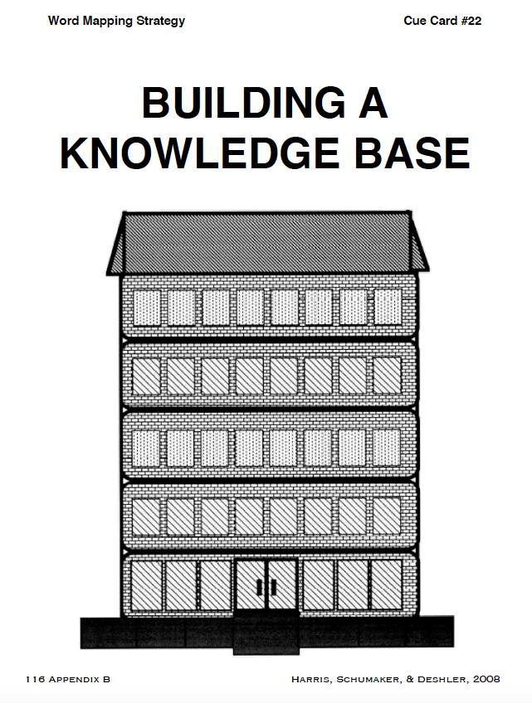
Notes:
Pg. 87

